Slide 1

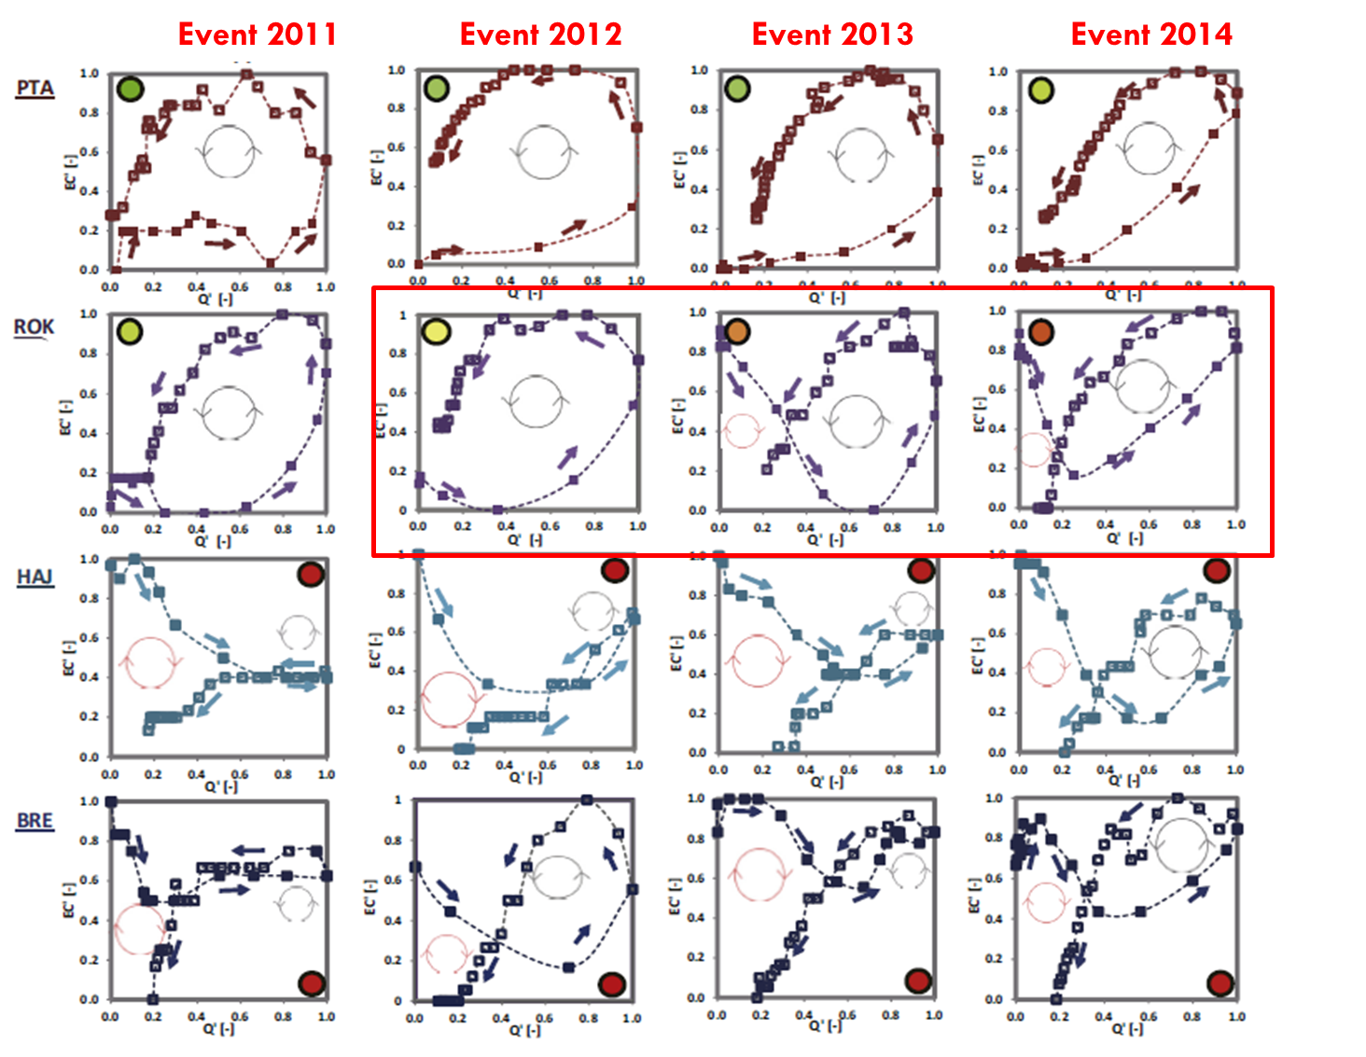
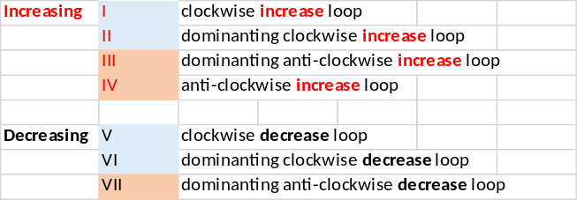

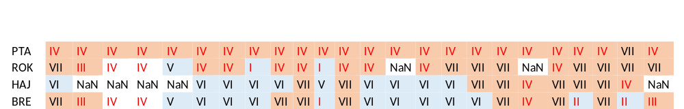
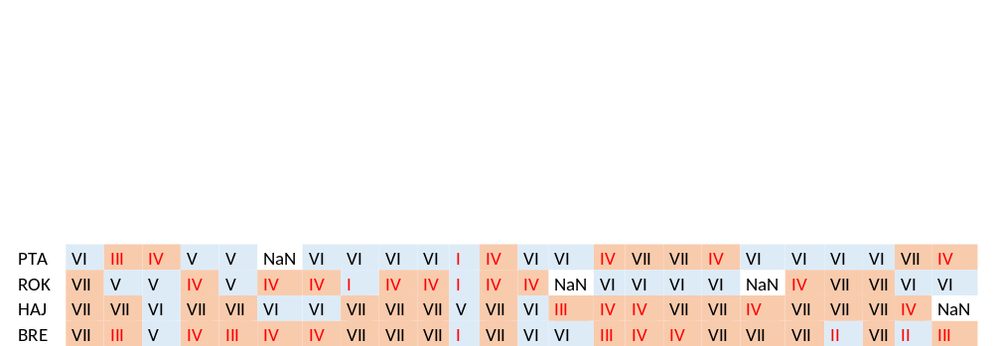
Geochemical transformation of forested catchments following bark beetle infestation:
Evidence from EC hysteresis during rainfall-runoff events
Ye Su¹, Jakub Langhammer¹, Jerker Jarsjö²
1 Department of Physical Geography and Geoecology, Faculty of Science, Charles University, Albertov 6, 128 43 Prague 2, Czechia 2 Department of Physical Geography, Stockholm University, SE-106 91 Stockholm, Sweden
Forest disturbance resulting from bark beetle infestation is becoming a widespread phenomenon due to climate change. Such disturbance could result in alterations of streamflow and stream geochemistry. We found that these changes developed relatively rapidly after infestation and have long-lasting (decadal-scale) effects, and event-scale dynamics of in-stream electric conductivity (EC) – discharge (Q) relations were considerable, impacting even the annual average EC-values.
In this study, therefore, all rainfall-induced runoff events occurring during 10 years were identified and their distinct EC-Q relations were evaluated. Results showed that after infestation the EC-Q hysteresis loops at the event-scale shifted from positive to negative relationships, implying changes in the subsurface chemical composition and runoff patterns. Specifically, healthy forest systems required event flows to mobilize substances in the soil and groundwater systems as the groundwater level rose into the relatively conductive, shallow part of the soil profile during an event. Such flush-driven systems were known for their release of large fractions of total annual in-stream substance loads showing a positive EC-Q relationship. By contrast, after infestation-induced tree mortality, the mobilization and downward percolation of nutrients and carbon from litter and decomposing needles may be considerable even during moderate rain and infiltration events. When the system is flooded under event conditions, substance-enriched soil water and groundwater may be mixed with and diluted by low-salinity event water, leading to a negative EC-Q relationships.
2009 2010 2011 2012 2013 2014 2015 2016 2017 2018 2019 2010

