Slide 1
3D basement geometry of the southwestern Pyrenees: Insights from seismic interpretation
Rosibeth Toro¹, Antonio Casas^{1,2}, Esther Izquierdo³, Emilio Pueyo^{2,4}, Javier Navas⁴, Juliana Martín⁴, Carlos Peropadre⁴, and Jon Jiménez¹
¹Geotransfer. Dpto. Ciencias de la Tierra. IUCA. Universidad de Zaragoza, Ciencias de la Tierra, Zaragoza, Spain (ingrosibethtoro@gmail.com, jimenezbjon@unizar.es) ²Unidad Asociada en Ciencias de la Tierra IGME/Universidad de Zaragoza, Zaragoza, Spain (acasas@unizar.es)
³Université de Pau et des Pays de l'Adour, E2S UPPA, CNRS, TOTAL, LFCR, Pau, France (esther.izquierdo-llavall@univ-pau.fr) ⁴Instituto Geológico y Minero de España, Spain (unaim@igme.es, j.navas@igme.es, j.martin@igme.es)
The Southwestern Pyrenees display some of the key geometric features of the range: 1) the westward termination of the main outcrop of the Axial Zone, the backbone of the chain where the basement rocks emerge 2) the outcrop of isolated basement units further west (the so-called Basque Massifs) and 3) the lateral variation in crustal geometries, characterized by the underthrusting of the lower Iberian crust beneath the European one, with the upper crust forming an orogenic wedge. The number, sequence, chronology and lateral relationships of the basement thrusts forming this upper crust wedge are complex and the focus of scientific debate. In this work, we show the first 3D model based on the interpretation of 142 available time seismic reflection sections in the region (PP, DP, JAT, JA, JAW, PJ & DP campaigns, comprising in total more than 1600 km of subsurface images that cover more than 9,000 km²). To carry out the time to depth conversion, we consider a seismic velocity model based on sonic logs from several wells (average time-depth equation obtained from Roncal-1, Sangüesa-1, Aoiz-1 and Pamplona south wells). Preliminary results from seismic, surface and well data evidence that the structure of the study area consists of a basement imbricate thrust system that is south-directed and connects to the fold-and-thrust cover system forming the External Sierras. The basement thrust system is detached within the Paleozoic (with a detachment level identified at a depth of ~4 km below the top of the basement) and stepping up into the Upper Triassic evaporites to the South. The basement thrust system involves two main thrusts that partly result from the reactivation of inherited Permian-Triassic extensional faults during the Cenozoic convergence. They produce all in all differences in height of the reference stratigraphic level (Upper Cretaceous) of more than 8000 m. Basement units in the hanging-wall of the northern thrust (Gavarnie thrust) progressively shallow eastwards whereas basement units in the southern thrust sheet (Guarga thrust) shallow westwards. Hanging-wall geometries consist of large, stepped flat panels that can be also complicated by smaller-scale thrusts oblique to the main Pyrenean trend. The geometry of thrust sheets can only be partly reconstructed from the seismic reflection profiles that evidence intermediate dips towards the North for the thrust surfaces, progressively horizontalizing towards the tip line. Additionally, we plan to complement in the short term the preliminary 3D model based on reflection seismic sections with a new vast densely and evenly distributed dataset of gravimetric measurements (several thousands).

Slide 2
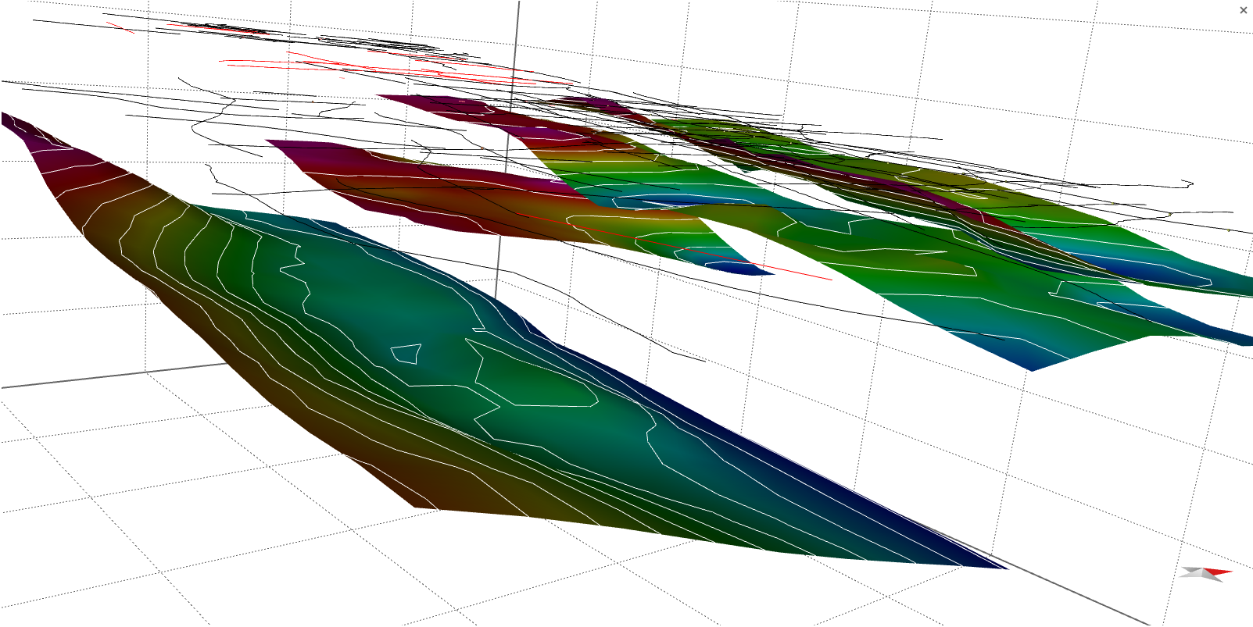
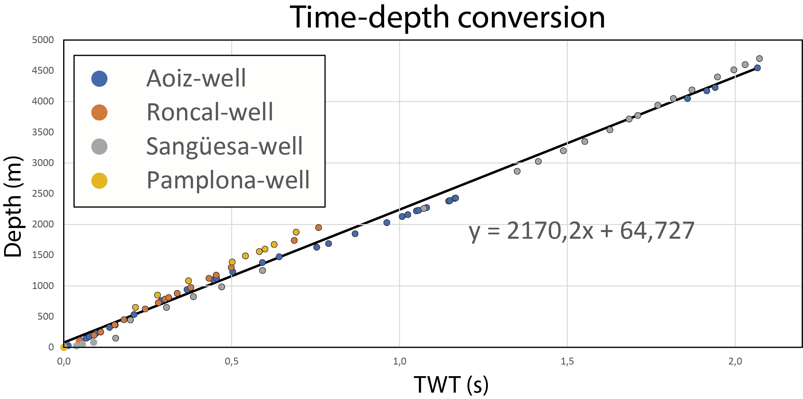
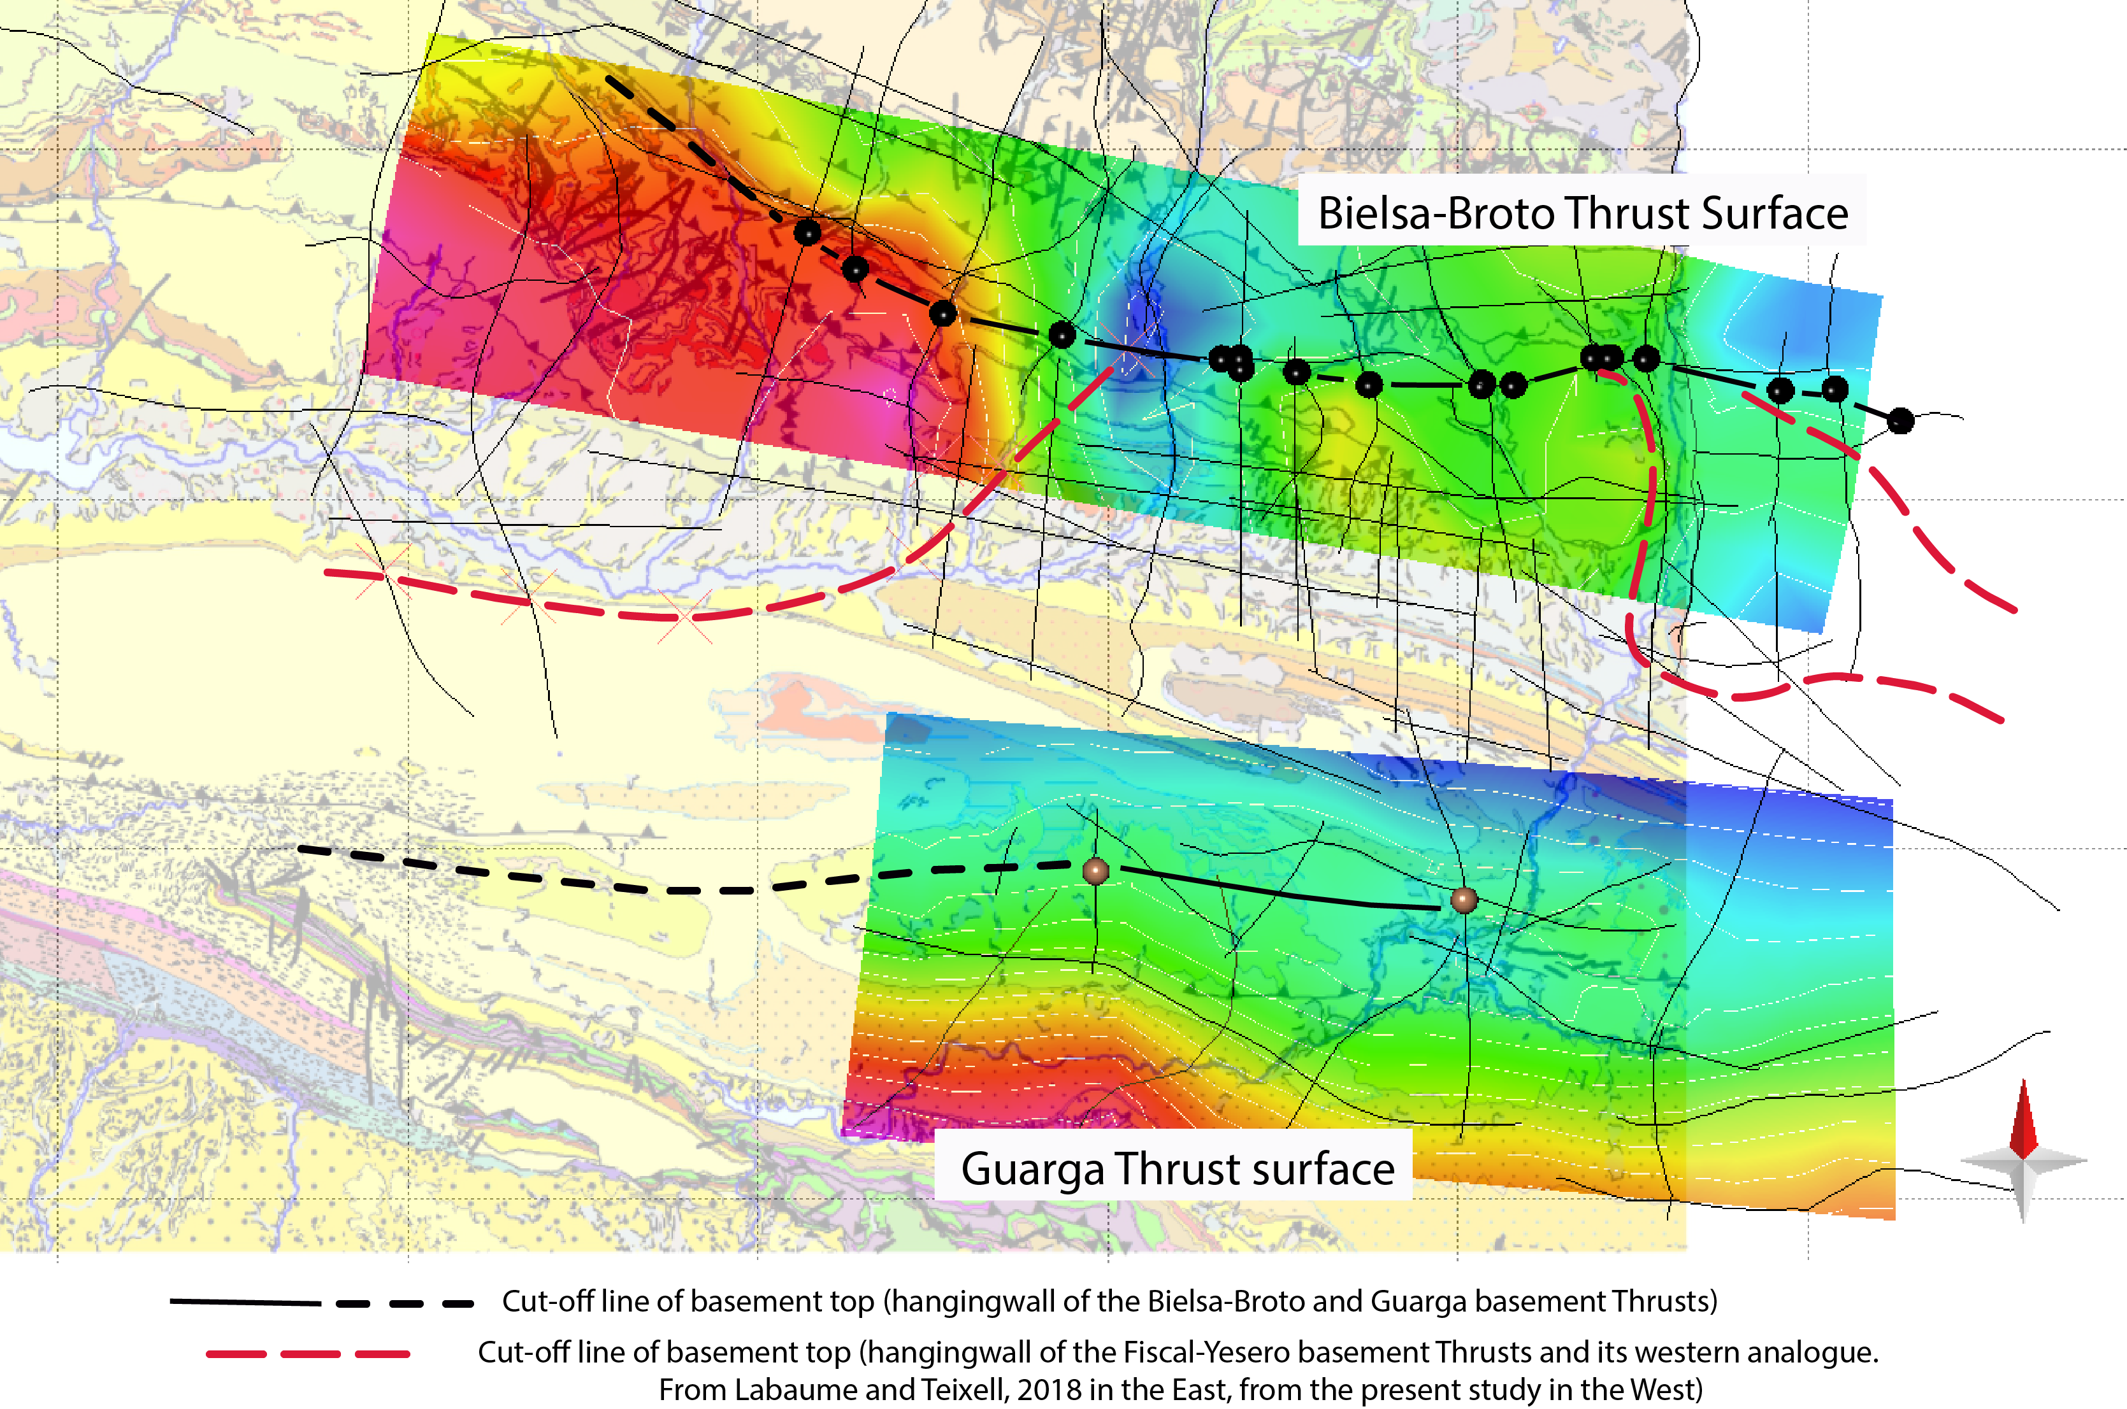
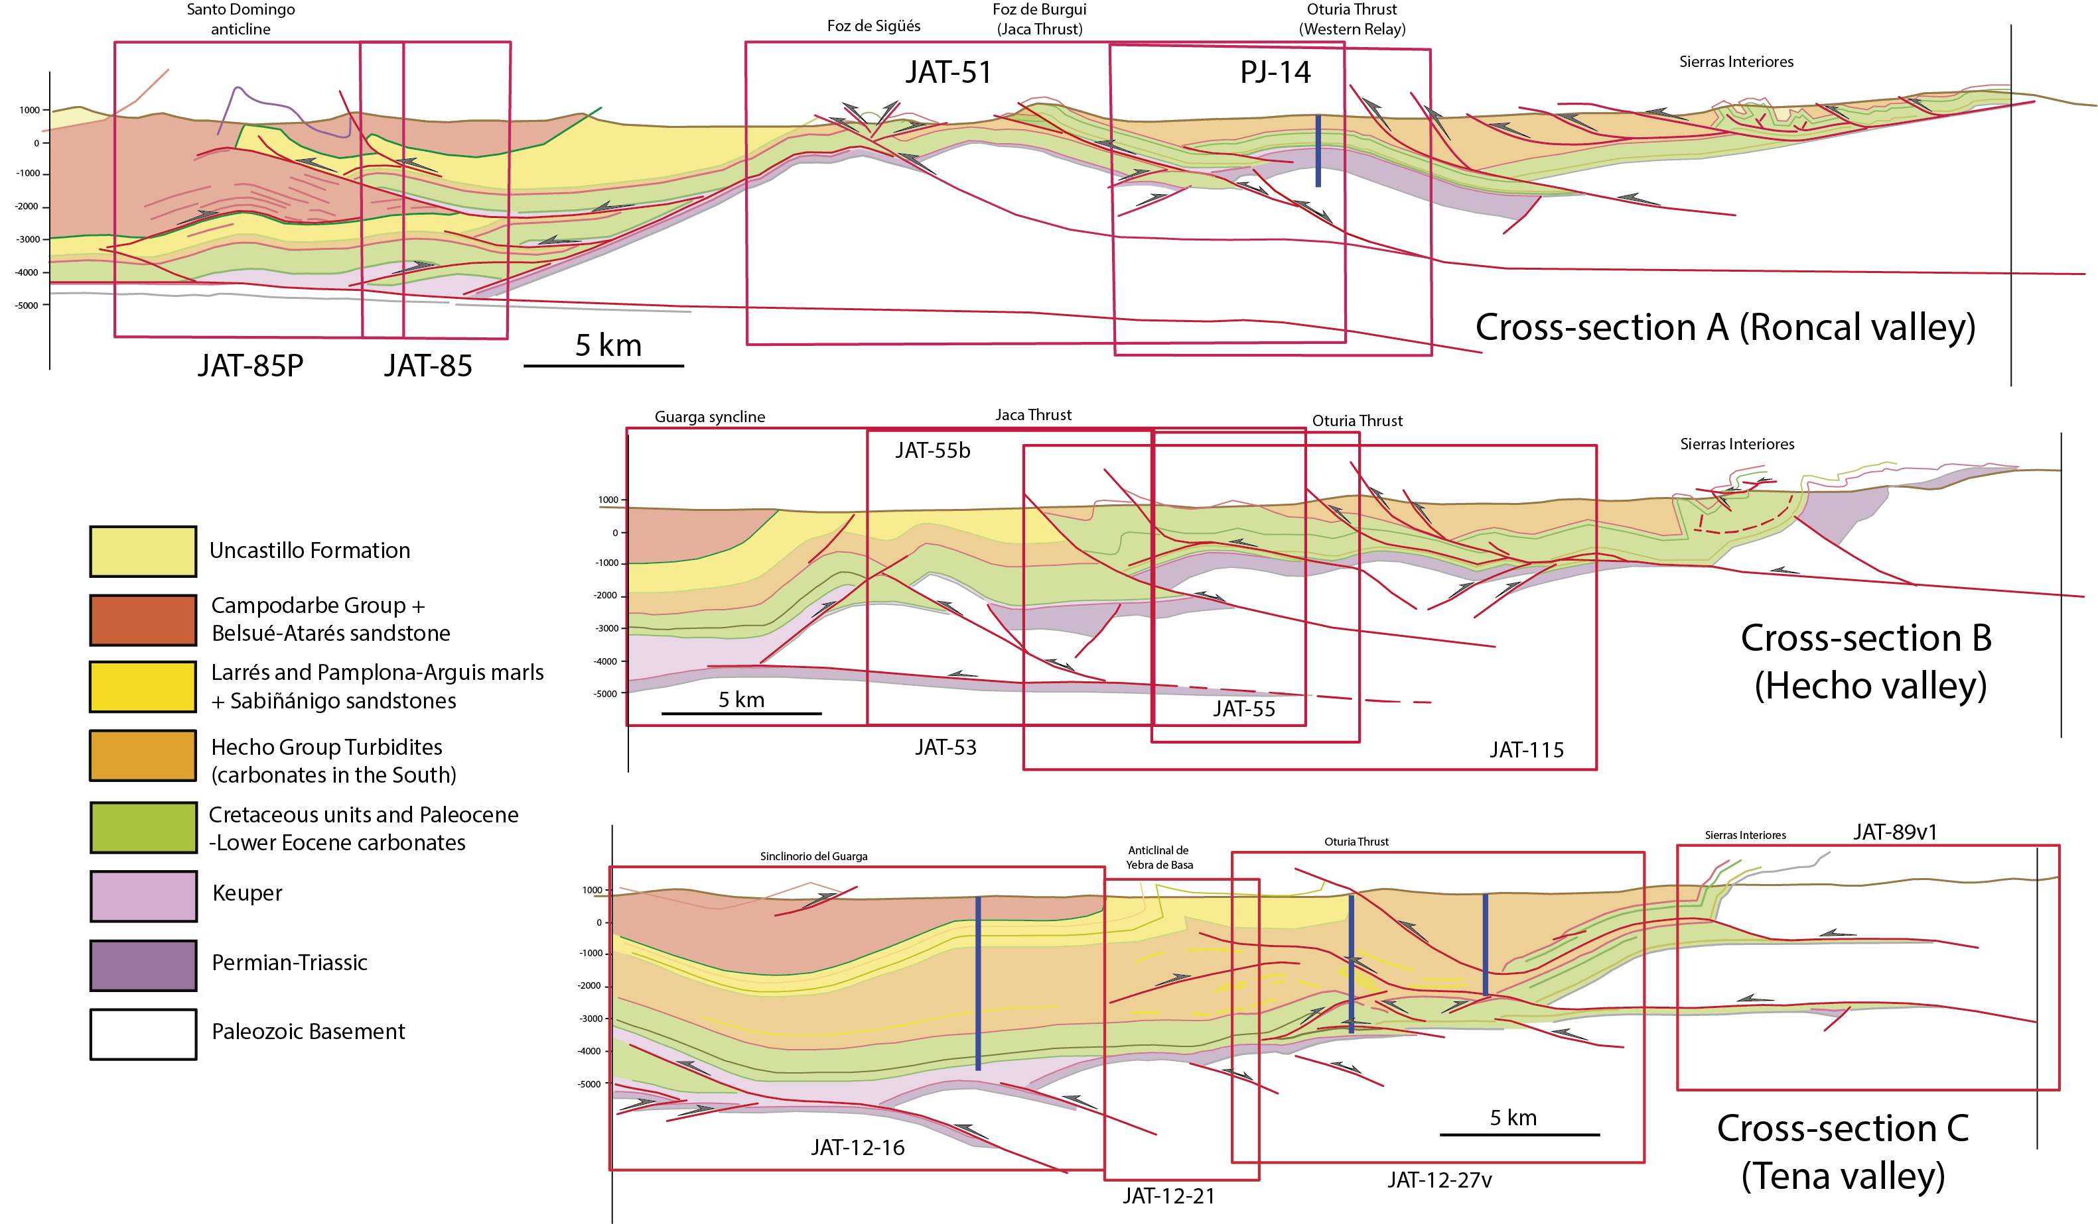
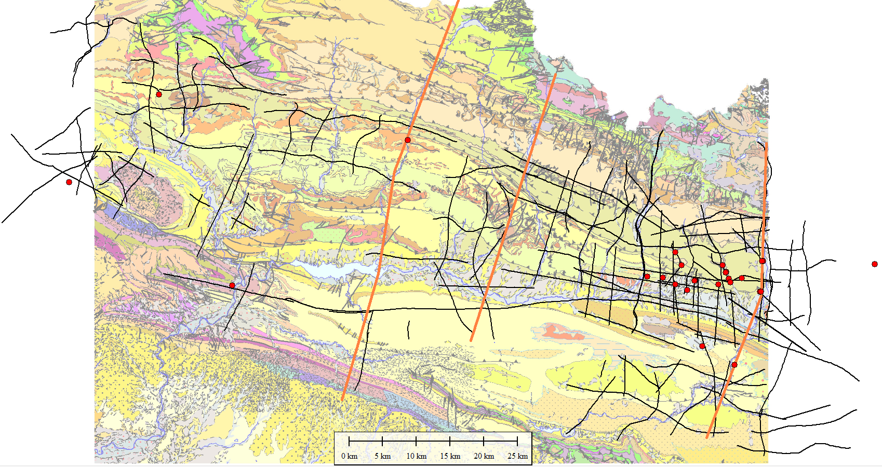
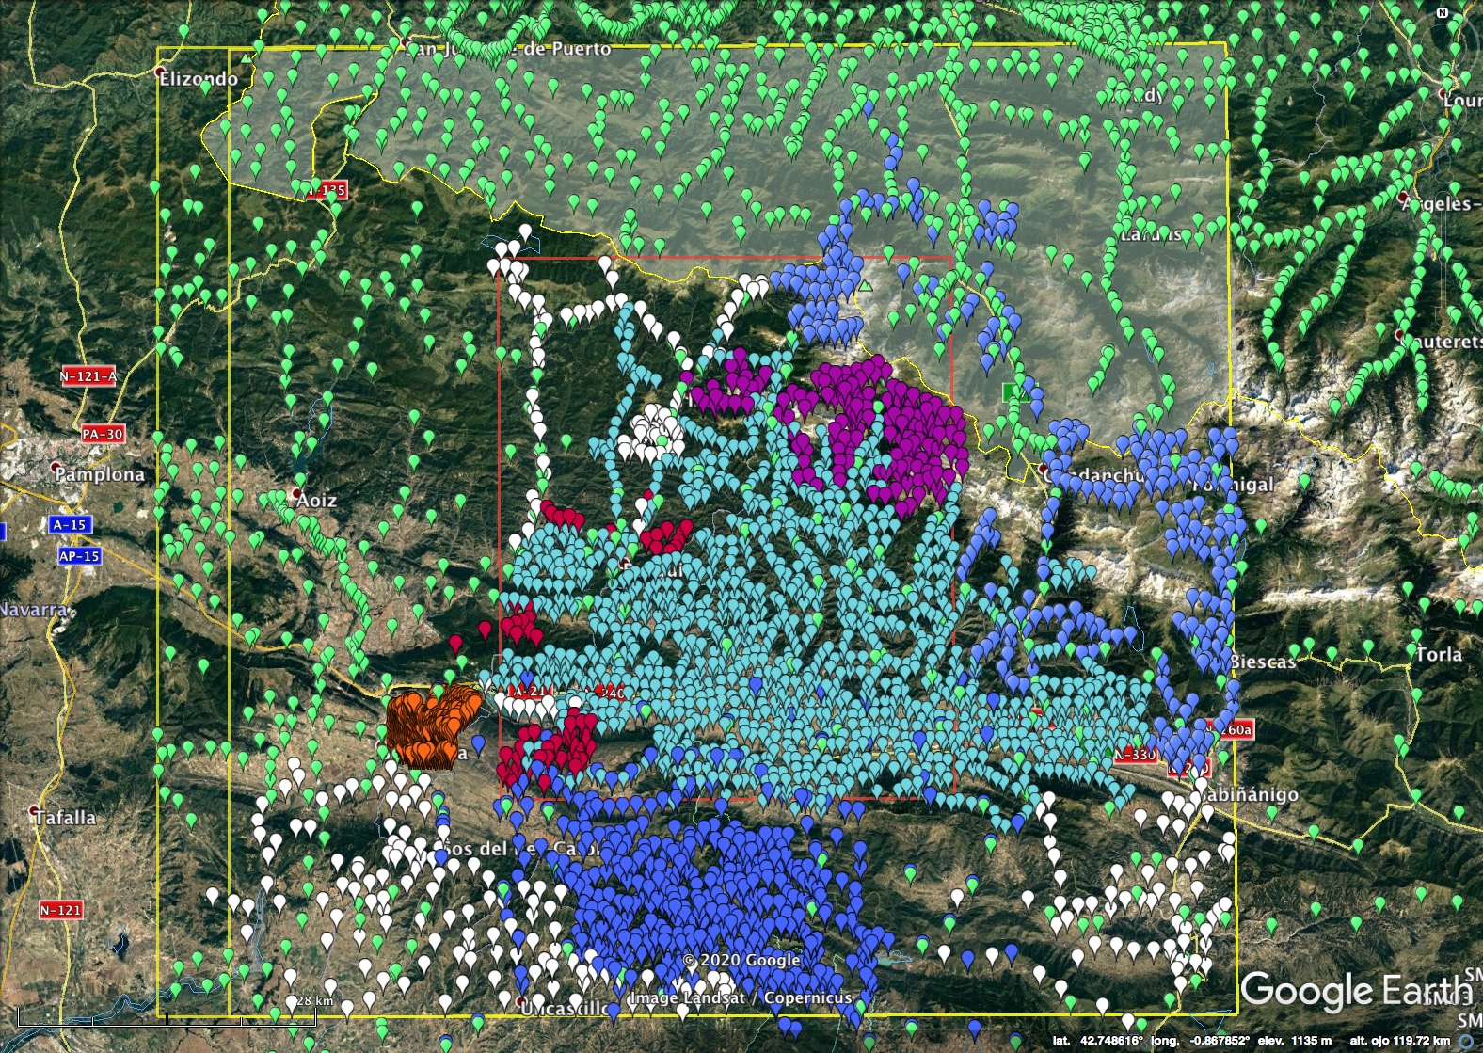
3D basement geometry of the southwestern Pyrenees: Insights from seismic interpretation
Rosibeth Toro¹, Antonio Casas^{1,2}, Esther Izquierdo³, Emilio Pueyo^{2,4}, Javier Navas⁴, Juliana Martín⁴, Carlos Peropadre⁴, and Jon Jiménez¹
¹Geotransfer. Dpto. Ciencias de la Tierra. IUCA. Universidad de Zaragoza, Ciencias de la Tierra, Zaragoza, Spain (ingrosibethtoro@gmail.com, jimenezbjon@unizar.es) ²Unidad Asociada en Ciencias de la Tierra IGME/Universidad de Zaragoza, Zaragoza, Spain (acasas@unizar.es)
³Université de Pau et des Pays de l'Adour, E2S UPPA, CNRS, TOTAL, LFCR, Pau, France (esther.izquierdo-llavall@univ-pau.fr) ⁴Instituto Geológico y Minero de España, Spain (unaim@igme.es, j.navas@igme.es, j.martin@igme.es)
Motivation and objectives of the study
Methodological Workflow
3rd : Lateral correlation of thrusts/horizons and construction of a 3D model
The number, sequence and chronology of basement thrusts in the South-Western Pyrenees change laterally. Main Objective: Characterize the 3D geometry of this thrust system
1st : Time seismic interpretation, well tying and Time-Depth conversion
Fiscal-Yesero? T.
Gavarnie T.
Four main basement thrusts in the East:
partly result from the inversion of inherited Permian-Triassic faults
uplift basement units in the West
define oblique basement structures
Bielsa-Broto T.
Guarga T.
4 available sonic logs
Time-depth conversion based on a linear equation → data from four sonic logs.
2nd : Integration of seismic and surface data and 2D cross-sections construction
Available Data
A
B
C
Nexts steps
4th : 2D and 3D validation using gravity data
Dense gravity survey will be
used to better constrain basement depths/geometries
TWT seismic profiles (142 profiles, >1600 km)
Wells (26)

