Slide 1

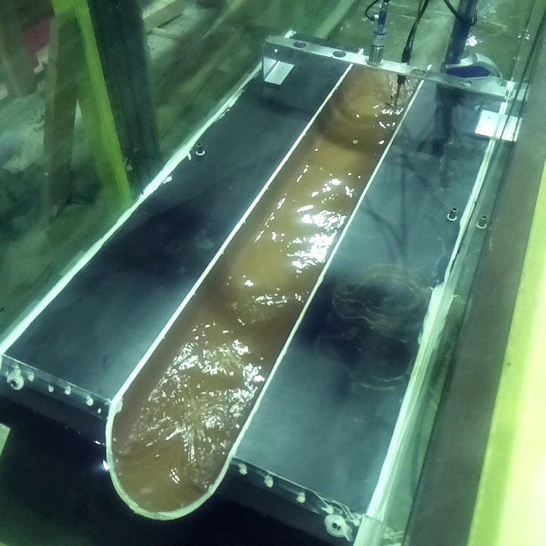
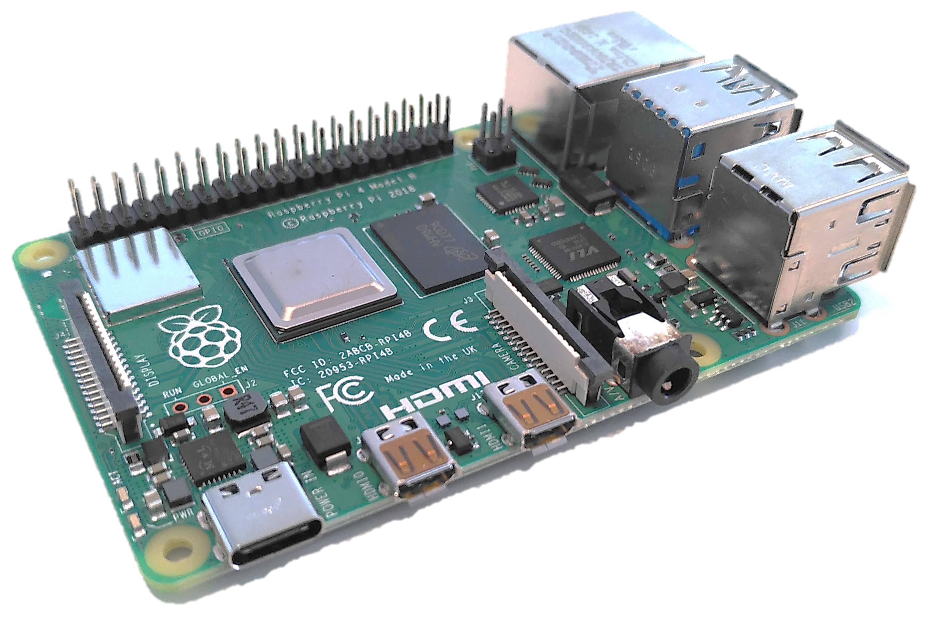
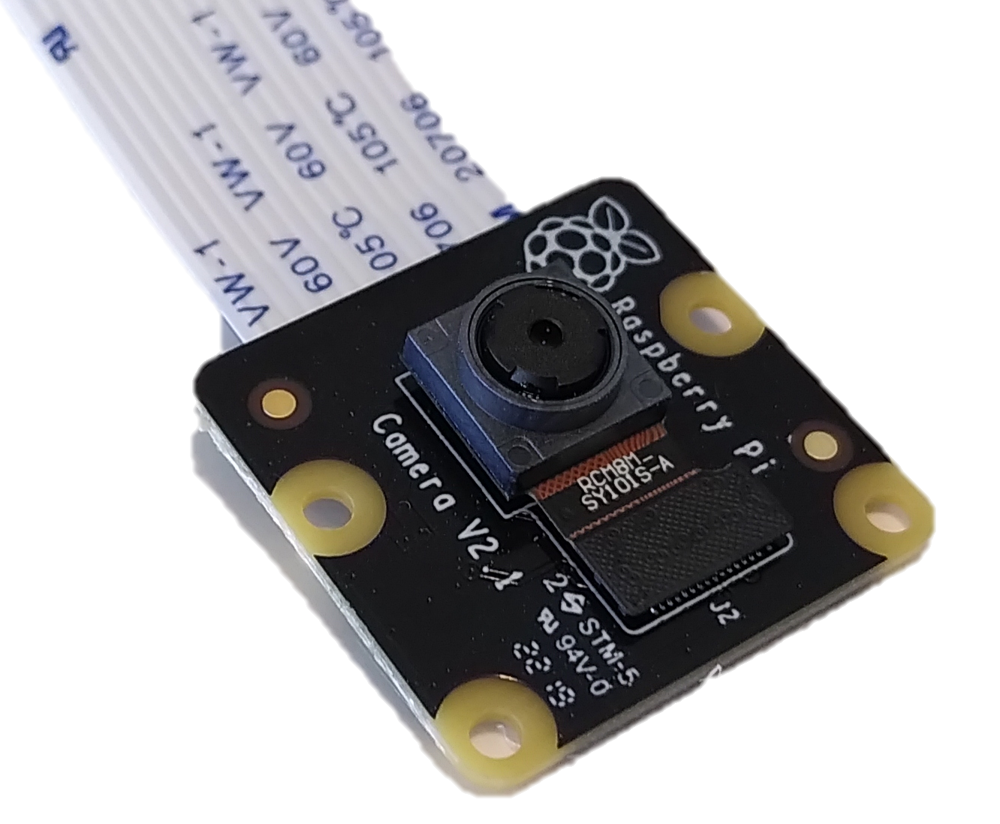
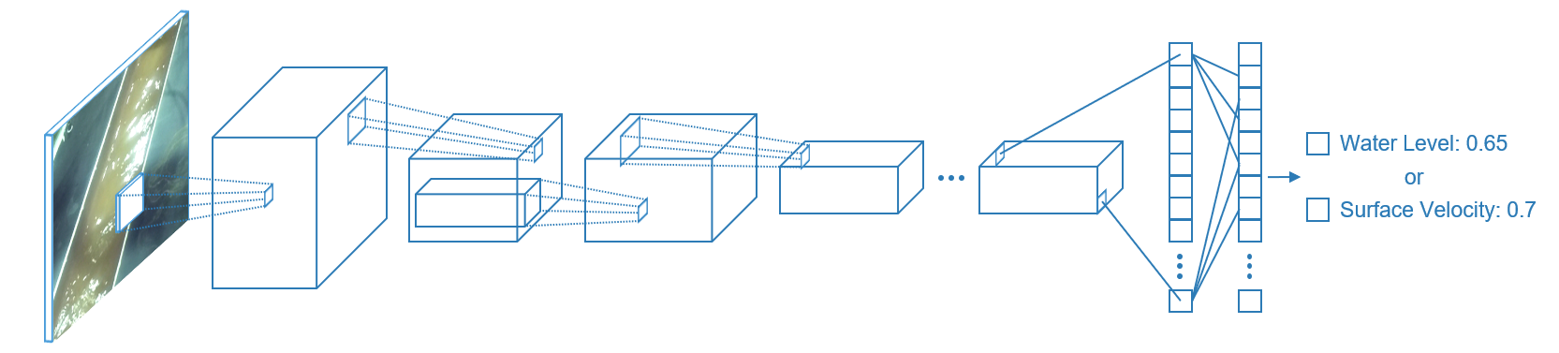
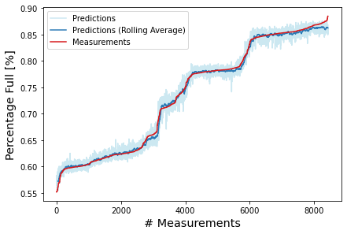
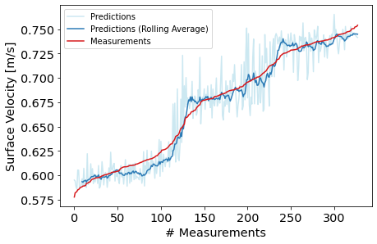

Spending Less Than 100$ on Real-Time Sewer Flow Measurements
Robert Meier, Franz Tscheikner-Gratl, Christos Makropoulos
Norwegian University of Science and Technology

Slide 2
Water Level

Slide 3
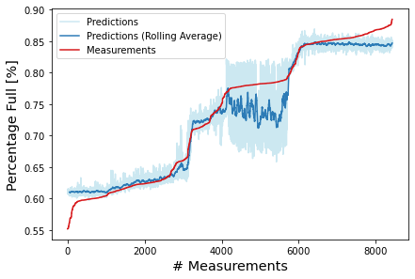
Water Level
(Gaps in Training Data)

Slide 4
Surface Velocity

Slide 5
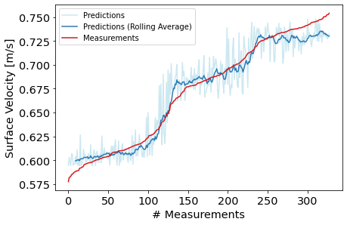
Surface Velocity
Excluding Border

Slide 6
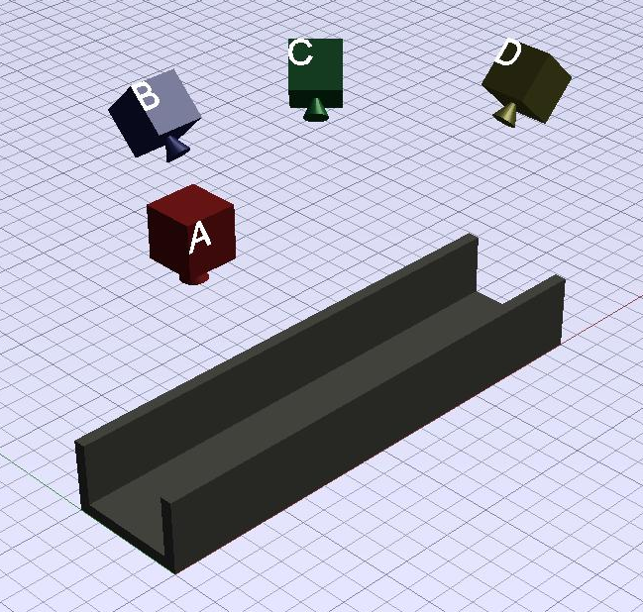
Possible Camera Positions

Slide 7
Footage Screenshot

Slide 8

Example Frames
Single frame for water level
Stacked frames for surface velocity

Slide 9
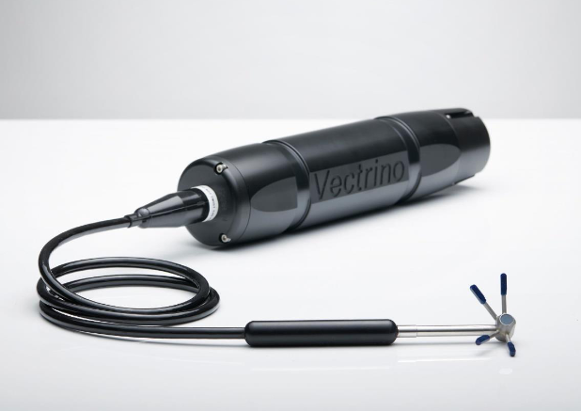
Nortek Vectrino
Image Credit: https://www.nortekgroup.com/assets/software/N3015-013-NQG_VECTRINO_1017.pdf

Slide 10
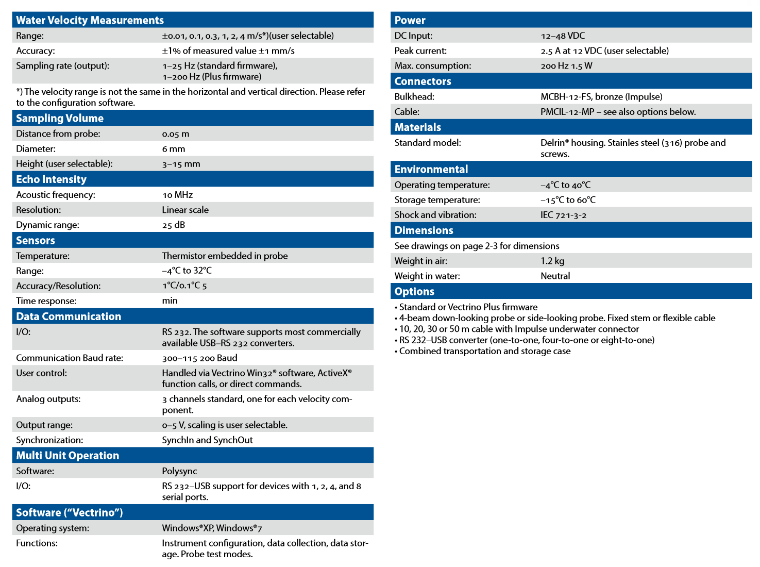
Nortek Vectrino, Specification
Image Credit: http://195.62.126.26/lib/data-sheets/datasheet-vectrino-lab

Slide 11
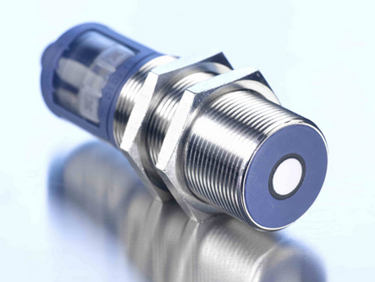
Microsonic (mic+35/IU/TC)
Image Credit: https://www.microsonic.de/en/distance-sensors/cylindrical/micplus/standard-sensors/standard-sensors/micplus35iutc.htm

Slide 12
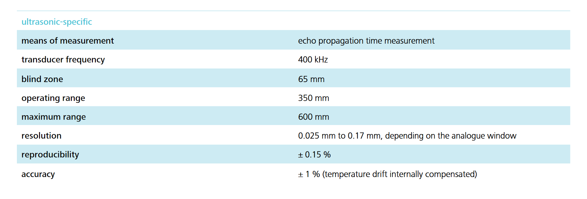
Microsonic (mic+35/IU/TC)
Image Credit: https://www.microsonic.de/DWD/_111327/pdf/1033/microsonic_mic+35_IU_TC.pdf

Slide 13
Example Costs
Raspberry Pi: ~39$
Camera Module: ~42$
SD-Card: ~2$
Case: ~10$
Assumptions:
  Power supply needed in any case
  Communication infrastructure present

