Slide 1
A two-stage analogue model for real-time urban flood forecasting
Chris Onof¹, Yuting Chen¹, Li-Pen Wang^{1,2}, Amy Jones³, and Susana Ochoa Rodriguez⁴
¹Dept. of Civil and Environmental Engineering, Imperial College London, London, United Kingdom
²Dept. of Civil Engineering, National Taiwan University, Taipei, Taiwan
³RPS Group, Derby, UK
⁴RainPlusPlus, Derby, UK

Slide 2
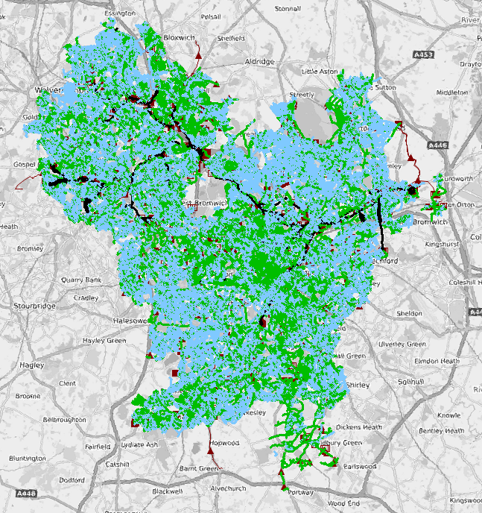
Pilot Area – Minworth Catchment (UK)
Hydrological Catchment
Flood risk hotspots
Sewer Model
(Source: [1])
Hydrological catchment area: 443 km², comprising the city of Birmingham.
Highly urbanised: 1.5M population served by sewer system with over 6M km of pipes.
Sources of flooding: often a combination of river, sewer and surface (pluvial) flooding.
Localised flooding can occur simultaneously in several areas across the catchment.
[1] https://www.birmingham.gov.uk/downloads/file/2561/surface_water_management_plan_for_birmingham_-_final_report

Slide 3


Objective
To develop a methodology for flood forecasting suitable for operational use by Birmingham City local authorities.
This methodology needs to be:
Computationally efficient
Operationally simple and inexpensive
Able to predict flooding occurrence at specific locations within the catchment area

Slide 4
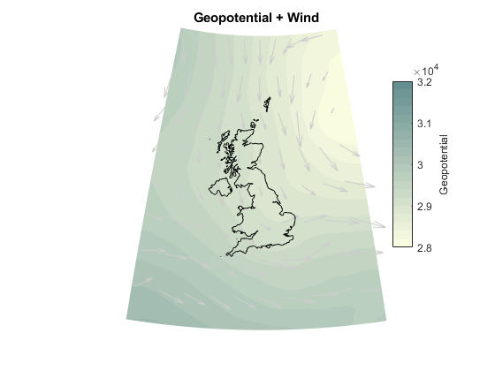

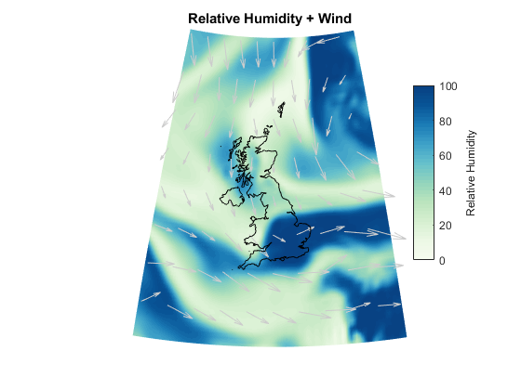
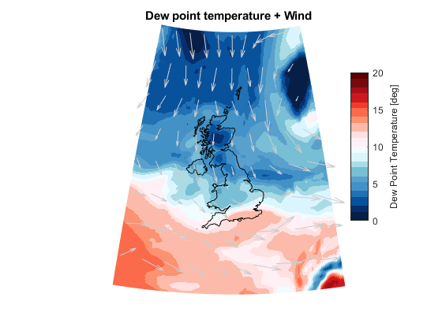
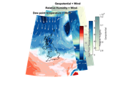
Forecasting Model Structure - Overview
Current mesoscale atmospheric conditions & 6h forecast
DB of weather conditions
120 analogue mesoscale atmospheric conditions
STAGE 1:
2-layer rainfall nowcasting
(0-6h)
Current Rain Map
DB of rainfall maps linked to analogue atmospheric conditions
12 rainfall analogues (ensemble nowcast)
STAGE 2:
Flood forecasting
(Averaged)
(Quantile based)
Notes:
Rainfall short-term forecasting based on mesoscale climatological conditions

Slide 5
Forecasting Model – Stage 1
Stage 1 - Rainfall nowcasting
NORA analogue-based forecasting tool, consisting of two layers:
  Layer 1: Identification of analogue mesoscale atmospheric conditions (120)
  Layer 2: from radar images linked to atmospheric analogues, select 12 most similar to those currently observed (images initially vectorised)
  Effectively, an ensemble rainfall forecast is obtained
Current mesoscale atmospheric conditions & 6h forecast
DB of weather conditions
120 analogue mesoscale atmospheric conditions
2-layer rainfall nowcasting
Current Rain Map
DB of rainfall maps linked to analogue atmospheric conditions
12 rainfall analogues (ensemble nowcast)
Key techniques: PCA-based dimensionality reduction, K nearest neighbour
Notes:
Rainfall short-term forecasting based on mesoscale climatological conditions

Slide 6
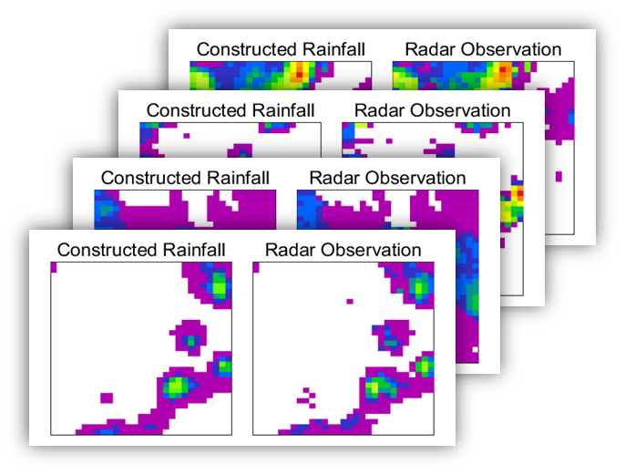
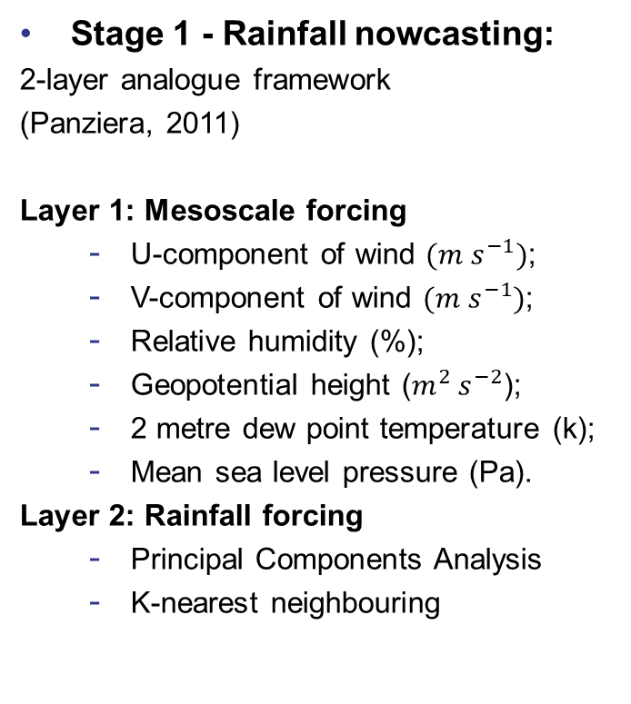
Forecasting Model – Stage 1
Stage 1 - Rainfall nowcasting:
2-layer analogue framework
(Panziera, 2011)
Layer 1: Mesoscale forcing
  U-component of wind $(m s^{−1})$;
  V-component of wind $(m s^{−1})$;
  Relative humidity (%);
  Geopotential height ($m^{2} s^{−2}$);
  2 metre dew point temperature (k);
  Mean sea level pressure (Pa).
Layer 2: Rainfall forcing
  Principal Components Analysis
  K-nearest neighbouring
Figure 2. Comparison of rainfall images from observed radar and PCA re-constructed
Panziera et al. 2011. NORA–Nowcasting of Orographic Rainfall by means of Analogues. Quarterly Journal of the Royal Meteorological Society. 137, 2106-2123.

Slide 7
Forecasting Model – Stage 2
Current mesoscale atmospheric conditions & 6h forecast
Stage 2 - Selection of flooding map(s) associated to historical rainfall from catalogue
  A deterministic flood prediction is obtained by using the averaged response from twelve flood maps, where for each gridded area (1×1 Km), the median value is adopted used (assuming 12 flood maps are equiprobability).
  A probabilistic flood prediction is obtained by generating a quantile-based flood map.
DB of weather conditions
120 analogue mesoscale atmospheric conditions
2-layer rainfall nowcasting
Current Rain Map
DB of rainfall maps linked to analogue atmospheric conditions
12 rainfall analogues (ensemble nowcast)
Flood forecast
(Averaged)
(Quantile based)
Key techniques: PCA-based dimensionality reduction, K nearest neighbour
Notes:
Rainfall short-term forecasting based on mesoscale climatological conditions

Slide 8
Offline Training Dataset
Historical Rainfall Data
KED merged radar-rain gauge records from 2005 to 2017
Historical Climate Data
ERA5 reanalysis data from ECMWF at 0.25deg/1h resolution
Variables selected: U, V, RH, DT, MSLP …
(Simulated) Historical Flood Response
Simulated max depth flood maps (IW + PondsimPro)
for each of 157 flood-inducing storm events
At 5min and 1km resolution

Slide 9
Real-time Data
Climate Forecasting
US Global Forecasting System (GFS)
Rainfall Information
Real-time weather radar data (assumed to be available)
Flood Information
FCS citizen flood reports
EA Rain gauge data (15min resolution) (with some hours of delay)
RT RG data can become available from FCS rainfall sensors
available every 6h (@ 00, 06, 12 and 18h UTC) @ 0.5° x 0.5°

Slide 10
Evaluation Method
Cross-assessment for each of 157 flooding events, leaving one event out from training in each iteration and using it for evaluation
Focus on spatial replication of flood/non-flood pattern – flood maps therefore converted to binary (flood/non-flood) maps
Quantitative assessment undertaken following contingency table:
Table 2 Contingency table of Flood Descriptors
 | Flooding in Hydraulic output | Non-flooding in Hydraulic output
Flooding in Data-driven output | True positives (TP) | False positives (FP) | Positive predictive rate (PPR) = TP/(TP+FP)
Non-flooding in Data-driven output | False negatives (FN) | True negatives (TN) | Negative predictive rate(NPR) = TN/(TN+FN)
 | True positive rate (TPR) = TP/(TP+FN) | True negative rate (TNR) = TN/(FP+TN) | Accuracy (ACC) = (TN+TP)/(TP+TN+FN+FP)

Slide 11
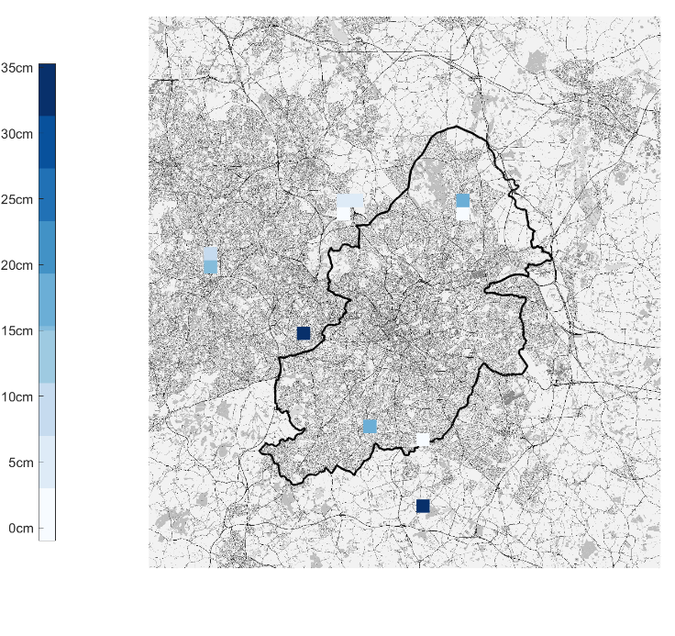
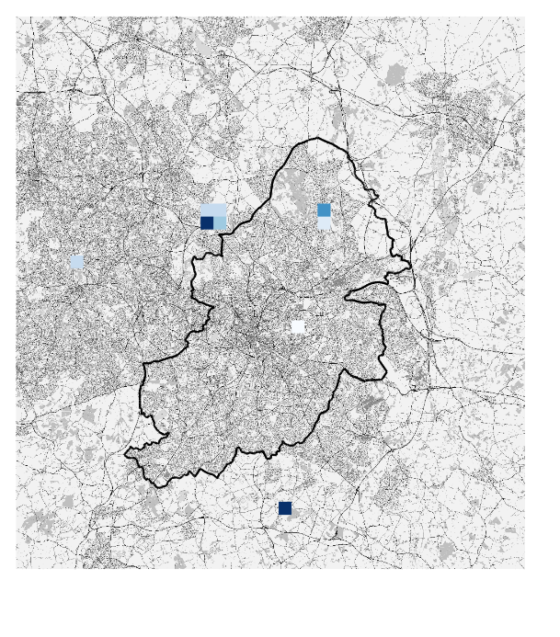
Results
(a) Simulated flood map (InfoWorks)
(b) Prediction Result
Figure 3. Example of deterministic flood prediction result

Slide 12
Results
Simulated flood map (InfoWorks)
Flood Depth
Probabilistic predictions
Figure 4. Example of probabilistic flood prediction result at Birmingham pilot: Comparisons of Flood Maps from InfoWorks and probabilistic predicted flood maps. Upper: ‘observed’ (numerically simulated) flood response, shown as the maximum depth within each grid cell of 3x3km; Bottom: ‘predicted’ (Data-driven prediction) flood risk, at same resolution and at 10, 50, 90 percentiles respectively. Circle size represents how severe the flood is at the location.

Slide 13
Results
Table 5 Performance of the prediction model
 | True conditions
Predicted conditions | True Positive: 28.6% (14.3%~42.9%) Areas ^{[1]} correctly predicted as flooded | False Positives: 14.3% (0%~21.43%) Areas incorrectly predicted as flooded | Positive Predictive Rate: 63.6% (50%~75%) (63.6% of predicted flooding areas are truly flooding areas)
 | False Negatives: 0% (0%~7.1%) Areas incorrectly predicted as non-flooded | True Negatives: 28.6% (28.6%~35.7%) Areas correctly predicted as non-flooded | Negative Predictive Rate: 99.9% (79.9%~99.9%) (99.99% of predicted non-flooding areas are truly non-flooding areas)
 | True Positive Rate: 85.7% (50.0%~99.9%) (85.7% of truly flooded areas can be correctly predicted as flooded) | True Negative Rate: 75.0% (63.6%~99.9%) (75.0% truly non-flooding areas can be correctly predicted) | Accuracy Rate: 71.4% (57.1% ~ 78.6%) (The overall accuracy is 71.4%)
[1] The percentage shown represents an area ratio: the area meeting the condition (km²) divided by the total area under investigation.
50th percentile of each metric over all test events is shown in bold. 25th and 75th percentile of each metric are shown within parentheses to indicate model uncertainty

Slide 14
Summary
We developed a data-driven urban flood prediction approach, based on rainfall records and flooding simulations over the period of 2005 to 2017.
The proposed approach can predict distributed (km scale) flood hazard over Birmingham city for operational use.
We optimized model settings and determined a suitable pattern recognition method.
The optimal model settings led to 85.7% true positive rate and 71.4% accuracy rate regarding spatial flooding prediction.
The proposed approach accounts for the complexities of urban rainfall nowcasting and flood simulation while avoiding the expensive the computational requirements and operational costs of utilising commercially available rainfall forecasts and running detailed flood models in real time.

Slide 15
Future work
Comparison of proposed nowcasting model vs. Met Office operational (paid-for) rainfall forecasts from their STEPS model (nowcasting + NWP)
Model refinement including more non-flooding events for training
Include more information of rainfall (such as extremes) in rainfall nowcasting, for the aim of flood prediction
Apply artificial neural network to predicting the flood events

Slide 16
Acknowledgements
The authors acknowledge the financial support and data supplied by different organisations, as follows:
The FloodCitiSense project was funded under the ERA-NET Cofund Smart Futures call (ENSUF), with funding for UK partners provided by the ESRC
The hydraulic model employed for training of the data-driven forecasting model was supplied by Severn Trent.
Flood records used for preparation of the training dataset were supplied by Severn Trent and Birmingham City Council.

