Slide 1
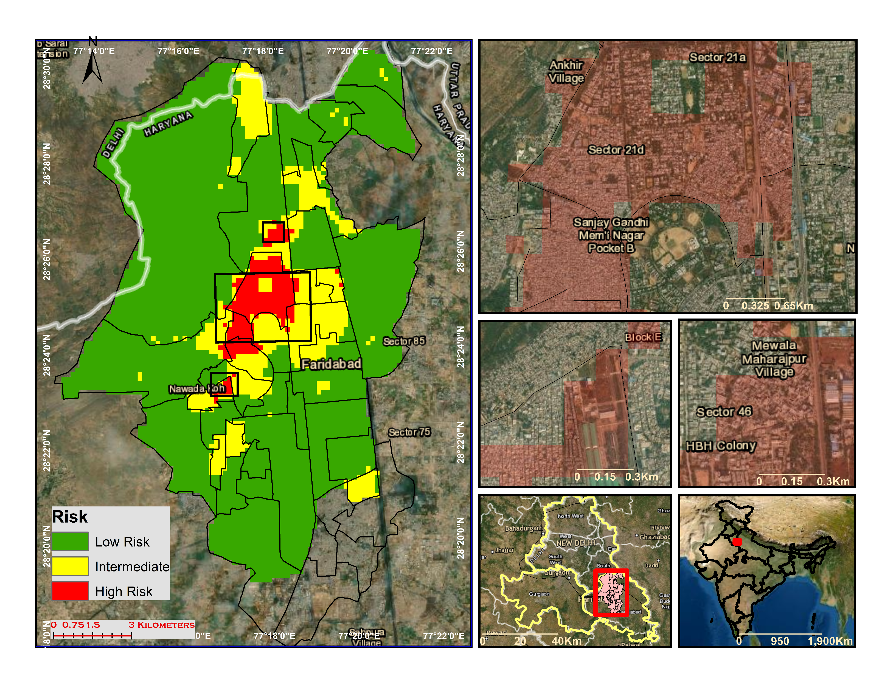
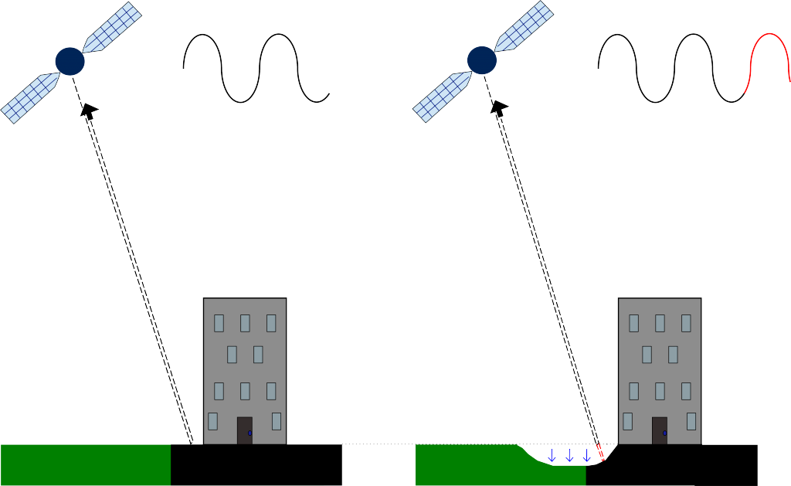
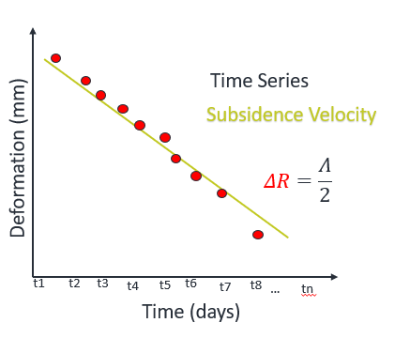
Risk of Ground Movement in Faridabad, India – Investigated using Remote Sensing and In-Situ Data
Study Area : Faridabad - Haryana, India
Hazard Map
Vulnerability Map
Urban/Built-up Areas
Vulnerability Indices
Population
Population Density
Fig. Study area is Faridabad, Haryana .
Problem : Water Crisis and Subsidence
Datasets Used : Sentinel-1 (2016-2018), Sentinel-2, Groundwater in-situ (CGWB) Lithology, Population census 2011
Hazard Indices
Subsidence Gradient
Land Subsidence
Lithology
Figure: Hazard and Vulnerabilty map classified into three classes.
Methodology
At t=t1
At t=t2
Fig. Working of Interferometric SAR (InSAR) for deformation estimation
Groundwater Depth
Groundwater extraction
Urban Areas
Subsidence Gradient
Subsidence velocity
Population
Vulnerability
Hazard
Groundwater depth
Population Density
Risk
Geomorphology
.
GW velocity
Figure: Risk map classified into 3 classes. Area under high risk of ground movement is approx. 8sq km and includes NIT Faridabad, HBH, Sector 21,46, and Sanjay Gandhi Memorial Nagar.
Flow chart of methodology used in the study

