Slide 1
Damage coalescence controls slow and fast faulting: Insights from dynamic X-ray microtomography experiments
François Renard, Jessica McBeck, Benoît Cordonnier
The Njord Centre, Department of Geosciences, University of Oslo, Norway
ISTerre, University Grenoble Alpes & CNRS, France
How does strain localization controls faulting ?
Pre-existing slip surface: slow slips can generate damage in the volume around the fault, leading to catastrophic faulting.
No pre-existing fault: microfractures accumulation leads to two end-member types of earthquakes.
- fast earthquake
- slow earthquake
Renard et al., Tectonophysics, 2020

Slide 2
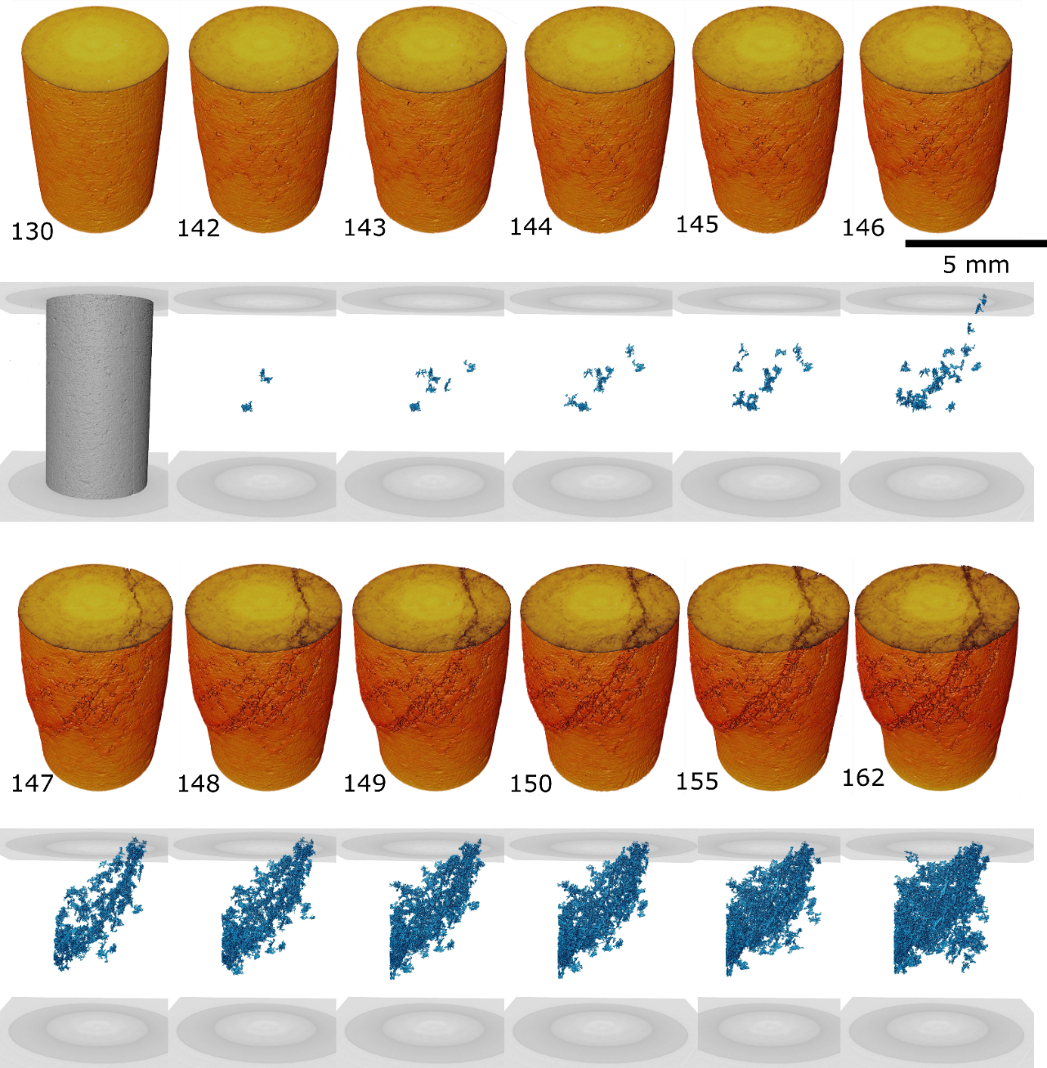
Damage coalescence and slow faulting
Renard et al., JGR, 2020

Slide 3
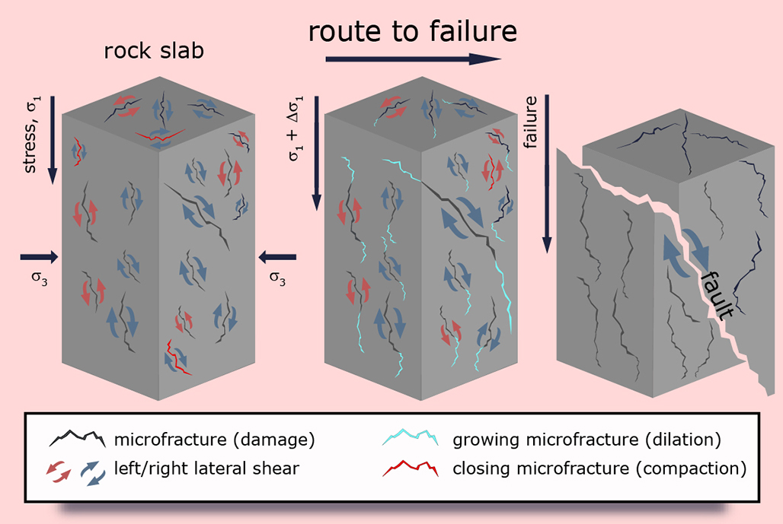
Damage coalescence influences the slow and fast behaviors of earthquake slip
Renard et al. PNAS, 2019

