Slide 1

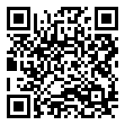
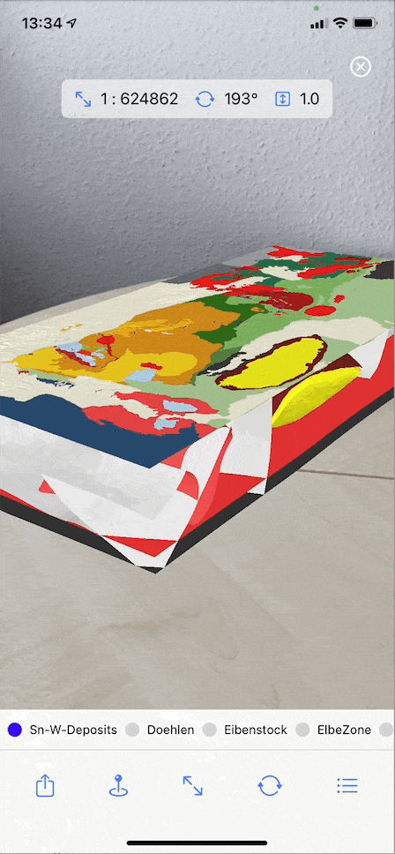
GST[AR]
How can AR help?
AR is very accessible
„Real“ 3D models
Users can explore the model in their own way, while there are still options for guidance
Allows for easy data access
Communicating geology can be hard
3D spatial concepts are sometimes difficult to grasp
This affects
  Education
  Professional workflows
  Public relations
  Presentations
Direct user manipulation is essential for understanding!
Complex software/hardware makes that complicated
There’s an app for that!
Place 3D geomodels in AR
Modify the scene
Share a session with peers
Highlight individual parts
Purpose: Gather feedback!
EGU 2021
ESSI4.2 – 'Innovations in Scientific Data Visualization'
Björn Wieczoreck (bjoern.wieczoreck@giga-infosystems.com)

Slide 2
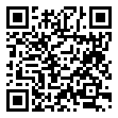
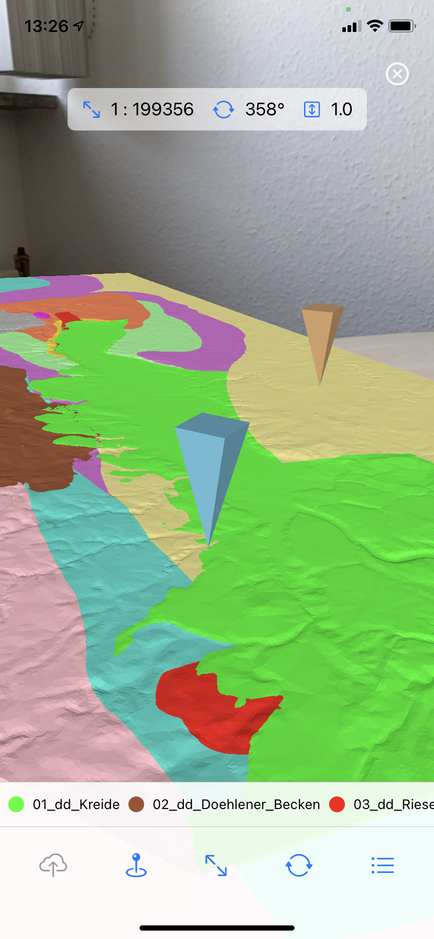
GST[AR]
Features
View 3D geological models in AR (TINs/Tetras)
Scale/Rotate/Superelevate
Highlight individual parts
Select parts of a larger model
New tech is exciting!
AR is very accessible!
Can it help us communicate complex 3D geology better in
  Education?
  Public relations?
  Professional workflows?
Collaboration!
Share session with other peers in the same room
Explore the same geological model at the same time
Highlight individual parts for others to see
There’s an app for that!
On iPhone and iPad (Android app in the works)
Purpose: Gather feedback
EGU 2021
ESSI4.2 – 'Innovations in Scientific Data Visualization'
Björn Wieczoreck (bjoern.wieczoreck@giga-infosystems.com)

