Slide 1
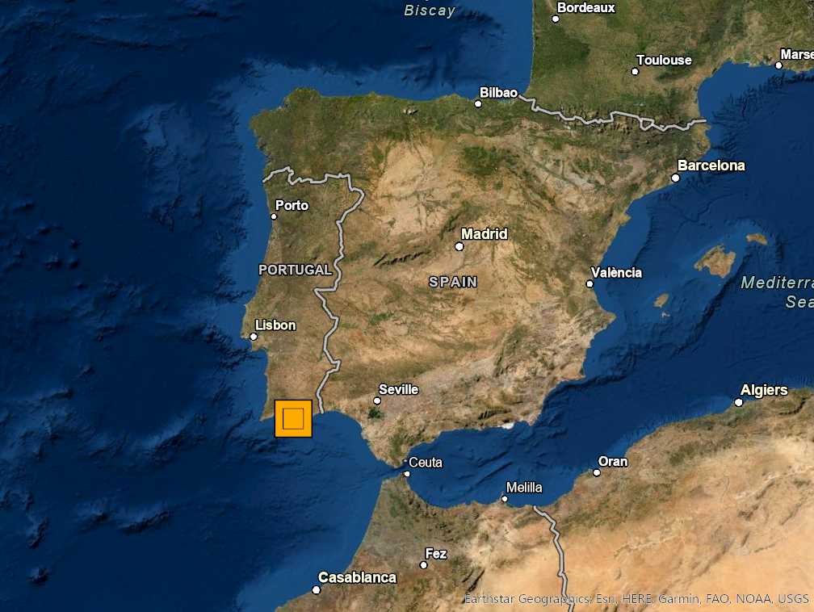
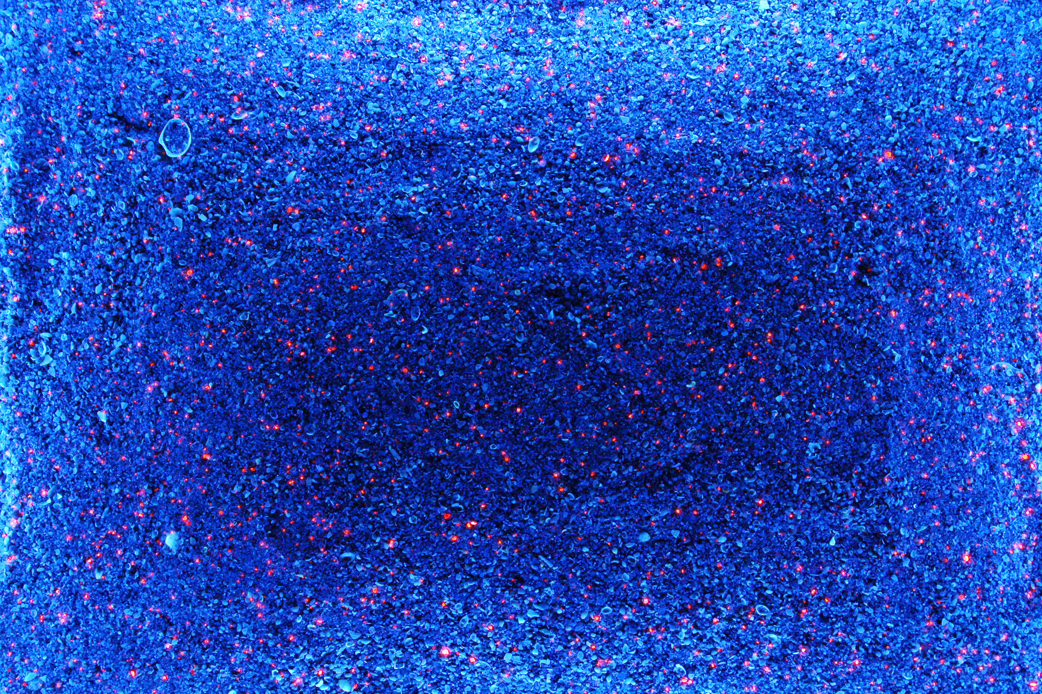
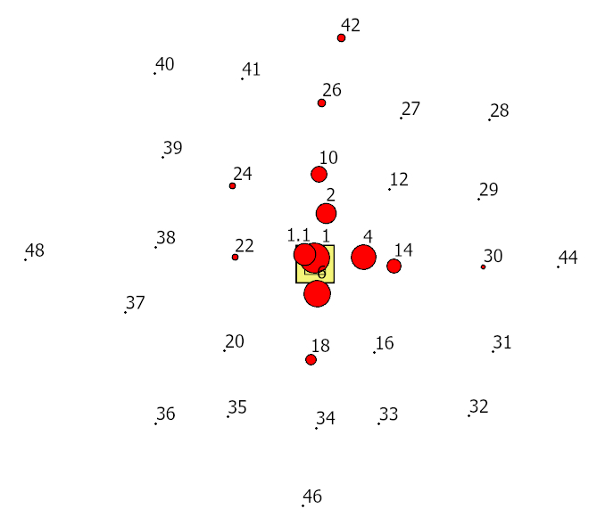
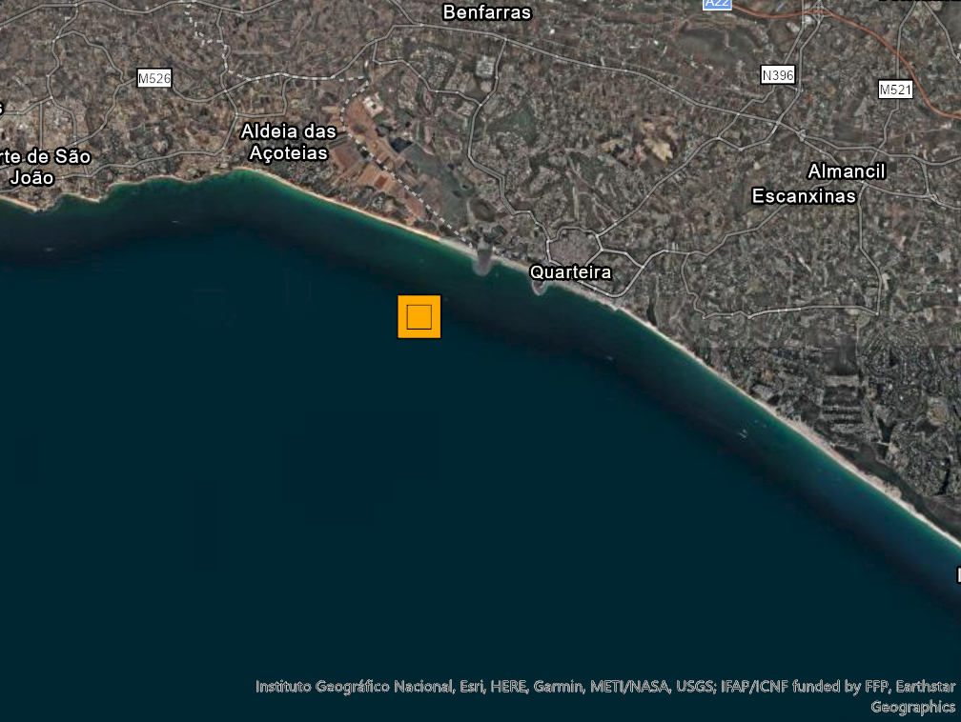
Monitoring inner shelf sediment transport using fluorescent sand tracers: an example from the south coast of Portugal
Cascalho J., Taborda R., Rosa M., Garel E., Teixeira S., Alberto A., Drago T.
Corrresponding author: jpcascalho@fc.ul.pt (J. Cascalho)
The main objective of this work is to assess sediment transport conditions at an inner shelf borrow site exploited to nourish a beach located at the updrift boundary of the same sedimentary cell (Belharucas, Albufeira, south coast of Portugal – Figure 1). The work is supported by a sand tracer experiment, where 600 kg of coated sand with fluorescent ink was deposited (August 17th, 2020) by divers at 11 m depth (referred to the mean sea level). Periodic sediment sampling using a Van Veen grab was performed using an adaptative sampling grid that accounted for tracer’s dispersion trough time. The samples were washed and dried in laboratory and tagged particles were automatically identified using an automated image analysis procedure based on ultraviolet lighting (Figure 2).
N
200 km
Sample 1 - 7437 grains/m²
Figure 2 - Image of the sediment present in sample 1 under UV light. This image shows the maximum concentration of the fluorescent tracer.
N
20 m
5 km
Figure 3 – Sample grid on November 14th, 2020. The numbers represent the collected samples.
Injection of tracer on August 17th , 2020- represented by the
yellow square (11 m depth – mean sea level).
Figure 4 – Tracer mass center on November 14th, 2020 -
green star (located about 1.5 m to the east of the injection point. Black circles represent the distance from the injection point (yellow square).
Figure 1 - Location of the study area (orange square).
Field data show that tracer distribution pattern around the injection point is dominated by diffusion (Figure 3). However, it is possible to detect a slight trend of tracer transport towards east considering the position of the tracer mass center (Figure 4). Also, it was detected the presence of tracer in very low concentrations (about 5 grains/m²) in samples 26 and 42 located more than 30 m north of the injection point (Figure 3).
The authors would like to acknowledge the financial support FCT through project UIDB/50019/2020 – IDL and ECOEXA project (MAR-01.04.02-FEAMP-0016).

