Slide 1






Environmental benefits of traditional irrigation ditches in the Sierra
Nevada (Spain) ecosystem by analysing the spatial-temporal evolution of
NDVI on different time scales
HS2.1.1
Changes in the Mediterranean hydrology: observation and modeling
Javier Aparicio¹
Rafael Pimentel¹
María J. Polo¹
¹ Fluvial Dynamics and Hydrology Research Group, Andalusian Institute for Earth System Research. University of Córdoba

Slide 2



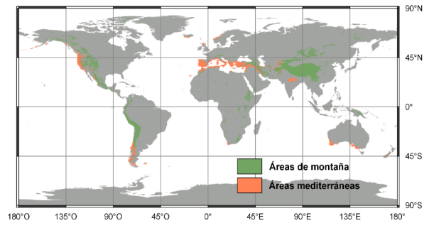
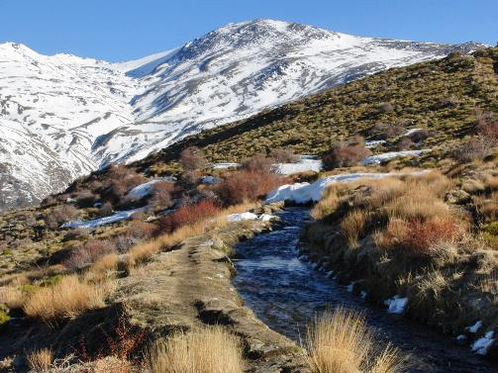
INTRODUCTION
In Mediterranean mountain regions, traditional irrigation systems still persist in areas where the modernization approaches do not succeed in being operational.
This is the case of the extensive network of irrigation ditches in the Sierra Nevada Mountain Range in southeastern Spain. This network is formed by two types of ditches. Ditches at higher elevations are called “careo” and are used to infiltrate water from melting snow. The second ones are called irrigation ditches and their utility is the agriculture.

Slide 3
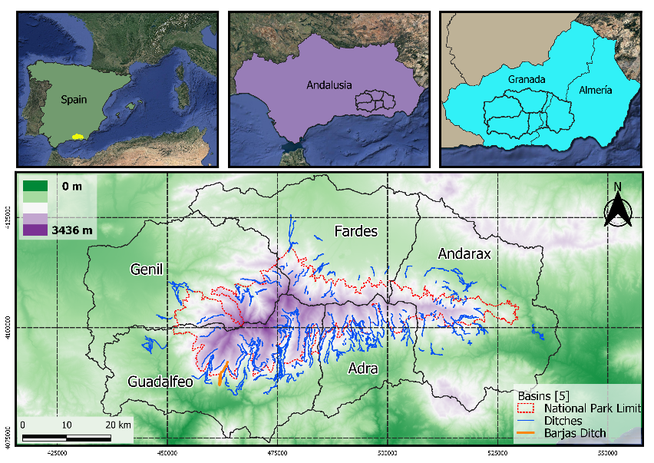
STUDY AREA
Sierra Nevada Mountains
Altitudinal range : 950 – 3479 m
Annual precipitation : 510mm*
Aver. daily temperature : 26, 12.5 & 0,4 ⁰C* for max., med. & min.
Snow from November until May, communly starting from 1000m
* Pérez-Palazón et al., 2015
Extreme values of snow-related variables in Mediterranean regions: trends and long-term forecasting in SierraNevada (Spain).

Slide 4

PRINCIPAL OBJECTIVE
EVALUATE THE HYDROLOGICAL ROLE OF DITCHES IN HIGH MOUNTAINS ZONES.
STEPS TO DO
Evolution of the response of NDVI as indicator of soil moisture* in Sierra Nevada (Spain) in the period 1984-2014.
*Gómez-Giráldez, Pedro J. & Aguilar, Cristina & Polo, María J.. (2014). Natural vegetation covers as indicators of the soil water content in a semiarid mountainous watershed. Ecological Indicators. 46. 524 - 535. 10.1016/j.ecolind.2014.06.024.
Analysis the NDVI of zone influence of ditches using differents buffer.
Evaluation in detail the effects of restorations of ditches, exactly the Barjas Ditch, restored in 2014.
GLOBAL & BASINS
SCALE
DITCH
SCALE

Slide 5
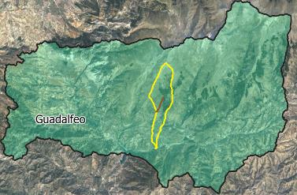
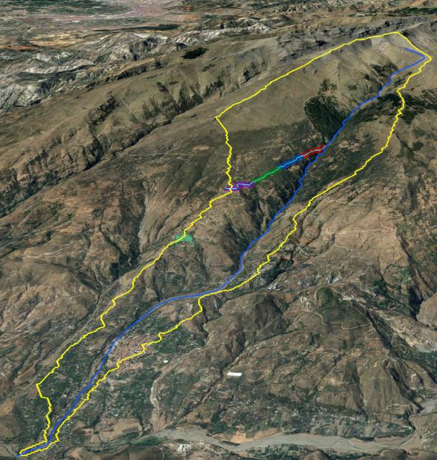
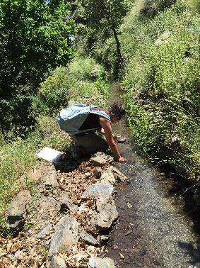
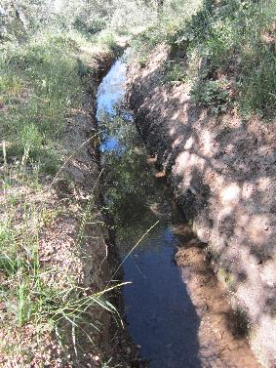

STUDY AREA
Barjas
South face of Sierra Nevada
Guadalfeo Basin
Cañar Town
MEMOLA Project in 2014 (Restoration)
Barjas Ditch
B1
B1
B1
B1
Chico River
Chico River Basin
Cañar

Slide 6
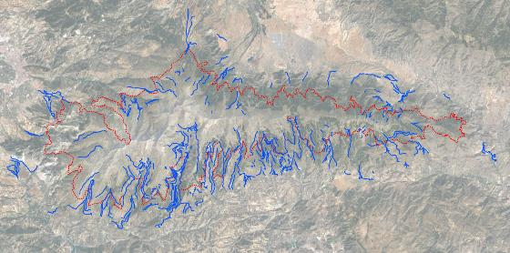
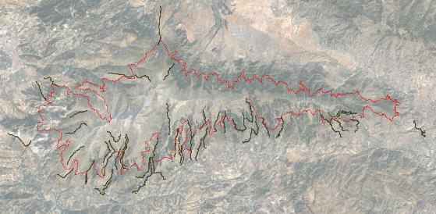
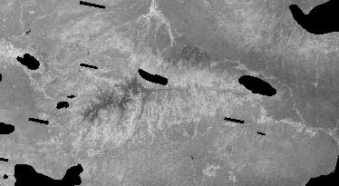
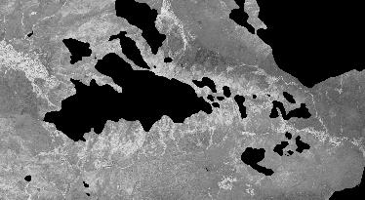
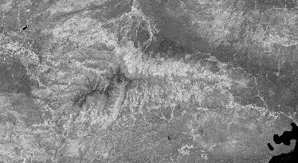
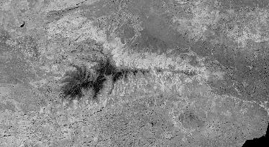
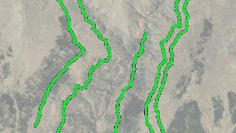
METHODOLOGY
FILTER N°
OF DITCHES
IMAGING PROCESSING
IMAGES
GLOBAL & BASINS SCALE
SINCE 26 / 07 / 1984 TO 15 / 03 / 2017
IN TOTAL 159 IMAGES
BLACK SPOTS ARE CLOUDS
ECOPOTENTIAL PROJECT COLLECTION (LANDSAT 5 , 7 , 8)
BARJAS DITCH
TIME EVOLUTION
PREC. & NDVI
PRE & POST RESTAURATION
26 / 07 / 1984
12 / 09 / 1984
DISTRIBUTIONS
LAND USES
BASINS
SOIL MOISTURE EVOLUTION LONGITUDINALLY
442 DITCHES
TO
45 DITCHES
Buffer 50m
INFLUENCE OF PROXIMITY
IN BASE OF P90 OF LENGTH OF THE DITCHES
THEN
BUFFERING
14 / 10 / 1984
03 / 02 / 1985

Slide 7
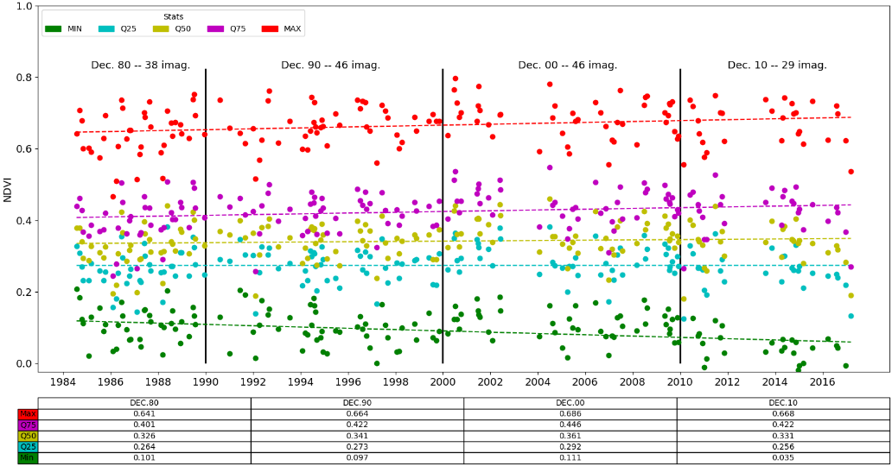
Results
GLOBAL SCALE
TIME EVOLUTION
DISTRIBUTIONS (LAND USE)
INFLUENCE OF PROXIMITY
Stats of 45 ditches areas (aprox. 3184 ha) for the image nº 99 of 159 – 23/01/2004

Slide 8
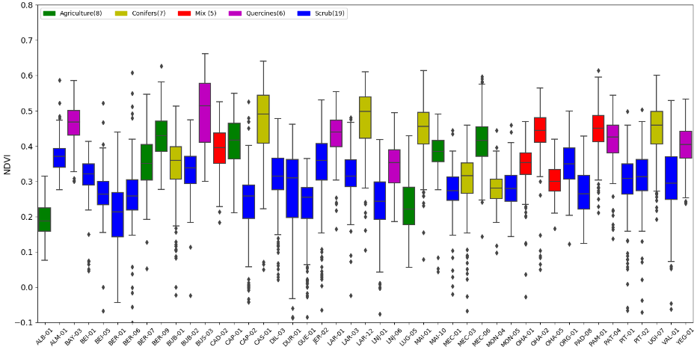
Results
GLOBAL SCALE
TIME EVOLUTION
DISTRIBUTIONS
(LAND USE)
INFLUENCE OF PROXIMITY
 | LAND USE
Stats NDVI | Agriculture | Conifers | Mix | Quercines | Scrub
Mean | 0.413 | 0.392 | 0.383 | 0.424 | 0.289
Median | 0.416 | 0.409 | 0.389 | 0.434 | 0.297

Slide 9
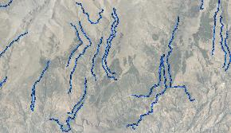
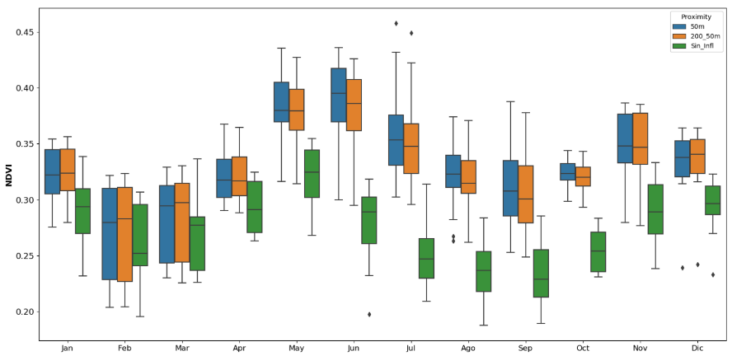
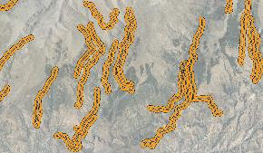
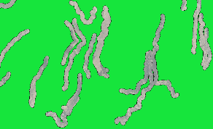
Results
GLOBAL SCALE
TIME EVOLUTION
DISTRIBUTIONS (LAND USE)
INFLUENCE OF PROXIMITY
Buffer 50m
Buffer 50-200m
Rest

Slide 10
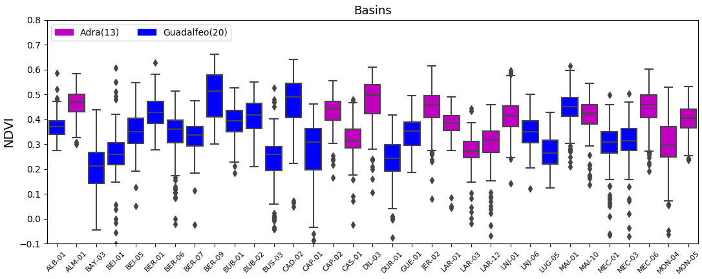
Results
BASINS SCALE
DISTRIBUTIONS (LAND USE)
INFLUENCE OF PROXIMITY
Stats NDVI | Mean | Median
Adra | 0.388 | 0.396
Guadalfeo | 0.341 | 0.350
Precipitation | Mean(1961-2015)
Adra | 581.3
Guadalfeo | 660.43
Pérez-Palazón et al., 2015

Slide 11
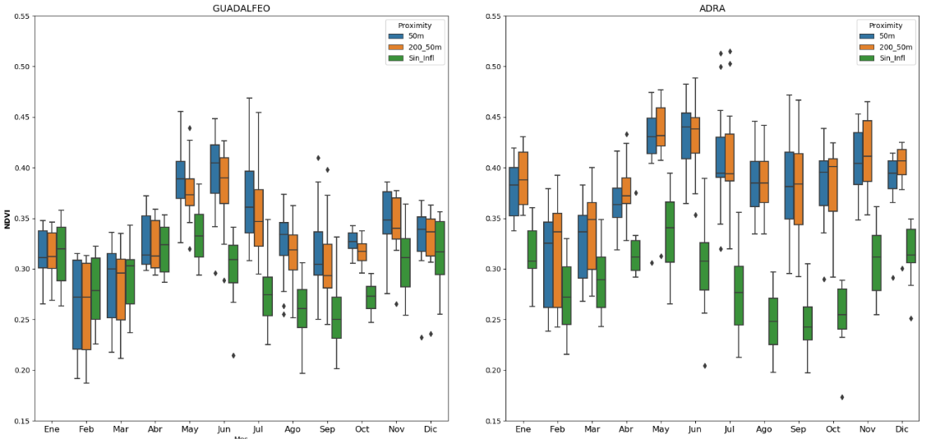
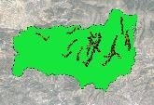
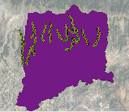
Results
BASINS SCALE
INFLUENCE OF PROXIMITY
DISTRIBUTIONS (LAND USE)

Slide 12
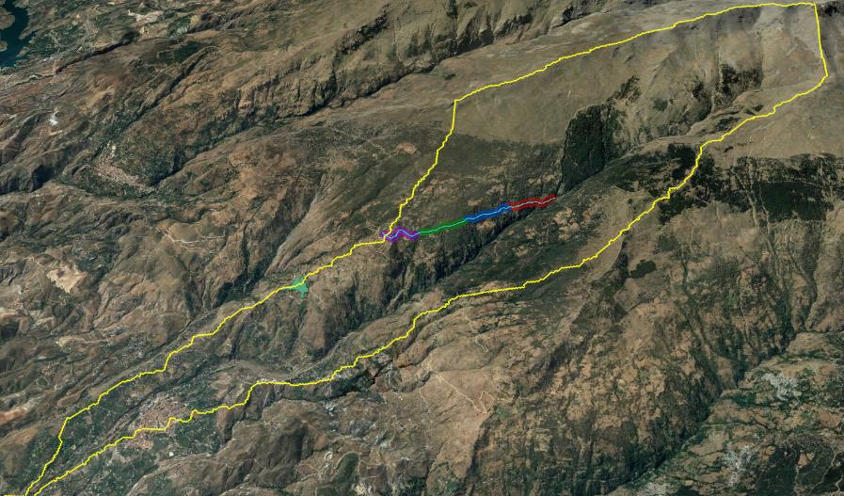
Results
BARJAS DITCH – REDUCED SCALE
B2
B3
B1
B4

Slide 13
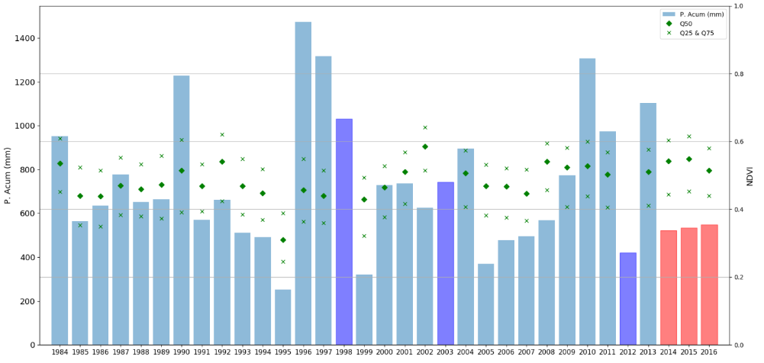
PRECIPITATION & NDVI
PRE & POST RESTAURATION
SOIL MOISTURE EVOLUTION LONGITUDINALLY
Results
BARJAS DITCH
Acumulative Precipitation & NDVI Stats of the nearest image to final of hydrological year (31-August)
PRE-RESTORATION
POST-RESTORATION

Slide 14
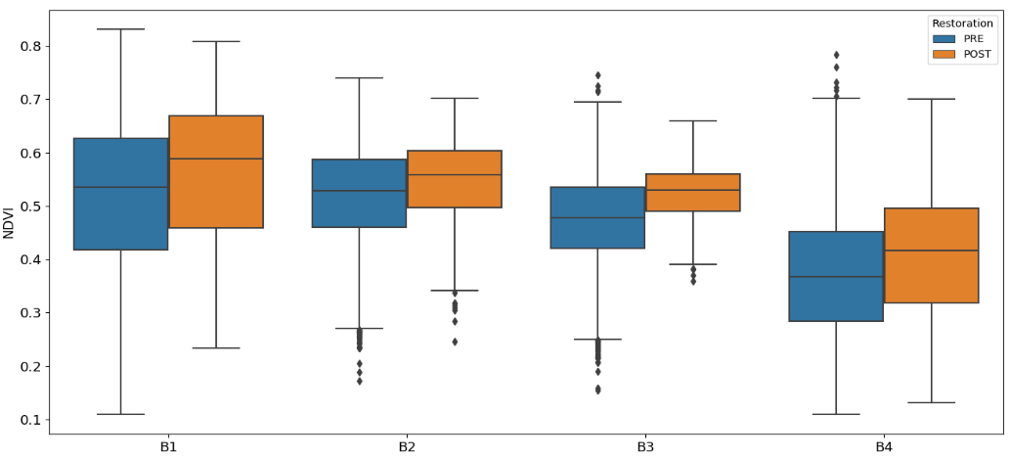
Results
PRECIPITATION & NDVI
PRE & POST RESTAURATION
SOIL MOISTURE EVOLUTION LONGITUDINALLY
BARJAS DITCH
Mean Prec. = 745.14mm
Dataset with the last image of hidrological years before the restoration (1984-2014) – 30 images
Mean Prec. = 534.36mm
Dataset with the last image of hidrological years after the restoration (2014-2016) – 3 images

Slide 15
Conclusions
GLOBAL /BASINS SCALE
SNOW PRECIPITATION KEEPS CONSTANT NDVI VALUES OVER TIMES, DESPITE PRECIPITATION IS DESCENDING (QUANTITY & DAYS)
NDVI VALUES IN DITCHES WITH AGRICULTURE LAND USES ARE HIGHER THAN CONIFERS, HOWEVER, LOWER THAN QUERCINES
THE NOTABLY DIFFERENCES IN NDVI FROM APRIL TO WINTER IN BUFFER ZONES AND NON INFLUENCES ZONES, IT IS CAUSED BY THE SNOWMELT SEASON AND ITS EFFECTS ON THE INCREASE OF WATER CIRCULATION IN DITCHES
ALTHOUGH ADRA HAS A LOWER PRECIPITATION, ITS IRRIGATION DITCHES HAVE HIGHER NDVI VALUES AND THIS MAY BE DUE TO THE LOWER PERSISTENCE OF SURFACE SNOW.
BARJAS DITCH
CLEARLY POSITIVE EFFECT OF THE RESTORATION PROJECT OF BARJAS. RESTORATION CONSISTED OF CLEARING VEGETATION AND RE-ESTABLISHING THE CHANNEL BED. THIS ALLOWED AN IMPROVEMENT IN WATER CIRCULATION AND CONSEQUENTLY BETTER INFILTRATION ALONG THE CHANNEL, AFFECTING THE SURROUNDING VEGETATION.
THE INCREASE OF NDVI VALUES IS UNIFORM ALONG THE CHANNEL, NON OBSERVING ANY IMPORTANT DIFFERENCE IN THE DIVIDED ZONES

Slide 16
THANK YOU!
Javier Aparicio Ibáñez
ACKNOWLEDGEMENTS:
This work was funded by:
European Union´s Horizon 2020 research and innovation programme under grant agreement Nº 641762 “Ecopotential- Improving Future Ecosystem Benefits Through Earth Observations “H2020-SC5-16-2014-641762.
Spanish Ministry of Science, Innovation and Universities– MICINN (Research Project RTI2018-099043-B-I00. "Operability in hydrological management under snow torrentiality/drought conditions in high mountain in semiarid watersheds (OPERA)".
japaricio@uco.es

