Slide 1
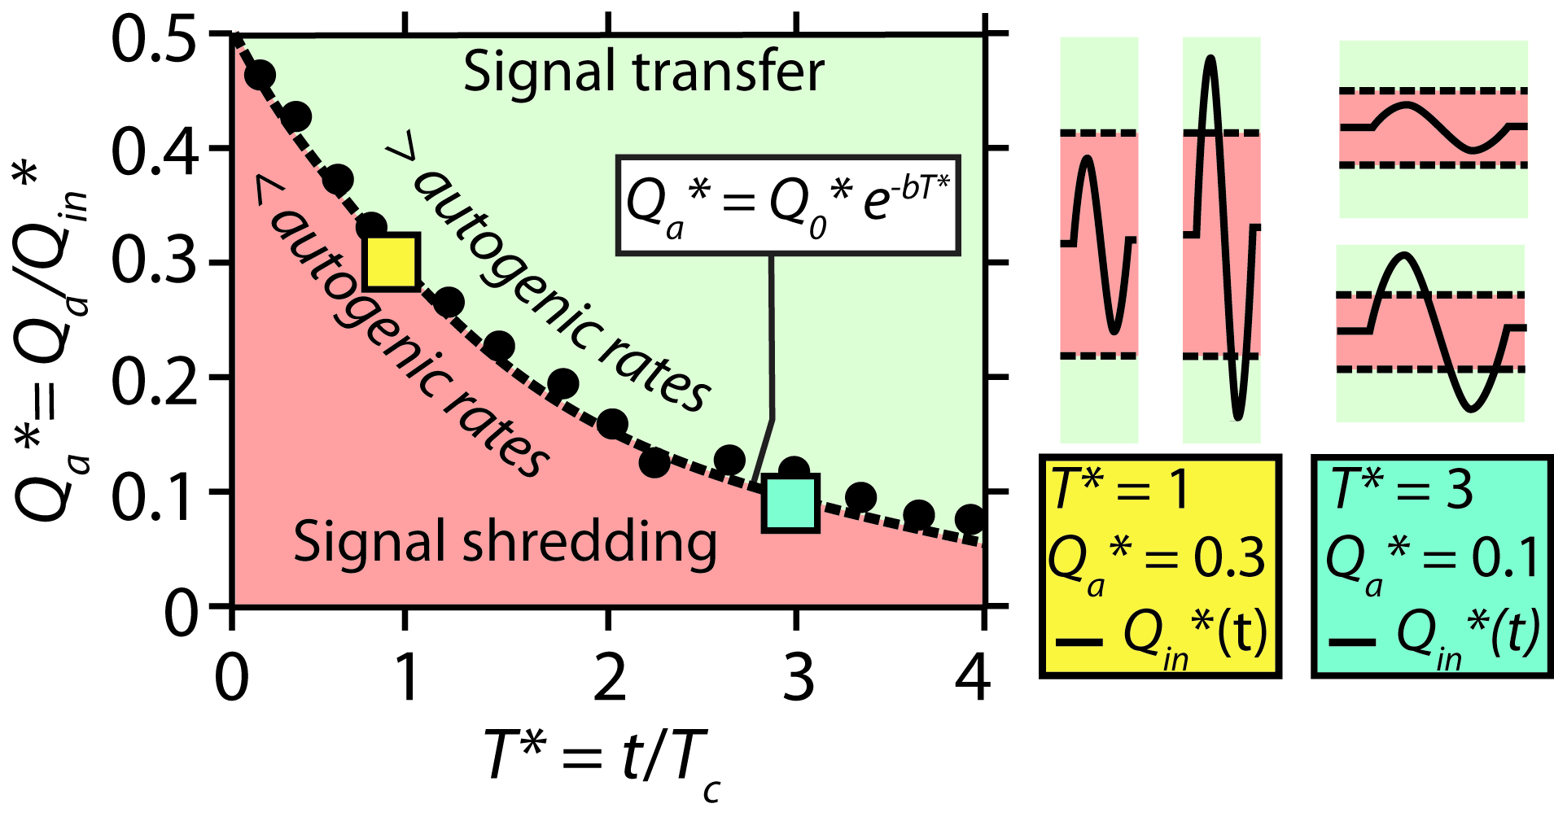
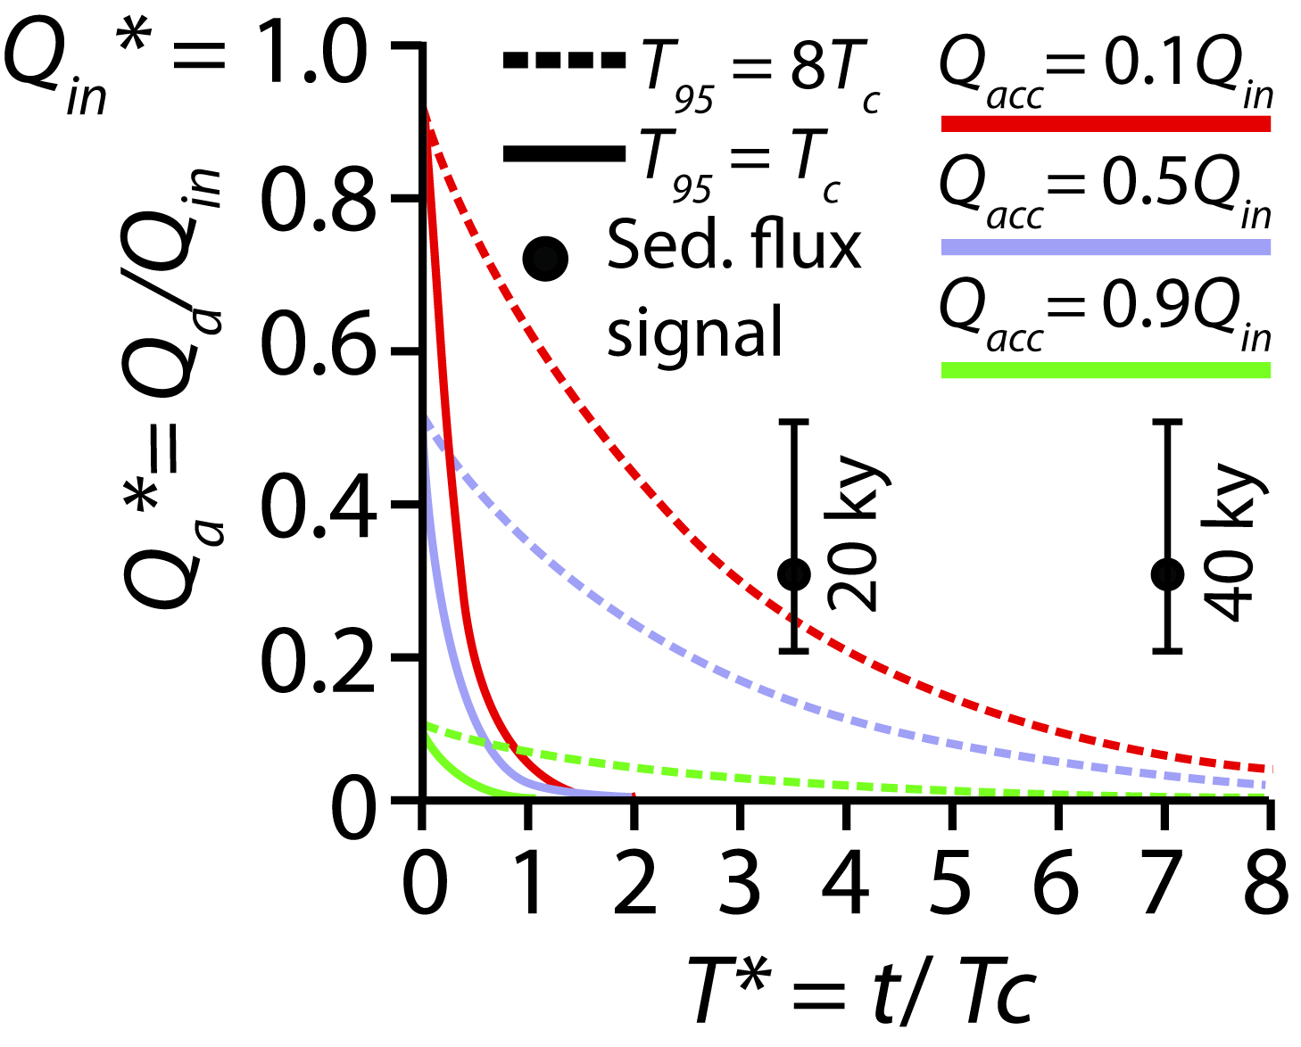
Quantifying environmental signal propagation & preservation in ancient sediment routing systems
Stephan Toby¹, Robert Duller¹, Silvio De Angelis¹, and Kyle Straub²
in
out
Toby et al., (2019) GRL
A. Measured autogenic threshold function
B. Field-approximated autogenic threshold function
Evaluates signal storage for any combination of magnitude-period
Kerinitis Delta (Barrett et al., 2019)
Toby et al. (2019) GRL.
Toby et al., in prep.
¹ University of Liverpool, UK
² Tulane University, New Orleans, USA

