Slide 1


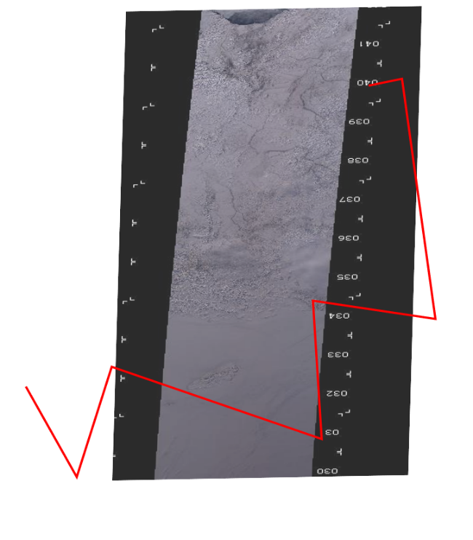

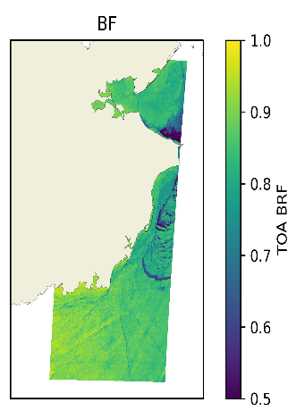
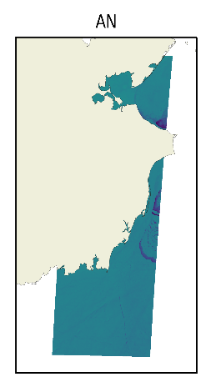
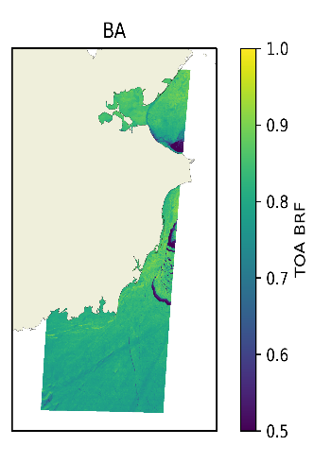
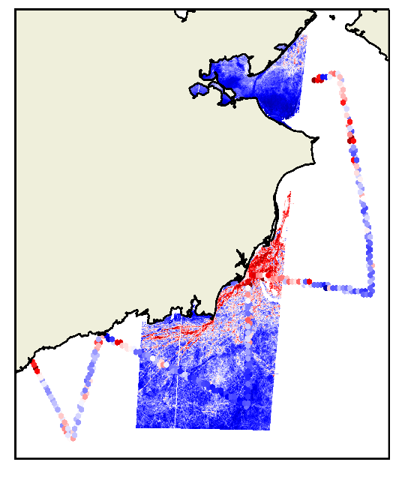
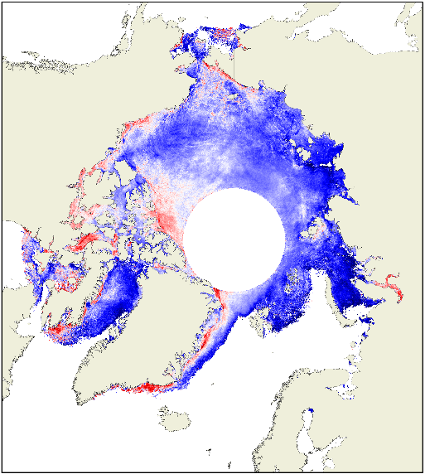
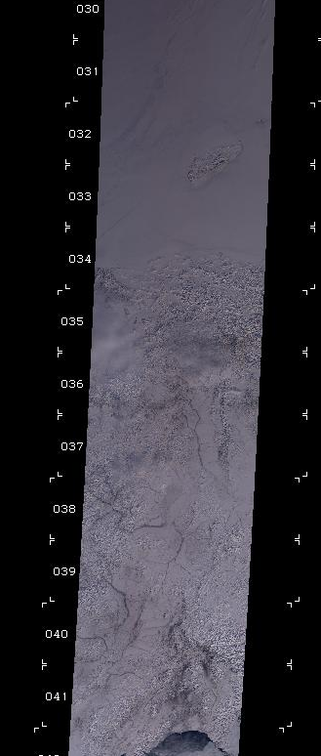

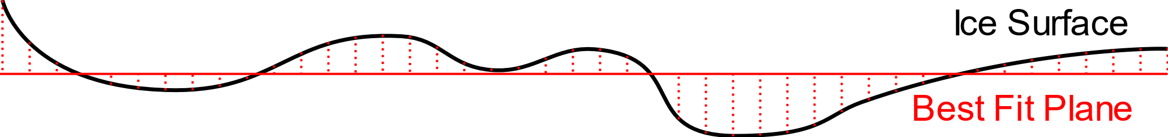


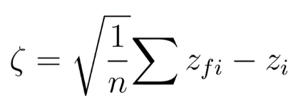
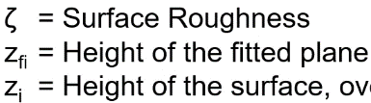
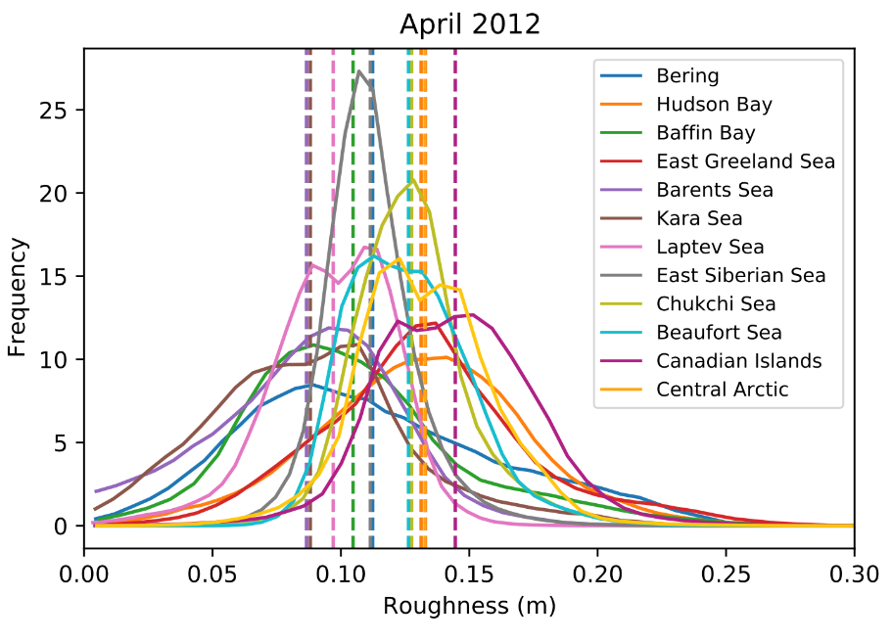
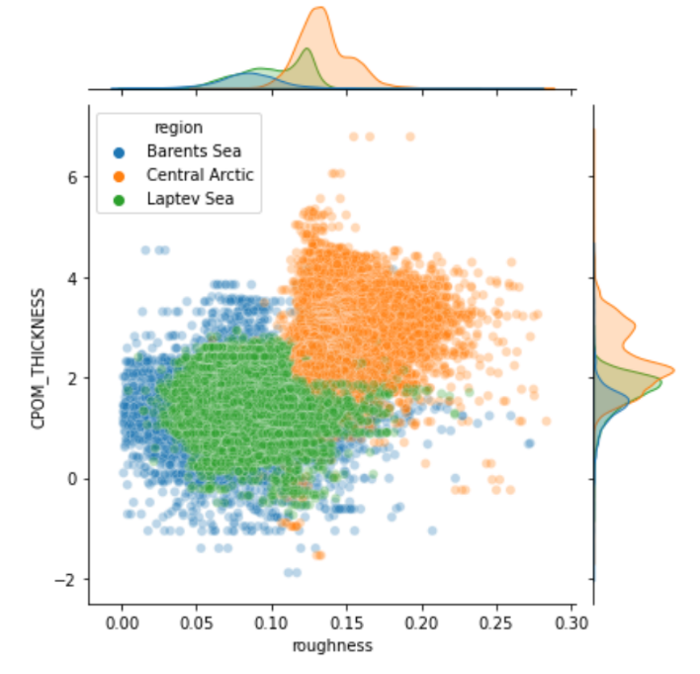
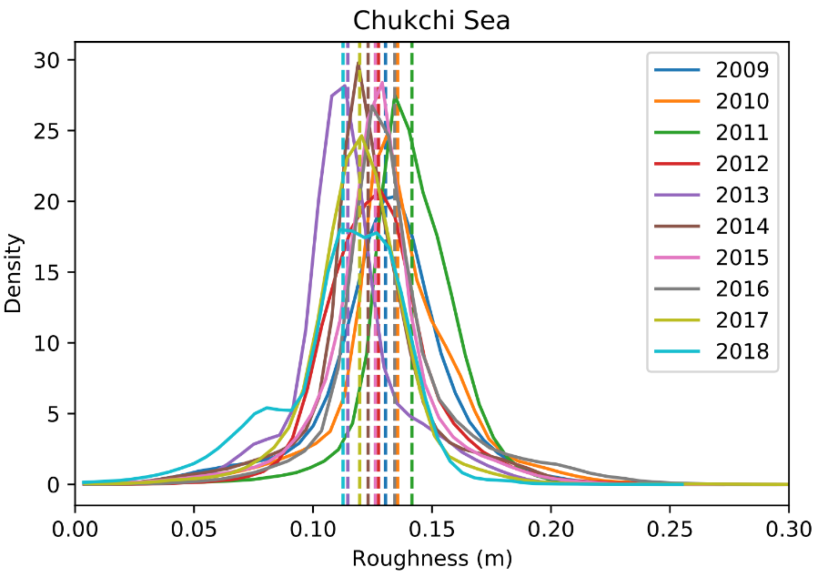
Mapping Arctic Sea Ice Surface Roughness with Multi-angle Imaging SpectroRadiometry
Tom Johnson¹, Michel Tsamados¹, Jan-Peter Muller², Julienne Stroeve¹
^{[1]} Department of Earth Sciences, Centre for Polar Observation and Modelling
^{[2]} Department of Space and Climate Physics, Mullard Space Science Laboratory
1. Introduction
Surface roughness is defined here as the standard deviation of elevations within a footprint minimized to a best fit plane.
Important for momentum transfer between atmosphere and ocean, provides preconditioning for summer melt pond extent, and proxy for sea ice age and thickness.
Generation of a novel algorithm to retrieve sea ice surface roughness from MISR via calibration of LiDAR elevation measurements from IceBridge.
High spatial (1.1km) and temporal resolution (~ 3 days) and multi-decadal archive (Spring only, 2000 onwards)
2. Method
April 2012
Elevations
Multi-angular Imagery
Operation IceBridge
Intersections
Roughness
Stacking
(SVR)
3. Results
Region | SRCC
Hudson Bay | 0.046
Baffin Bay | 0.28
East Greenland | 0.28
Barents Sea | 0.086
Kara Sea | 0.23
Laptev Sea | 0.51
East Siberian | 0.034
Chukchi Sea | 0.32
Beaufort Sea | 0.43
Canadian Isl. | 0.27
Central Arctic | 0.72
CPOM Thickness (m)
A time series of roughness probability distribution functions for April 2009-2018 in the Chukchi Sea
MISR Roughness (m)
A time series of roughness probability distribution functions for each Arctic region in 2012
Correlations between MISR derived sea ice roughness and thickness (CPOM* processed CS-2)
* Laxon S. W., et al. (2013), CryoSat-2 estimates of Arctic sea ice thickness and volume, Geophysical Research Letters, 40, doi:10.1002/grl.50193.

