Slide 1
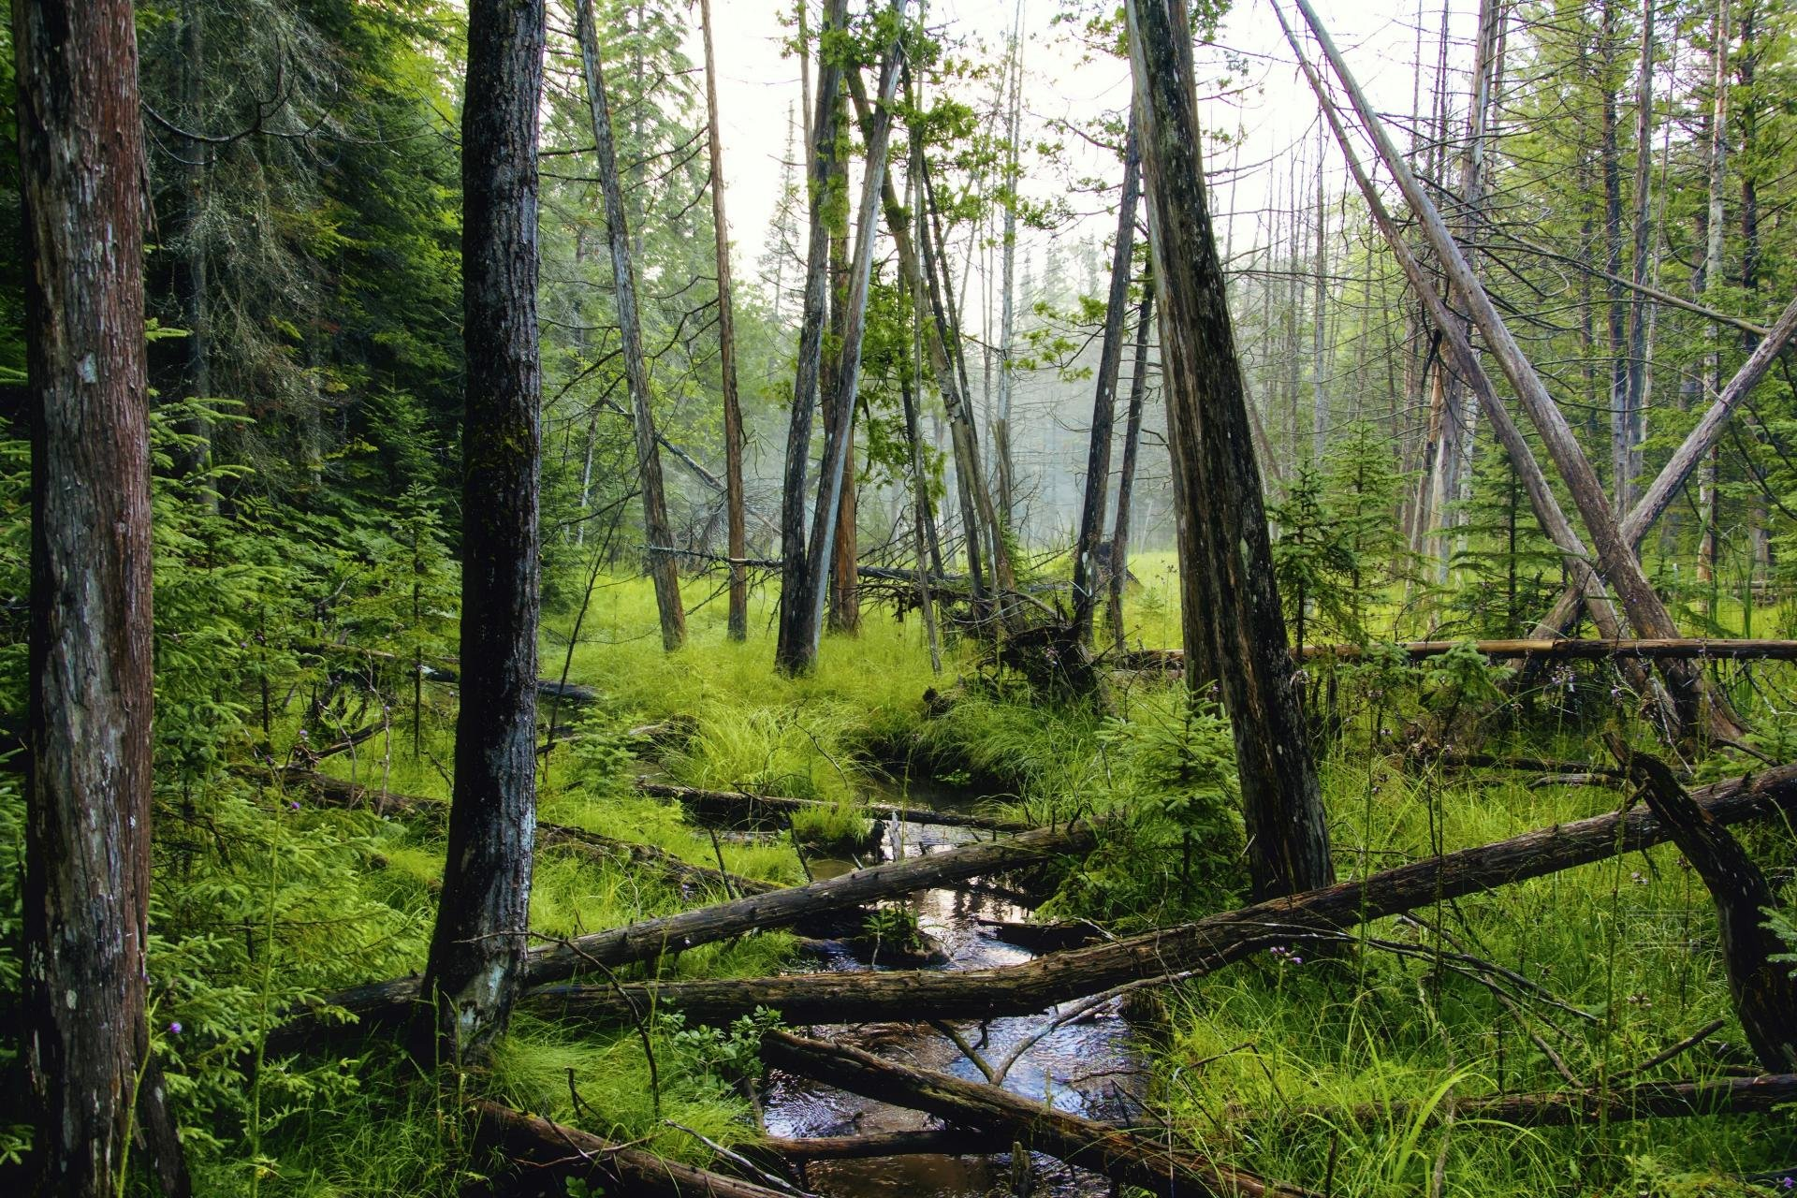


Investigating the potential of forested lands for natural flood management in Wales
A KESS2 East/Forest Research funded PhD project at Bangor University undertaken by Matt Cooper
Notes:
Hi, My name is Matt Cooper and I’m a PhD student at Bangor University in North Wales in the UK. I am currently working on A KESS2 and Forest Research funded study into the use of forests as natural flood management tools in Wales. As part of this study I’m developing a novel method for collecting rainfall throughfall daya in a remote forest. I will outline the overall study before going into greater detail about the data collection method.

Slide 2
How much potential do forested lands have for facilitating natural flood management of rivers in Wales, and how can we quantify it?
Natural Flood Management is the use of natural processes to manage flood risk.
Afforestation within a catchment has been shown to reduce the flood risk.
The amount and type of forest in a catchment will affect the level of reduction.
The comparative effectiveness of afforestation is an unknown quantity.
Comparing different canopy types within the same catchment will help to fill this knowledge gap.
Notes:
The project is designed to answer a relatively simple question based around the concept of natural flood management, which is beginning to have a stronger voice in the development of land management and flood mitigation strategies moving forward.
<click and read>
I began with several assumptions- <click and read>

Slide 3
Project Aims: the collection and development of
A rich dataset of canopy rainfall interception rates for storm/flood events across the two most common types of forest in Wales, broadleaved deciduous and coniferous, in mature and immature stages of growth.
A new canopy interception model for storm events that is developed and validated using the data from our field sites.
A coupled canopy interception and rainfall-runoff model that can facilitate scenario-based assessment of different land use types for reducing flood risk across different seasons and a range of catchment scales.
Notes:
Here are the initial aims of the project
<click and read through>

Slide 4
Fieldwork and data collection
Four field sites will be chosen within the Afon Pennal catchment, a tributary of Afon Dyfi in mid Wales, to represent the different forest types: and stages of maturity
Four throughfall gauges will be installed at each site to measure the amount of rainfall that passes through the tree canopy to reach the forest floor.
A rainfall collector will be set up in an open area to measure the total rainfall, which will be used to calculate canopy rainfall interception.
Local stream flow data will also be collected to provide run-off and peak flow values
Historical and current climate data will also be collected
Notes:
The data collection phase of the study is due to begin shortly and will consist of: <click and read through>

Slide 5
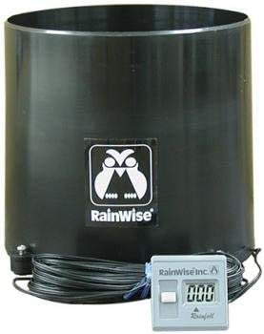
Data collection: The traditional method
FREQUENT AND TIME CONSUMING TRIPS TO SITE
RECORDING DATA LOGGER
Tipping bucket rain gauge
Notes:
To develop a canopy interception model we need to collect local meteorological data and also measure the amount of rainfall which falls through the forest canopy to reach the forest floor. This is done by using tipping bucket rain gauges placed under the canopy. <click>Traditionally these contain data loggers and are visited regularly to download the data. It is only when these visits occur that you find out if the gauge has been recording successfully, is not blocked or has been disturbed. This potential loss of data can be a problem for a study. A method was needed to record and report the data in real time, and also to be able to discern functionality.

Slide 6
LoRaWAN
Long Range, Wide Area Network technology utilises ‘Internet of Things’ technology
Each rain gauge has a transmitter which connects with the gateway
The gateway connects via 4G mobile internet to a central server
The data is downloaded to our data warehouse, where it can be processed for further use, and monitored in real time
Notes:
How will we collect this data from a remote forest site? <click>Long range wide area network, or LoRaWAN technology uses the internet of things technology to gather data from remote sensors and send it to a central server using mobile internet. It has a very wide potential application base, and is becoming very widespread. The system combines sensors, known as end nodes with local gateways which connect to the internet. A good analogy for this is to think of the way that the internet in your house works. The end nodes are your personal devices, and the gateway is your router.
<click>In our case we have replaced the data logger in the rain gauge with a LoRaWAN transmitter <click>and installed two gateways in the study site. The gateways connect via the 4G mobile network and send the data to the things network, from where iMarDIS collects the data

Slide 7
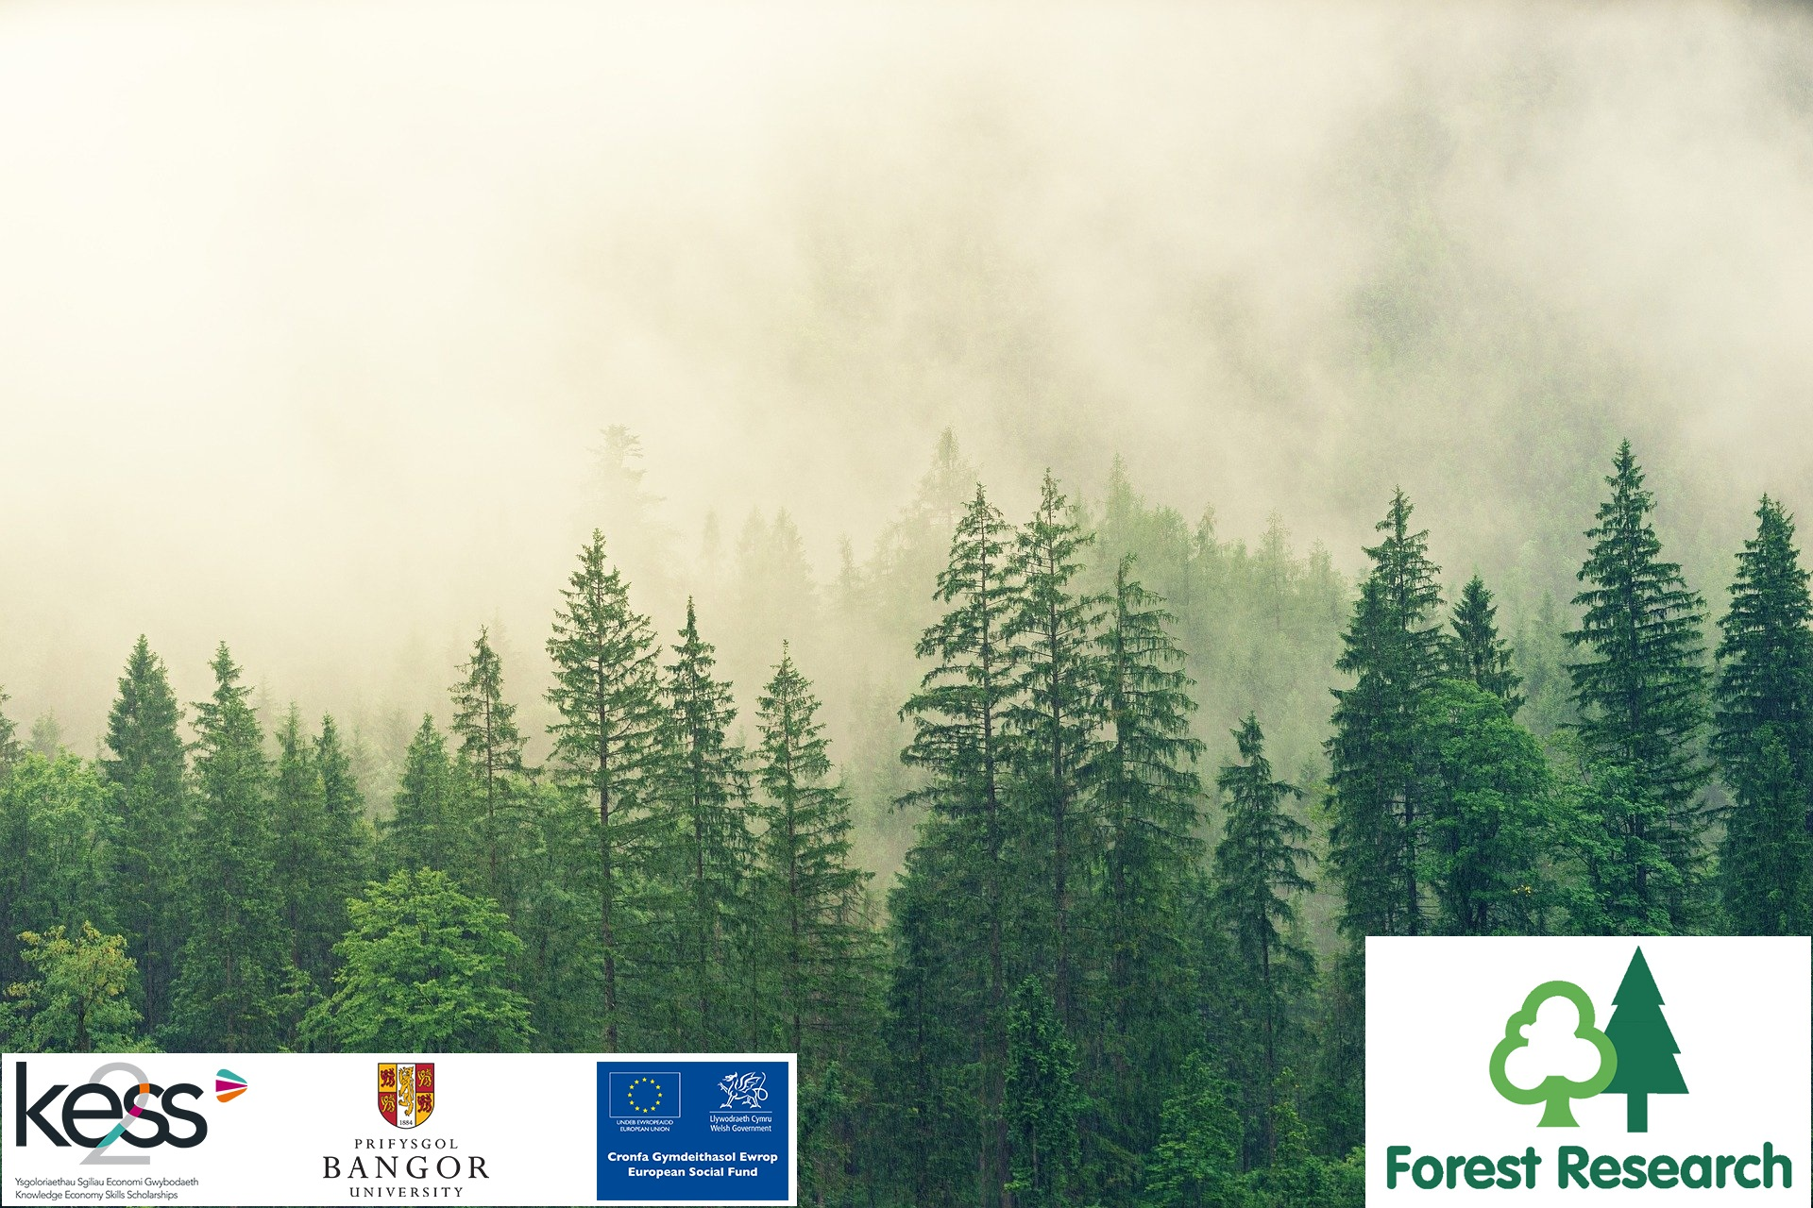

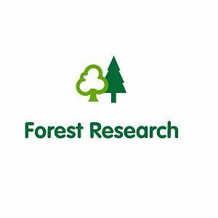
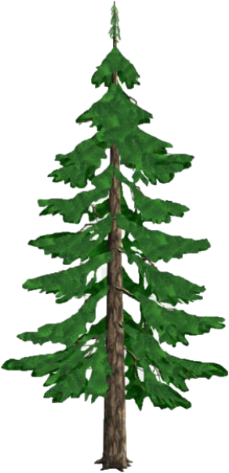
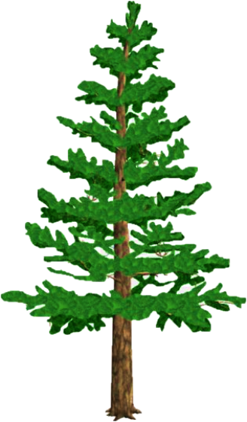

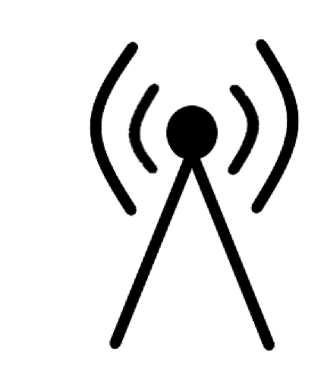
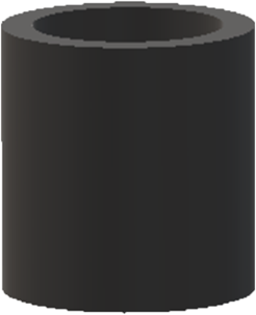
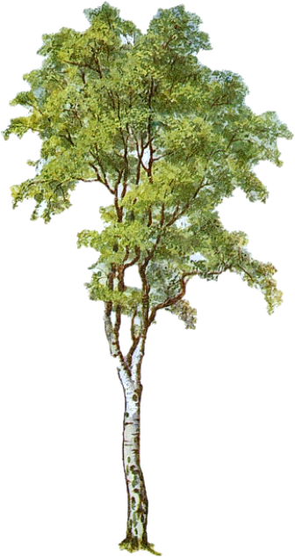
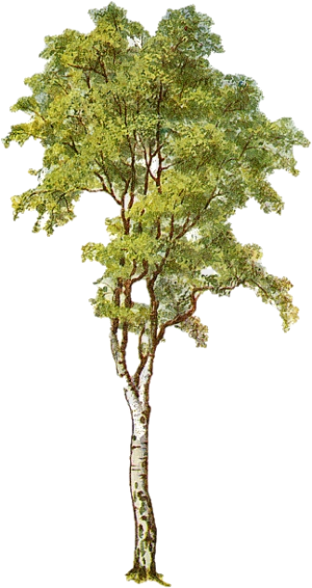
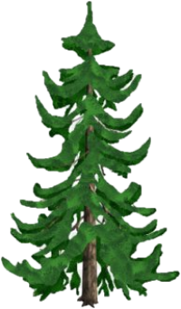
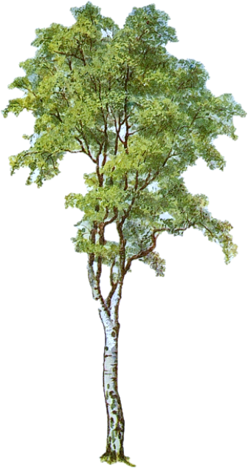
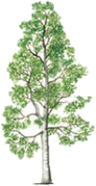
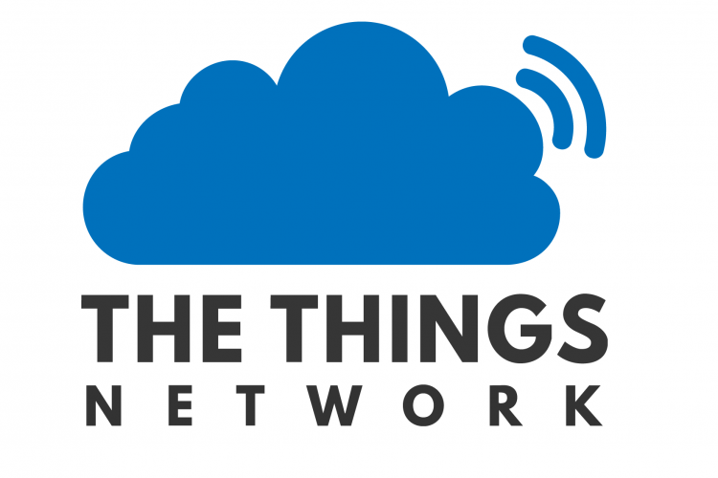
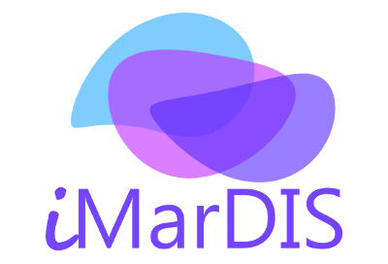
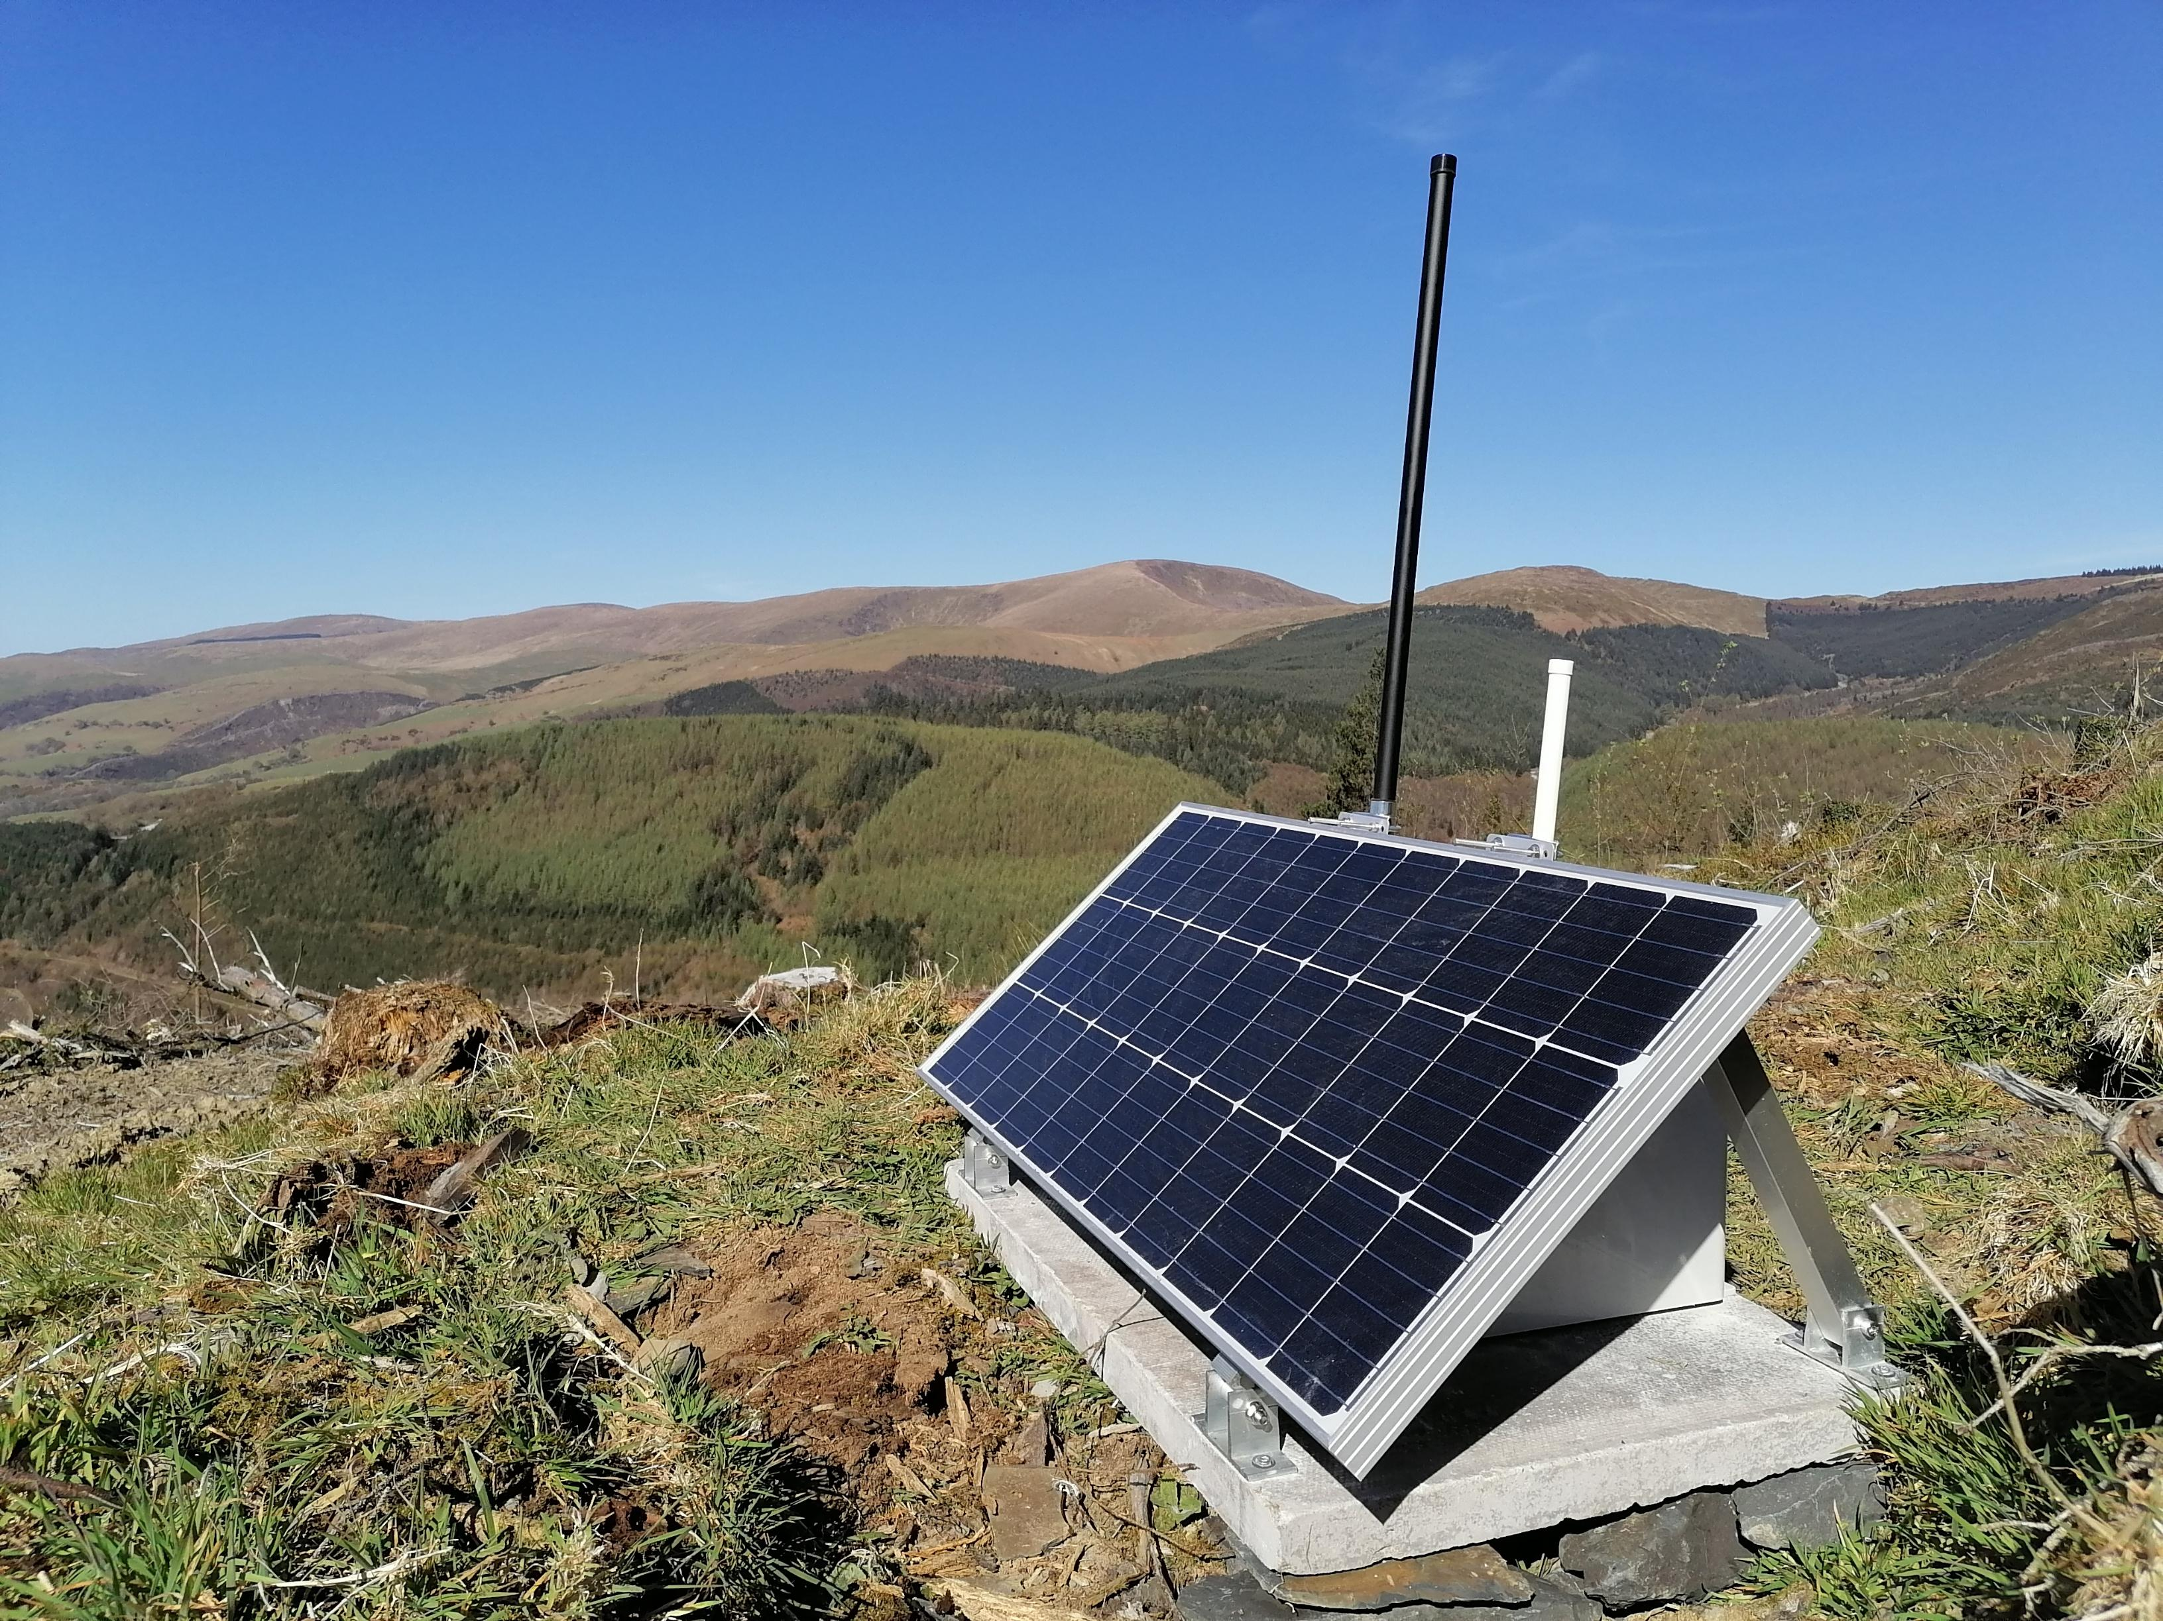
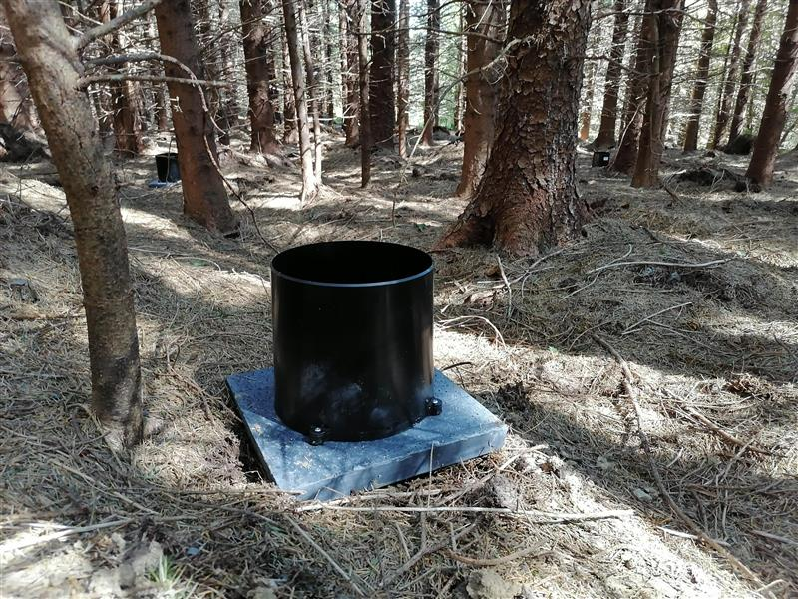
End Nodes
Gateways
Network Server
Application Server
Network Topology
Notes:
This schematic of the network shows the data flow, from the rain gauges, or end nodes, to the application server. IMARDIS is the integrated marine data and information system developed by Bangor University and funded by the smart efficient energy centre project and will act as both a storage facility for our data, and provide a user dashboard for the data which will allow for real time monitoring of the study site. As this dashboard is currently under construction I cant show an image of it here,

Slide 8
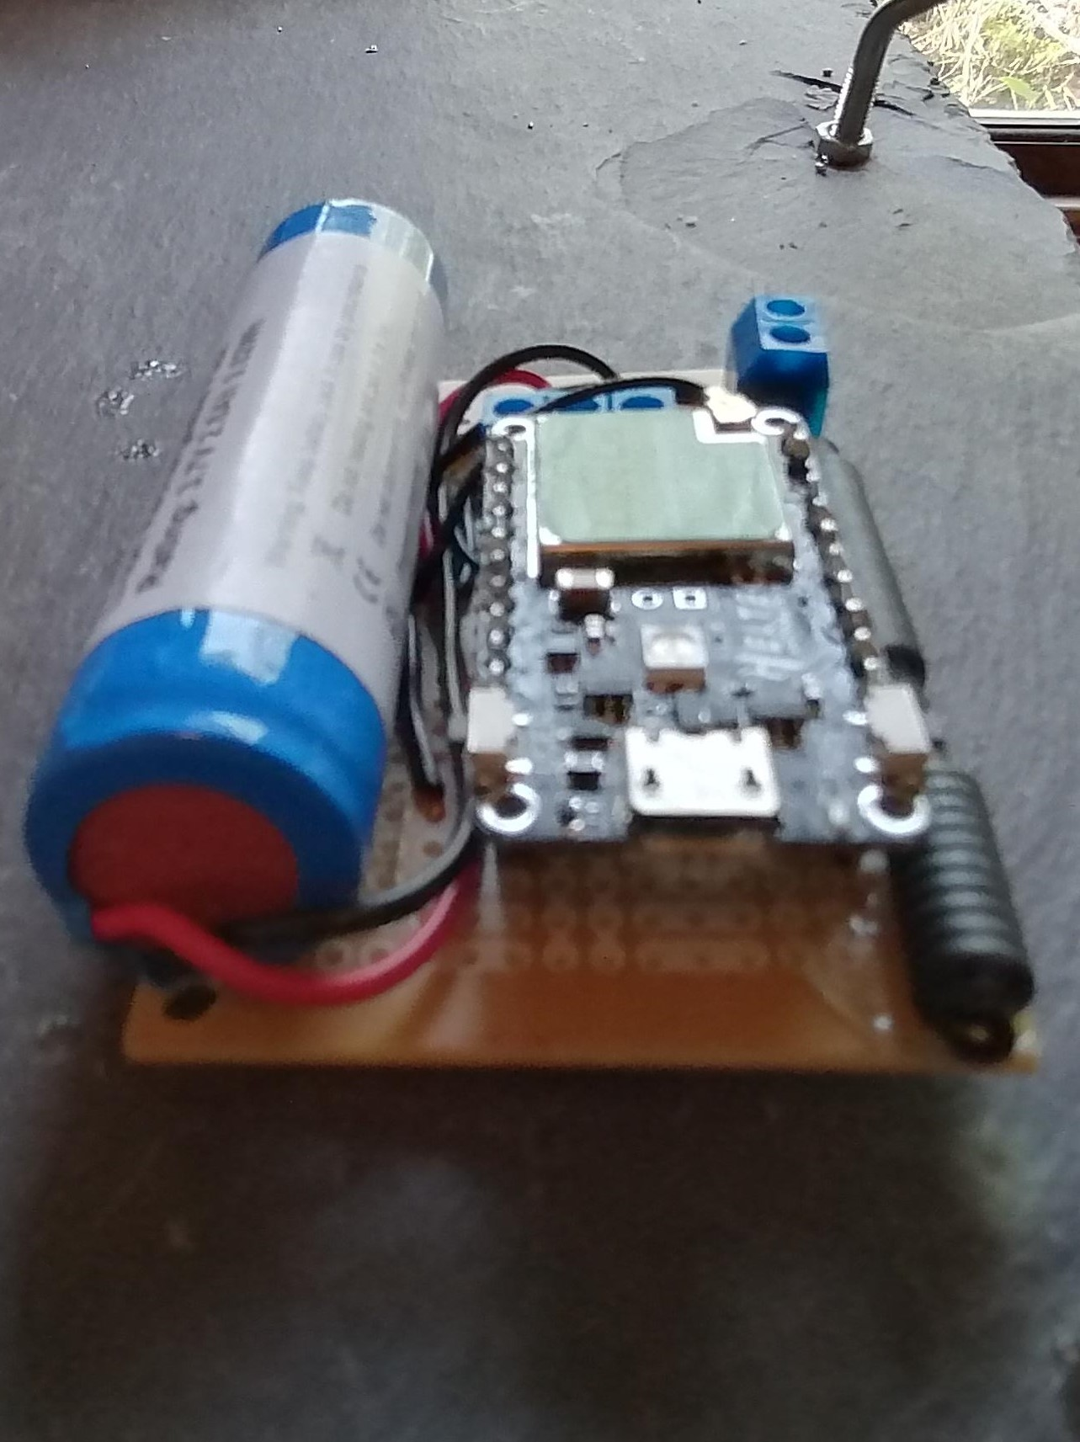
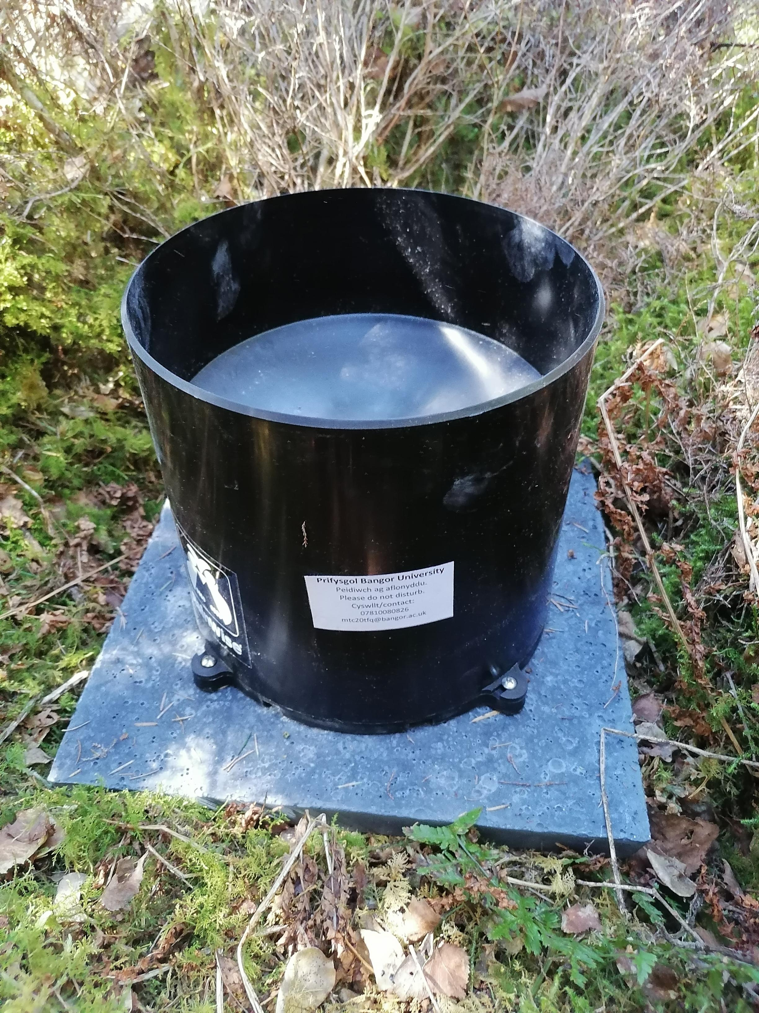
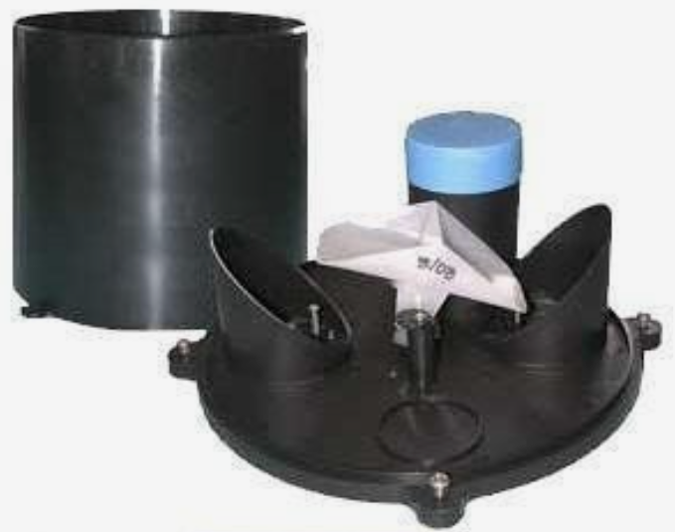
The Rain Gauge
Notes:
The Rainwise rainew 111 was chosen for this study as it is an economical, reliable unit. <click>It was mounted on a 30 cm square paving slab to allow for easy levelling and ensure stability in the study site. <click> This device records the rainfall by means of a tipping bucket, (the white triangular shaped piece in the picture) One tip of the bucket is representative of 0,0254 mm of rainfall.
The LoRaWAN node was located in the watertight compartment with the blue top in this picture of the partially disassembled unit. <click>The node consists of a 3.7 volt, 2.6 amp hour lithium ion battery, antenna and the LoRaWAN transmitter board, which is a Heltec Cubecell dev board. This unit records the number of tips in a five minute period and then transmits that data to the gateway. If this transmission fails, the data is recorded and transmitted at the next available transmission, meaning no loss of data, but a possible loss in temporal resolution, which is acceptable foir this study/

Slide 9
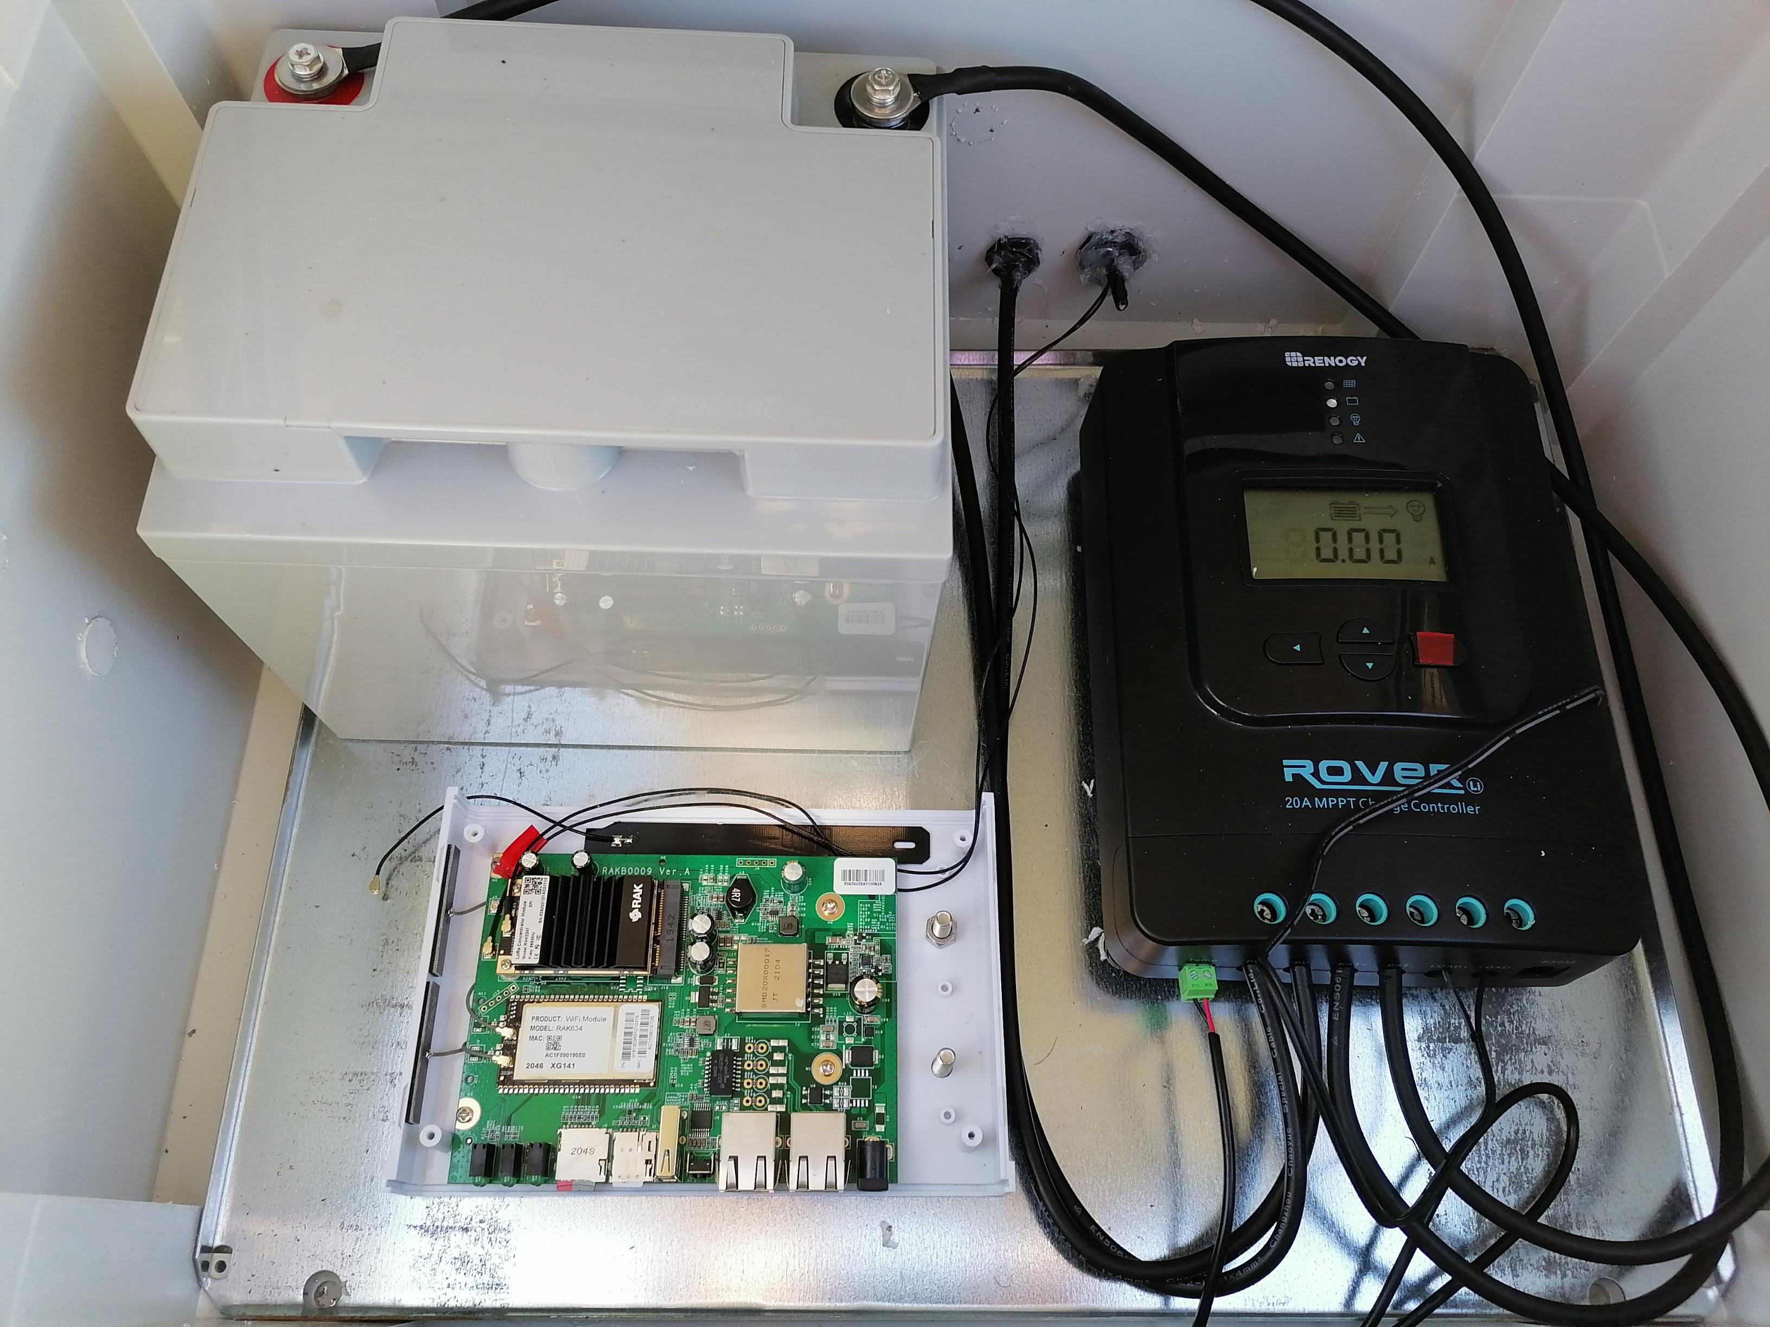
The Gateway
Antenna 1.
Battery
Charge controller
Antenna 2.
Gateway
Notes:
<click>This is the gateway unit developed by us here at Bangor University. It consists of a one hundred watt solar panel, which can be seen here, along with the two antennae, <click>Antenna one is the LoRaWAN antenna which connects with the rain gauges and <click>antenna two is the 4G network antenna. The panel is mounted on a 90 cm by 60 cm paving slab for stability.
Under the solar panel is a box containing <click> <Click>the battery, , a Yuasa 12 volt 38 amp hour unit, <click> the Renogy Rover charge controller which receives the power input from the panel and charges the battery, and <click> the gateway itself, which is a RAK RAK 7258 8 channel gateway which connects to the things network, an open source, community based initiative aiming to provide an energy saving wide area network which temporarily stores the data begore it is downloaded by iMarDis

Slide 10
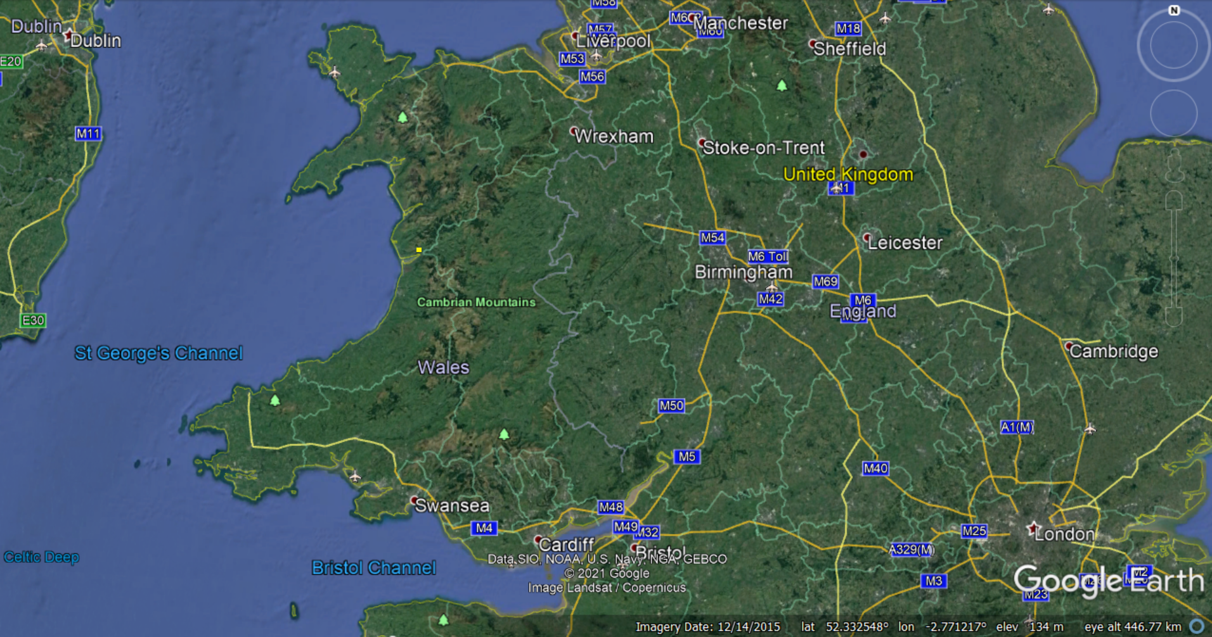
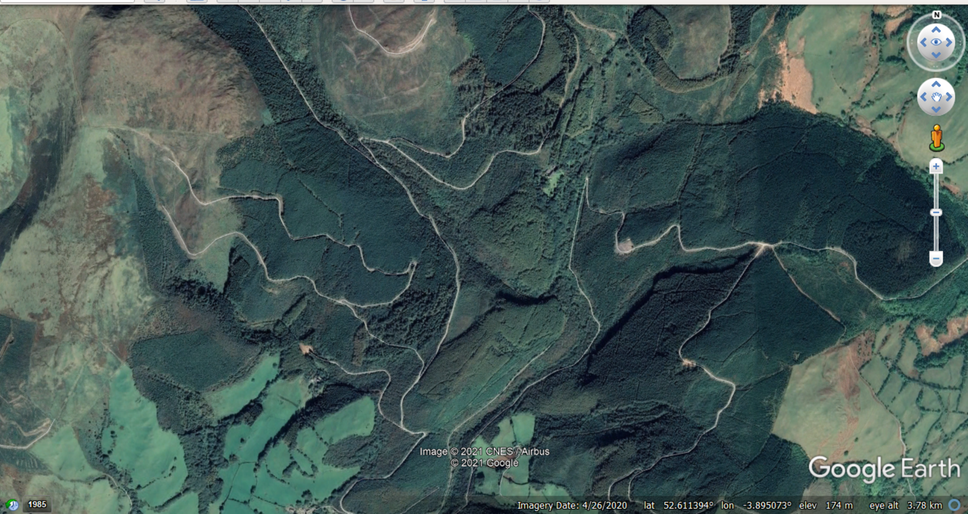


Study Site
Gateway site
Rain gauge site
Notes:
The study site, marked with the yellow square on this overview map of Wales is an actively managed forestry area just outside the town of Machynlleth in Mid Wales. Closer inspection <click> shows that the site is dominated by thick forest cover and is typical of Welsh mountain terrain, with steep slopes and narrow valleys. There is no local power supply and the only access is rough forest tracks.
The gateways were installed at these points,<click>, they give full coverage of the study site and are in areas with 4G connectivity.
The four separate study sites are as follows <click> mature coniferous <click> immature deciduous <click> mature deciduous, and <click> Immature coniferous

Slide 11
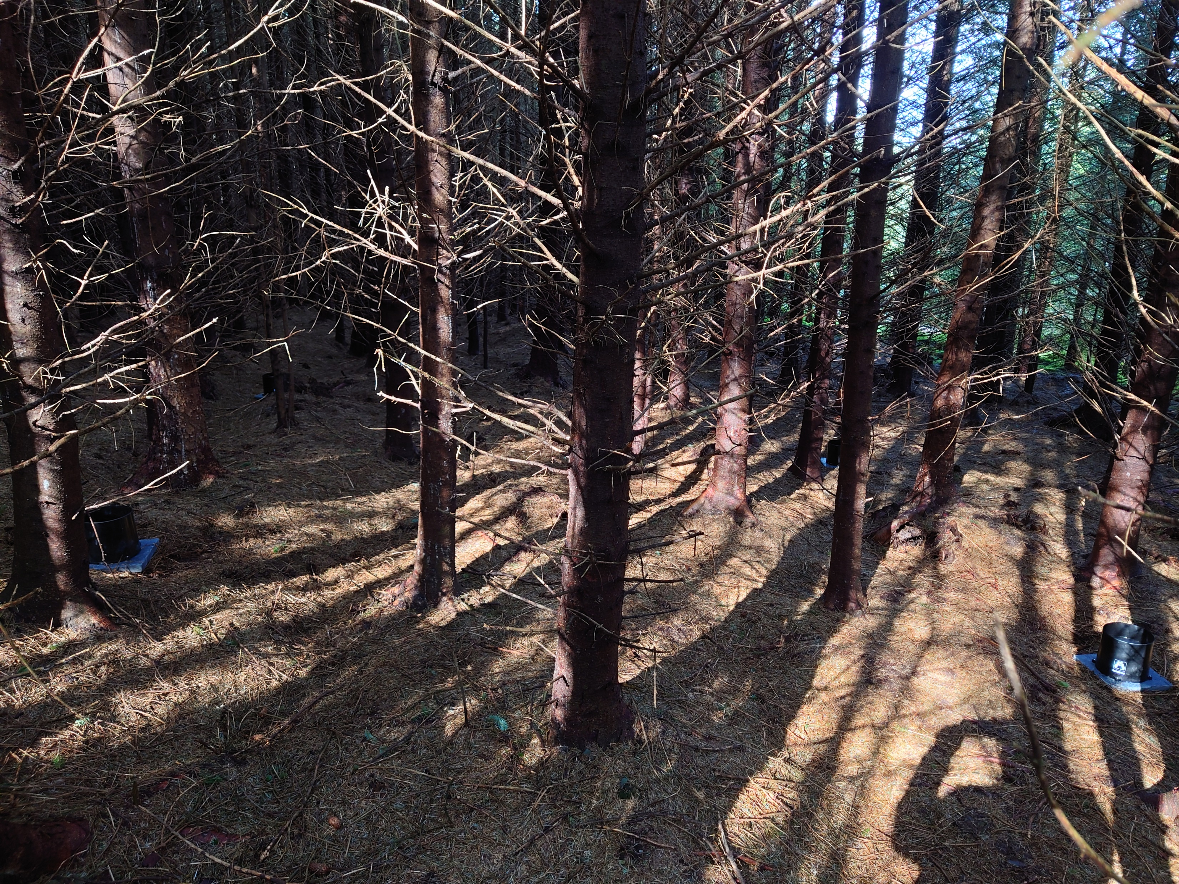
Mature Coniferous

Slide 12
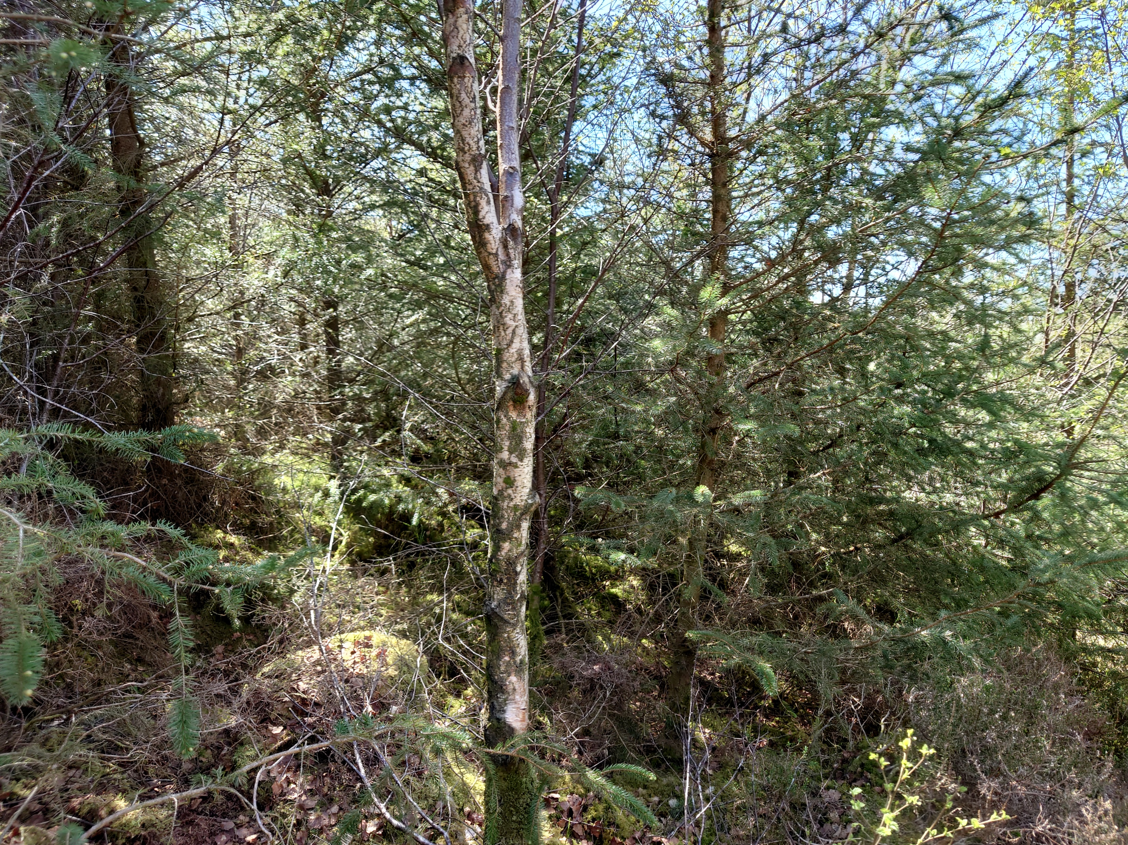
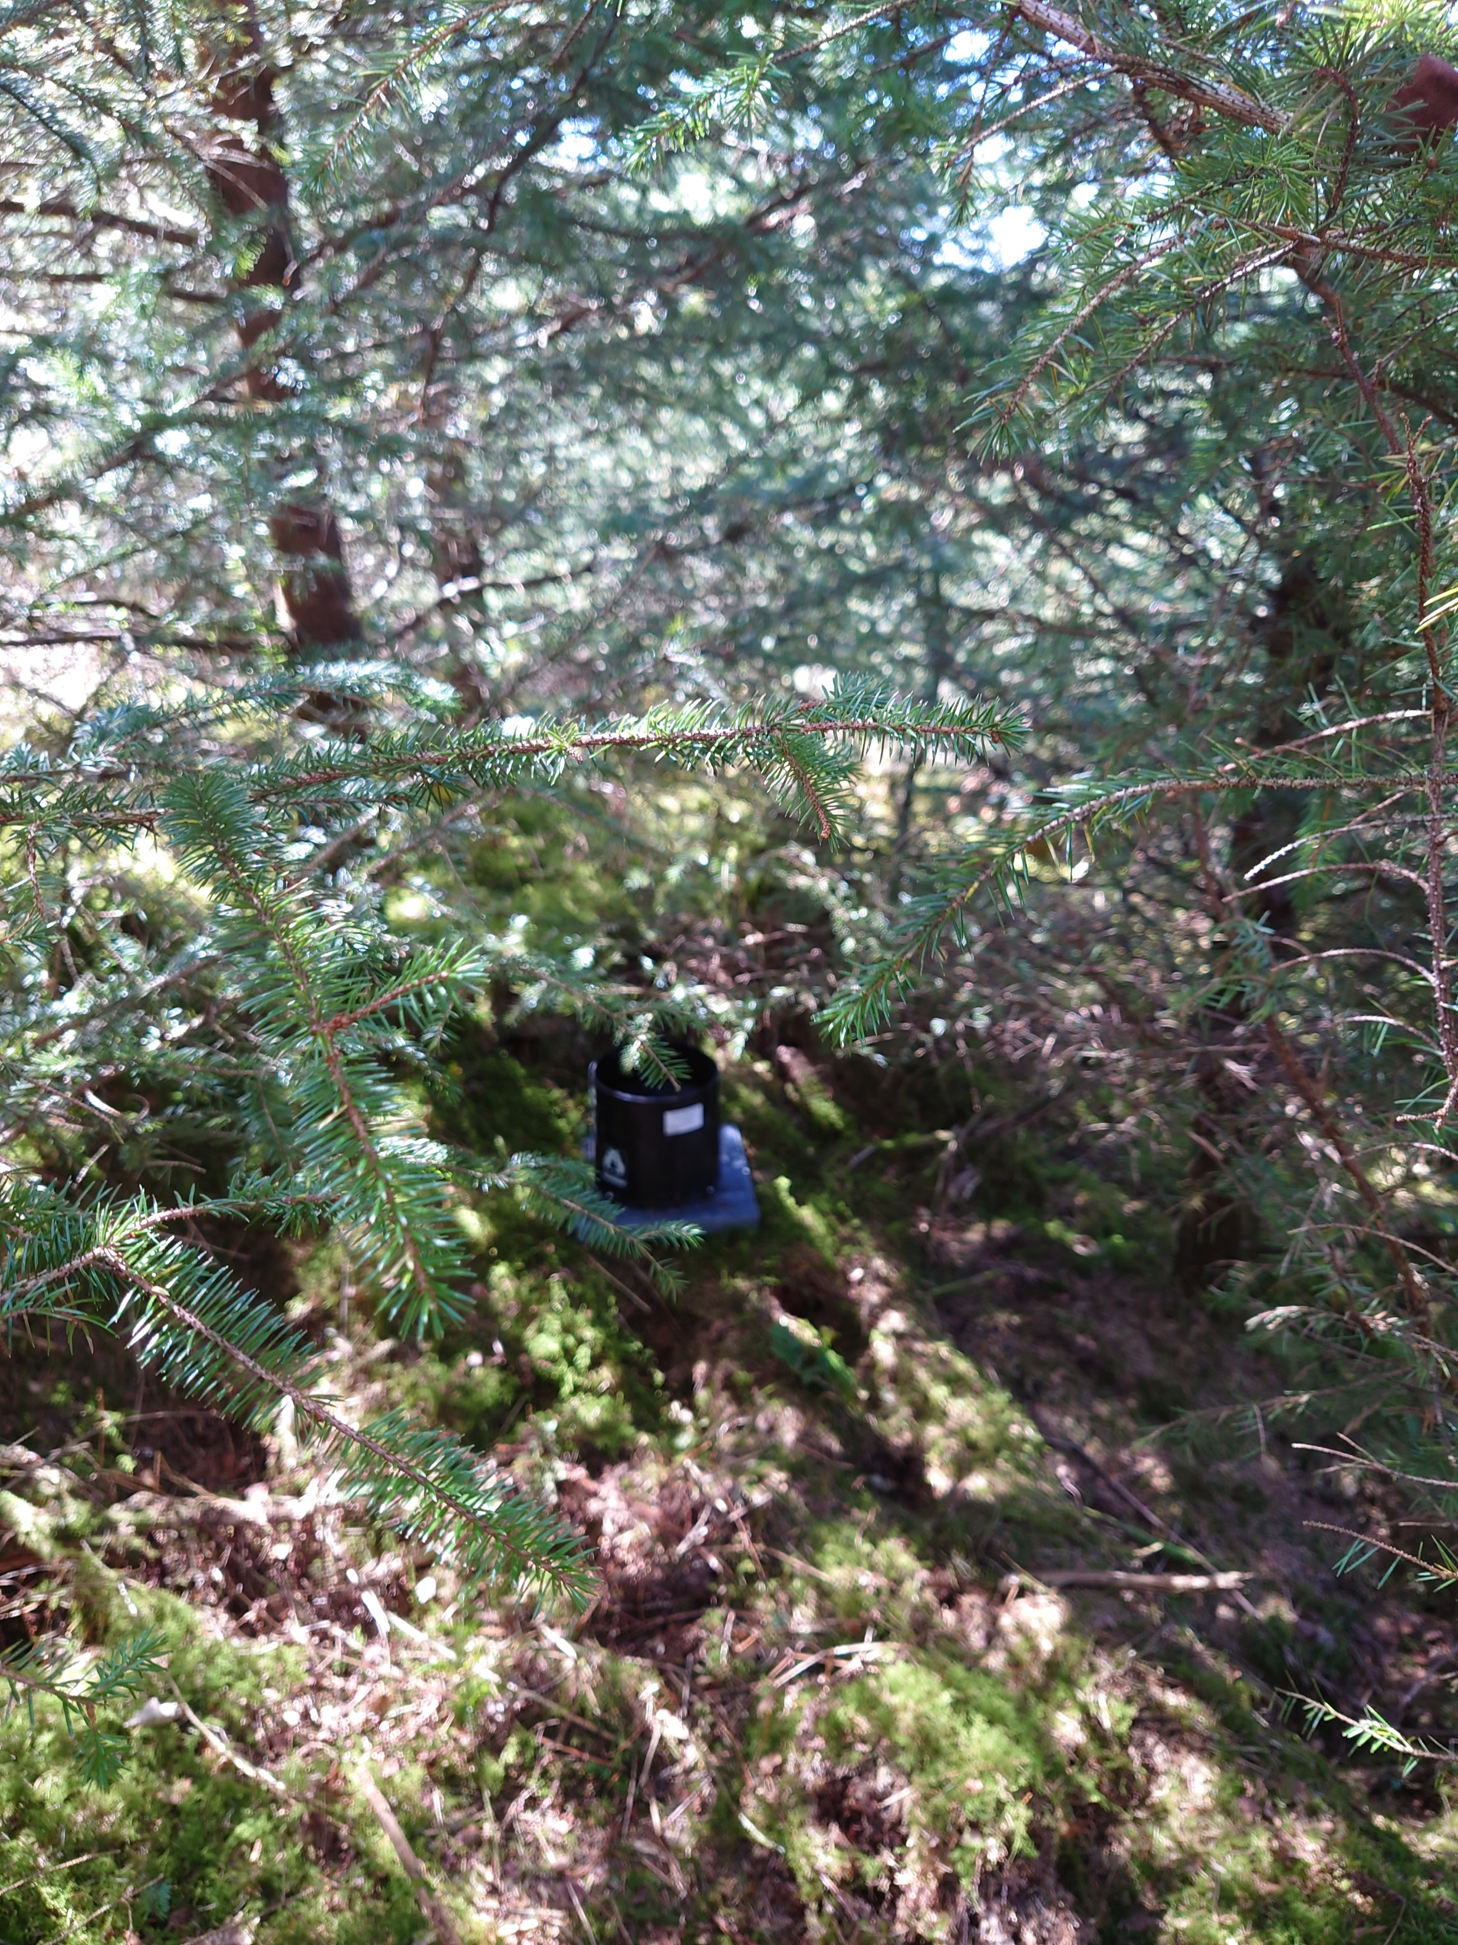
Immature Coniferous

Slide 13
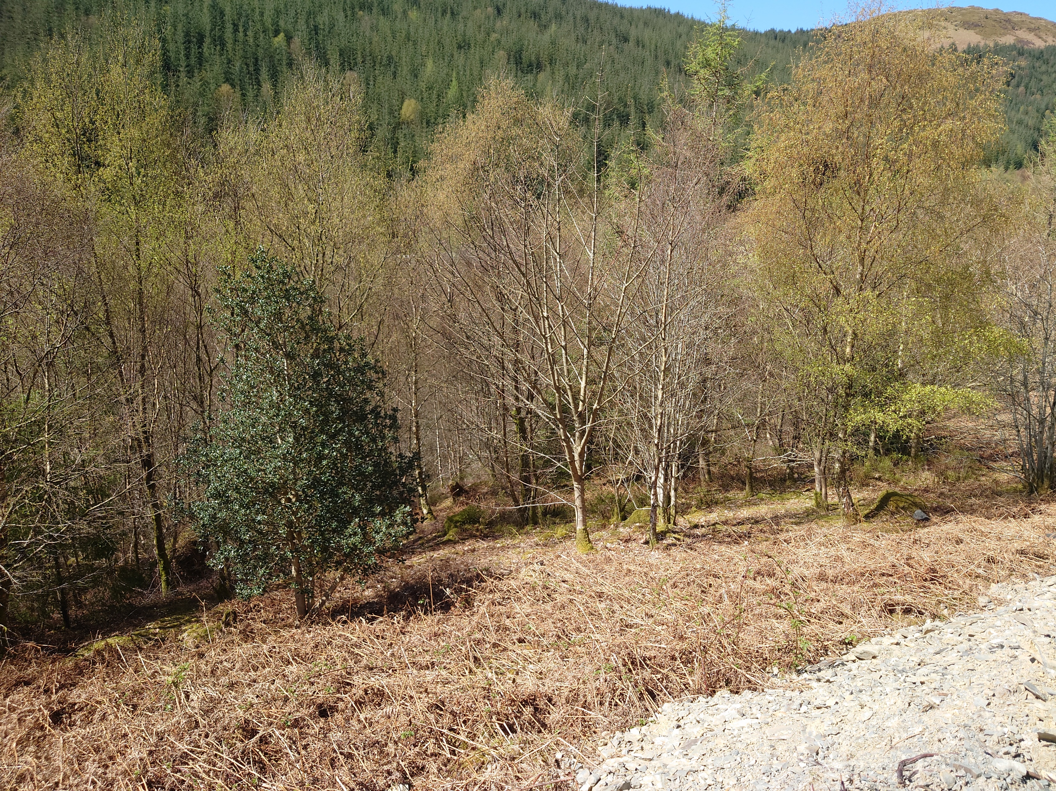
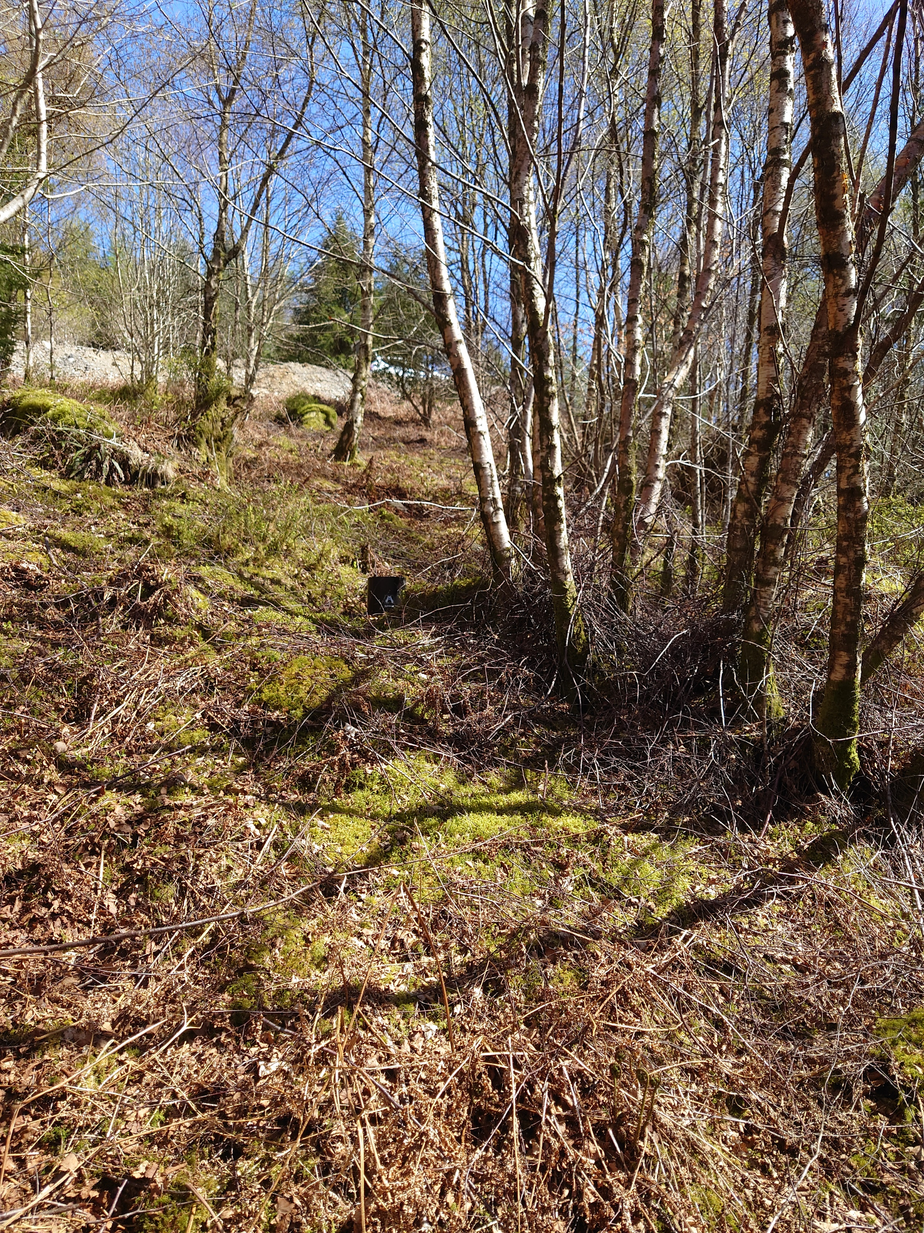
Mature deciduous

Slide 14
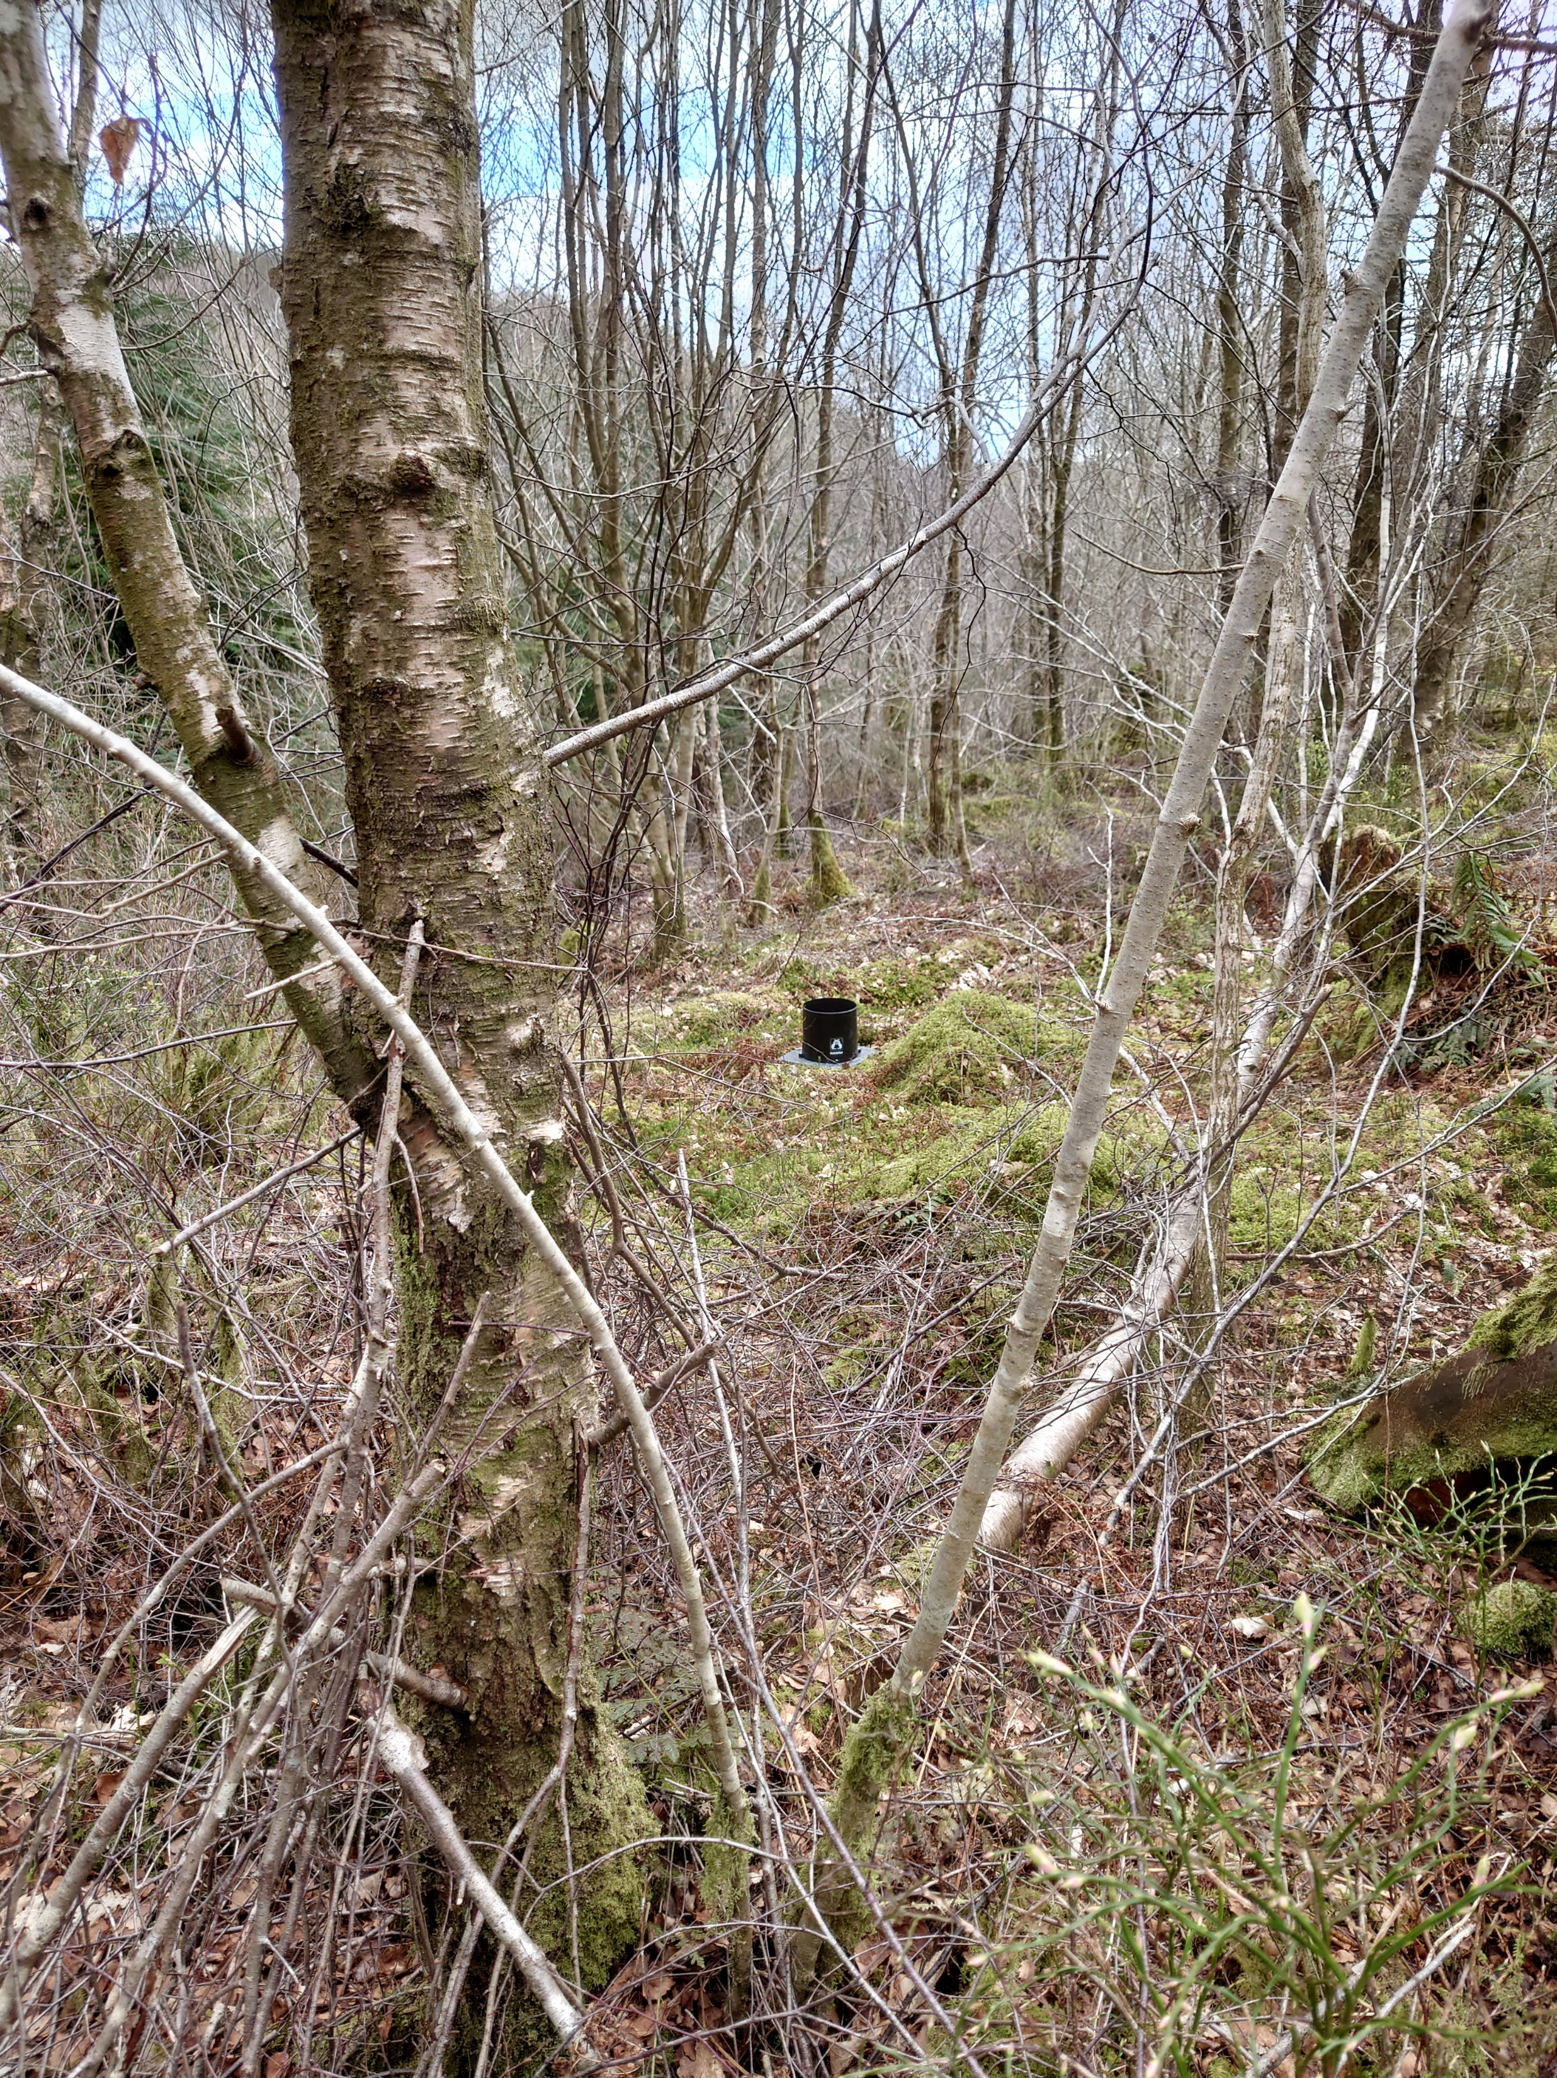
Immature deciduous

Slide 15
Progress to date:
The gateways have been installed and are connected to The Things Network
The rain gauges have been installed and are connected to the gateways
Data collection is scheduled to start on 1st May 2021
Development of the iMarDIS dashboard is almost complete
Notes:
This study is still in development and has only gone live in the past few days.<click> the gateways have been installed and are connected to the things networf. <click> the rain gauges have been positioned and are connecting to the gateways. <click> Data collection is due to start on the 1st May, <click> and the development of the iMardis dashboard is in progress. Initial results are promising and we are confident that this network represents a novel method of collecting data from remote sites without the need for frequent visits.

Slide 16
Thankyou for watching
For any further information please contact me at mtc20tfq@bangor.ac.uk

