Slide 1
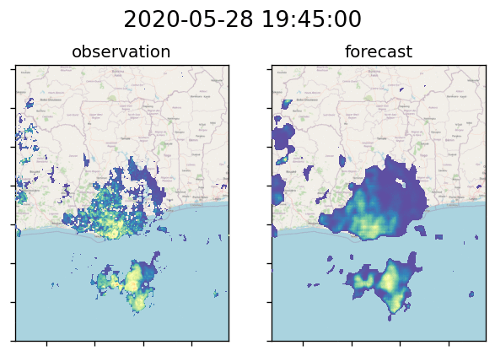
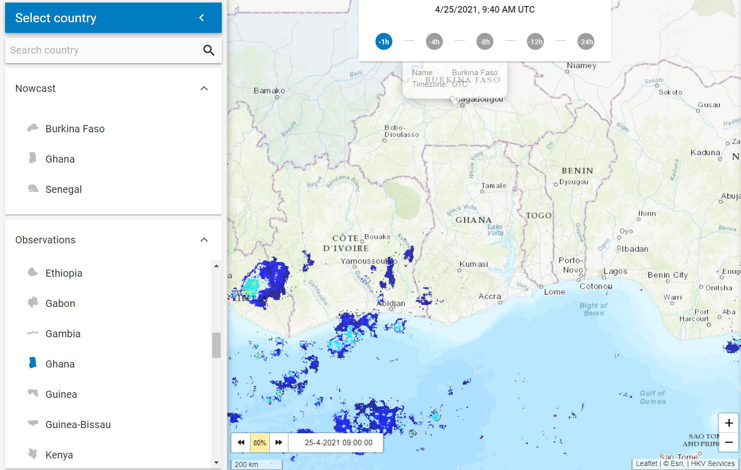
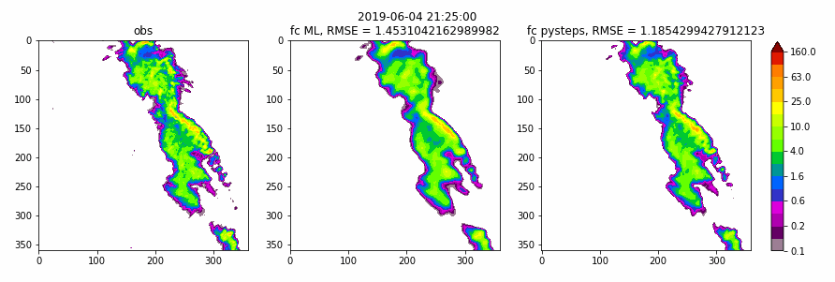
Nowcasting for urban flash floods in Africa: a machine-learning and satellite-observation based model
Dorien Lugt¹, Mattijn van Hoek¹, Jan Fokke Meirink², Eva van der Kooij^{1,3}
HKV 2. KNMI 3. TU Delft
Contact: lugt@hkv.nl
Nowcasting rainfall (0-3 hours):
Traditional: Optical Flow
ML: TrajGRU (Shi et al., 2017)
Trained on 1-year dataset for Ghana:
Many African cities face frequent flash floods due to
rapid urbanization with poor drainage, and
high intensity convective rainfall.
Early warning is effective for risk reduction,
but small latency, high spatial and temporal resolution are required.
Meteosat Second Generation (MSG) – SEVIRI
for Africa and Europa
at 45 min. latency
at 15 min. frequency
at 3x3km spatial resolution (at nadir)
Retrieval: Nighttime Precipitation Estimation (Brasjen, A.M., et al., 2014).
Trained on 13-year radar data for the Netherlands:
TrajGRU better than Pysteps-SPROG (Optical Flow) for:
higher intensities
longer lead times
MSc thesis Eva van der Kooij (HKV, KNMI, TU Delft)
Available for free on rainsat.net and appstore:
observation
TrajGRU
SPROG
Next steps:
Train TrajGRU on larger MSG-SEVIRI dataset
Compare PySTEPS with TrajGRU in Ghana
Evaluate the use of nowcasts in Early Warning Systems
Notes:
Rivers, coasts and deltas enable prosperity and development, but are often also vulnerable due to flooding. Management strategies like Room for the River, Building with Nature or construction of flood defences
like dykes and storm surge barriers help to reduce the flood risk. Our experts ensure that proposed plans meet desired objectives. To this end, we offer extensive knowledge of hydraulics and morphology.

