Slide 1
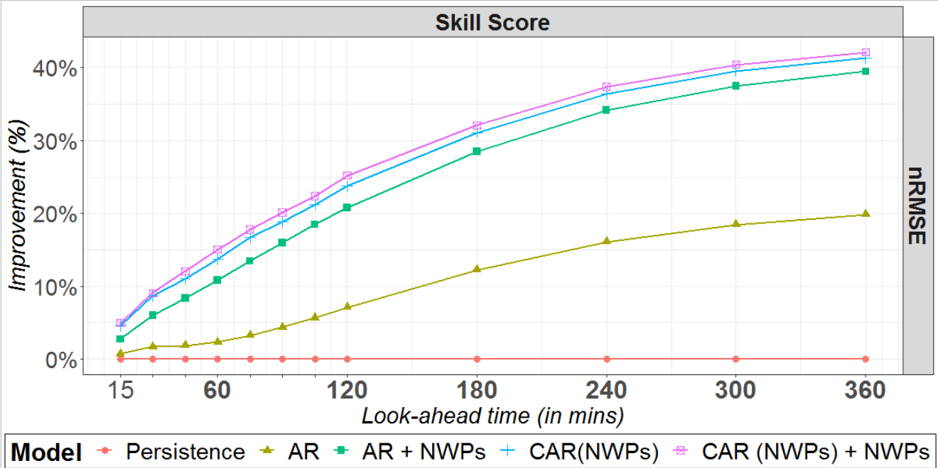
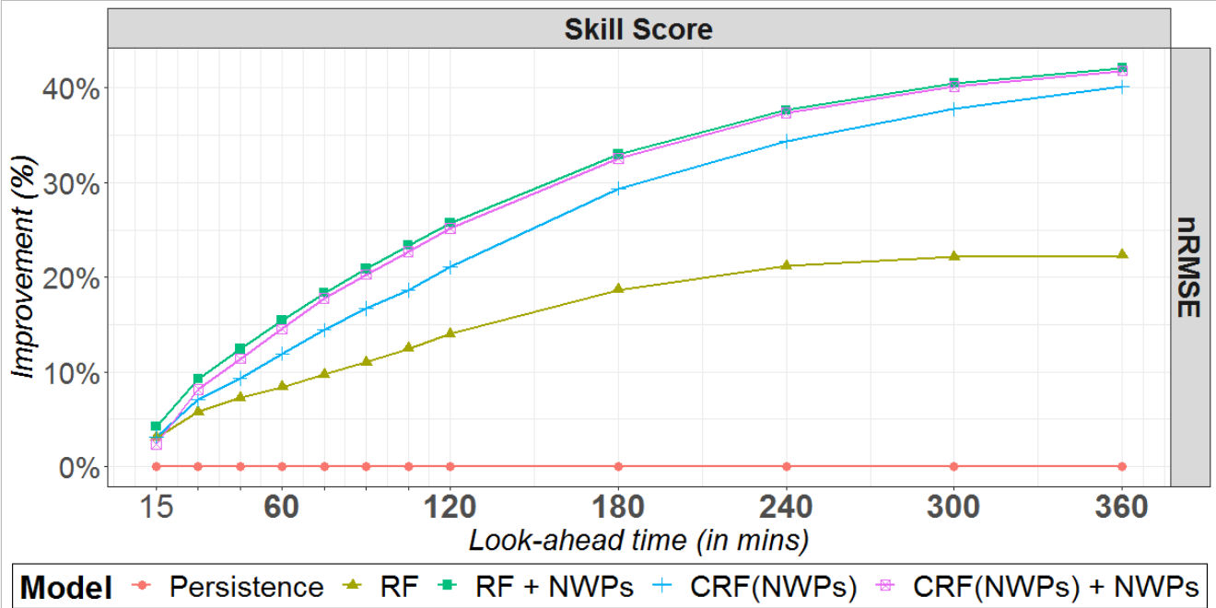
Assessment of Alternative Ways to Integrate Weather Predictions in Photovoltaic Generation Forecasting K. Bellinguer¹, R. Girard¹, G. Bontron², G. Kariniotakis¹
¹
²
I-Objective
III-Results
The accuracy of PV forecasts maybe weak under specific weather situations which challenges the economic and secure integration of PV systems.
In the literature, the integration of NWPs (either as explanatory or conditioning features) enhances models’ performance for a wide range of weather conditions.
What is the best practice to integrate NWPs within PV forecasting models ?
II-Methodology
Forecasting Model
State Features - $Z_{t}$
Spot NWPs
Weather State Conditioning
$θ\left(Z_{t}\right)$
IV-Conclusions & Perspectives
Explanatory Features - $X_{t}$
PV Production
Spot NWPs
Weather conditioning provides better performances for linear models while straightforward integration is more fitted for non-linear models.
Combining both integration ways improves performances of linear models
Models $CAR\left(NWPs\right)+NWPs$ and $RF+NWPs$ perform similarly (nRMSE/nMAE) $→$ tradeoff Simplicity/Interpretability
A forthcoming journal paper
Root Model
$$f_{root}\left(X_{t},θ\left(Z_{t}\right)\right)$$
Output - $Y_{t}$
PV Production

