Slide 1
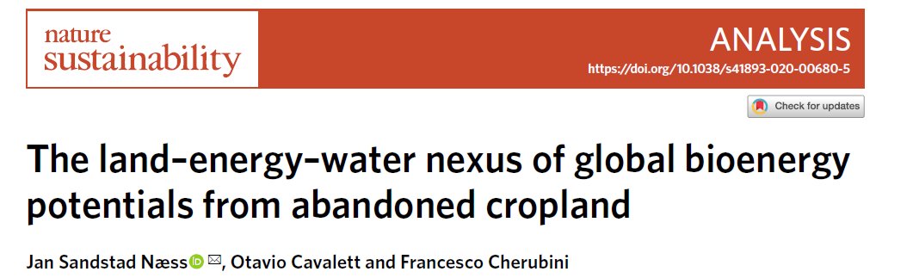
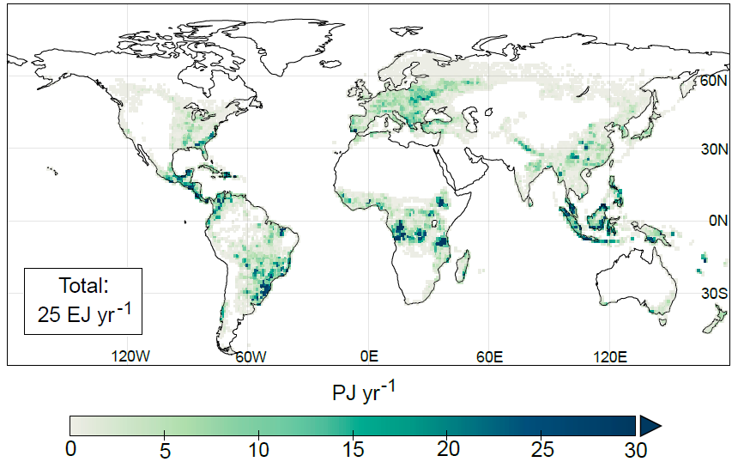



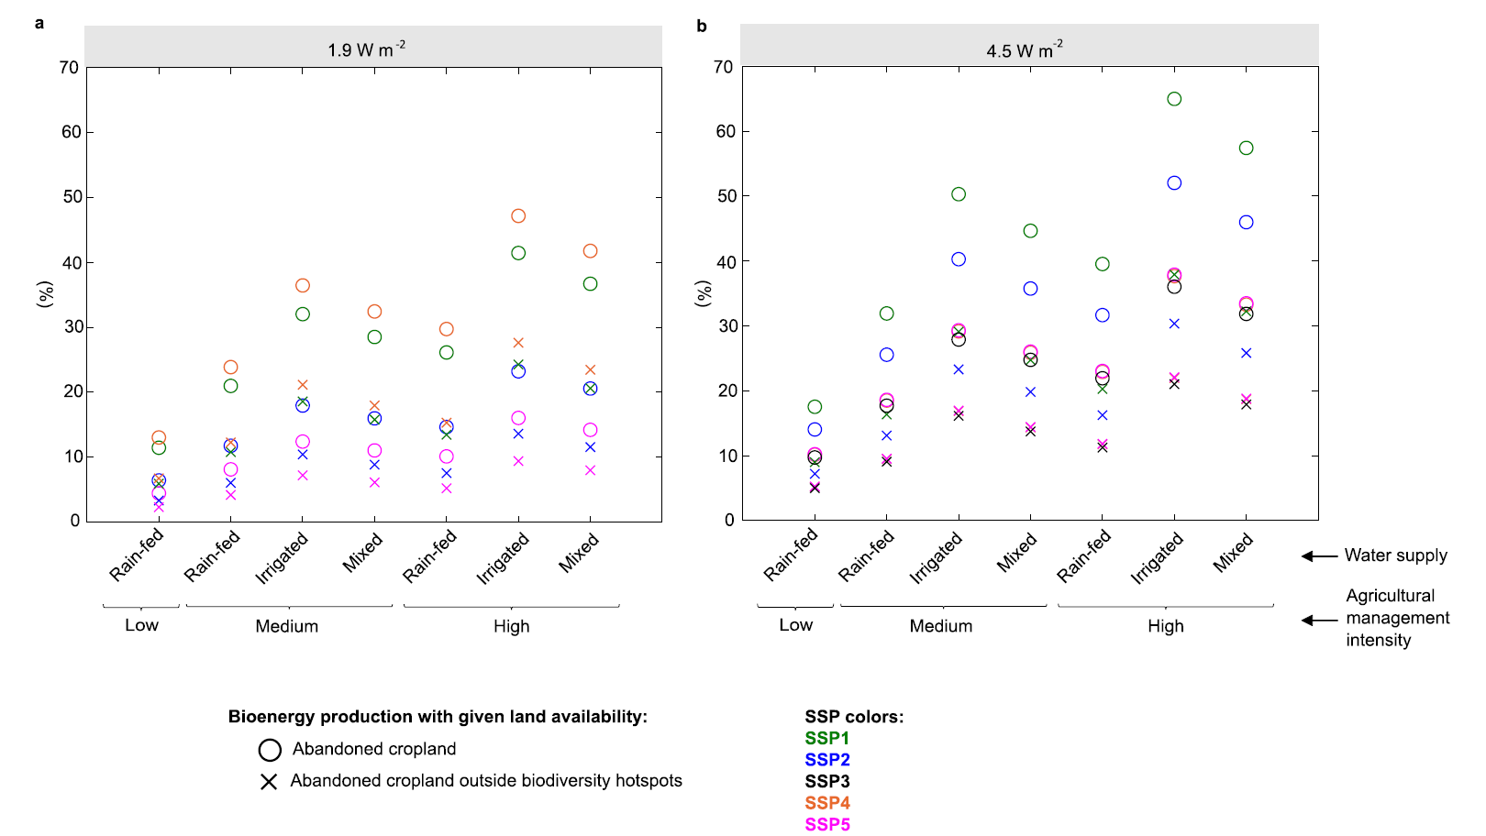
Global bioenergy potential on abandoned cropland
(rain-fed, high management intensity):
@Naess_JS
Highlights:
Abandoned cropland represents an opportunity to ramp-up bioenergy supply with minimal environmental risks.
We found 83 Mha of abandoned cropland globally between 1992-2015 using satellite data.
Bioenergy potentials are 6-39 EJ year⁻¹ depending on management and land and water constraints. This equals 11-68% of today’s global bioenergy demand.
We unravel interlinkages between bioenergy potentials, land use and irrigation water use.
Nexus approaches integrating multiple environmental factors can help guide more sustainable bioenergy deployment.
Bioenergy potentials vs median projected primary bioenergy demand in 2050 across 1.5°C scenarios (IAMs):

