Slide 1


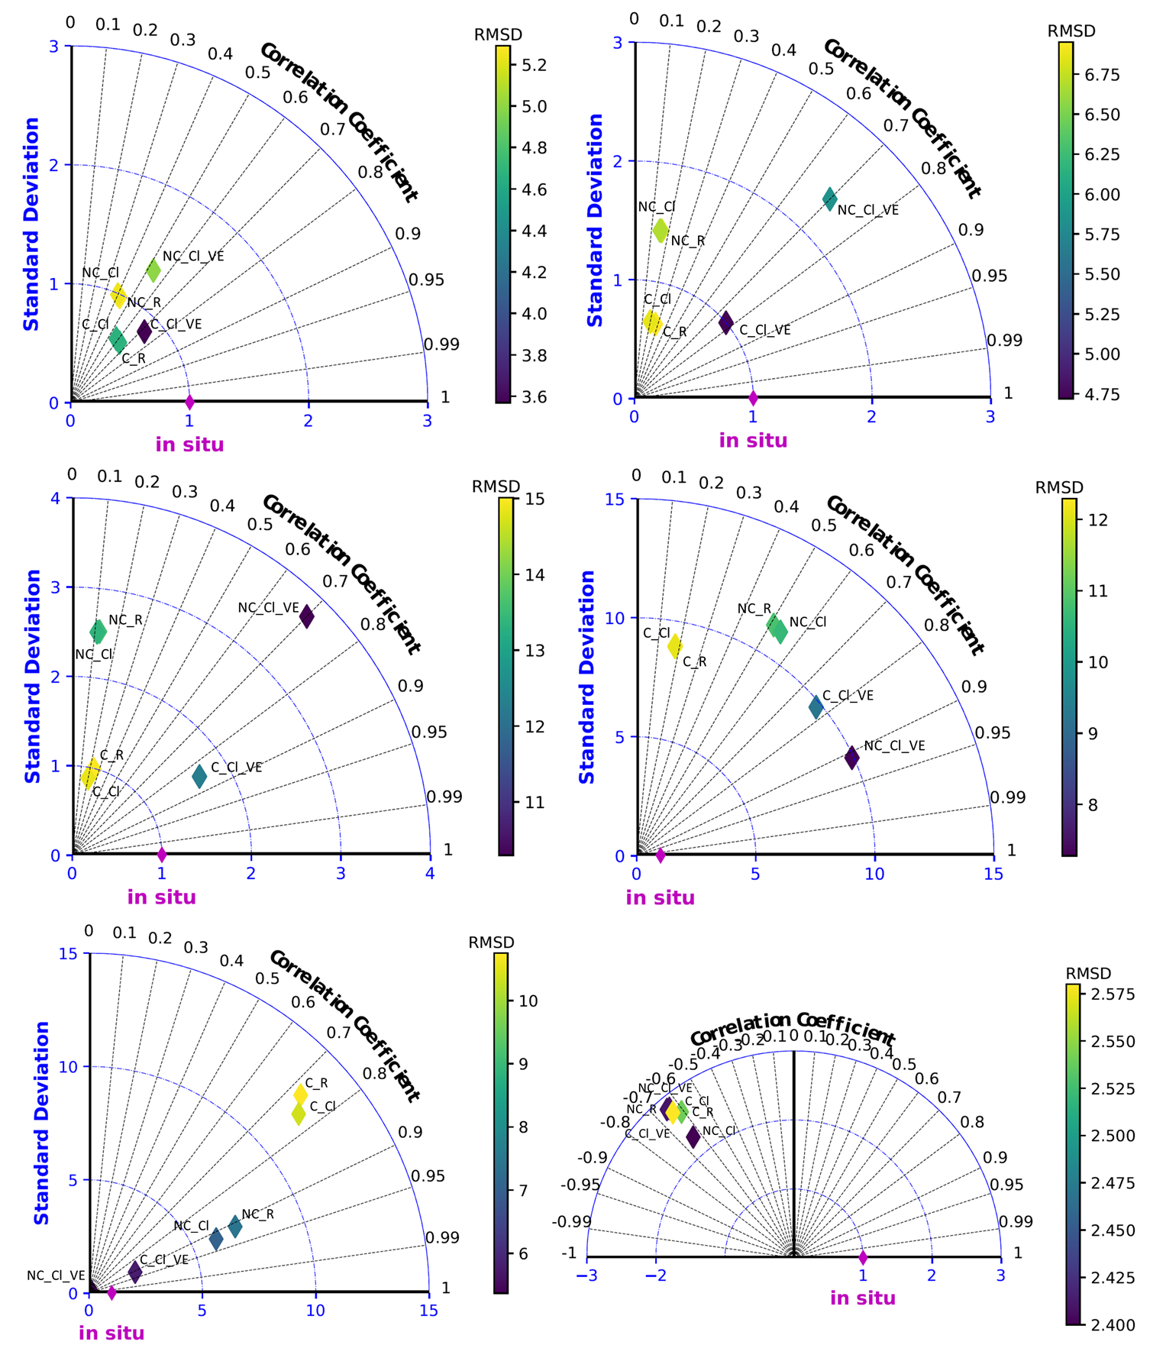
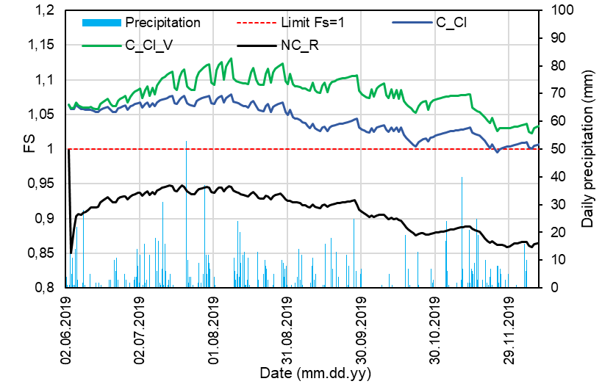
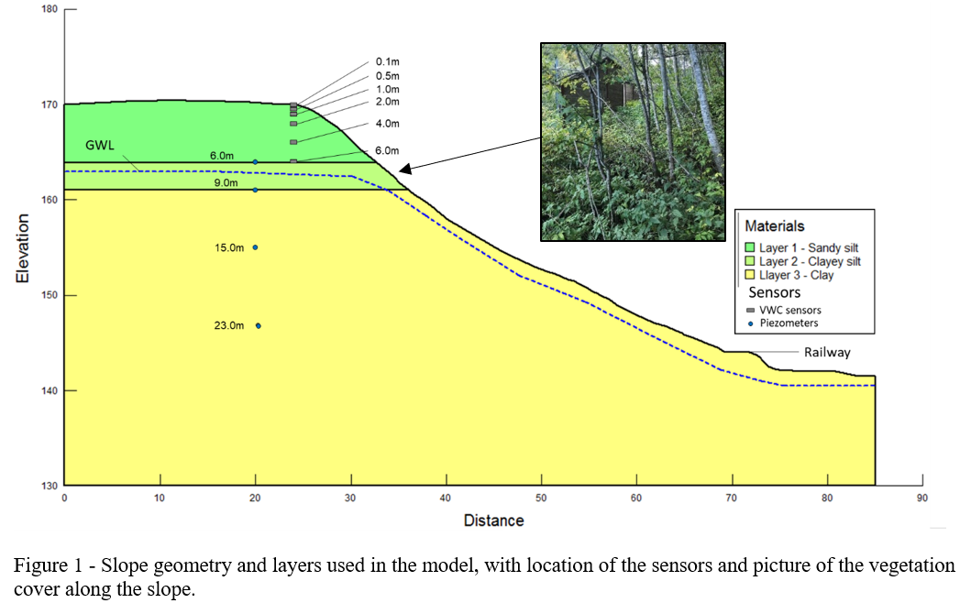
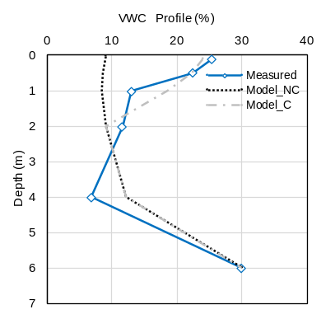
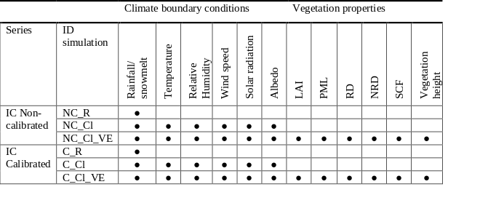
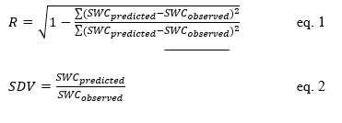


The importance of accounting vegetation on unsaturated slopes prone to rainfall-induced instabilities – a case study in Norway
Luca Piciullo, Vittoria Capobianco, Håkon Heyerdahl
Aim of the study
Results
Slope stability
This study aims to provide insights on considering climate boundary conditions, including rainfall, snowmelt, climate variables and vegetation cover, to the stability of an unsaturated slope prone to failure in Norway.
Taylor diagrams comparing modelled and measured VWC respectively for the following depth: a) 0.1 m, b) 0.5 m, c) 1 m, d) 2 m, e) 4 m and f) 6 m.
FS vs time for relevant simulated cases: best fit case with (C_Cl_VE) and without vegetation (C_Cl) and worst simulated case (N_R).
Study area – instrumented slope
Slope geometry and layers used in the model, with location of the sensors and picture of the vegetation cover along the slope.
Layer | Soil type | Depth of the layer (m) | Water content (%) | Conditions
1 | Sandy silt | 6 | 12-20 | Unsaturated
2 | Clayey silt | 3 | 24-29 | Unsaturate
3 | Firm marine clay | > 30 | >29% | Saturated
The Safety Factor is < 1 in the case NC_R, so it underestimates the real FS condition
The Safety factor (FS) can have an increment of up to 18% when considering climate conditions and vegetation.
Materials and Methods
Calibration procedure
Series of simulations in GEOSTUDIO (SEEP/W – SLOPE/W)
Conclusions
Validation procedure
Best correlation coefficients for C_Cl_VE;
Accurate simulation at small depths (< 1m)
The simulations are not so accurate for intermediate depths, possibly due to the presence of a drained layer (not simulated)
Calibration plays an important role when modelling the in-situ pore water pressure regime of unsaturated slopes;
The hydrological effects of vegetation can be crucial for the stability of unsaturated slopes;
Evaporation and Evapotranspiration processes can change the PWP regime and contribute to the improvement of the stability

