Slide 1
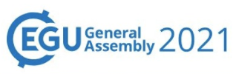
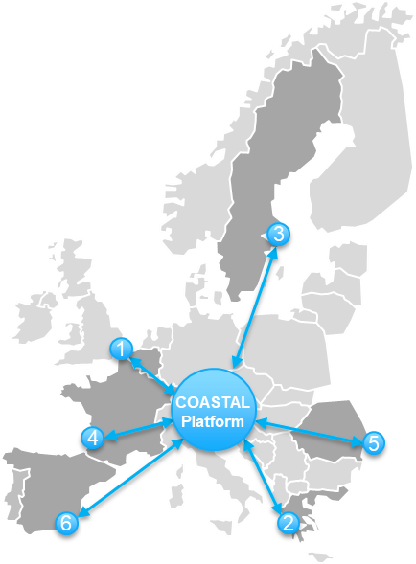

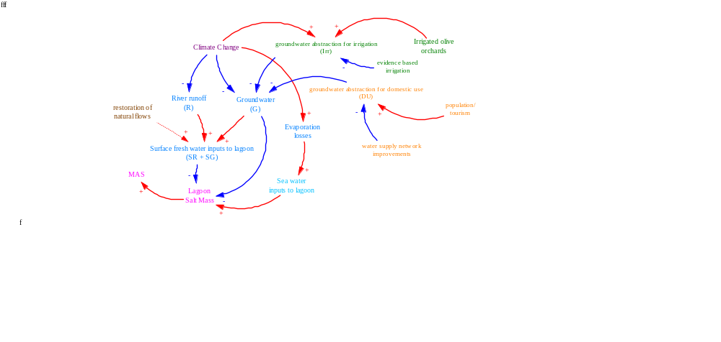
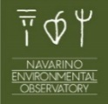
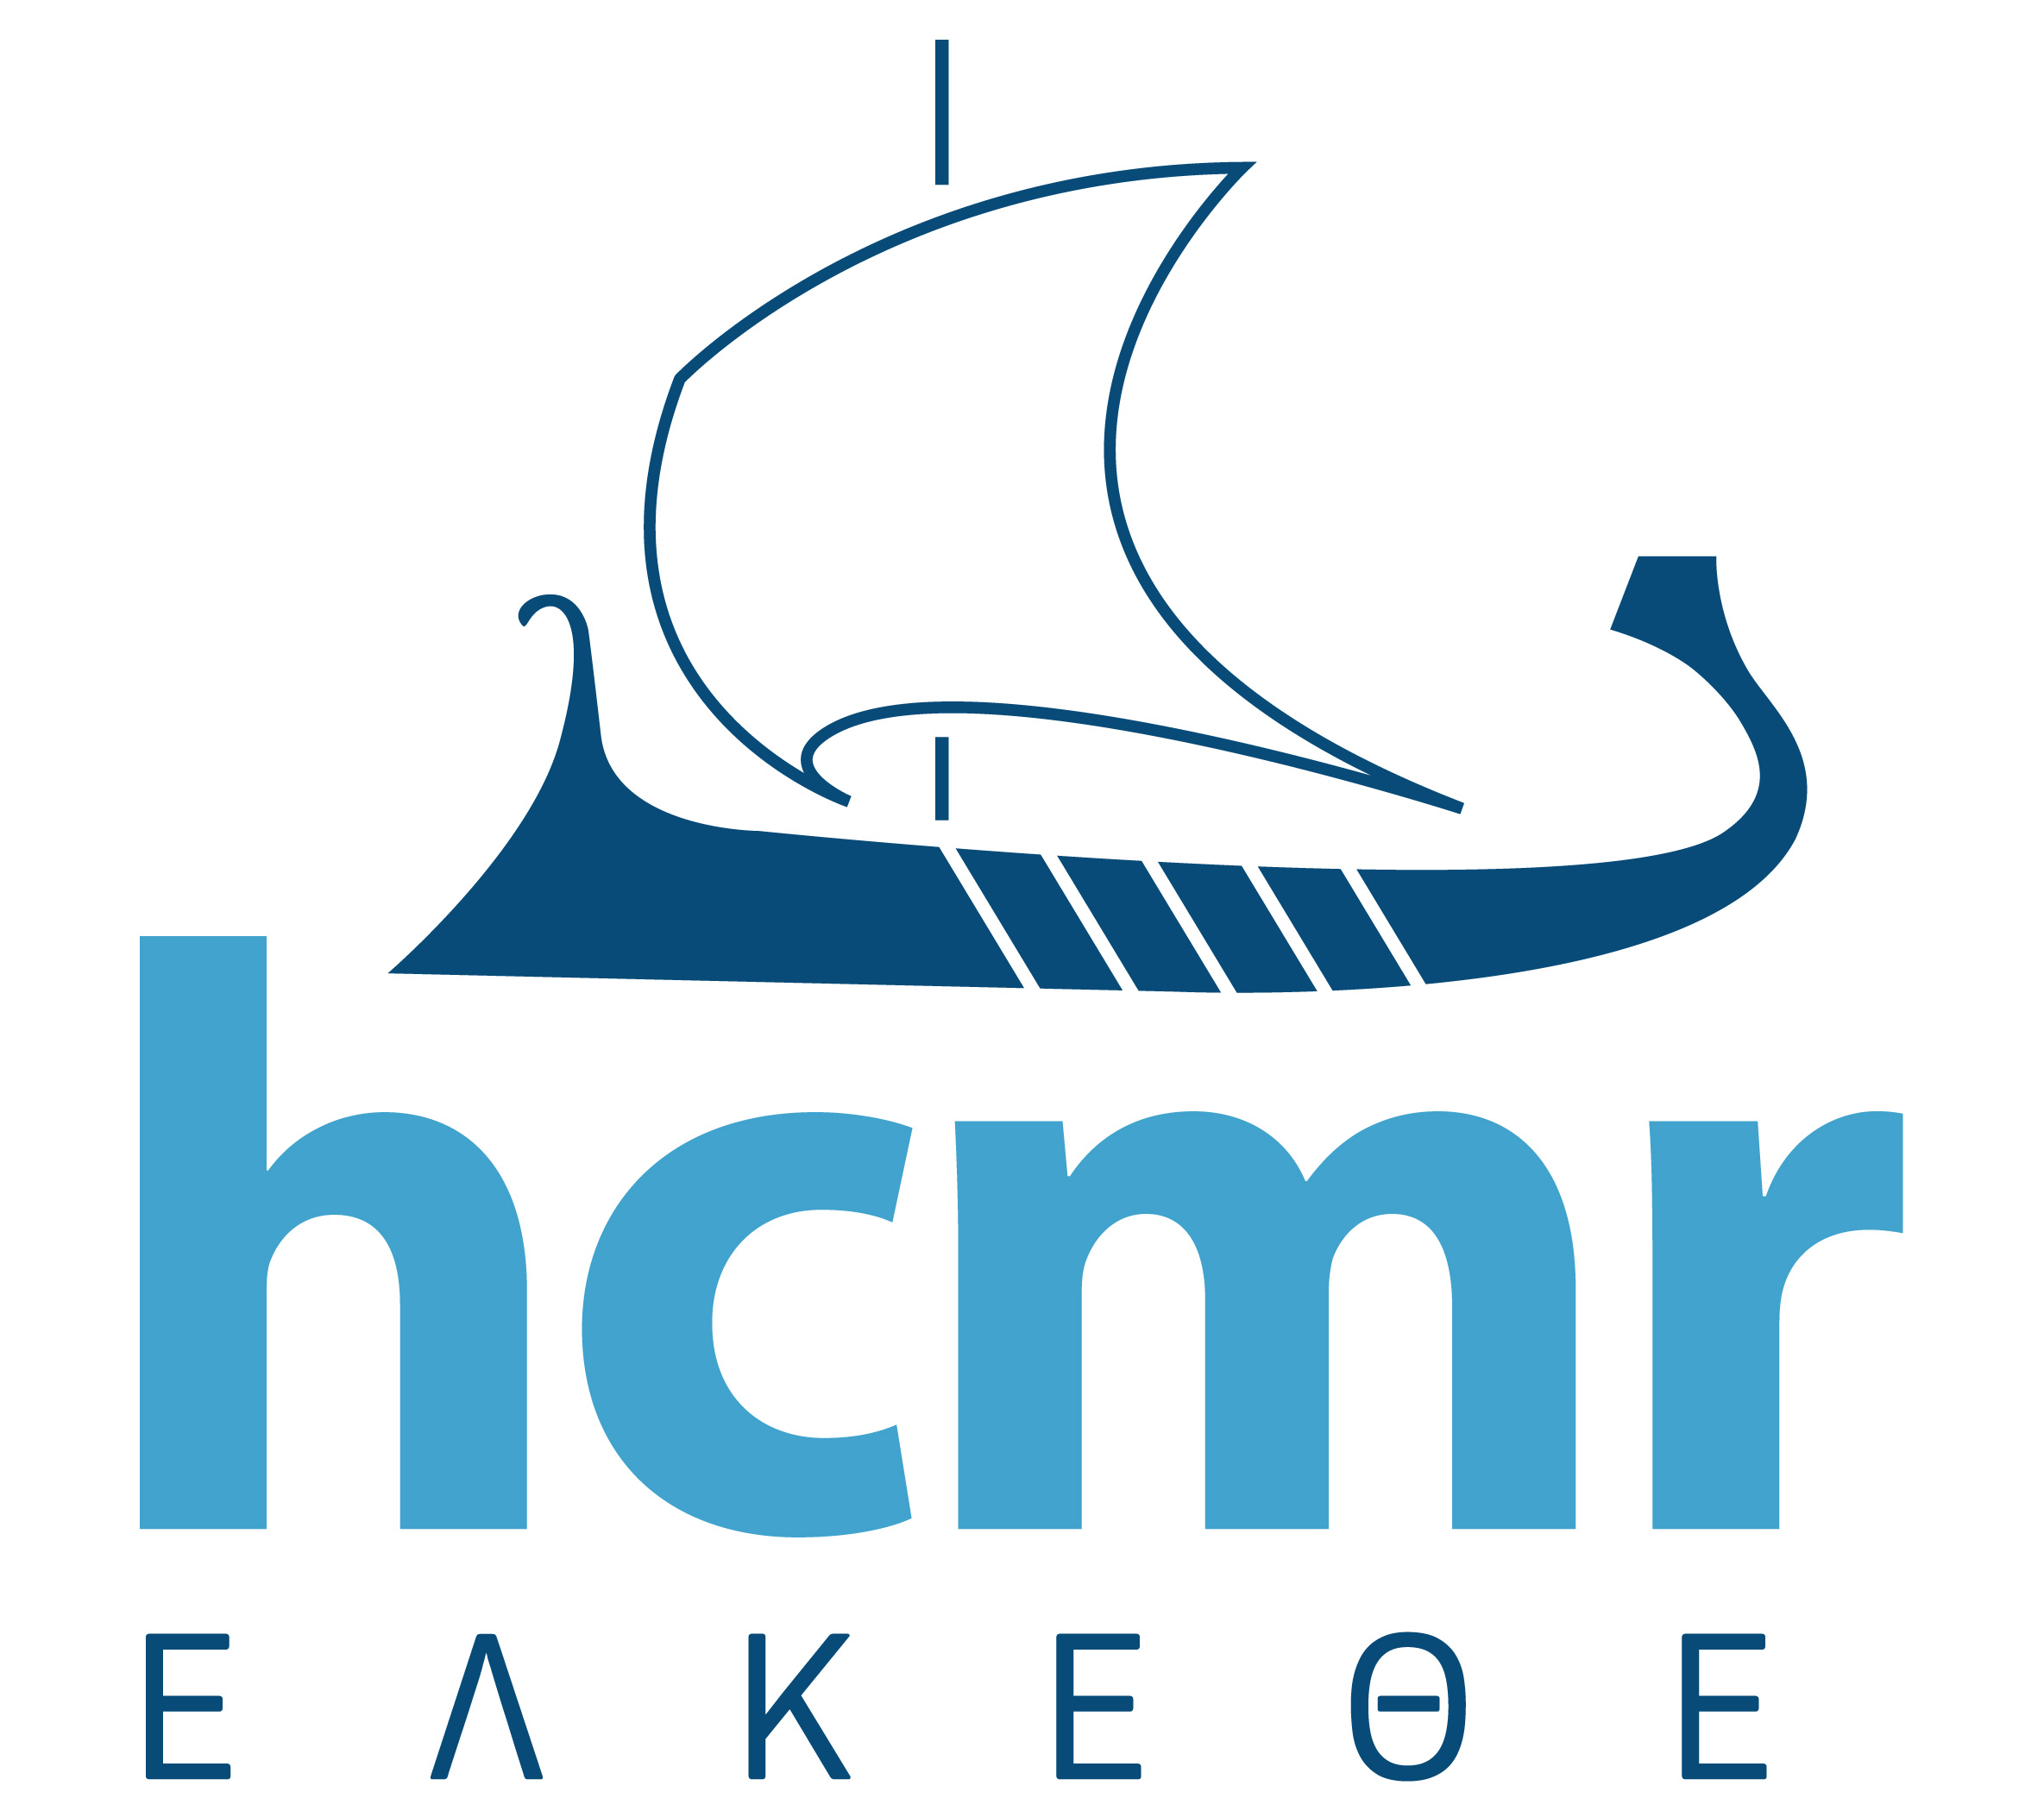


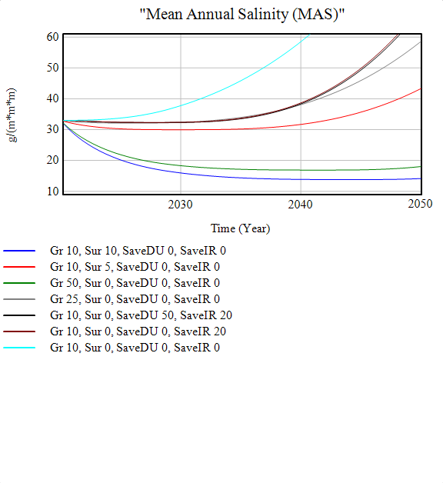
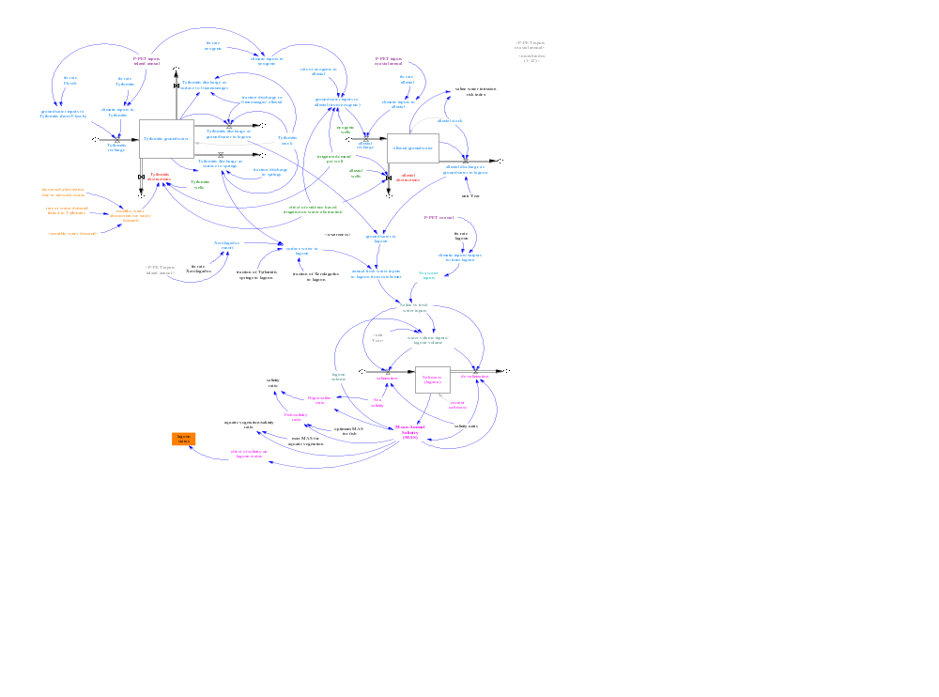
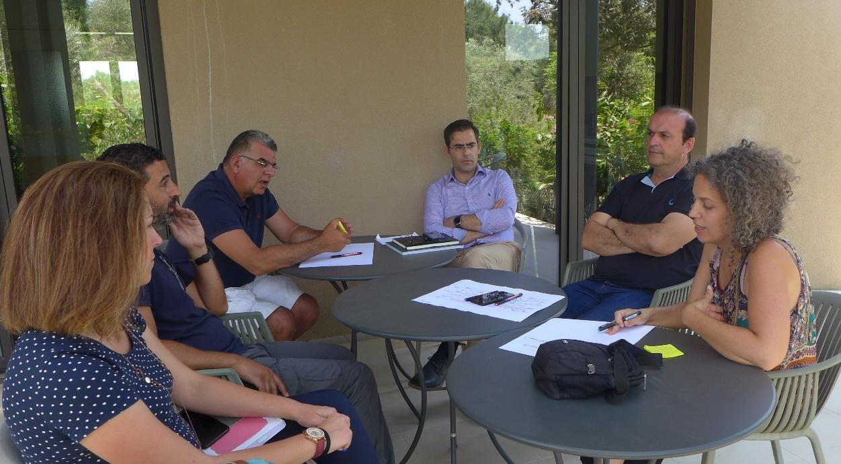
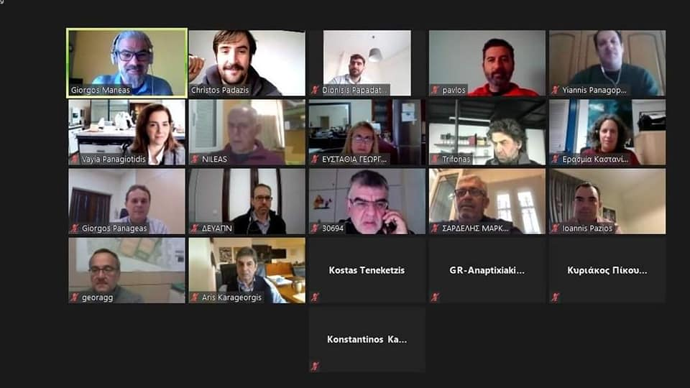
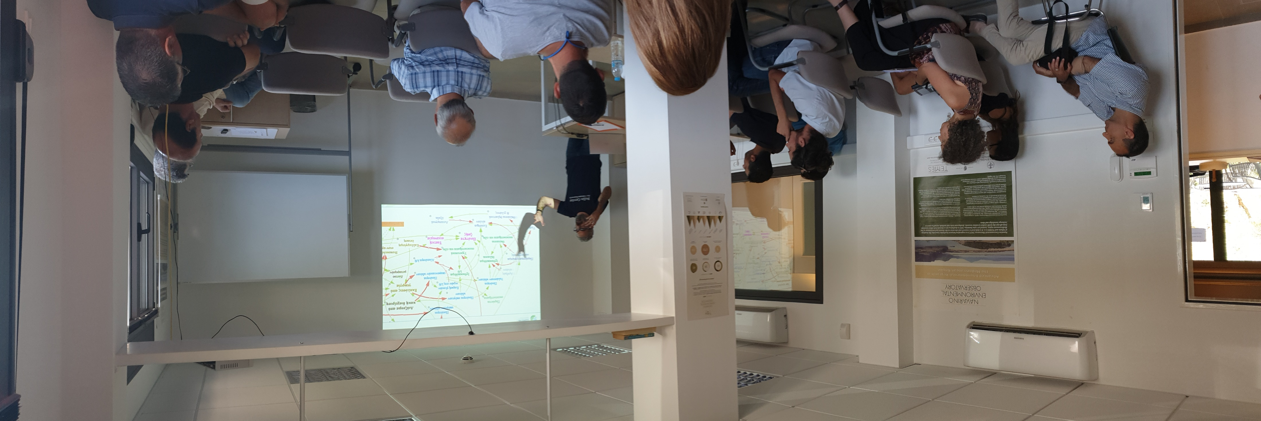

Systems-Dynamic modelling for salinity restoration in wetlands. The case of SW Messinia, Greece.
Giorgos Maneas^{1,2}, Erasmia Kastanidi³, Yiannis Panagopoulos³, Håkan Berg¹, Stefano Manzoni¹, Jean-Luc De Kok⁴, Peter Viaene⁴
¹Department of Physical Geography, Stockholm University, Sweden
²Navarino Environmental Observatory, Greece
³Hellenic Centre of Marine Research, Greece
⁴Environmental Modelling Unit (RMA), VITO NV , Belgium
3. SD modelling
3.1 Concept formulation
1. Problem formulation
In SW Messinia, Greece, all human activities depend on groundwater resources to support their livelihoods (irrigation, domestic use). These resources also serve as the main freshwater sources for Gialova Lagoon, a coastal wetland with high ecological and commercial value.
During the previous century, the wetland has been gradually transformed from brackish to saline (Maneas et al., 2019).
At present, the Mean Annual Salinity (MAS) is at 33 g/lt, and it is expected to increase even more under future drier and warmer conditions (Manzoni et al., 2020).
These values have already profound implications on species and habitats, which impacts the local fishing economy and the recognition of the area (COASTAL workshops, 2018).
A challenge for the region is how to balance societal and conservation needs, and suggest salinity restoration solutions with a broader acceptance by the society.
4. MAS trends under different fresh water restoration approaches
Conceptual SD model
3.2 Validation by experts
& stakeholders
3.3. Operational SD model (validated)
Sea salinity
g/ L
Fish optimum
SR: 10%, SG: 10%, Savings: Irr:20%, DU 0%
2. The approach under COASTAL EU project
SR: 5%, SG: 10%, Savings: Irr: 0%, DU 0%
SR: 0%, SG: 50%, Savings: Irr: 0%, DU 0%
SR: 0%, SG: 25%, Savings: Irr: 0%, DU 0%
Engaging local and regional Business Entrepreneurs, Administrations, and Scientific Experts in a Multi-actor process for Knowledge Exchange.
Co-development of Systems-Dynamic (SD) models and co-creation of policy recommendations & business roadmaps.
SR: 0%, SG: 10%, Savings: Irr: 20%, DU 50%
SR: 0%, SG: 10%, Savings: Irr: 20%, DU 0%
SR: 0%, SG: 10%, Savings: Irr: 0%, DU: 0% (current status)
This project has received funding from the European Union’s Horizon 2020 research and innovation programme under grant agreement N° 773782.

Slide 2
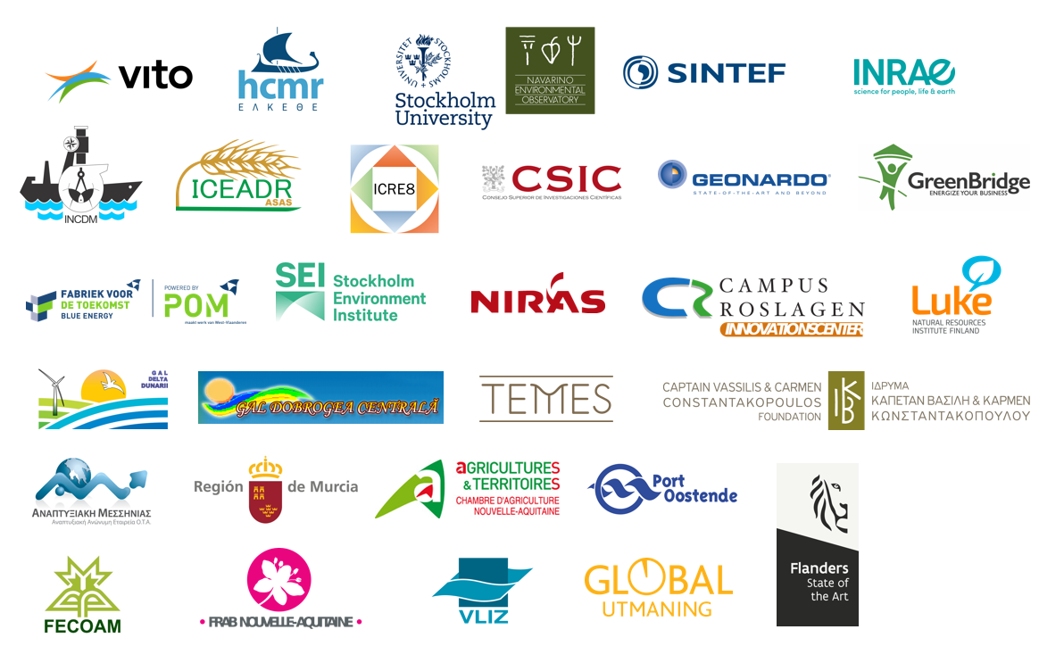
COASTAL in a glance
COASTAL EU project – Collaborative Land-Sea Integration Platform
Engaging Local and Regional Business Entrepreneurs, Administrations, Stakeholders, and Scientific Experts in a Multi-actor process for Knowledge Exchange
Quantifying the physical, socio-economic and environmental coastal-rural interactions in six representative case studies
(Black Sea, East and West Mediterranean, Atlantic, Northern and Baltic Seas)
Qualitative and quantitative tools for evaluating and comparing business and policy solutions for new problem contexts and case studies in the EU territory
Co-creating evidence-based business roadmaps and policy solutions for enhancing coastal-rural collaboration and synergies
This project has received funding from the European Union’s Horizon 2020 research and innovation programme under grant agreement N° 773782.

Slide 3
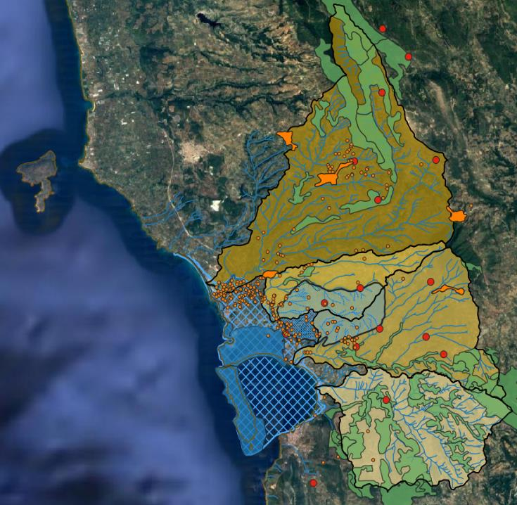
Characteristics of the Greek case study (SW Messinia)
Problem formulation
In SW Messinia, Greece, all human activities depend on groundwater resources to support their livelihoods (irrigation, domestic use). These resources also serve as the main freshwater sources for Gialova Lagoon, a coastal wetland with high ecological, cultural and commercial value.
During the previous century, the wetland has been gradually transformed from brackish to saline (Maneas et al., 2019).
At present, the Mean Annual Salinity (MAS) is at 33 g/lt, and it is expected to increase even more under future drier and warmer conditions (Manzoni et al., 2020).
These values have already profound implications on species and habitats, which impacts the local fishing economy and the recognition of the area (COASTAL workshops, 2018).
A challenge for the region is how to balance societal and conservation needs, and suggest salinity restoration solutions with a broader acceptance by the society.
Land Uses/ Land Cover
Natura 2000 area
Protection zone
Buffer zone
Olive orchards / total area
70 – 75 %
Gialova wetland
65 – 70 %
Basic economic activities of the local population (10.500 inhabitants, 2011 census)
  Agriculture: 44% (olive groves mainly)
  Coastal tourism: 10% (increasing)
  Fisheries: 1%
  Food manufacturing: 2%
45 – 50 %
Natural vegetation
Hydrology
Groundwater aquifer
Rivers and streams
Private wells (irrigation)
Public wells (domestic use)
This project has received funding from the European Union’s Horizon 2020 research and innovation programme under grant agreement N° 773782.

Slide 4
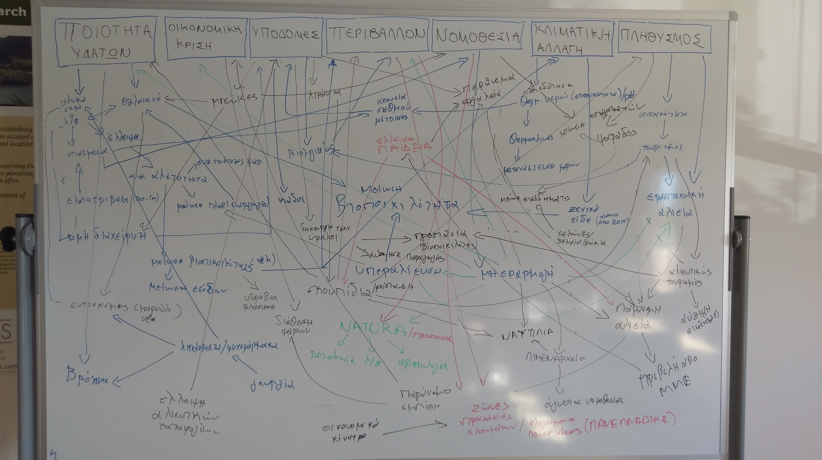
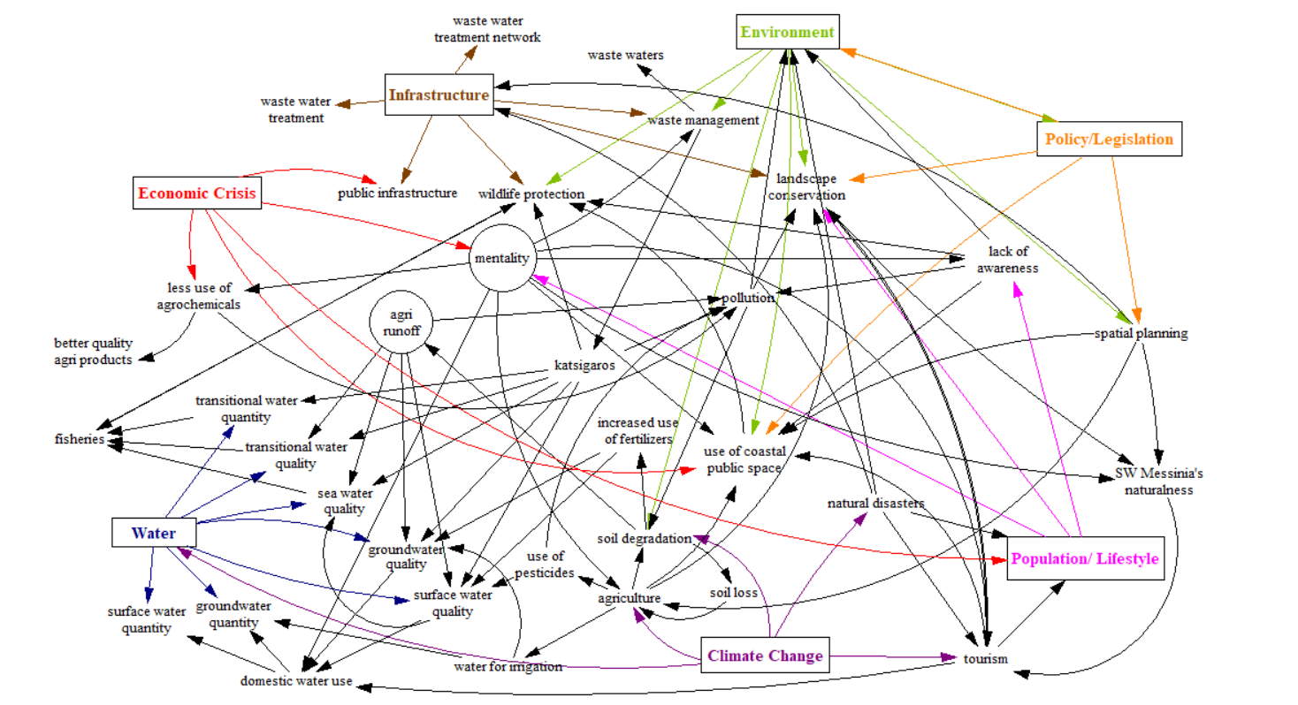
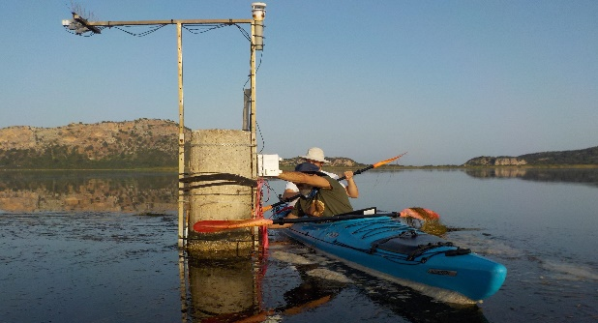
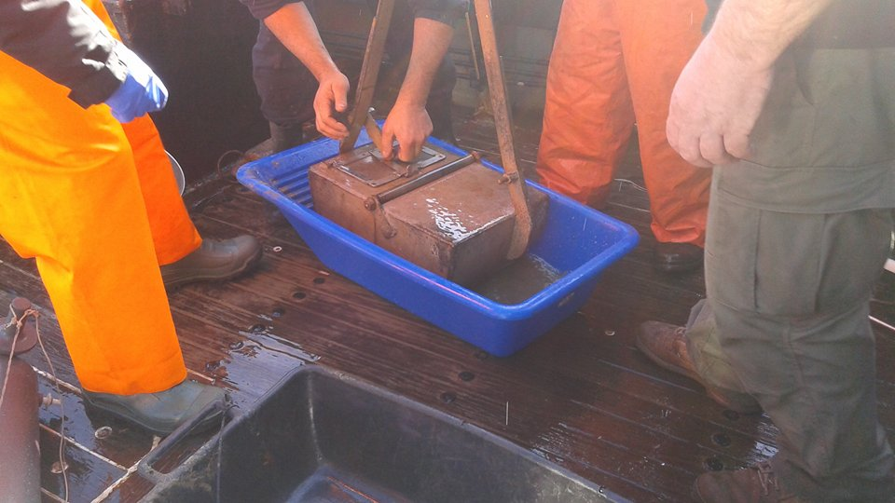
SD modelling approach under COASTAL
70 stakeholders
Sectoral mind maps capturing the land-sea interactions as perceived by participants
6
sectoral workshops
Agriculture
Fishing
Local industry
Tourism
Local & reginal administration
Institurions & NGOs
Engaging Local and Regional Business Entrepreneurs, Administrations, Stakeholders, and Scientific Experts in a Multi-actor process for Knowledge Exchange
Scientific knowledge and data collection
This project has received funding from the European Union’s Horizon 2020 research and innovation programme under grant agreement N° 773782.

Slide 5
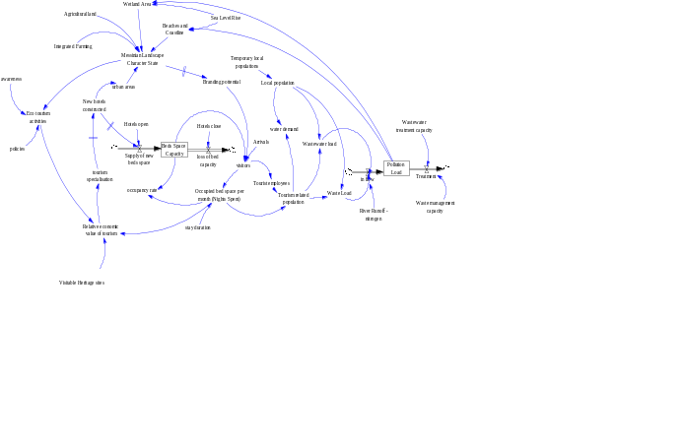
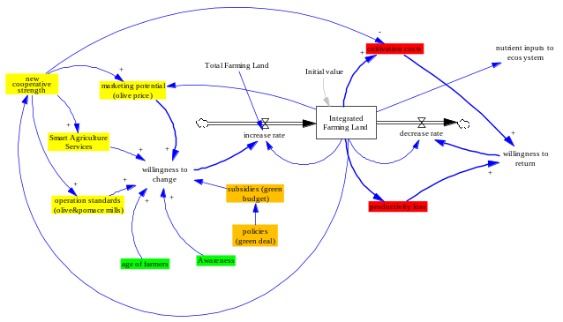
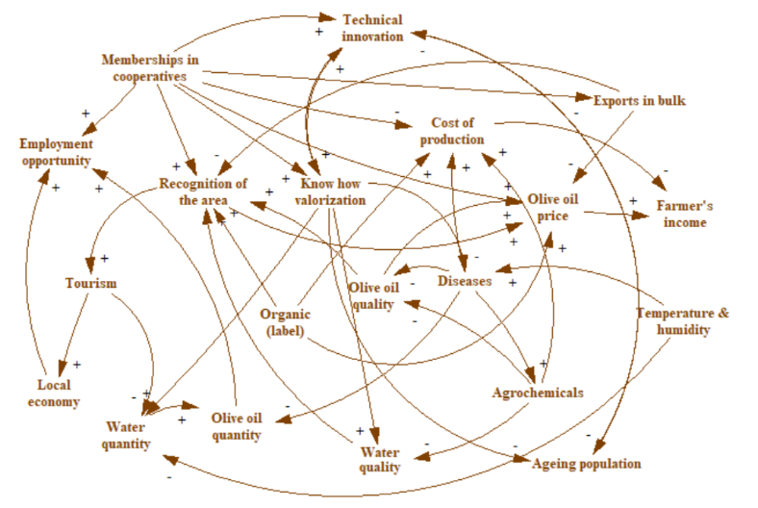
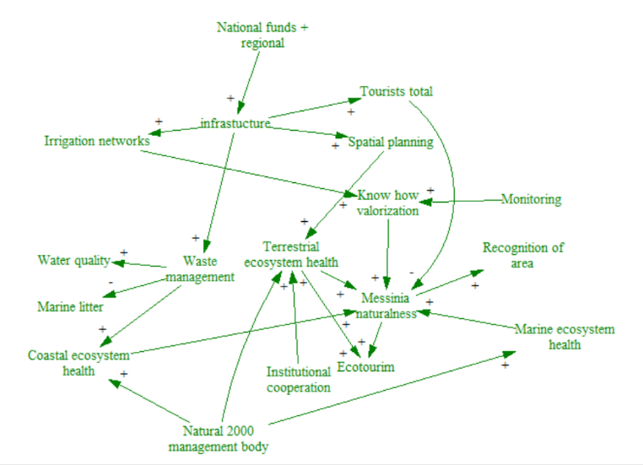
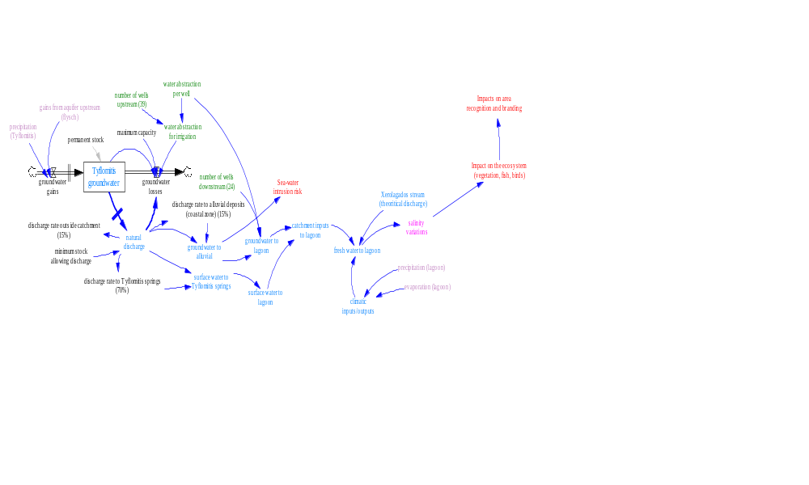
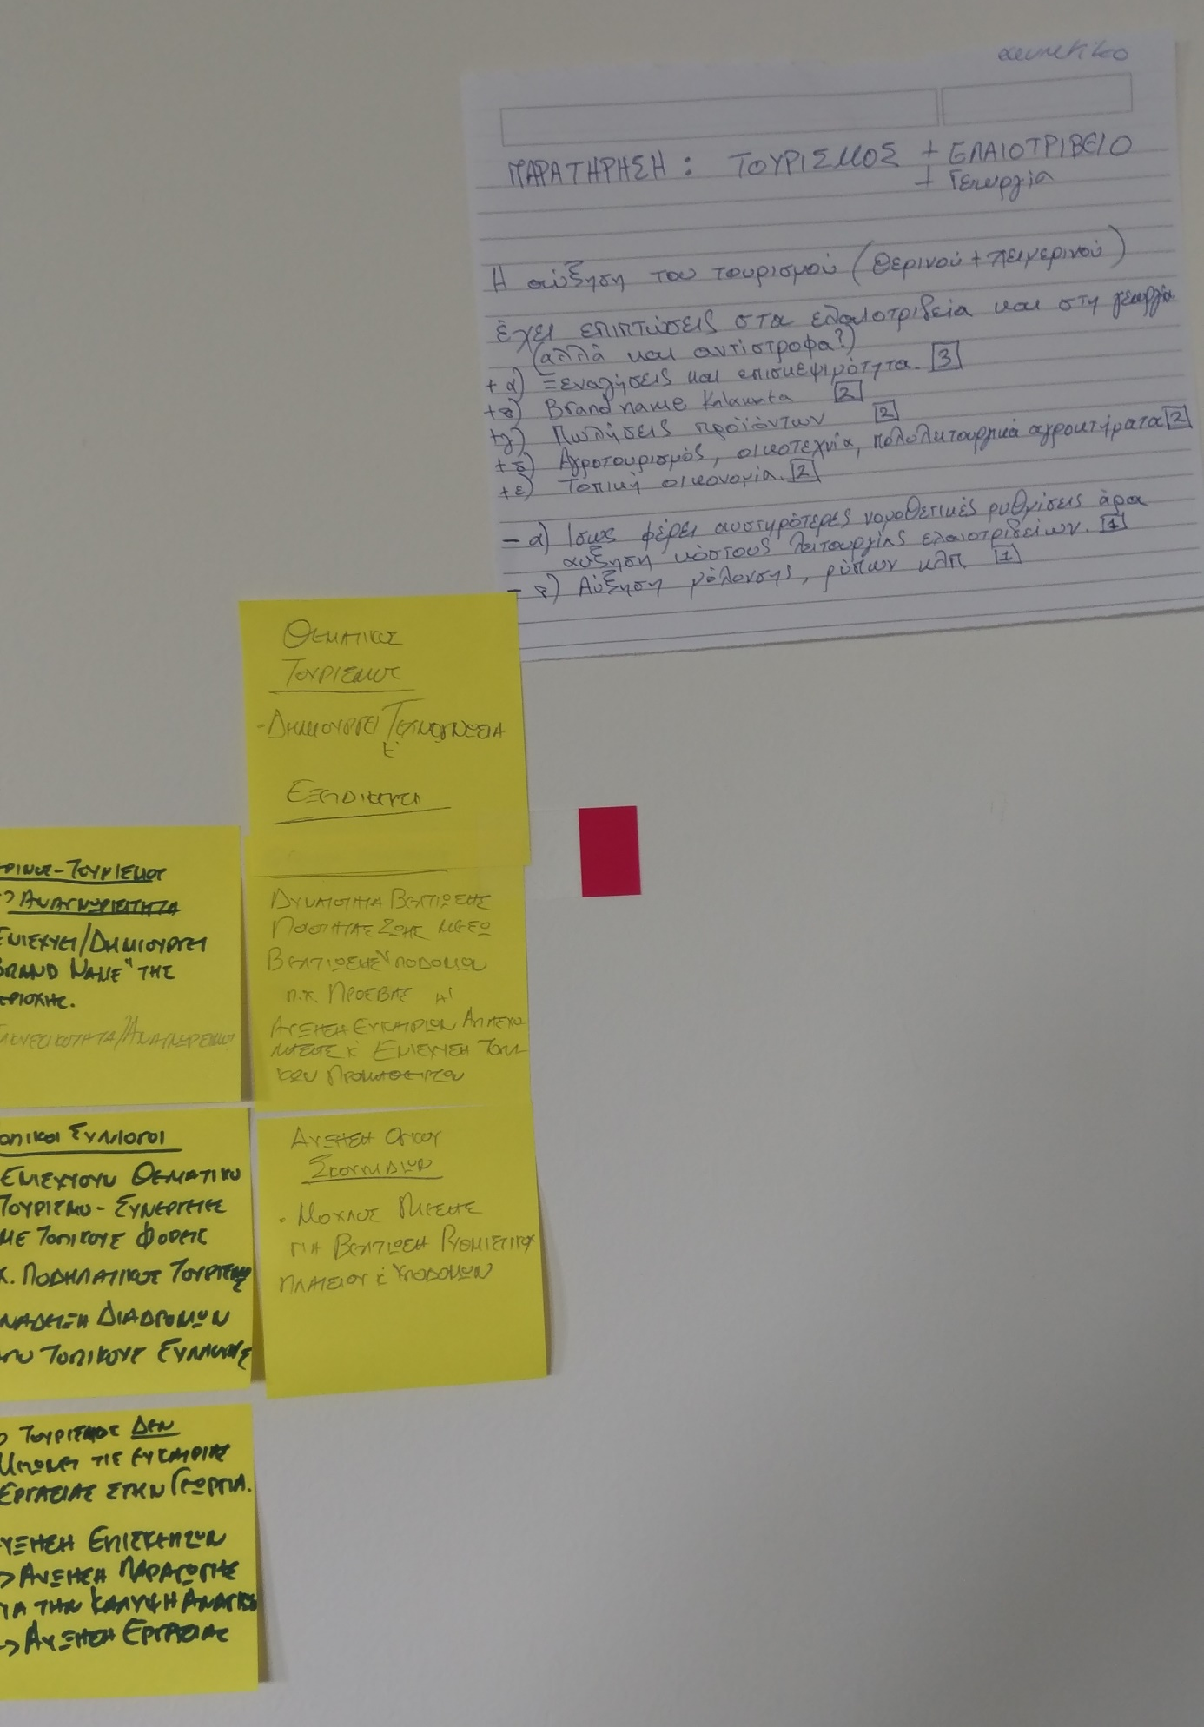
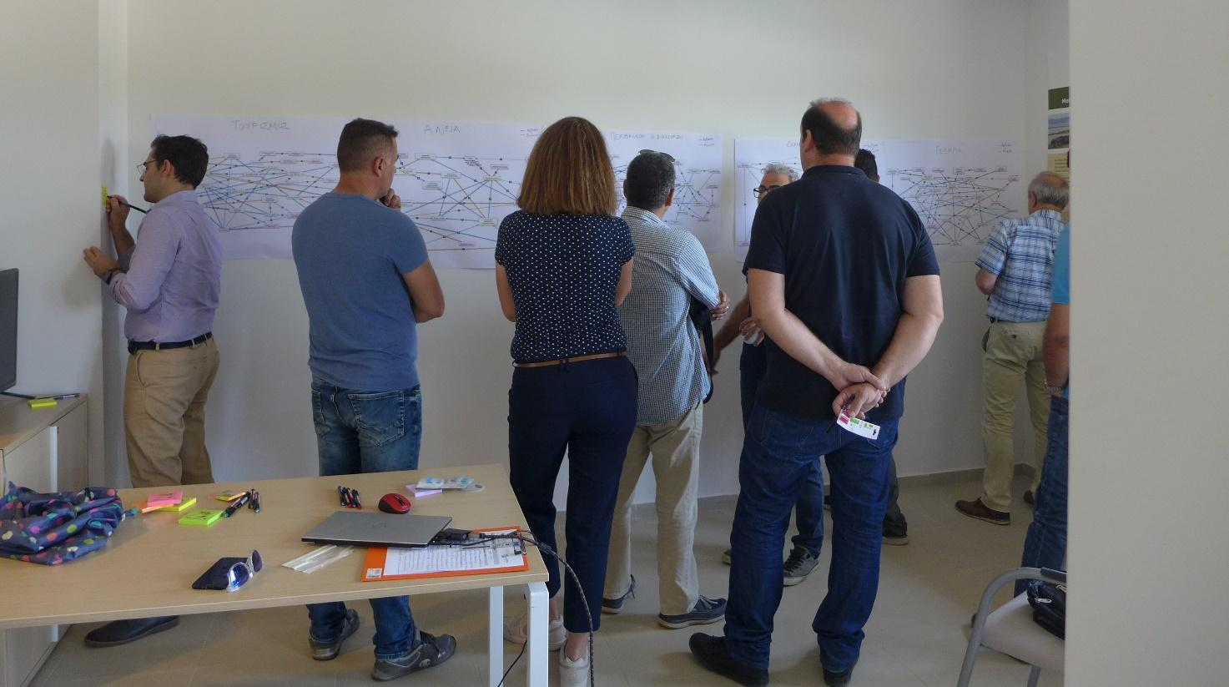
SD modelling approach under COASTAL
Causal Loop Diagrams with the Challenges and the Opportunities for improving rural-coastal synergies
Development of SD sub models addressing how :
the transition from conventional to integrated olive farming
the adoption of more resilient forms of tourism and
the restoration of the local wetland
could pave the way for achieving the goal of Sustainable Messinia (common vision).
Workshop with experts & stakeholders:
CLD validation, and co-creation of
a common vision for a sustainable future
This project has received funding from the European Union’s Horizon 2020 research and innovation programme under grant agreement N° 773782.

Slide 6
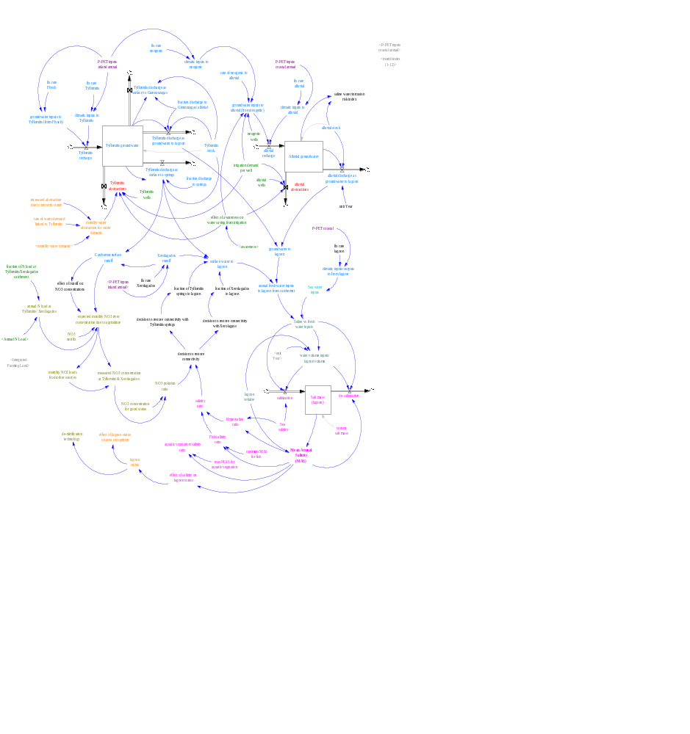
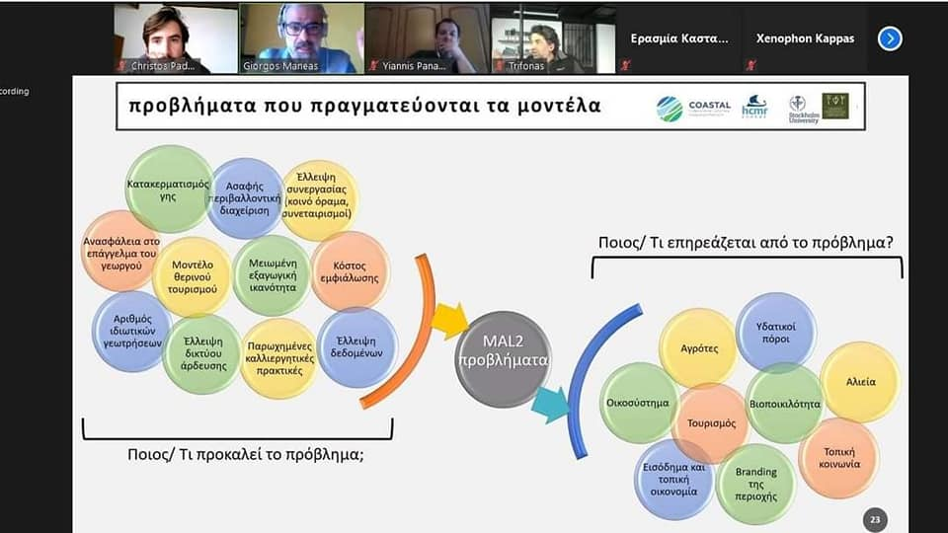
SD modelling approach under COASTAL
Online workshop with experts and stakeholders:
Model validation (e.g. structure, behaviour)
Business recommendations for improving land-sea interactions
Combined SD model validated for co-creation of
policy recommendations & business roadmaps
at a case study level
This project has received funding from the European Union’s Horizon 2020 research and innovation programme under grant agreement N° 773782.

Slide 7
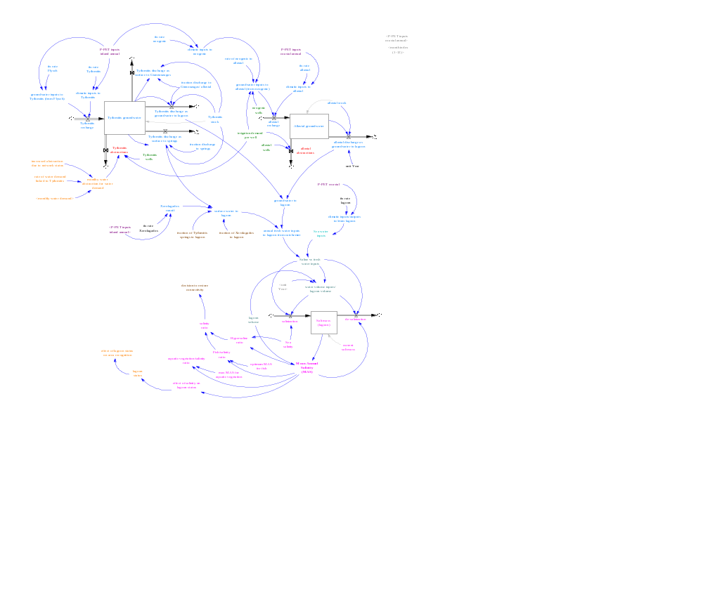
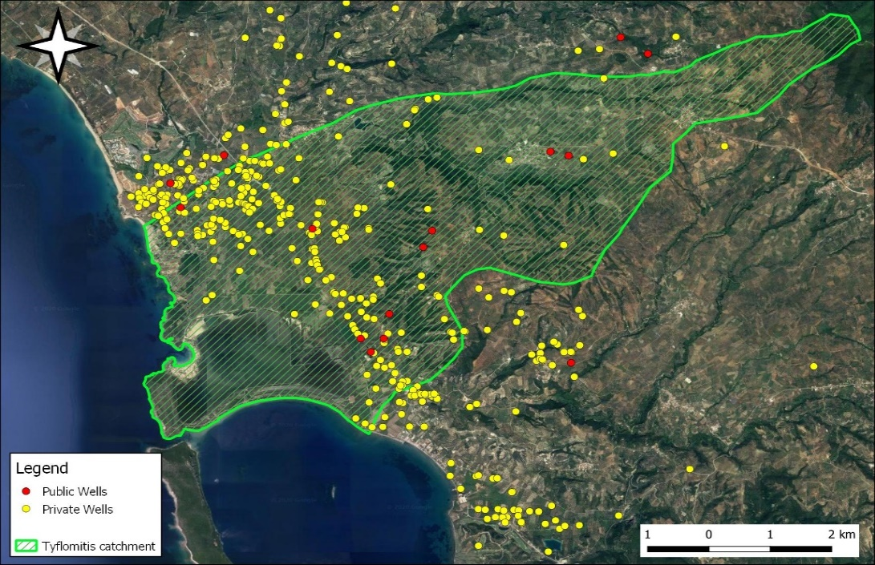
Applying the SD model for salinity restoration in Gialova wetland
Conceptual SD model
Operational SD model
Catchemnt
Groundwater aquifer
Wells
Municipal use
Irrigation
Gialova wetland

Slide 8
Model inputs
Catchment characteristics
Climatic conditions (in model as m³/month)
Total catchment area
Size
Tyflomitis groundwater aquifer
Size
Infiltration rate:
Permanent stock
Max capacity
Flysch groundwater aquifer
Size
Infiltration rate
Output to Tyflomitis
Xerolagados stream
Runoff
Lagoon
Size
Volume
Precipitation (inland): 793 mm
Evapotranspiration (inland): 887 mm
Precipitation (coastal): 695 mm
Evaporation (coastal): 912 mm
Catchemnt
Groundwater aquifer
Wells
Municipal use
Irrigation
Climate change effect
2021-2050
2071-2100
Gialova wetland
Precipitation (mm): (–) 60 (–) 200
Temperature (°C): (+) 1,6 (+) 4
Species tolerance to salinity
Cattail: 0 – 15 g/L
Reeds: 0 – 22,5 g/L
Sea Bream: 20 – 40 g/L
Sea salinity: 38,5 g/L
This project has received funding from the European Union’s Horizon 2020 research and innovation programme under grant agreement N° 773782.

Slide 9
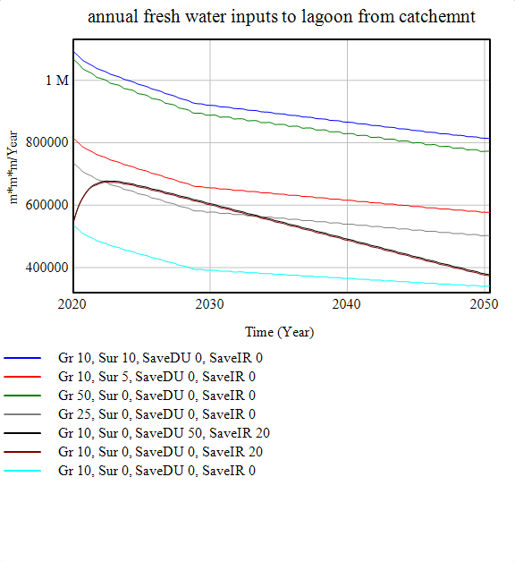
Model outputs and uses
The model suggests that the increase of freshwater inputs are vital for regulating lagoon salinity.
By saving water from irrigation and domestic use, the model suggests that wetland salinity could be kept to current values for the next decade, but this is not enough to achieve salinity values optimum for fish or to reverse salinization after 2030.
Based on the model outputs, the de-salinization to optimum salinity values can be achieved only by restoring the natural flows with Xerolagados and Tyflomitis, whose water quality depend on agricultural activities.
Within the framework of the COASTAL project, the co-creation of a systems dynamic model, fosters analytic-deliberation and promotes social learning about the system among participants.
Including stakeholders in the process increases understanding about system’s behavior and helps connect local needs and concerns with wetland management.
This is essential for achieving the transition towards collaborative integrated land-sea interactions that will enable the restoration of wetland’s salinity without further adverse impacts on the wetland’s ecology.
m³/ Year
Sea salinity
g/ L
Fish optimum
SR: 10%, SG: 10%, Savings: Irr:20%, DU 0%
SR: 5%, SG: 10%, Savings: Irr: 0%, DU 0%
SR: 0%, SG: 50%, Savings: Irr: 0%, DU 0%
SR: 0%, SG: 25%, Savings: Irr: 0%, DU 0%
SR: 0%, SG: 10%, Savings: Irr: 20%, DU 50%
SR: 0%, SG: 10%, Savings: Irr: 20%, DU 0%
SR: 0%, SG: 10%, Savings: Irr: 0%, DU: 0% (current status)
This project has received funding from the European Union’s Horizon 2020 research and innovation programme under grant agreement N° 773782.

