Slide 1
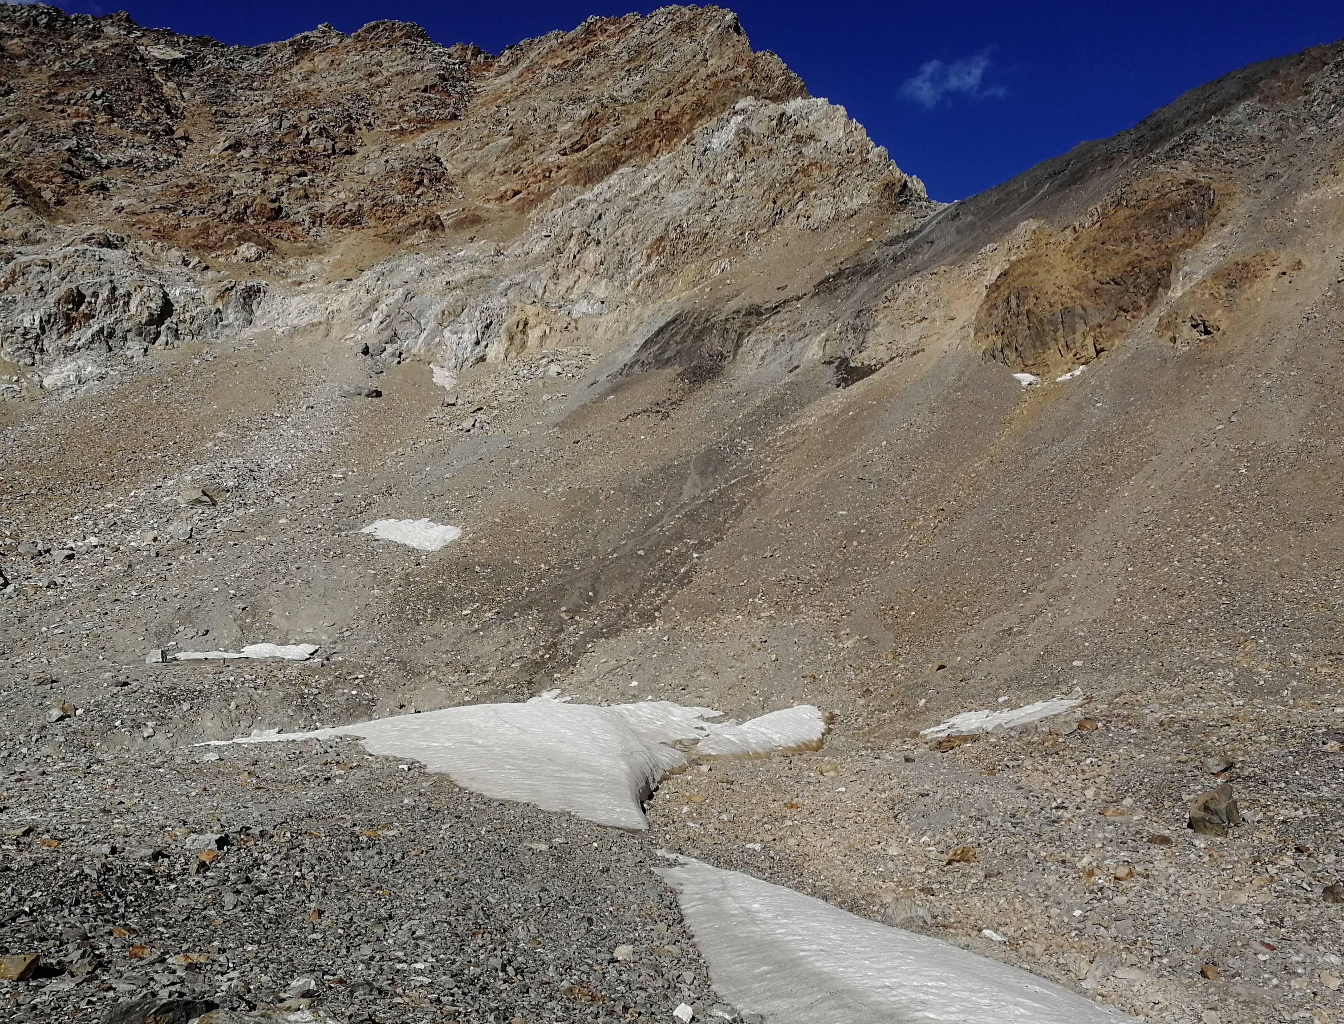
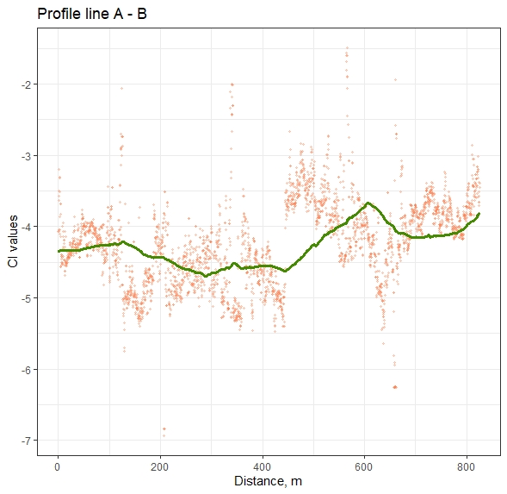
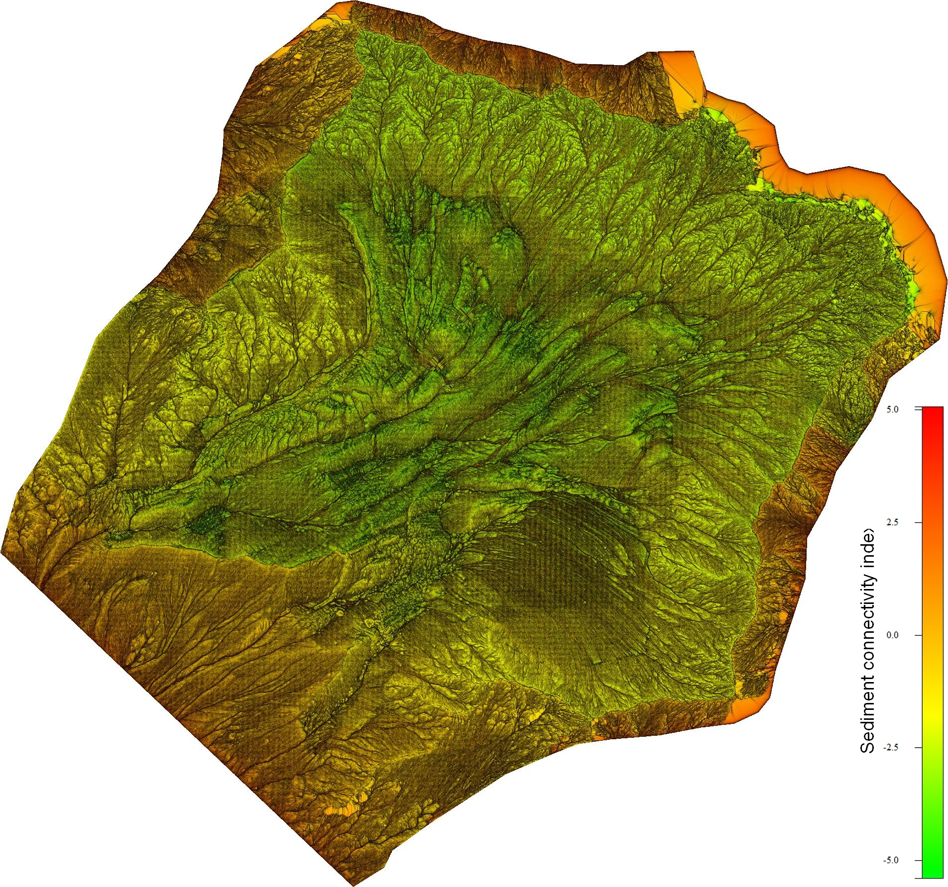
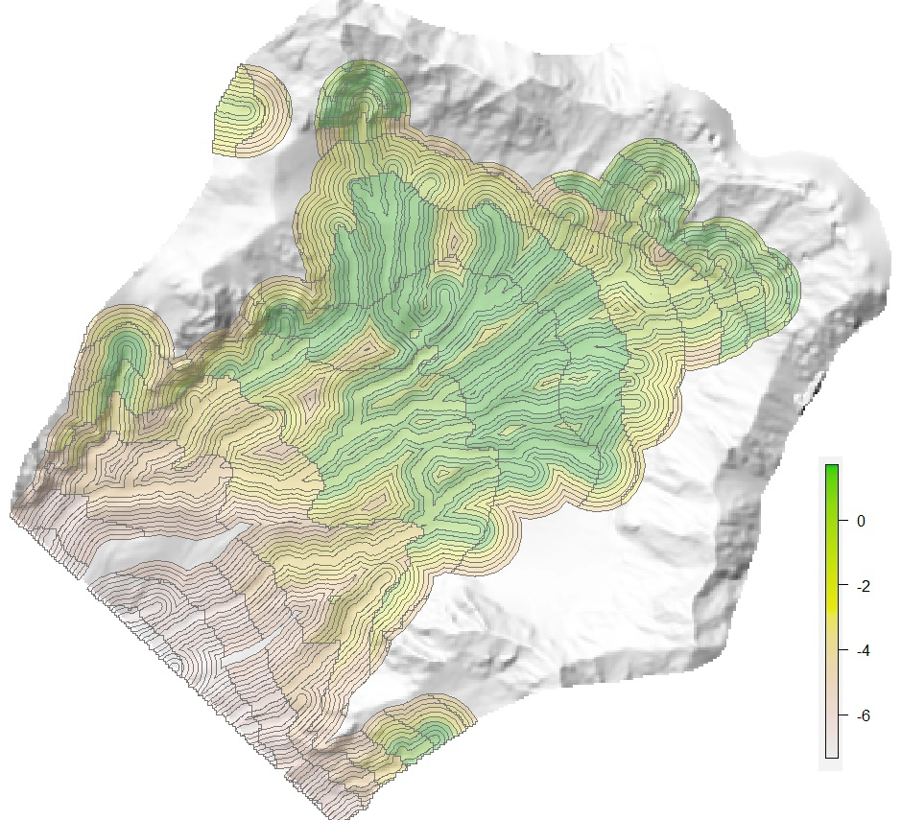
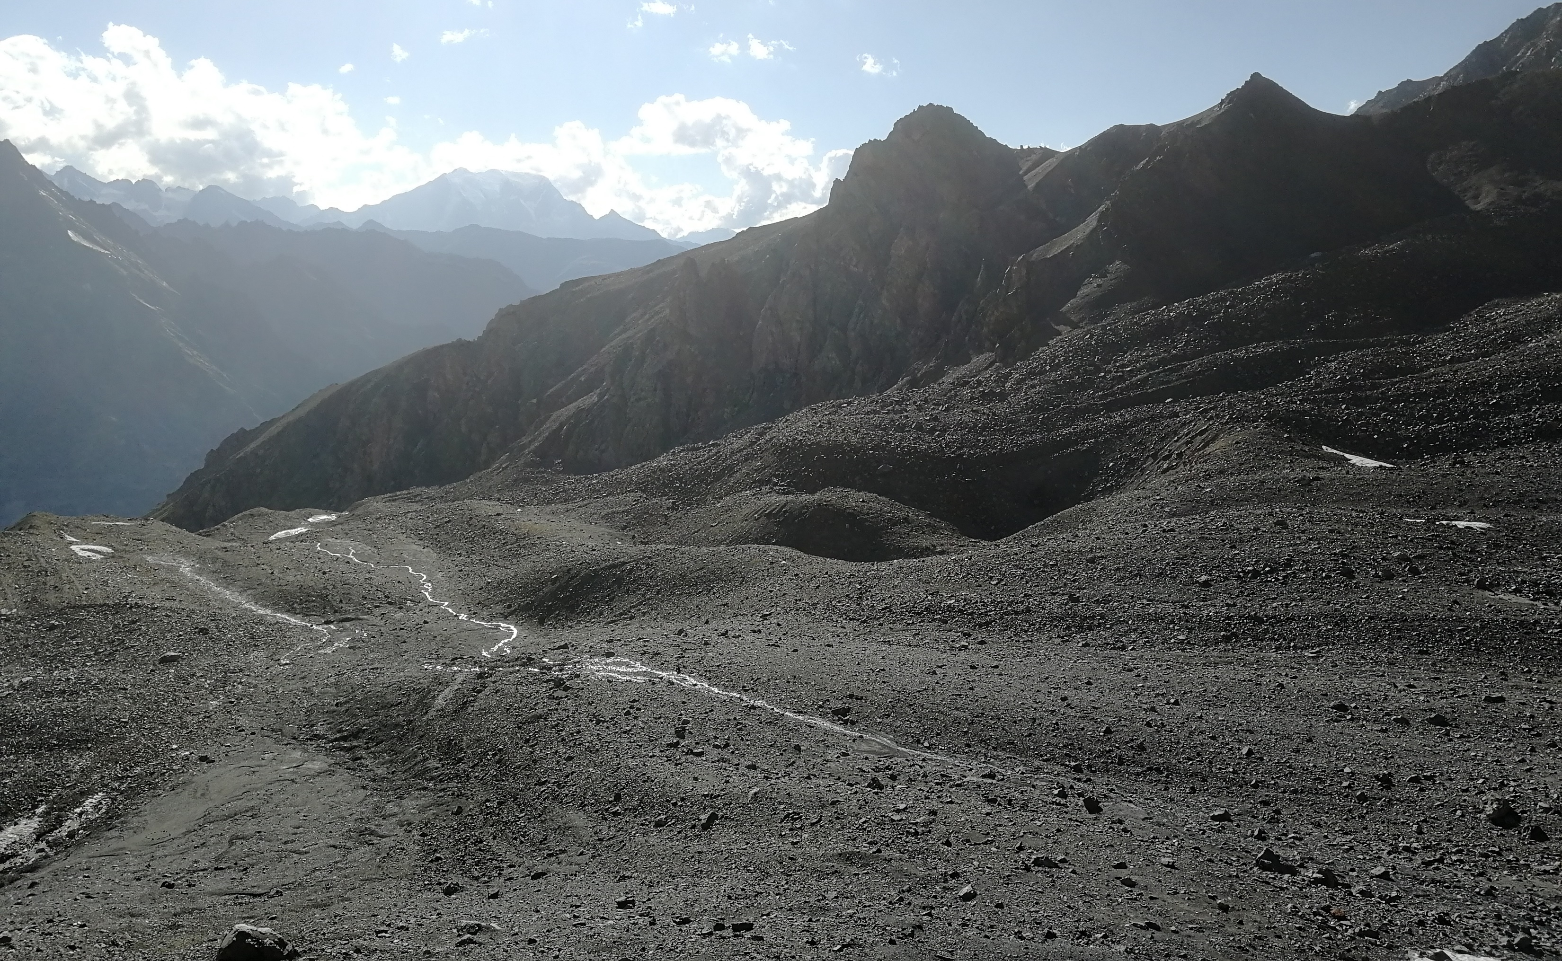
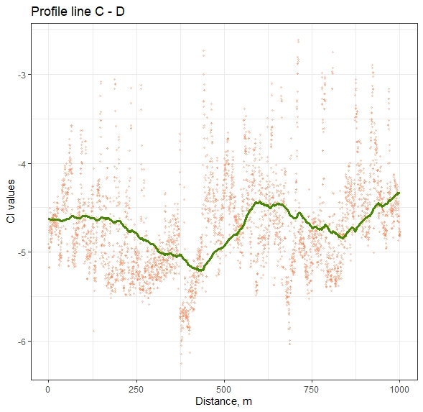
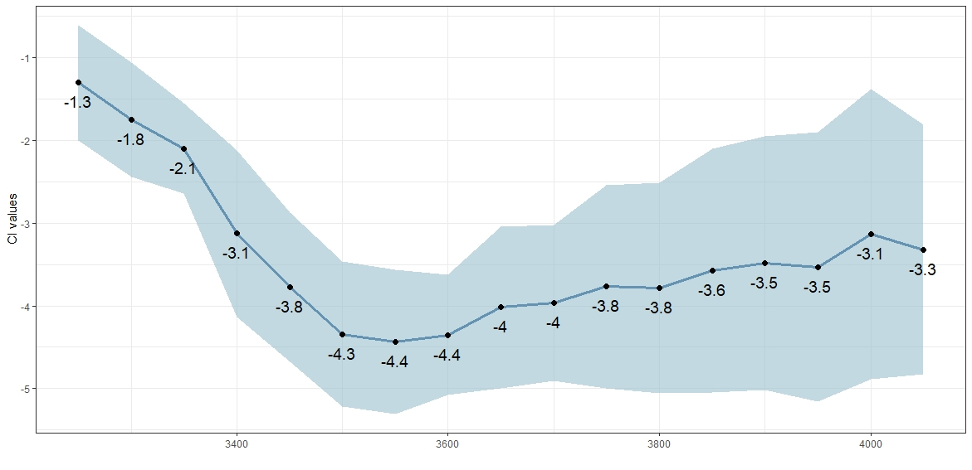
Sediment connectivity in the Koiyavgan glacier's cirques (Adyl-Su river basin, Caucasus, Russia)
Andrei Kedich^{1,2}, Maxim Uspensky^{1,2}, Anatoly Tsyplenkov^{1,2}, Sergey Kharchenko^{1,2}, and Valentin Golosov^{1,2}
¹ Faculty of Geography, Lomonosov Moscow State University, Moscow, Russian Federation
² Institute of Geography, Russian Academy of Sciences, Moscow, Russian Federation
Connectivity index for Koiyavgan cirques
Connectivity index for buffer zones along streams
C
C
Turn into accumulation – value -2.3
A
D
A
D
IC values, line A – B
IC values, line C– D
B
B
Turn into accumulation – value -2.5
Were calculated threshold values when sediment transit turns into accumulation. For talus sheets they are about -2.3, for alluvial fans are -2.5. Heights 3500-3600 m (colluvial sediments just below the slopes) are characterized by the lowest values. For upper sections were observed low index values along streams, while downstream these areas are characterized by maximum ones.
Distribution of connectivity index values along with height

