Slide 1
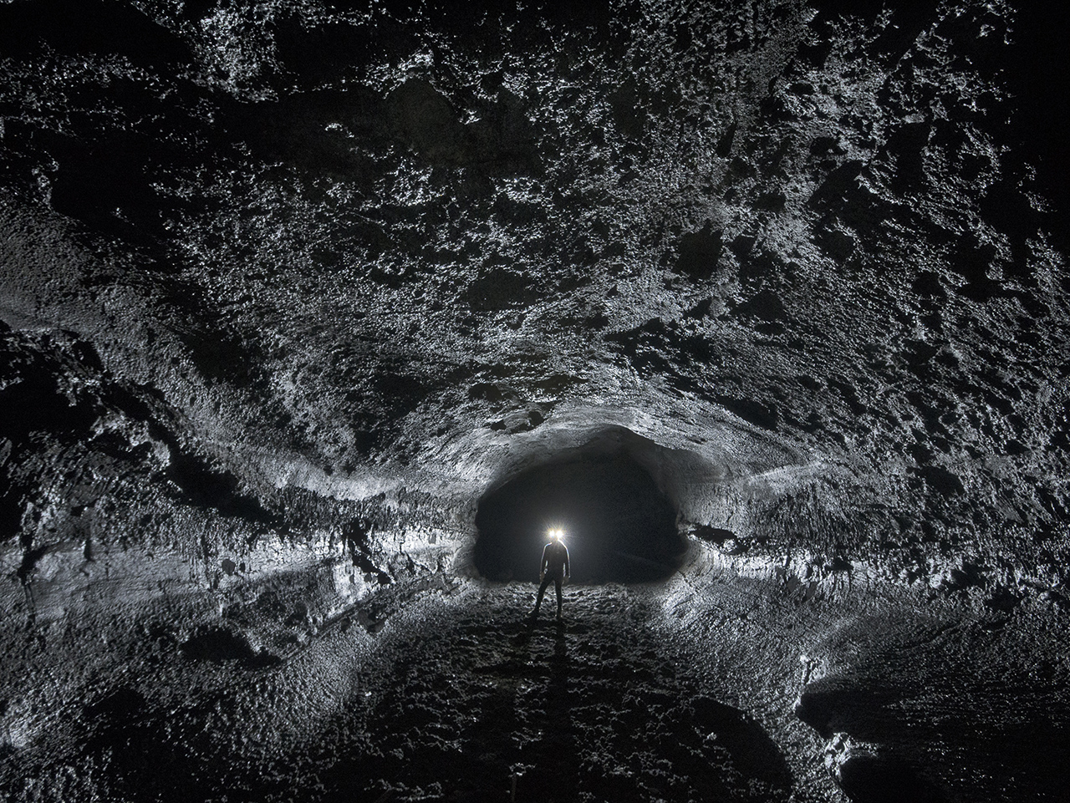
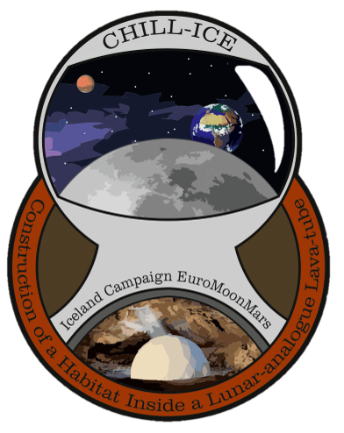

CHILL-ICE
Construction of a
Habitat
Inside a
Lunar-analogue
Lava tube
Iceland
Campaign 2020-2021 of EuroMoonMars

Slide 2
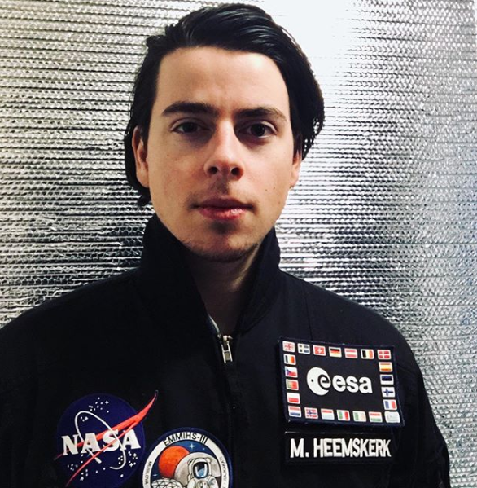
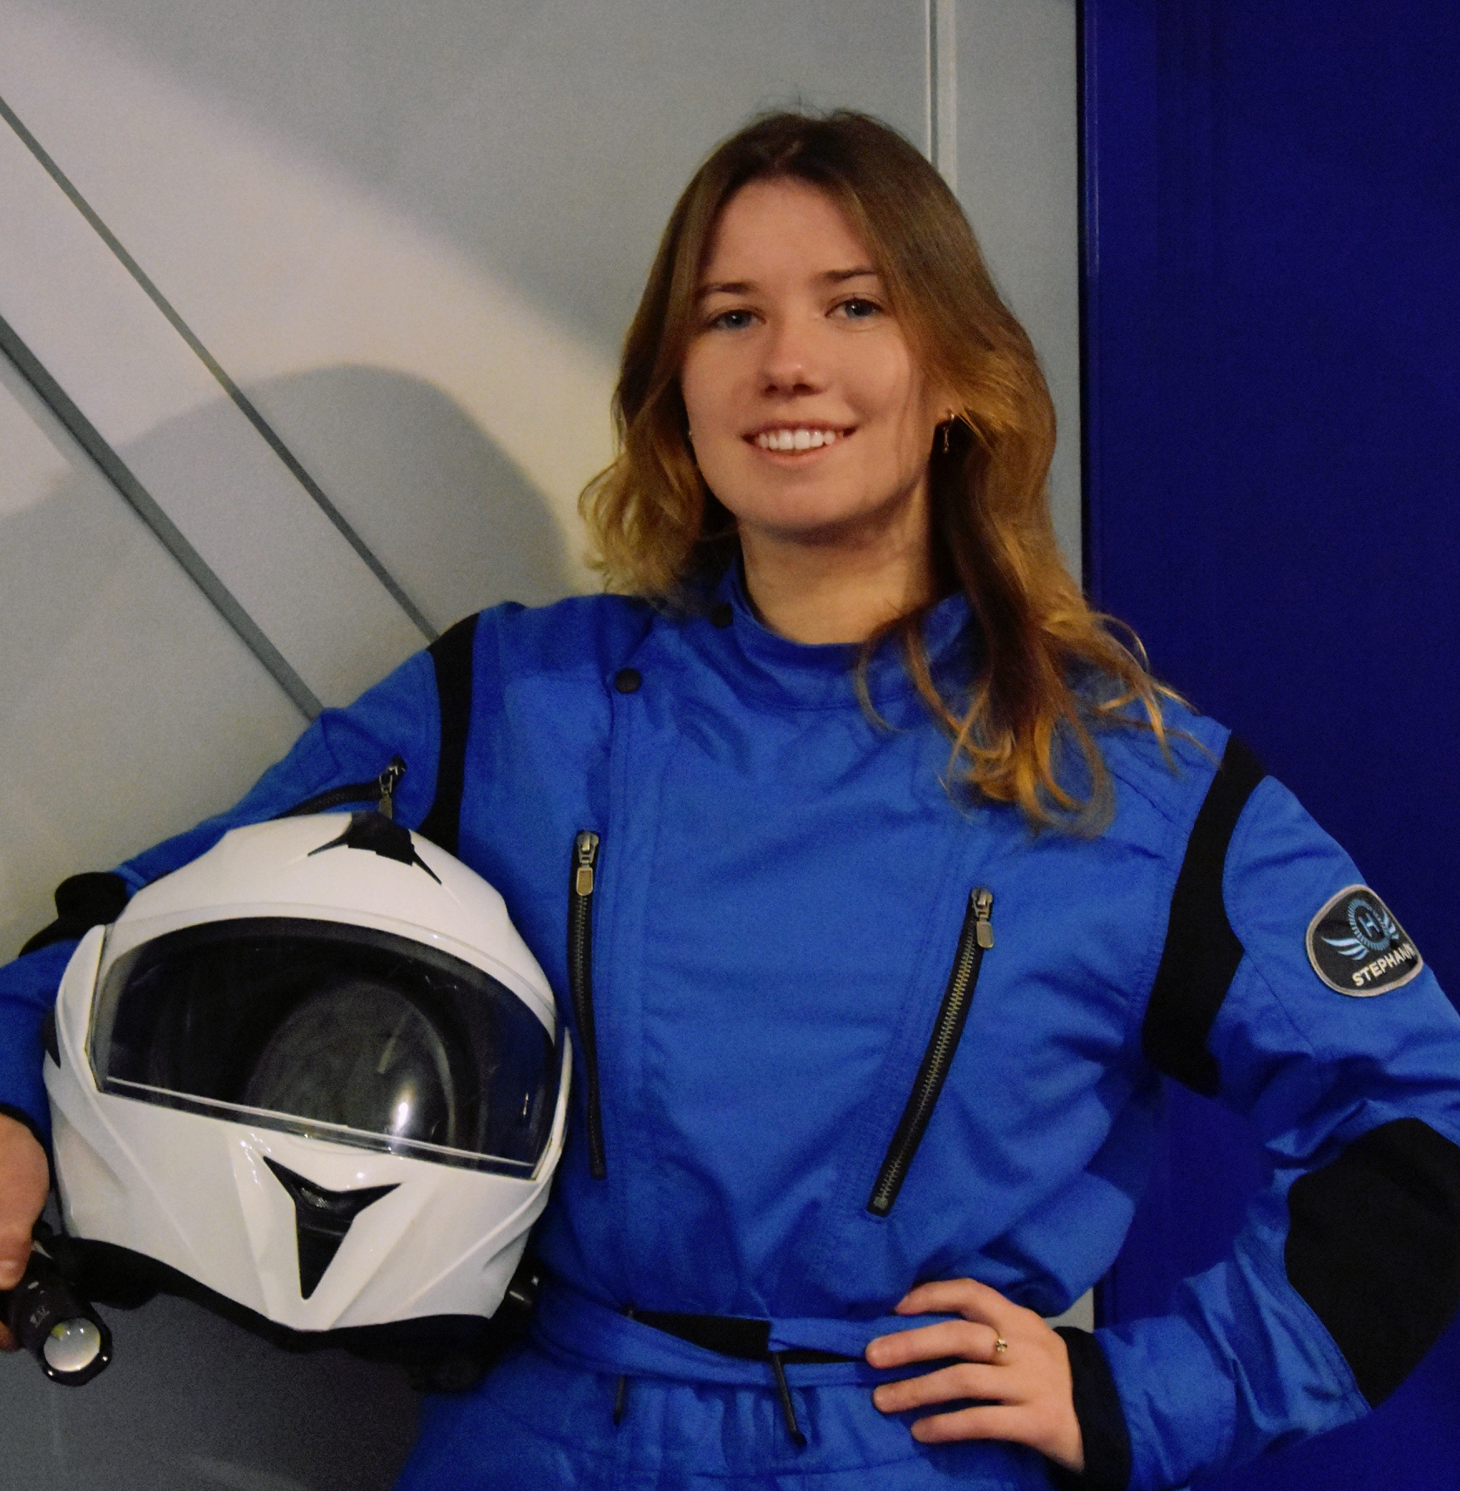
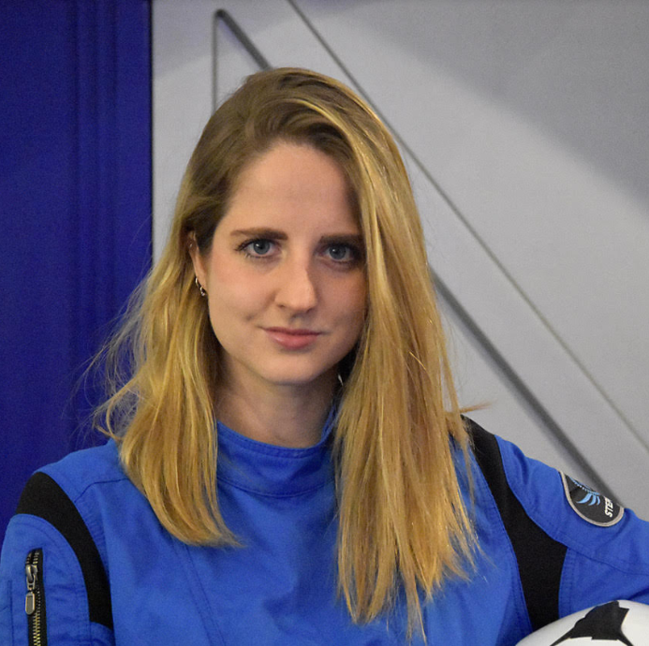
CHILL-ICE core Mission team HEads
Marc Heemskerk
Charlotte Pouwels
Sabrina Kerber
Sub-Surface Operations
Exogeologist
Head of Logistics
Physicist
Communications Officer
Space Architect
marc@chill-ice.com
info@chill-ice.com

Slide 3
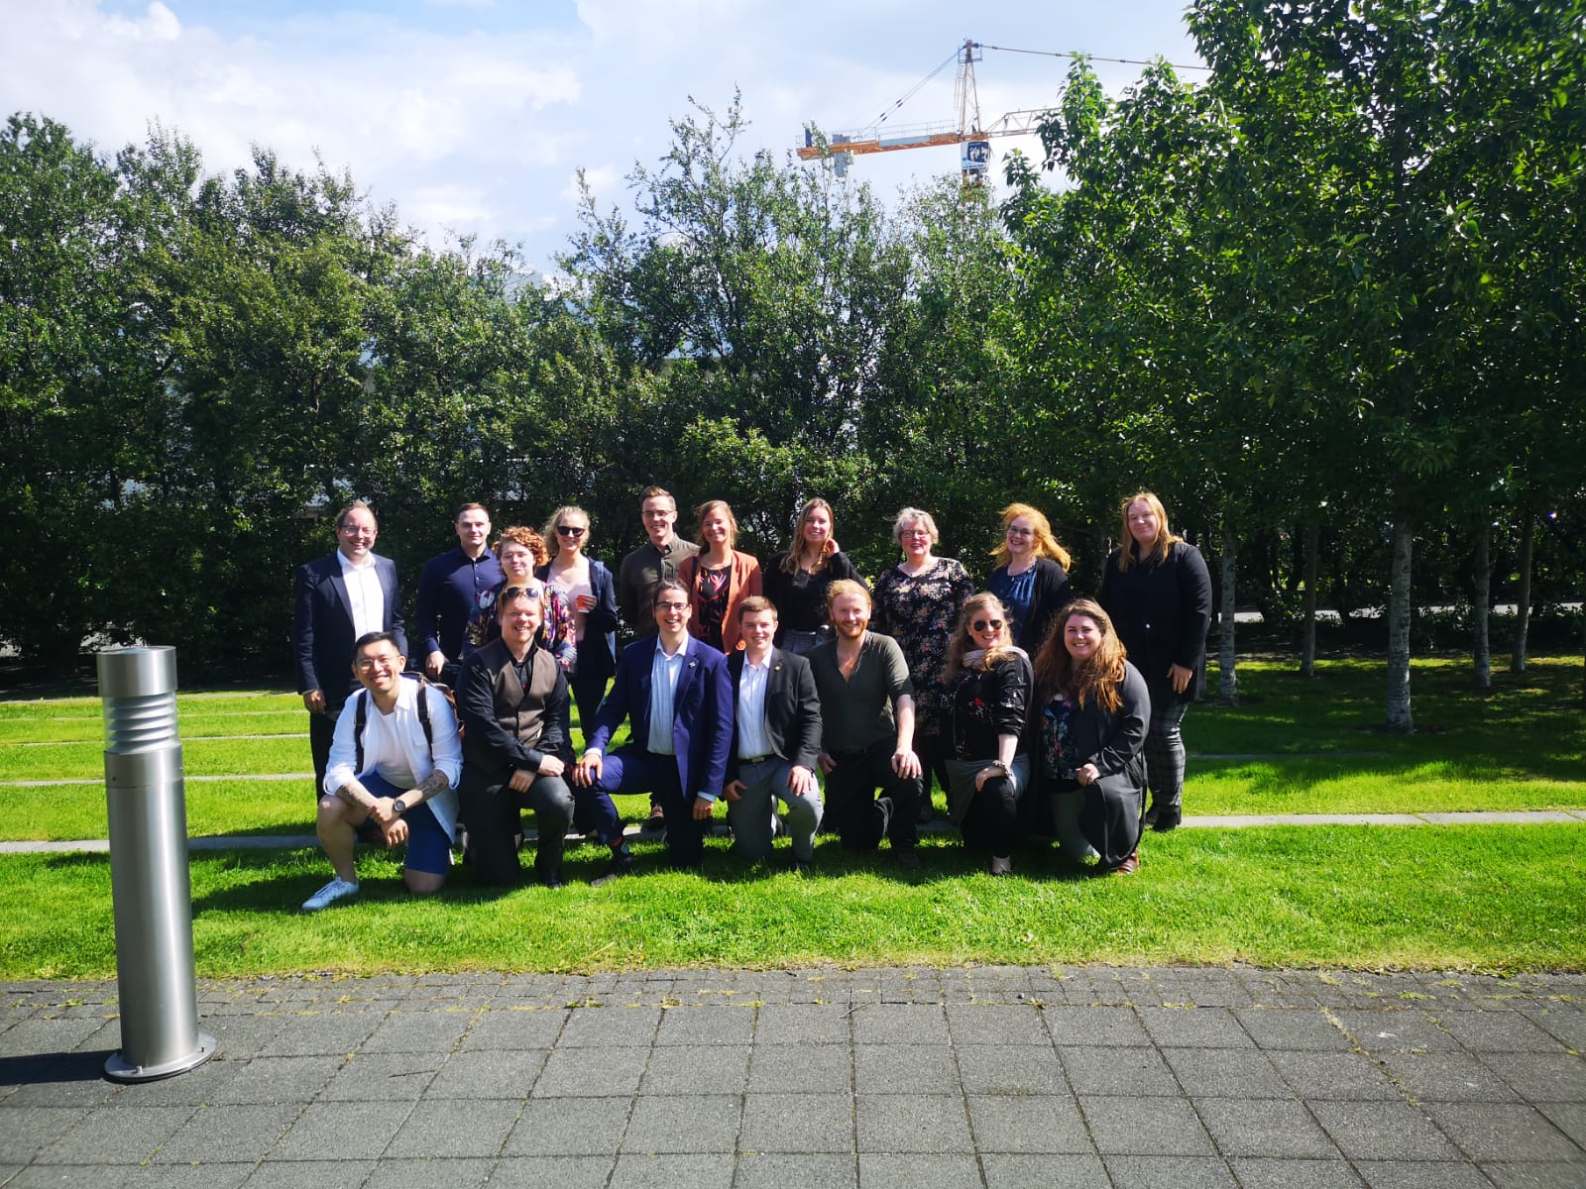
CMT:
Annelotte Weert
Benedetta Cattani
Charlotte Pouwels
Eibhlín Laffan Downes
Esther Konijnenberg
Jamal Ageli
Kevin McGrath
Lilja Ýr Guðmundsdóttir
Marc Heemskerk
Robert Heemskerk
Roberto Landolina
Sabrina Kerber

Slide 4
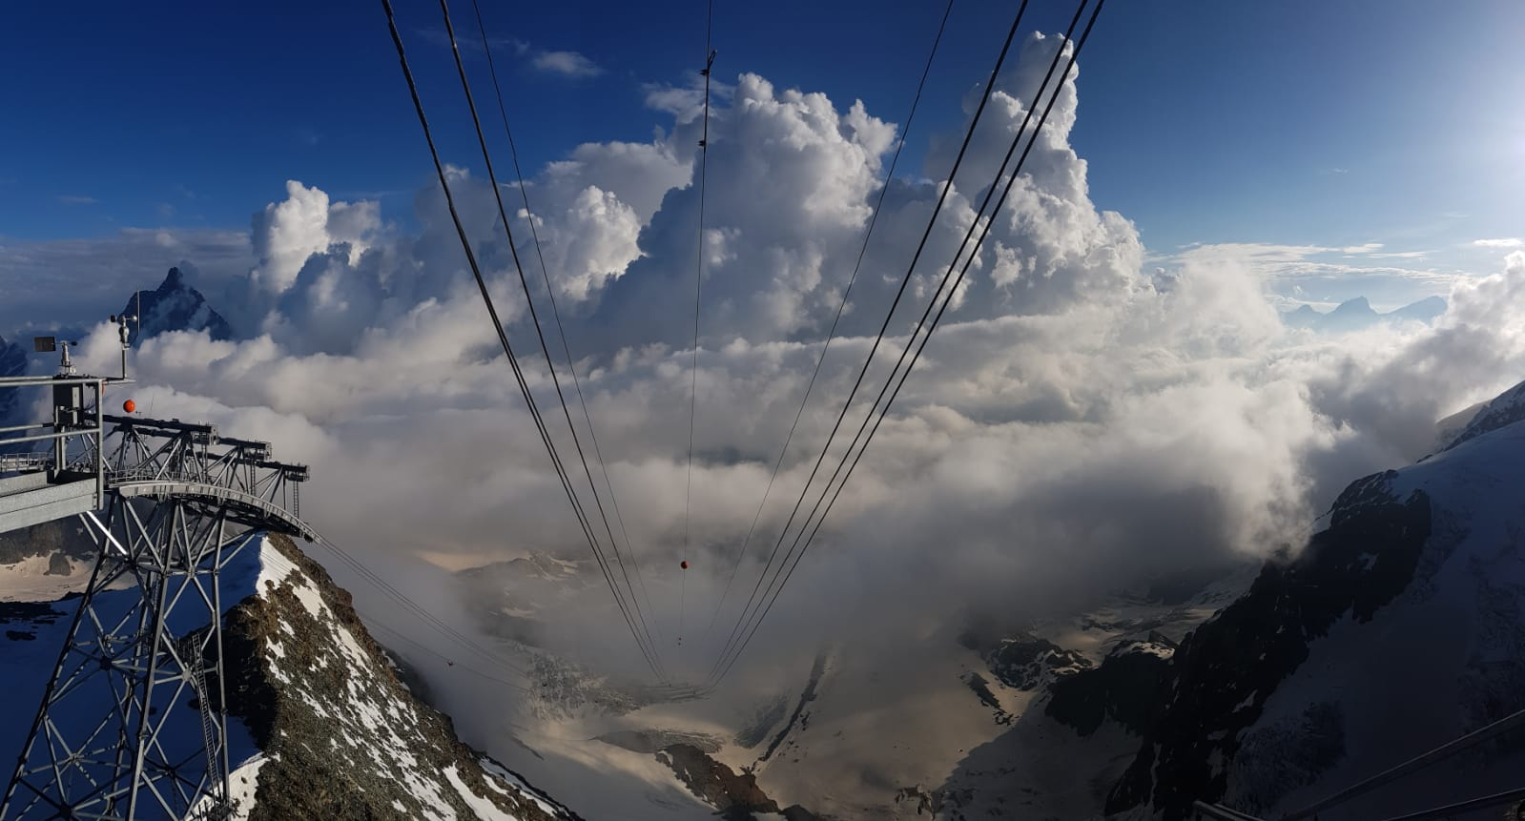
EuroMoonMars

Slide 5
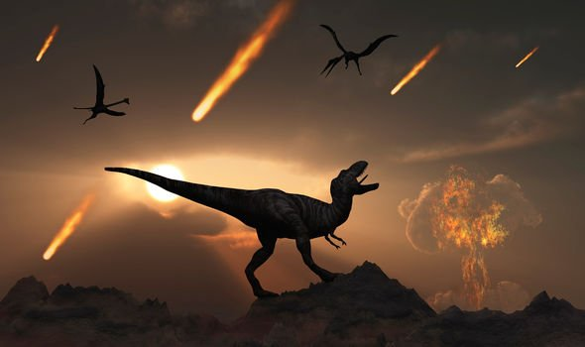
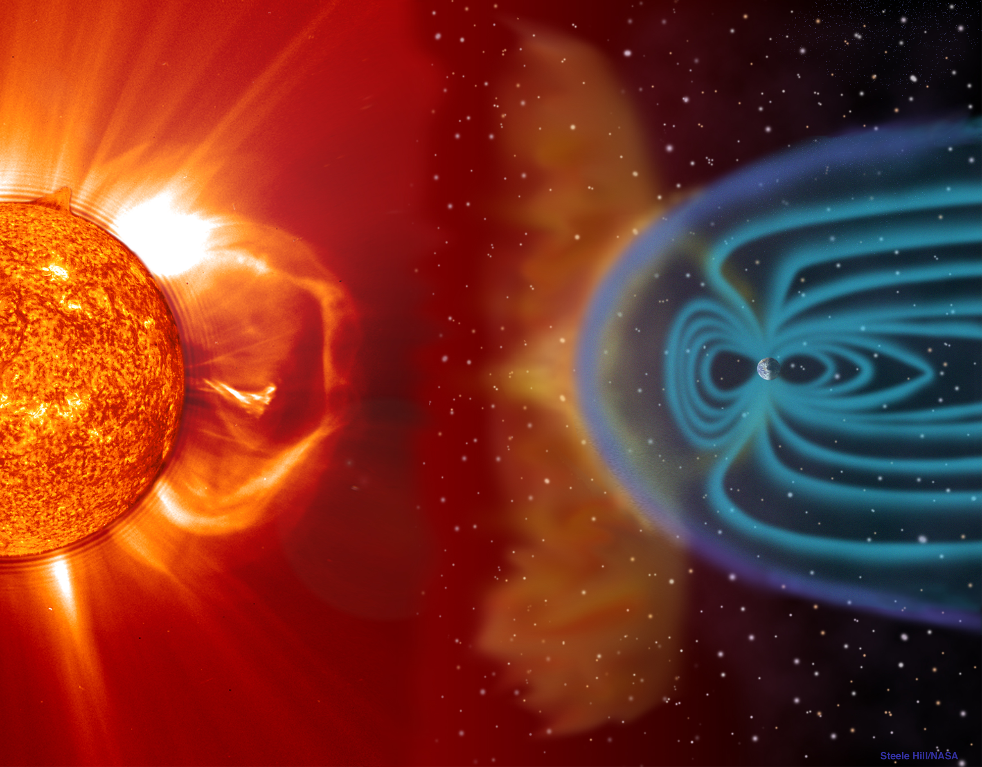
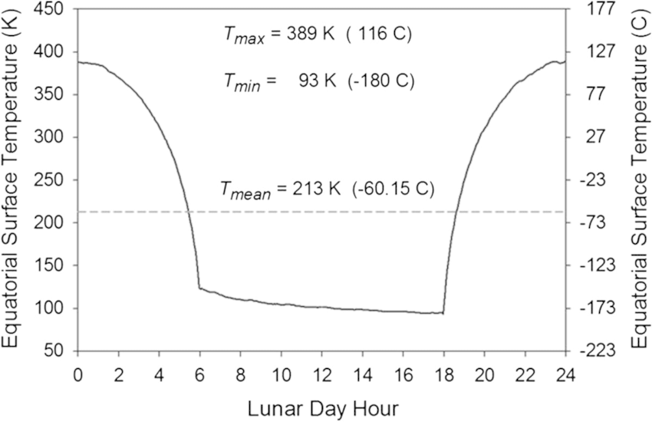
Protection
(Micro)meteorites
Solar activity
Background radiation
Regolith
Thermal insulation
BUT: Costs??
Source: Daily Press
Source: Zeller (2014)
Source: ESA

Slide 6
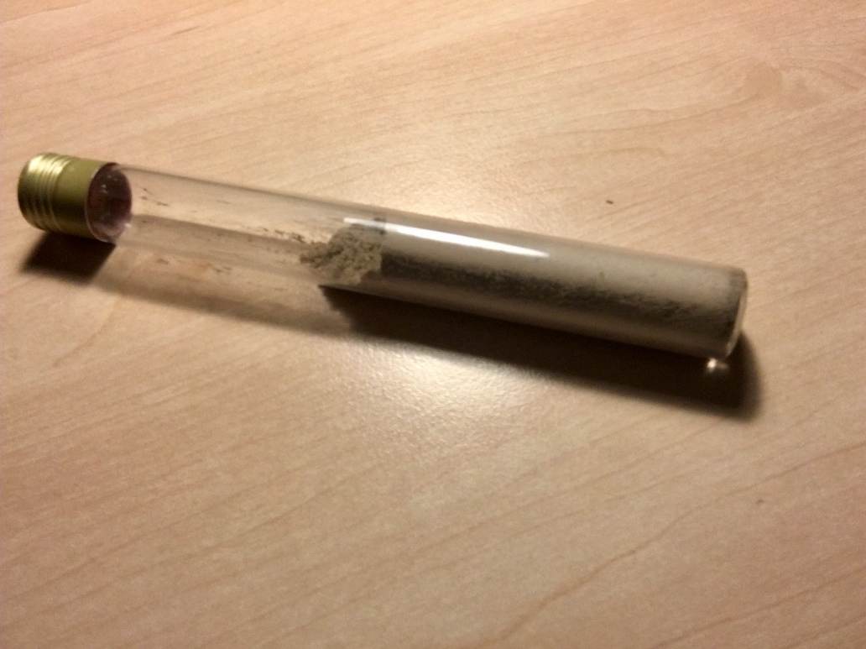
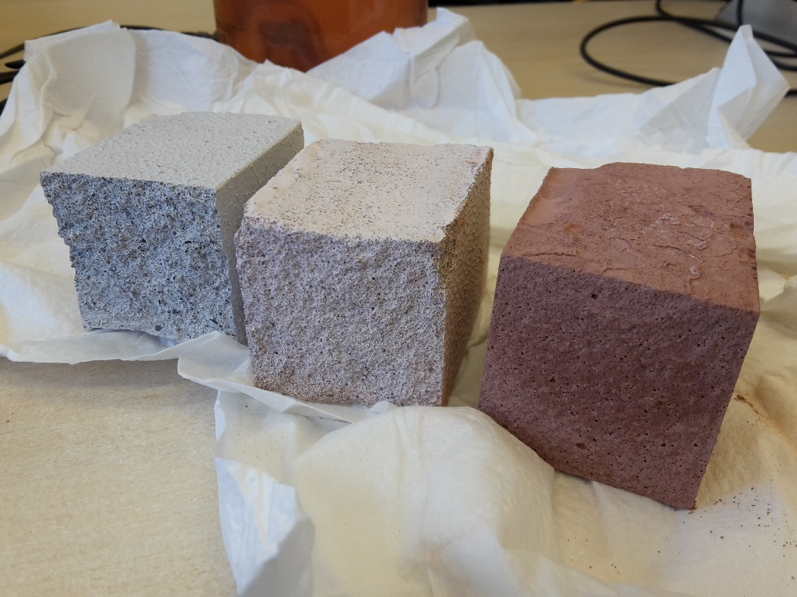
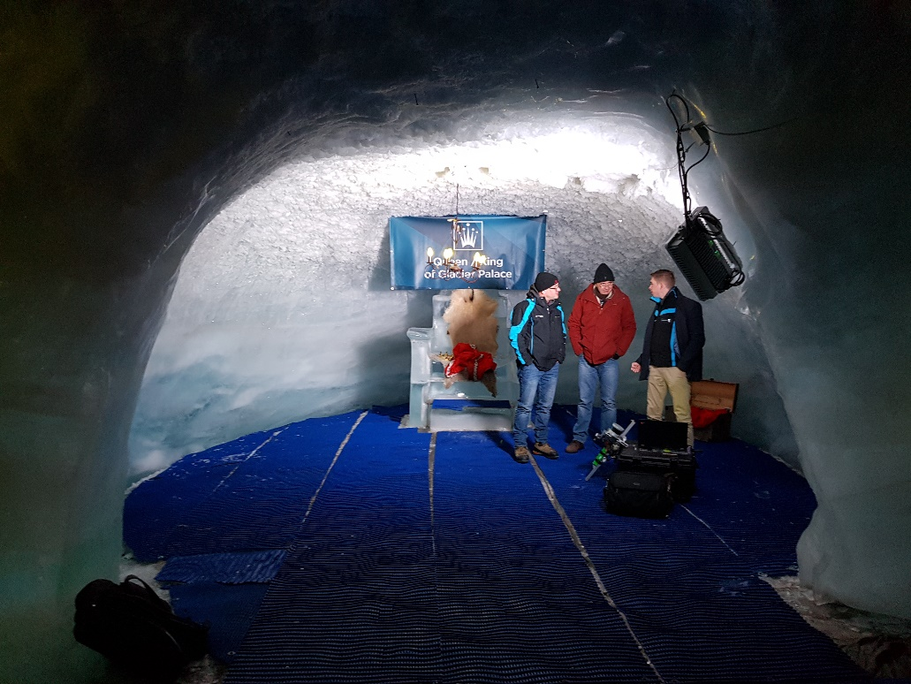
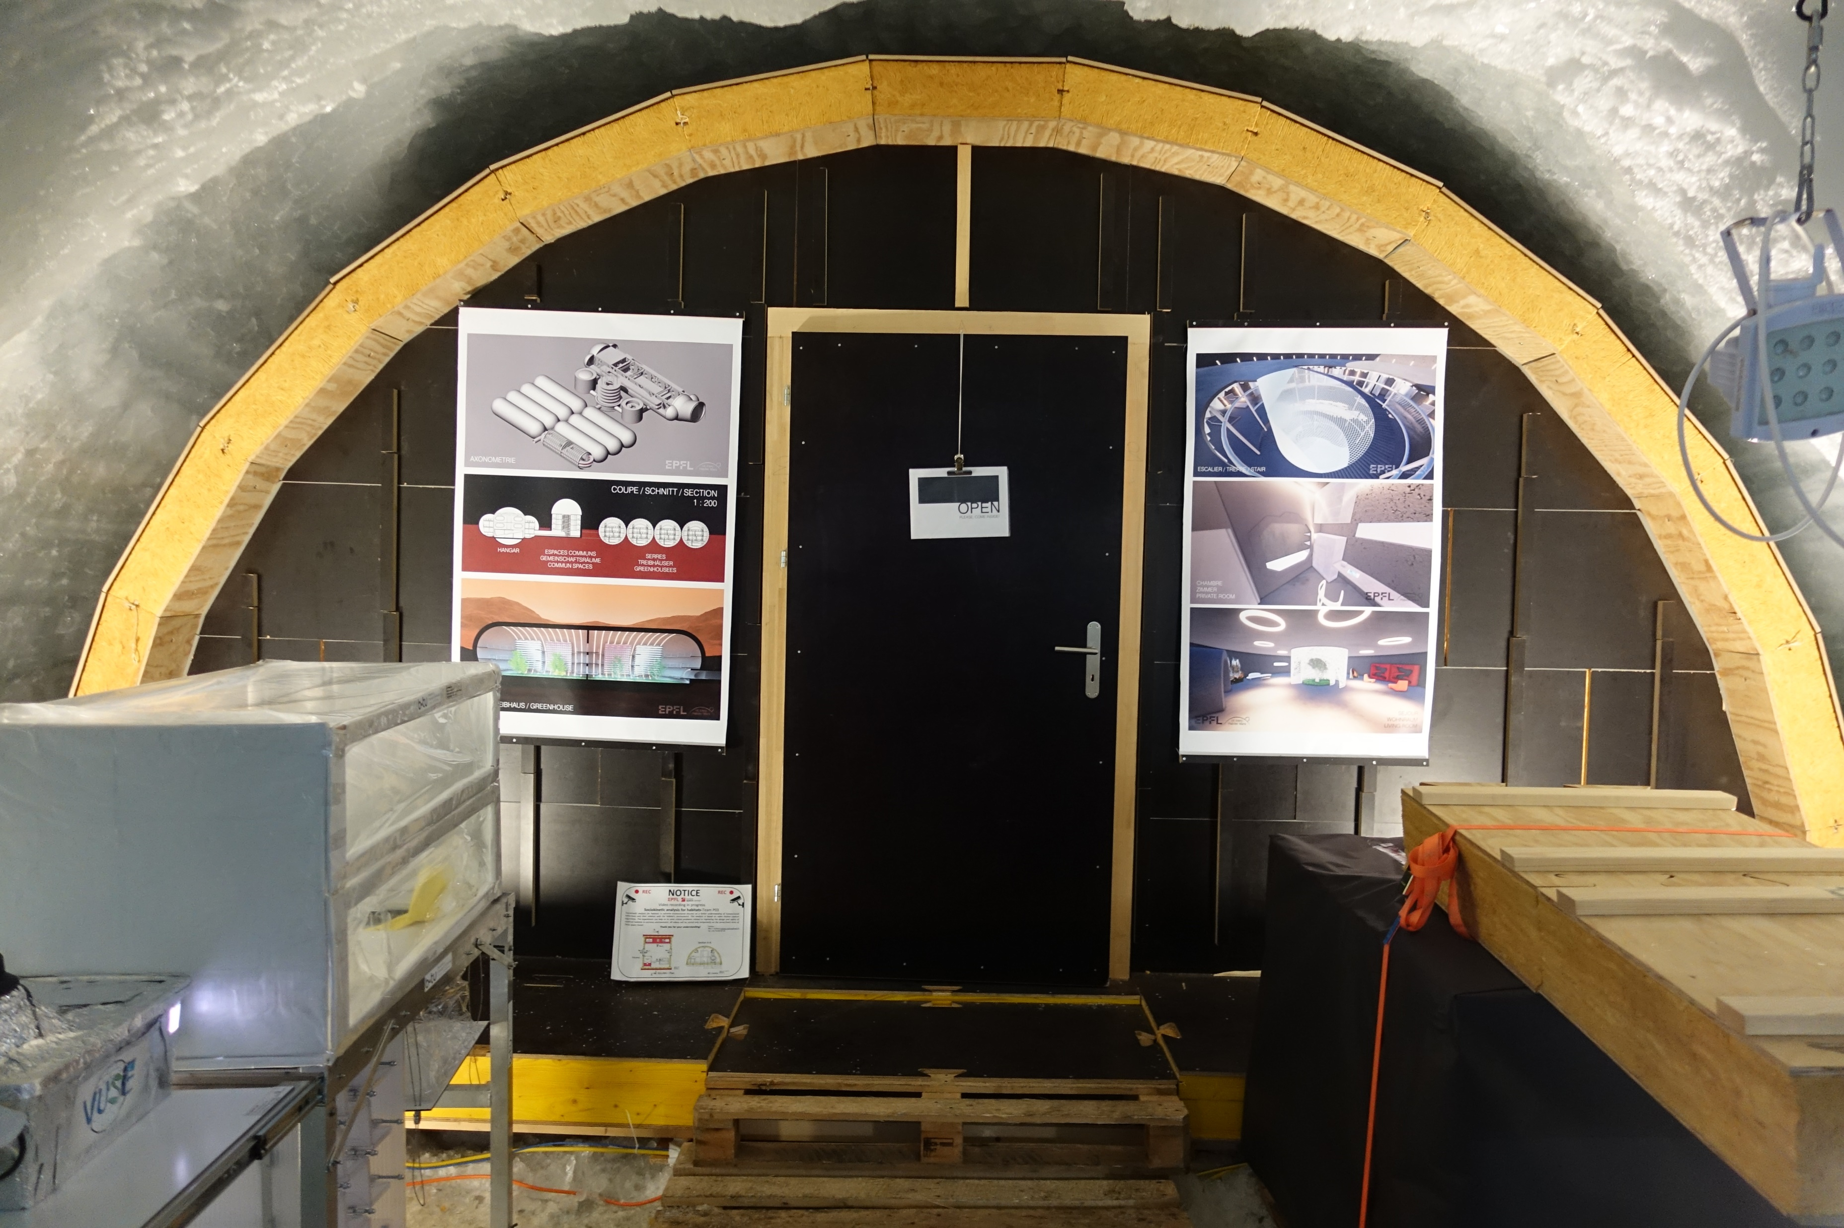
ISRU

Slide 7
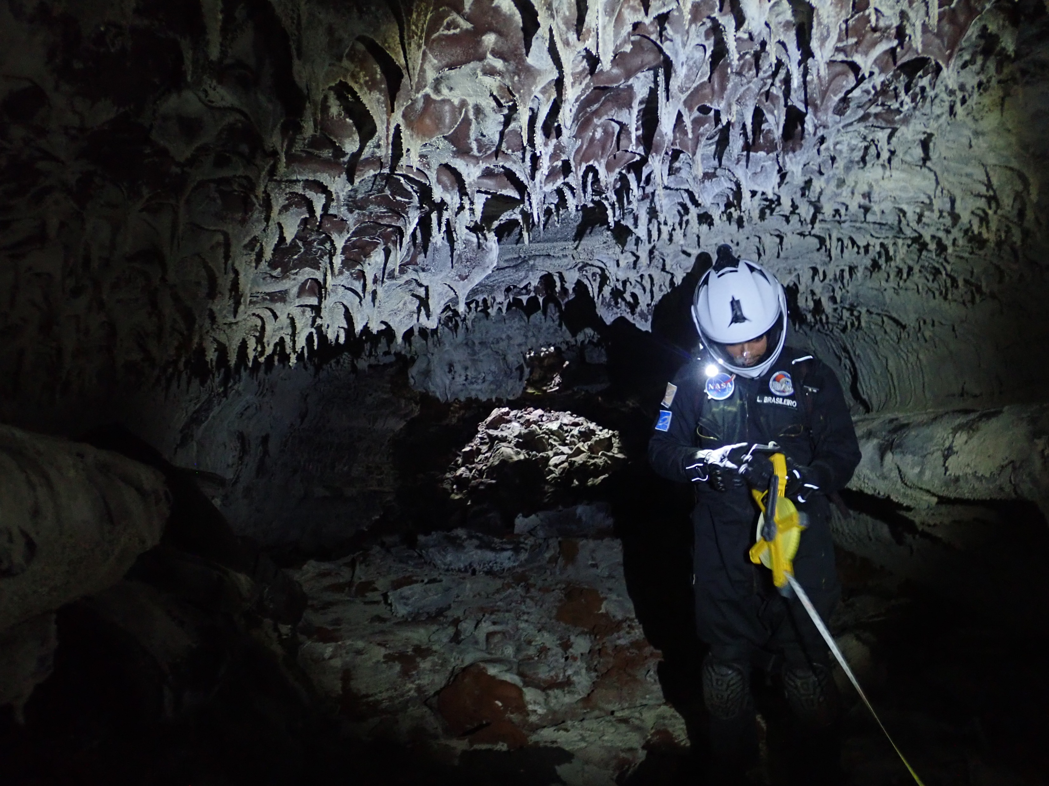
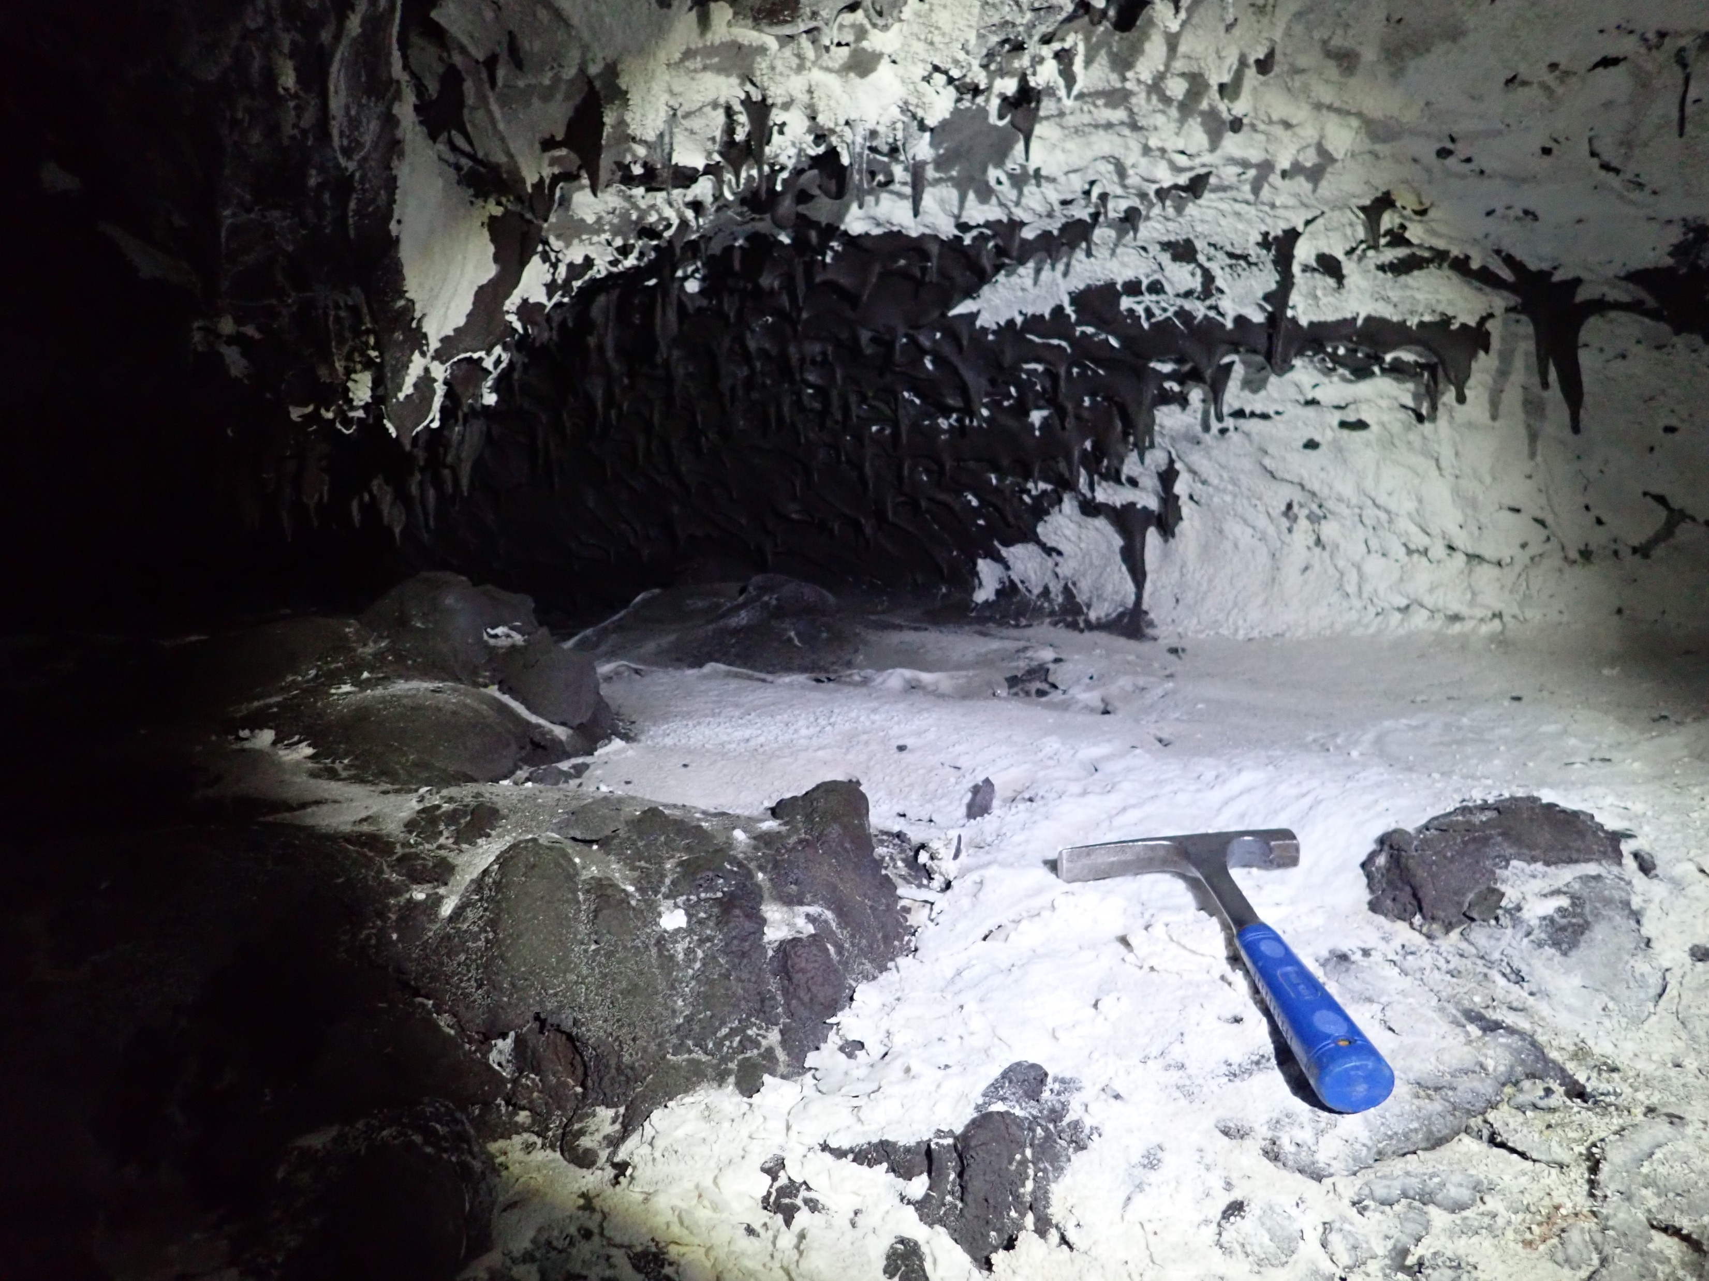
Research!

Slide 8
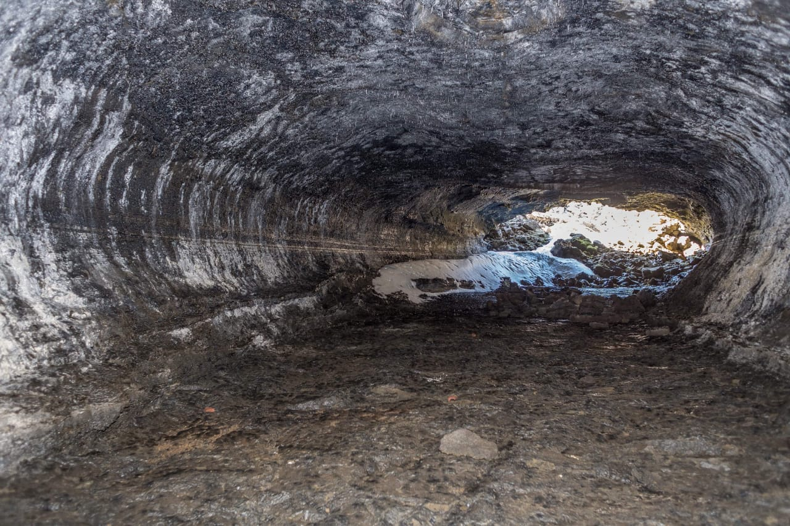

Slide 9
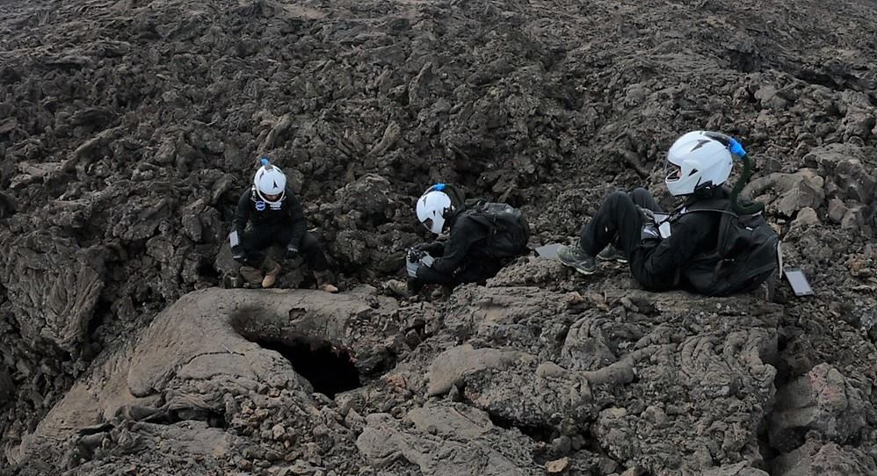
Objectives mission
Discover suitable lava tubes
Conduct research on settlement habitability
Habitat design suitable for lava tubes
International collaborations
CHILL-ICE Mission
  (Planned for May 2021)
  8 hours of oxygen
  Setup habitat inside lava tube
  2 Day mission
  Take down habitat
Research!
  To build a habitat inside a lava tube in 8 hours.

Slide 10
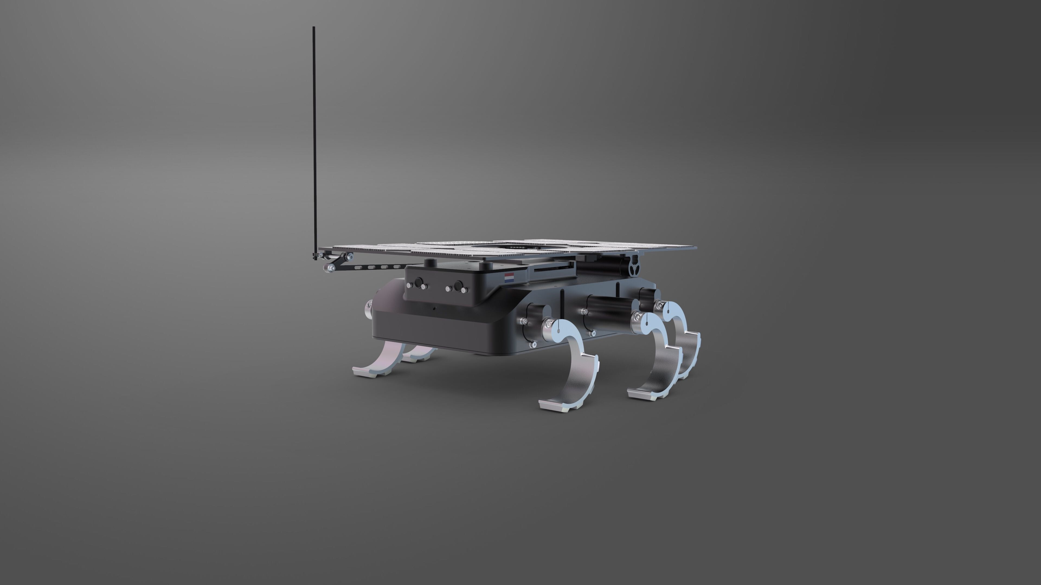
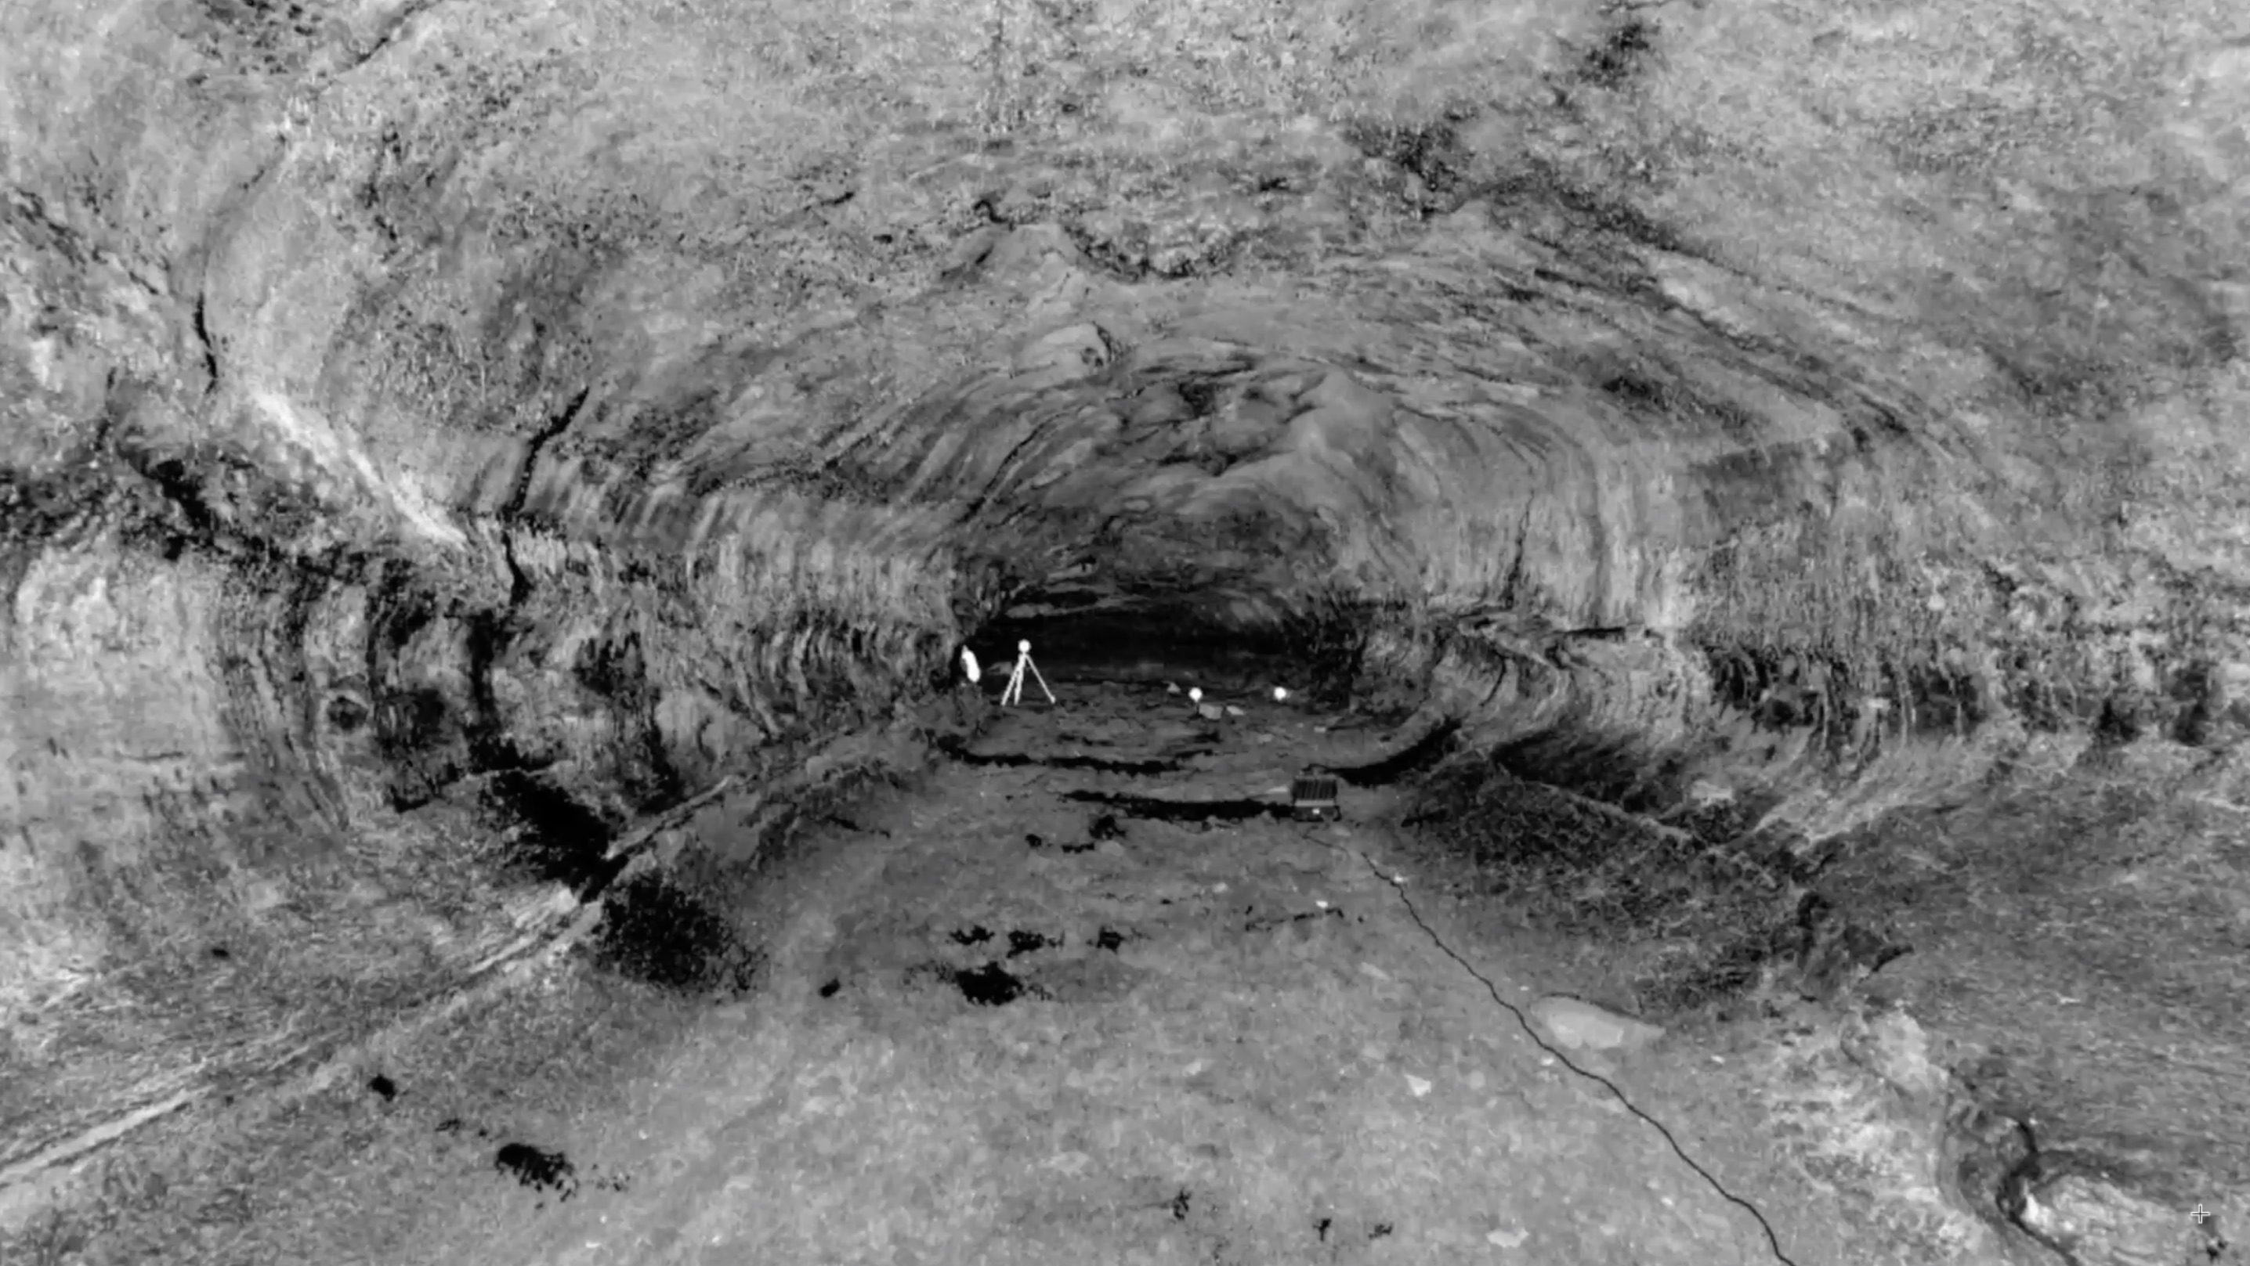
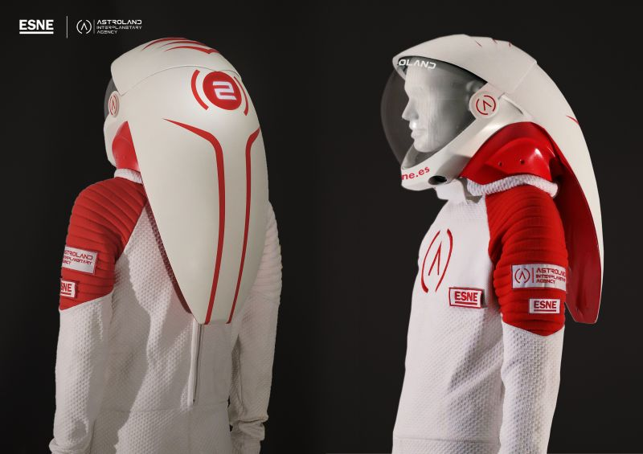
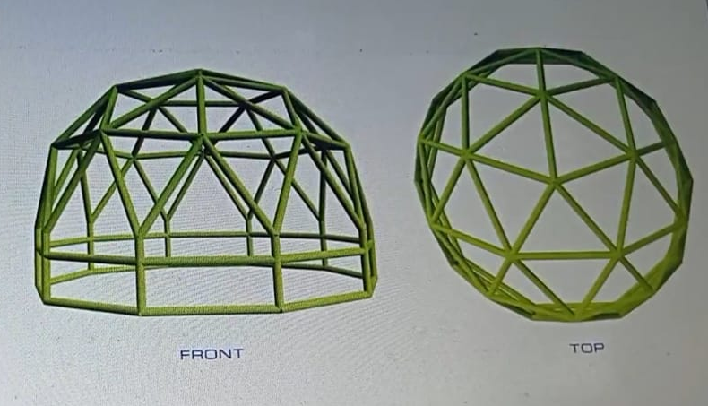
Research objectives:
Lunar Zebro
LiDAR 3D-mapping
Astrobiological research
Tephrostratigraphy (photogrammetry)
Habitat deployment
Suits testing
Psychological wellbeing

Slide 11
CHILL-ICE mission May 2021
Phase 0
2 Day preparation on site.
Phase 1
3 Days of analog astronaut training.
Phase 2a,b
2 Days simulation of habitat setup.
Phase 3a,b
1 Day local outreach
Phase 4
2 Days wrap-up
Phase 5
National outreach and sponsors
Phase 6
Publications of research results
Phase 7
Set-up of a semi-permanent lunar analogue lava tube habitat

Slide 12
THANK YOU!
Kwantlen Polytechnic University
EuroMoonMars
ILEWG
VU Amsterdam
Reykjavik University
Astroland Interplanetary Agency
Icelandic Speleological Society
4th Planet Logistics
Space Iceland
Lyo Food
Lunar Zebro
TU Dublin
TU Delft
…
You!
https://gf.me/u/y7s2yt

Slide 13
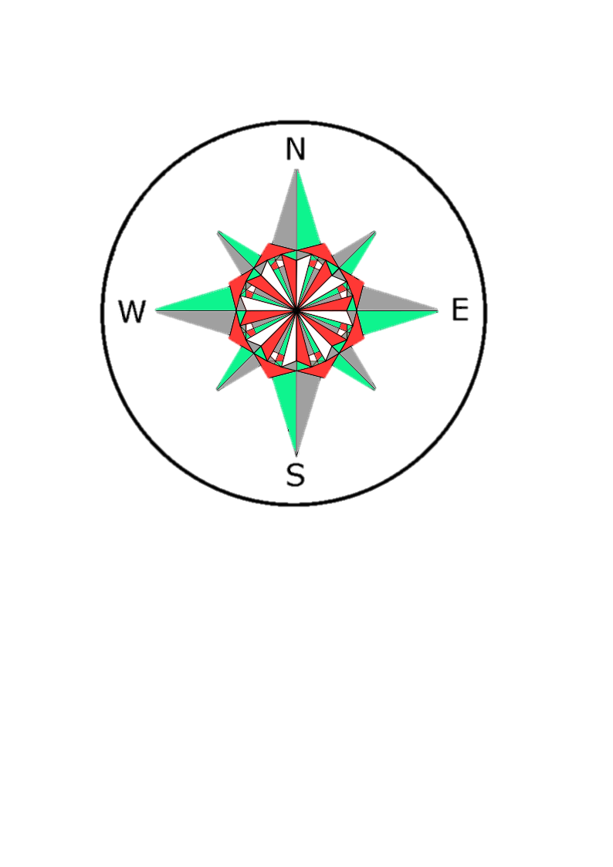




CHILL-ICE: The Mission
Exploration
Technology
Human Wellbeing
Settlement Preparation
Solar System Colonization

Slide 14
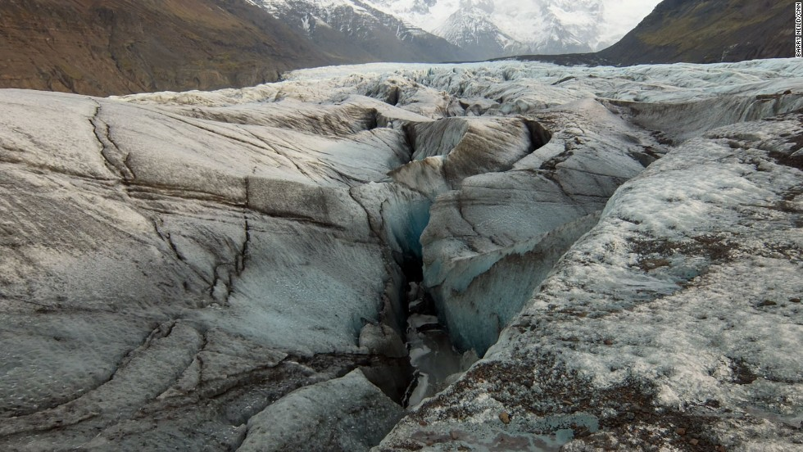
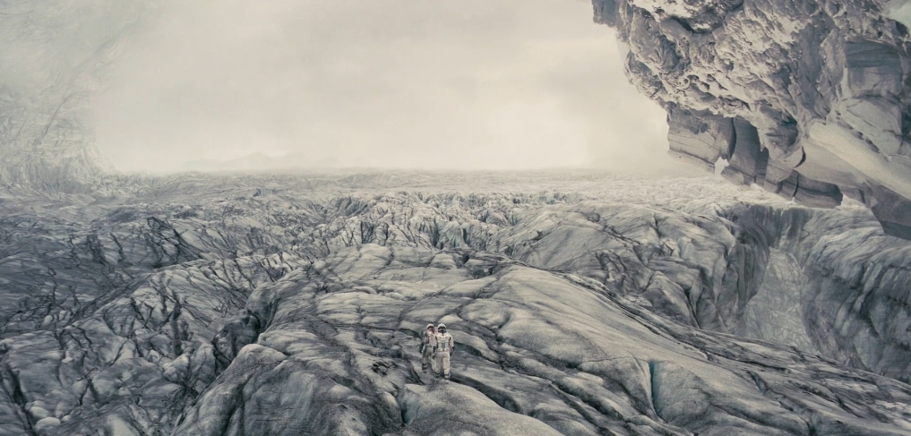
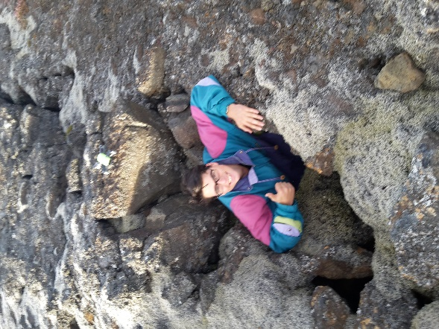
From into the Earth to into the universe

Slide 15
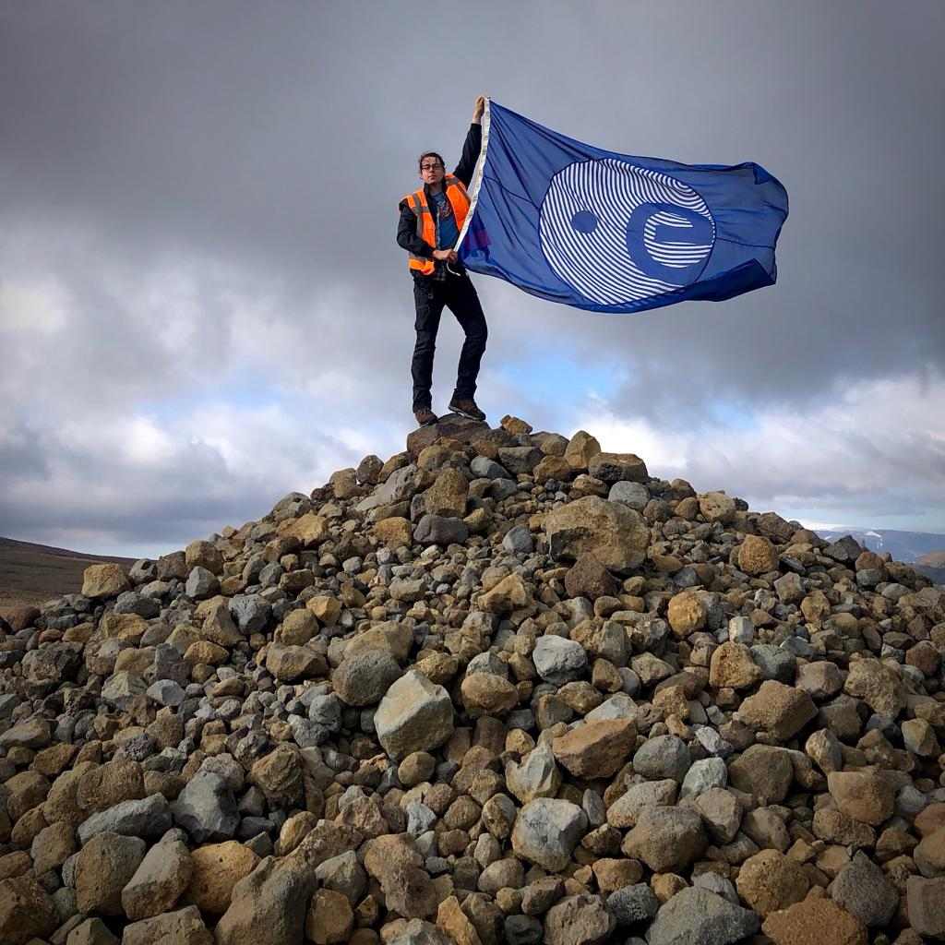
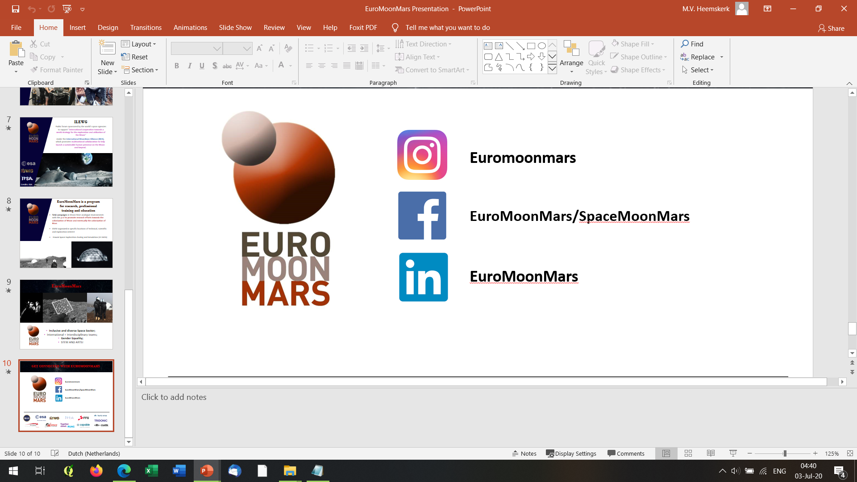
Marc@Chill-ice.com
Source: Daniel Leeb Photography

