Slide 1
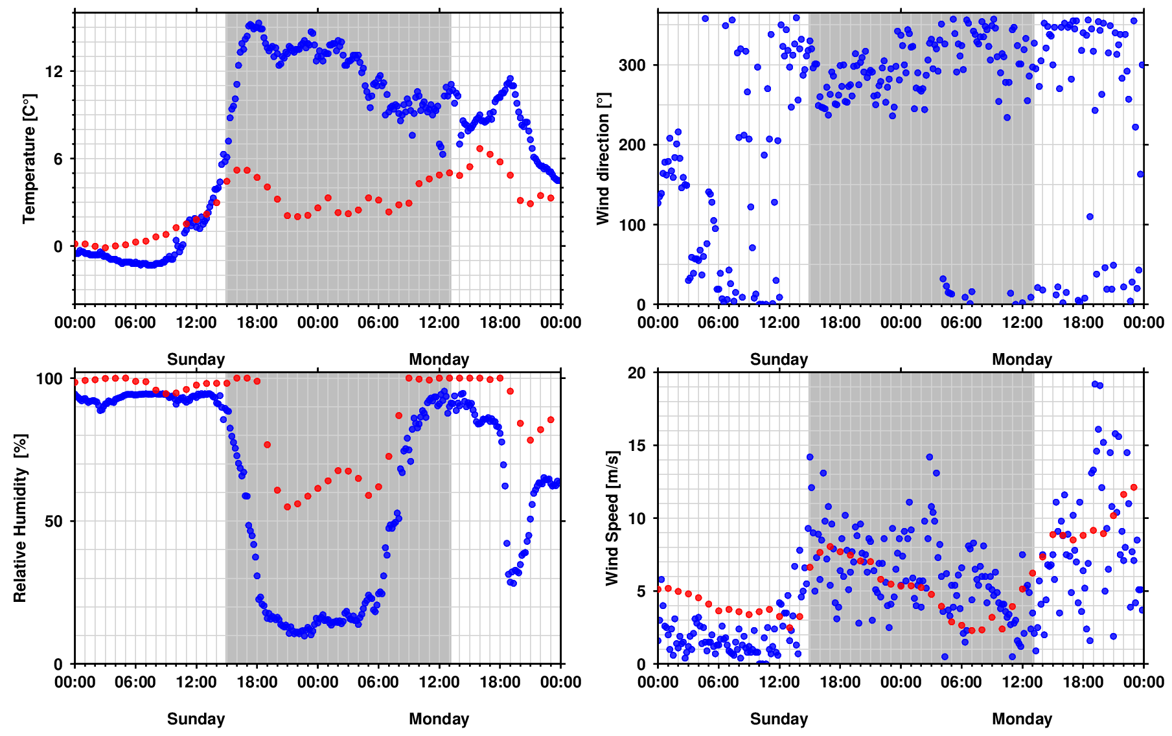
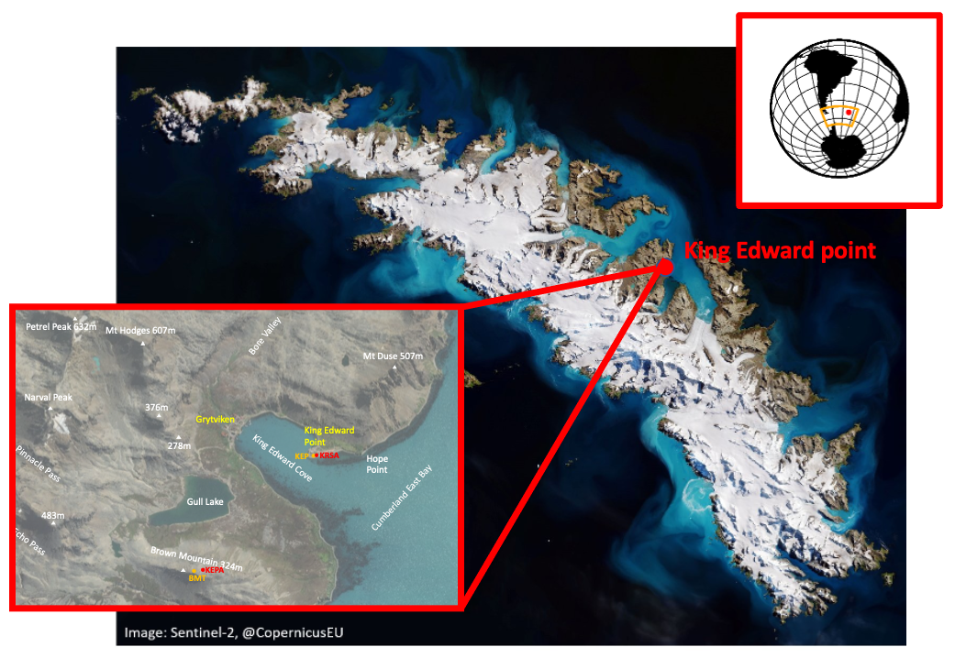
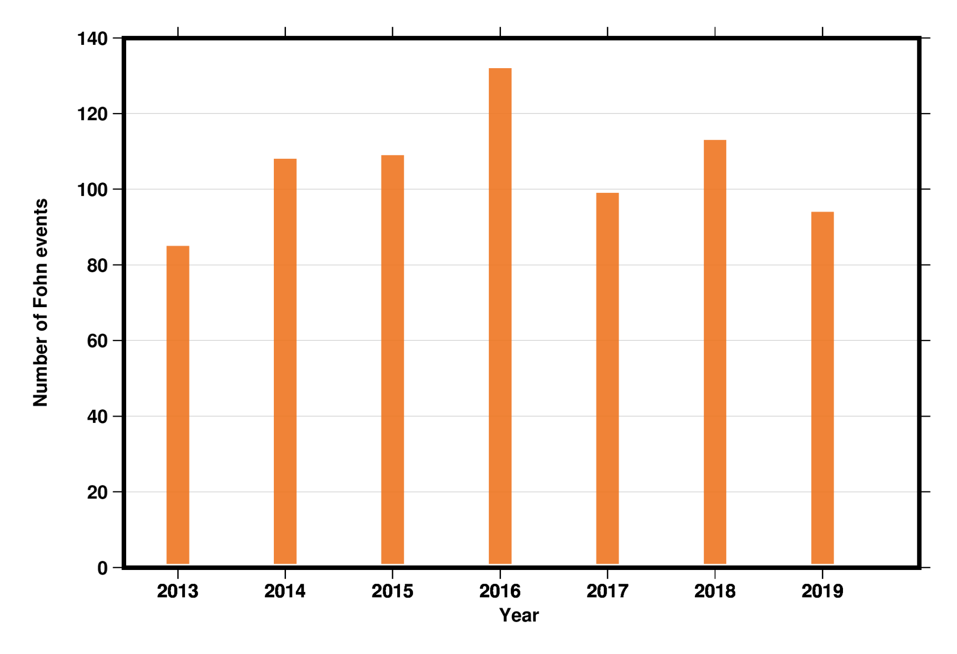
Investigation of Foehn Events on South Georgia Island using Meteorological Surface Data and GNSS Precipitable Water Vapour
E.N. Erkihune¹, F.N. Teferle¹, A. Hunegnaw¹, J. Dousa²
¹ University of Luxembourg, Department of Engineering, Geodesy and Geospatial Engineering, Luxembourg
² Research Institute of Geodesy, Topography and Cartography - Geodetic Observatory Pecný (GOP), Czech Republic
Fig. 2. Brown Mountain observed (blue circles) and modelled (red circles) air temperature, relative humidity, wind direction and wind speed during a Foehn event (grey-shaded region).
Fig. 1. South Georgia Island with King Edward Point and the surrounding area. Imagery from Google Earth.
Abstract ID: EGU21-16200, EGU ID: 572073
Session Date and Time: Thursday, 29 April 2021, 15:42 CEST
Session Number and Title: Session G5.2 - Atmospheric and Environmental Monitoring with Space-Geodetic Techniques
Fig. 3. The yearly number of identified Foehn events

Slide 2
South Georgia Island is a small and isolated island between the South Atlantic and Southern Ocean that is roughly 150 km long and 45 km wide.
South Georgia has a maritime cold oceanic climate characterized by proximity to the Antarctic Polar Front with substantial glaciation covering nearly around 63% of the total surface area of the island.
Fig. 1. South Georgia Island with King Edward Point and the surrounding area. Imagery from Google Earth.
virtual PICO presentation (vPICO) at the virtual EGU General Assembly 2021, 29 April 2021, Session G5.2

Slide 3
Fohen events are warm, dry wind that drops down from high mountainous areas and warms the surface temperature. Consequently, it results in a rapid retreat in the northeast; as shown from the satellite image in the 1st Figure, the North-Eastern part of the island is the only Ice-free area.
There is also a reported glacier retreating that fohen events are potentially responsible for the retreat.
virtual PICO presentation (vPICO) at the virtual EGU General Assembly 2021, 29 April 2021, Session G5.2

Slide 4
We have performed a first investigation of the meteorological surface observations at King Edward Point and Broun Mountain, which is co-located with the GNSS station.
Then compared and identified the onset and cessation of Foehn events from the GNSS stations to those with model values from the ECMWF reanalysis.
Fig. 2. Brown Mountain observed (blue circles) and modelled (red circles) air temperature, relative humidity, wind direction and wind speed during a Foehn event (grey-shaded region).
virtual PICO presentation (vPICO) at the virtual EGU General Assembly 2021, 29 April 2021, Session G5.2

Slide 5
The morning of 30 March 2014 was cold and calm, with relatively high humidity values. The mean temperature, relative humidity, wind speed and wind direction at BMT (up until 090 UTC) was -0.9°C, 90%, 2.5 m/s and 207°, respectively.
Throughout the afternoon of 30 March, the air temperature and wind speed began to increase slowly. At 1430 UTC, a warming event was recorded in the BMT observations, with a 5.3°C rise in temperature within 1 hour, which also coincided with a rapid increase in wind speed (by 4 m/s) and a slight drop in relative humidity (coming a minimum of 78%).
For the foehn study our approach to identify events followed that of Bannister and King (2019).
virtual PICO presentation (vPICO) at the virtual EGU General Assembly 2021, 29 April 2021, Session G5.2

Slide 6
Finally, this study counted the yearly number of identified foehn events (as seen from Fig 3).
Around 100 foehn events per year can be detected in the meteorological observations using our employed method. Statistically, this implies an event every 3-4 days.
Fig. 9. The yearly number of foehn events as identified by the above method recorded at BMT between February 2013 and March 2020 For 2020 only data from January to March were used.
virtual PICO presentation (vPICO) at the virtual EGU General Assembly 2021, 29 April 2021, Session G5.2

Slide 7
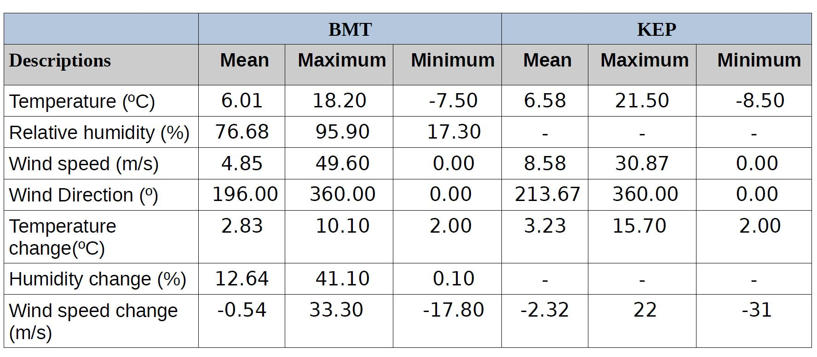
In conclusion, our analysis confirms the existence of warm, dry, and windy conditions at the unobstructed site BMT, which is consistent with the lee-side foehn events reported for KEP.
The case study selected here are captured in the AWS observations at KEP and non-AWS (GNSS) at BMT, and provide a good range of foehn characteristics to optimise and test with the ECMWF model. Each of the two sites foehn event is explored and investigated separately.
Table 1: The statistical conditions of the 772 and 1986 number of observed foehn events at the BMT and KEP stations. All change values shown here are relative to values observed at the time of foehn.
Thank you for your attention!
Contact: eshetu.erkihune@uni.lu
virtual PICO presentation (vPICO) at the virtual EGU General Assembly 2021, 29 April 2021, Session G5.2

Slide 8
Acknowledgments
Dr. Hunegnaw is funded through the Luxembourg Fonds National de la Recherche Project VAPOUR (FNR Ref 12909050).
The authors would like to thank the International GNSS Service community for data and products (Johnston et al., 2017).
virtual PICO presentation (vPICO) at the virtual EGU General Assembly 2021, 29 April 2021, Session G5.2

Slide 9
References
Bannister, D. and J. King (2015). "Föhn winds on South Georgia and their impact on regional climate." Weather 70(11): 324-329.
Bannister, D. and J. C. King (2019). "The characteristics and temporal variability of föhn winds at King Edward Point, South Georgia." International Journal of Climatology n/a(n/a).
Bevis et al. (1994), GPS meteorology: Mapping zenith wet delays onto precipitable water, Journal of applied meteorology 33(3), 379{386.
Bock et al. (2007), Comparison of ground-based GPS precipitable water vapour to independent observations and NWP model reanalyses over Africa: PRECIPITABLE WATER VAPOUR DATA OVER AFRICA, 133(629), 2011{2027.
Boehm et al. (2006), Troposphere mapping functions for GPS and very long baseline interferometry from European Centre for Medium-Range Weather Forecasts operational analysis data: TROPOSPHERE MAPPING FUNCTIONS FROM ECMWF', JGR:111(B2). 10.1029/2005JB003629.
Dach et al. (2015), Bernese GNSS Software Version 5.2 User Manual, University of Bern.
Ejigu et al. (2020), Tracking Hurricane Harvey using GPS tropospheric products.
Hosking, J. S., D. Bannister, A. Orr, J. King, E. Young and T. Phillips (2015). "Orographic disturbances of surface winds over the shelf waters adjacent to South Georgia." Atmospheric Science Letters 16(1): 50-55.
Johnston et al. (2017), The International GNSS Service. 10.1007/978-3-319-42928-1_33.
Shanklin, J., C. Moore and S. Colwell (2009). "Meteorological observing and climate in the British Antarctic Territory and South Georgia: Part 1." Weather 64(5): 127-134.
Thomas et al. (2018), A New Daily Observational Record from Grytviken, South Georgia: Exploring Twentieth-Century Extremes in the South Atlantic, 31(5), 1743{1755.
Vosper, S. B., A. R. Brown and S. Webster (2016). "Orographic drag on islands in the NWP mountain grey zone." Quarterly Journal of the Royal Meteorological Society 142(701): 3128-3137.
virtual PICO presentation (vPICO) at the virtual EGU General Assembly 2021, 29 April 2021, Session G5.2

