Slide 1


Topographic amplification of crustal subsidence by the rainwater load of the 2018 heavy rain in SW Japan
Syachrul Arief1,Kosuke Heki2
1.Geospatial Information Authority, Indonesia
2.Hokkaido Univ., Sapporo, Japan

Slide 2
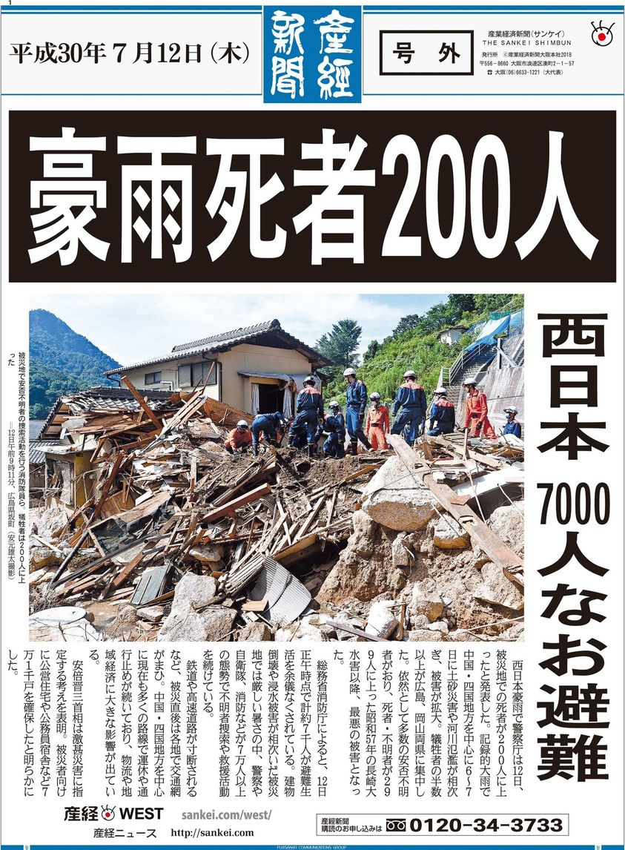
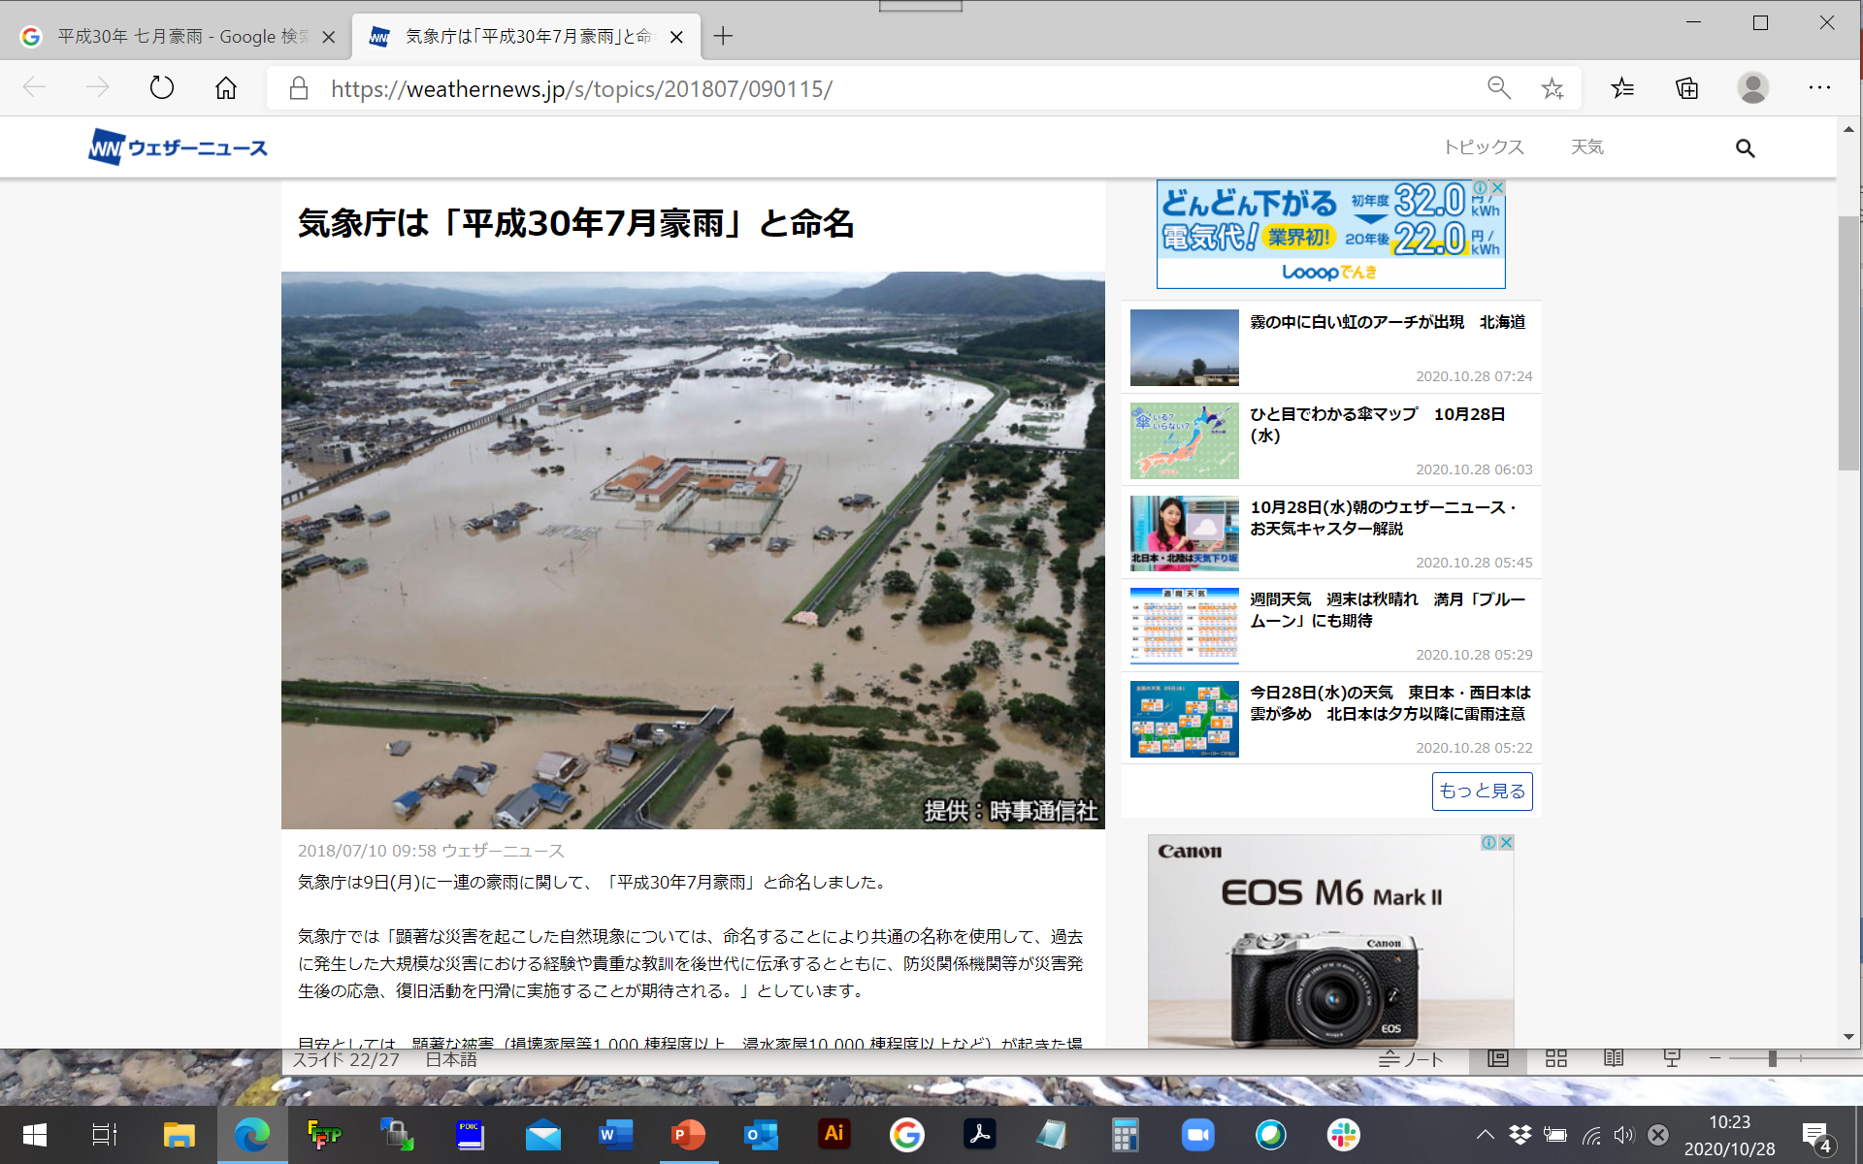
Disastrous rain hits SW Japan every summer
2018 Episode

Slide 3
Three different stages of vertical crustal movements by rain
Stage 1: Atmosphere
Uplift by negative load
Stage 2 : Stormwater
Subsidence by positive load
Stage 3 : Groundwater
Poro-elastic uplift
1 hPa = 1 cm water
1 hPa = 1 cm water
Significant only for typhoon
Difficult to model

Slide 4
Data used in this study
1. AMeDAS hourly/daily rain gauge data
www.jma.go.jp
2. GEONET F5 daily vertical coordinates
terras.gsi.go.jp + common mode error removal
3. River water level data
www1.river.go.jp

Slide 5
Removing the common mode errors from the F5 solution
z
z
z
Observed
Observed adjusted to reference by Helmert transformation
y
y
y
subsidence
x
x
x
Reference
Reference
Reference
F5 solution much better than F3 solution (less common mode errors), see Zhan et al. (submitted)

Slide 6
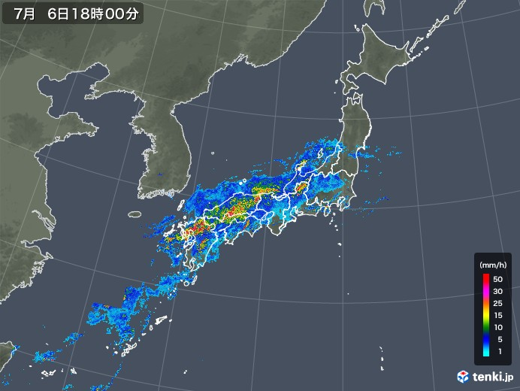
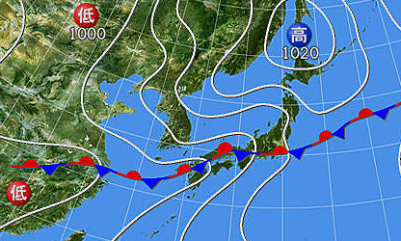
2018 Jul. 6 9:00UT
Hourly precipitation by rain gauges
2018 Jul. 2-9 平成３０年７月豪雨 61.4 Gt
Bai-u front
2018 Jul. 6 9:00UT

Slide 7
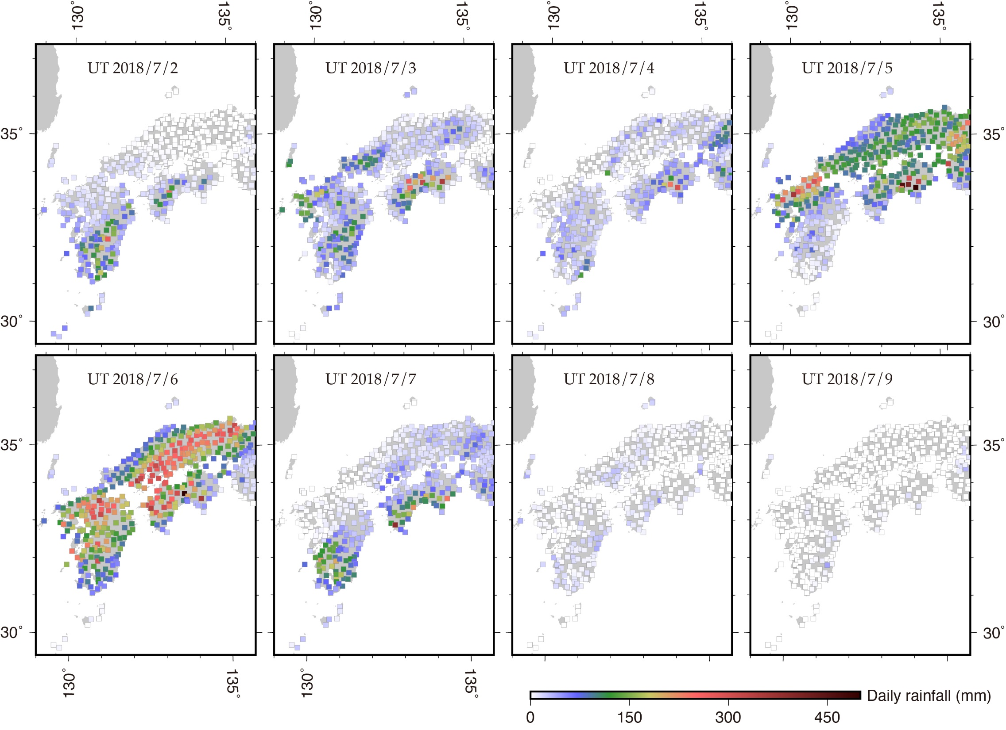
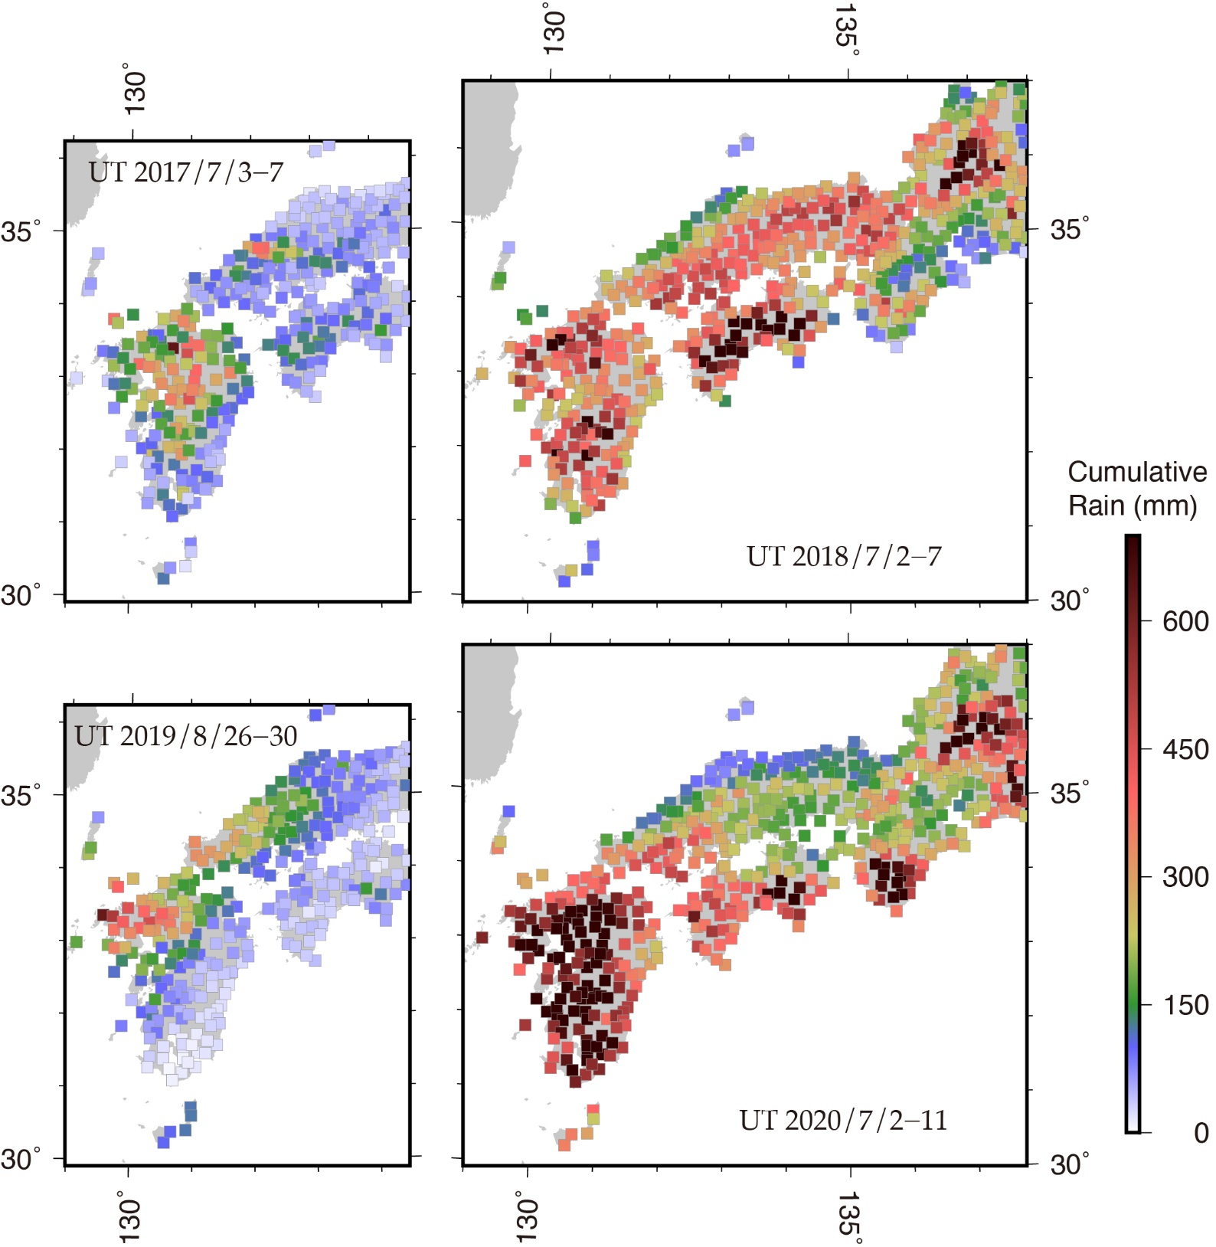
Rain in 2018
Whole SWJ
3.3 Gt
6.7 Gt
5.2 Gt
16.8 Gt
Total 61.4 Gt
21.7 Gt
7.5 Gt
0.7 Gt
0.1 Gt

Slide 8
Daily vertical position by GEONET GNSS
2018 Jul. 2-9 平成３０年７月豪雨
GEONET GNSS stations

Slide 9
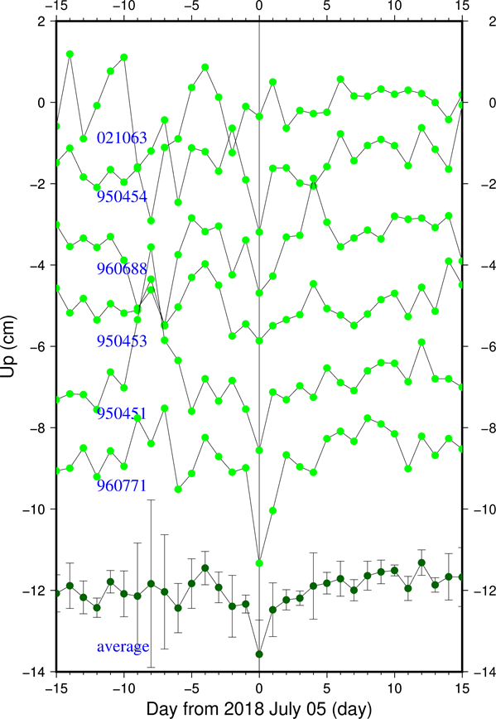
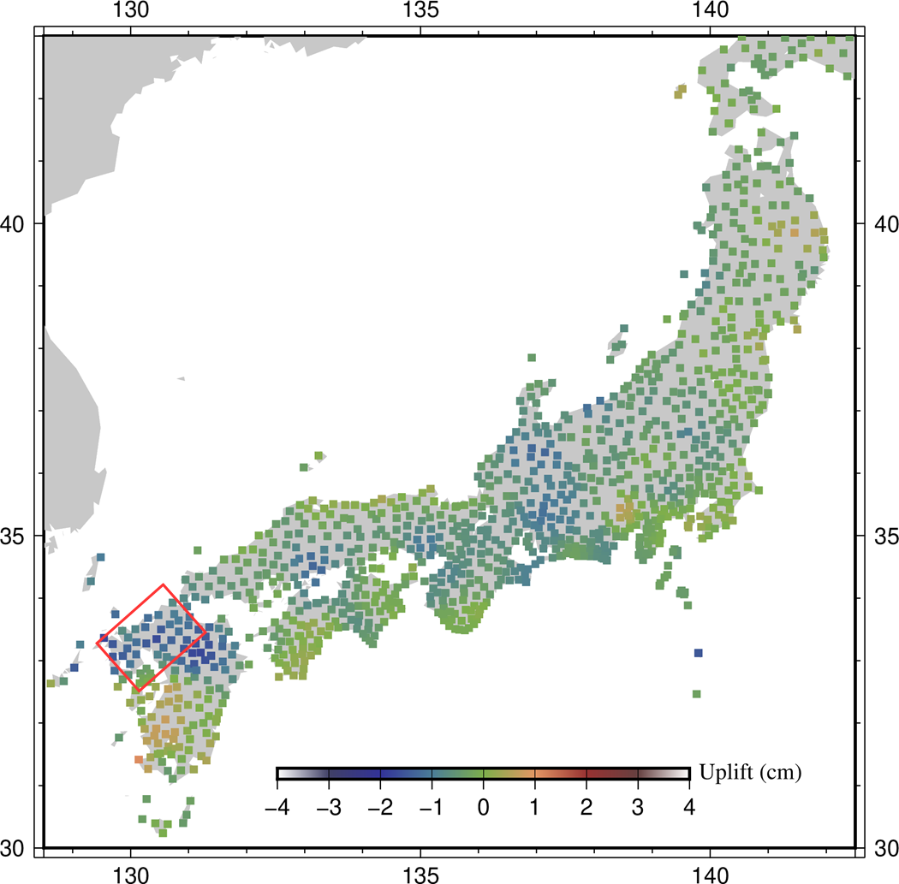
Analysis of station position change
Subsidence on 2018 Jul.5 by Heavy rain water load
Spatial smoothing applied
Jul.5 2018
1 hPa = 1 cm water
Stage 2 dominant?
Network filter applied to remove translation, rotation, scale errors
Day from Jul.5 2018

Slide 10
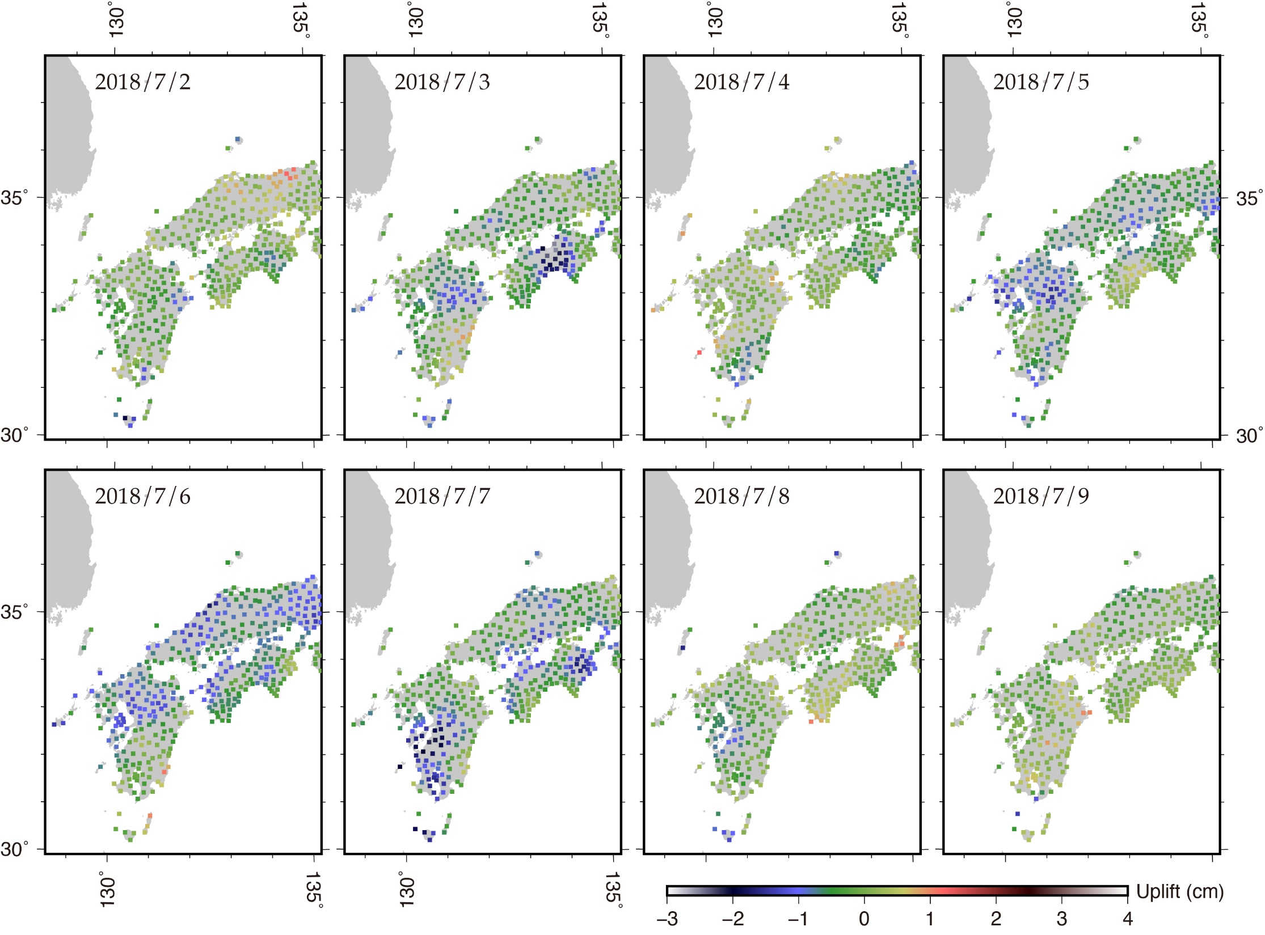

Subsidence in 2018

Slide 11
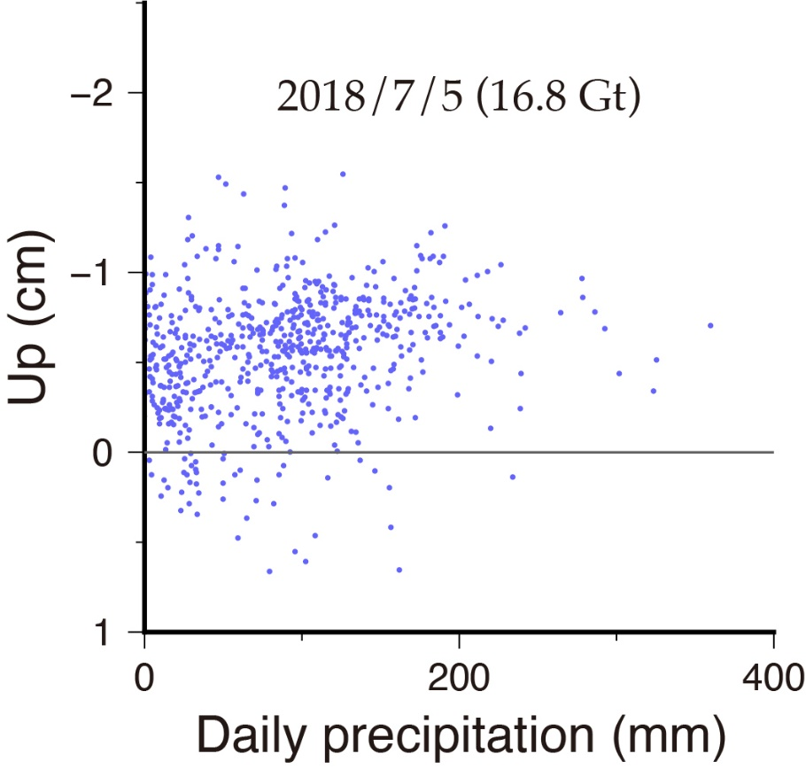
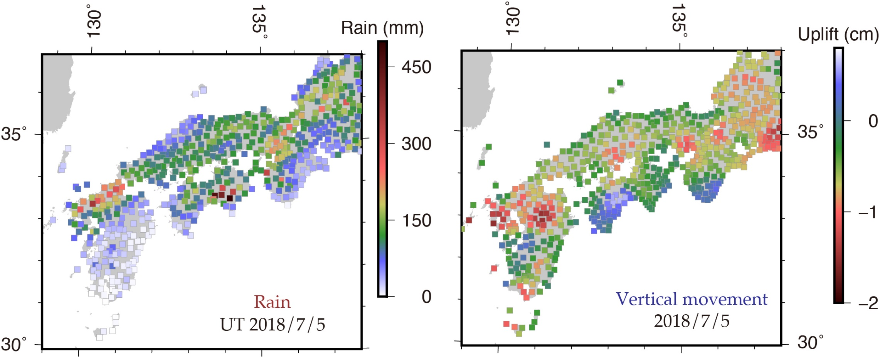
Multi GNSS sites vs nearby rain gauges –2018 July 5
Correlation not so high as expected

Slide 12
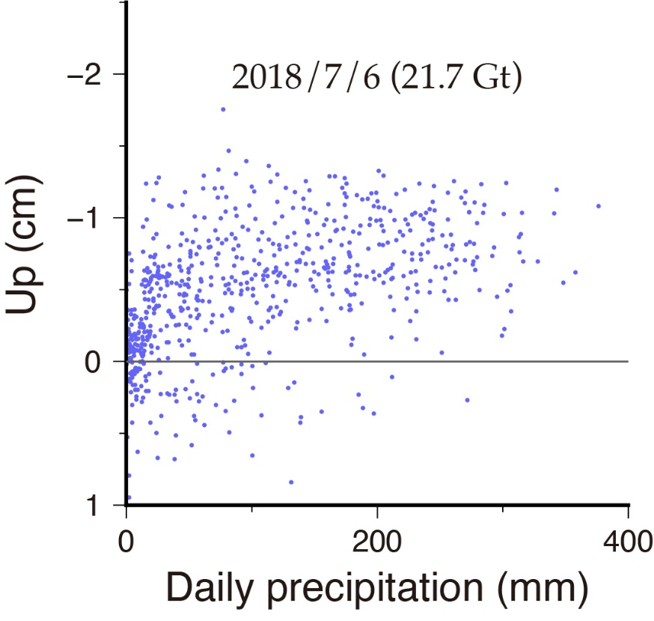
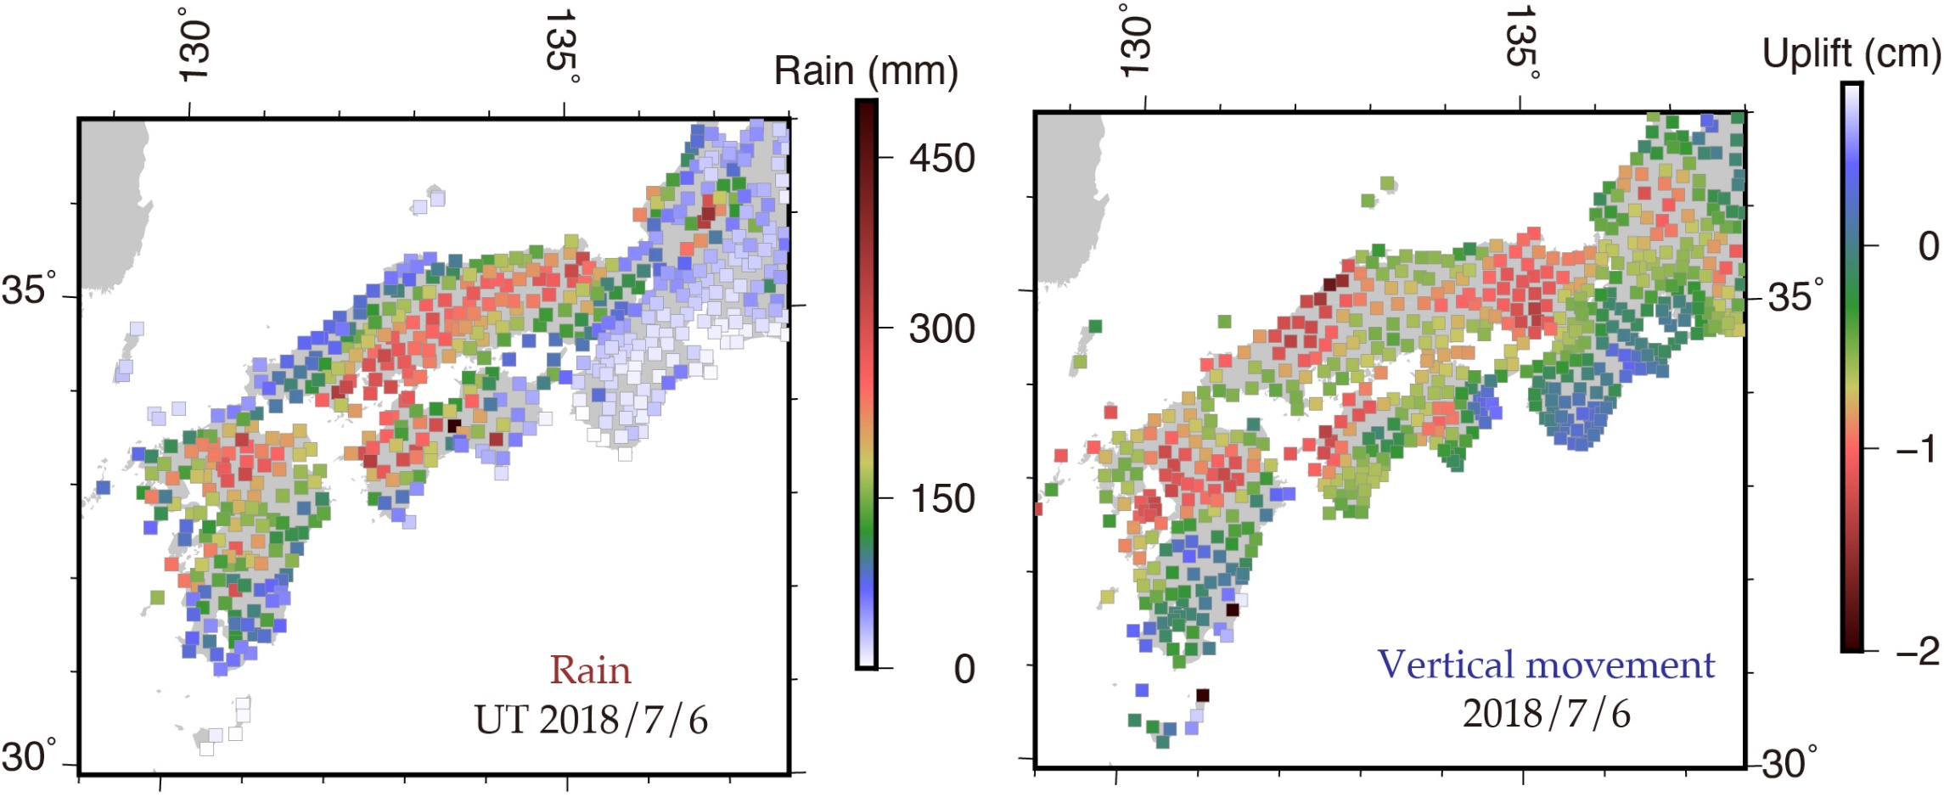
Multi GNSS sites vs nearby rain gauges –2018 July 6
Slightly different distribution
subsidence
rain

Slide 13
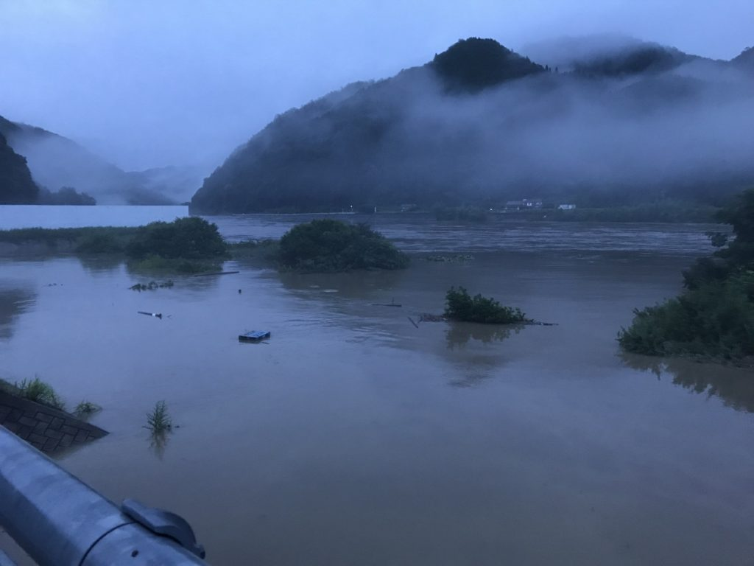
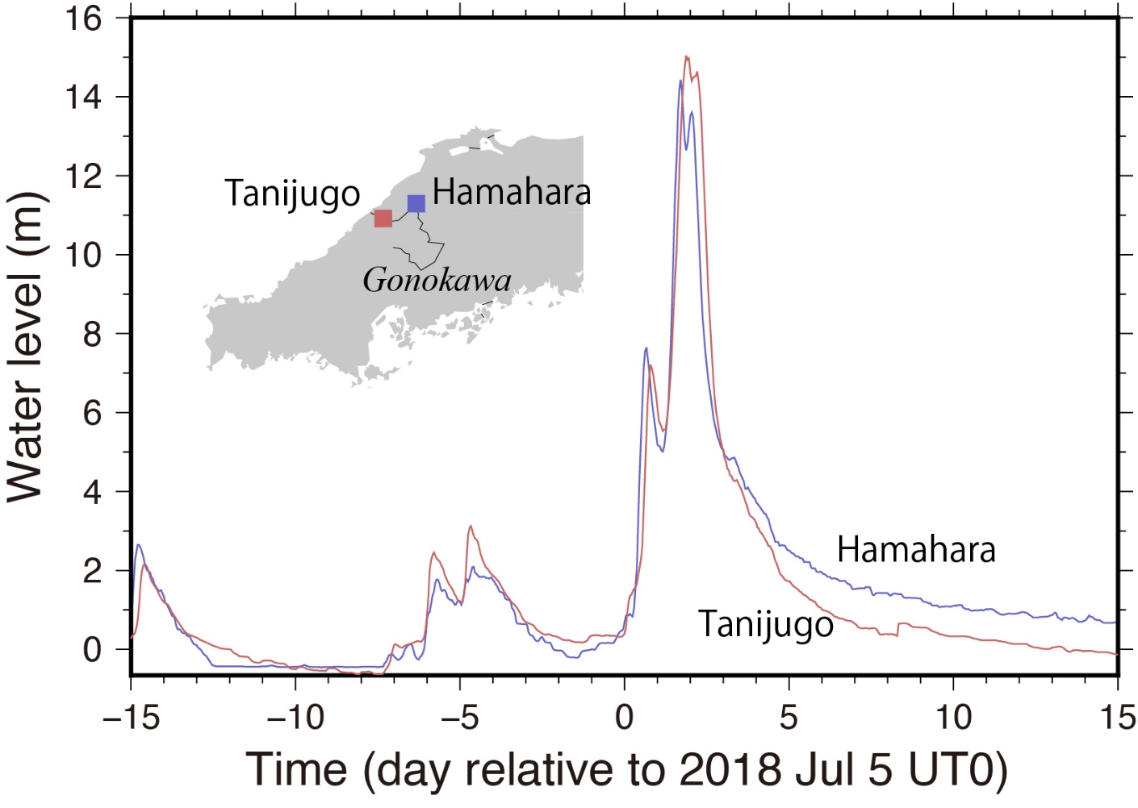
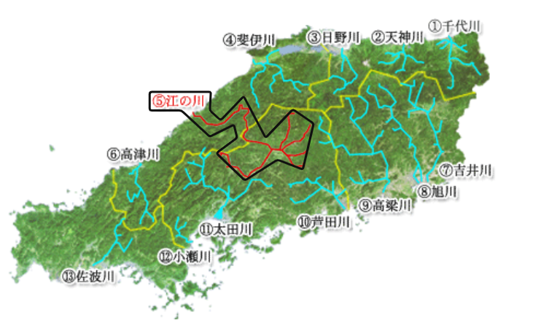
Downstream water redistribution caused the shift of the subsidence area from the heavy rain area
Gōnokawa, an only river crossing the backbone range
Kawamoto
water
Early morning on July 7, 2018
in Kawamoto-town
www.tele-log.net/kawamoto/2019/06/post-259
http://www.cgr.mlit.go.jp/

Slide 14
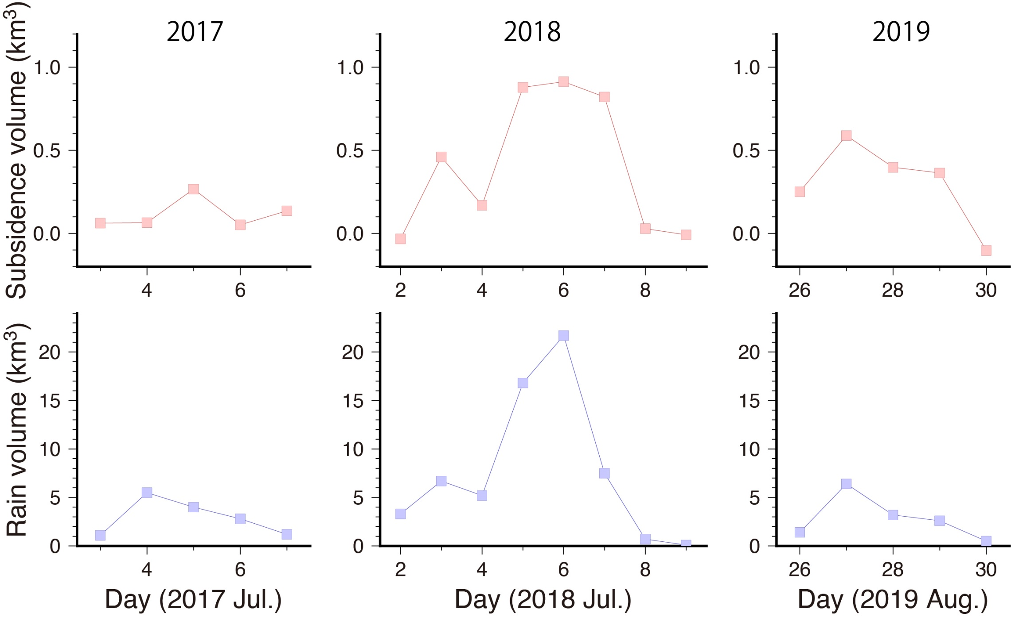
Rain vs subsidence 2018
Very Good Correlation
Not smoothed

Slide 15
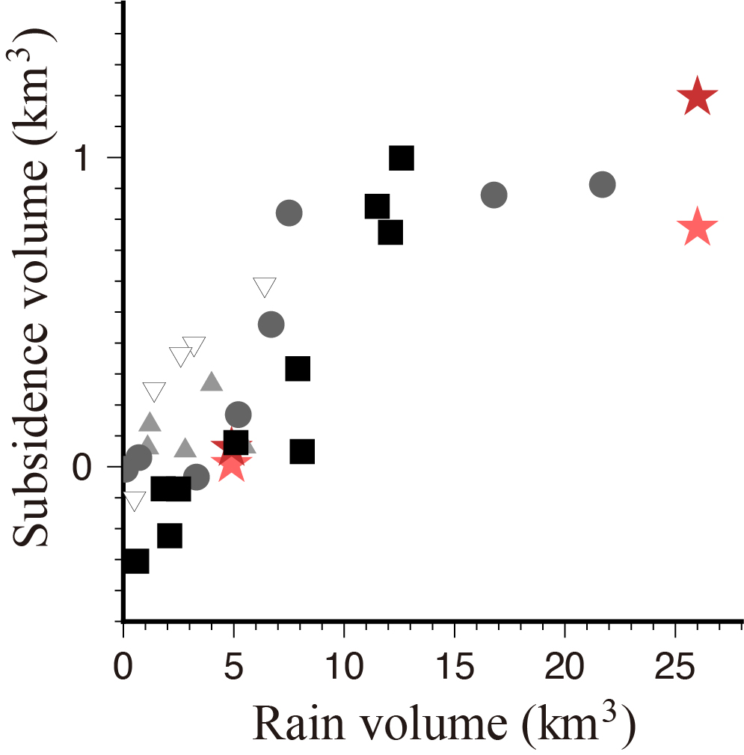
2020
Saturating at ~10 km³?
2018
2019
2017
All heavy rain episodes in SWJ
(2017-2020)
Daily

Slide 16
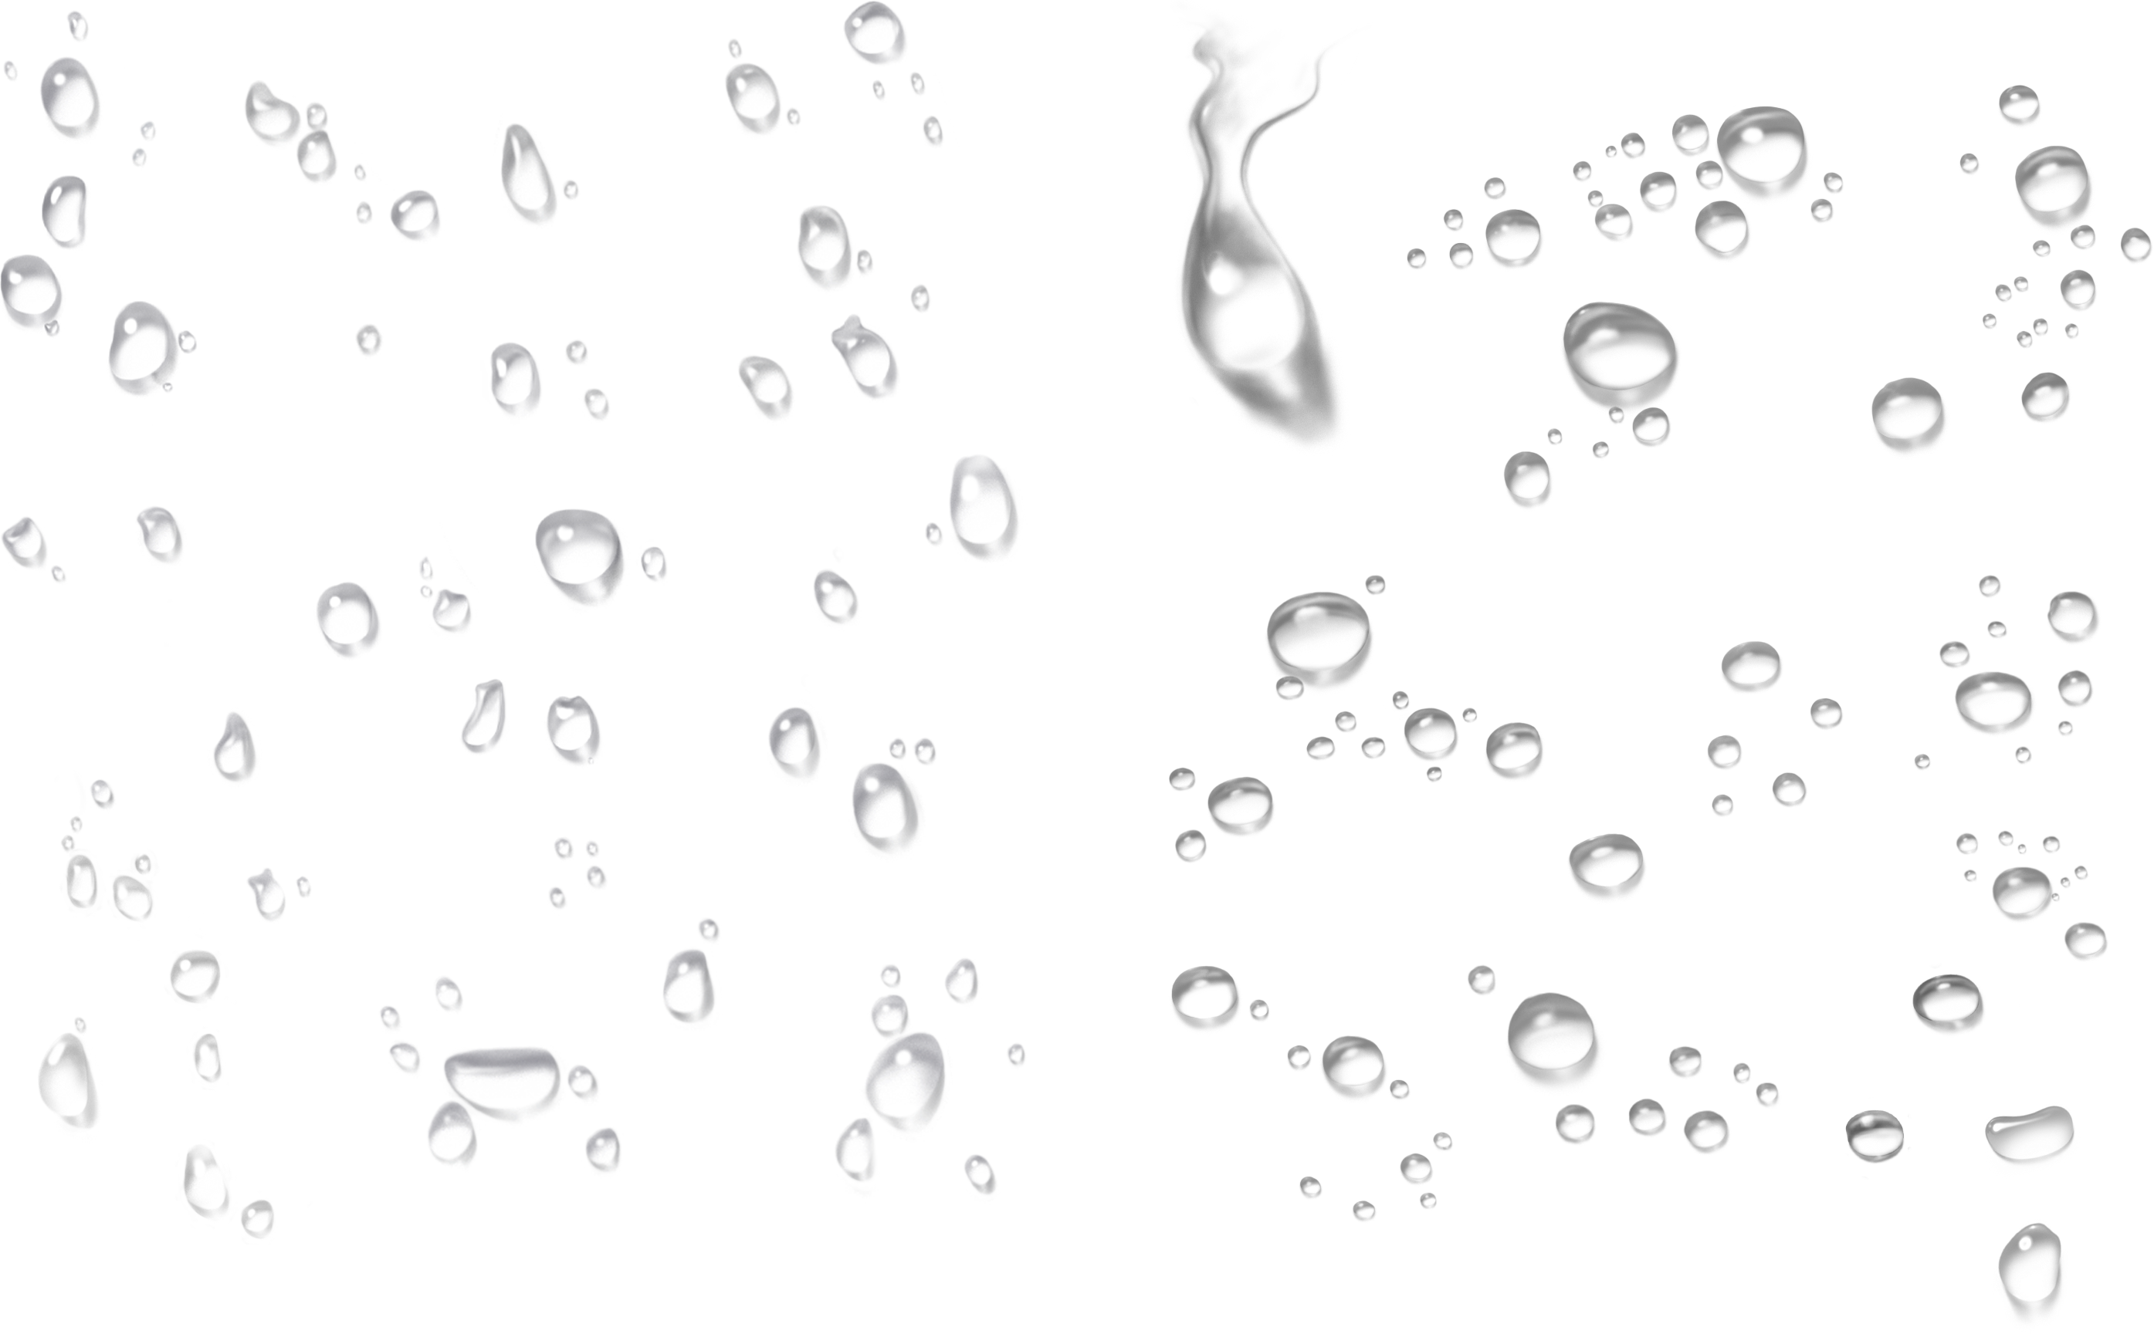
Conclusions
We studied heavy rain 2018 in SW-Japan
Heavy rains depress the ground
Regional subsidence is ~1/10 of daily rain volume
Thank you for your attention
This Photo by Unknown Author is licensed under CC BY-NC

