Slide 1


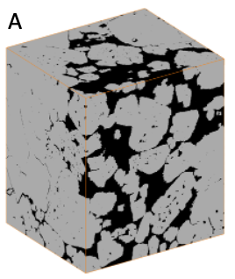
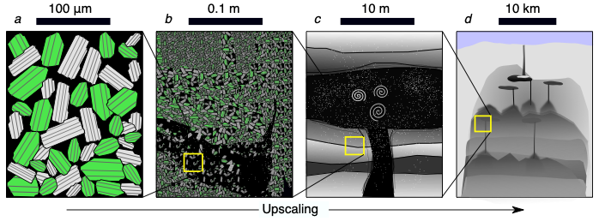
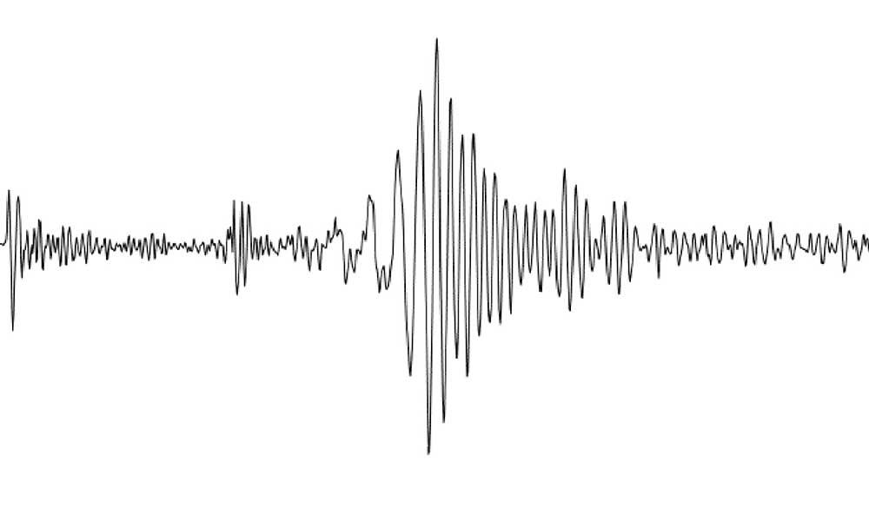
Zooming in on crystal mush: Recent advances in volcano tomography
Michele Paulatto, Kajetan Chrapkiewicz, Joanna Morgan, Emilie Hooft, Ben Heath, Doug Toomey, Costas Papazakos, Paraskevi Nomikou

Slide 2
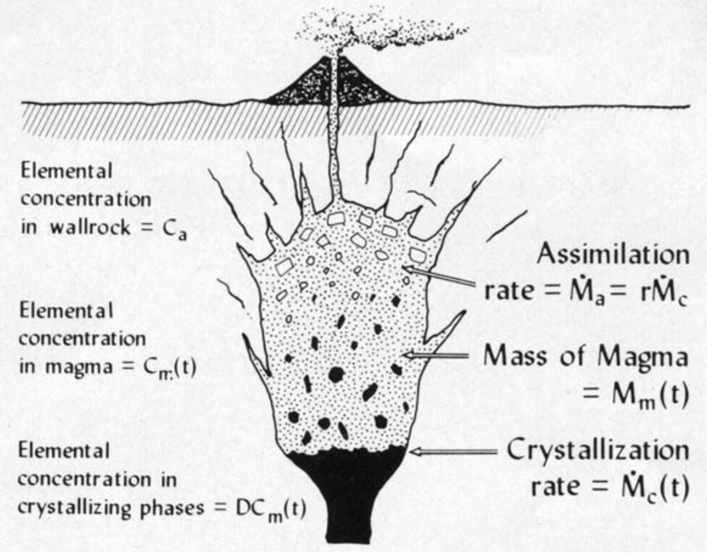
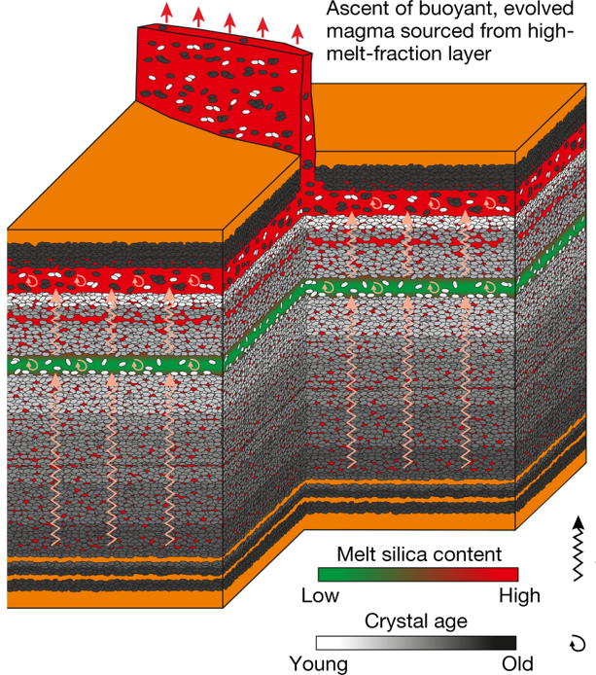
Crystal Mush
Competing models for magma differentiation
Magma Chamber
High melt fraction > 50 %
Large volume, Long-lived
Assimilation-Fractional crystallization and crystal settling
Melt stored in low melt fraction crystal mush for most of its life
Reactive flow explains magma differentiation
Melt-rich and volatile-rich lenses likely at top of mush
De Paolo, 1981
Jackson et al., 2018

Slide 3
Crystal Mush
Expected seismological signature
Magma Chamber
-30% to -60% velocity anomalies
S-wave shadow zones
No anisotropy
Strong reflections and diffractions
-10% to -30% velocity anomalies
Anisotropy
High Vp/Vs ratio
Volcano tomography is a key body of evidence for the Mush model
Lees, 2007:
“Most anomalies are found to be in the range of ±10%”
“there is a general lack of strong evidence for large regions of pure melt“
Cashman & Giordano 2014:
“Geophysical studies of active volcanic systems have failed to locate large volumes of crystal-poor melt. These observations are difficult to reconcile with a classical magma chamber model”

Slide 4
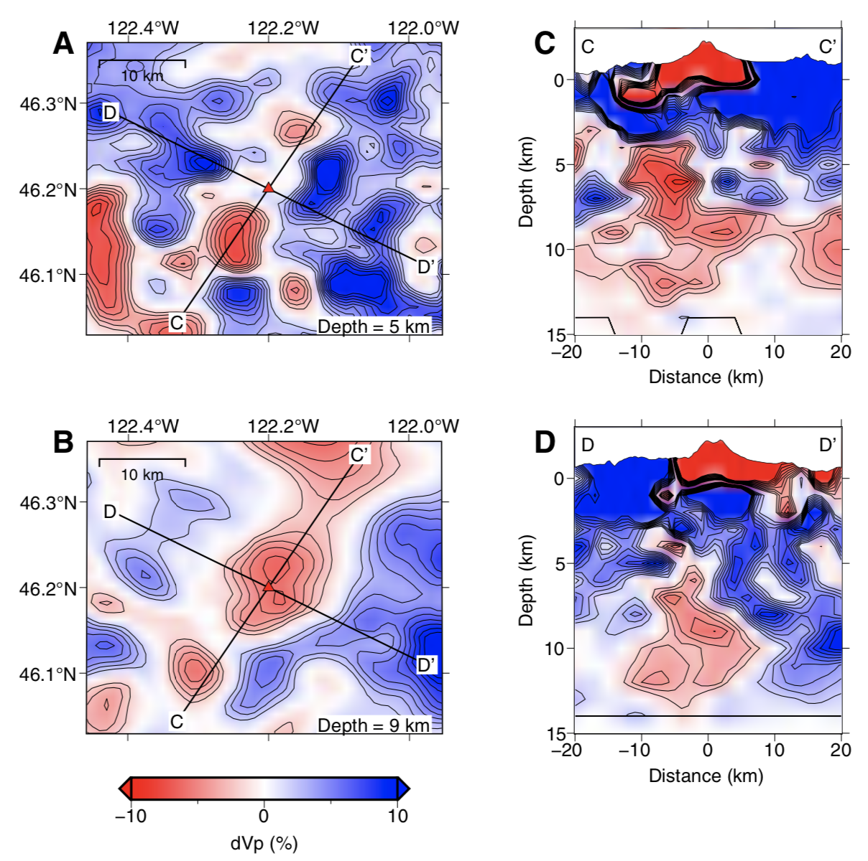
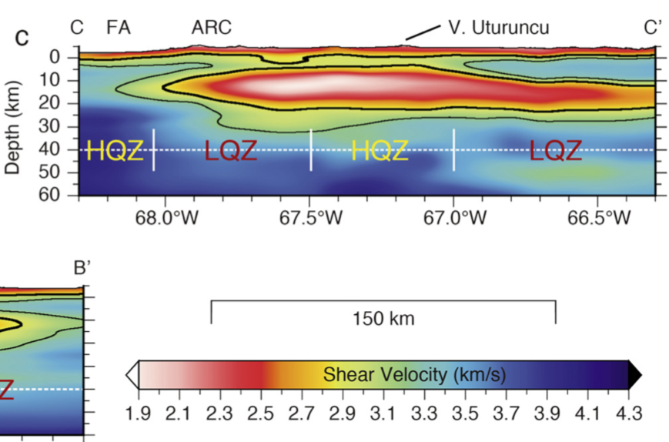
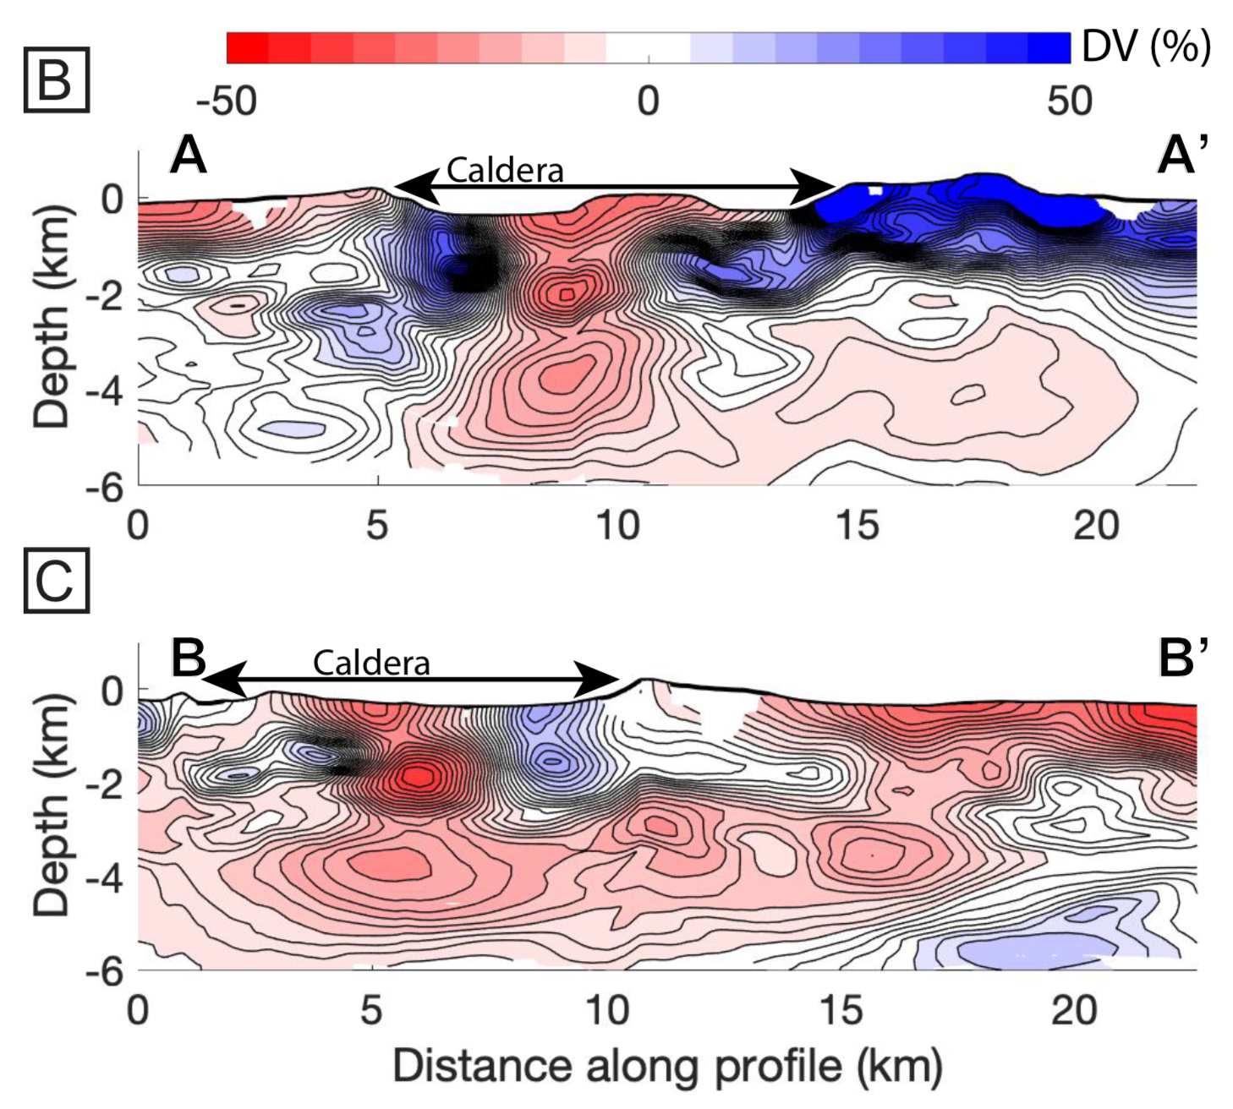
Recent volcano tomography constraints all seem to support low melt fraction crystal mush beneath active arc volcanoes:
Mount St. Helens, USA
Altiplano Puna, Andes
Montserrat, Lesser Antilles
Santorini, Greece
Paulatto et al., 2019
McVey et al., 2020
Kiser et al., 2018
Ward et al., 2014
Vp anomaly | -17%
Melt fraction | 3 - 13 %
-21%
4 - 13 %
-6 to -10 %
10 - 12 %
Vs anomaly | -36%
Melt fraction | 10 - 40 %

Slide 5
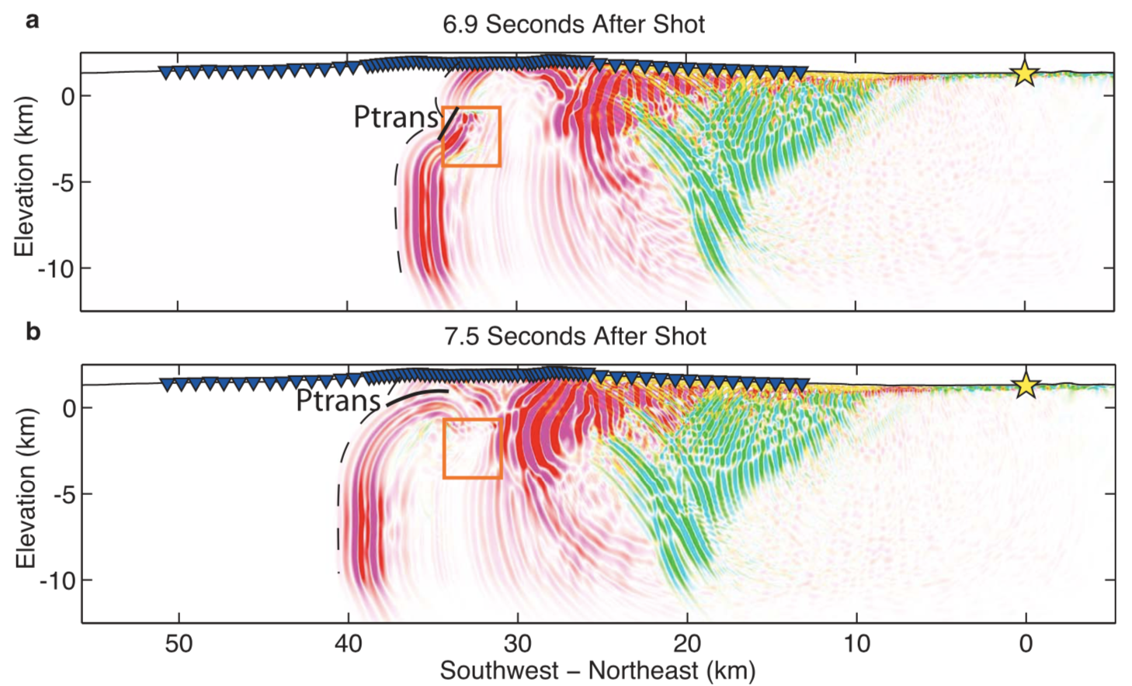
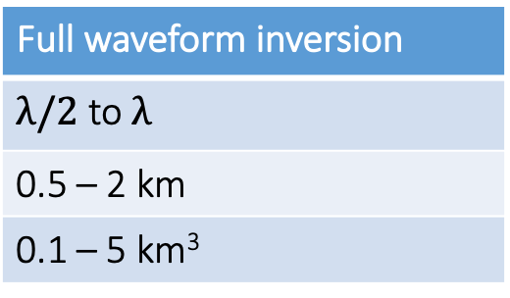
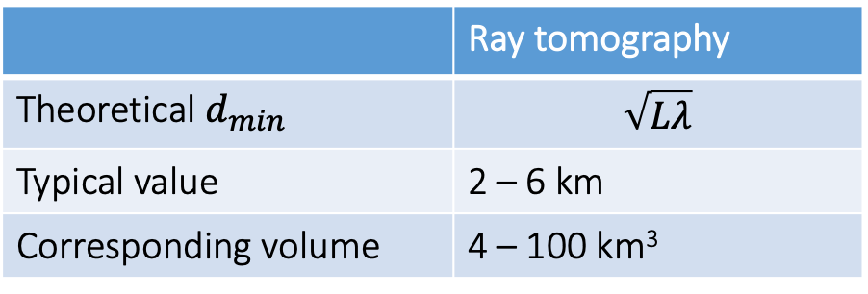
Limitation 1: The resolution length of conventional seismic tomography is typically 2-6 km for crustal targets at 5 to 20 km depth. Smaller anomalies can be significantly blurred and under-recovered
Typical resolution length
 | Ray tomography
Theoretical $d_{min}$ | $$\sqrt{Lλ}$$
Typical value | 2 – 6 km
Corresponding volume | 4 – 100 km³
Full waveform inversion
$λ/2$ to $λ$
0.5 – 2 km
0.1 – 5 km³
Wavefront healing: Wavefronts wrap around anomalies and “heal” due to diffraction of seismic waves.
This results in:
→ Limited recovery of anomalies
High-Vp bias
Likely underestimate of melt fraction
Image from Beachley et al 2012

Slide 6
Limitation 2: Uncertainties in seismic properties of mush and magma. The sensitivity of seismic velocity to melt fraction depends strongly on melt geometry
Semi-analytical methods assume simple melt inclusion shapes e.g. ellipsoidal inclusions with a given aspect ratio
The choice of aspect ratio affects the melt estimate
2% max melt fraction
8% max melt fraction
9%
23%
32%
Adapted from Paulatto et al., 2019
Example adapted from Arnoux et al., 2019

Slide 7
Objectives
1. Use waveform inversion methods to improve resolution of low velocity anomalies
2. Reduce uncertainties in melt estimates
3. Re-asses seismological evidence for Mush model

Slide 8
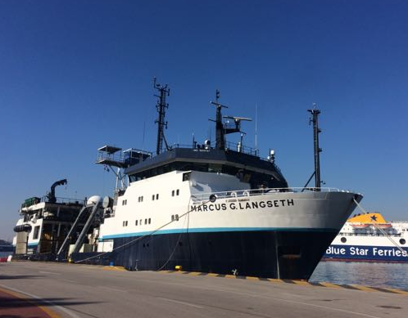
Seismic tomography at Santorini volcano
PROTEUS Active source experiment autumn 2015 funded by NSF (P.I. E. Hooft)
91 ocean bottom seismometers
70 land seismometers
6600 cu. in. airgun source
~14000 shots at 1 min interval (144 - 165 m)
Travel time inversion by Ben Heath and Brennah McVey with Emilie Hooft and Doug Toomey
Heath et al. (2019), JGR, https://doi.org/10.1029/2019JB017699
Hooft et al. (2019), EPSL, https://doi.org/10.1016/j.epsl.2019.02.033
McVey et al. (2020), Geology, https://doi.org/10.1130/G47127.1

Slide 9
Full waveform inversion (FWI) imaging of Kolumbo submarine volcano
It last erupted in 1650 (VEI 4)
Pyroclastic flows reached Santorini, ash as far as Turkey
Frequent seismic unrest
Significant tsunami hazard
FWI Inversion of a subset of the PROTEUS dataset carried out by PhD student Kajetan Chrapkiewicz with Fullwave code (Imperial College London)
FWI advantages:
Uses more of the data – match wiggle for wiggle
Better resolution - down to one hundred meters
Less affected by wavefront healing
No high-Vp bias

Slide 10
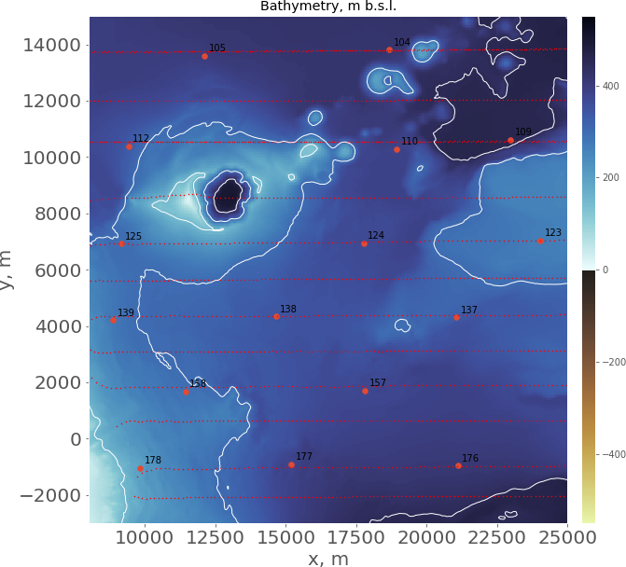
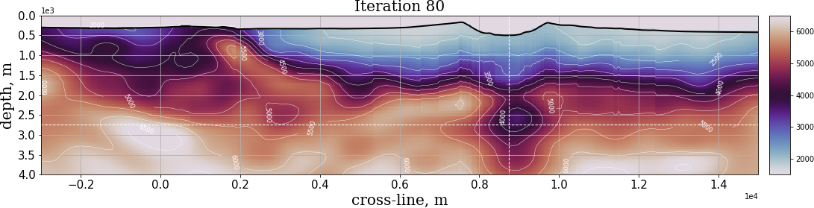
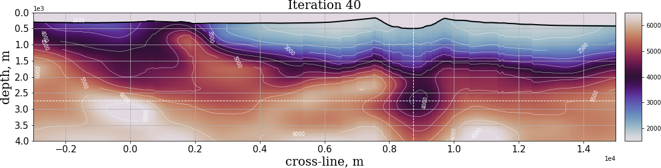
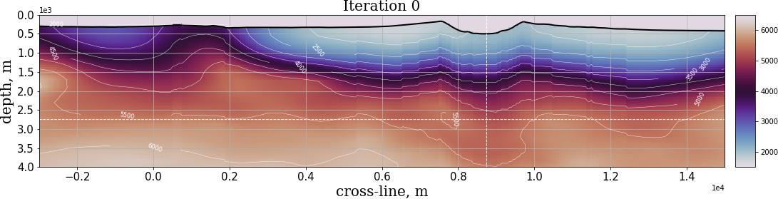
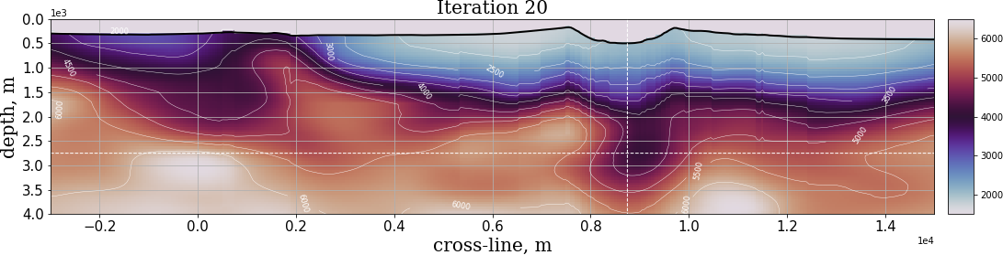
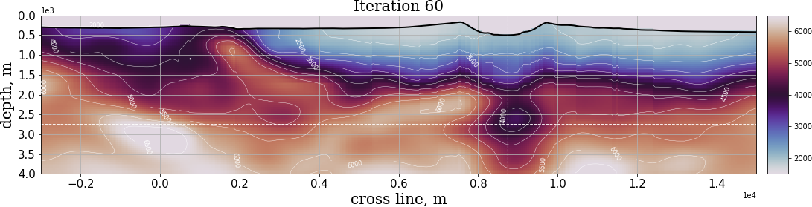
Full waveform inversion (FWI) imaging of Kolumbo submarine volcano
Kolumbo
The Vp anomaly grows
Weak low-Vp anomaly
Iteration 0 = starting model from travel time tomography
Iteration 20 = FWI at 3.0 Hz
Iteration 40 = FWI at 3.5 Hz
Iteration 60 = FWI at 4.0 Hz
Iteration 80 = FWI at 4.5 Hz
Currently working on including higher frequencies
Properties of the Vp anomaly
Absolute Vp = 3600 m/s
Anomaly strength = -1900 / -2400 m/s depending on reference background (granite Vp = 5500 – 6000 m/s)
Anomaly percentage = -35 % / -40 %

Slide 11
How do we estimate melt fraction?
Experimental relationship, fit to experimental data - not practical for magma as data is scarce
Analytical methods assuming simple melt inclusion shapes – depend strongly on aspect ratio
Critical porosity method
Critical porosity
Voigt average
Vp (km/s)
Vp (km/s)
Fluid suspension
1. Derive a constitutive relationship between melt fraction and Vp
2. Invert relationship to determine melt fraction from a given Vp or Vs

Slide 12
Alternative approach: Numerical homogenization
Predict seismic properties based on magma/mush microstructure
Recover mush fragment
X-ray CT scan of sample
Segmentation of components (crystals, glass, bubbles)
Reconstruct paleo-porosity
Build virtual rock sample
Model elastic response with numerical methods
Derive effective elastic properties

Slide 13
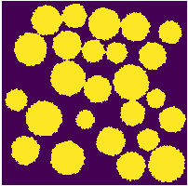
Alternative approach: Numerical homogenization
Dynamic methods
Solve wave propagation problem through digital sample (pulse propagation)
Extract P and S wave travel times
Repeat modelling in multiple directions
Determine average anisotropic Vp and Vs
Static methods
Simulate static load experiment
Consider multiple load cases (compression, shear)
Calculate stress and strain distribution
Determine full elasticity matrix

Slide 14
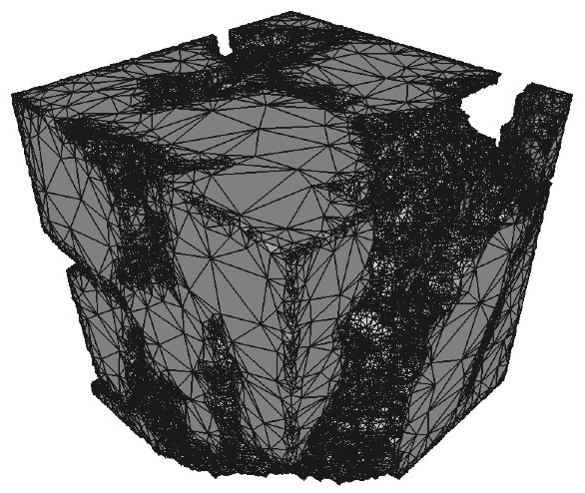
Real data application
Mush fragment from St. Kitts (Lesser Antilles), KS-21
Coarse grained ol-amph gabbro cumulate KS-21, Melekhova et al., 2017
14% melt fraction
Simple binary segmentation (solid/melt)
Populate with elastic properties of components
KS-21
Solid crystals
Liquid melt
Segmented CT data from A. Rust (Bristol)
3D digital rock model

Slide 15
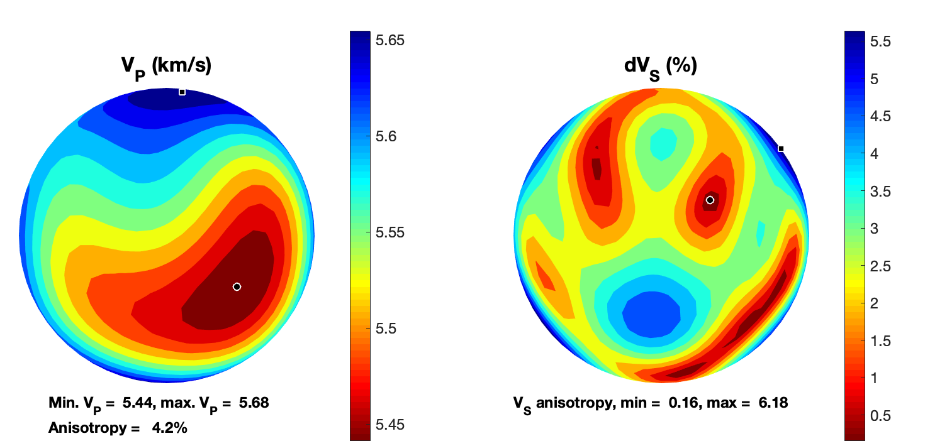
FFT homogenization (static method)
Computationally efficient
Grid-based (no meshing!)
Fibergen (Ospald, 2019)
https://github.com/fospald/fibergen
Segmented sample cross-section
Vp (km/s)
dVs (%)
C_{eff}
Vp anisotropy = 4%
Vs anisotropy = 6%
Derived elasticity matrix
Poles image created with MSAT, https://www1.gly.bris.ac.uk/MSAT/

Slide 16
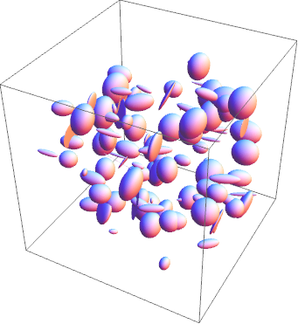
Comparison with semi-analytical methods
Oblate ellipsoidal melt inclusions
Predicted curves with self consistent approximation method for different aspect ratios
Predicted values for KS-21
0.10
0.14
0.07
Digital rock physics predictions consistent with:
Equivalent aspect ratio = 0.07 – 0.14
Critical porosity = 45-55%
Consistent with results by Takei (2000) which are based on equilibrium geometry and dihedral angles

Slide 17
Melt fraction estimate at Kolumbo
1
Envelope of constitutive relationships
2
3
4
6
8
10
12
Melt fraction = 28 – 44 %
Highest reported melt estimate from Vp
Close to critical porosity (~50%)
Melt fraction could be even higher (pending FWI with higher frequency)
Volume < 1 km³
Weaker low-Vp anomaly continues deeper
Curves for aspect ratio = 0.07 – 0.14

Slide 18


No more blobs
Conclusions
We use Full Waveform Inversion to image a low velocity volume beneath Kolumbo volcano (Santorini)
The largest measured Vp anomaly is -35%/-40%
The microstructure for St Kitts’ mush is equivalent to 0.1 aspect ratio ellipsoids
The melt fraction at Kolumbo is 28-44%, possibly above 50%
Likely small-volume, high-melt-fraction melt lens located at the top of the magmatic system
We need new ways to collect seismic data that can make use of waveform methods
We need microstructure information from Petrology for a wide range of melt fractions and compositions
m.paulatto@imperial.ac.uk
@michpaulatto

