Slide 1
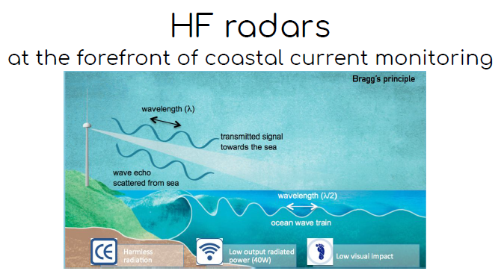
E. Reyes and P. Lorente (co-chairs of the MONGOOS HF Radar task team)

Slide 2
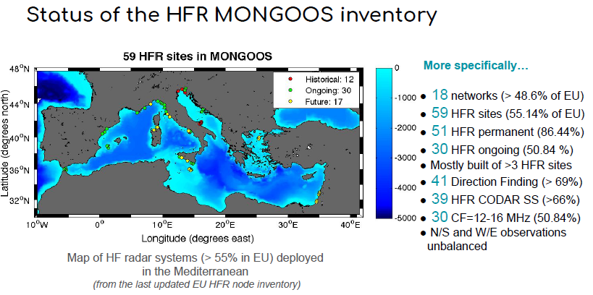
62
54
44
42
No major changes in the regional network to be notified, despite of few novelties:
i) 3 new CODAR stations: 1 station (MIO system) + 2 stations (CALYPSO system)
ii) Future deployments of few SeaSonde sites are expected by 2021 in continental Italy.

Slide 3

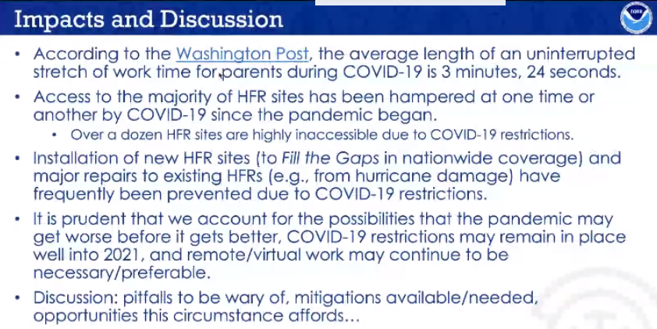
Impact of COVID on HF radar activities
We got some general feed-backs from the GLOBAL network (via ROWG meeting)….
…that seem also well suited for the Mediterranean HF radar network:

Slide 4
Impact of COVID on HF radar activities
Coastal observing stations (tide-gauges & HFR) have largely maintained critical functions, with many individual operators maintaining data flow whilst working from home under lockdown restrictions.
Feed-backs from the survey launched by GOOS:
(Participants from MedSea: 4 Spain, 2 Italy, 1 Malta, 1 Slovenia)
Major Concerns
Access to HFR sites hampered > highly inaccesible due to travel restrictions and quarentien periods
Installations of new ~4 HFR sites prevented (CNR-ISMAR) / Second system installation in Slovenia was on delay
Major repairs, maintenance tasks and calibrations postponed or re-scheduled
On site Periodical and preventive maintenance tasks interrupted / Fine tuning of the CALYPSO new installation sites (southern Malta) delayed
100% unexpected backlogs in repairs, maintenance tasks and calibrations postponed
Direct support of radar providers not possible in CALYPSO (du to travel restrictions)
Reschedule EU Project activities depending on the data availability
Impact to deliver to operational services:
Loss of data continuity. Impacts on Data Availability: <5 HFR sites offline
Immediate risk: Near real time data unavailability
Long-term risk: bad data quality due to lack of calibration/replacement of failing components
Failure in the data distribution to EU and Global marine data portals

Slide 5
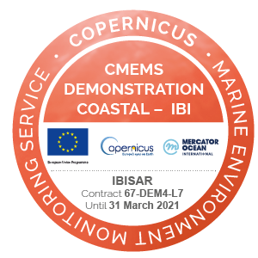




Update of the projects/programs in which HF radars are involved
• Ongoing at European level:
1) IBISAR
http://www.ibisar.es/
Already mature & consolidated service! for real-time data ranking in the IBI area for emergency responders and SAR operators
Ongoing since 2019! 1) Enhance use of HFR data and added value products; 2) Implement Best Practices of HFR operations and maintenance; 3) Define a governance structure that ensures long-term sustainability; 4) Network development prioritized at sea-basin scale.
2) EuroSea
https://eurosea.eu/
3) Jerico-3S
https://www.jerico-ri.eu/
Recently launched! Provide valuable coastal data (coupling physical and biological information) and extend cooperation with Marine Infrastructures in Europe (CMEMS, EuroARGO, EMSO, ICOS, EMBRC) and outside Europe
4) Sharemed
Enhance capabilities to address environmental threats in Mediterranean Sea. Its HFR group targets to valorize the role of national observing systems in the regional context, and to seek their long-term sustainability within consolidated frameworks of funding and support
https://sharemed.interreg-med.eu/
5) SICOMAR plus
Cross-border system for marine safety against the risks of navigation and for the preservation of the marine environment. It provides investments to improve the coverage of monitoring networks, such as HFR, among others.
http://interreg-maritime.eu/fr/web/sicomarplus/projet
• Ongoing at National/local level:
Extension of the HFR network with particular emphasis on enhancing data quality and availability to support added value services. International team with 4 Sicilian and 2 Maltese partners.
6) Calipso-South

Slide 6
Relevant messages / activities from the HF radar task team
-Already collaborating in a more coordinated way: video-conferences on a regular basis
-Aware of the need to get fundings for the long-term sustainability of the HF radar network
• Papers in preparation:
1) Two joint contributions: “Operational coastal HF radars in the Mediterranean in support of science priorities and societal need (Part I and Part II)”. - To be submitted to a Special Issue in Ocean Science
Orchestrated initiative among the entire MONGOOS HF radar community: 37 co-authors, 12 institutions, 6 countries!
2) “On the performance of HF radar in the Western Mediterranean during the record-breaking Storm Gloria”
- HF radars as decisional tool to monitor extreme coastal hazards and unveil hydrodynamic aspects still unresolved by current state-of-the-art ocean models. To be submitted to Frontiers in Marine Sciences.

Slide 7
Relevant messages / activities from the HF radar task team
• Papers published in 2020-2021:
Bagaglini et al. (2020). Eddy Detection in HF Radar-Derived Surface Currents in the Gulf of Naples. Remote Sensing, 12(1), 97.
De Leo et al. (2020). Evaluation of HF-radar wave measures in the Gulf of Naples. 2019 IMEKO TC19 International Workshop on Metrology for the Sea: Learning to Measure Sea Health Parameters, MetroSea 2019, 276.
Dumas, D. & Guérin, C.-A (2020). Self-calibration and antenna grouping for bistatic oceanographic High-Frequency Radars.
Mantovani et al. (2020). Best Practices on High Frequency Radar Deployment and Operation for Ocean Current Measurement. Front. Mar. Sci. https://doi.org/10.3389/fmars.2020.00210
Saviano et al. (2020). An Integrated Reconstruction of the Multiannual Wave Pattern in the Gulf of Naples (South-Eastern Tyrrhenian Sea, Western Mediterranean Sea). Journal of Marine Science and Engineering 8, 372.
Révelard et al. (2021): Sensitivity of Skill Score metric to validate Lagrangian simulations in coastal areas: recommendations for Search and Rescue applications. Front. Mar. Sci. 8:630388. doi: 10.3389/fmars.2021.630388
Lorente et al. (2021): On the Performance of High Frequency Radar in the Western Mediterranean During the Record-Breaking Storm Gloria. Front. Mar. Sci. 8:645762., doi:10.3389/fmars.2021.645762
4 Upcoming events & opportunities:
  SPRING 2021: SICOMAR-plus Summer School
  MAY 2021: EGU session devoted to MonGOOS
  Spring-summer 2021: HFR meeting with MyCoast project
ROWG major outcomes (17-18 NOV with > 90 attendeees)
MONGOOS viewer: HFR are shown as Fixed stations // moorings > they should be apart since they do not share similar features

