Slide 1
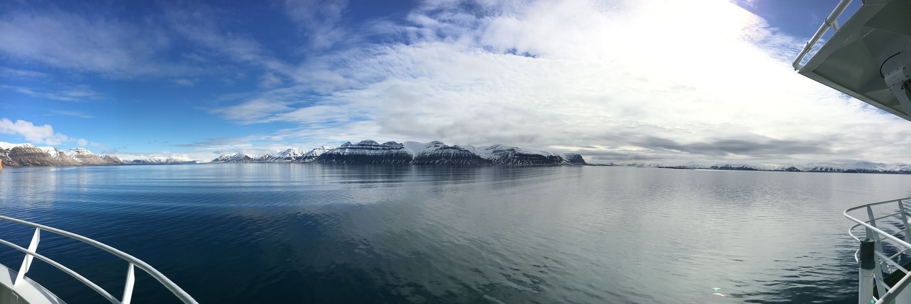
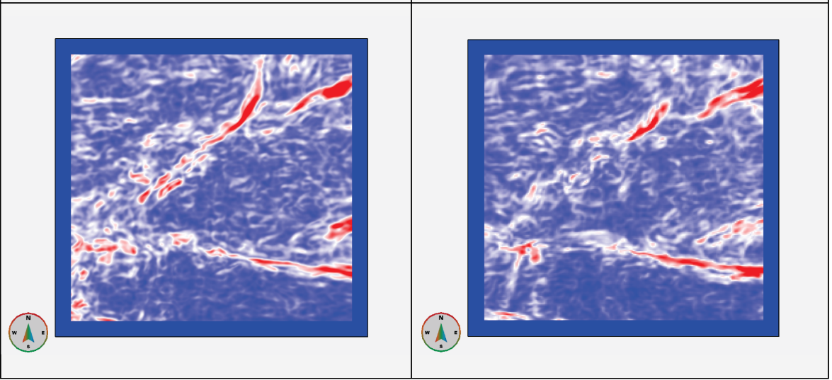
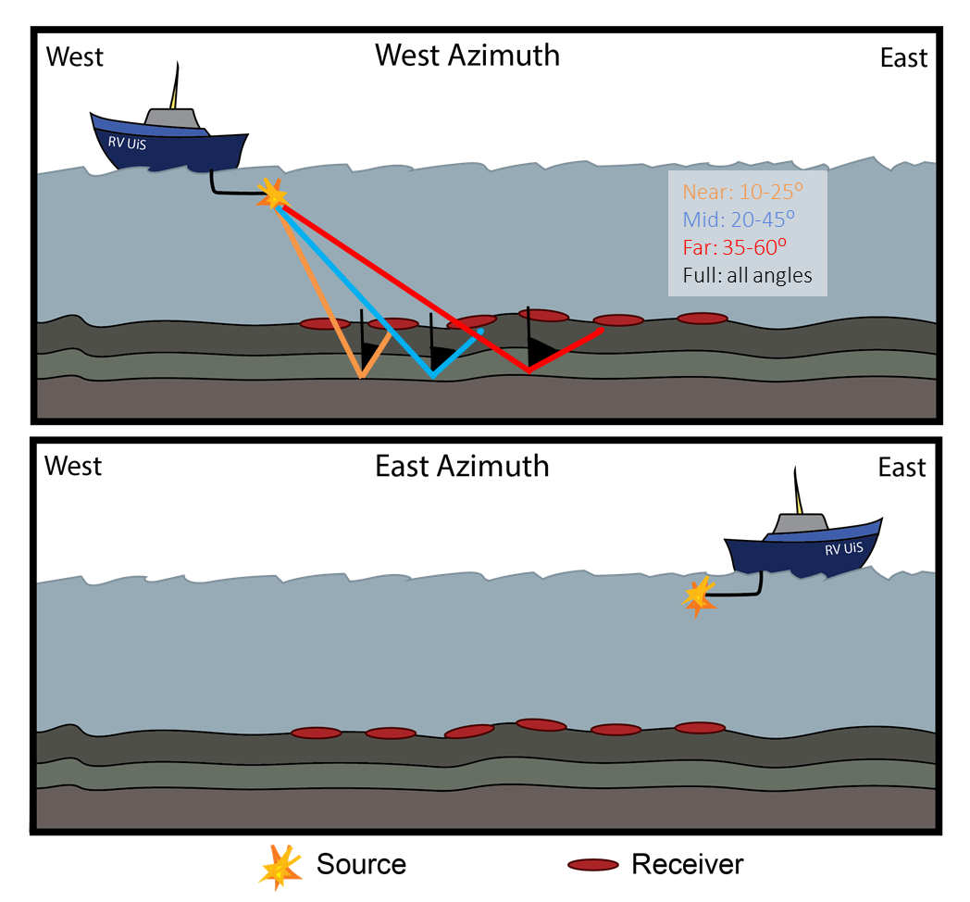
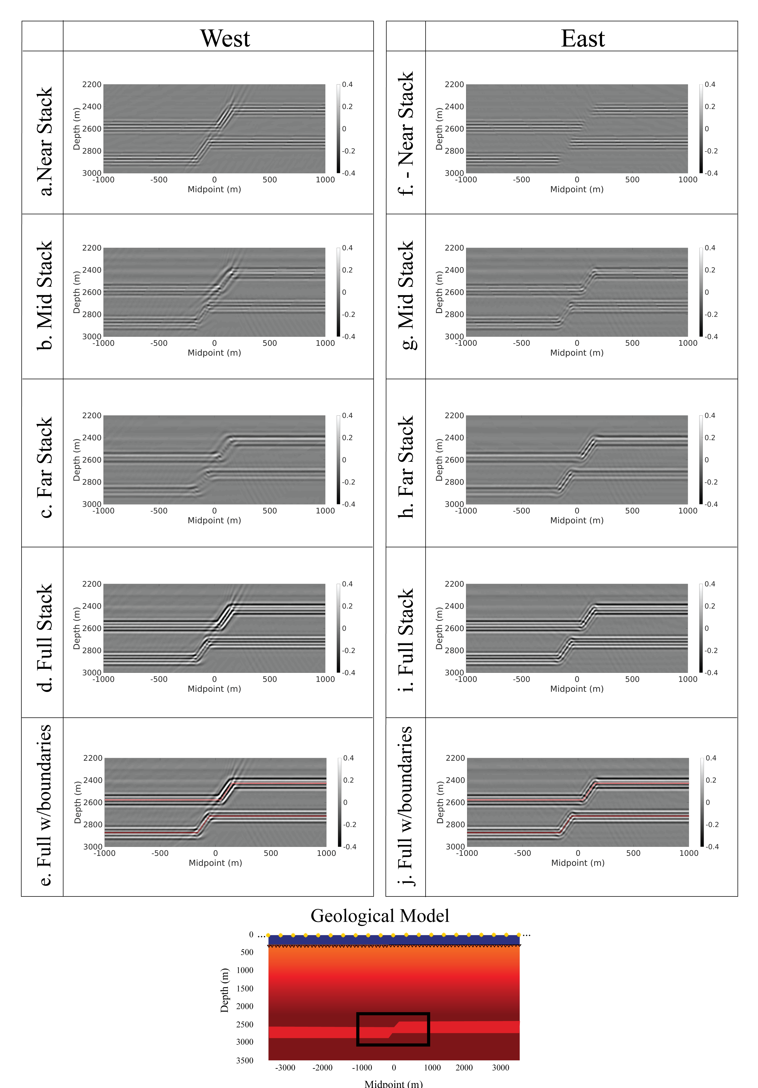
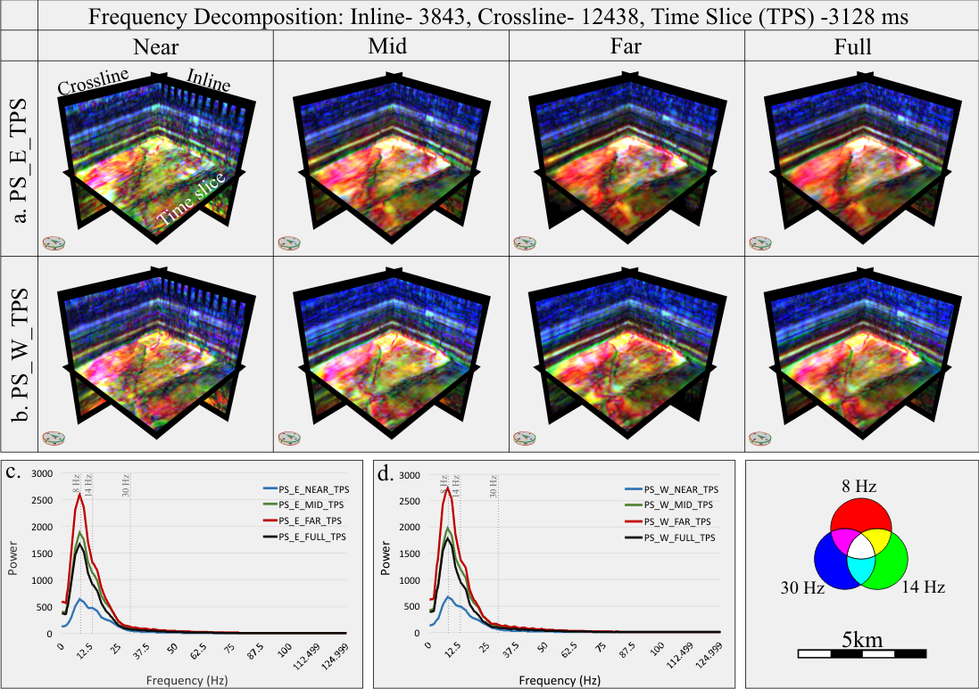
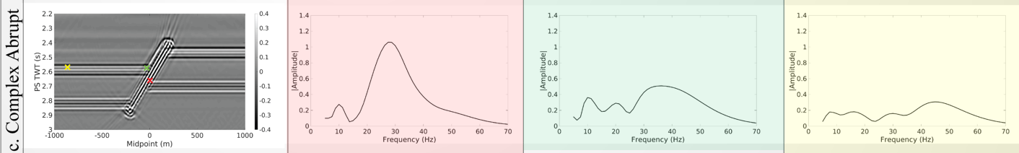
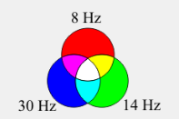
Two minutes of fault imaging in seismic data
West Azimuth
East Azimuth
Case Study
Snøhvit Area
Part 1: Azimuthal Separation
Forward Modelled
Snøhvit Case Study
Forward Modelled
Part 2: Frequency
Seismic data are acquired and processed in different ways. Today we will investigate how azimuth impacts fault imaging and how the morphology of faults may impact the obtained seismic frequencies.
Geology of Svalbard, photo by Jennifer Cunningham
Notes:
1

Slide 2

Investigating the seismic imaging of faults using PS data from the Snøhvit Field, Barents Sea and forward seismic modelling
Jennifer Cunningham¹^{,2}, Wiktor Weibull², Nestor Cardozo² David Iacopini³
¹Equinor ASA
Stavanger, Norway
²University of Stavanger
Department of Energy Resources
³University of Naples
Department of Earth Sciences
Notes:
2
State title and coauthors on the paper and status

Slide 3

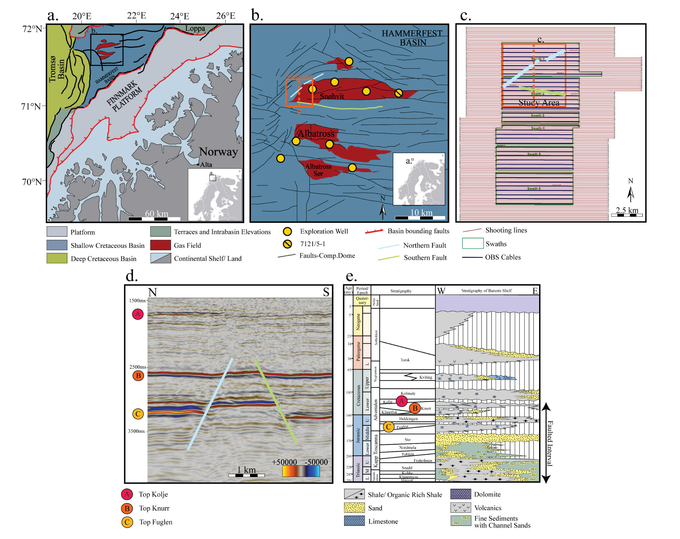
The Snøhvit data and purpose of work
Part 1: To investigate how azimuthal separation effects the imaging of faults by comparing the case study with forward modelled data
Part 2: Investigate the effect of fault complexity on the frequencies in and surrounding faults

Slide 4

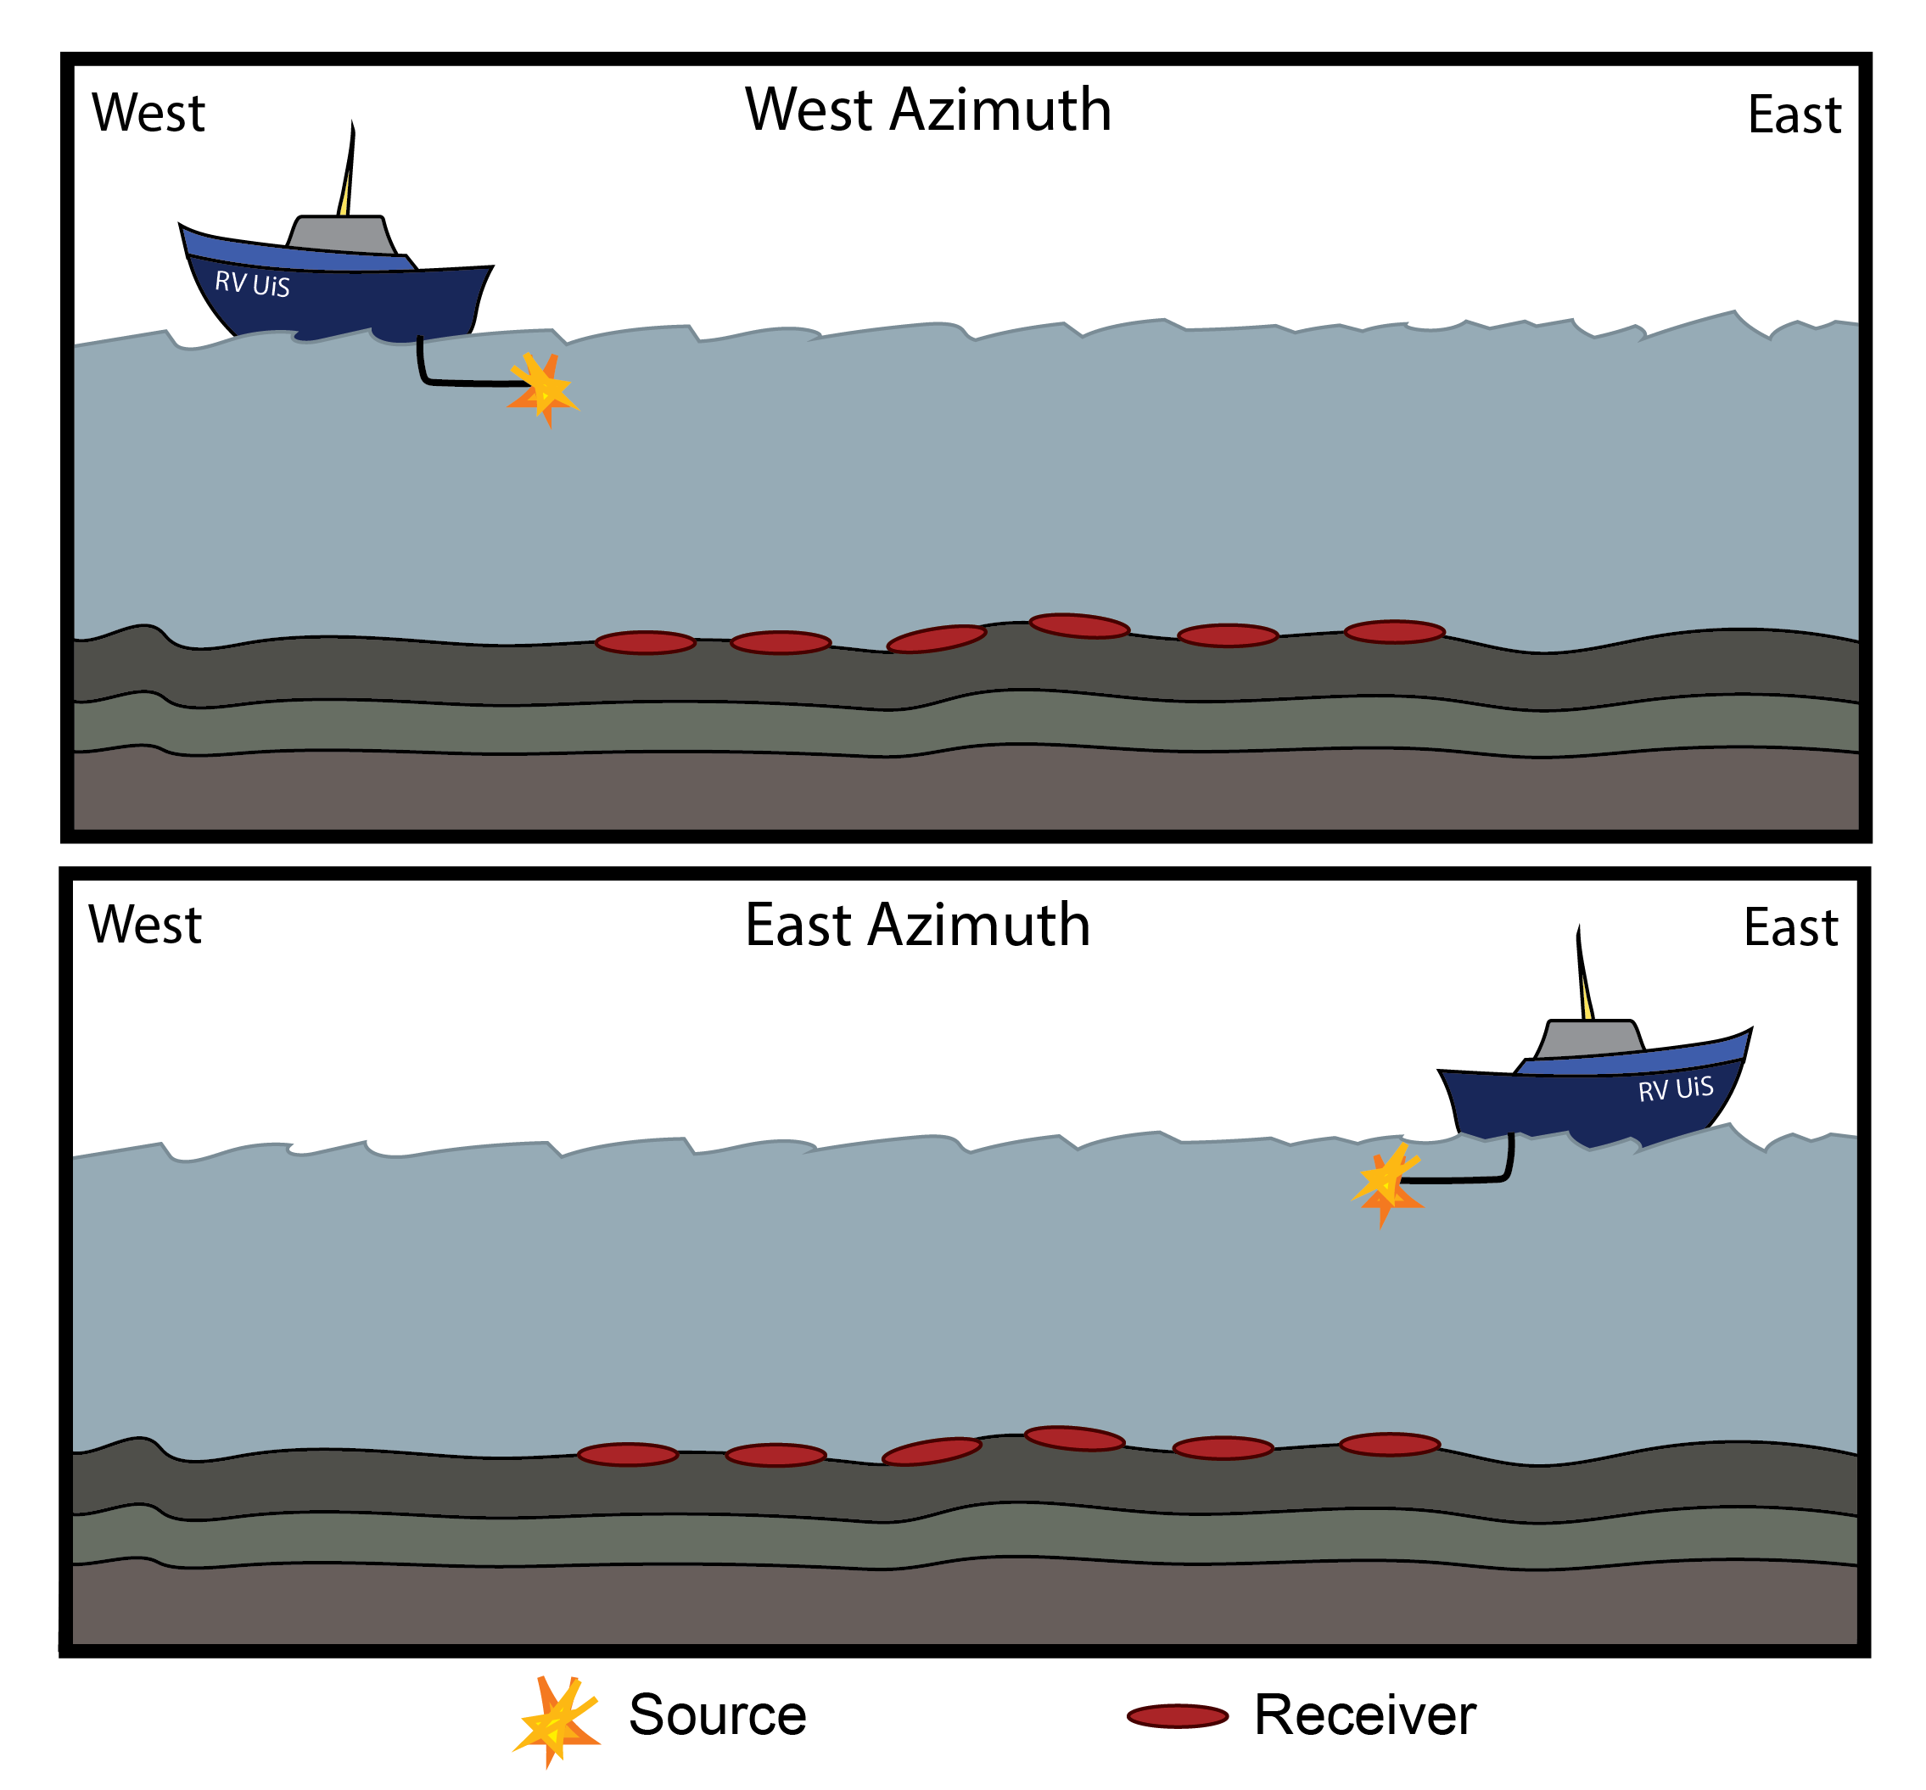
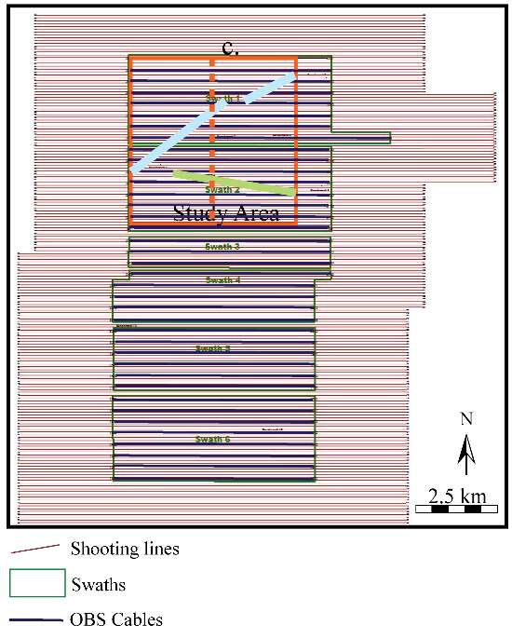
Azimuthal Separation and Incidence Stacking
Near: 10-25⁰
Mid: 20-45⁰
Far: 35-60⁰
Full: all angles
This processing results in 8 seismic volumes- near, mid, far and full angle stack volumes in both E and W azimuth.
Notes:
This figure shows the definition of azimuth going forward.

Slide 5

The workflow
Snøhvit Case Study
Forward Modeled Seismic
Azimuthal Separation
Frequency
Azimuthal Separation
Frequency
Part 1: Comparison of Azimuthal Separation
Part 2: Comparison of Frequency
Notes:
Today we focus on azimuth
There were other aspects of the paper we will not have time to highlight today.
First we will look at the case study part of the workflow

Slide 6
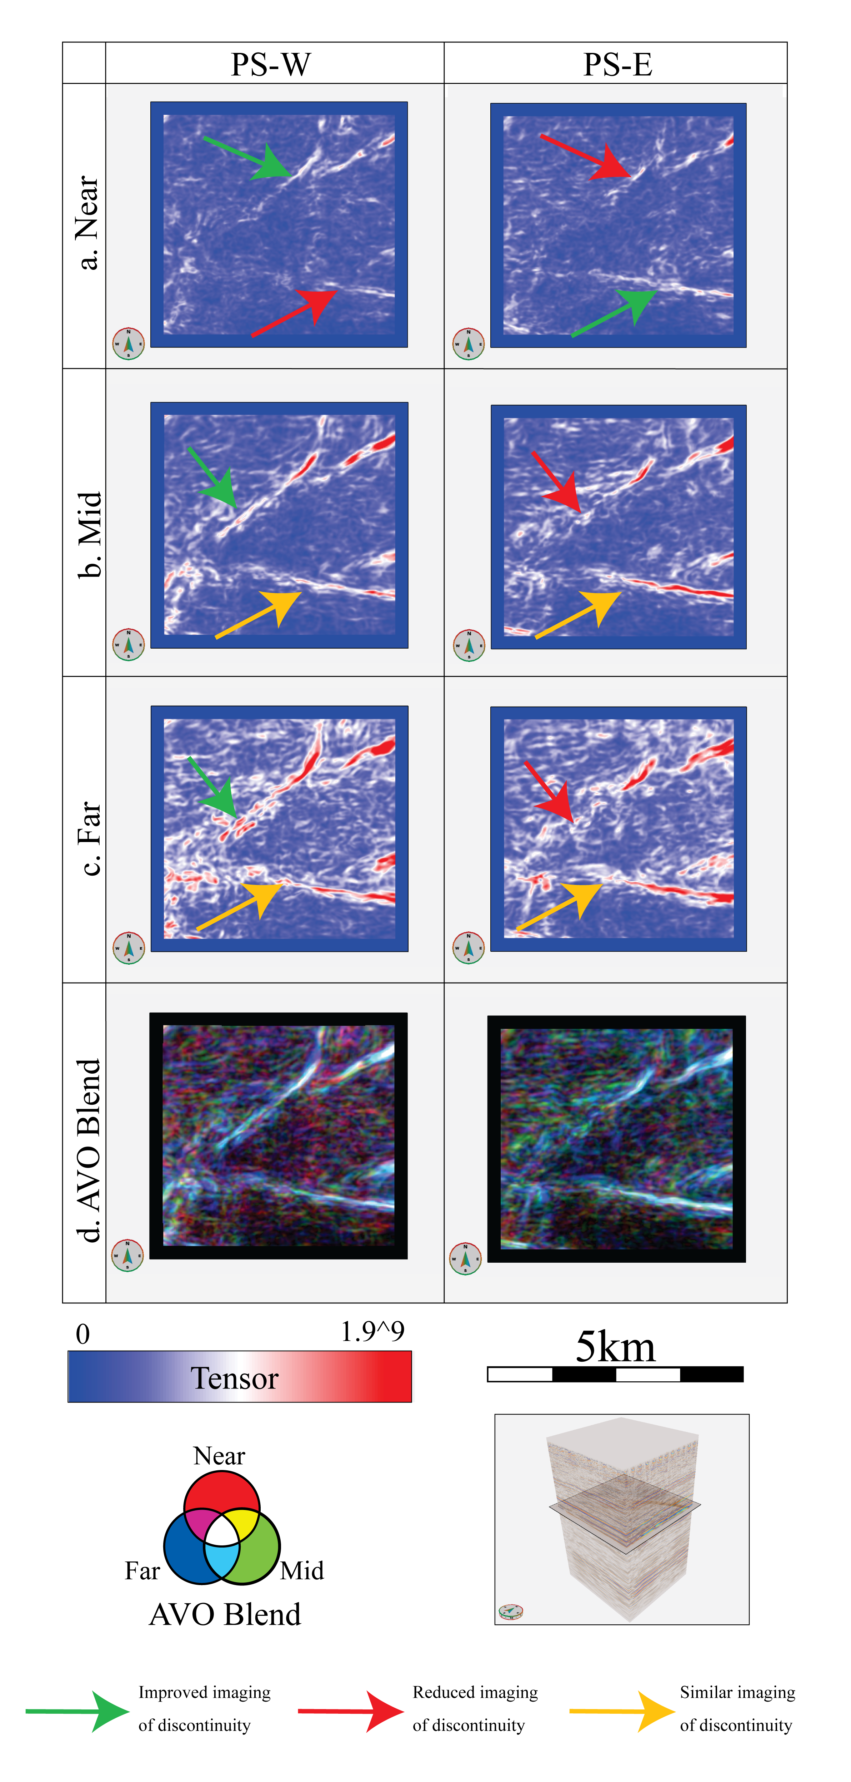
Part 1: Case Study
Analysis of Azimuthal Separation
Red represents a change in the seismic amplitude with respect to the orientation of the reflector, while blue is where the orientation is consistent. Orientation changes occur at faults, noise, stratigraphic and structure edges, etc.
Comparing azimuth:
Northern Fault:
-Oblique to survey orientation
-Better in W data (lateral extent, brightness)
Southern Fault:
-Parallel with survey
-Fault extent the same in the W and E data
W azimuth: source is W relative to receivers
E azimuth: source is E relative to receivers
Notes:
Methods for creating attributes
Run on incidence stacks and azimuthally separated data
Observations: northern fault more affected than south
Beter in w data
Show length, brightnes, detail, extents etc improved.

Slide 7
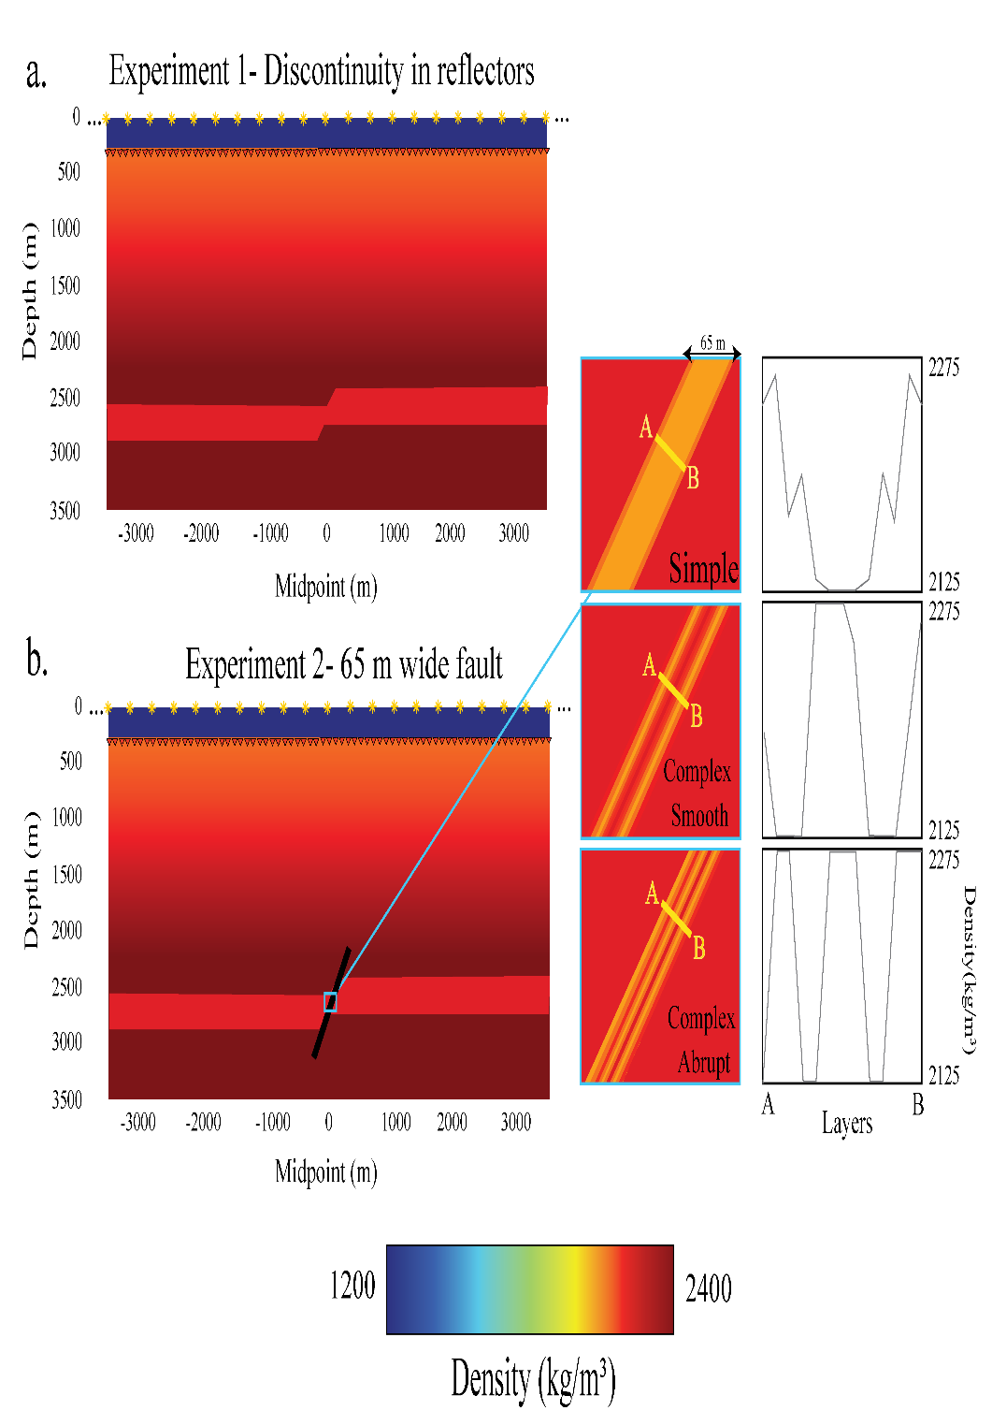
Part 1: Method- 2D Forward Modelling
Velocity model used in seismic forward modelling
Geologic Model:
-300 m thick layer at 2500 m depth, displaced 150 m by a discontinuity dipping 55° W
Seismic Modelling:
-+/- 7000 m wide model
-41 sources placed at water surface
-1401 receivers placed at 300 m depth
-Source isotropic pressure, zero phase wavelet
Processing:
-Free surface multiples were removed
-Direct wave was muted
-Data were separated by incidence angle and azimuth
W azimuth: source is W relative to receivers
E azimuth: source is E relative to receivers
Notes:
We made a geologic model, we placed receivers on the ocean floor and sources in the water column
Data were processed in the same way as the Snøhvit data into inceidence angle and azimuth.

Slide 8
Part 1: Modelled Data- Azimuthal separation
In most stacks, the imaging of the discontinuity and the horizons are improved in the W data relative to the E data.
The discontinuity was imaged as a plane in all stacks but one, showing the importance of survey geometry relative to fault orientation.
W azimuth: source is W (left) relative to receivers
E azimuth: source is E (right) relative to receivers
Notes:
In the azimuthally separated data, the W data is almost always better at imaging the discontiuinity planes. In the near E you can see there is no signal created. This proves the importance of seismic geometry in fault imaging. Since the acoustic wave was not returned to receivers from the duiscontinuity plane
We proved these concepts by running some raytracing.
In figure to L you can see a single fault much more data is returned by west going waves. The E data is far less dominant. We weer also able to see the impact of shot position and incidence angle on the imaging, W were dominanat in both cases.

Slide 9
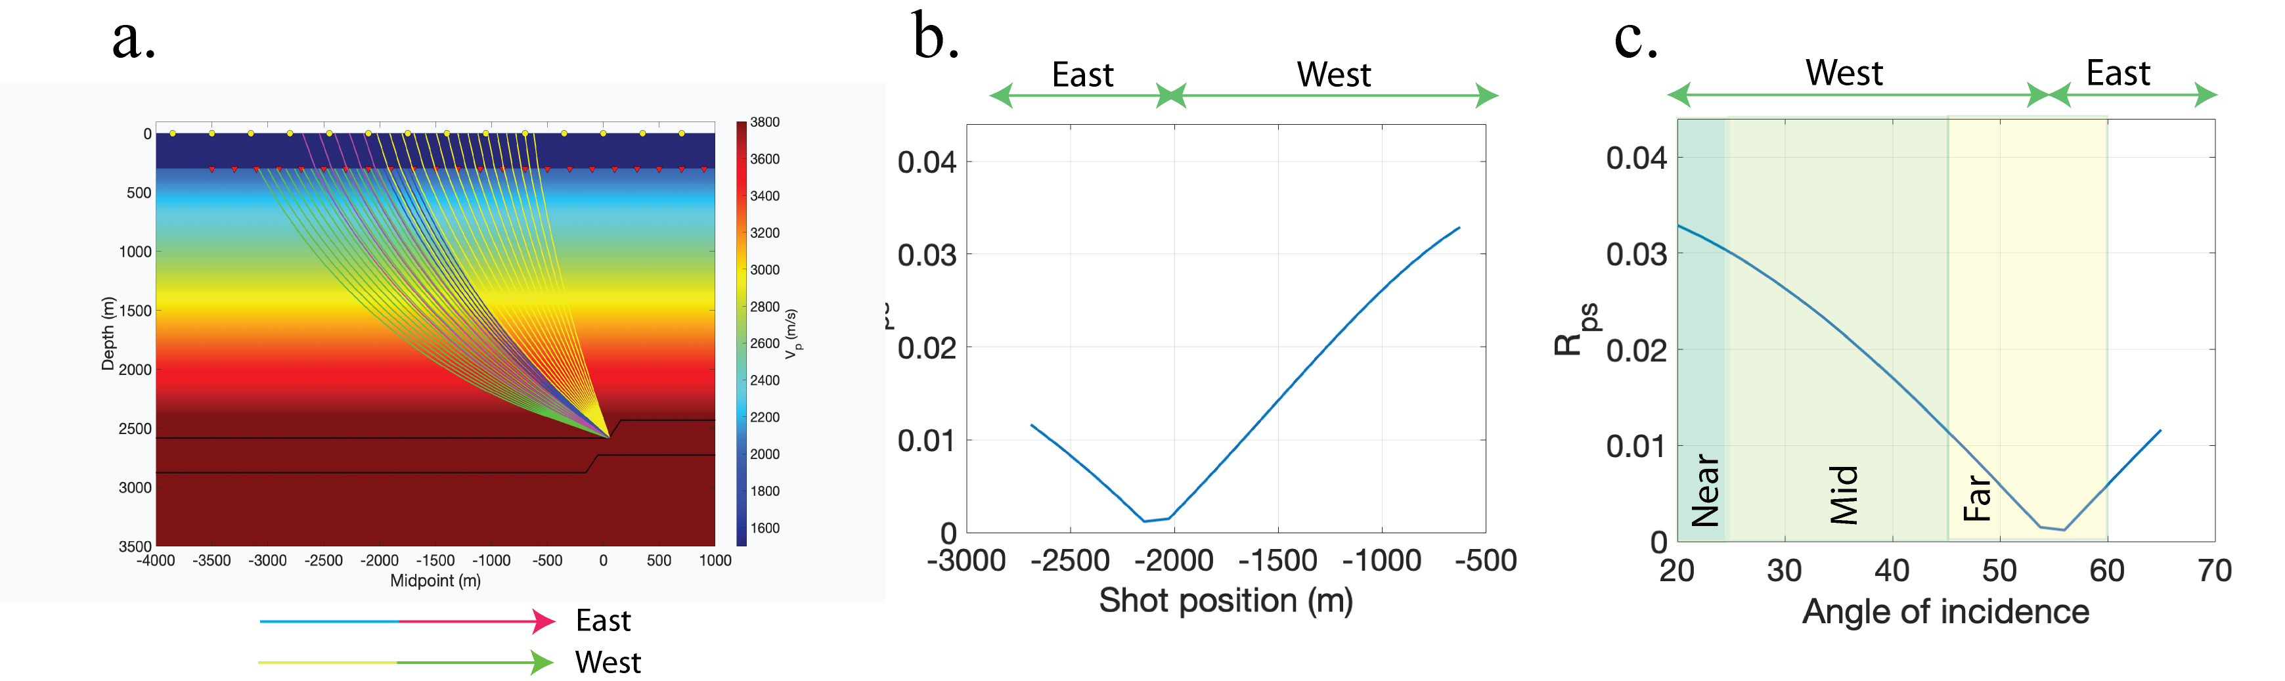
Part 1: Azimuthal Separation Conclusions
R_{ps}
R_{ps}
(ϴ_{f})
Case study and model show more successful fault imaging in W azimuth data.
In the case study, it was clear that the orientation of the fault relative to the survey orientation was a key factor. The N fault (oblique with survey) was affected more by azimuth than the southern (survey-parallel) fault.
The modelled data also showed the importance of survey geometry to fault orientation.
Notes:
As the slide reads
-may mention here we also looked into comparing offset/incidnence angle stacks but the results were inconclusive.?

Slide 10
Part 2: Case Study
Frequency Analysis
Method: Frequency decomposition was run at time slice 3128 ms, at the centre of the faulted interval, to understand the seismic frequency content in and near faults
Observations:
-Faults appear as dark lineaments devoid of frequency
-In reality, fault lineaments have subtle shadows of low-medium frequencies (8-14Hz)
-Faults in all slices are surrounded by green haloes, which represent higher frequency than the surrounding unfaulted area
Notes:
Explain method
Main observations are that faults appear as dark linemantents with green haloes.. But the lineaments have shadows of low – med frequency. The haloes show faults are surrounded by higher frequencies.
These observations are in all stacks.
As seen in seismic, fault imaging is better ni west data.

Slide 11
Part 2: Methods
Seismic forward modelling
Seismic parameters same as in Part 1. In the geomodel, a fault body is added with three slightly different “morphologies”.
Notes:
As the slide reads
-may mention here we also looked into comparing offset/incidnence angle stacks but the results were inconclusive.?

Slide 12
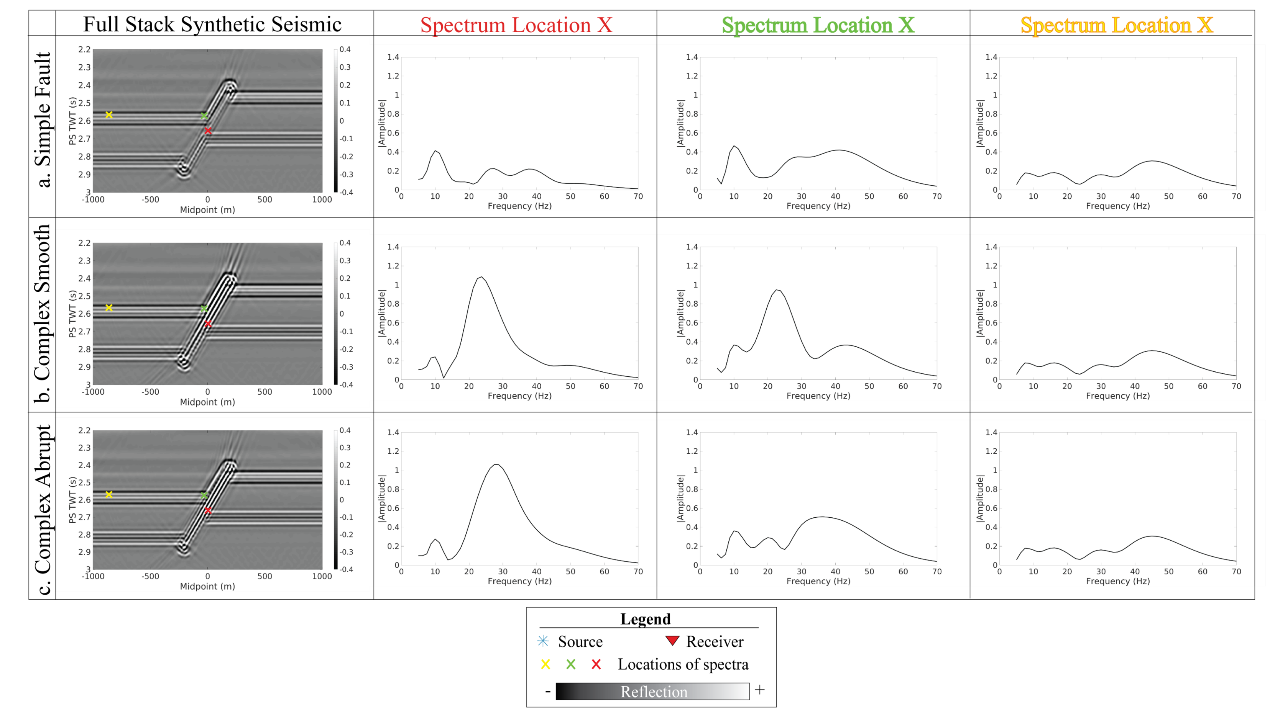
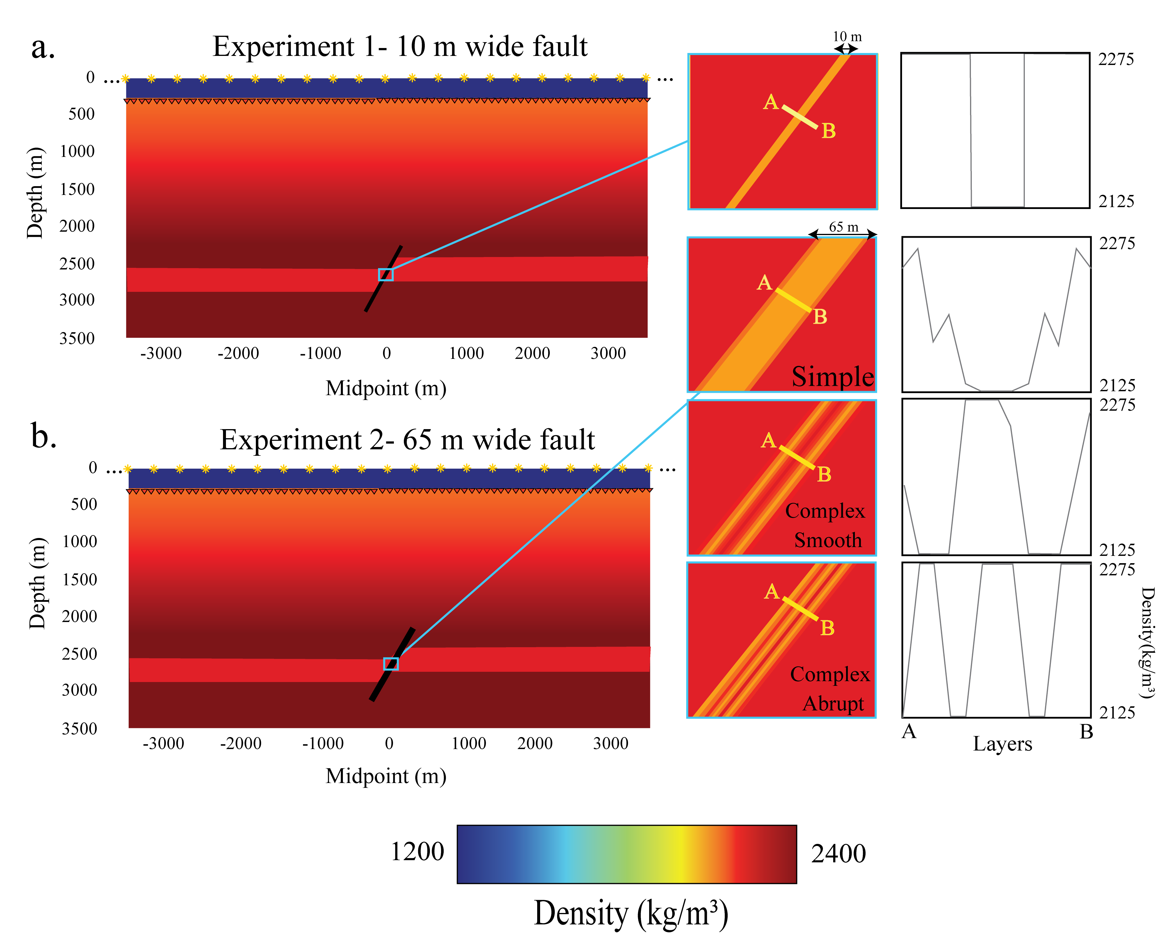
Part 2: Modelled Data
Frequency Analysis
In modelled fault: dominant frequency increases with fault complexity.
Adjacent to fault: Dominant frequency increases with fault complexity: the signal is affected by the fault.
Away from fault: Consistent across all models and not affected by the fault
Notes:
This experiment was run using three different geological models. The first has simple velocity transitions, second complex smooth and third complex abrupt
In all cases an amplitude spectrum was extracted from three locations in the data.
The red marker- inside the fault- increase with complexity
Green- adjacent- increase with complexity
Yellow-no change regardless of complexity.
Some shortcomings- the contrast between the faults and horizons in this data has been amplitfied when comparted to the snohvit data.

Slide 13
Part 2: Conclusions
Snøhvit Data: low-medium frequency shadows surrounded by medium frequency haloes.
Modelling: The more complex the fault is, the higher the frequencies are in and near the fault.
Frequency changes in both datasets are interpreted to be linked to the internal acoustic properties (lithology) of faults. The modelling also proved that the frequencies of the horizon terminations with the fault are influenced by the higher frequencies in the fault zones. This was also observed in the Snøhvit data.
Modeled Data
Snøhvit Data
Notes:
As shown in slide.
Some other things to mention: The Snøhvit data likely has complex and very large scale faults in the subsurface. The contrast between the fault and horizons is very different to what we have created in the modelling. The models have been “exaggerated” to understand the effect of internal fault architecture of the faults relative to the horizons.
We do believe the same raltionship in the subsurface for the snohvit data, just much less obvious.

Slide 14
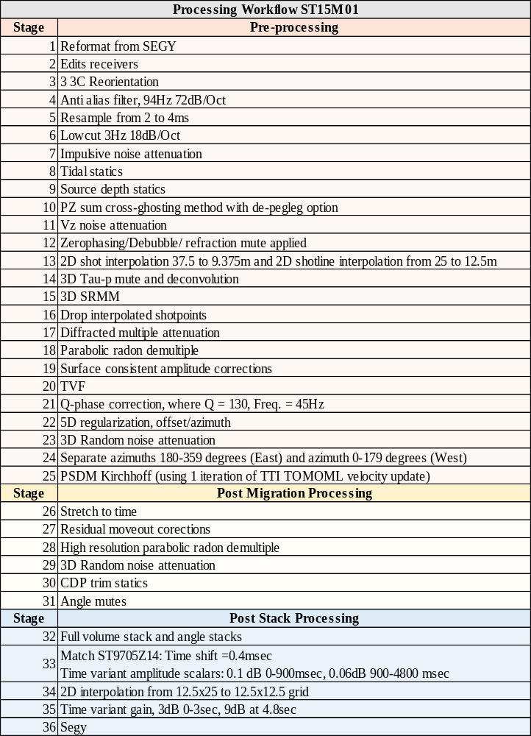

Slide 15
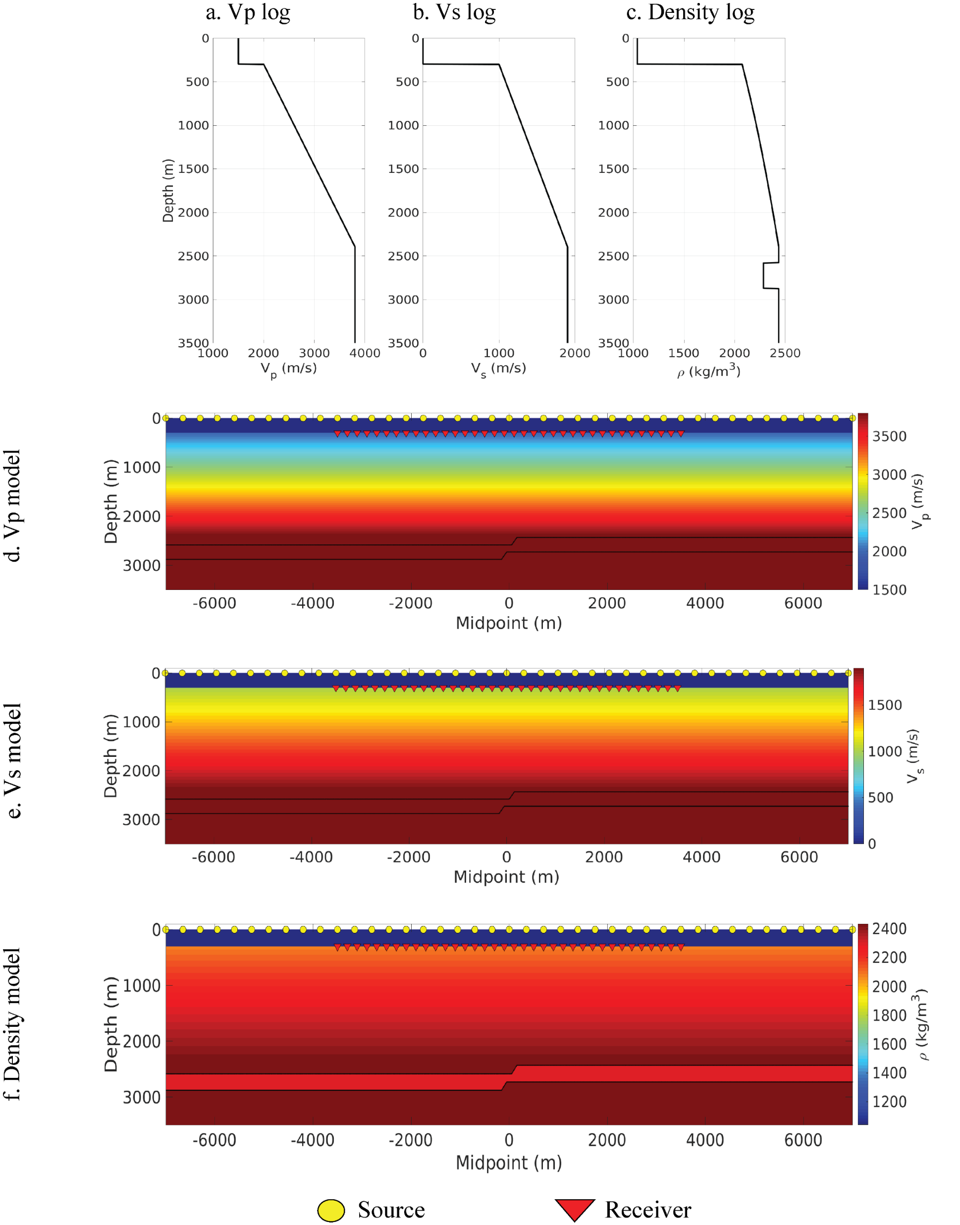
Further info on modelling

Slide 16
Further info on modelling

Slide 17
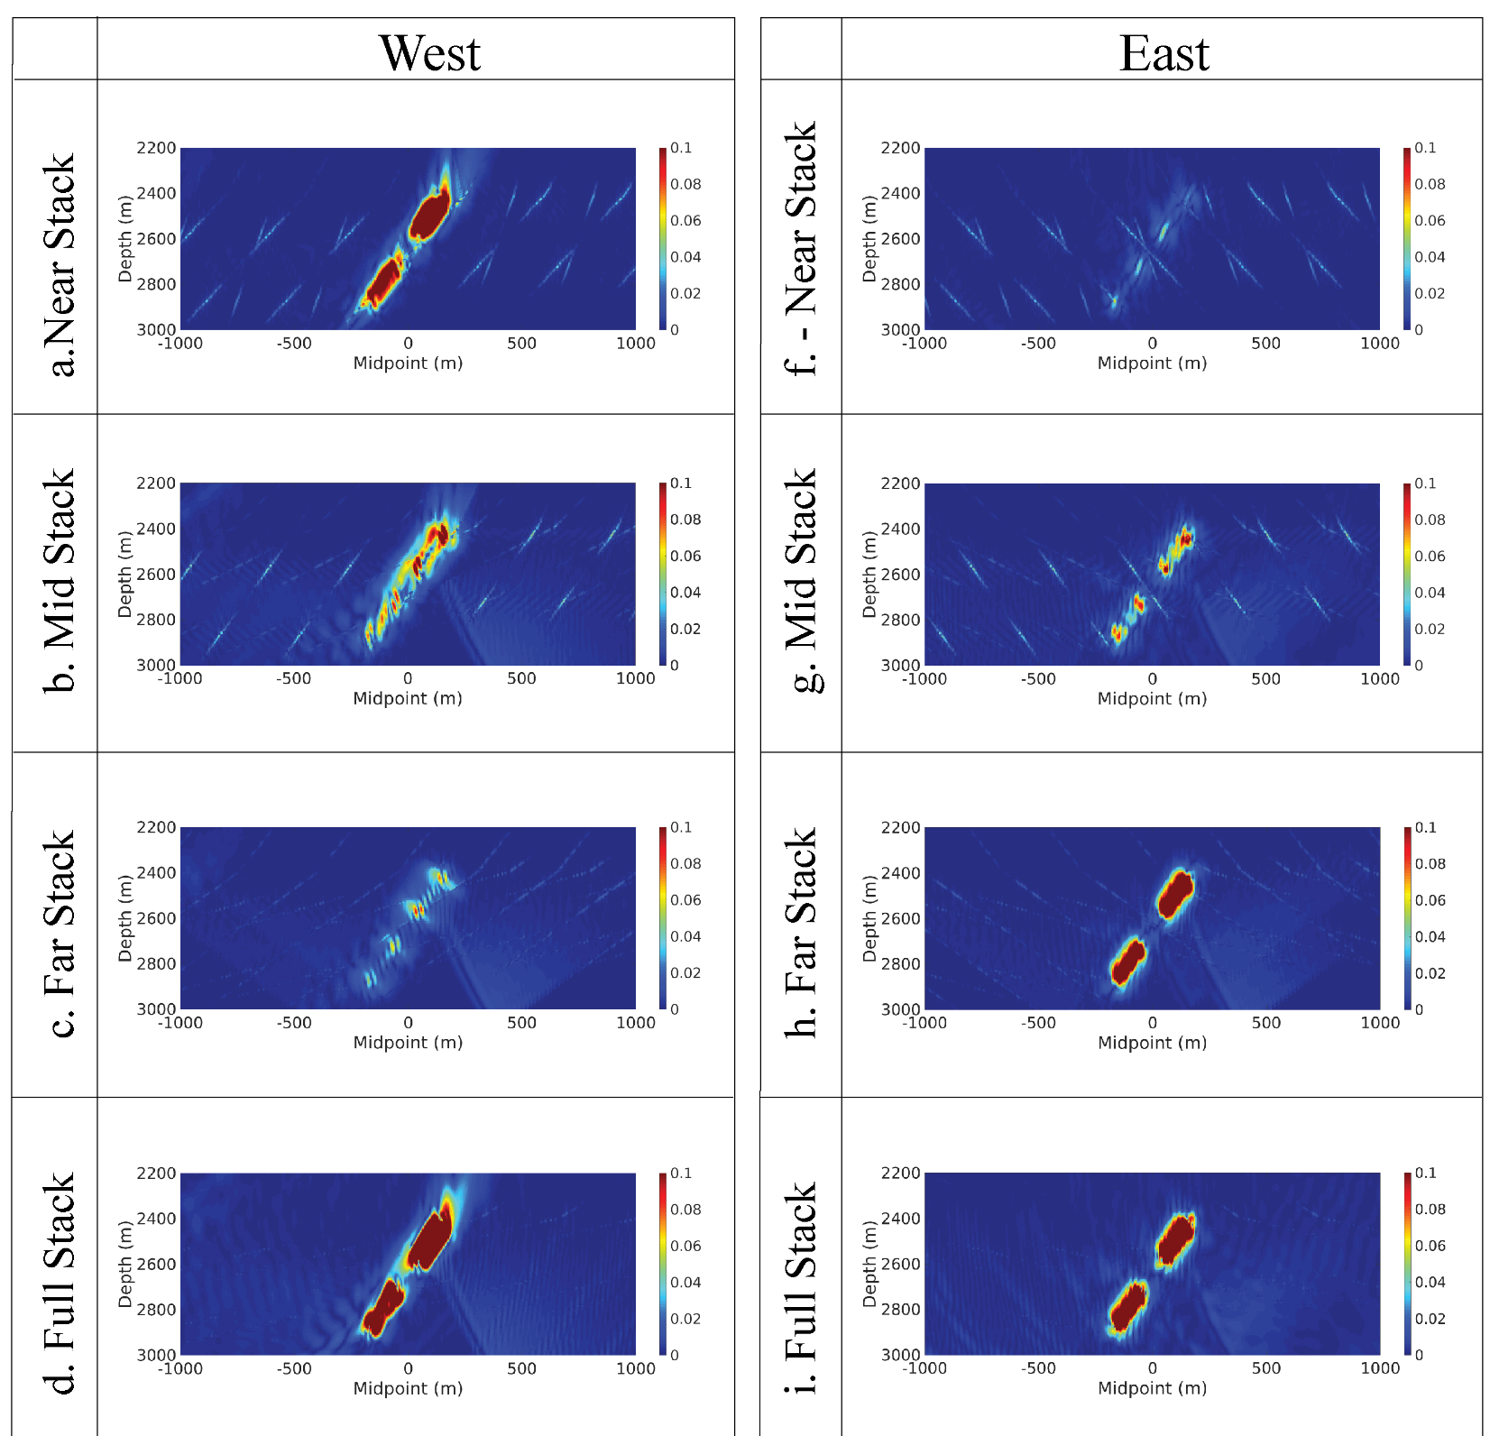
Part 1: Modelled Data
Azimuthal separation comparison
The image on the left is the Envelope attribute of the lateral gradient attribute of experiment 1.
The results show the W data is more effective at imaging the faults, but it is harder to conclude on how incidence stacking has impacted fault imaging.
Notes:
In the azimuthally separated data, the W data is almost always better at imaging the discontiuinity planes. In the near E you can see there is no signal created. This proves the importance of seismic geometry in fault imaging. Since the acoustic wave was not returned to receivers from the duiscontinuity plane
We proved these concepts by running some raytracing.
In figure to L you can see a single fault much more data is returned by west going waves. The E data is far less dominant. We weer also able to see the impact of shot position and incidence angle on the imaging, W were dominanat in both cases.

