Slide 1
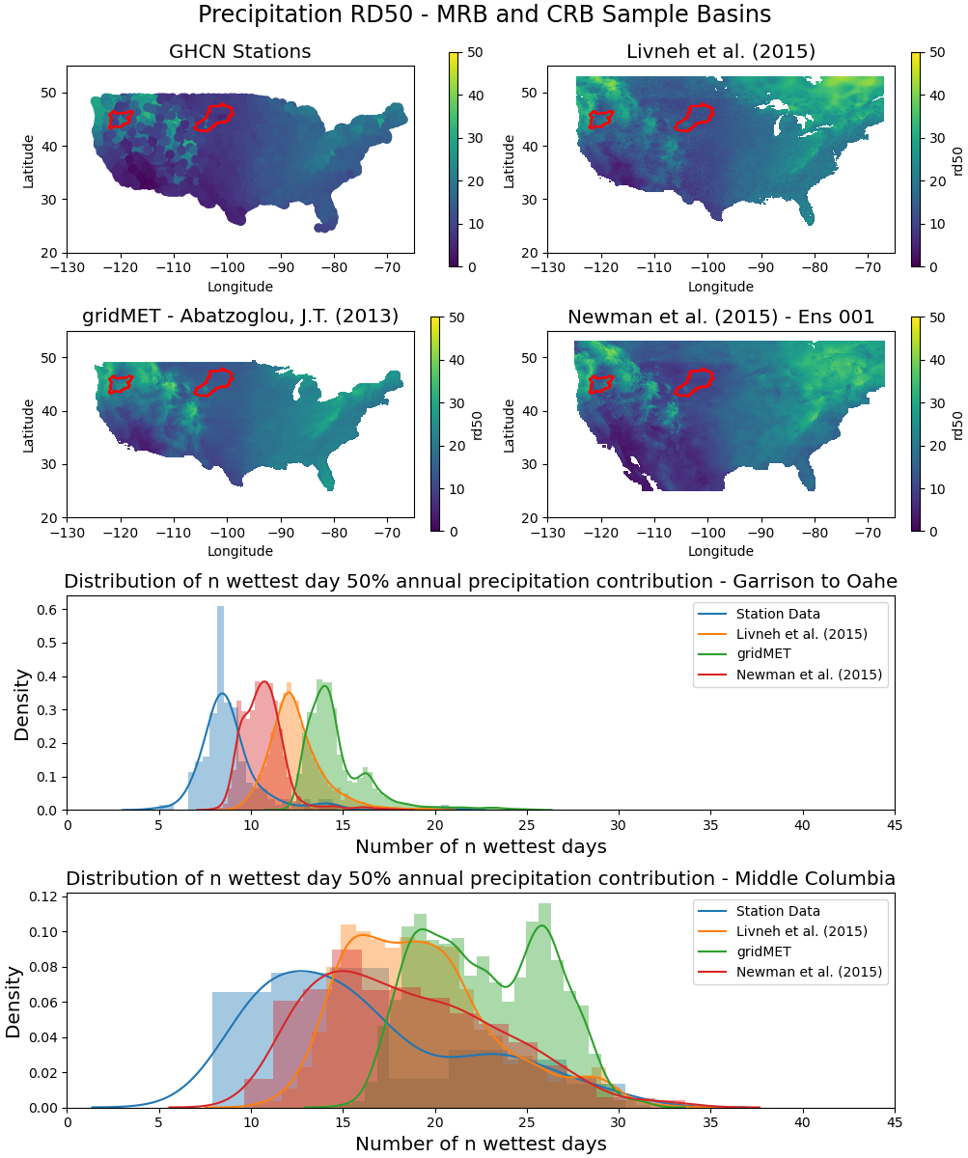
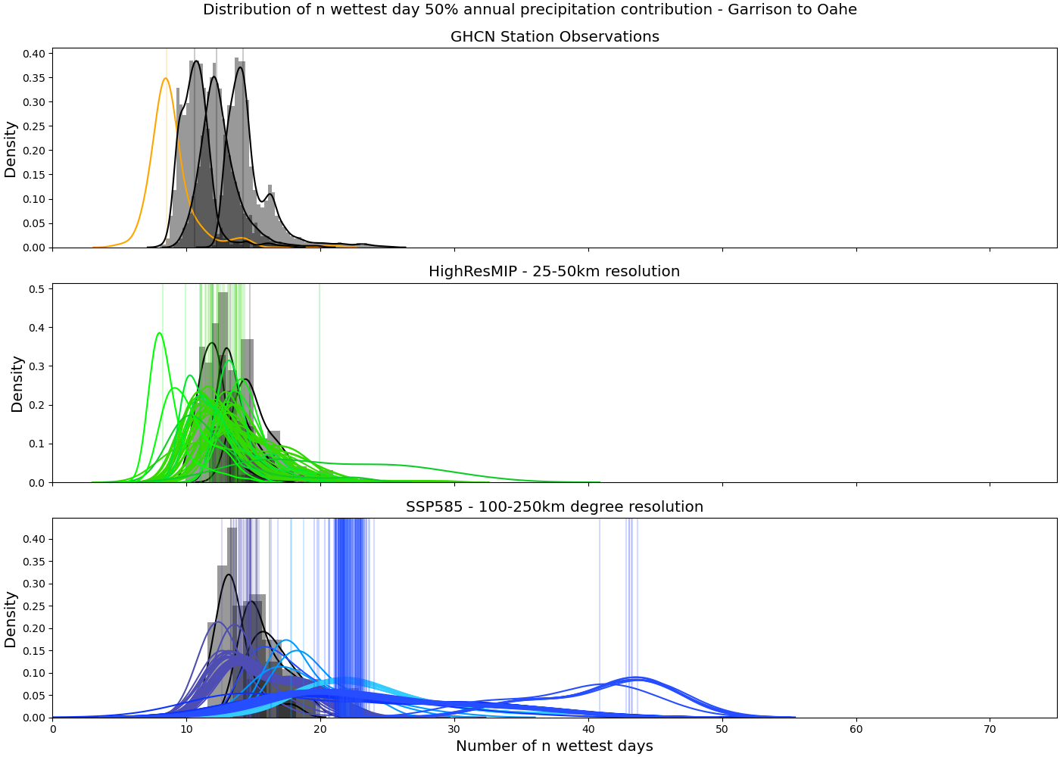
A multi-resolution analysis of historical and future precipitation variability across the western United States
Nels Bjarke, Ben Livneh, Joseph Barsugli, Xiao Wei Quan, and Martin Hoerling
- Gridded Observational Precipitation
- GHCN Station Precipitation
- Gridded Observational Precipitation – Coarsened to 50km
- HighResMIP Simulations
- Gridded Observational Precipitation – Coarsened to 250 km
- SSP585 Simulations

