Slide 1
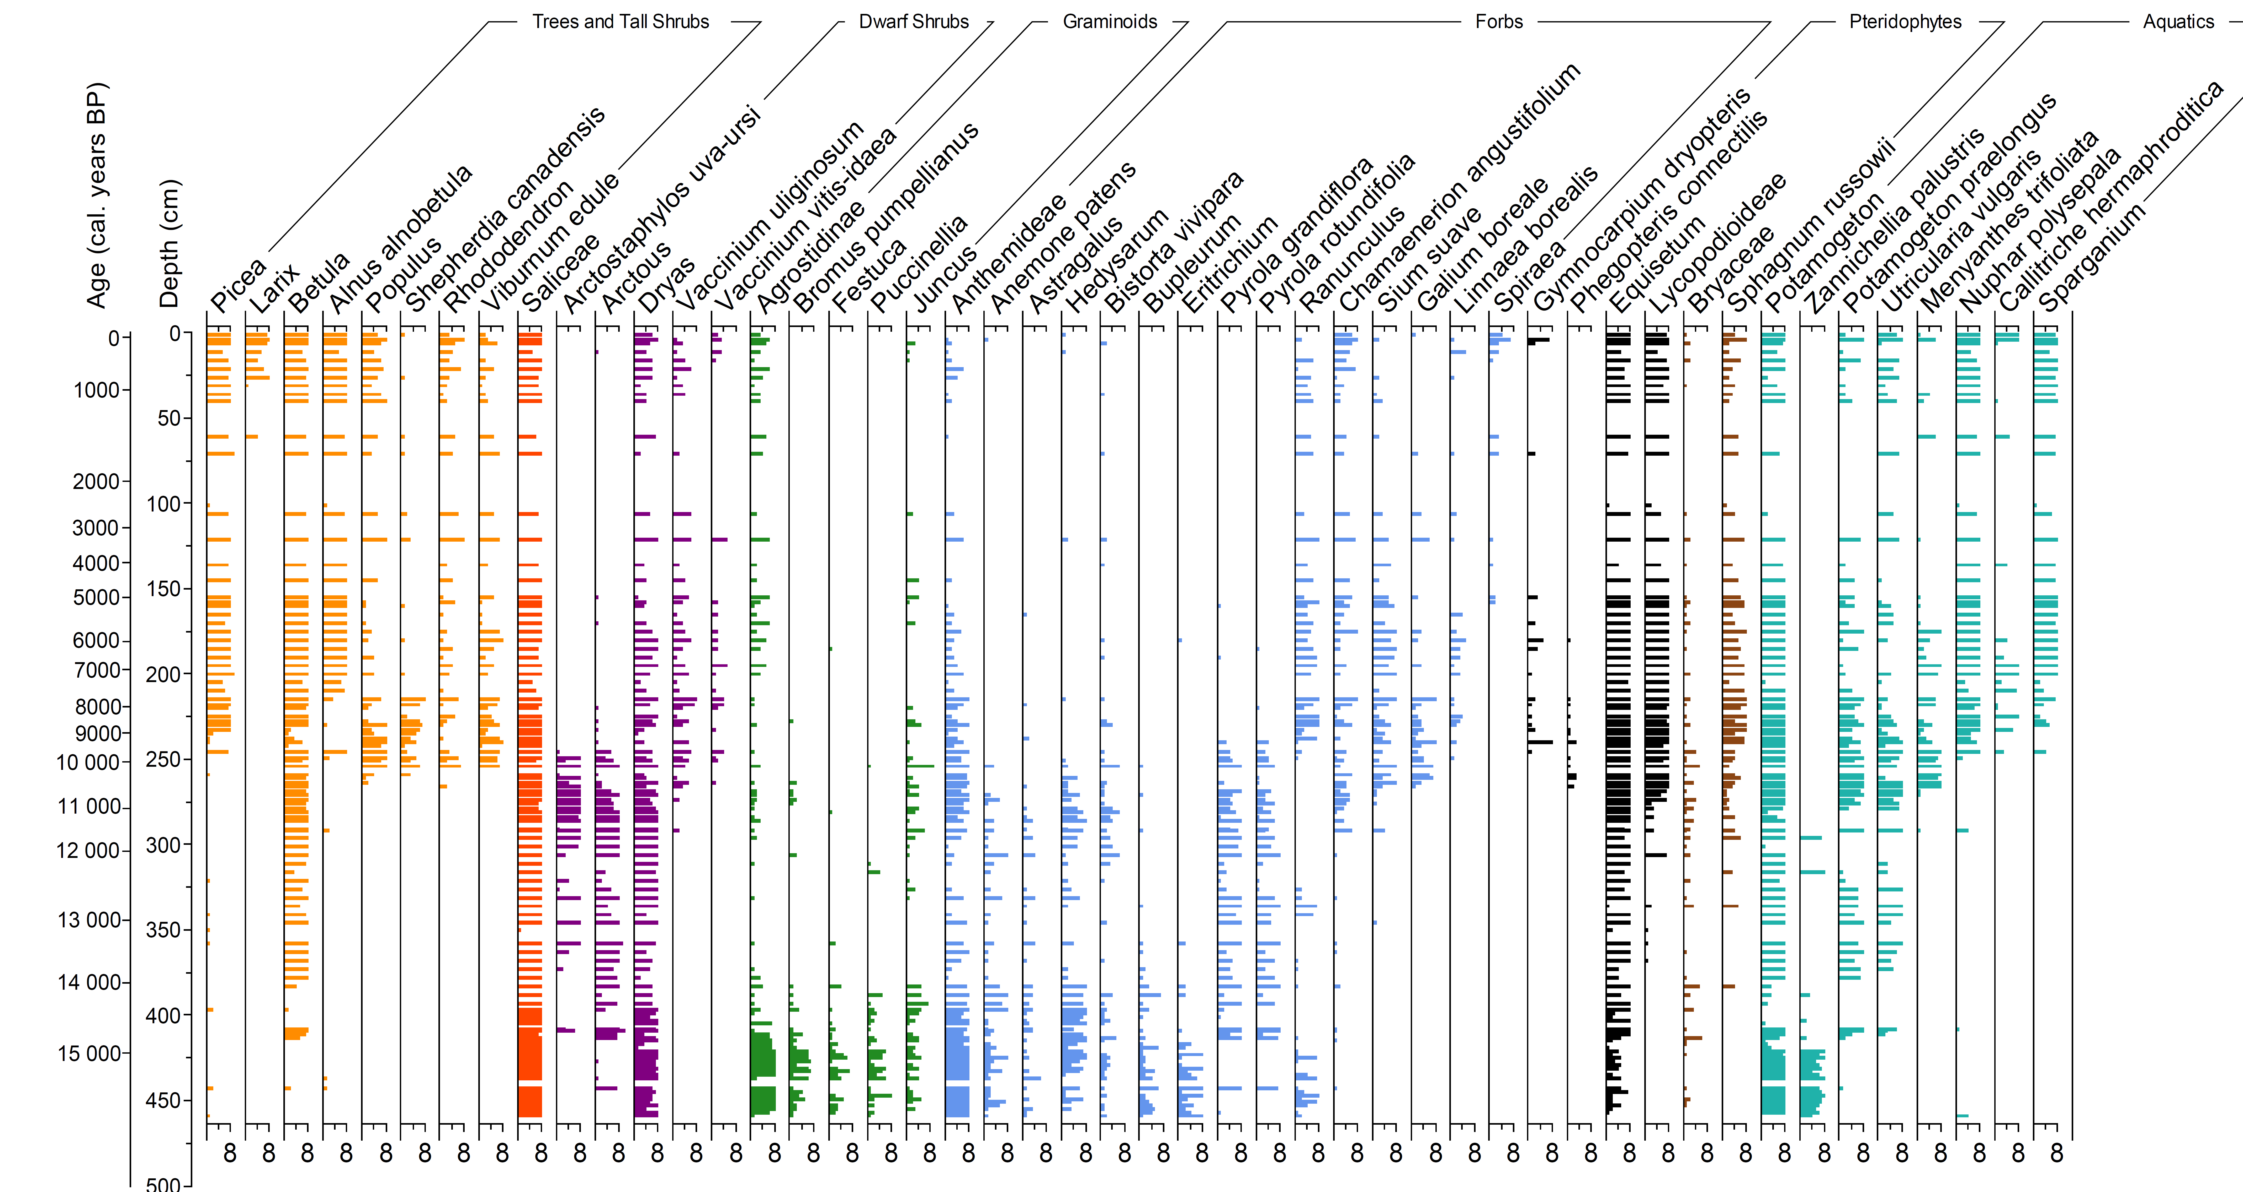
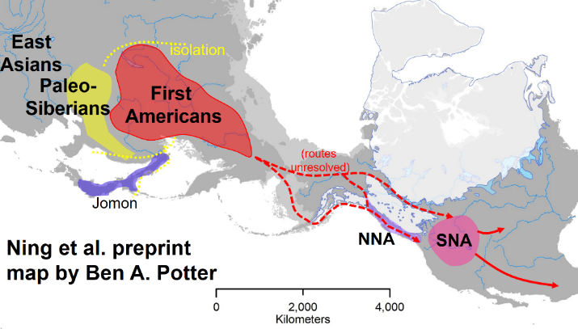
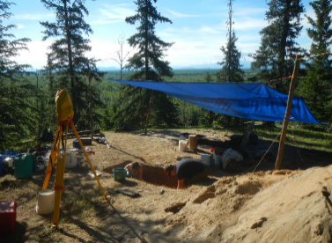




Late Quaternary vegetation dynamics in interior Alaska revealed by sedimentary ancient DNA (sedaDNA) from lake sediment and unfrozen (loessic) archaeological sediments
Charlotte Clarke, Mary Edwards, Nancy Bigelow, Peter Heintzman, Ben Potter , Inger Alsos and Joshua Reuther
The first humans arrived in interior Alaska just before and during a major reorganization of climate, fauna and vegetation ~14 ka BP. What resources were available, and how did they change through this transition?
16-13 ka BP
A sedaDNA record from Chisholm Lake, in the middle Tanana valley (Charlotte Clarke) shows grass-forb (open) vegetation giving way to shrub-dominated vegetation between 15 and 14 ka BP. At this time, megafaunal taxa such as mammoth and horse we still present in the region. Open-landscape plant taxa remained a component of the shrub vegetation and appear in sedaDNA samples from unfrozen archaeological sites ~13 ka BP; samples also include birch, willow and poplar, matching charcoal IDs from hearths. In some horizons, however, DNA of spruce and alder may reflect some downward penetration of roots, but not complete mixing of modern material.
Tanana valley early archaeological site (Josh Reuther)
Notes:
2-minute slide

Slide 2
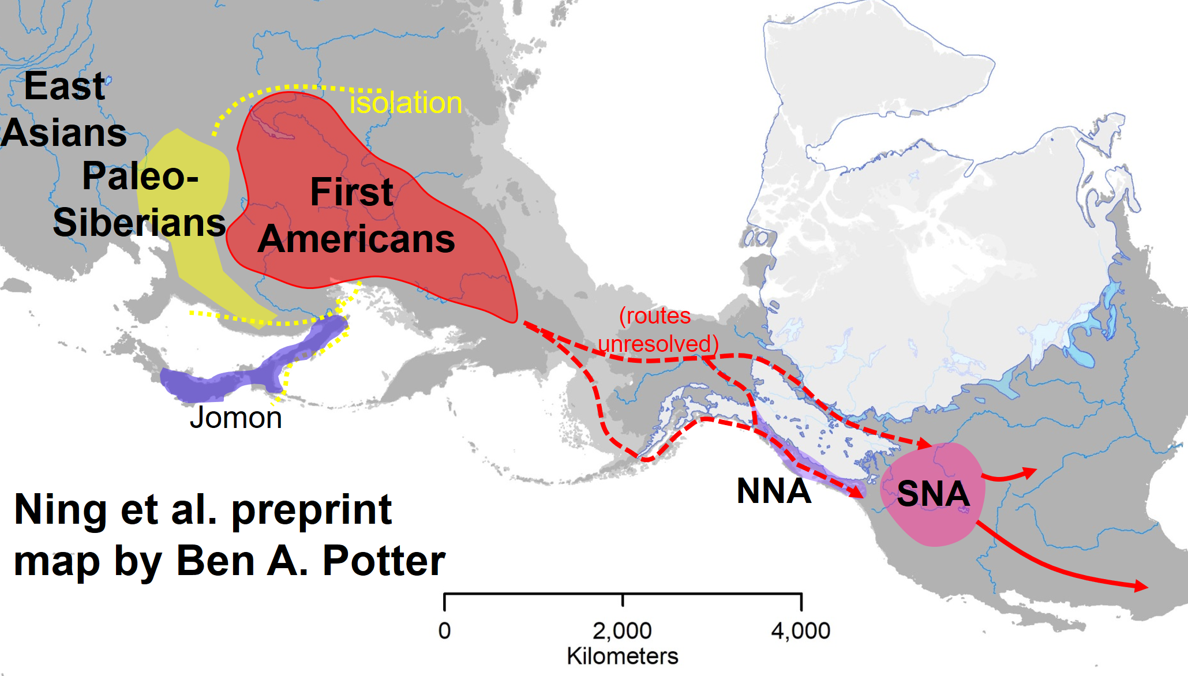
Late Quaternary vegetation dynamics in interior Alaska revealed by sedimentary ancient DNA (sedaDNA) from lake sediment and unfrozen (loessic) archaeological sediments
OVERVIEW
The aim to use sedaDNA to enhance our understanding of the biological resources available to the first human communities in interior Alaska and how these changed with the major climate changes of deglaciation ca. 14-9 ka BP. We compare a catchment-scale record from a lake in the valley with individual samples taken from loess sections within archaeological sites, the oldest dating from ca. 13 ka BP.
A secondary aim is to examine preservation characteristics of sedaDNA in unfrozen loess deposits and infer taphonomic processes and problems.
This presentation is focused on plant sedaDNA
Human migration to Alaska in the late Pleistocene and environmental change
Regional vegetation changes – Chisholm Lake sedaDNA record
sedaDNA from archaeological sites in the Tanana Valley
Conclusions
Notes:
Structure of longer presentation

Slide 3
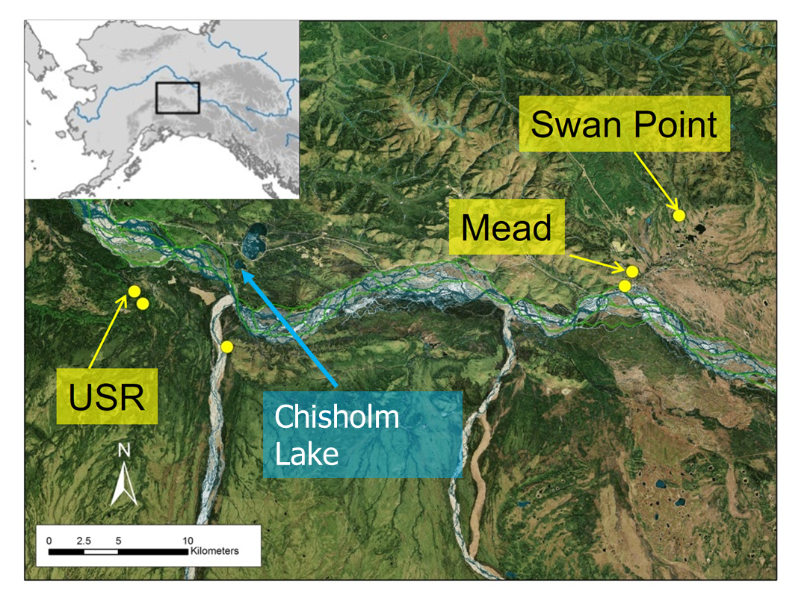

Human migration to Alaska in the late Pleistocene and environmental change
Site Map
16-13 ka BP
The oldest well dated early human sites in northern North America are in the Tanana valley of interior Alaska. People migrated across the Bering Land Bridge as the changes associated with global deglaciation triggered a warming and moistening of the climate and a related shift from tundra-steppe to vegetation largely dominated by deciduous woody plants.
Map: Ben Potter
We examined sedaDNA from several archaeological sites (3 discussed here) and a long sediment core from Chisholm Lake. USR – Upward Sun River

Slide 4
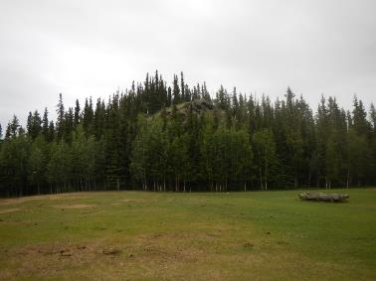
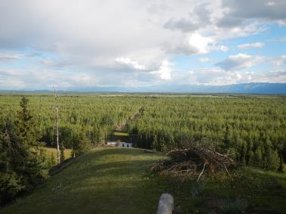
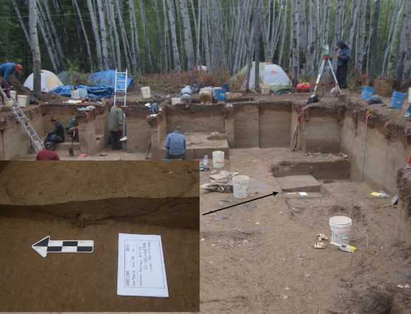
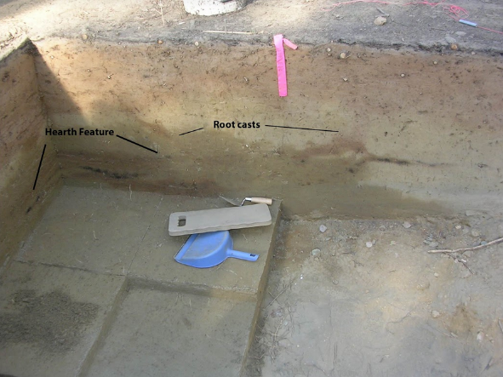
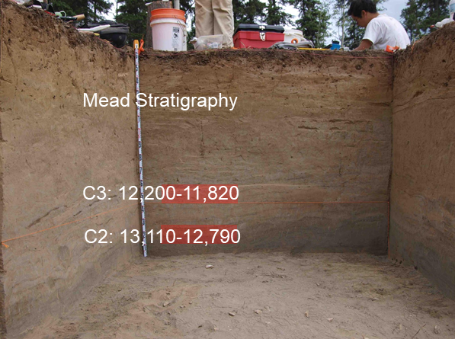
Sites are located on hilltops or locations that otherwise afford overlooks of the floodplain and/or wetland areas. Occupation horizons are within, and are overlain by, late-Pleistocene/Holocene loess deposits. Samples for DNA analysis were collected from freshly cleaned walls using sterile equipment.
Upward Sun River (Potter et al 2011 Science) contains a pit with a child burial and and a house site dating to ~11.5 ka BP.
At Swan Point human occupation dates to at least 14.0 ka BP, but the loess cover is relatively thin.
Occupation of the Mead site also dates to at least 14 ka BP, and here the loess is up to 4 m thick.

Slide 5
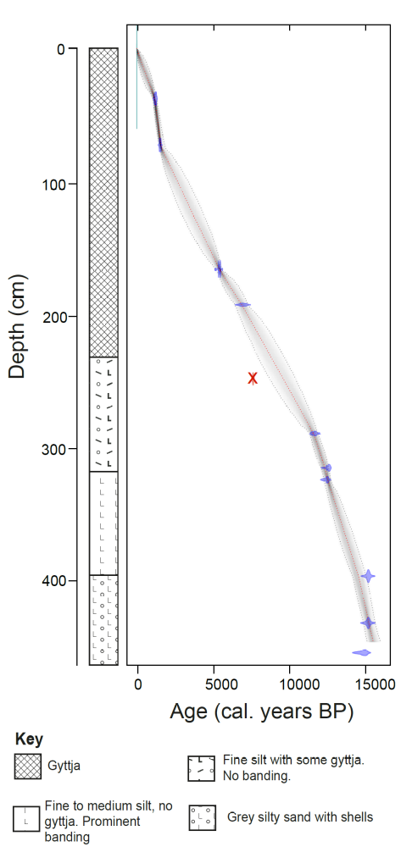
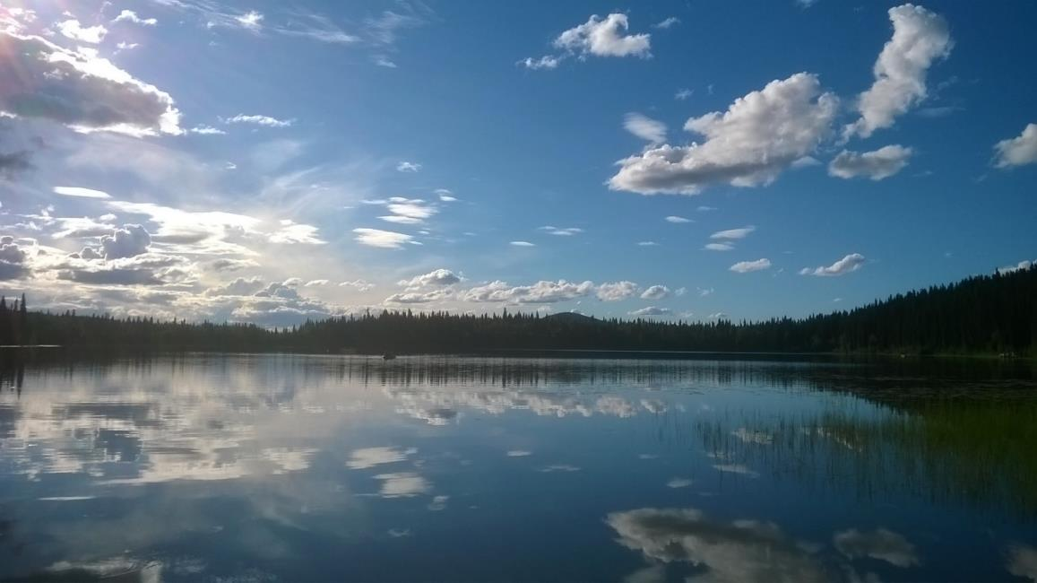
Regional vegetation changes – Chisholm Lake sedaDNA record
Chisholm Lake (64º18’8.345” N, 146º41’17.705” W) in the Tanana River valley lies at 240 m a.s.l. Surface area ~31 ha, catchment area of 780 ha. Surrounded by northern boreal forest.
Age-depth model is based on 10 dates (plus one outlier omitted). Water depth ~10 m. Core length ~4.5 m, taken over open water with a Livingstone piston corer. Anti-contamination procedures undertaken—no evidence of tracer in samples. sedaDNA analysis (Tromsø): metabarcoding of 120 sediment samples and catalogues of arctic and boreal vascular plant taxa plus bryophytes [DNA methods follow those described in Rijal et al. 2020 BioRxiv.].

Slide 6
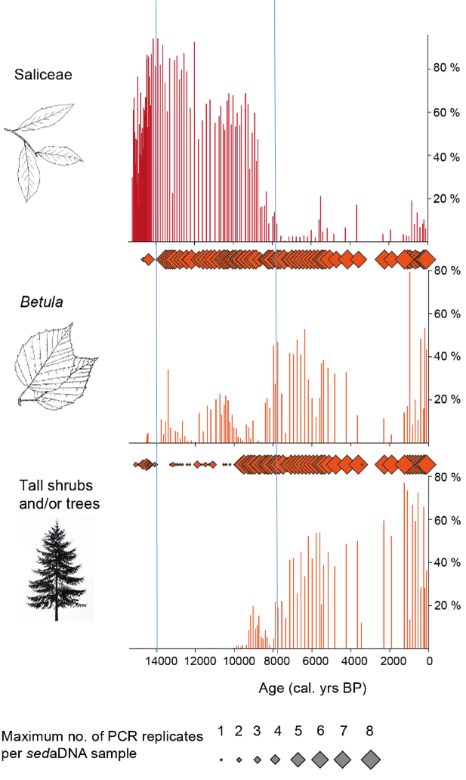
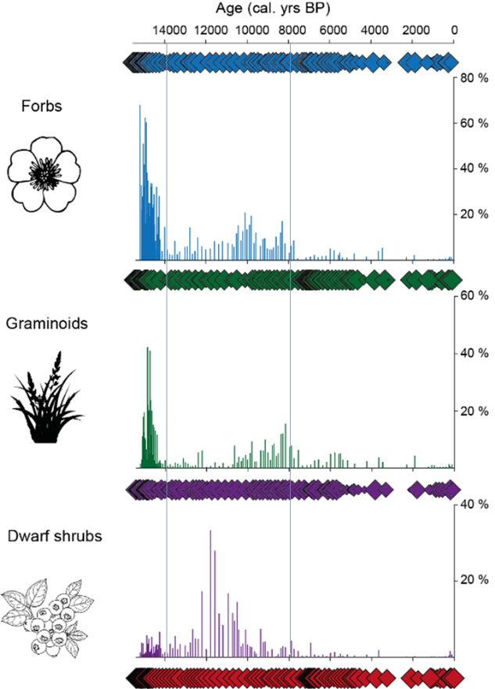
Plant functional groups (percent read abundance) summarize the main vegetation changes
An early period dominated by grasses and forbs until ~14 ka BP
A mixture of dwarf and tall shrub taxa ~14-8 ka
Expansion of spruce and associated taxa from ~10 ka BP, then dominance of forest taxa until the present
Salix present in both early period (probably prostrate) and also shrub zone
167 vascular plant and 14 bryophyte taxa
45 % identified to species, 39% to genus and 16 % higher taxonomic level.
Charlotte Clarke

Slide 7
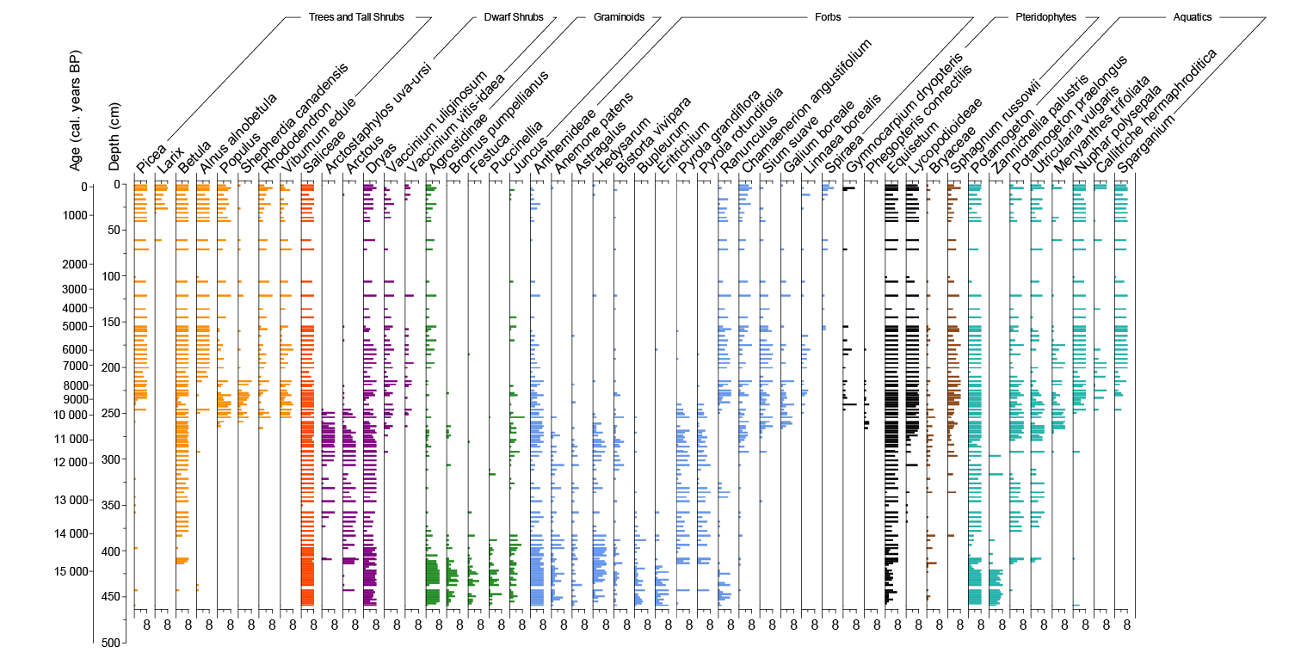
sedaDNA taxa (summary of common woody plants, graminoids and Equisetum) at Chisholm Lake
Position of archaeological horizons located using ¹⁴C chronologies: USRB – Upward Sun River Burial horizon (11.5 ka BP); MEAD 2 – Mead component 2, SP – Swan Point (both ~13.0 ka BP). DNA taxa from the sites can be compared with the taxa recorded at Chisholm Lake
USRB
MEAD 2 and SP
Ca. 14 ka BP
Charlotte Clarke
There are 48 forb taxa, ~30 of which form an important component, along with 7 grass taxa, of the pre-14 ka vegetation. Many forbs continue as a component of the deciduous woody vegetation that developed subsequently, about the time of the first human arrivals. The floristic richness compares favourably with pollen data from the lake (Tinner et al 2006 Veg Hist Arch), which records 23 taxa with low and sporadic values. The sedaDNA highlights the forb-rich tundra and steppe elements of the open late-Pleistocene vegetation (prior to 14 ka BP).

Slide 8

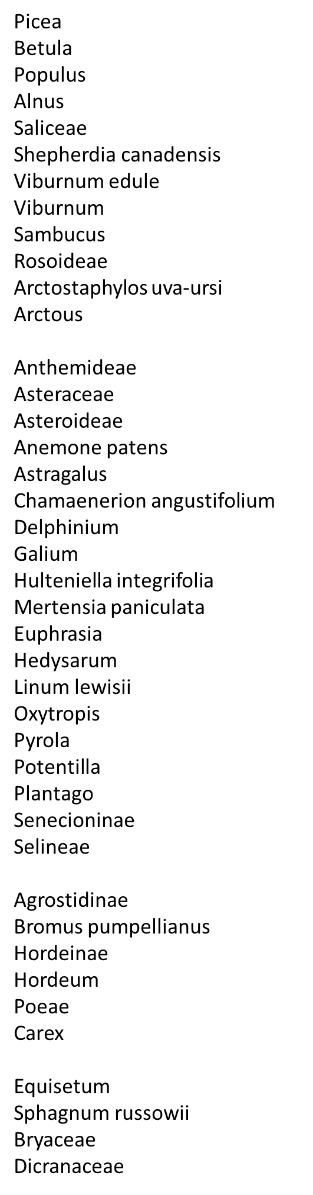
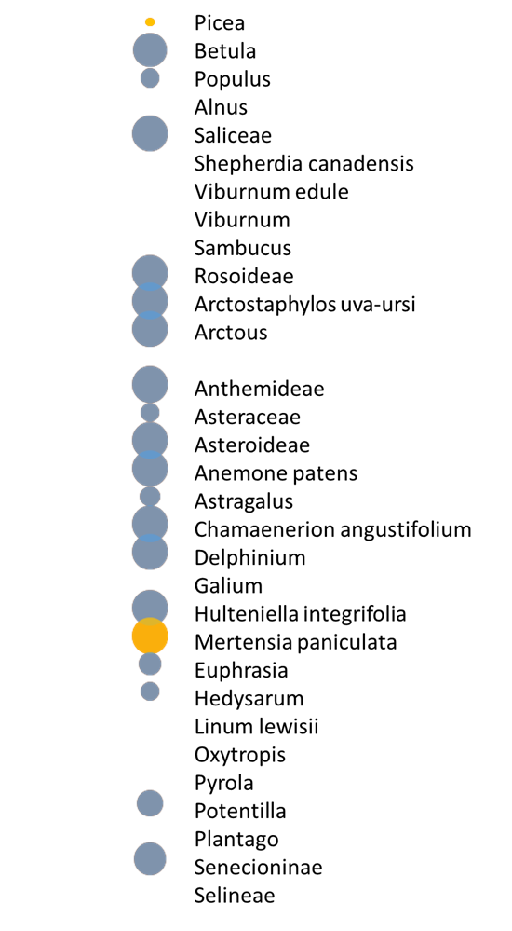
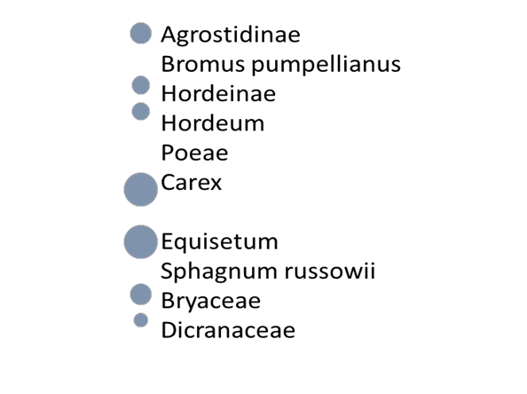

Eager Arch 08: Component 2 Mead 13,000 BP
sedaDNA from archaeological sites in the Tanana Valley
MEAD
Eager Arch 09: Component 2 Mead 13,000 BP
Woody
Not all taxa shown. No bubble, taxon absent.
Woody
Graminoids
Lower plants
Forbs
Forbs
The oldest Mead horizon has a DNA flora that largely matches Chisholm’s flora at 13,000 ka BP. The exceptions are Picea and Populus (see SP), plus a few other taxa that are absent from Chisholm but could have been present, based on their modern ecology
Bubble size: proportion of sample replicates (weighted)
Contemporaneous at Chisholm Lake
Not contemporaneous at CL, but probable/possible
Not recorded at CL, but in local boreal steppe today
Not contemporaneous at CL

Slide 9
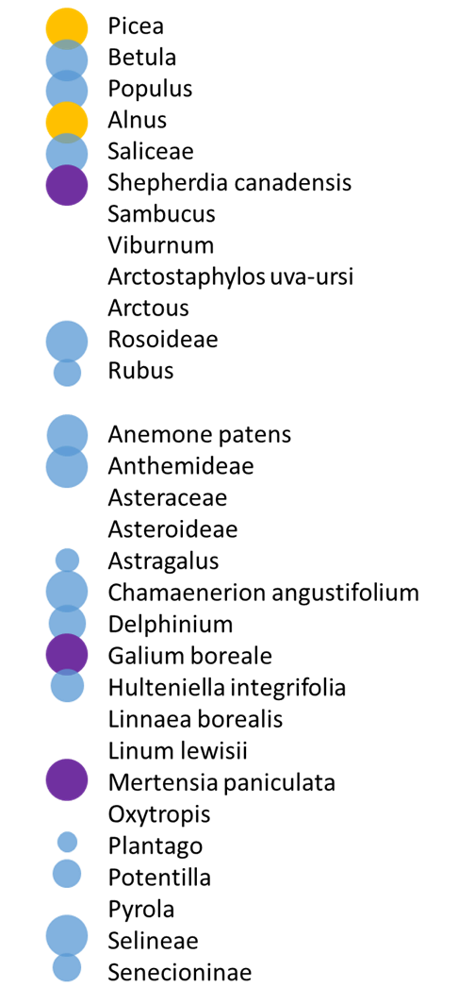
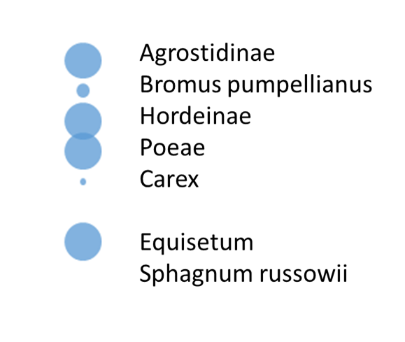
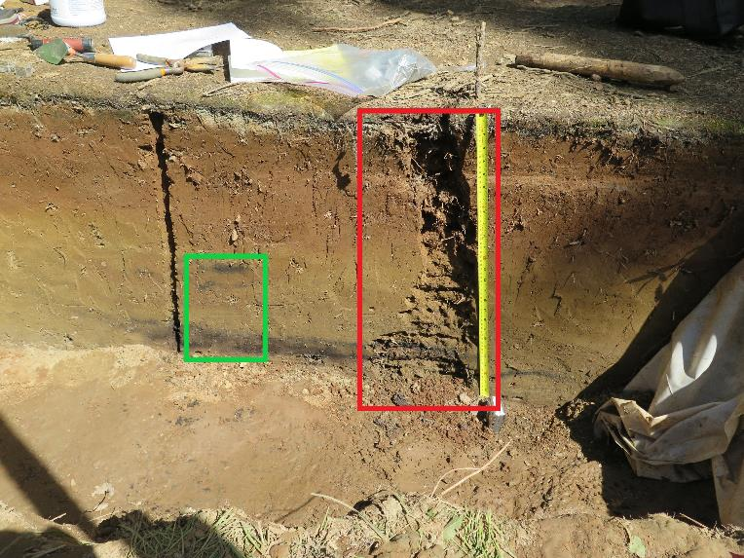
SWAN POINT
Swan point has the shallowest loess cover. Sample from basal loess (62-64 cm depth; green rectangle), probably 13-14 ka BP (dating underway). Rootlets are visible in the excavated wall. While most taxa are consistent with the Chisholm Lake record, Picea, Alnus are unlikely to be contemporaneous; Populus is not present at Chisholm but is recorded elsewhere in Alaska at this time.
Woody
EAG_ARCH_48: Swan Point
N94.78 E102, East Wall, basal loess, 62-64 cmBS
Forbs
Graminoids
Contemporaneous at Chisholm Lake
Not contemporaneous at CL, but prob/poss
Not contemporaneous at CL

Slide 10
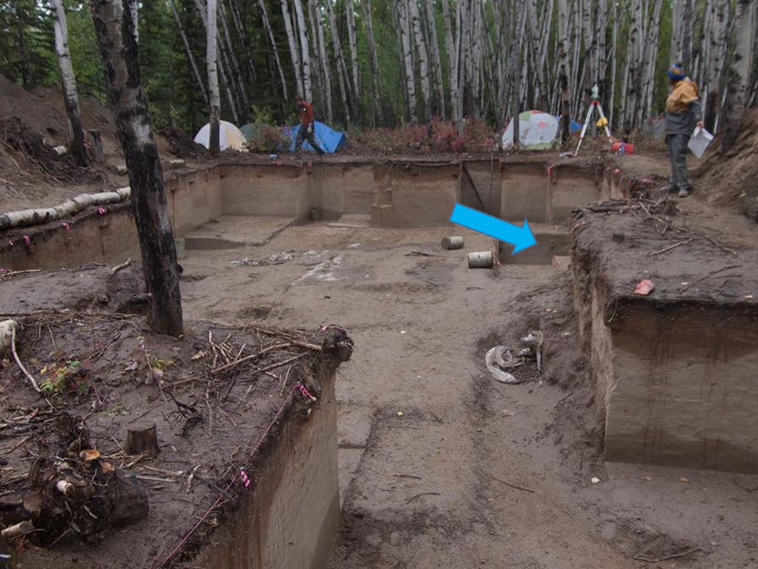
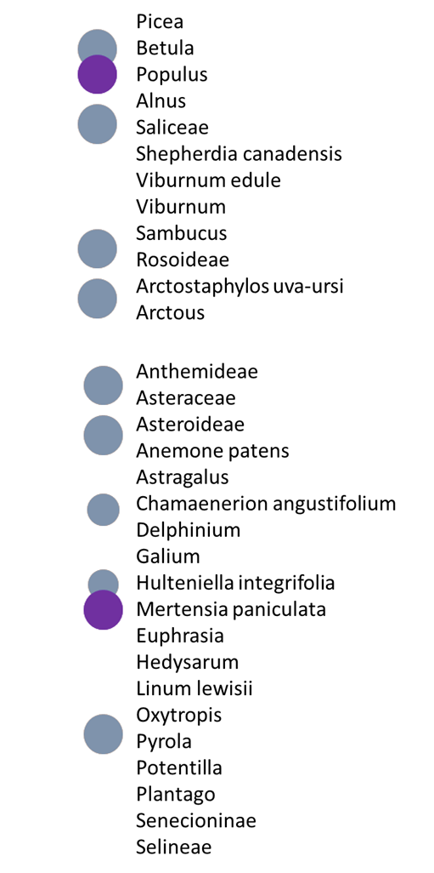

Upward Sun River, Component 3 (11,500 cal yr BP), Feature 2011-13 (burial pit)
UPWARD SUN RIVER
Woody
Graminoids
Forbs
DNA was successfully retrieved from one of three samples from the burial pit, which was dug downward into the ancient surface to accommodate the remains and then rapidly filled.
The sample is not particularly rich floristically, but all taxa represent possible contemporaneous occurrences. All taxa occur at Chisholm lake at 11-11.5 ka BP, except Mertensia, which is widespread in varied habitats in Alaska and could be contemporaneous with the horizon. The deep position in the burial site suggests that the material has been shielded from downward penetration from later accumulating surfaces. There are no taxa indicative of contamination from above. Populus, Betula and Salix also appear as macrofossils in occupation horizons at this time.
Photo: Ben Potter
Contemporaneous at Chisholm Lake
Not contemporaneous at CL but probable
Notes:
There is possibly an issue with spruce (Picea) as it has been implicated in laboratory contamination (via paper products). We therefore examined Picea in the controls carefully, and we conclude that the spruce signal comes from the samples. If it were lab- or reagent-related then our controls would positive far more than was observed. Spruce sequences do occur in controls but only with very sporadic amplification.

Slide 11
Conclusions
The sedaDNA metabarcoding approach has worked well at Chisholm Lake and provides an exceptional insight into the composition of the open vegetation that was widespread until ~14 ka BP. Floristic composition shows tundra and steppe elements. Woody vegetation (Betula, Salix) began to dominate the landscape ~14 ka BP but many taxa of the forb flora persisted. Spruce (Picea) forest established ca 10 ka BP.
At archaeological sites (samples from loess horizons, hearths and burial pit), all non-frozen samples that amplified seem to have worked well (replicability is high). Those that did not amplify [e.g., two from Component 3 (11,500 cal yr BP), Feature 2011-13 (burial pit] were inhibited (clear discoloration of extracts).
Comparison with the Chisholm flora acted as a “reality check” on the archaeological samples. In some samples, appearance of Alnus (alder) suggests contamination by) downward penetrations of roots. Other “suspect” taxa are Picea (spruce), which probably expanded ~10 ka BP and thus should not appear in the oldest horizons (such as Mead 2), and other taxa typical of spruce forest that first appear in the Chisholm record at the same time as spruce. The pattern is most pronounced at Swan Point, which has the thinnest loess cap and where some root penetration can be seen in the exposed walls of the site.
Downward root penetration is likely to occur in any non-waterlogged soil profile, whether or not it overlies permafrost, and thus at their inception, all horizons lie within a zone of biological mixing with a time-span that will depend on the rate at which sediment accumulation buries the horizon below the active rooting zone. The absence in most older archaeological samples of Sphagnum (which has no root penetration) indicates that there is not complete top-down mixing of material into the lowest levels.
Notes:
Further work involves modern samples taken at distance from archaeological sites and within bison pastures. We are exploring the mammalian palaeorecord, but results are not yet available.

Slide 12
Authors and Affiliations
Charlotte Clarke¹, Mary Edwards^{1,2*}, Nancy Bigelow², Peter Heintzman³, Ben Potter⁴ , Inger Alsos³ and Joshua Reuther^{4,5}
¹ School of Geography and Environmental Science, University of Southampton, Southampton, United Kingdom. *m.e.edwards@soton.ac.uk
² Alaska Quaternary Center, University of Alaska Fairbanks, Fairbanks, USA.
³ The Arctic University Museum of Norway, UiT- The Arctic University of Norway, Tromsø, Norway.
⁴ Arctic Studies Centre, Liaocheng University, P.R. China.
⁵ University of Alaska Museum of the North, University of Alaska Fairbanks, Fairbanks, USA.
Acknowledgements: Work was supported by NSF Grant 180122 to Nancy Bigelow and a NERC Spitfire studentship (NE/L002531/1) to Charlotte Clarke. ¹⁴C dating supported by NERC allocation 2140.1018 to CC. Youri Lammers contributed to the sequence analysis. Marie Kristine Føreid Merkel provided technical assistance during laboratory work.
Notes and References:
Bubble size reflects the proportion of weighted PCR replicates, whereby the replicates are weighted by relative sequencing depth. This reduces the impact of dropout from under-sequenced replicates. See Rijal et al. 2020.
There is possibly an issue with spruce (Picea), as it has been implicated in laboratory contamination (via paper products). We therefore examined Picea in the controls carefully, and we conclude that the spruce signal comes from the samples. Spruce sequences do occur in controls but only with highly sporadic amplification. If it were lab- or reagent-related then our controls would positive far more than was observed.
Further work involves exploration of modern samples taken at distance from archaeological sites and within bison pastures. We are developing the mammalian palaeorecord, but results are not yet available.
Potter et al. 2011. A Terminal Pleistocene Child Cremation and Residential Structure from Eastern Beringia. Science 331:1058-1062.
Rijal et al. 2020. Sedimentary ancient DNA shows terrestrial plant richness continuously increased over the Holocene in northern Fennoscandia. https://www.biorxiv.org/content/10.1101/2020.11.16.384065v2

