Slide 1
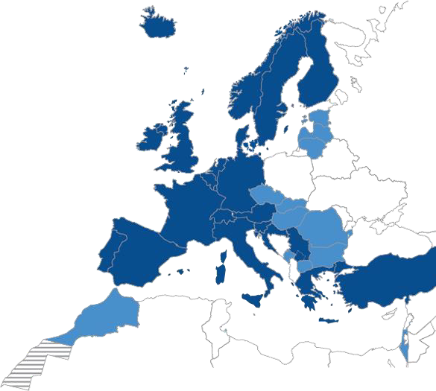
















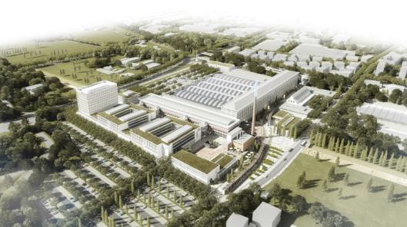


ECMWF’s Data Handling System migration to the Bologna Data Centre.
Sébastien Denvil, Manuel Fuentes, Matthew Manoussakis, Sebastien Villaume, Tiago Quintino, Simon Smart, and Baudouin Raoult
What do we do?
Time Critical - Operational weather forecasting
High resolution 0-10 day, 00Z+12Z (O1280 (9km) 137 levels)
Ensemble 0-15 days, 00Z+12Z (O640 (18km) 91 levels)
Ensemble extended 16-46 days, twice weekly (O320 (36km) 91 levels)
Boundary Conditions 06Z and 18Z (hourly post-processing 0-5 days)
Non Time Critical - Research
Experiments to improve our models
Reforecasts, Climate reanalysis, etc
How will we swing our Data handling System to Bologna?
Join the chat to know more.
Production move
Cray HPC clusters
DHS (HPSS + MARS + ECFS)
Reading
Bologna
DHS Swing
Limited user access to DHS
Move most equipment between sites
Up to 4 weeks
DHS (HPSS+ MARS+ECFS)
Atos HPC clusters
Acquisition
IFS Model
Product generation
Product Dissemination
Member States &
Customers
Global Observations
Obs
Fields
Products
EUROPEAN CENTRE FOR MEDIUM-RANGE WEATHER FORECASTS

Slide 2
DHS-Swing - Terminology
Data Handling System(s): Main-DHS, Temporary-DHS, Main-DHS Blank
DHS-Swing, HPSS-Swing, Set Date: D
Dark-period: period of limited visibility to data (D + 28 days)
Dry-runs exercise services with users (infrastructure and applications): suites, dark-period
Temporary-DHS-copy: essential datasets only
  start production 4 months before dark period, until main-DHS is fully operational in Bologna
  read-only during the dark-period
  possibly accept double-archiving few weeks before dark period
Temporary-DHS-prod: new data only
  start production at the same time as dark period, in production for 6 days + back-archive
  read/write during the dark-period
  any data archived here during dry-runs will be discarded before dark period starts

Slide 3
DHS-Swing high-level timeline
4Q2019 1Q2020 2Q2020 3Q2020 4Q2020 1Q2021 2Q2021 3Q2021 4Q2021 1Q2022
V V V V V V V V V V
Production move
Cray HPC clusters
DHS (HPSS + MARS + ECFS)
Reading
Bologna
DHS (HPSS + MARS +ECFS)
Dates are based on access
to the building starting in Nov2020
DHS Swing
Limited user access to DHS
Move most equipment between sites
Up to 4 weeks
Atos HPC clusters

Slide 4
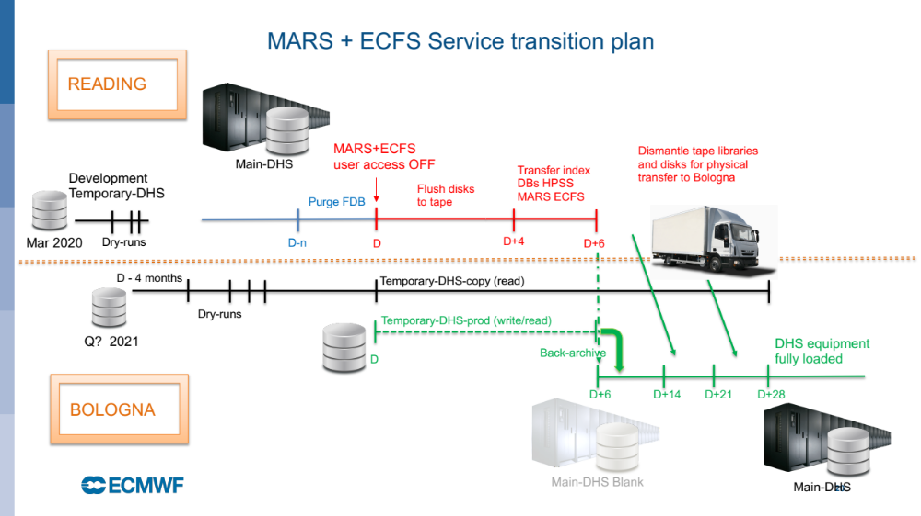
DHS-Swing
Temporary-DHS
HPSS-Swing
Temporary-DHS
Dark Period – 28 days

Slide 5

Log management : Turning machine data into Operational Intelligence
Log management platforms are used to store and analyze large amounts of machine logs.
We use Splunk to store and process logs from all our services.
Benefits:
  Improve operations: monitoring, troubleshooting and proactivity.
  Improve cooperation: sharing logs and tools and communicating findings
  Cultivate data-driven approach: decisions and plans based on data analysis
Use case:
  Apply log management ideas, on the dry runs for the migration of DHS to Bologna, to obtain optimal answers and make better decisions and plans
Notes:
Log management (LM) comprises an approach to dealing with large volumes of computer-generated log messages (machine data). (Log collection, Centralized log aggregation and analysis, search and reporting etc)
In DADS team:
Splunk since 2015
collecting and analysing massive amounts of logs (today's ingestion : ~4-6GB/day) from several components of all our services
Use cases and benefits:
Operational monitoring and troubleshooting, raising alarms, investigating issues, testing a new Web-API release etc
To gain smarter insights, obtain optimal answers and make better decisions and plans
…to cultivate a more data-driven approach
Also very helpful tool for analysing big amount of data for the migration to Bologna

Slide 6
Development temporary-DHS (Reading): suite dry-runs
Investigation phase
  Identify essential datasets by logging MARS and ECFS activity from most suites (prod + research)
  Use Splunk to analyze the activity
  Discuss with suite owners & challenge unnecessary access and suggest improvements
  Establish minimum set of datasets (MARS) and files (ECFS) required
  Create suites to copy those datasets+files from main-DHS to Dev Temporary-DHS copy
Create a dry-run suite (usually an e-suite) as close as possible to real suite
  Dry-run suite reads only from temporary-DHS by setting 1 env. variable
  Still archive to the Main-DHS
  Make the dry-run suite cycle for days/weeks
  Analyse logs to confirm no read access to Main-DHS
Archive dry-runs: double-archiving

Slide 7
Benefits of dry-runs in Reading
Make sure we are able to run critical suites using only a temporary-DHS
Develop all the tools/workflows needed for the DHS-Swing
  Identification of essential datasets
  Splunk tools
  Suites to copy essential datasets efficiently
  Switch suites/users from one DHS to another
  Developments in MARS and ECFS applications (eg, ability to run with a blank DHS)
Validate developments & exercise tools
Engage with all stakeholders and raise awareness
Dry-runs:
  Reading : Development Temporary-DHS : Suite dry-runs
  Bologna: Temporary-DHS : Dark-period dry-runs

Slide 8
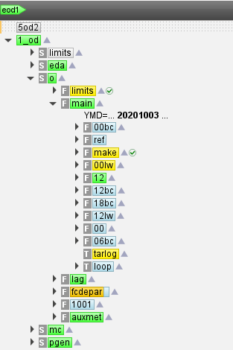
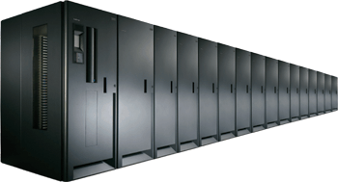


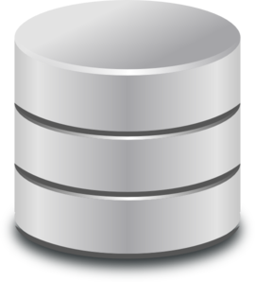
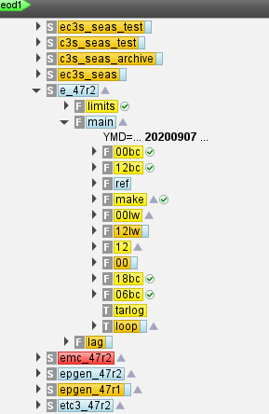
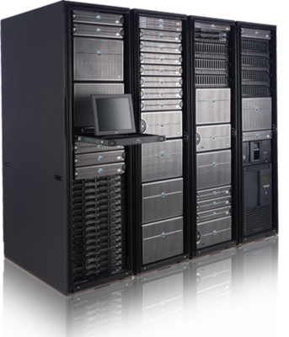
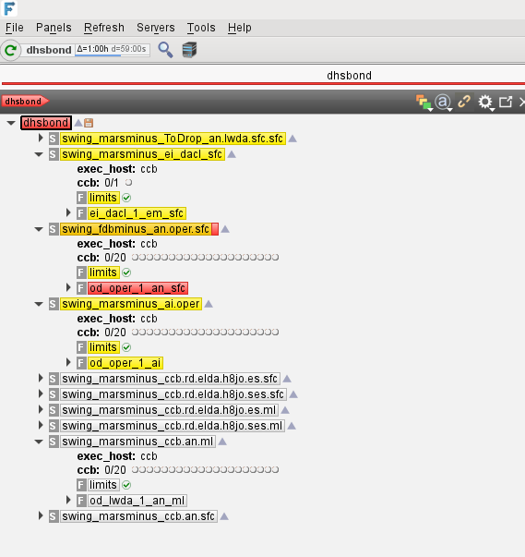

Development Temporary-DHS: Dry-run retrieve
retrieve,get
archive, put
Main-DHS
Essential datasets
CrayHPC
retrieve, get
FDB
MARS Service
ECFS Service
Development Temporary-DHS

Slide 9
User Impact vs Size Temporary-DHS copy
Size
Content
Enabled work
300 PB
All MARS + ECFS data
No User Impact
Selected MARS data (ERA) Selected User data (ECFS)
Selected user work, Data Portals
100s PB
Temporary-DHS copy
ERA5 Back, any RD experiment, all Evaluation, CDS
All ERA5, All extractions (ECFS), selected ECFS data
10s PB
CAMS experiments, RD experiments, selected Evaluation
Few PB
Analysis, Essential ERA5, Essential extractions (ECFS)
100s TB
Selected RD experiments MS TC suites
Observations
Critical-path Production
Notes:
The size of the temporary-DHS-copy (essential data) will have a direct impact on the work we will be able to run during The Move.
On the left hand side we have various sizes, from nothing, to 100s TB, few PBs, 10s PB, 100s PB to the whole archive.
Depending on the size, we will be able to hold a copy of certain essential datasets.
Depending on the essential datasets we are able to copy, will determine the type of work we will be able to run
Obviously having 300 PB of disks with a copy of the whole MARS+ECFS will minimize user impact. However, this is not possible for two reasons: we will not have 300PB disks (very expensive!), and if we had them, we will not be able to copy 300 PB.
We aim to be in the few PBytes bar

Slide 10
Development Temporary-DHS: Dry-run archive
retrieve,get
archive, put
Main-DHS
Cray HPC
retrieve,get
FDB
MARS Service
ECFS Service
Development Temporary-DHS

Slide 11
Temporary-DHS (Bologna): Dark-period Dry runs
Aimed at validating the plans for the Dark-period
  Switch-off user access to the Main-DHS
  Gain confidence over DHS-Swing, but will be very disruptive
  Requires Temporary-DHS-copy fully loaded with essential datasets
Several short dry-runs 1-2 days long
Final dry-run 5-7 days long
  Help establish the Set Date for the DHS-Swing
  Six to four weeks before DHS-Swing, depending on logistics company
  Ideally aligned with similar time-of-month for the DHS-Swing
  Ideally, during a period with the same kind of activity that during the DHS-Swing
User impact
  No general user access to the Main-DHS
    No access to public datasets or services that requires the DHS (eg, CDS ERA5-complete)

Slide 12
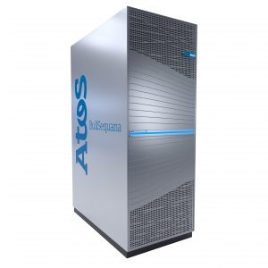
Temporary-DHS: Dark-period Dry-run
archive, put
Cray HPC
READING
Main-DHS
FDB
retrieve, get
archive, put
retrieve, get
BOLOGNA
MARS Service
ECFS Service
FDB
Temporary-DHS

Slide 13
Thank you!

