Slide 1






Site Effect Analysis to Support the future Seismic
Microzonation of Dushanbe, Tajikistan
Georisk &
Environment
Farkhod Hakimov^{1,3,4,} Gisela Domej², Anatoly Ischuk¹, Klaus Reicherter³, Léna Cauchie⁴, and Hans- Balder Havenith⁴
¹ Academy of Sciences, Institute of Geology, Earthquake Engineering and Seismology, Dushanbe, Tajikistan
² Università degli Studi di Milano-Bicocca, DISAT, Milano, Italia
³ RWTH Aachen University, Neotectonics and Natural Hazards, Aachen, Germany
⁴ University of Liège, Geology Department, Liège, Belgium
Similar to other big cities in Central Asia (such as Tashkent, the capital of Uzbekistan, or Bishkek, the capital of Kyrgyzstan), the capital of Tajikistan, Dushanbe, is highly exposed to earthquake and associated secondary hazards due to its close vicinity to two active fault systems, the Hissar–Kokshal Fault located in the north of the city, and the Iyak–Vaksh Fault in the south. The most recent damaging earthquake near Dushanbe was located in the Tajik Depression in western Tajikistan, the Hissar Earthquake in 1989 (Mw = 5.8), causing small direct damage on buildings, but triggered extensive liquefaction phenomena and related landslide in loess deposits. The villages of Sharora and Okuli-Bolo were affected by mudflows destroying more than 100 houses, and 247 persons died.
Study area
Overview
Methodology
Data processing
and results
Button takes you to
the section menu
vPICO Navigation
Conclusions

Slide 2
Site Effect Analysis to Support the future Seismic
Microzonation of Dushanbe, Tajikistan
Georisk &
Environment
Farkhod Hakimov^{1,3,4,} Gisela Domej², Anatoly Ischuk¹, Klaus Reicherter³, Léna Cauchie⁴, and Hans- Balder Havenith⁴
¹ Academy of Sciences, Institute of Geology, Earthquake Engineering and Seismology, Dushanbe, Tajikistan
² Università degli Studi di Milano-Bicocca, DISAT, Milano, Italia
³ RWTH Aachen University, Neotectonics and Natural Hazards, Aachen, Germany
⁴ University of Liège, Geology Department, Liège, Belgium
To ensure people’s safety, especially for a rapidly growing city such as Dushanbe, adequate constructions and a detailed seismic microzonation map (and related data) are the keys for sustainable urban planning.
Existing estimations of seismic hazards date back to 1978; they are based on engineering geological investigations and observed macroseismic data. These were used to create the Tajik Seismic Building Code which considers seismic intensities according to the Medvedev–Sponheuer–Karnik Scale, MSK-64. However, this code does not accurately account for soil types which vary considerably in Dushanbe – not only by their nature but also due to increasing anthropogenic alteration.
Study area
Overview
Methodology
Data processing
and results
Button takes you to
the section menu
vPICO Navigation
Conclusions

Slide 3
Site Effect Analysis to Support the future Seismic
Microzonation of Dushanbe, Tajikistan
Georisk &
Environment
Farkhod Hakimov^{1,3,4,} Gisela Domej², Anatoly Ischuk¹, Klaus Reicherter³, Léna Cauchie⁴, and Hans- Balder Havenith⁴
¹ Academy of Sciences, Institute of Geology, Earthquake Engineering and Seismology, Dushanbe, Tajikistan
² Università degli Studi di Milano-Bicocca, DISAT, Milano, Italia
³ RWTH Aachen University, Neotectonics and Natural Hazards, Aachen, Germany
⁴ University of Liège, Geology Department, Liège, Belgium
This study uses an iterative approach, the workflow of which is overview on this slide. In this study, we performed a series of analyses on Microtremor Array Measurements, Seismic Refraction Tomography, and instrumental data recording from permanent as well as from mobile seismic stations (H/V method) in order to provide the site effect analysis for a new comprehensive microzonation of Dushanbe (and neighboring areas) accounting for the different soil types. Our results identify several critical areas where major damage is likely to occur during strong earthquakes.
Study area
Overview
Methodology
Data processing
and results
Button takes you to
the section menu
vPICO Navigation
Conclusions

Slide 4
Site Effect Analysis to Support the future Seismic
Microzonation of Dushanbe, Tajikistan
Georisk &
Environment
Farkhod Hakimov^{1,3,4,} Gisela Domej², Anatoly Ischuk¹, Klaus Reicherter³, Léna Cauchie⁴, and Hans- Balder Havenith⁴
¹ Academy of Sciences, Institute of Geology, Earthquake Engineering and Seismology, Dushanbe, Tajikistan
² Università degli Studi di Milano-Bicocca, DISAT, Milano, Italia
³ RWTH Aachen University, Neotectonics and Natural Hazards, Aachen, Germany
⁴ University of Liège, Geology Department, Liège, Belgium
For more information about this study, please click on the different steps described on this slide. The results of each method are also presented in the "Data Processing and Results" section. Clicking on the title buttons on the right side of the slide will take you to view each section individually. You can always use the Back and Next arrows to view each section, the Up arrow will always take you back to the first slide.
Study area
Overview
Methodology
Data processing
and results
Button takes you to
the section menu
vPICO Navigation
Conclusions

Slide 5
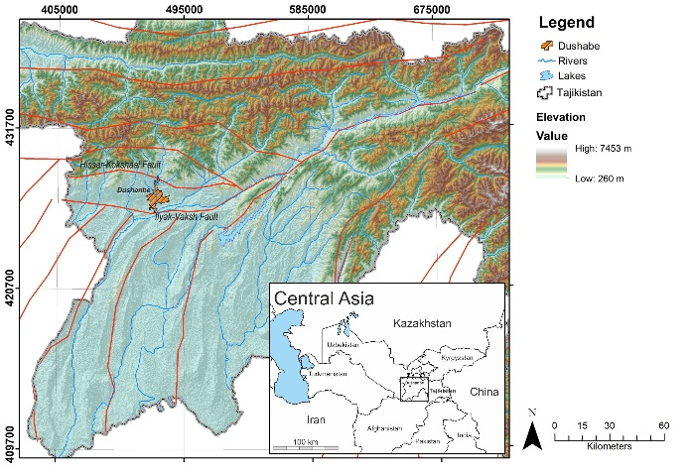
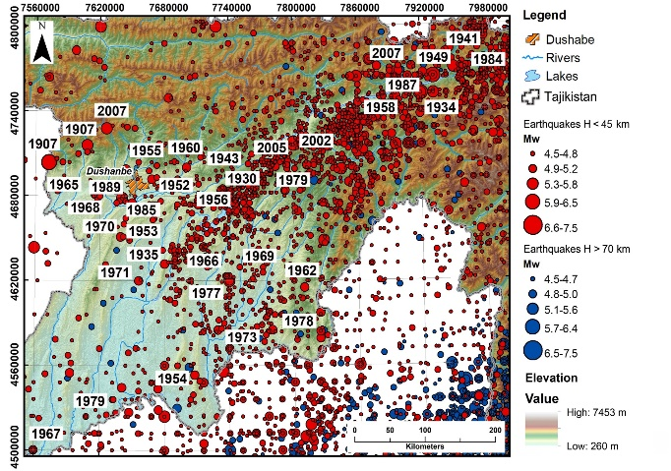
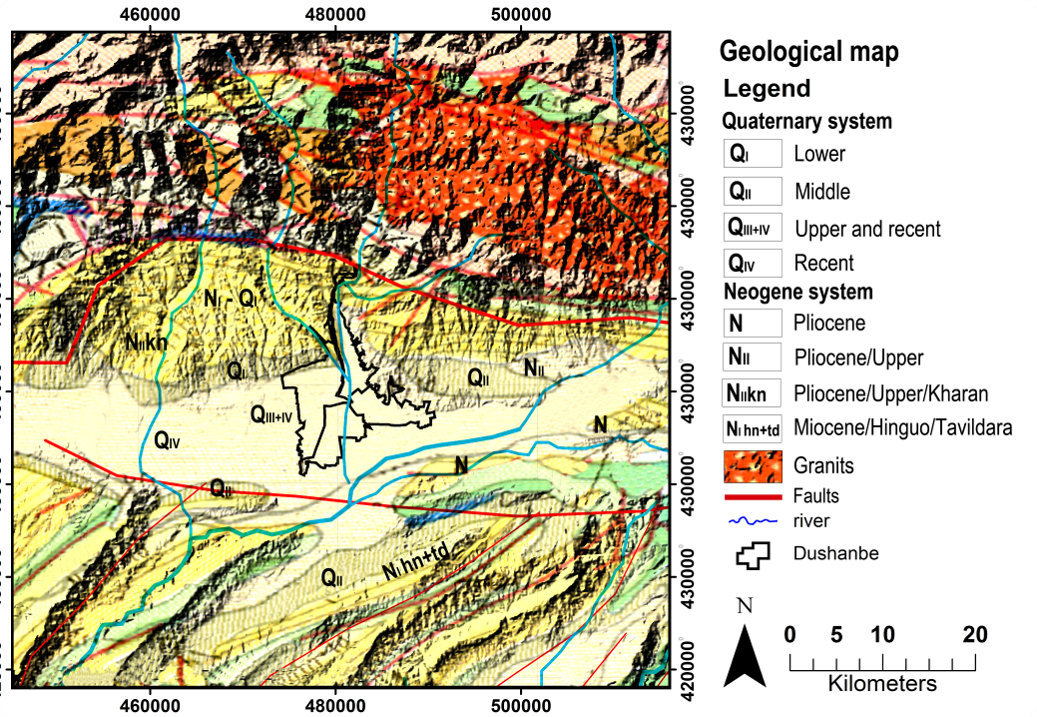
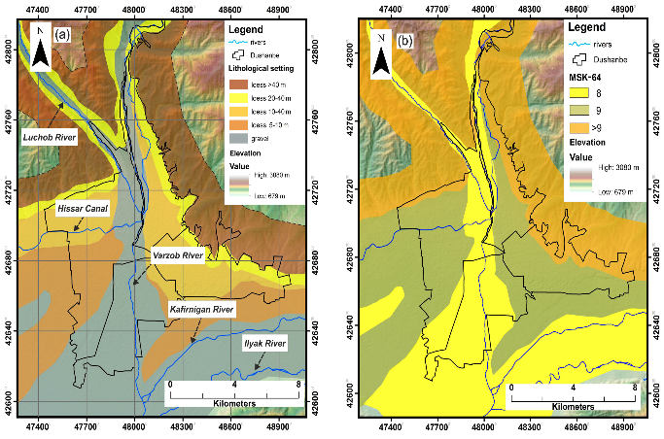
Site Effect Analysis to Support the future Seismic
Microzonation of Dushanbe, Tajikistan
Georisk &
Environment
Farkhod Hakimov^{1,3,4,} Gisela Domej², Anatoly Ischuk¹, Klaus Reicherter³, Léna Cauchie⁴, and Hans- Balder Havenith⁴
¹ Academy of Sciences, Institute of Geology, Earthquake Engineering and Seismology, Dushanbe, Tajikistan
² Università degli Studi di Milano-Bicocca, DISAT, Milano, Italia
³ RWTH Aachen University, Neotectonics and Natural Hazards, Aachen, Germany
⁴ University of Liège, Geology Department, Liège, Belgium
Dushanbe is the capital of Tajikistan, a mountainous country marked by high to very high seismic hazard. Situated at the confluence of two rivers, Varzob and Kafirnigan, nowadays Dushanbe has around 1 000 000 inhabitants. The city is located in the central part of the Hissar valley which has a sublatitudinal extension and which is limited to the north by the Hissar Range and to the south by the Babatag and Rangon ridges. The reason for the high seismic hazard specifically near Dushanbe is related to its location between two fault systems: South Hissar-Kokshaal fault and Ilyk-Vaksh fault. Therefore, earlier seismic zonation maps assigned an intensity of IX to most districts of the city (Bune and Gorshkov, 1980; Nazarov and Nechaev, 1953).
In the territory of the city and its southern peripheral parts Quaternary deposits are widespread. They tend to form accumulated terraces of ancient and modern valleys, also covering the lower parts of watersheds and slopes of ridges.
Study area
Study area
Seismicity
Geology
Previous Microzonations

Slide 6
Site Effect Analysis to Support the future Seismic
Microzonation of Dushanbe, Tajikistan
Georisk &
Environment
Farkhod Hakimov^{1,3,4,} Gisela Domej², Anatoly Ischuk¹, Klaus Reicherter³, Léna Cauchie⁴, and Hans- Balder Havenith⁴
¹ Academy of Sciences, Institute of Geology, Earthquake Engineering and Seismology, Dushanbe, Tajikistan
² Università degli Studi di Milano-Bicocca, DISAT, Milano, Italia
³ RWTH Aachen University, Neotectonics and Natural Hazards, Aachen, Germany
⁴ University of Liège, Geology Department, Liège, Belgium
These Quaternary sediments are interleaved by alluvial and diluvial sediments and their paragenetic combinations. The thickness of the Quaternary deposits can be up to several hundreds of meters in the central part of the valley but it decreases to a few meters at the foothills and in areas where the bedrock outcrops.
The territory east of the Varzob river (where 40% of building stock is located) differs also from the rest by the presence of thick macrospores loess-type soils having high subsidence features under watering. Of course, this fact negatively influences upon technical condition of buildings and structures. Therefore, a part of buildings and structures on the left-bank part of the city are in deformed condition as the result of soil´s subsidence, therefore being highly vulnerable under seismic excitations. Moreover, also non-linear effects cannot be excluded which have already been observed on the loess soils in Dushanbe during the 1989 Mw = 5.8 Gissar earthquake.
Study area
Study area
Seismicity
Geology
Previous Microzonations

Slide 7
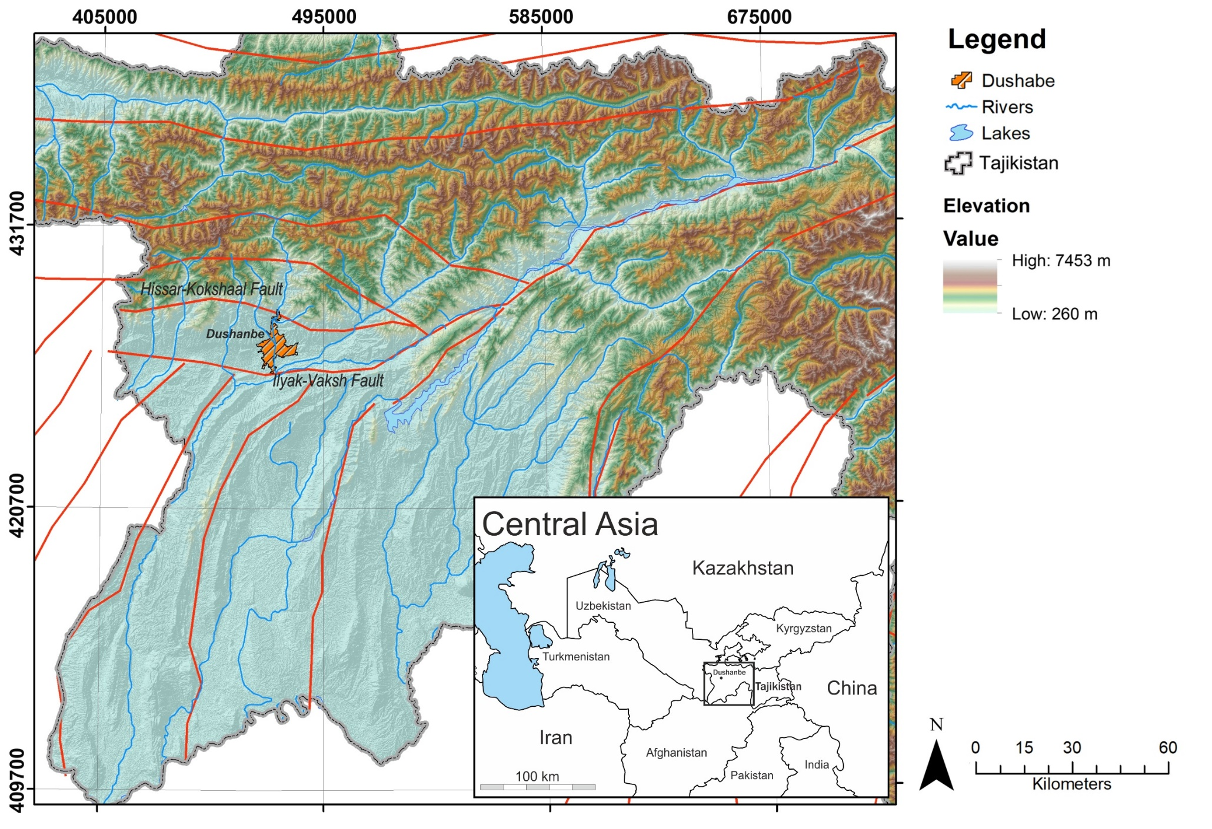
Site Effect Analysis to Support the future Seismic
Microzonation of Dushanbe, Tajikistan
Georisk &
Environment
Farkhod Hakimov^{1,3,4,} Gisela Domej², Anatoly Ischuk¹, Klaus Reicherter³, Léna Cauchie⁴, and Hans- Balder Havenith⁴
¹ Academy of Sciences, Institute of Geology, Earthquake Engineering and Seismology, Dushanbe, Tajikistan
² Università degli Studi di Milano-Bicocca, DISAT, Milano, Italia
³ RWTH Aachen University, Neotectonics and Natural Hazards, Aachen, Germany
⁴ University of Liège, Geology Department, Liège, Belgium
Dushanbe is the capital of Tajikistan, a mountainous country marked by high to very high seismic hazard. Situated at the confluence of two rivers, Varzob and Kafirnigan, nowadays Dushanbe has around 1 000 000 inhabitants. The city is located in the central part of the Hissar valley which has a sublatitudinal extension and which is limited to the north by the Hissar Range and to the south by the Babatag and Rangon ridges. The reason for the high seismic hazard specifically near Dushanbe is related to its location between two fault systems: South Hissar-Kokshaal fault and Ilyk-Vaksh fault. Therefore, earlier seismic zonation maps assigned an intensity of IX to most districts of the city (Bune and Gorshkov, 1980; Nazarov and Nechaev, 1953).
In the territory of the city and its southern peripheral parts Quaternary deposits are widespread. They tend to form accumulated terraces of ancient and modern valleys, also covering the lower parts of watersheds and slopes of ridges.
Study area
Study area
Seismicity
Geology
Previous Microzonations
The Hissar–Kokshal Fault passes some 10–15 km north of the city, and the Iyak–Vaksh Fault crosses at about 20–25 km in the south. For both fault systems Babaev et al. (2005) estimate maximum M_{w} magnitudes of 7.5 and 6.5, respectively
Image: Environment Agency (England)

Slide 8
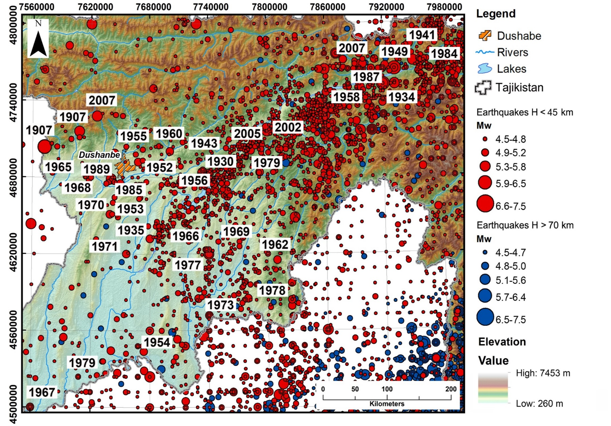
Site Effect Analysis to Support the future Seismic
Microzonation of Dushanbe, Tajikistan
Georisk &
Environment
Farkhod Hakimov^{1,3,4,} Gisela Domej², Anatoly Ischuk¹, Klaus Reicherter³, Léna Cauchie⁴, and Hans- Balder Havenith⁴
¹ Academy of Sciences, Institute of Geology, Earthquake Engineering and Seismology, Dushanbe, Tajikistan
² Università degli Studi di Milano-Bicocca, DISAT, Milano, Italia
³ RWTH Aachen University, Neotectonics and Natural Hazards, Aachen, Germany
⁴ University of Liège, Geology Department, Liège, Belgium
Dushanbe is the capital of Tajikistan, a mountainous country marked by high to very high seismic hazard. Situated at the confluence of two rivers, Varzob and Kafirnigan, nowadays Dushanbe has around 1 000 000 inhabitants. The city is located in the central part of the Hissar valley which has a sublatitudinal extension and which is limited to the north by the Hissar Range and to the south by the Babatag and Rangon ridges. The reason for the high seismic hazard specifically near Dushanbe is related to its location between two fault systems: South Hissar-Kokshaal fault and Ilyk-Vaksh fault. Therefore, earlier seismic zonation maps assigned an intensity of IX to most districts of the city (Bune and Gorshkov, 1980; Nazarov and Nechaev, 1953).
In the territory of the city and its southern peripheral parts Quaternary deposits are widespread. They tend to form accumulated terraces of ancient and modern valleys, also covering the lower parts of watersheds and slopes of ridges.
Study area
Study area
Seismicity
In terms of tectonics, Dushanbe is located in an area affected by strong seismicity regularly experiencing shallow (focal depths <45 km) and deep (focal depths >70 km) earthquakes. The frequency of medium to strong events is shown in this figure, in which epicenters of earthquakes from the Central Asia Seismic Risk Initiative, Earthquake Modeling for Central Asia Catalogue (CASRI-EMCA; Abdrakhmatov, 2009; Mikhailova et al., 2015) over the period from 850 to 2015, and updated from USGS catalogue (U.S. Geological Survey) over the period from 2015 to 2020. Strong earthquakes in Western Tajikistan with magnitude 4.5≤ M ≤8.2 are shown in this figure (with dates of large historical earthquakes near Dushanbe city).
Geology
Previous Microzonations
Image: Environment Agency (England)

Slide 9
Site Effect Analysis to Support the future Seismic
Microzonation of Dushanbe, Tajikistan
Georisk &
Environment
Farkhod Hakimov^{1,3,4,} Gisela Domej², Anatoly Ischuk¹, Klaus Reicherter³, Léna Cauchie⁴, and Hans- Balder Havenith⁴
¹ Academy of Sciences, Institute of Geology, Earthquake Engineering and Seismology, Dushanbe, Tajikistan
² Università degli Studi di Milano-Bicocca, DISAT, Milano, Italia
³ RWTH Aachen University, Neotectonics and Natural Hazards, Aachen, Germany
⁴ University of Liège, Geology Department, Liège, Belgium
Dushanbe is the capital of Tajikistan, a mountainous country marked by high to very high seismic hazard. Situated at the confluence of two rivers, Varzob and Kafirnigan, nowadays Dushanbe has around 1 000 000 inhabitants. The city is located in the central part of the Hissar valley which has a sublatitudinal extension and which is limited to the north by the Hissar Range and to the south by the Babatag and Rangon ridges. The reason for the high seismic hazard specifically near Dushanbe is related to its location between two fault systems: South Hissar-Kokshaal fault and Ilyk-Vaksh fault. Therefore, earlier seismic zonation maps assigned an intensity of IX to most districts of the city (Bune and Gorshkov, 1980; Nazarov and Nechaev, 1953).
In the territory of the city and its southern peripheral parts Quaternary deposits are widespread. They tend to form accumulated terraces of ancient and modern valleys, also covering the lower parts of watersheds and slopes of ridges.
Study area
Study area
Seismicity
Geology
Previous Microzonations
The general geological map of the region of the Dushanbe city (from Geological map of the Tajik SSR. Scale 1:500000. Chief Editors: A.P. Markovsky and V.I. Verkhov. Published by VSEGEI, Moscow, 1974).
Image: Environment Agency (England)

Slide 10
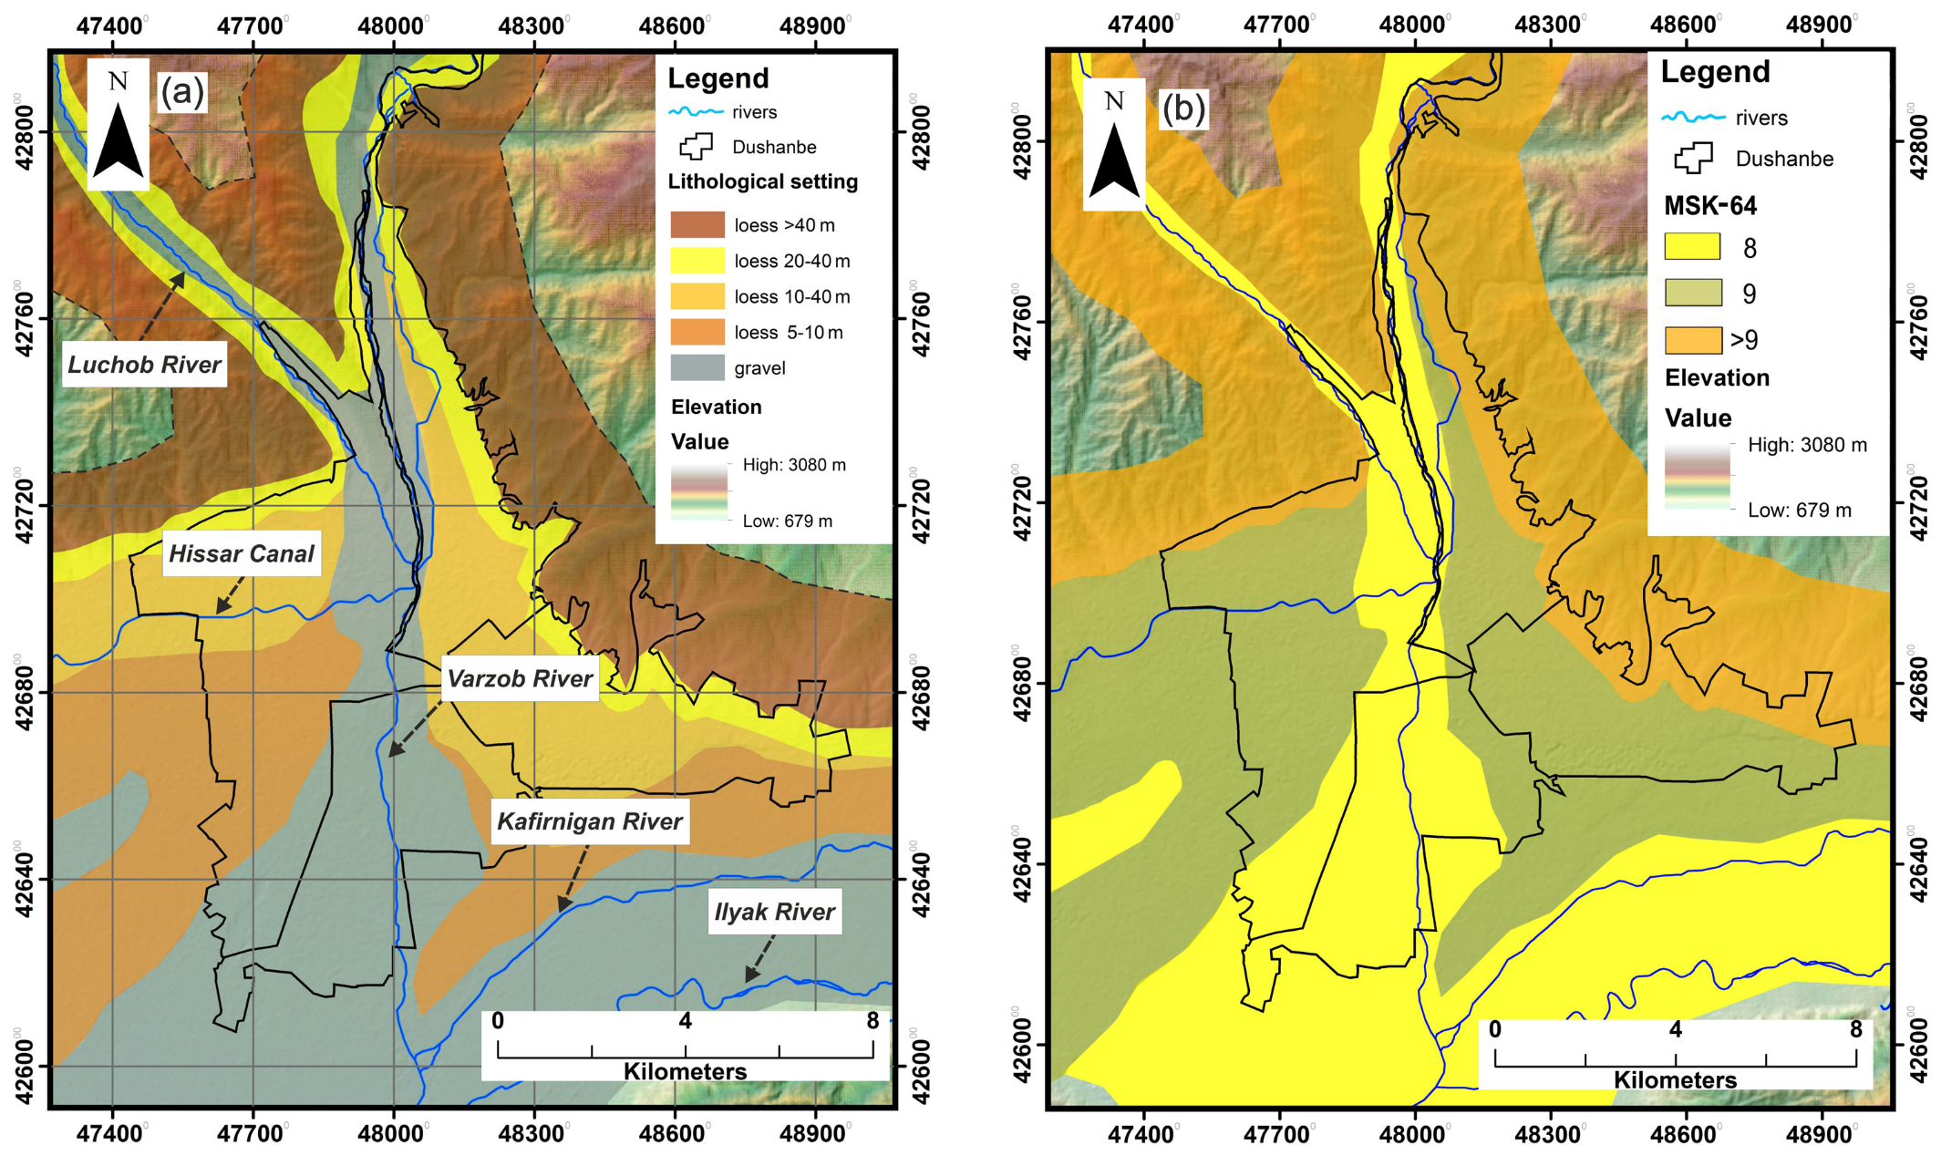
Site Effect Analysis to Support the future Seismic
Microzonation of Dushanbe, Tajikistan
Georisk &
Environment
Farkhod Hakimov^{1,3,4,} Gisela Domej², Anatoly Ischuk¹, Klaus Reicherter³, Léna Cauchie⁴, and Hans- Balder Havenith⁴
¹ Academy of Sciences, Institute of Geology, Earthquake Engineering and Seismology, Dushanbe, Tajikistan
² Università degli Studi di Milano-Bicocca, DISAT, Milano, Italia
³ RWTH Aachen University, Neotectonics and Natural Hazards, Aachen, Germany
⁴ University of Liège, Geology Department, Liège, Belgium
Dushanbe is the capital of Tajikistan, a mountainous country marked by high to very high seismic hazard. Situated at the confluence of two rivers, Varzob and Kafirnigan, nowadays Dushanbe has around 1 000 000 inhabitants. The city is located in the central part of the Hissar valley which has a sublatitudinal extension and which is limited to the north by the Hissar Range and to the south by the Babatag and Rangon ridges. The reason for the high seismic hazard specifically near Dushanbe is related to its location between two fault systems: South Hissar-Kokshaal fault and Ilyk-Vaksh fault. Therefore, earlier seismic zonation maps assigned an intensity of IX to most districts of the city (Bune and Gorshkov, 1980; Nazarov and Nechaev, 1953).
In the territory of the city and its southern peripheral parts Quaternary deposits are widespread. They tend to form accumulated terraces of ancient and modern valleys, also covering the lower parts of watersheds and slopes of ridges.
Study area
Study area
Seismicity
Geology
Previous Microzonations
River system and lithology in the area of Dushanbe (a). The latest seismic zonation was established by Kapylov, 1989 based on the two separate zonings and use the same partition of intensity units (b).
Image: Environment Agency (England)

Slide 11
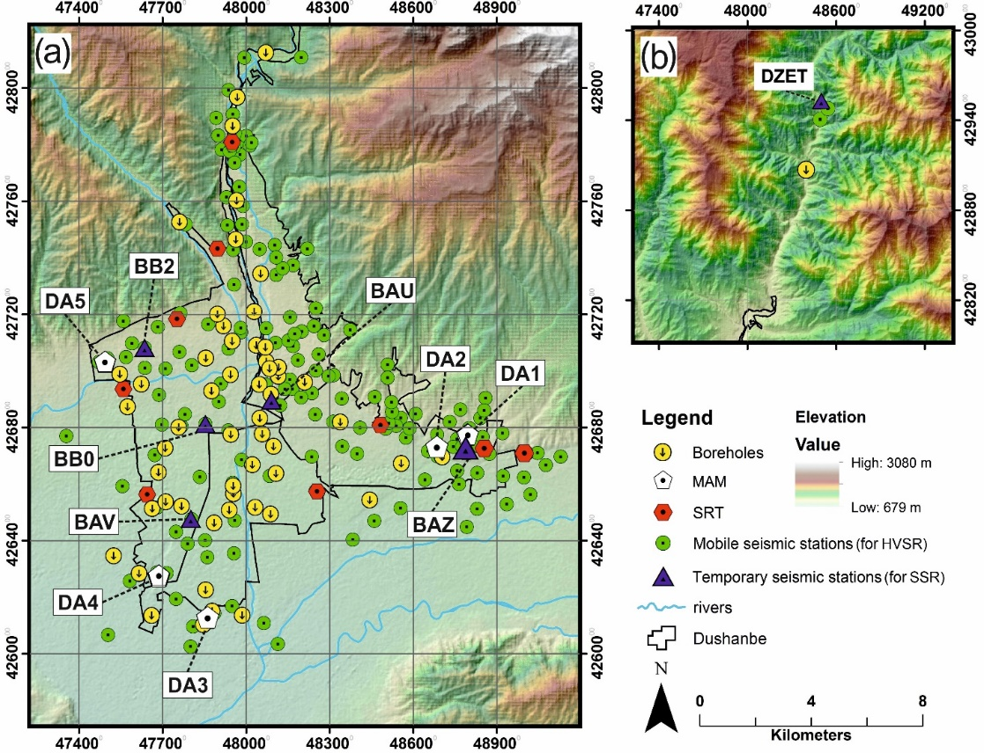
Site Effect Analysis to Support the future Seismic
Microzonation of Dushanbe, Tajikistan
Georisk &
Environment
Farkhod Hakimov^{1,3,4,} Gisela Domej², Anatoly Ischuk¹, Klaus Reicherter³, Léna Cauchie⁴, and Hans-Balder Havenith⁴
¹ Academy of Sciences, Institute of Geology, Earthquake Engineering and Seismology, Dushanbe, Tajikistan
² Università degli Studi di Milano-Bicocca, DISAT, Milano, Italia
³ RWTH Aachen University, Neotectonics and Natural Hazards, Aachen, Germany
⁴ University of Liège, Geology Department, Liège, Belgium
In order to better understand the local seismic response of the different soil types and subsurface structures, the following non-invasive seismic methods were conducted: five microtremor array measurements (MAM), nine seismic refraction tomography (SRT) profiles, five temporary seismic stations for standard spectral ratio (SSR) measurements with one permanent station serving as reference, and 175 horizontal to vertical spectral ratio (HVSR) measurements. The results of recent measurements were combined with lithological maps, cross sections and data from 60 borehole logs. All methods were completed between 2018 and 2020, and borehole log from 1965 to 2019.
Methodology
HVSR
MAM
SSR
SRT

Slide 12
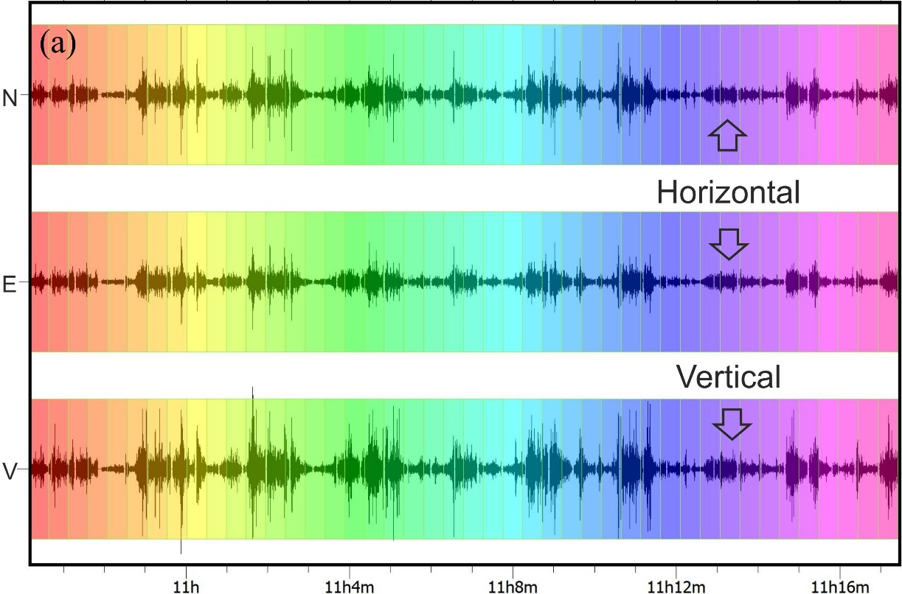
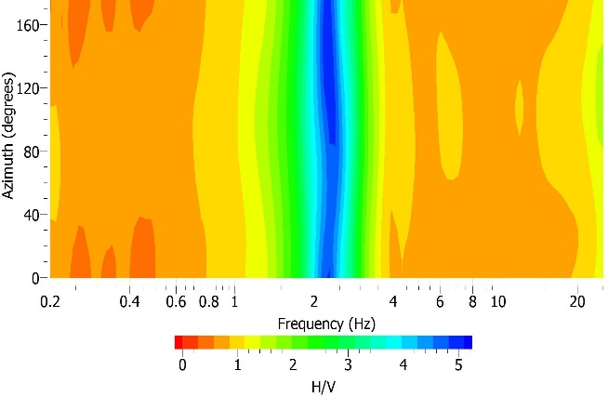
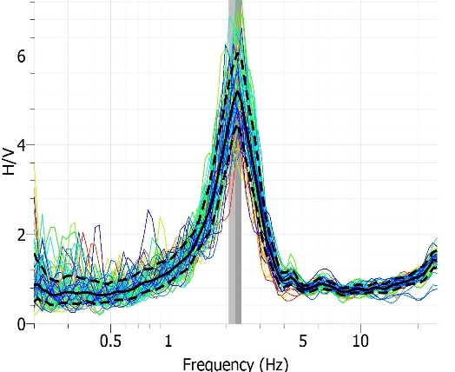
Site Effect Analysis to Support the future Seismic
Microzonation of Dushanbe, Tajikistan
Georisk &
Environment
Horizontal to Vertical Spectral Ratio (HVSR)
Farkhod Hakimov^{1,3,4,} Gisela Domej², Anatoly Ischuk¹, Klaus Reicherter³, Léna Cauchie⁴, and Hans-Balder Havenith⁴
¹ Academy of Sciences, Institute of Geology, Earthquake Engineering and Seismology, Dushanbe, Tajikistan
² Università degli Studi di Milano-Bicocca, DISAT, Milano, Italia
³ RWTH Aachen University, Neotectonics and Natural Hazards, Aachen, Germany
⁴ University of Liège, Geology Department, Liège, Belgium
Originally, the method of measuring the horizontal to vertical spectral ratio (HVSR)
from ambient noise or passive vibration input was popularized by Nakamura, 1989 and largely used for two decades. Nakamura, 1989 described that the HVSR between horizontal and vertical ambient noise records is related to the fundamental resonant frequency (natural frequency) of the soil (f₀) when a sedimentary deposits lies over bedrock. This method involves evaluating the ratio of the amplitude spectra obtained from the horizontal and vertical components of the seismometer; results characterize the frequency spectra in terms of resonance and predominant frequencies.
In order to better understand the local seismic response of the different soil types and subsurface structures, the following non-invasive seismic methods were conducted:
five microtremor array measurements (MAM), nine seismic refraction tomography (SRT) profiles, five temporary seismic stations for standard spectral ratio (SSR) measurements with one permanent station serving as reference, and 175 horizontal to vertical spectral ratio (HVSR) measurements. The results of recent measurements were combined with lithological maps, cross sections and data from 60 borehole logs. All methods were completed between 2018 and 2020, and borehole log from 1965 to 2019.
Methodology
HVSR
MAM
SSR
SRT

Slide 13
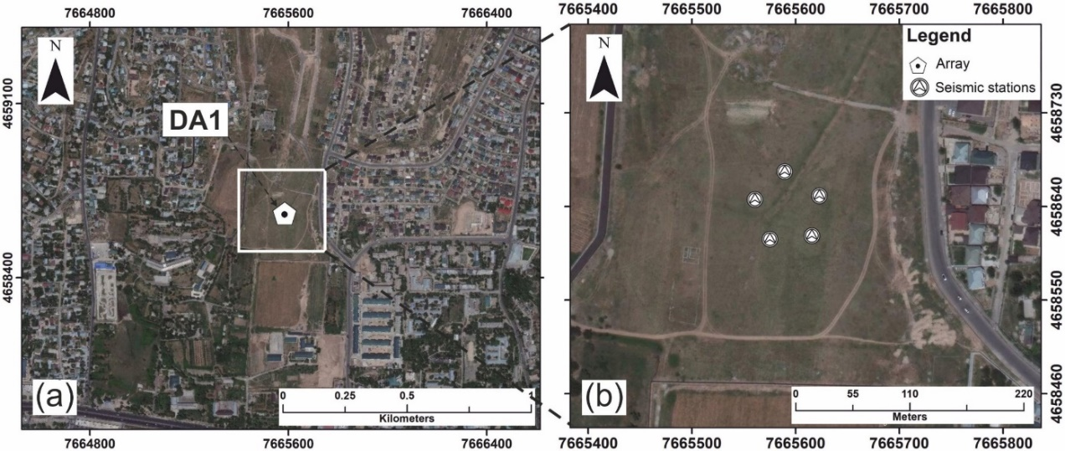
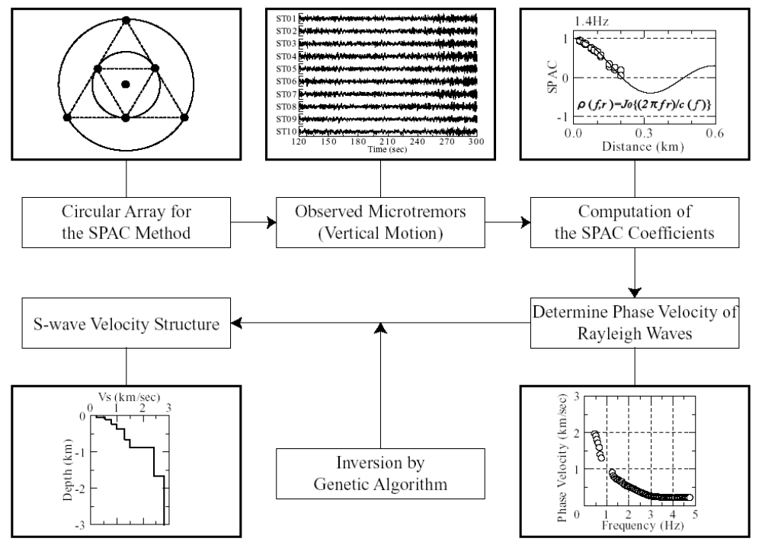
Site Effect Analysis to Support the future Seismic
Microzonation of Dushanbe, Tajikistan
Georisk &
Environment
Microtremor Array Measurements (MAM)
Farkhod Hakimov^{1,3,4,} Gisela Domej², Anatoly Ischuk¹, Klaus Reicherter³, Léna Cauchie⁴, and Hans-Balder Havenith⁴
¹ Academy of Sciences, Institute of Geology, Earthquake Engineering and Seismology, Dushanbe, Tajikistan
² Università degli Studi di Milano-Bicocca, DISAT, Milano, Italia
³ RWTH Aachen University, Neotectonics and Natural Hazards, Aachen, Germany
⁴ University of Liège, Geology Department, Liège, Belgium
Microtremor Array Measurements (MAM) enables identification of the phase velocities of surface waves (vertical components of the Rayleigh Waves were mainly analyzed). Via the method of Spatial Autocorrelation (SPAC; Aki, 1957 & 1965; Ohori, 2002; Okada, 2003), dispersion curves of Rayleigh Wave phase velocities are obtained and then processed through surface wave inversion to compute the 1D (vertical) shear wave velocity (VS) distribution of the underground. Dispersion curves are commonly shown in graphs plotting shear wave velocities (VS) as a function of wavelengths (or frequencies). MAM with resulting vertical shear wave velocity (VS) variations are representative for a single location bounded by the array polygon.
In order to better understand the local seismic response of the different soil types and subsurface structures, the following non-invasive seismic methods were conducted:
five microtremor array measurements (MAM), nine seismic refraction tomography (SRT) profiles, five temporary seismic stations for standard spectral ratio (SSR) measurements with one permanent station serving as reference, and 175 horizontal to vertical spectral ratio (HVSR) measurements. The results of recent measurements were combined with lithological maps, cross sections and data from 60 borehole logs. All methods were completed between 2018 and 2020, and borehole log from 1965 to 2019.
Methodology
HVSR
MAM
SSR
SRT
Kudo et al., 2002

Slide 14

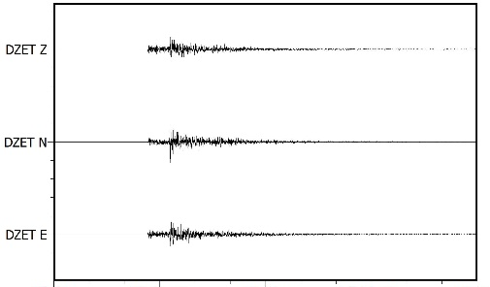
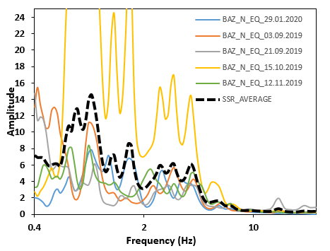
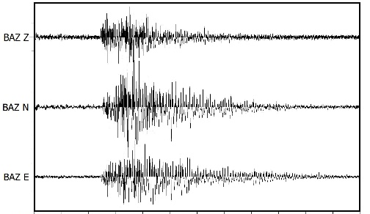
Site Effect Analysis to Support the future Seismic
Microzonation of Dushanbe, Tajikistan
Georisk &
Environment
Standard Spectrum Ratio (SSR)
DZET
BAZ
Farkhod Hakimov^{1,3,4,} Gisela Domej², Anatoly Ischuk¹, Klaus Reicherter³, Léna Cauchie⁴, and Hans-Balder Havenith⁴
¹ Academy of Sciences, Institute of Geology, Earthquake Engineering and Seismology, Dushanbe, Tajikistan
² Università degli Studi di Milano-Bicocca, DISAT, Milano, Italia
³ RWTH Aachen University, Neotectonics and Natural Hazards, Aachen, Germany
⁴ University of Liège, Geology Department, Liège, Belgium
The spectral amplifications were calculated using the reference site method, namely, the Standard Spectrum Ratio (SSR; Borcherdt, 1970) method, by comparing records of earthquakes at the study area with records of a reference station nearby. It is assumed that records from the reference site (ingeneral, a station placed on a solid rock outcrop) contain the same sources and propagation effects as records from other sites. This ratio can be computed separately for all three components i.e. Vertical (Z), North-South (N) and East-West (E), but it is generally applied to the average horizontal spectra. The spectral ratio can therefore directly deliver the site response. The method is called standard because previously in seismology, when the spectrum calculation had not been used, the maximum amplitude was simply compared for the records of two stations, one of which was located on hard rock
Soil
Rock
Earthquake
In order to better understand the local seismic response of the different soil types and subsurface structures, the following non-invasive seismic methods were conducted:
five microtremor array measurements (MAM), nine seismic refraction tomography (SRT) profiles, five temporary seismic stations for standard spectral ratio (SSR) measurements with one permanent station serving as reference, and 175 horizontal to vertical spectral ratio (HVSR) measurements. The results of recent measurements were combined with lithological maps, cross sections and data from 60 borehole logs. All methods were completed between 2018 and 2020, and borehole log from 1965 to 2019.
Methodology
HVSR
MAM
SSR
SRT

Slide 15
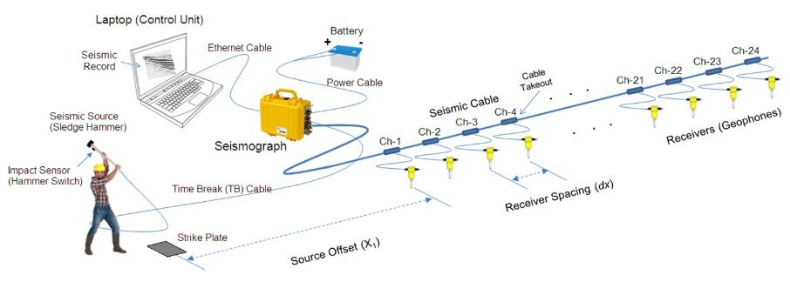
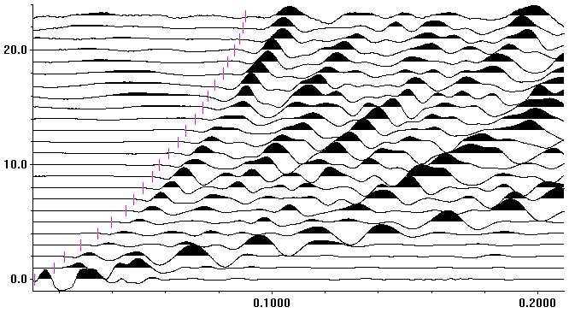
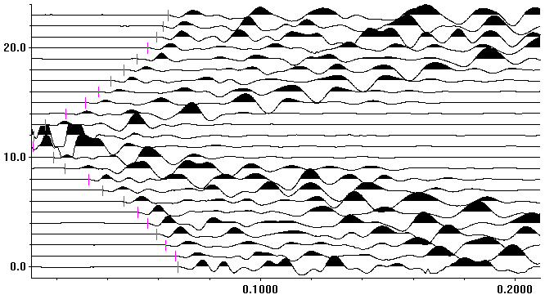
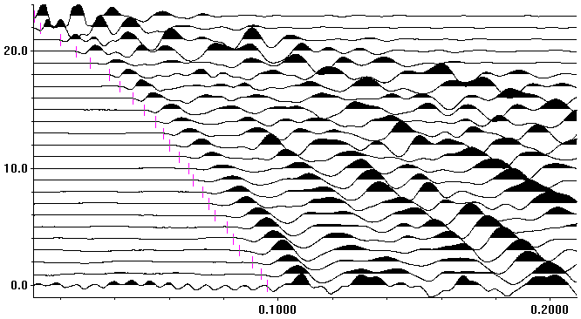
Site Effect Analysis to Support the future Seismic
Microzonation of Dushanbe, Tajikistan
Georisk &
Environment
Seismic Refraction Tomography (SRT)
Farkhod Hakimov^{1,3,4,} Gisela Domej², Anatoly Ischuk¹, Klaus Reicherter³, Léna Cauchie⁴, and Hans-Balder Havenith⁴
¹ Academy of Sciences, Institute of Geology, Earthquake Engineering and Seismology, Dushanbe, Tajikistan
² Università degli Studi di Milano-Bicocca, DISAT, Milano, Italia
³ RWTH Aachen University, Neotectonics and Natural Hazards, Aachen, Germany
⁴ University of Liège, Geology Department, Liège, Belgium
Seismic Refraction Tomography (SRT) is a common method to assess the P- and S-wave velocities of soils, and is widely used in the field of geotechnical engineering. The frequent usage of SRT is owed to its simplicity, flexibility and rapidity; the limitation of investigations to depths of several tens of meters could, however, be regarded as drawback. Generally, SRT is based on the hypothesis that P- as well as S-wave velocities increase with depth. By applying inversion methods (i.e., either P- and/or S-wave inversions) on SRT profiles, P- and/or S-wave velocity patterns within the underground are obtained, which shed light on subsurface structures.
In order to better understand the local seismic response of the different soil types and subsurface structures, the following non-invasive seismic methods were conducted:
five microtremor array measurements (MAM), nine seismic refraction tomography (SRT) profiles, five temporary seismic stations for standard spectral ratio (SSR) measurements with one permanent station serving as reference, and 175 horizontal to vertical spectral ratio (HVSR) measurements. The results of recent measurements were combined with lithological maps, cross sections and data from 60 borehole logs. All methods were completed between 2018 and 2020, and borehole log from 1965 to 2019.
Methodology
HVSR
MAM
SSR
SRT

Slide 16
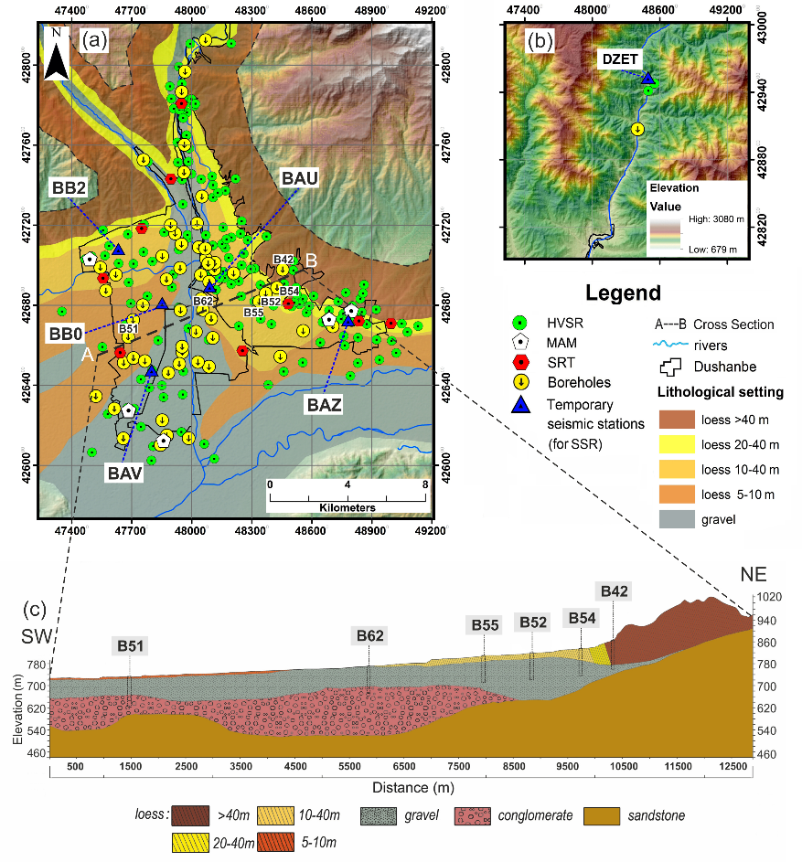
Site Effect Analysis to Support the future Seismic
Microzonation of Dushanbe, Tajikistan
Georisk &
Environment
Farkhod Hakimov^{1,3,4,} Gisela Domej², Anatoly Ischuk¹, Klaus Reicherter³, Léna Cauchie⁴, and Hans-Balder Havenith⁴
¹ Academy of Sciences, Institute of Geology, Earthquake Engineering and Seismology, Dushanbe, Tajikistan
² Università degli Studi di Milano-Bicocca, DISAT, Milano, Italia
³ RWTH Aachen University, Neotectonics and Natural Hazards, Aachen, Germany
⁴ University of Liège, Geology Department, Liège, Belgium
Typical for most urbanized areas is a dense agglomeration inducing a wide range of conditions and disturbing factors, which limit the application of many geophysical methods that allow for complex seismic microzonation. In many cases, invasive methods (e.g., drilling and borehole measurements) are impossible to implement. For this reason, only non-invasive methods were used for data acquisition: microtremor array measurements (MAMs), seismic refraction tomography (SRT), and instrumental data recording from temporary and permanent and from mobile seismic stations for long- and short-term acquisition, respectively. The use of these methods individually or in combination has proven to be successful for detailed seismic characterization and microzonation in the past. The newly assessed data was combined with local geological and geotechnical data in the form of lithological maps and cross sections as well as borehole logs provided by the Head Institute of Engineering and Technical Surveys of the State Construction Committee of Tajikistan.
BOREHOLE
Results
HVSR
MAM
SSR
SRT

Slide 17

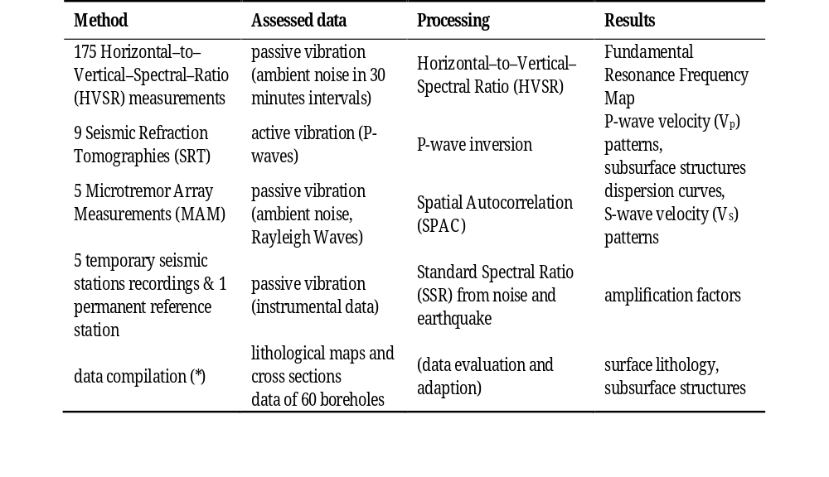
Site Effect Analysis to Support the future Seismic
Microzonation of Dushanbe, Tajikistan
Georisk &
Environment
Farkhod Hakimov^{1,3,4,} Gisela Domej², Anatoly Ischuk¹, Klaus Reicherter³, Léna Cauchie⁴, and Hans-Balder Havenith⁴
¹ Academy of Sciences, Institute of Geology, Earthquake Engineering and Seismology, Dushanbe, Tajikistan
² Università degli Studi di Milano-Bicocca, DISAT, Milano, Italia
³ RWTH Aachen University, Neotectonics and Natural Hazards, Aachen, Germany
⁴ University of Liège, Geology Department, Liège, Belgium
Typical for most urbanized areas is a dense agglomeration inducing a wide range of conditions and disturbing factors, which limit the application of many geophysical methods that allow for complex seismic microzonation. In many cases, invasive methods (e.g., drilling and borehole measurements) are impossible to implement. For this reason, only non-invasive methods were used for data acquisition: microtremor array measurements (MAMs), seismic refraction tomography (SRT), and instrumental data recording from temporary and permanent and from mobile seismic stations for long- and short-term acquisition, respectively. The use of these methods individually or in combination has proven to be successful for detailed seismic characterization and microzonation in the past. The newly assessed data was combined with local geological and geotechnical data in the form of lithological maps and cross sections as well as borehole logs provided by the Head Institute of Engineering and Technical Surveys of the State Construction Committee of Tajikistan.
HVSR
Results
HVSR
MAM
SSR
SRT

Slide 18
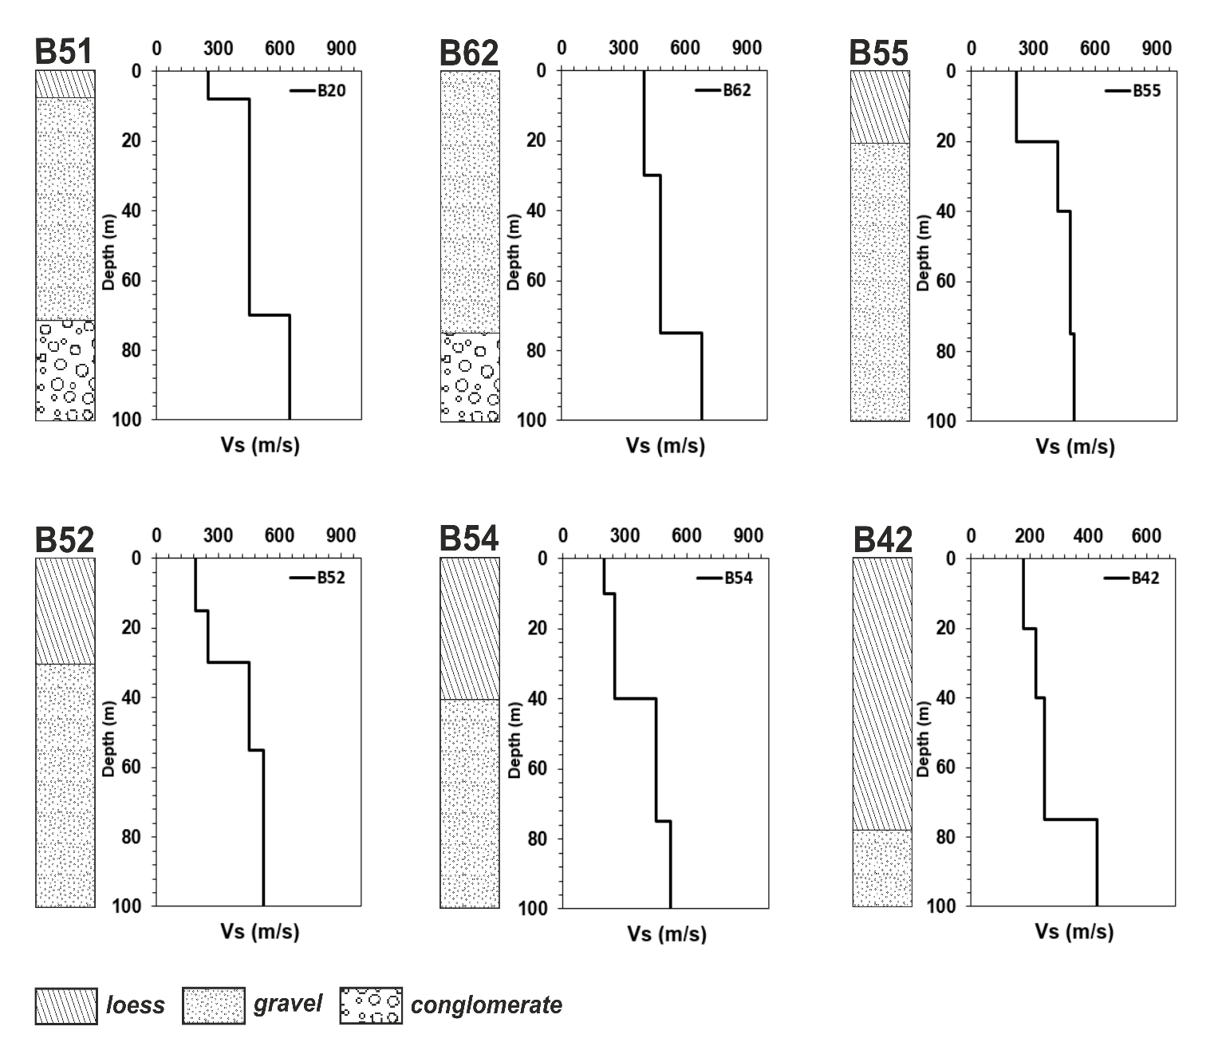
Site Effect Analysis to Support the future Seismic
Microzonation of Dushanbe, Tajikistan
Georisk &
Environment
Comparison of the Borehole Data
In the geotechnical map in Dushanbe (Zolotarev et al., 1985), lithological profiles' cross-sections were included. Based on the map, the cross-section A-B is compared with the use example at six sites information of the borehole data. Figure 9 compares the borehole data with inverted Vs profiles from downhole data of the previous study's Kopilov (1989). The depths of the borehole data and Vs profile are up to 100 m. Based on the borehole data, the soil in the south-west of the city is composed of thin layers of loess, gravel deposits, and conglomerate in the lower layers
In the center of the profile, according to the borehole data, the soil consists of gravel deposits, and conglomerates made of lime cement and rocks in the lower layers. In the north-eastern part, the total thickness of loess deposits within the study area varies, according to drilling and geophysical data, from 40–120 m at the junction of the foothill plain with a high terrace and to 160–200 m at the adyrs. Vs profiles, which correspond to gravel deposits, ranges from 380 to 550 m/s and for conglomerate from 600 to 750 m/s
Farkhod Hakimov^{1,3,4,} Gisela Domej², Anatoly Ischuk¹, Klaus Reicherter³, Léna Cauchie⁴, and Hans-Balder Havenith⁴
¹ Academy of Sciences, Institute of Geology, Earthquake Engineering and Seismology, Dushanbe, Tajikistan
² Università degli Studi di Milano-Bicocca, DISAT, Milano, Italia
³ RWTH Aachen University, Neotectonics and Natural Hazards, Aachen, Germany
⁴ University of Liège, Geology Department, Liège, Belgium
Typical for most urbanized areas is a dense agglomeration inducing a wide range of conditions and disturbing factors, which limit the application of many geophysical methods that allow for complex seismic microzonation. In many cases, invasive methods (e.g., drilling and borehole measurements) are impossible to implement. For this reason, only non-invasive methods were used for data acquisition: microtremor array measurements (MAMs), seismic refraction tomography (SRT), and instrumental data recording from temporary and permanent and from mobile seismic stations for long- and short-term acquisition, respectively. The use of these methods individually or in combination has proven to be successful for detailed seismic characterization and microzonation in the past. The newly assessed data was combined with local geological and geotechnical data in the form of lithological maps and cross sections as well as borehole logs provided by the Head Institute of Engineering and Technical Surveys of the State Construction Committee of Tajikistan.
HVSR
Results
HVSR
MAM
SSR
SRT

Slide 19
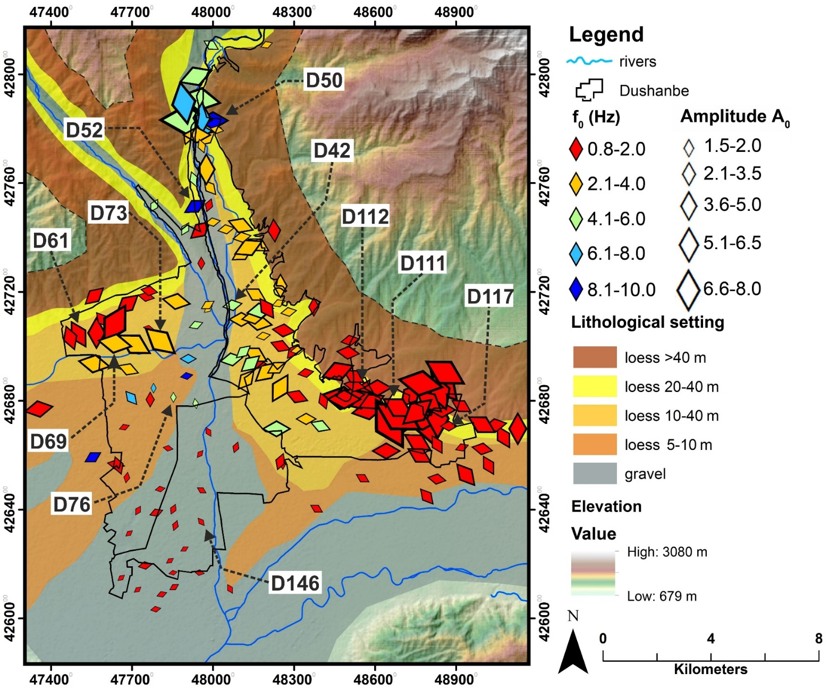
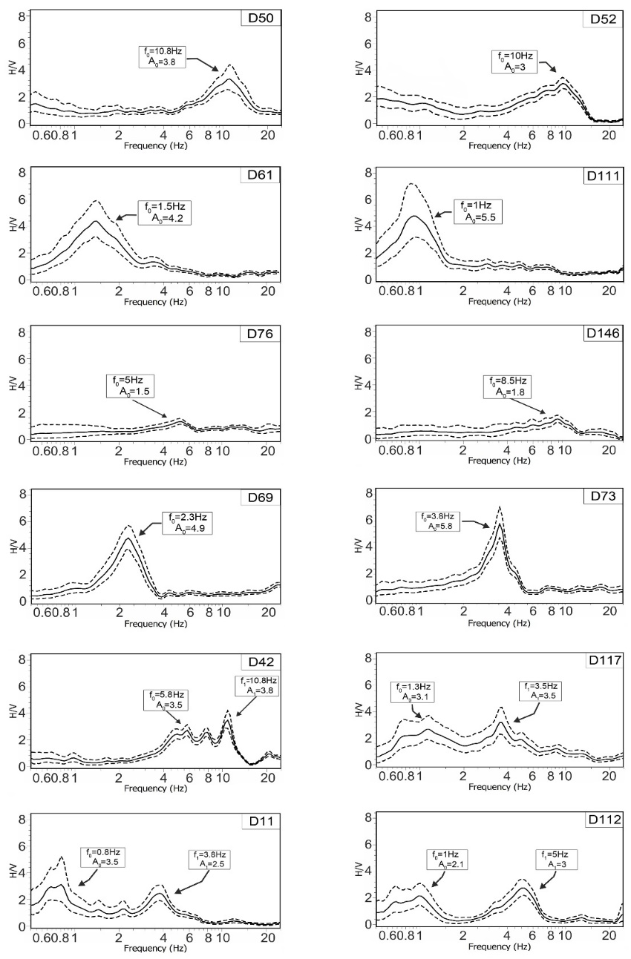
Site Effect Analysis to Support the future Seismic
Microzonation of Dushanbe, Tajikistan
Georisk &
Environment
Results of the Horizontal to Vertical Spectral Ratio (HVSR)
Farkhod Hakimov^{1,3,4,} Gisela Domej², Anatoly Ischuk¹, Klaus Reicherter³, Léna Cauchie⁴, and Hans-Balder Havenith⁴
¹ Academy of Sciences, Institute of Geology, Earthquake Engineering and Seismology, Dushanbe, Tajikistan
² Università degli Studi di Milano-Bicocca, DISAT, Milano, Italia
³ RWTH Aachen University, Neotectonics and Natural Hazards, Aachen, Germany
⁴ University of Liège, Geology Department, Liège, Belgium
Typical for most urbanized areas is a dense agglomeration inducing a wide range of conditions and disturbing factors, which limit the application of many geophysical methods that allow for complex seismic microzonation. In many cases, invasive methods (e.g., drilling and borehole measurements) are impossible to implement. For this reason, only non-invasive methods were used for data acquisition: microtremor array measurements (MAMs), seismic refraction tomography (SRT), and instrumental data recording from temporary and permanent and from mobile seismic stations for long- and short-term acquisition, respectively. The use of these methods individually or in combination has proven to be successful for detailed seismic characterization and microzonation in the past. The newly assessed data was combined with local geological and geotechnical data in the form of lithological maps and cross sections as well as borehole logs provided by the Head Institute of Engineering and Technical Surveys of the State Construction Committee of Tajikistan.
HVSR
Results
HVSR
MAM
SSR
SRT

Slide 20
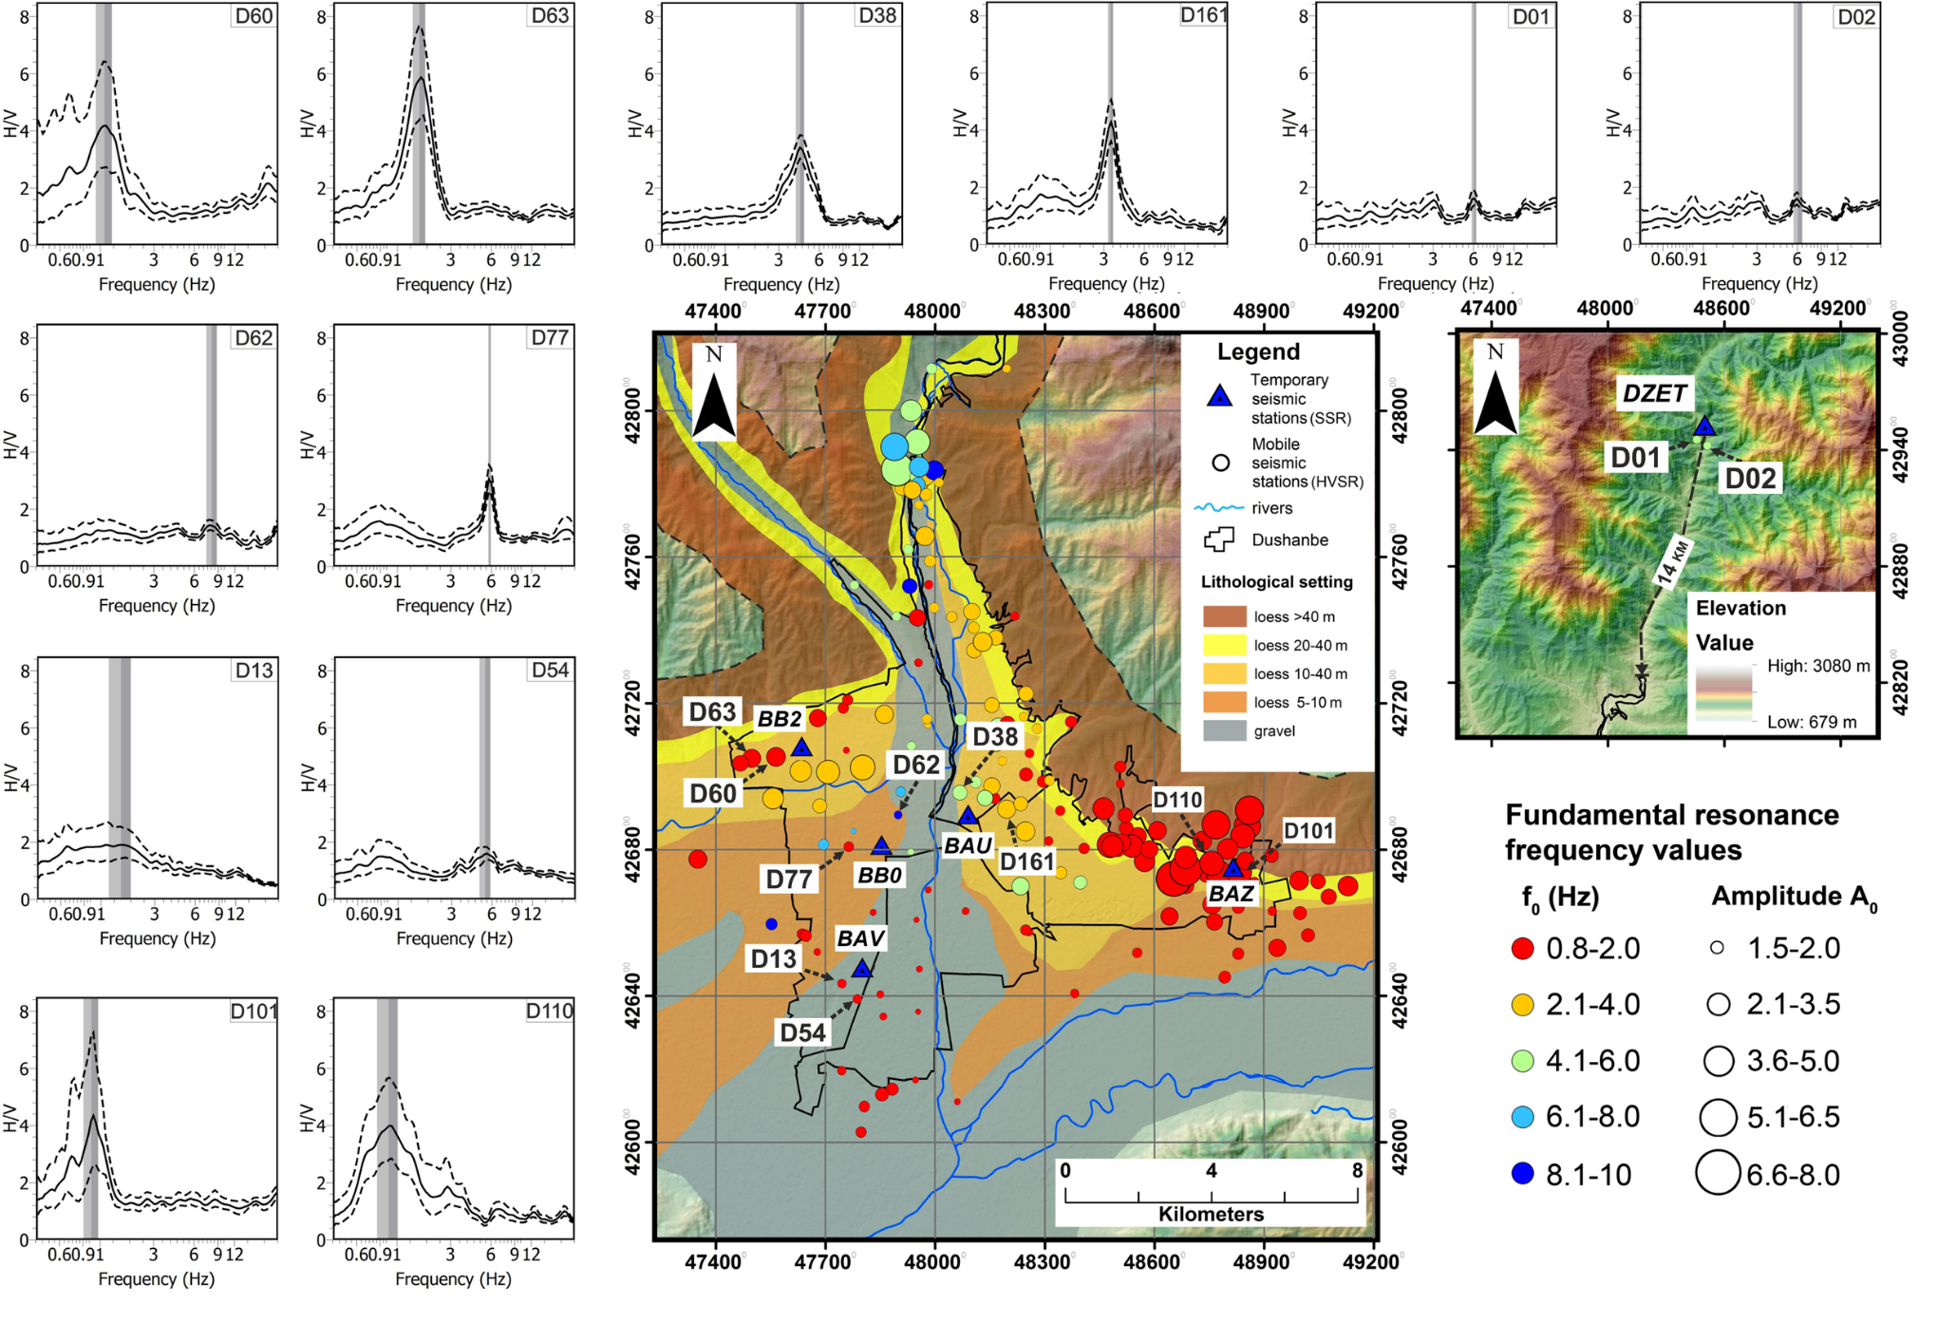
Site Effect Analysis to Support the future Seismic
Microzonation of Dushanbe, Tajikistan
Georisk &
Environment
Results of the Horizontal to Vertical Spectral Ratio (HVSR)
Farkhod Hakimov^{1,3,4,} Gisela Domej², Anatoly Ischuk¹, Klaus Reicherter³, Léna Cauchie⁴, and Hans-Balder Havenith⁴
¹ Academy of Sciences, Institute of Geology, Earthquake Engineering and Seismology, Dushanbe, Tajikistan
² Università degli Studi di Milano-Bicocca, DISAT, Milano, Italia
³ RWTH Aachen University, Neotectonics and Natural Hazards, Aachen, Germany
⁴ University of Liège, Geology Department, Liège, Belgium
Typical for most urbanized areas is a dense agglomeration inducing a wide range of conditions and disturbing factors, which limit the application of many geophysical methods that allow for complex seismic microzonation. In many cases, invasive methods (e.g., drilling and borehole measurements) are impossible to implement. For this reason, only non-invasive methods were used for data acquisition: microtremor array measurements (MAMs), seismic refraction tomography (SRT), and instrumental data recording from temporary and permanent and from mobile seismic stations for long- and short-term acquisition, respectively. The use of these methods individually or in combination has proven to be successful for detailed seismic characterization and microzonation in the past. The newly assessed data was combined with local geological and geotechnical data in the form of lithological maps and cross sections as well as borehole logs provided by the Head Institute of Engineering and Technical Surveys of the State Construction Committee of Tajikistan.
HVSR
Results
HVSR
MAM
SSR
SRT

Slide 21
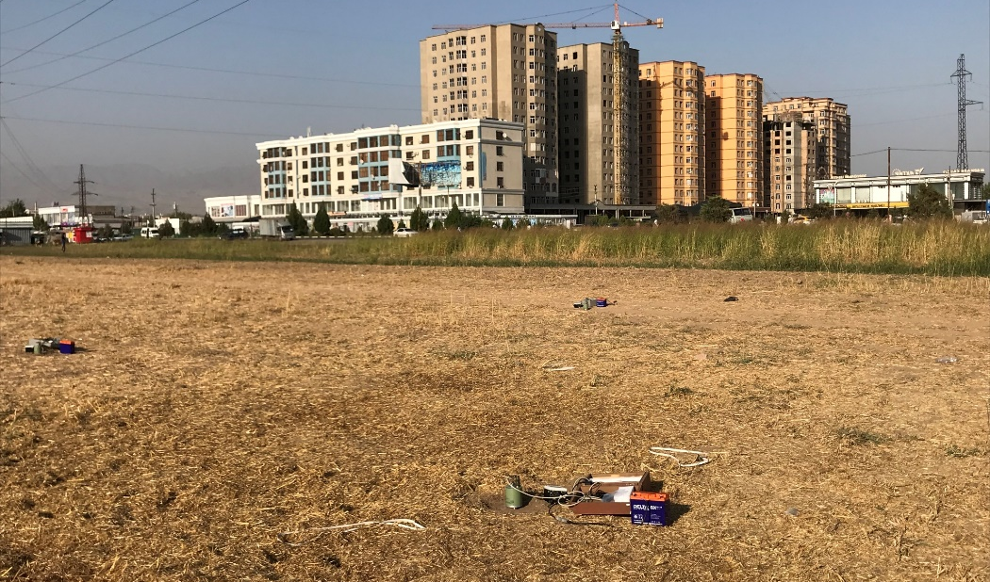
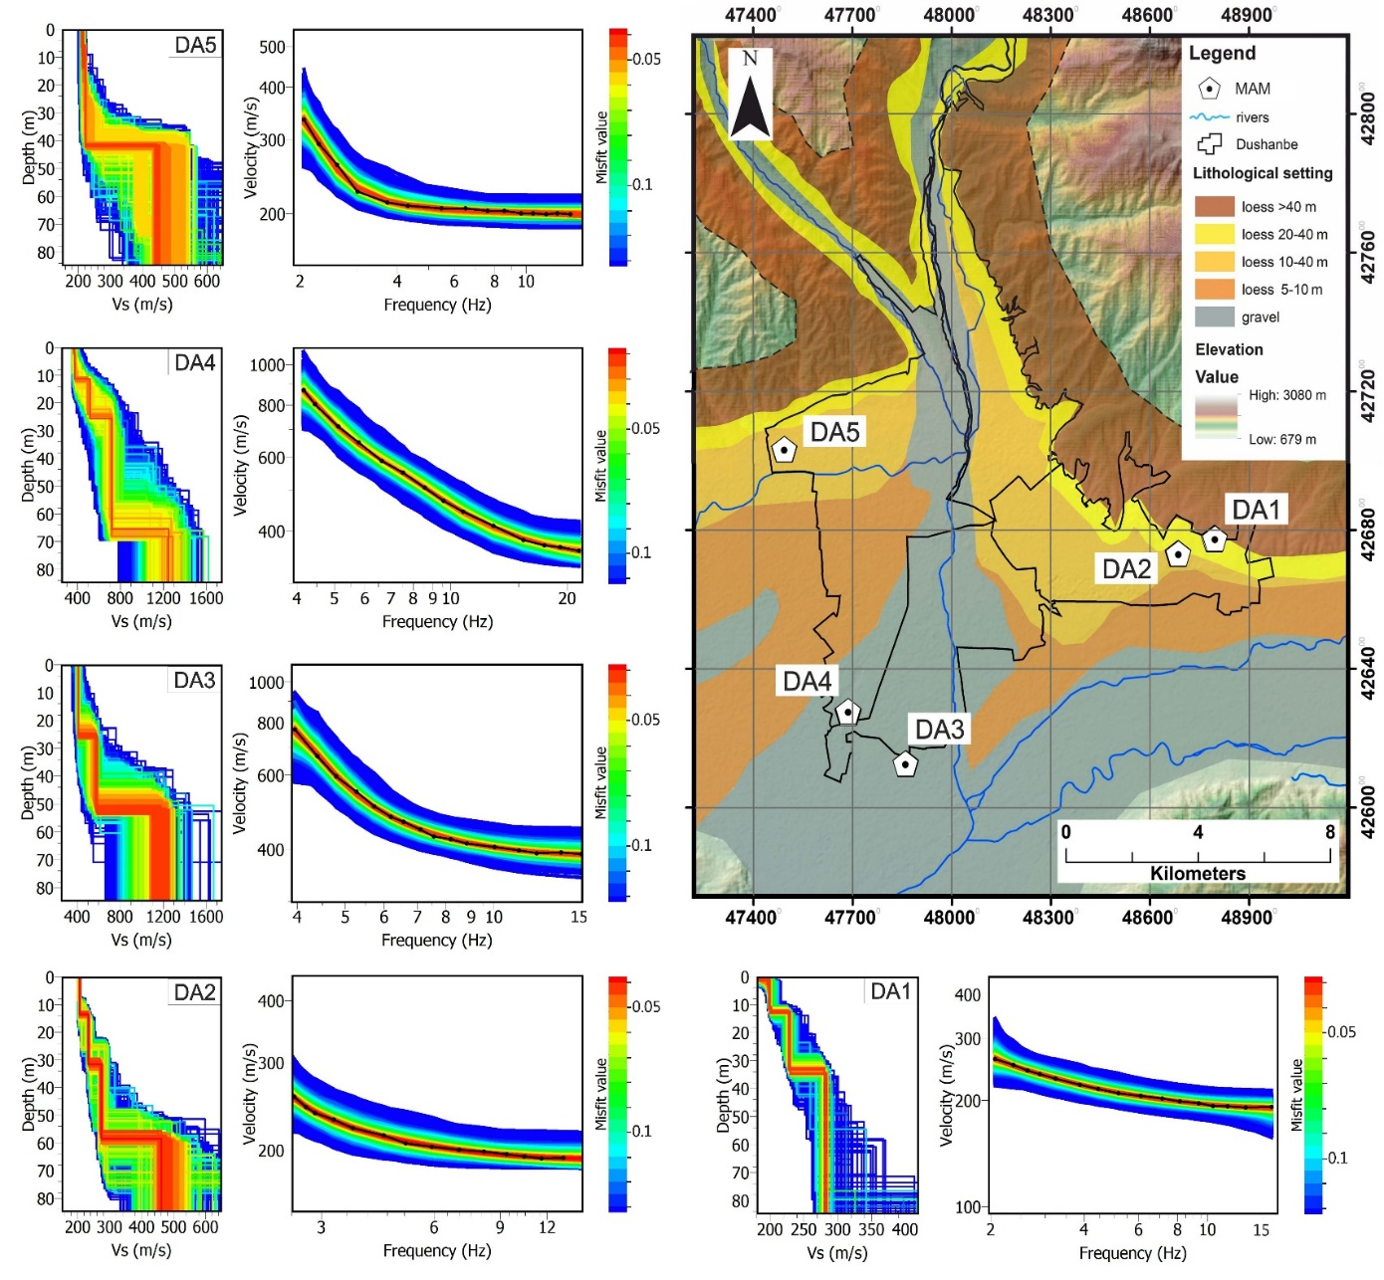
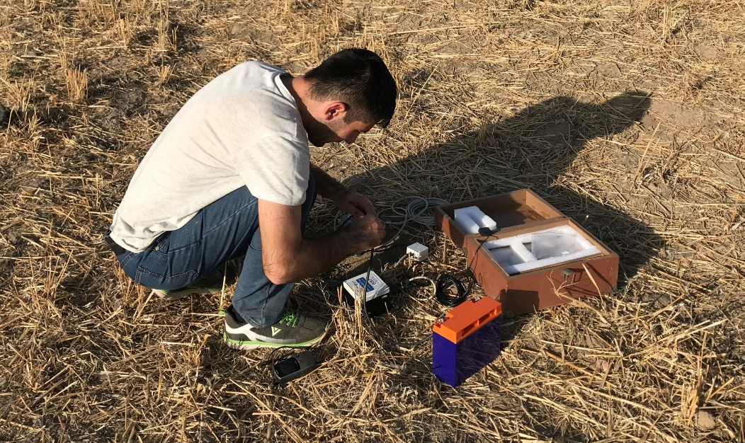
Site Effect Analysis to Support the future Seismic
Microzonation of Dushanbe, Tajikistan
Georisk &
Environment
Results of the Microtremor Array Measurements (MAMs)
Farkhod Hakimov^{1,3,4,} Gisela Domej², Anatoly Ischuk¹, Klaus Reicherter³, Léna Cauchie⁴, and Hans-Balder Havenith⁴
¹ Academy of Sciences, Institute of Geology, Earthquake Engineering and Seismology, Dushanbe, Tajikistan
² Università degli Studi di Milano-Bicocca, DISAT, Milano, Italia
³ RWTH Aachen University, Neotectonics and Natural Hazards, Aachen, Germany
⁴ University of Liège, Geology Department, Liège, Belgium
Typical for most urbanized areas is a dense agglomeration inducing a wide range of conditions and disturbing factors, which limit the application of many geophysical methods that allow for complex seismic microzonation. In many cases, invasive methods (e.g., drilling and borehole measurements) are impossible to implement. For this reason, only non-invasive methods were used for data acquisition: microtremor array measurements (MAMs), seismic refraction tomography (SRT), and instrumental data recording from temporary and permanent and from mobile seismic stations for long- and short-term acquisition, respectively. The use of these methods individually or in combination has proven to be successful for detailed seismic characterization and microzonation in the past. The newly assessed data was combined with local geological and geotechnical data in the form of lithological maps and cross sections as well as borehole logs provided by the Head Institute of Engineering and Technical Surveys of the State Construction Committee of Tajikistan.
HVSR
Results
HVSR
MAM
SSR
SRT

Slide 22
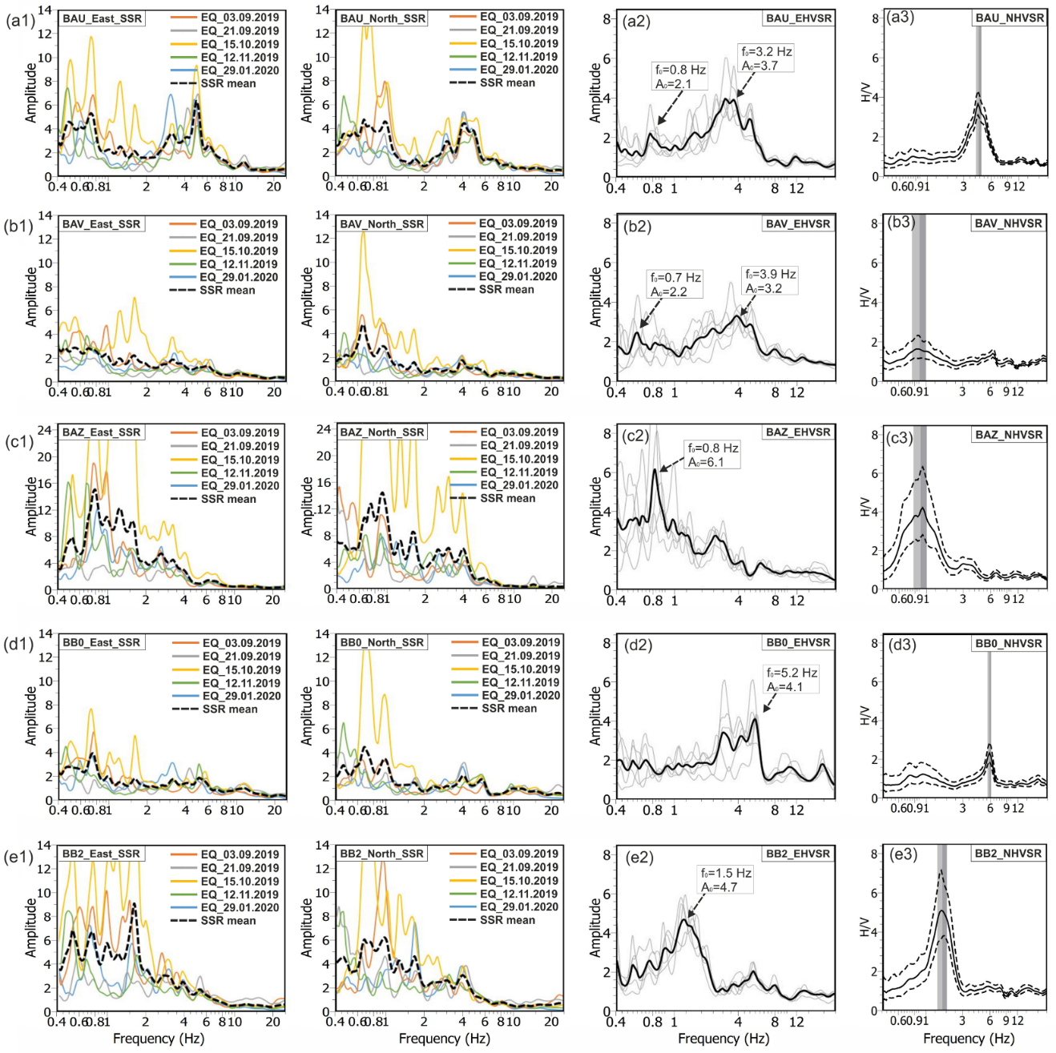
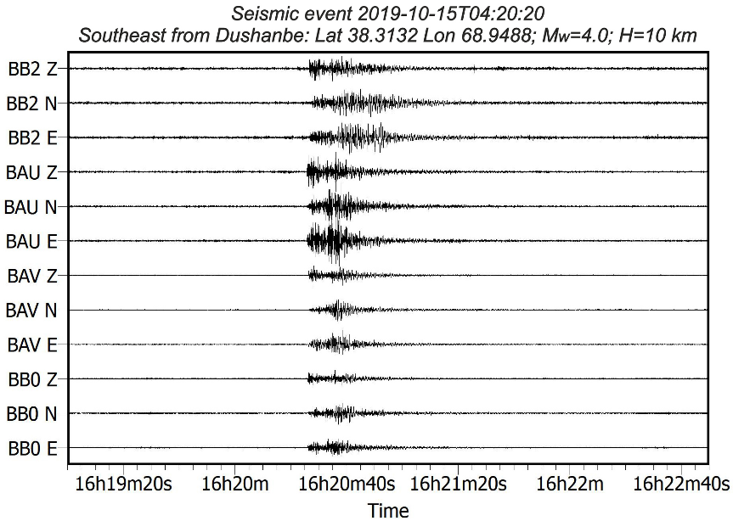
Site Effect Analysis to Support the future Seismic
Microzonation of Dushanbe, Tajikistan
Georisk &
Environment
Results of the Standard Spectrum Ratio (SSR)
Farkhod Hakimov^{1,3,4,} Gisela Domej², Anatoly Ischuk¹, Klaus Reicherter³, Léna Cauchie⁴, and Hans-Balder Havenith⁴
¹ Academy of Sciences, Institute of Geology, Earthquake Engineering and Seismology, Dushanbe, Tajikistan
² Università degli Studi di Milano-Bicocca, DISAT, Milano, Italia
³ RWTH Aachen University, Neotectonics and Natural Hazards, Aachen, Germany
⁴ University of Liège, Geology Department, Liège, Belgium
The SSR calculated for the S-wave window (a1–e1) from five selected earthquakes for the east–west and north–
south components at each station and the corresponding spectrum at the DZET (reference station). In addition, (a2–e2) show the HVSR earthquake (EHVSR) curves and (a3–e3) show the HVSR noise (NHVSR) curves from each station. In all figures, the black dashed curve shows the average SSR for the east–west and north–south components for five selected earthquakes. Please note the different amplitude range variation for the station BAZ (c1).
Typical for most urbanized areas is a dense agglomeration inducing a wide range of conditions and disturbing factors, which limit the application of many geophysical methods that allow for complex seismic microzonation. In many cases, invasive methods (e.g., drilling and borehole measurements) are impossible to implement. For this reason, only non-invasive methods were used for data acquisition: microtremor array measurements (MAMs), seismic refraction tomography (SRT), and instrumental data recording from temporary and permanent and from mobile seismic stations for long- and short-term acquisition, respectively. The use of these methods individually or in combination has proven to be successful for detailed seismic characterization and microzonation in the past. The newly assessed data was combined with local geological and geotechnical data in the form of lithological maps and cross sections as well as borehole logs provided by the Head Institute of Engineering and Technical Surveys of the State Construction Committee of Tajikistan.
HVSR
Results
HVSR
MAM
SSR
SRT

Slide 23
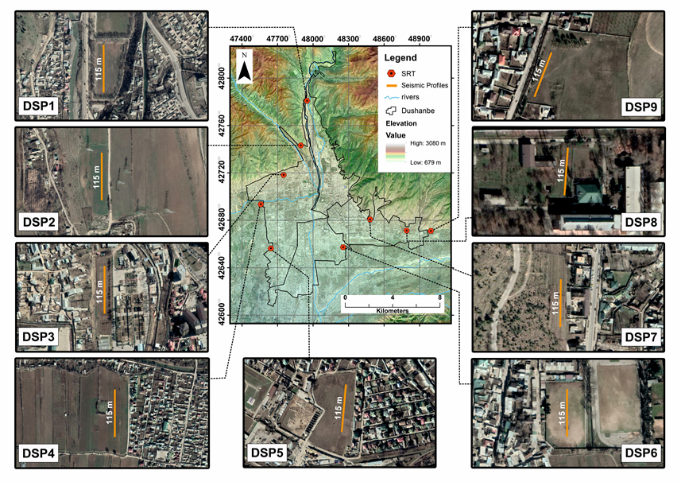
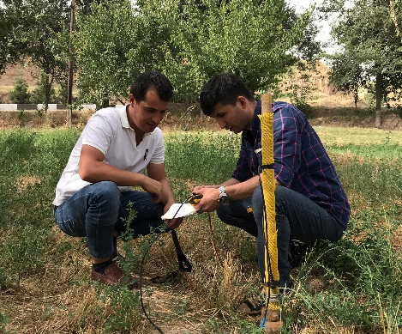
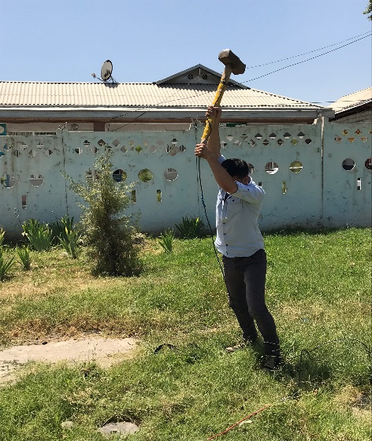
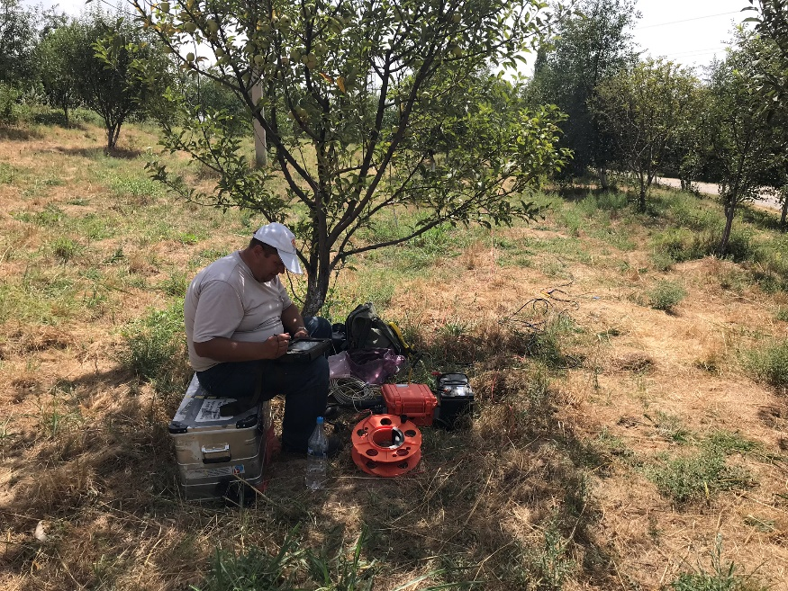
Site Effect Analysis to Support the future Seismic
Microzonation of Dushanbe, Tajikistan
Georisk &
Environment
Results of the Seismic Refraction Tomography (SRT) Profiles
Farkhod Hakimov^{1,3,4,} Gisela Domej², Anatoly Ischuk¹, Klaus Reicherter³, Léna Cauchie⁴, and Hans-Balder Havenith⁴
¹ Academy of Sciences, Institute of Geology, Earthquake Engineering and Seismology, Dushanbe, Tajikistan
² Università degli Studi di Milano-Bicocca, DISAT, Milano, Italia
³ RWTH Aachen University, Neotectonics and Natural Hazards, Aachen, Germany
⁴ University of Liège, Geology Department, Liège, Belgium
Typical for most urbanized areas is a dense agglomeration inducing a wide range of conditions and disturbing factors, which limit the application of many geophysical methods that allow for complex seismic microzonation. In many cases, invasive methods (e.g., drilling and borehole measurements) are impossible to implement. For this reason, only non-invasive methods were used for data acquisition: microtremor array measurements (MAMs), seismic refraction tomography (SRT), and instrumental data recording from temporary and permanent and from mobile seismic stations for long- and short-term acquisition, respectively. The use of these methods individually or in combination has proven to be successful for detailed seismic characterization and microzonation in the past. The newly assessed data was combined with local geological and geotechnical data in the form of lithological maps and cross sections as well as borehole logs provided by the Head Institute of Engineering and Technical Surveys of the State Construction Committee of Tajikistan.
HVSR
Results
HVSR
MAM
SSR
SRT

Slide 24
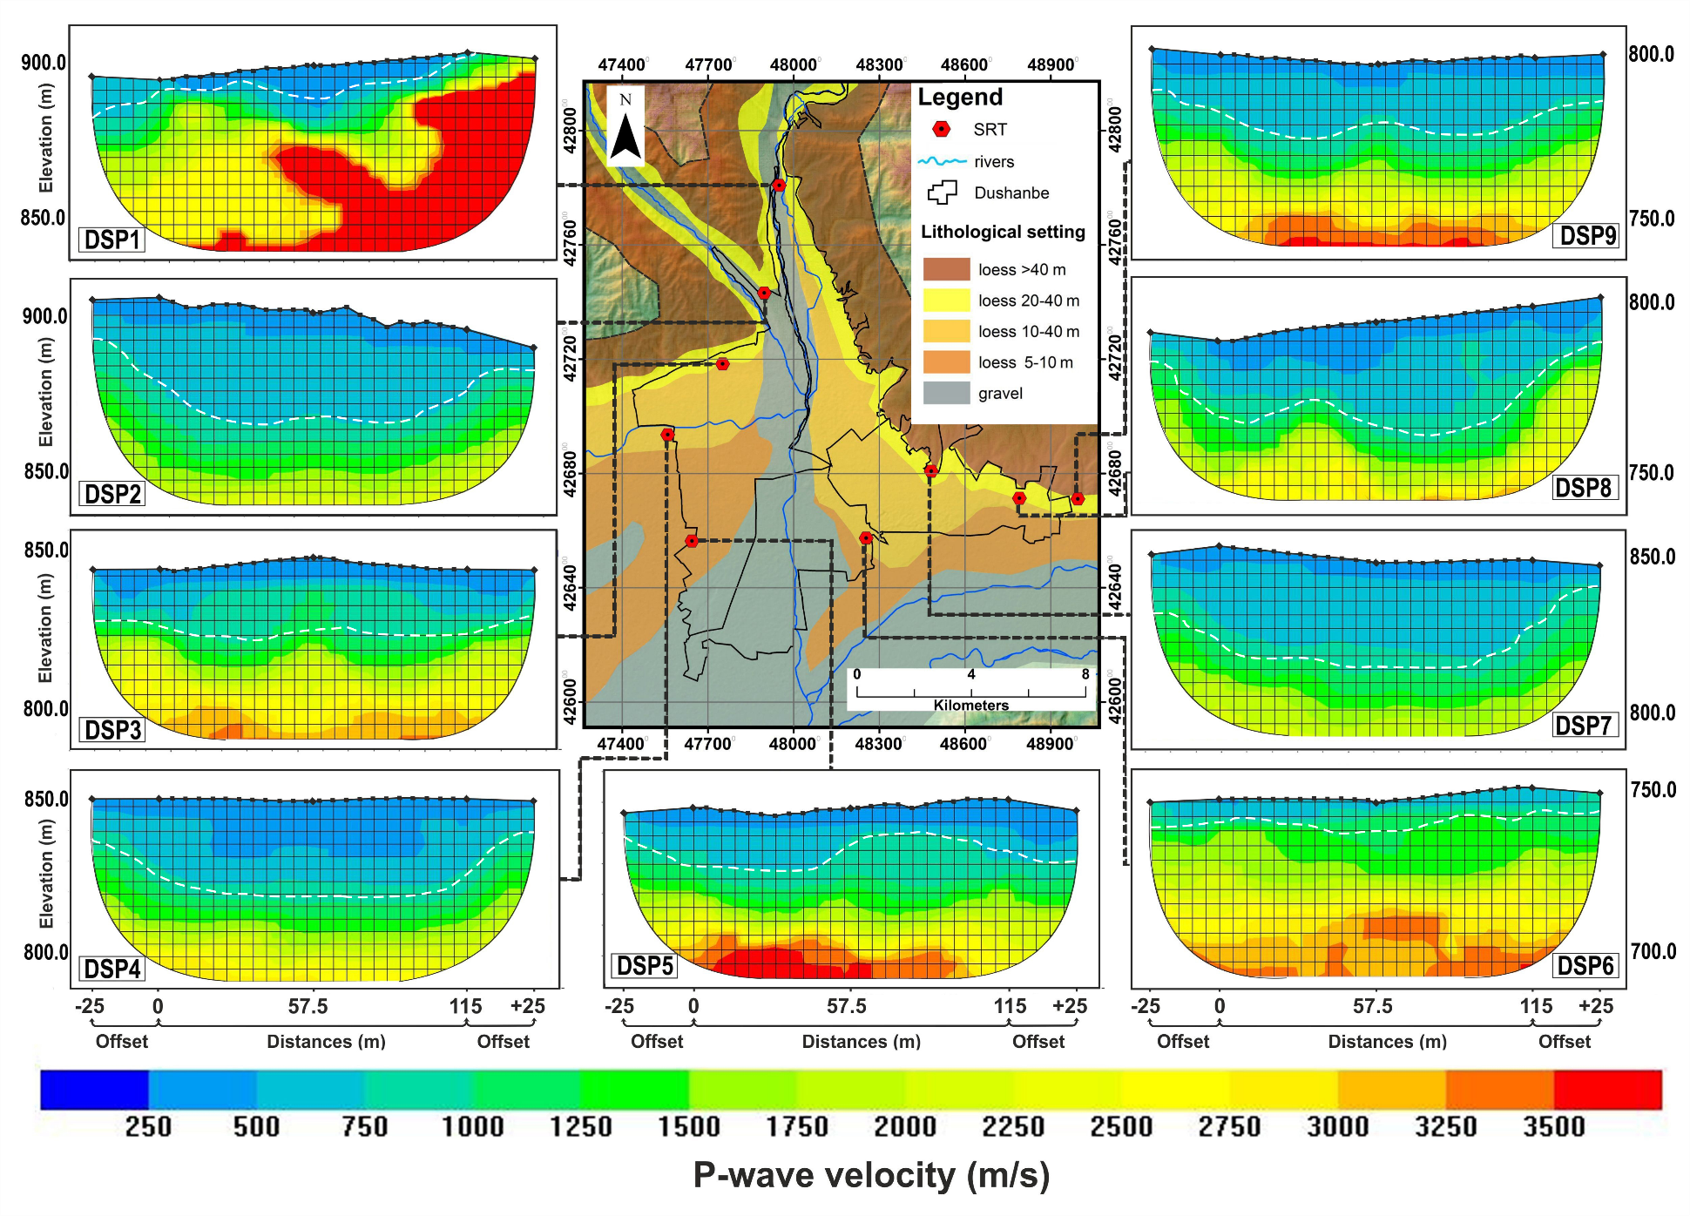
Site Effect Analysis to Support the future Seismic
Microzonation of Dushanbe, Tajikistan
Georisk &
Environment
Results of the Seismic Refraction Tomography (SRT) Profiles
Farkhod Hakimov^{1,3,4,} Gisela Domej², Anatoly Ischuk¹, Klaus Reicherter³, Léna Cauchie⁴, and Hans-Balder Havenith⁴
¹ Academy of Sciences, Institute of Geology, Earthquake Engineering and Seismology, Dushanbe, Tajikistan
² Università degli Studi di Milano-Bicocca, DISAT, Milano, Italia
³ RWTH Aachen University, Neotectonics and Natural Hazards, Aachen, Germany
⁴ University of Liège, Geology Department, Liège, Belgium
Typical for most urbanized areas is a dense agglomeration inducing a wide range of conditions and disturbing factors, which limit the application of many geophysical methods that allow for complex seismic microzonation. In many cases, invasive methods (e.g., drilling and borehole measurements) are impossible to implement. For this reason, only non-invasive methods were used for data acquisition: microtremor array measurements (MAMs), seismic refraction tomography (SRT), and instrumental data recording from temporary and permanent and from mobile seismic stations for long- and short-term acquisition, respectively. The use of these methods individually or in combination has proven to be successful for detailed seismic characterization and microzonation in the past. The newly assessed data was combined with local geological and geotechnical data in the form of lithological maps and cross sections as well as borehole logs provided by the Head Institute of Engineering and Technical Surveys of the State Construction Committee of Tajikistan.
HVSR
Results
HVSR
MAM
SSR
SRT

Slide 25
Site Effect Analysis to Support the future Seismic
Microzonation of Dushanbe, Tajikistan
Georisk &
Environment
Farkhod Hakimov^{1,3,4,} Gisela Domej², Anatoly Ischuk¹, Klaus Reicherter³, Léna Cauchie⁴, and Hans-Balder Havenith⁴
¹ Academy of Sciences, Institute of Geology, Earthquake Engineering and Seismology, Dushanbe, Tajikistan
² Università degli Studi di Milano-Bicocca, DISAT, Milano, Italia
³ RWTH Aachen University, Neotectonics and Natural Hazards, Aachen, Germany
⁴ University of Liège, Geology Department, Liège, Belgium
The specific and validated seismic hazard assessment for the cities with high infrastructure industry and the population is extremely important. Such a task is particularly important for a city such as Dushanbe, as it is located in a region of high seismicity. The morphology and position of the underlying rocks (depth from the surface), covered by different soft sediments with variable thickness, have previously not been studied sufficiently to be able to provide the information for a reliable seismic microzonation of the urban areas. The same is true for the variability affecting the physical properties of the soils, considering their distribution over the whole area and over different depths. This study is the first one to use four modern seismological methods and data processing methods to clarify the impact of different ground conditions in Dushanbe on seismic actions. Here, the geophysical-seismological data are presented and analyzed with respect to their geological relevance.
The resulting data and models that we acquired have enormously important applications for the city. An overall hazard map for the city can be developed, which then can be used to define building codes, lifelines and community planning. Moreover, these results can be used as inputs for further studies such as liquefaction or slope/ground failure assessment.
Conclusions

Slide 26
Site Effect Analysis to Support the future Seismic
Microzonation of Dushanbe, Tajikistan
Georisk &
Environment
Farkhod Hakimov^{1,3,4,} Gisela Domej², Anatoly Ischuk¹, Klaus Reicherter³, Léna Cauchie⁴, and Hans-Balder Havenith⁴
¹ Academy of Sciences, Institute of Geology, Earthquake Engineering and Seismology, Dushanbe, Tajikistan
² Università degli Studi di Milano-Bicocca, DISAT, Milano, Italia
³ RWTH Aachen University, Neotectonics and Natural Hazards, Aachen, Germany
⁴ University of Liège, Geology Department, Liège, Belgium
Abdrakhmatov, K. Establishment of the Central Asia Seismic Risk Initiative (CASRI); ISTC Project No. KR 1176, 2009; Technical Report on theWork Performed from: 02.01.2006 to 04.30.2009; Institute of Seismology, National Academia of Sciences: Bishkek, Kyrgyzstan, 2009.
Aki, K. Space and time spectra of stationary stochastic waves, with special reference to microtremors. Bull. Earthq. Res. Inst. 1957, 35, 415–456.
Babaev, A.M.; Ischuk, A.R.; Negmatullaev, S.K. Seismic Conditions of the Territory of Tajikistan; Publication of the International University of Tajikistan: Dushanbe, Tajikistan, 2005; pp. 93–98.
Borcherdt, R.D. Effects of local geology on ground motion near San Francisco Bay. Bull. Seismol. Soc. Am. 1970, 60, 29–61.
Bune, V.I.; Gorshkov, G.P. Seismic Zonation of USSR; Nauka: Moscow, Russia, 1980; p. 307. (In Russian)
Kopilov, A.L. The Map of the Seismic Microzonation of the Dushanbe AreaMade Using the Method of Acoustic Stiffness; Quarterly Report; GIINTIZ Institute: Dushanbe, Tajikistan, 1989; p. 170. (In Russian)
Kudo, K., Kanno, T. et al., 2002. Site-specific issues for strong motions during the Kocaeli, Turkey earthquake of 17 August 1999, as inferred from Array observations of microotremors and aftershocks, Bull. Seism. Soc. Am., 92, 448-465.
Nakamura, Y.A. Method for Dynamic Characteristics Estimation of Subsurface Using Microtremor on the Ground Surface; Quarterly Report; Railway Technical Research Institute: Tokyo, Japan, 1989; Volume 30, pp. 25–33.
Nazarov, A.G.; Nechaev, V.A. Seismic Microzonation Map—The Administrative Area of Stalinabad; Academy Science, USSR: Dushanbe, Tajikistan, 1953; p. 15. (In Russian)
Mikhailova, N.; Mukambayev, A.; Aristova, I.; Kulakova, G.; Ullah, S.; Pilz, M.; Bindi, B. Central Asia earthquake catalogue from ancient time to 2009. Ann. Geophys. Italy 2015, 58, 102–111.
Ohori, M.; Nobata, A.; Wakamatsu, K. A comparison of ESAC and FK methods of estimating phase velocity using arbitrarily shaped microtremor arrays. Bull. Seismol. Soc. Am. 2002, 92, 2323–2332.
Okada, H. The Microtremor Survey Method. American Geophysical Monograph 12; American Geophysical Union: Washington, DC, USA, 2003; pp. 1–14.
Zolotarev, G.S.; Fachorenko, W.S.; Lipmija, W.I.; Hergow, D.; Rohdijow, N.A.; Jaodokowa, P. Polygon-Based Engineering and Geological Map of the Dushanbe Region; Soviet Academy of Science: Moscow, Russia, 1985; p. 15. (In Russian)
References

