Slide 1




Precipitation nowcasting based on multifractal advection and deformation
Victória Santos Duarte Ramos

Slide 2
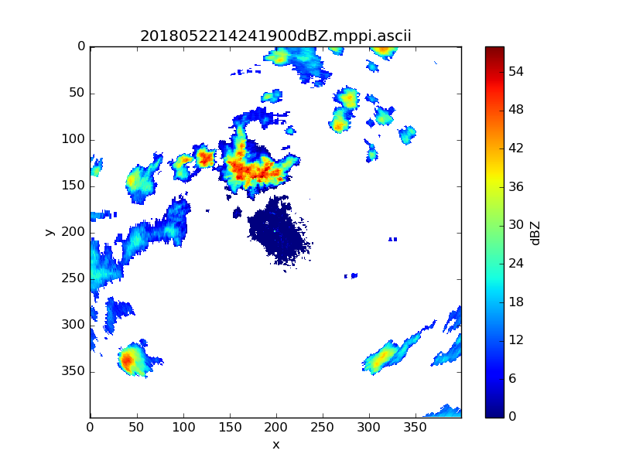
Introduction
Nowcasting is considered as forecasting with local detail, by any method, over a period from the present to 6 hours ahead, including a detailed description of the present weather.
Classical precipitation nowcasting methods include methods of image processing to identify precipitation cells and extrapolate their motion. Due to the strong nonlinearity of the precipitation processes, such methods face some limitations, for example, cell identification lacks physics and can be quite difficult or even fail because of their fast deformation.
Spectral and multifractal analyses of radar data enable a comparison of the structure and the morphology of both the precipitation and vector fields through space time scales. This provides a unique framework to nowcast both fields over scales relevant to urban decision-making.
Plotting radar reflectivity data

Slide 3
Methodology
In this research, 299 samples of meteorological radar data from the HM&Co laboratory from the same meteorological event were used, these samples were equally spaced in time. All the code to perform the analysis was developed in Python.
During the three-month internship, the main reference for conducting the study was Marsan et Al, Causal space-time multifractal processes: Predictability and forecasting of rain field, Journal of Geophysical Research, 1996.
The steps followed were the Z-R conversion using the Marshall and Palmer equation, obtaining and analyzing the Fourier spectrum of the data and the isocorrelated contours. These steps were followed to see and understand the anisotropy induced by the overall advection to be able to calculate the parameters associated with this phenomenon in the future.

Slide 4
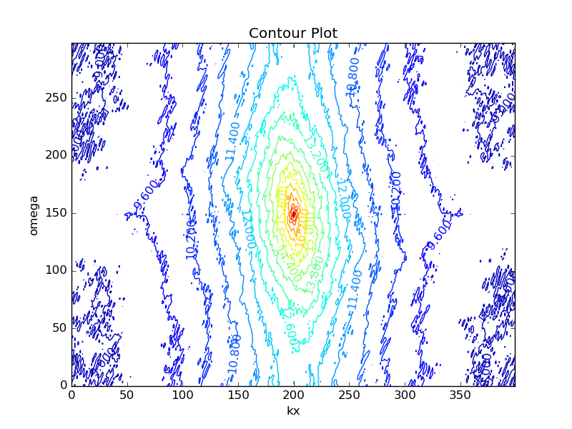
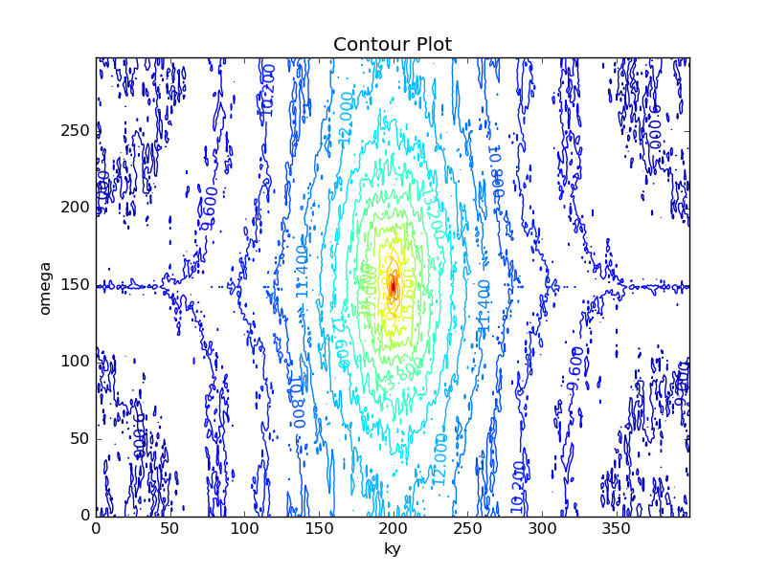
Latest results
Fourier transform of each data was first performed separately. After that, all 299 matrices (400x400) already transformed were joined in a 3D matrix (400x400x299). Then, the average along the x axis has been calculated to obtain the contour for the y-t section. Similarly, the average along the y axis has been averaged to obtain the contour for the x-t section. After averaging, the values have been plotted in logarithmic scale. We can see that the contours have undergone a global "rotation” compared to their expected shape, this transform being due to an anisotropy induced by the overall advection.

Slide 5
Thank you!
Special thanks to Ioulia Tchiguirinskaia, Daniel Schertzer and Igor Paz for having guided me during this research and for all the teachings they transmitted to me during this period.

