Slide 1




Hydrological modelling of a (semi-) urbanized catchment with the help of the Multi-Hydro Model
Rodrigo Ribeiro de Moura

Slide 2

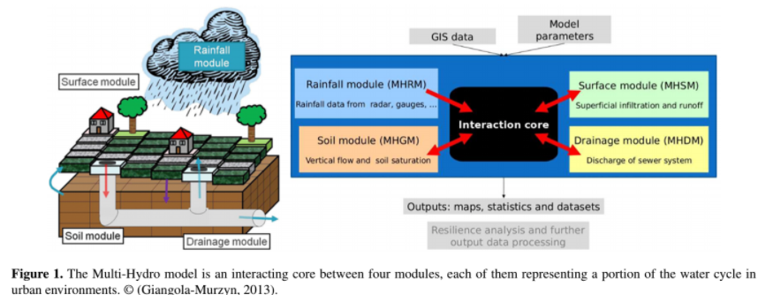


Hydrological modelling of a (semi-) urbanized catchment with the help of the Multi-Hydro Model
Rodrigo Ribeiro de Moura
How it works?
What is Multi-Hydro?
GIS data
Topography
Landuse
Sewer system
MH-AssimTool
Catchment
Multi-Hydro

Slide 3
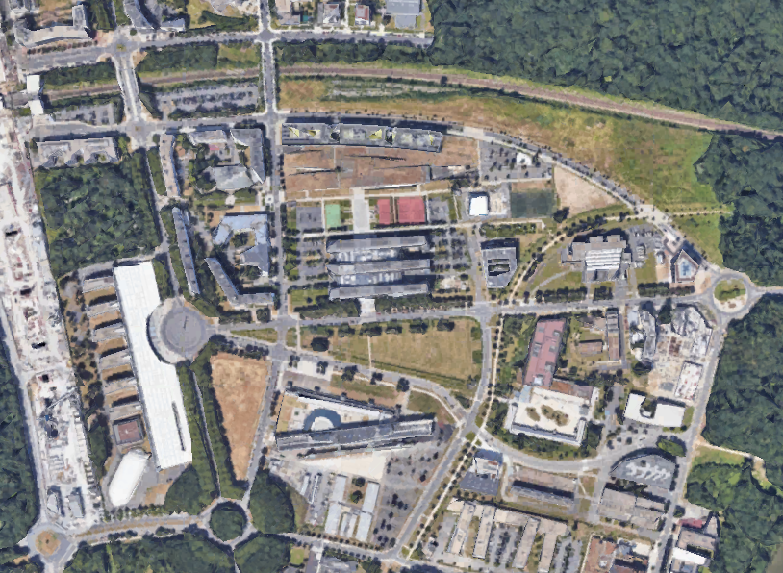
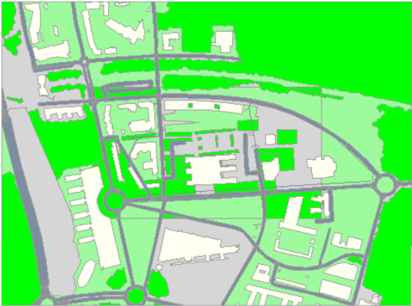
Hydrological modelling of a (semi-) urbanized catchment with the help of the Multi-Hydro Model
Land use GIS shapefile containing six land use categories:
Study Area - École des Ponts Campus site
(Marne-la-Vallée - France)
Green areas, roads, forest, buildings, impervious and gullies.

Slide 4
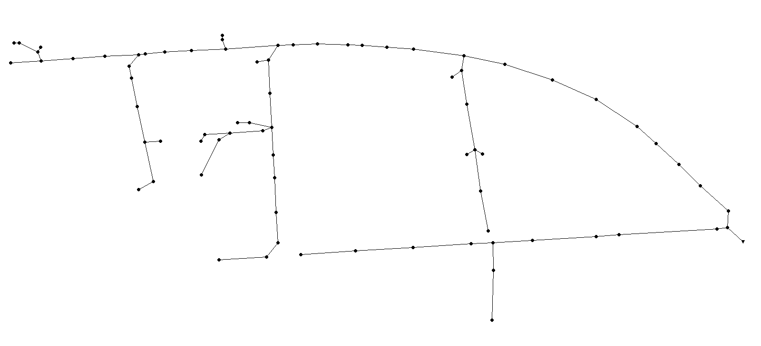
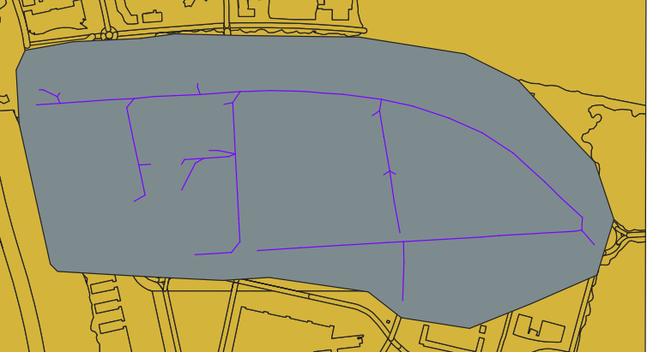
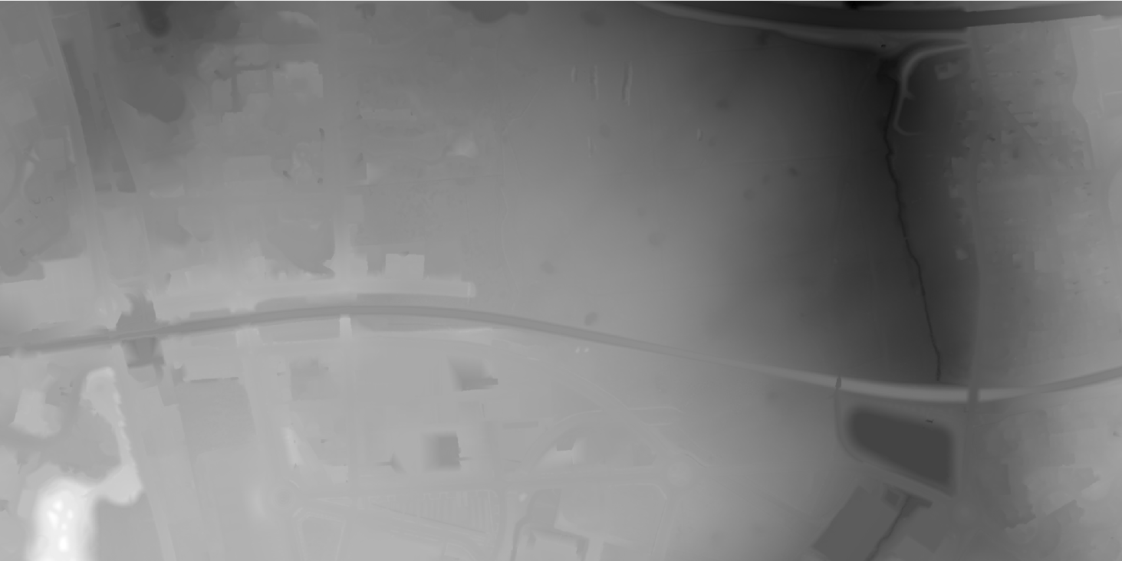
Hydrological modelling of a (semi-) urbanized catchment with the help of the Multi-Hydro Model
Sewer system (just the stormwater network)
Catchment (gray) contrasting with land use and sewer system
Topography with one meter resolution

Slide 5
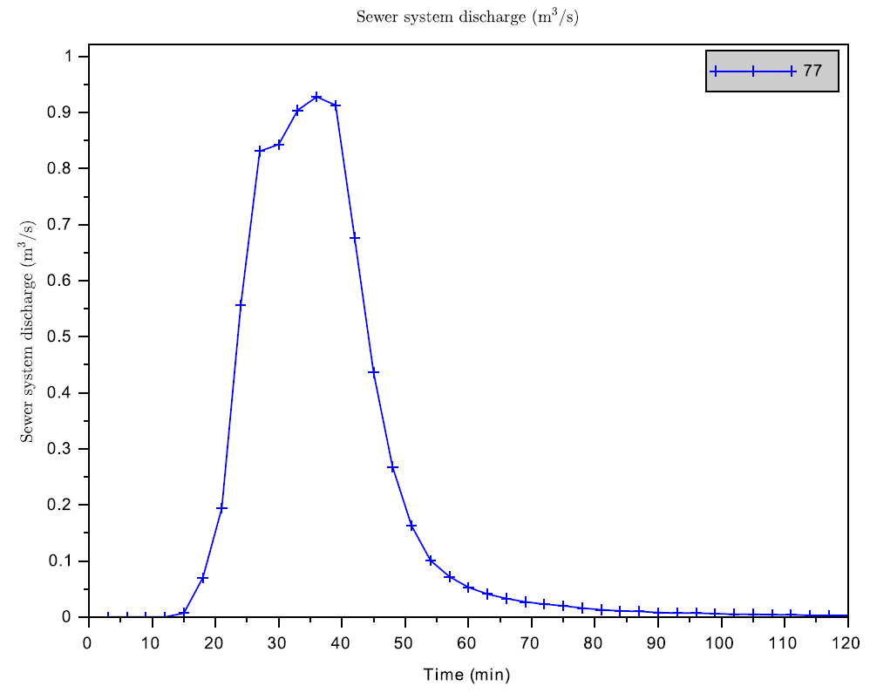
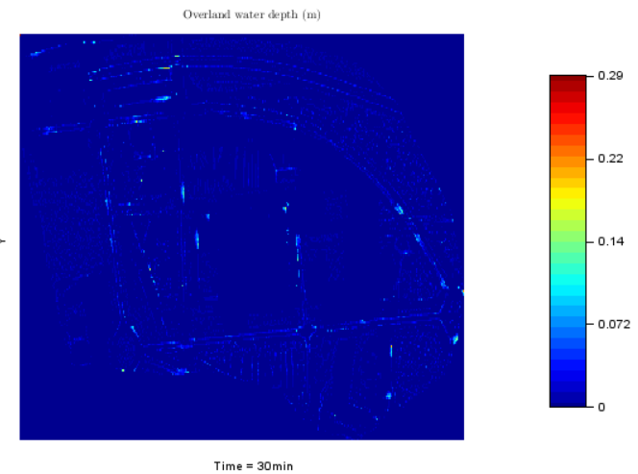
Hydrological modelling of a (semi-) urbanized catchment with the help of the Multi-Hydro Model

Slide 6
My special thanks to:
Ioulia TCHIGUIRINSKAIA
Daniel SCHERTZER
Pierre-Antoine VERSINI
Auguste GIRES
Igor DA SILVA ROCHA PAZ
for the support and reception.

