Slide 1



No. EGU21-16557
Study on the precipitation gradient characteristics in the high mountains of southern Tibet
Chen ZENG and Fan ZHANG
Key Laboratory of Tibetan Environment Changes and Land Surface Processes, Institutes of Tibetan Plateau Research, Chinese Academy of Sciences

Slide 2
Significance and Study area
Precipitation is the main source of river discharge in the high mountain headwater areas and hence as a key parameter in hydrological modelling.
However, spatiotemporal distribution of precipitation in the remote high mountain headwater areas on the Tibetan Plateau (TP) has been poorly characterized.
Precipitation intensity is another critical parameter that can influence hydrological processes.
Three catchments on the southern TP: ZRC (2013-2015), KRC (2013-2016) and MRC (2013 only) during the Monsoon season (July to September)
Precipitation (rainfall) gradient (PG) characteristics under different precipitation intensity grades (PIG)
FIGURE. Locations of the Zhuodi River catchment (ZRC), Karuxung River catchment (KRC), Mabengnong River catchment (MRC) and precipitation observation sites.

Slide 3
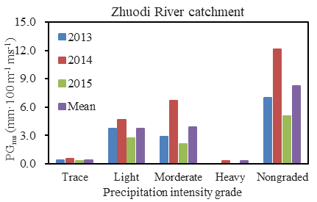
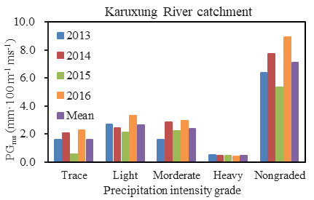
PG under different PIGs
Temporal variation
Trace: P ≤ 0.1 mm·d⁻¹
Light: 0.1 < P ≤ 10 mm·d⁻¹
Moderate: 10 < P ≤ 25 mm·d⁻¹
Heavy: 25 < P ≤ 50 mm·d⁻¹
Average PG varied during 0.71 to 0.82 mm·100 m⁻¹ for the total (non-intensity-graded) precipitation during the monsoon.
PG strongly varied (2.4 to 28.7 times) among different PIGs.
PG showed relatively persistent patterns of variation in different PIGs among different years.

Slide 4
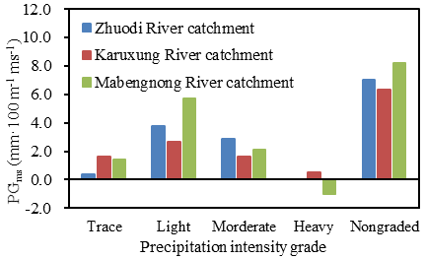
PG under different PIGs
Spatial variation
The patterns of PG under different PIGs varied among different catchments.

Slide 5
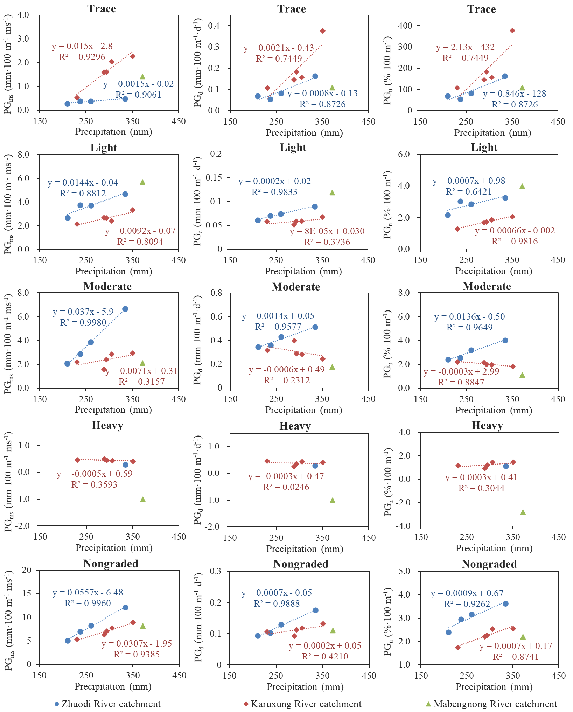
Correlations between PG and precipitation amount
PGs were strongly correlated to precipitation amounts
A steep positive slope under fine precipitation grade but became flat or even negative with stronger PIG
Mechanism:
Precipitation in southern TP was influenced more by valley-scale convection (Positive PG) than by large-scale monsoon circulation (Negative PG) .
Notes:
Precipitation in southern TP was influenced more by valley-scale convection than by large-scale monsoon circulation.

Slide 6
Thank you for your attention!
zengchen@itpcas.ac.cn

