Slide 1
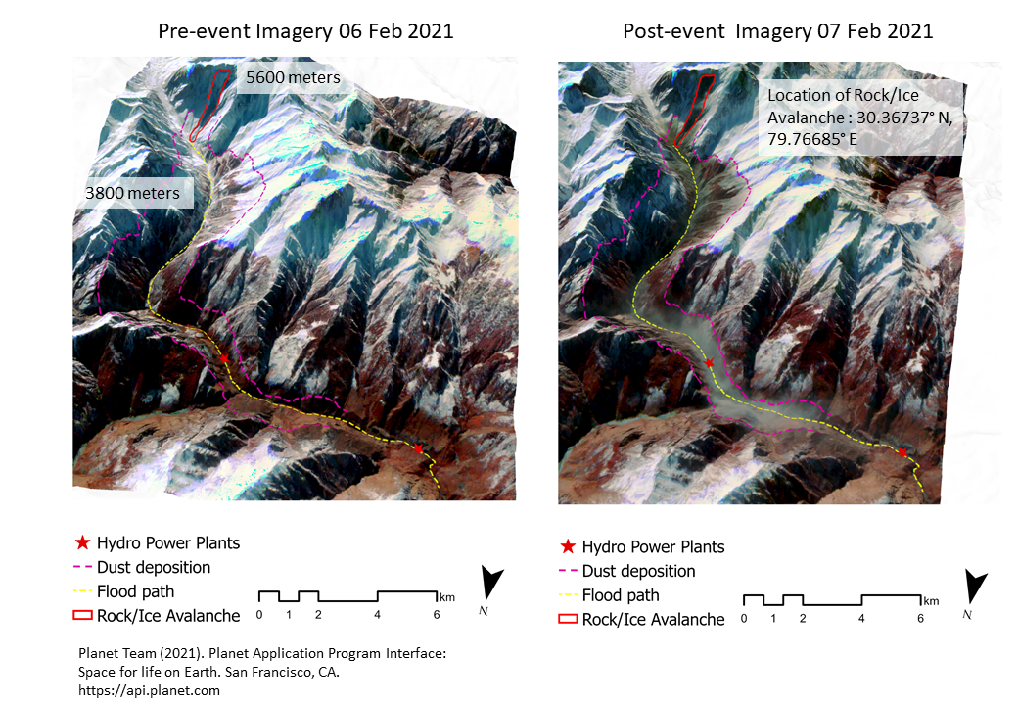
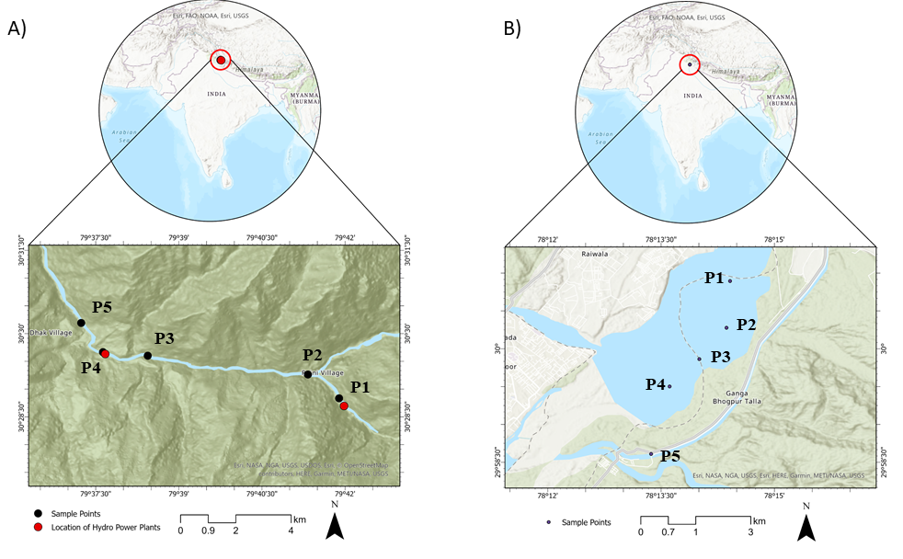
Impact of the Chamoli Disaster on Flood Plain and Water Quality along the Himalayan Rivers
Sansar Raj Meena*, Akshansha Chauhan, Kushanav Bhuyan, and R. P. Singh
General
The rivers originating from the Himalayas are very dynamic and can carry huge amounts of eroded rocks and sediments that can affect the water quality downstream. The deposition of such sediments in river water which is used by about 500 million people residing within the Ganga Basin, especially along the Ganga River and its tributaries, can have massive implications on their lives and economy. The consequences of the Chamoli Disaster contributed by the influx of debris along with broken glacial fragments flooding the Rishi Ganga river and its subsequent tributaries are worth investigating.
Our study was to qualitatively evaluate the effects of the disaster on river water quality using Sentinel 1 and 2 images.
We used normalized difference indices: NDCI, NDTI and NDWI to analyse the changes in water quality to examine the effects of the Chamoli Disaster using pre-and post-event images.
Interpretation of the pronounced water changes were studied by evaluating the variations in the spectral profiles and the backscatter information for locations of interest.
Objectives and Approaches
Fig 1: Affected area due to Chamoli Disaster
*Corresponding author
Notes:
Änderungen:
-Grafik links von Autoren → wie in Flyer
-Überschriften → komplett in Rot
-Nummerierung von ‚Methodological framework‘ und ‚Integrated Landslide Mapping‘ ausgetauscht → Lesbarkeit
-Grafiken mit weißem Rahmen und iSLIDE Logo etwas verkleinert
-Integrated Landslide Mapping: Textteil weggelassen ‘Such a conceptual foundation will make the approach robust and transferable to other study areas, en route to fully automated landslide analysis’
-Reihenfolge von Bullet 2 und 3 ausgetauscht
-Evtl. sollten die Abbildungen eine einheitliche Formatierung haben? Im Moment sehr verschieden (weiche Kanten, schwarzer Rahmen, weißer Rahmen,…)

Slide 2
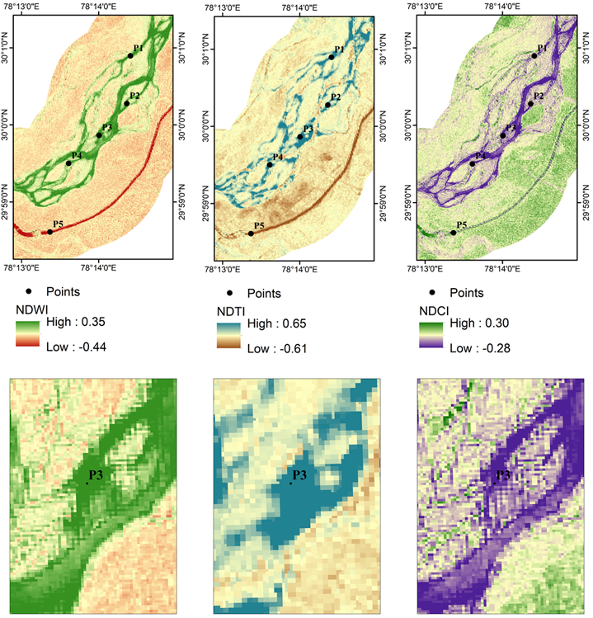
Highlights
Our results show that pronounced changes were witnessed in the river water and the flood plains.
The abrupt changes in the water indices of NDWI, NDTI and NDCI are indicative of the increase in the water levels as well as total suspended matter in the river channels.
Apparent variations in the spectral profiles and backscatter information of the regions of interest throughout the lower plain areas indicate decrease in the flood plain.
Fig 4: Spectral Profile of Tapovan and Haridwar; Backscatter co-efficient of Tapovan and Haridwar.
Fig 2: Change Detection of NDWI, NDTI and NDCI on Haridwar.
Fig 3: Change Detection of NDWI, NDTI and NDCI on Tapovan.
Notes:
Änderungen:
-Grafik links von Autoren → wie in Flyer
-Überschriften → komplett in Rot
-Nummerierung von ‚Methodological framework‘ und ‚Integrated Landslide Mapping‘ ausgetauscht → Lesbarkeit
-Grafiken mit weißem Rahmen und iSLIDE Logo etwas verkleinert
-Integrated Landslide Mapping: Textteil weggelassen ‘Such a conceptual foundation will make the approach robust and transferable to other study areas, en route to fully automated landslide analysis’
-Reihenfolge von Bullet 2 und 3 ausgetauscht
-Evtl. sollten die Abbildungen eine einheitliche Formatierung haben? Im Moment sehr verschieden (weiche Kanten, schwarzer Rahmen, weißer Rahmen,…)

