Slide 1
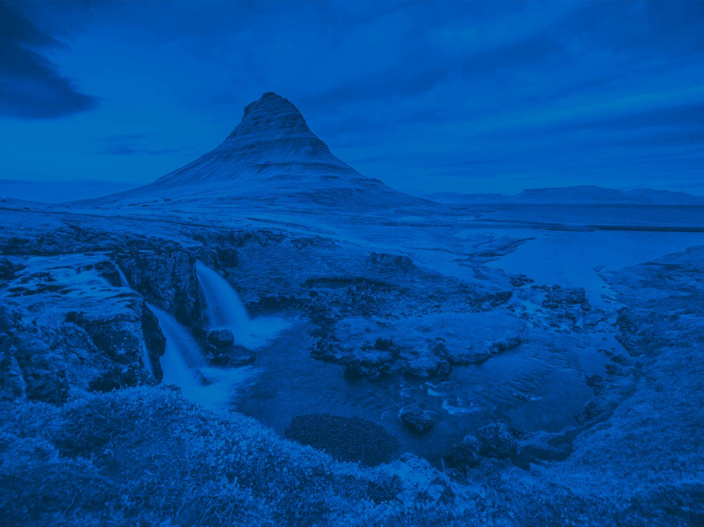

How to #vEGU21 : Networking
Your guide to networking
Conference Networker
Getting to grips with Gathertown
Pop-up Networker
networking@egu.eu
Meetings | Publications | Outreach | www.egu.eu/policy

Slide 2
Your guide to networking at #vEGU21:
The next few slides will introduce the different ways you can network at this year’s General Assembly. For more information check out the links below!
Useful blogs:
Conference Networker and Handshake: https://blogs.egu.eu/geolog/2021/04/02/how-to-vegu-your-vegu21-profile-and-the-conference-networker/
Pop-Up Scheduler: https://blogs.egu.eu/geolog/2021/04/09/how-to-vegu-the-pop-up-networking-scheduler/
ECS Networking Events: https://blogs.egu.eu/geolog/2021/04/13/how-to-vegu-early-career-scientist-newtorking-events/
Top 10 Networking Events: https://blogs.egu.eu/geolog/2021/04/15/how-to-vegu-top-q0-networking-events/
Notes:
Science for policy is the process by which information is transferred from the scientific community to decision-makers with the intention to produce evidence informed policy. In this way, science can clarify the options that policymakers have, showing the possibilities and the consequences of any action or inaction. Don’t worry – I’ll be coming back to this on the next slide.
Evidence-informed policy aims to use the best available research to inform decision-making. So science for policy is the process – and evidence-informed policies are, ideally, the result. The reason we used “evidence-informed” over the previously popular “evidence-based” is because evidence is only one component of any policy decision. While science and research can certainly support policy and enable policymakers to make the most appropriate decision given the situation, policies are not made by science alone. Successful policies need to consider many different factors including values, coalitions, economic inputs, and the potential impact on other policies.
Scientists engage with policy for a wide number of reasons.
Firstly, as mentioned a few slides ago, involving science in the policymaking process ideally enables policymakers to make the most appropriate decision that leads to the best outcome of a given situation. Many scientists are motivated by a desire to make the world a better place, and to use their skills and knowledge to improve society. Science for policy can facilitate this.
Engaging in the policymaking process can increase the impact of a scientist's research! As I mentioned, science isn’t and shouldn't be the sole consideration in the policymaking process but scientific evidence – when presented effectively – can contribute to how a particular policymaker perceives and reacts to the issue.
Engaging in policy can also help the scientist understand more about upcoming policy needs or issues. This may help scientists engage further in policy issues in the future or even provide inspiration for a new research project.
Engaging with policy will almost certainly result in you reading different documents that you would otherwise and meeting new people. Expanding and diversifying your network can lead to a whole range of different opportunities for yourself and your research.
Effectively communicating your research will help prevent it from being accidently or intentionally misinterpreted by others

Slide 3
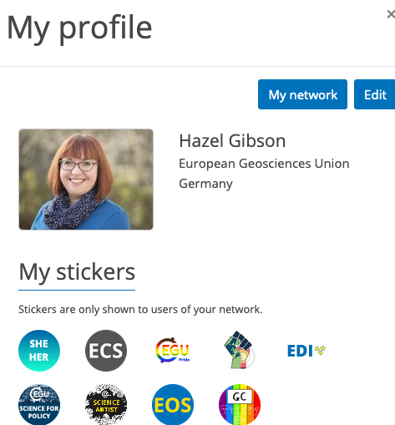
What is the Conference Networker?
A new networking platform to help you find, meet, and chat with other conference attendees, and maintain a lasting connection whilst forging new ones the rest of the year.
Complete your profile, choose what contact information is shown, your affiliations, interests, Division, – you can even add stickers to help you represent your identity and roles in EGU
Access the Conference Networker here: https://www.egu21.eu/
Notes:
Science for policy is the process by which information is transferred from the scientific community to decision-makers with the intention to produce evidence informed policy. In this way, science can clarify the options that policymakers have, showing the possibilities and the consequences of any action or inaction. Don’t worry – I’ll be coming back to this on the next slide.
Evidence-informed policy aims to use the best available research to inform decision-making. So science for policy is the process – and evidence-informed policies are, ideally, the result. The reason we used “evidence-informed” over the previously popular “evidence-based” is because evidence is only one component of any policy decision. While science and research can certainly support policy and enable policymakers to make the most appropriate decision given the situation, policies are not made by science alone. Successful policies need to consider many different factors including values, coalitions, economic inputs, and the potential impact on other policies.
Scientists engage with policy for a wide number of reasons.
Firstly, as mentioned a few slides ago, involving science in the policymaking process ideally enables policymakers to make the most appropriate decision that leads to the best outcome of a given situation. Many scientists are motivated by a desire to make the world a better place, and to use their skills and knowledge to improve society. Science for policy can facilitate this.
Engaging in the policymaking process can increase the impact of a scientist's research! As I mentioned, science isn’t and shouldn't be the sole consideration in the policymaking process but scientific evidence – when presented effectively – can contribute to how a particular policymaker perceives and reacts to the issue.
Engaging in policy can also help the scientist understand more about upcoming policy needs or issues. This may help scientists engage further in policy issues in the future or even provide inspiration for a new research project.
Engaging with policy will almost certainly result in you reading different documents that you would otherwise and meeting new people. Expanding and diversifying your network can lead to a whole range of different opportunities for yourself and your research.
Effectively communicating your research will help prevent it from being accidently or intentionally misinterpreted by others

Slide 4
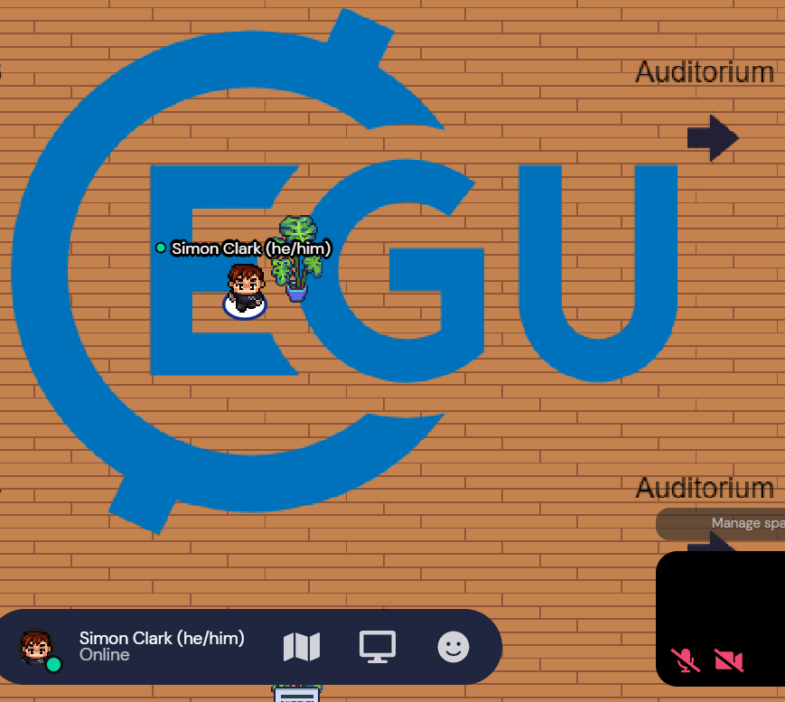
Getting to grips with Gathertown:
A spatial video conferencing tool, you move a customisable avatar through virtual rooms, meeting and talking with others similar to real-life.
Move using the keyboard arrows and interact with objects by pressing “x”. Approaching other attendee’s avatars activates the video and audio functions which allow you to interact. Moving away deactivates these functions.
Read more on Gathertown here: https://gather.town/

Slide 5
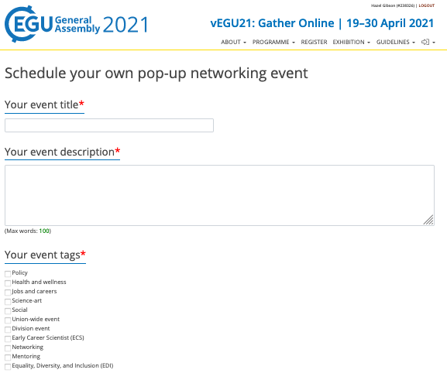
What is the Pop-Up Scheduler?
The Scheduler is for anyone who wants to run their own event, of any kind and any size, at the Assembly.
Enter your event title, description, date, and time, and a link to your platform. Add tags to make it easier to find (such as “Policy”, or “Networking”). When submitted it will be added to the programme. You can link to any platform you like. Check out the next few slides inspiration beyond Zoom!
Access the Pop-Up Scheduler here: https://webforms.copernicus.org/egu21/pop-up-networking

Slide 6
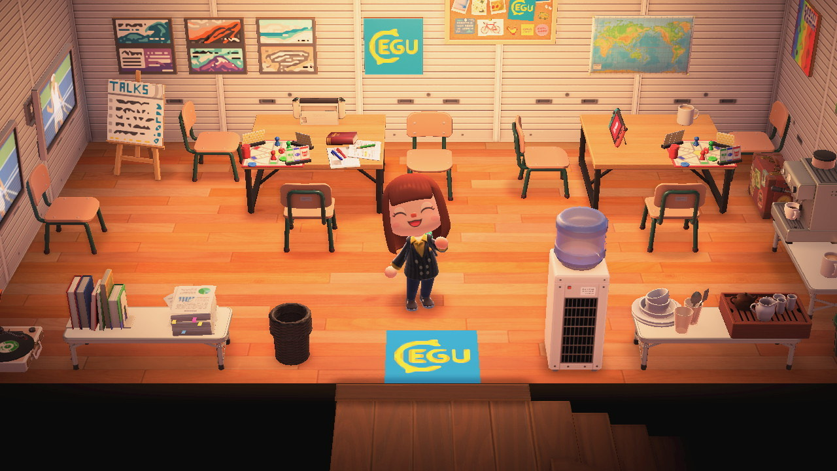
EOS7.4
Exploring the Art-Science Interface
Animal Crossing: New Horizons
a video game franchise all about building and looking after a community of animal characters
users can build their own tropical island, organising their village and landscape
invite guests over to socialise and interact with a mini-paradise.
Image by Kelly Stanford, EGU Artist in residence. Find out more at EOS7.4 Exploring the Art-Science Interface

Slide 7

Discord
a popular community-building platform particularly with video gamers
Discord attendees can join different channels – or topics – where they may communicate with one another through text chat, voice, or video
easily share files or media as you build a community.
Source: https://discordapp.com/

Slide 8
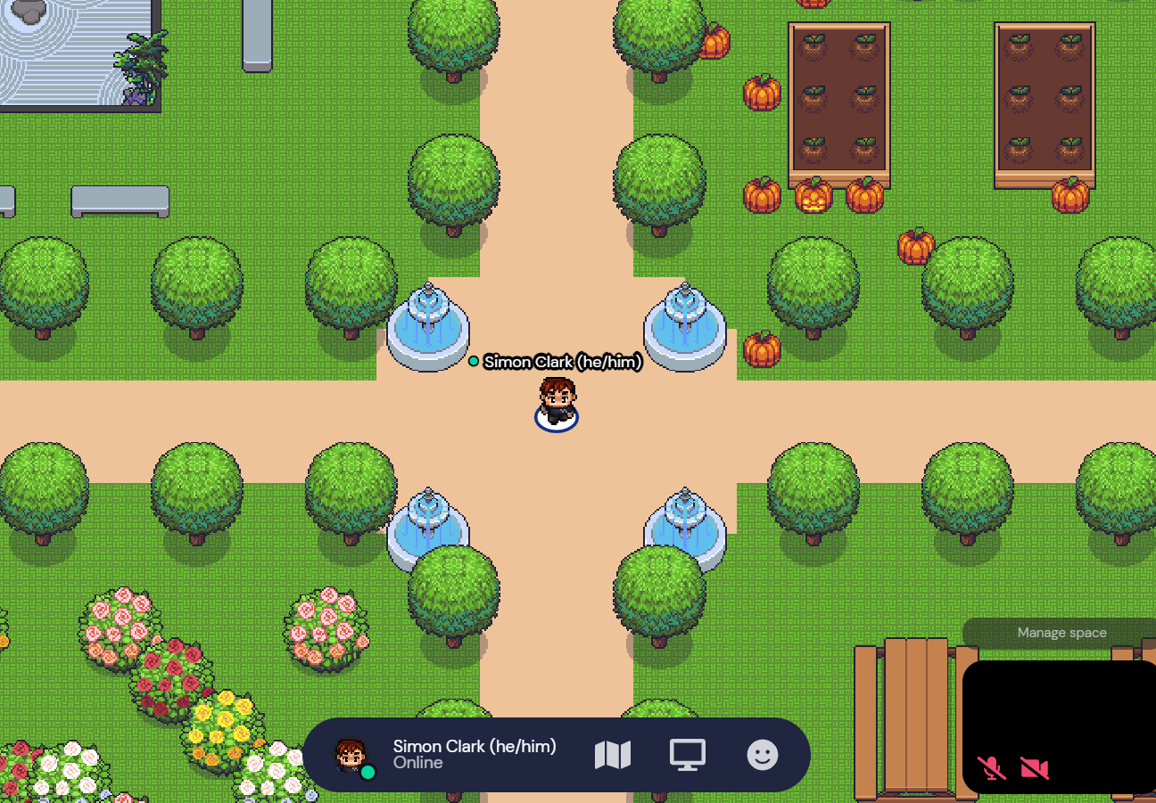
Gathertown
a virtual networking platform that uses proximity-based video conferencing tools which allow you interact with other people similar to real life!
customise your environment with interactable objects with message, website links, games, and more!

Slide 9
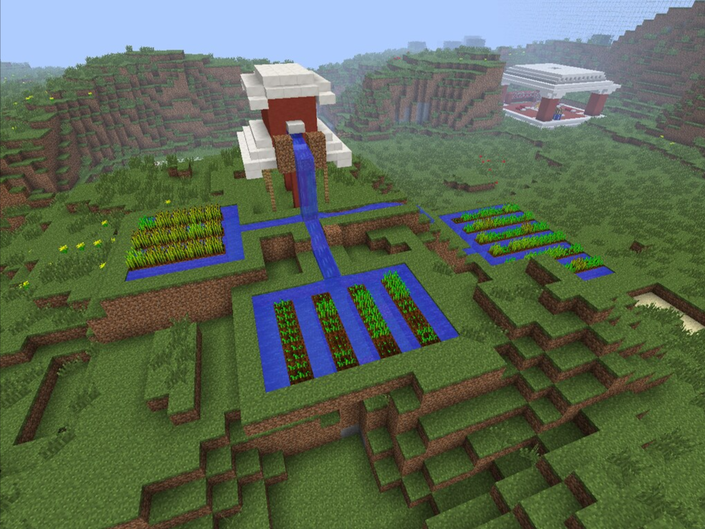
Minecraft:
this widely popular video game lets users build massive digital environments.
Minecraft spaces have been used as an education tool, visualise the cost of carbon emissions, and demonstrate programming logic.
create or connect with each other as you create your own landscape.
Credit: Wesley Fryer

Slide 10
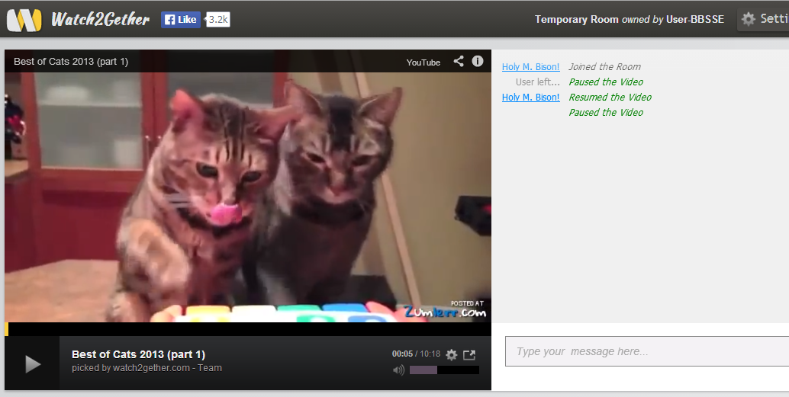
Video sharing:
Platforms like tv and Watch2gether allow you watch content together with other attendees from video services like Youtube or Vimeo with minimal effort.
signing up to websites such as Scener, Kast, and TwoSeven means you can watch content over a number of streaming services like Netflix or Disney+.
Source: Watch2gether..com

