Slide 1
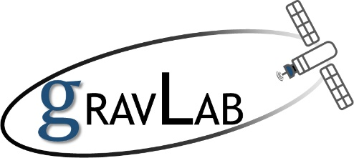
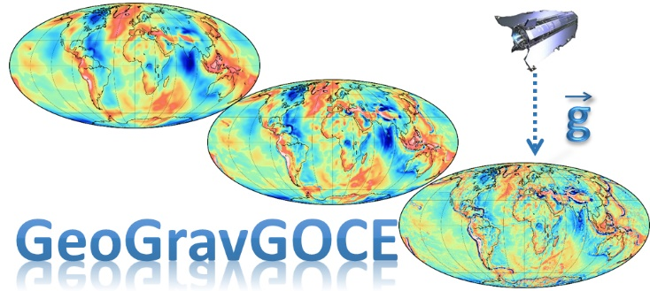




Software
GeoGravGOCE: A GOCE SGG processing software for datum
transformations and filtering
E.G. Mamagiannou, E.A. Pitenis, D.A. Natsiopoulos, G.S. Vergos, I.N. Tziavos
GravLab – Laboratory of Gravity Field Research and Applications, DGS, AUTH, Greece
European Geosciences Union GA 2021
Session G1.5
Vienna, Austria
April 29, 2021
Software: GeoGravGOCE
E.G. Mamagiannou et al.

Slide 2
Outline
Software description
SGG Pre-processing tab
GGM Transformation tab
Filtering tab
Reference Systems Transformation tab
GUI efficiency
Conclusions
References
Acknowledgements
Software: GeoGravGOCE
E.G. Mamagiannou et al.

Slide 3
Software description
goal & structure
GeoGravGOCE software is designed to pre-process the SGG data, reduce the gravity field's systematic trends of GGs, filter the reduced signals, and transform the final GOCE signals to the conventional reference frames.
The software consists of a GUI divided into the four following tabs:
GeoGravGOCE
1. SGG Pre-processing
2. GGM Transformation
3. Filtering
4. Reference Systems Transformations
Software: GeoGravGOCE
E.G. Mamagiannou et al.

Slide 4
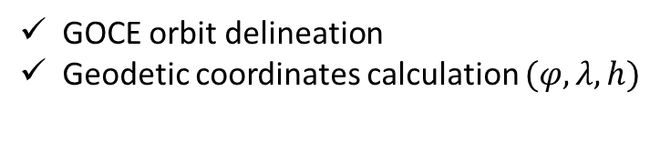
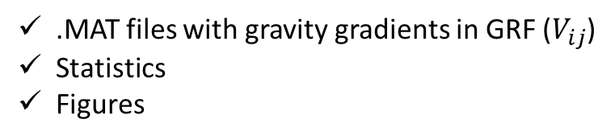
SGG Pre-processing
Info
This tab pre-processes the Level 2 GOCE products, provides visualization of the output files and offers additional output options.
Inputs:
GOCE gradiometric data (EGG_NOM_2)
Precise science kinematic orbits (SST_PSO_2)
Processes:
GOCE orbit delineation
Geodetic coordinates calculation $(φ,λ,h)$
Outputs:
.MAT files with gravity gradients in GRF ($V_{ij}$)
Statistics
Figures
Software: GeoGravGOCE
E.G. Mamagiannou et al.

Slide 5
SGG Pre-processing
outputs
Figures:
Time series of the GOCE gravity gradients
GOCE altitude
Global maps with the GOCE orbit track
The maps are created via the m_map mapping toolbox (Pawlowicz, 2020).
Software: GeoGravGOCE
E.G. Mamagiannou et al.

Slide 6
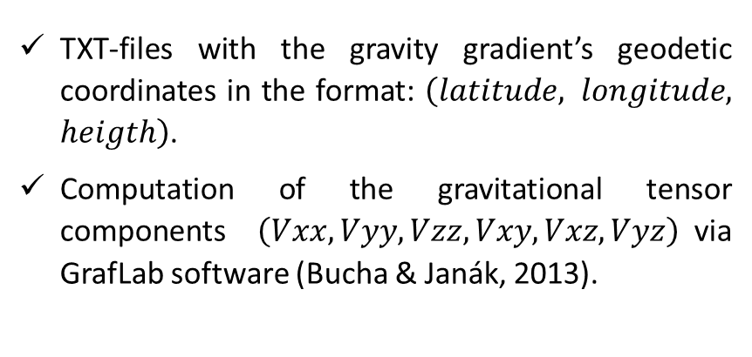
SGG Pre-processing
outputs
Additional outputs:
TXT-files with the gravity gradient’s geodetic coordinates in the format: $\left(latitude, longitude, heigth\right)$.
Computation of the gravitational tensor components $\left(Vxx,Vyy,Vzz,Vxy,Vxz,Vyz\right)$via GrafLab software (Bucha & Janák, 2013).
Software: GeoGravGOCE
E.G. Mamagiannou et al.

Slide 7
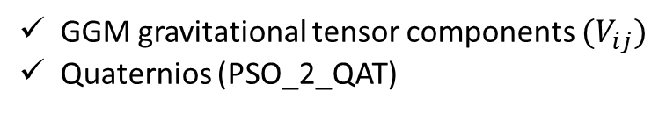
GGM Transformation
Info
This tab is used for the transformation of a Global Geopotential Model's gravity gradients from the LNOF to the GRF.
Inputs:
GGM gravitational tensor components ${(V}_{ij})$
Quaternios (PSO_2_QAT)
Processes:
Quaternion interpolation
Transformations: LNOF EFRF IRF GRF
Outputs:
.MAT files with the transformed gravity gradients
Figures
Statistics
Software: GeoGravGOCE
E.G. Mamagiannou et al.

Slide 8
GGM Transformation
outputs
Figure:
The transformed gravity gradients in GRF.
Software: GeoGravGOCE
E.G. Mamagiannou et al.

Slide 9

Filtering
options
Info
This tab provides optimal filtering methods for the observed gravity gradients, which remove low-frequency errors and undesired effects by preserving the signals in GOCE MBW (0.005-0.1 Hz).
The tab offers:
3 input options for the upcoming filtering
3 filtering methods (FIR, IIR, Wavelet).
Note:
Each method performance evaluation is done in terms of the Power Spectral Densities (PSDs) of the original unfiltered and filtered signal.
Software: GeoGravGOCE
E.G. Mamagiannou et al.

Slide 10

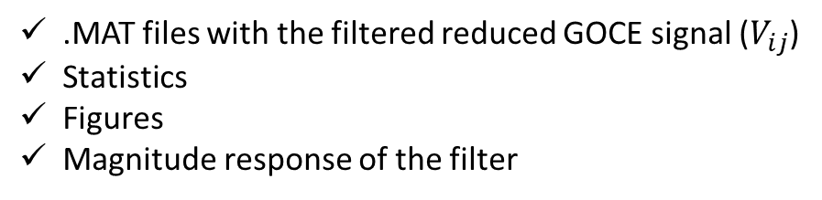
Filtering
FIR
Info
FIR filter is non-recursive. Its output is computed using only the current and previous inputs. So, there is no feedback in the filter structure.
Input:
Filter's $N^{th}$ order (user’s choice)
Outputs:
.MAT files with the filtered reduced GOCE signal ($V_{ij}$)
Statistics
Figures
Magnitude response of the filter
Software: GeoGravGOCE
E.G. Mamagiannou et al.

Slide 11
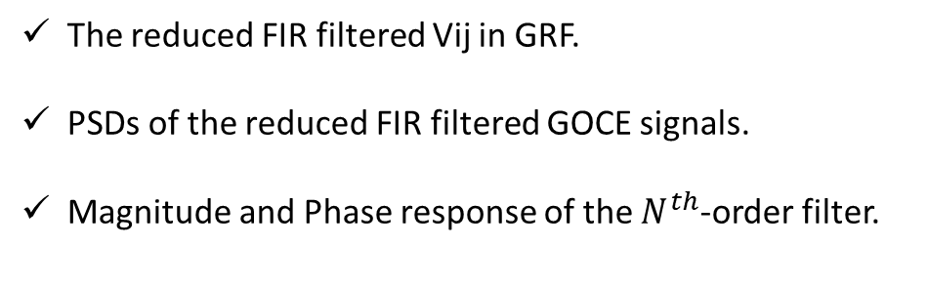
Filtering
FIR
outputs
Unfiltered
Figures:
The reduced FIR filtered Vij in GRF.
PSDs of the reduced FIR filtered GOCE signals.
Magnitude and Phase response of the $N^{th}$-order filter.
Software: GeoGravGOCE
E.G. Mamagiannou et al.

Slide 12

Filtering
IIR
Info
IIR is a recursive filter. The filter's output is computed using the current and former inputs and former outputs.
Input:
Filter's $N^{th}$ order (user’s choice)
Outputs:
.MAT files with the filtered reduced GOCE signal
Statistics
Figures
Magnitude response of the filter
Software: GeoGravGOCE
E.G. Mamagiannou et al.

Slide 13
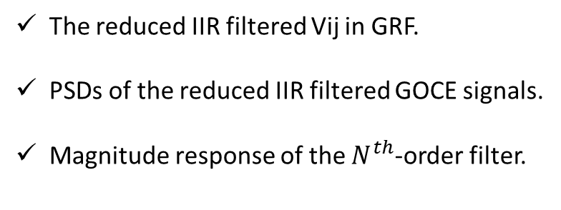
Filtering
IIR
outputs
Figures:
The reduced IIR filtered Vij in GRF.
PSDs of the reduced IIR filtered GOCE signals.
Magnitude response of the $N^{th}$-order filter.
Software: GeoGravGOCE
E.G. Mamagiannou et al.

Slide 14
Filtering
Wavelet
Info
Wavelet Multi-Resolution Analysis uses a 1d Daubechies family wavelet with 10 vanishing moments (db10) at 12 levels of decomposition.
Processes:
Decomposition in twelve levels.
Reconstruction of the selected detail coefficients (user’s choice).
Outputs:
.MAT files with the filtered reduced GOCE signal
Statistics
Figures
13 checkboxes: the twelve detail coefficients of the levels and the approximation coefficient of the last level.
Software: GeoGravGOCE
E.G. Mamagiannou et al.

Slide 15
Filtering
Wavelet
decomposition
outputs
d1
d2
d5
d6
Info
Spatial resolution
d1: 8-16 km
d2: 16-32 km
...
d3
d4
d7
d8
d9
d10
a12
d11
d12
Figures:
The detail and approximation coefficients of the $V_{zz}$ gradient of the first orbit.
Software: GeoGravGOCE
E.G. Mamagiannou et al.

Slide 16
Filtering
Wavelet
decomposition
outputs
d1
d2
d5
d6
d3
d4
d7
d8
d9
d10
a12
d11
d12
Figures:
PSDs of the detail and approximation coefficients of the $V_{zz}$ gradient of the first orbit.
Software: GeoGravGOCE
E.G. Mamagiannou et al.

Slide 17
Filtering
Wavelet
reconstruction
outputs
Filtered
Figures:
Reconstructioned gravity gradients & their PSDs.
Unfiltered
Software: GeoGravGOCE
E.G. Mamagiannou et al.

Slide 18
Reference Systems Transformations
Info
This tab is used for the transformation of the gravity gradients from the GRF to the LNOF and vice versa.
Input:
.MAT file (in the required format)
Processes:
Transformations: LNOF EFRF IRF GRF
Transformations: GRF IRF EFRF LNOF
Outputs:
.MAT files with the transformed gravity gradients
Figures
Statistics
Software: GeoGravGOCE
E.G. Mamagiannou et al.

Slide 19
Reference Systems Transformations
outputs
LNOF
GRF
Figures:
The transformed gravity gradients.
Software: GeoGravGOCE
E.G. Mamagiannou et al.

Slide 20
GUI efficiency
Multi-processing
The GeoGravGOCE software has been developed in such a way that when multiple files are requested as input, parallel processing capabilities are enabled.
SGG Pre-processing (1st tab)
GGM Transformation (2nd tab)
Software: GeoGravGOCE
E.G. Mamagiannou et al.

Slide 21
Conclusions
GeoGravGOCE:
Is an open-source software developed with MATLAB.
Consists of an easy-to-use Graphical User Interface divided into four tabs.
Allows the reliable pre-processing of the GOCE gravity gradients, precise transformation in their reference frames, and appropriate filtering with a FIR, an IIR, and a Wavelet MRA filter.
Is suitable for educational purposes, as it provides all the necessary pre-process of GOCE GGs, and can manage extensive experiments with multiple files.
Free download: http://olimpia.topo.auth.gr/GeoGravGOCE/
Software: GeoGravGOCE
E.G. Mamagiannou et al.

Slide 22
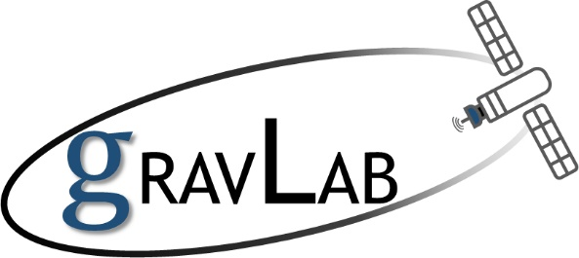
References
Bucha, B., & Janák, J. (2013). A MATLAB-based graphical user interface program for computing functionals of the geopotential up to ultra-high degrees and orders. Computers and Geosciences. https://doi.org/10.1016/j.cageo.2013.03.012
Pawlowicz, R. (2020). M_Map: A Mapping package for Matlab (1.4m). https://www.eoas.ubc.ca/~rich/map.html
Software: GeoGravGOCE
E.G. Mamagiannou et al.

Slide 23
Acknowledgements
The research project was supported by the Hellenic Foundation for Research and Innovation (H.F.R.I.) under the “1st Call for H.F.R.I. Research Projects to support Faculty members and Researchers and the procurement of high-cost research equipment grant” (Project Number: 3488.).
GeoGravGOCE is funded by (HFRI) within its Call for Research Projects for Research and Academic Staff (HFRI/Staff) following a successful application to the General Secretariat for Research & Technology (GSRT).
Software: GeoGravGOCE
E.G. Mamagiannou et al.

