Slide 1

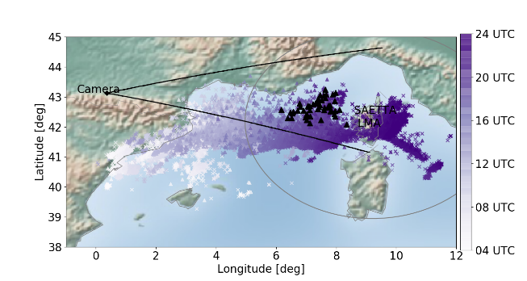
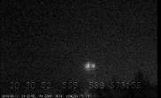
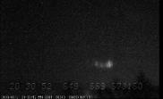
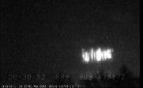
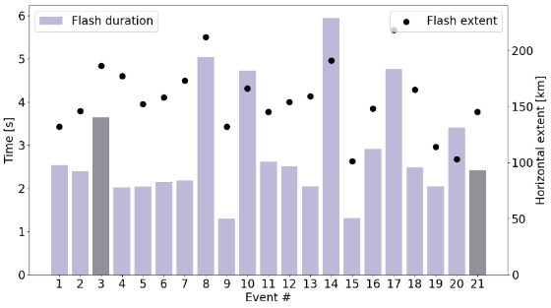
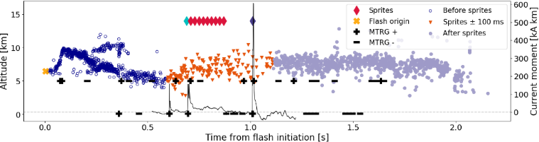




Dancing Sprites Above a Lightning Mapping Array
- an analysis of the storm and flash/sprite developments
M. Tomicic¹, S. Soula², E. Defer², S. Prieur², J. Mlynarczyk³, T. Farges⁴, O. Chanrion¹, C. Köhn¹ and T. Neubert¹
¹DTU Space, Technical University of Denmark, Lyngby, Denmark,²Laboratoire d'Aérologie, Université de Toulouse, UT3, CNRS, IRD, Toulouse, France,³Department of Electronics, AGH University of Science and Technology, Krakow, Poland,⁴CEA, DAM, DIF, F-91297, Arpajon, France
Lightning detected by GLD360 on Sep 21st 2019
Case study of dancing sprite including new type of “wall” sprite
SP+CG flash characteristics for all sprite events
▲ SP+CG stroke
▲ +CG flash
X -CG flash
Key points
A very high percentage (90%) of dancing sprites were produced by a large asymmetric MCS with bow echo structure
Long duration and strong convection (CAPE= 3500 J/kg) produced pockets of charge in the stratiform region
Sprite parent (SP) flashes had long extent (up to 200 km) and produced several ±CG strokes in the stratiform region
Possibly a new type of dancing sprite (a wall-like sprite group) was produced by three distinct +CG strokes that occurred within 3 ms
Contact: majtom@space.dtu.dk. Presentation available under session programme. Paper submitted to JGR – Atmospheres. Preprint version available on ESSOAr via QR-code:
EGU21-1695

Slide 2




Maja Tomicic¹, Serge Soula², Eric Defer², Serge Prieur², Janusz Mlynarczyk³, Thomas Farges⁴, Olivier Chanrion¹, Christoph Köhn¹ and Torsten Neubert¹
¹DTU Space, Technical University of Denmark, Lyngby, Denmark,
²Laboratoire d'Aérologie, Université de Toulouse, UT3, CNRS, IRD, Toulouse, France,
³Department of Electronics, AGH University of Science and Technology, Krakow, Poland,
⁴CEA, DAM, DIF, F-91297, Arpajon, France
EGU21-1695
Dancing Sprites Above a Lightning Mapping Array
- an analysis of the storm and flash/sprite developments

Slide 3
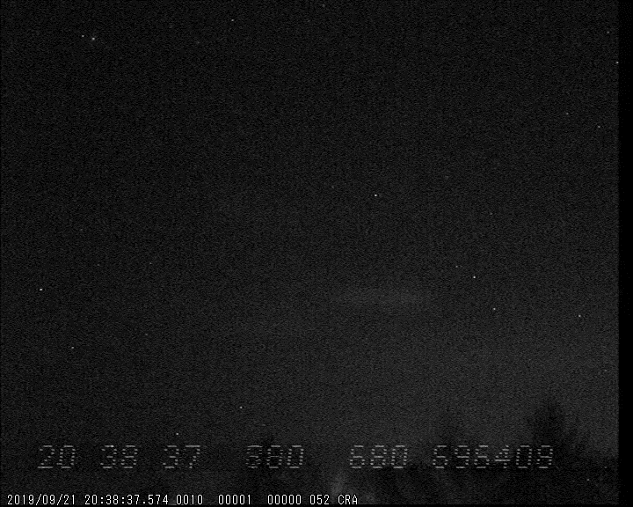
Introduction
Slowed down video of dancing sprites with 4 sequences from this study
Sprites that occur in the form of sequential luminous emissions are called dancing or jumping sprites because the sprite elements seem to “dance” above the storm.
Dancing sprites occur in relatively small proportion (e.g. 9% in Bór (2013)) and many aspects of their generation remain unknown.
We present a multi-instrumental analysis of a 20-hour duration Mesoscale Convective System (MCS) over the Northwestern Mediterranean sea on September 21, 2019, that produced 21 sprites, of which 19 (90%) were dancing.
We aim to answer the questions : How are the dancing sprites produced and why did this storm produce so many dancing sprites?

Slide 4
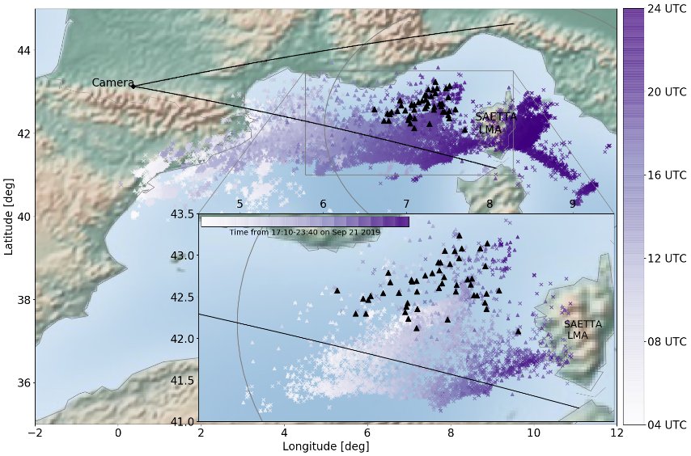
Instrumentation
Methodology: The events detected by GLD360 were clustered into flashes using the criteria that events within 20 km and 0.5 s belong to the same flash.
Watec 902H camera installed at Atmospheric Research Center (CRA), in Lannemezan. Same as in Soula et al. (2017).
SAETTA Lightning Mapping Array (LMA) in Corsica (Coquillat et al., 2019).
Lightning data from Météorage (MTRG) (e.g. Pedeboy (2015)) and Vaisala Global Lightning Dataset GLD360 (e.g. Said & Murphy (2016)).
Broadband ELF measurement system (0.02 Hz to 1.1 kHz at 3 kHz) located in Poland (~1500 km from storm location) (Mlynarczyk et al. (2015)).
Broadband (<1kHz - 5 MHz at 12.5 MHz) vertical dipole whip antenna in center of France (~700 km from the storm) (Farges & Blanc (2011)).
Météo-France Collobrière weather radar.
Cloud top Temperatures from Meteosat Second Generation (MSG) Spinning Enhanced Visible and InfraRed Imager (SEVIRI) radiometer.
▲ SP+CG stroke
▲ +CG flash
X -CG flash
CG lightning flashes detected by GLD360 (colored) and SP+CG strokes detected by MTRG (black triangles) for the whole storm duration and (in inset) the part of storm relevant for this analysis. Camera location and field of view as well as SAETTA detection range are also indicated.

Slide 5
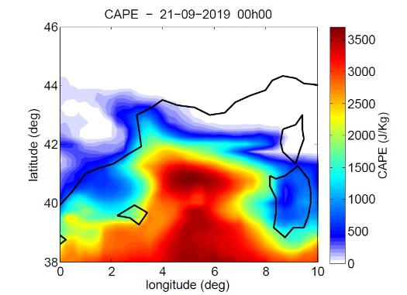
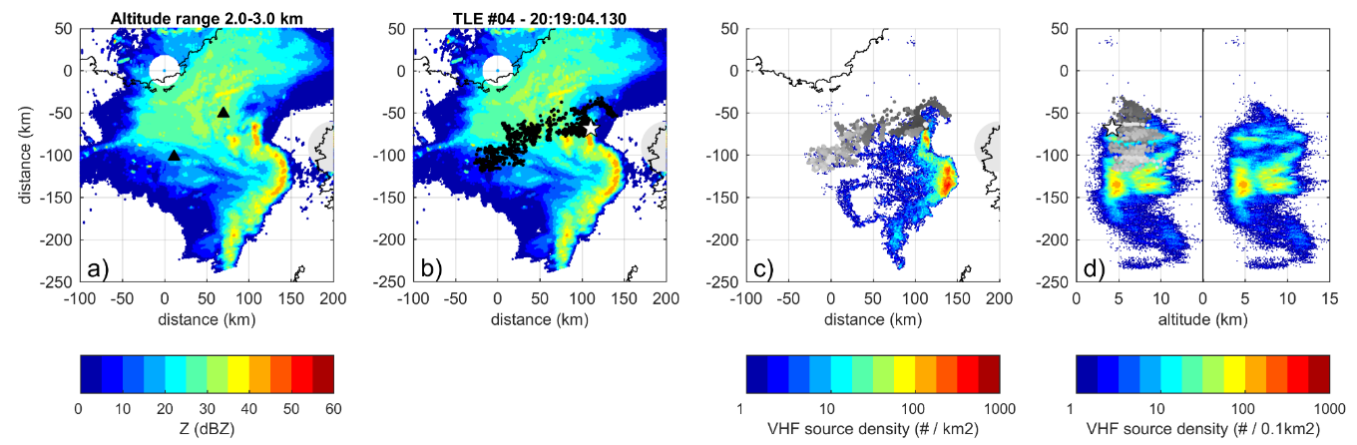
Storm development and structure
Radar reflectivity and overlay of VHF sources from a dancing sprite event with two sequences
VHF source density from SAETTA LMA 10 min around the dancing sprite event
The star represents the flash origin
Storm developed in extreme CAPE conditions with about 3500 J kg⁻¹ within a large area over Northwestern Mediterranean Sea.
Before and during the maximum sprite production the storm exhibited a bow-echo structure in the convective line and the overall storm structure can be classified as an asymmetrical bow-echo MCS.
The strong maximum of VHF source density around 5 km altitude in the bow-echo corresponds with a positive charge layer.

Slide 6
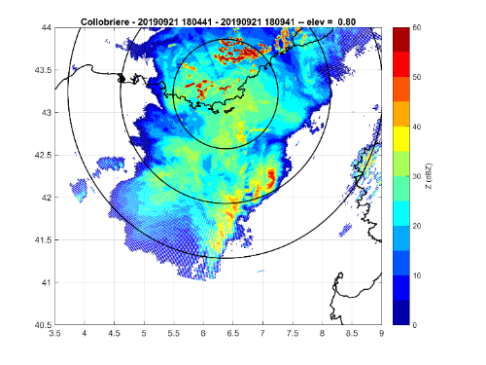
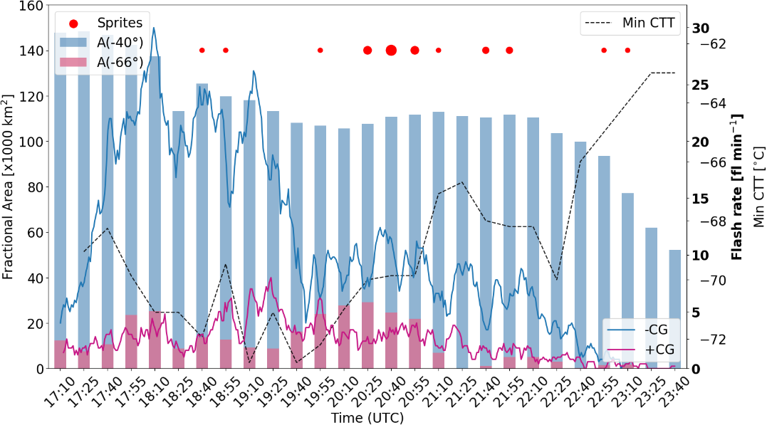
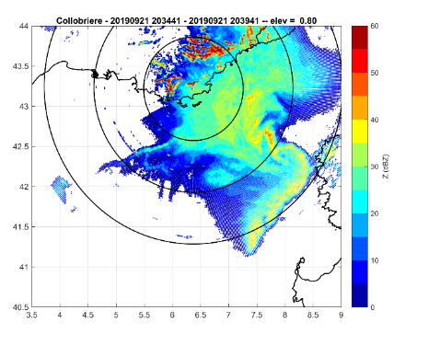
Storm development and activity
Radar reflectivity before (18:35) and during (20:35) maximum sprite production
18:35 UTC
20:35 UTC
Storm size and duration
The MCS was of long duration (~20 h) but we focus on the evening part when the sprites were observed.
The MCS covered more than 140,000 km² at its maximum (area with cloud top temperature <-40Cº) and had an area of 25,000 km² with cloud top temperature <-66Cº.
The maximum CG flash rate was 30-35 flashes/min around 18:10 UTC.
Radar reflectivity at 0.8º elevation. Rings are centered on radar location and correspond to 1 km, 2 km, 3 km altitude.

Slide 7
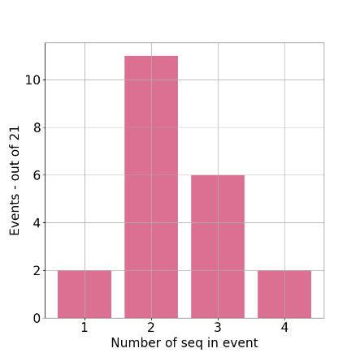
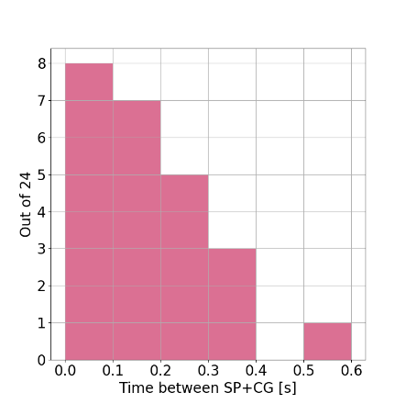
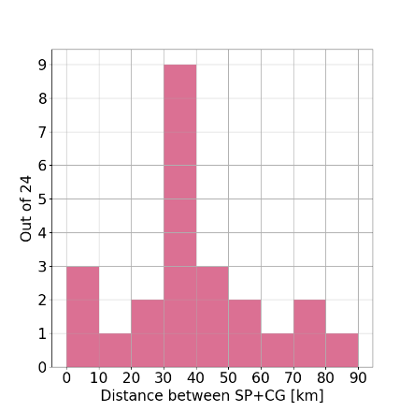
Dancing sprites
A sprite event is defined as one video including one or more sprite sequences
A sprite sequence includes all successive video fields with sprite elements separated in time by at least 20 ms from another sequence
We find 21 events, of which 19 were dancing sprites that included 49 sequences
Histograms of dancing sprite characteristics – for all events
Range:1-4 sprites
Range:2-87 km
Range: 40-516 ms
*
*In four cases the SP+CG strokes were missed by the lightning locating systems. In addition, there is a small uncertainty according to the video imagery perception.

Slide 8
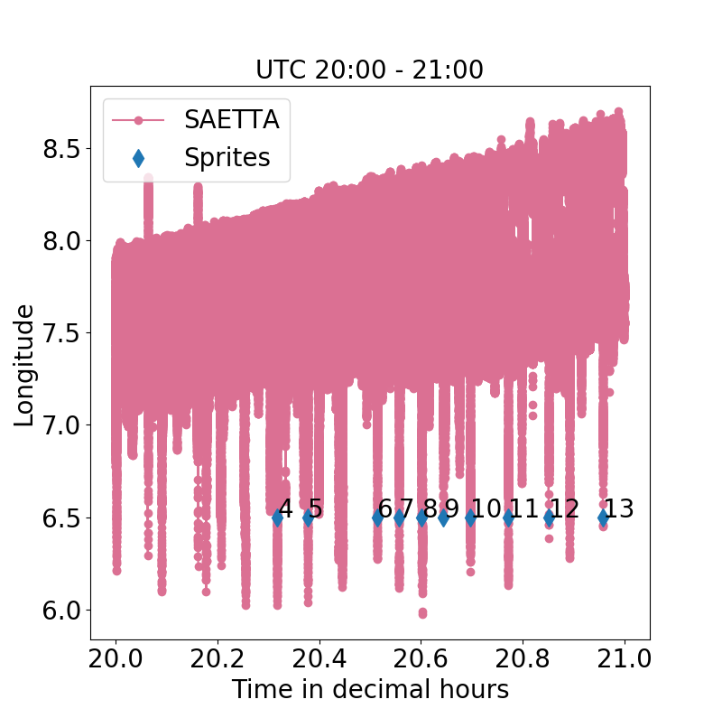
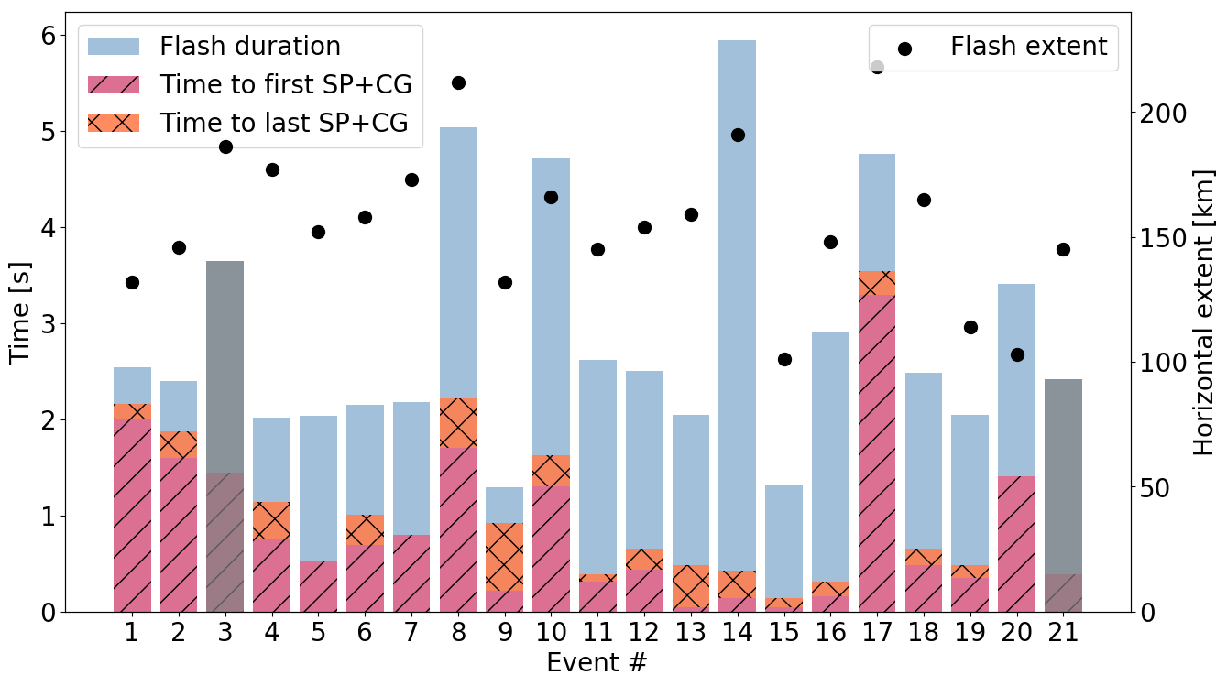
SP+CG flashes
Methodology: Flash extent and duration are estimated from the LMA data.
VHF source longitude with time during the hour of maximum sprite production. The SP+CG flashes are annotated with the event number at an arbitrary longitude of 6.5º.
SP+CG flash characteristics – grey bars are single sprite events
Flash propagation
Most SP+CG flashes initiated at the edge of the convective region and propagated far (up to 200 km) into the stratiform region.
A few SP+CG flashes initiated in the stratiform region and propagated towards the convective line.
The SP+CG flashes produced several CG strokes of both polarities.

Slide 9
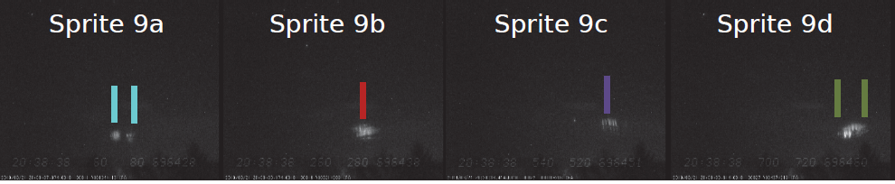
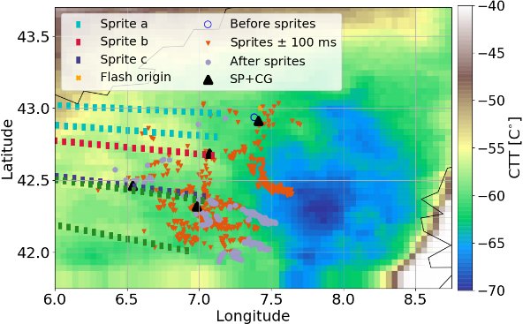
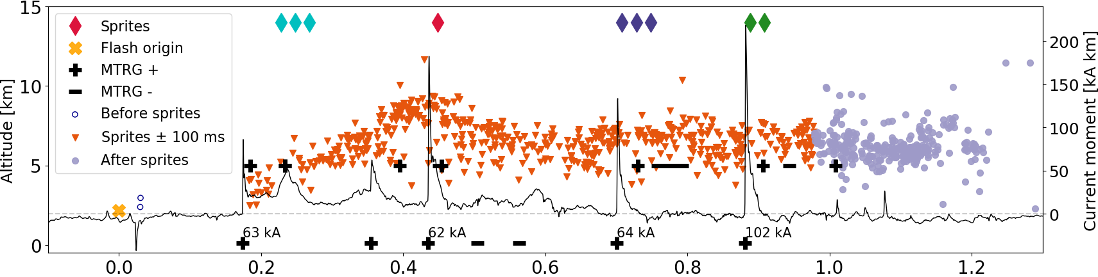
Typical dancing sprite
Methodology: We analyzed the LMA data using typical 3D projections (e.g. Coquillat et al.,2019), the time-distance plot (van der Velde & Montanyà, 2013) and also looked at the raw SAETTA data to identify regions with strong VHF radiation, but poor reconstruction. To minimize the influence of noise, VHF sources detected by at least seven stations were used in the analysis, and goodness-of-fit values were required to be ≤0.5 in the source location solutions.
Four sprite sequences (9a, 9b, 9c, 9d)
Four SP+CG strokes separated by ~200 ms
Flash initiated in the stratiform region (not so typical)
Lines of sight
Altitude-time plot of VHF sources from LMA, with current moment waveform and MTRG detections (IC at 5 km CG at 0 km)
Peak current is only shown for SP+CG strokes
Current moment waveform plotted as black line

Slide 10
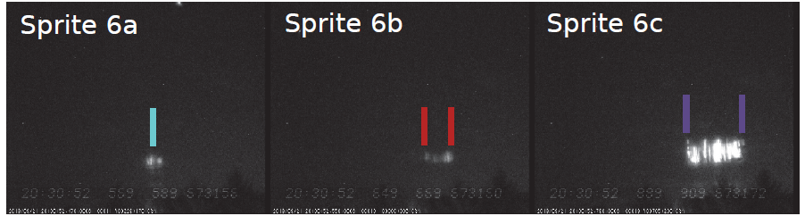
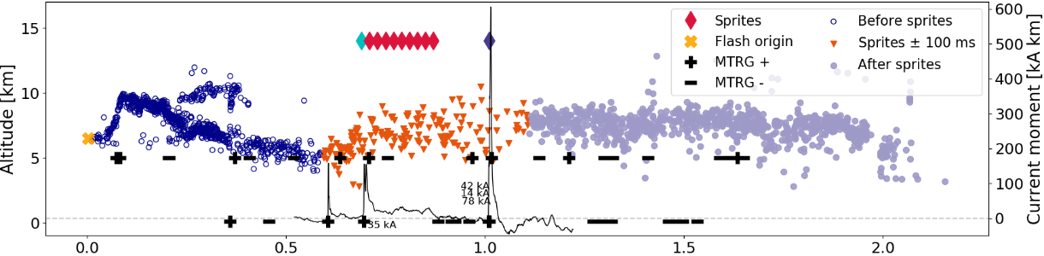
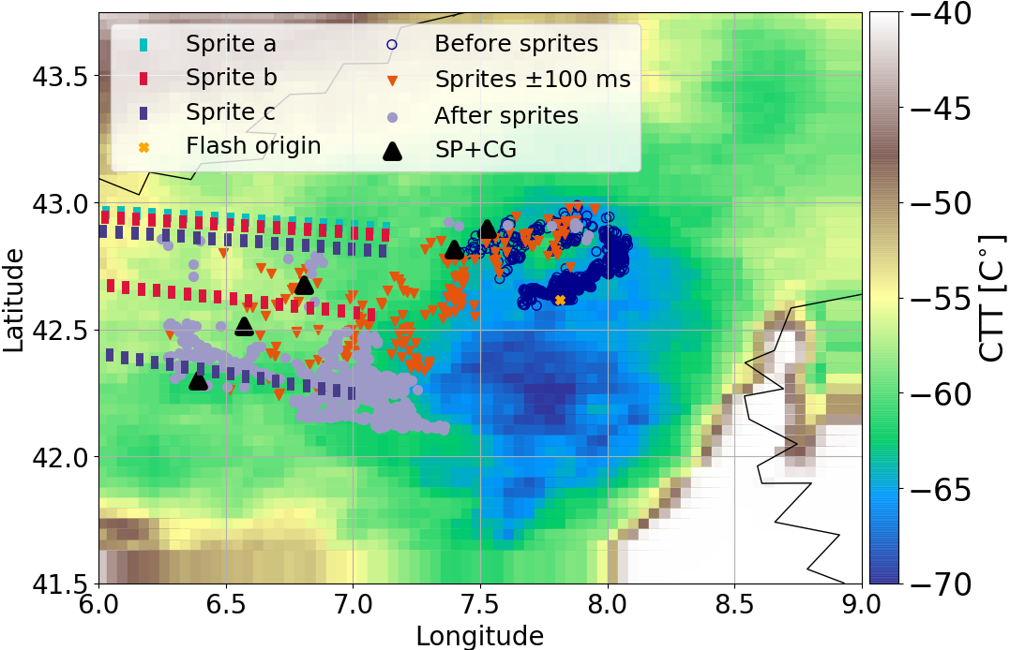
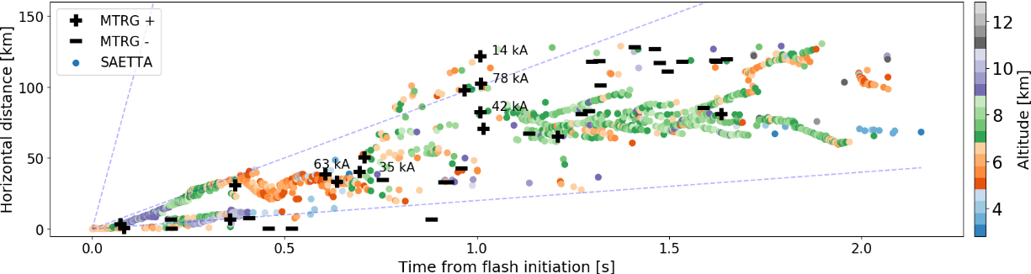
Special case
Next slide focuses on this bright and wide sprite
Three sprite sequences (6a, 6b, 6c)
Sprite 6b produced during the continuing current following the previous stroke and has a long duration (<180 ms)
Sprite 6c produced by 3 +CG strokes separated by 3 ms and 54 km.
Negative CG strokes detected in the stratiform region meaning negative charge layers are also present within this region
Altitude-time plot of VHF sources from LMA, with current moment waveform and MTRG detections (IC at 5 km CG at 0 km)
Time-distance-altitude plot of VHF sources from LMA, with MTRG detections (peak current only shown for SP+CG strokes)

Slide 11
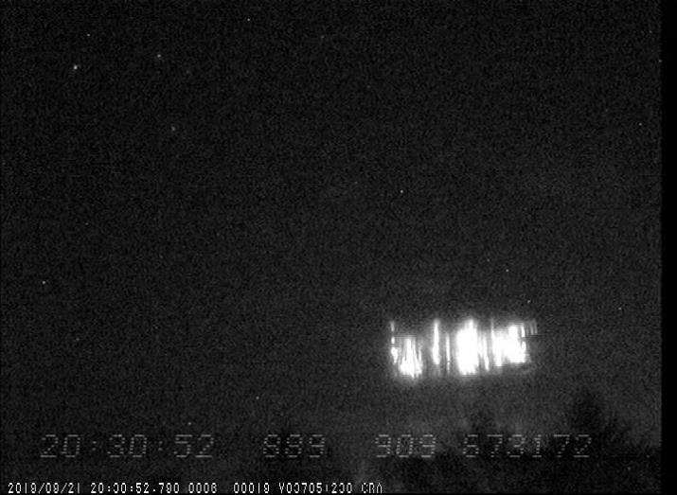
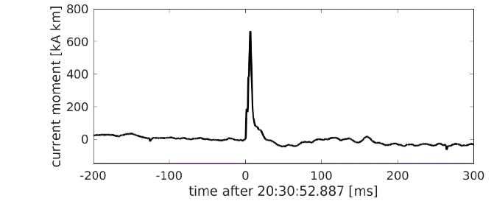
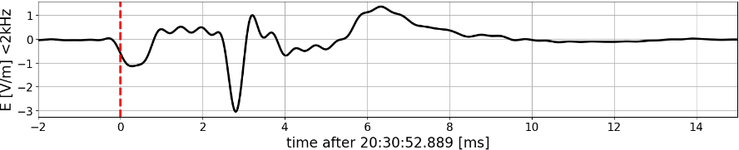
Wall sprite
Video field showing exceptionally bright sprite cluster (sprite 6c)
This sprite followed three +CG strokes separated by 3 ms and 54 km.
It was visible in one field (< 20 ms), resembles a wall and spanned 6º 35’ in azimuth corresponding to around 65 km at 550 km distance from the camera.
Potentially, this sprite is a new type of sprite sequence within the dancing sprite category, where the individual sprites are triggered by strokes that are too close in time to be resolvable in the video field.
The atypical morphological characteristics of the sprite supports this explanation, since it would mean that it consists of three sprite sequences partly overlaid in the image and thus, the dancing appearance is not seen, even if the sprite sequences are triggered one after the other.
Characteristics of the three SP+CG strokes from MTRG
It is possible to distinguish three structures, each with column elements on the edges and a bright structure in the center. However, camera observations in higher temporal resolution or from multiple locations are necessary to confirm this.
Time | Lat [deg] | Lon [deg] | Peak current [kA]
20:30:52.887 | 42.67 | 6.81 | 42
20:30:52.888 | 42.30 | 6.39 | 14
20:30:52.890 | 42.51 | 6.57 | 78
Current moment waveform
The three strokes blend together because of the time resolution of the ELF measurement system. The cumulative charge moment change for the three CG strokes is 4295 C km
Vertical electric field (<2 kHz) during the event
Sprite current
1st and 2nd +CG
3rd +CG

Slide 12
Conclusions
A very high percentage (90%) of dancing sprites was produced by a large long duration asymmetric MCS.
94% of the dancing sprite sequences were produced by distinct SP+CG strokes. The rest by current surges during continuing current phases.
Possibly a new type of dancing sprite, resembling a wall, was produced by three distinct +CG strokes separated in time by 3 ms or less.
Strong convective conditions (CAPE at 3500 J/kg) and the long lifetime (~20 h) of the storm allowed for an evolution of the main charge structure to an inverted dipole during the phase of a bow echo and for an extensive stratiform region with large amount of charge of both polarities.
This enabled the SP+CG flashes to propagate over large distances (up to 200 km) from convective to stratiform regions and reverse producing multiple CG strokes. The +CG strokes of the same flash discharged a substantial amount of charges in a sequential manner which is reflected above the storm by triggering a sequence of sprites that then appears to be dancing.

Slide 13
References
Bór, J. (2013). Optically perceptible characteristics of sprites observed in Central Europe in 2007-2009. Journal of Atmospheric and Solar-Terrestrial Physics,92, 151–177. doi: 10.1016/j.jastp.2012.10.008
Coquillat, S. et al.(2019). SAETTA : high-resolution 3-D mapping of the total lightning activity in the mediterranean Basin over Corsica , with a focus on a mesoscale convective system event. Atmospheric Measurement Techniques, 12 , 5765–867 5790. doi: 10.5194/amt-12-5765-2019
Farges, T., & Blanc, E. (2011). Champs électriques induits par les éclairs et les événements lumineux transitoires et leur effet sur l’ionosphère. Comptes Rendus Physique, 12 (2), 171–179. Retrieved from http://dx.doi.org/10.1016/j .crhy.2011.01.013 doi:0.1016/j.crhy.2011.01.013
Mlynarczyk, J. et al.(2015). An unusual sequence of sprites followed by a secondary TLE: An analysis of ELF radio measurements and optical observations. Journal of Geophysical Research: Space Physics, 120 , 2241–2254. doi: 10.1002/2014JA020780
Pedeboy, S. (2015). Analysis of the French lightning locating system location accuracy. 2015 International Symposium on Lightning Protection, XIII SIPDA 2015 , 337–341. doi: 10.1109/SIPDA.2015.7339299
Said, R. K., & Murphy, M. J. (2016). GLD360 Upgrade: Performance Analysis and Applications. In 24th international lightning detection conference.
Soula, S. et al. (2017). Dancing sprites: Detailed analysis of two case studies. Journal of Geophysical Research, 122 (6), 3173–3192. doi:10.1002/2016JD025548
van der Velde, O. A., & Montanyà, J. (2013). Asymmetries in bidirectional leader development of lightning flashes. Journal of Geophysical Research Atmospheres, 118 (24), 13504–13519. doi: 10.1002/2013JD020257

