Slide 1


#vEGU21
Abstract EGU21-1725
Natural and artificial pore pressure variation for
distinguishing earthquakes induced by CO2 injection
from natural earthquakes
Chanmaly Chhun¹, Takeshi Tsuji^{1,2,3}
Department of Earth Resources Engineering, Kyushu University
International Institute for Carbon-Neutral Energy Research (I2CNER), Kyushu University
Disaster Prevention Research Institute, Kyoto University

Slide 2
Research Highlights
Develop a method to distinguish earthquakes induced by CO2 injection from natural ones
Natural pore pressure changes are estimated from snowmelt, rainfall, and remote earthquakes
Artificial pore pressure changes due to CO2 injection are estimated by fluid flow simulations
Earthquake is natural if natural pressure variation at fault is much larger than artificial variation
Natural pressure variations at hypocenters exceed those from CO2 injection of Nagaoka project

Slide 3
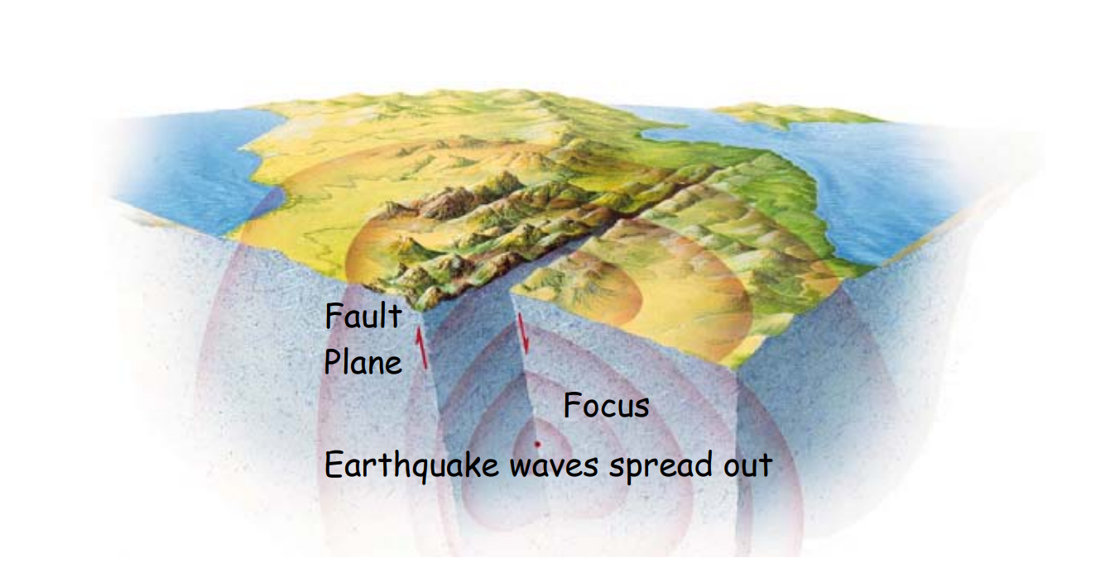
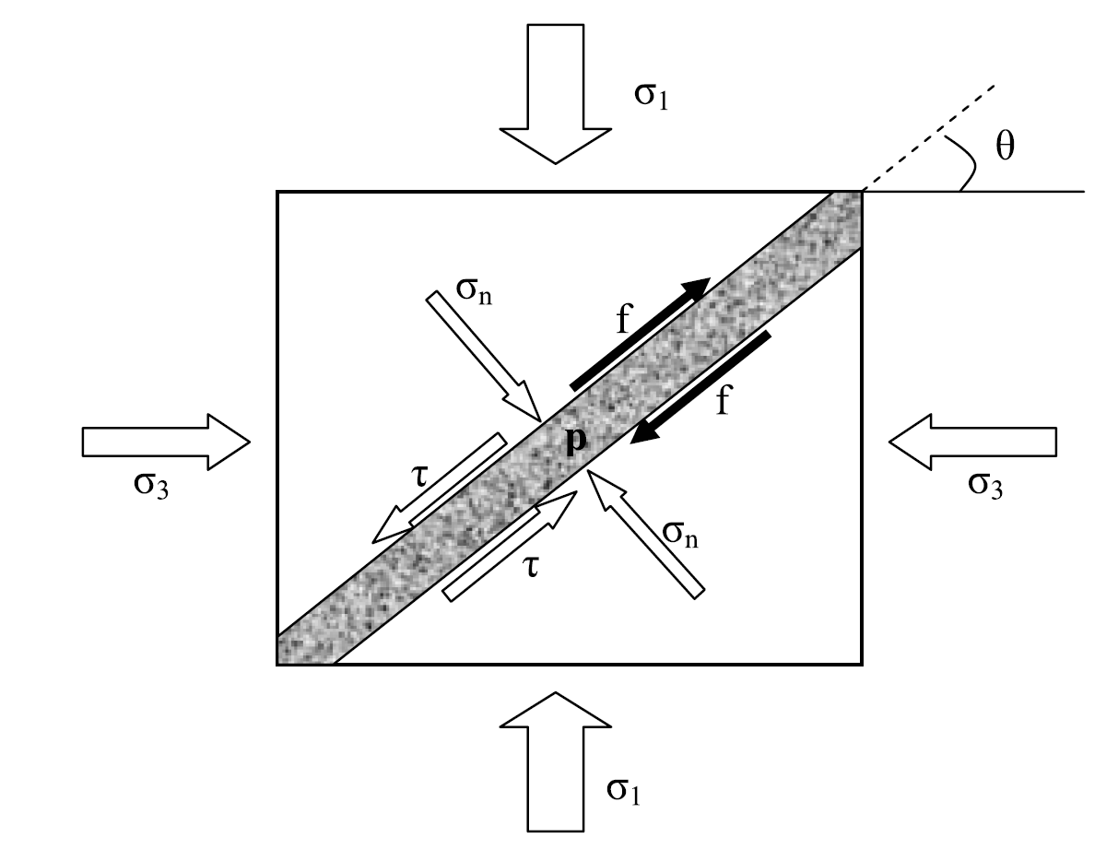
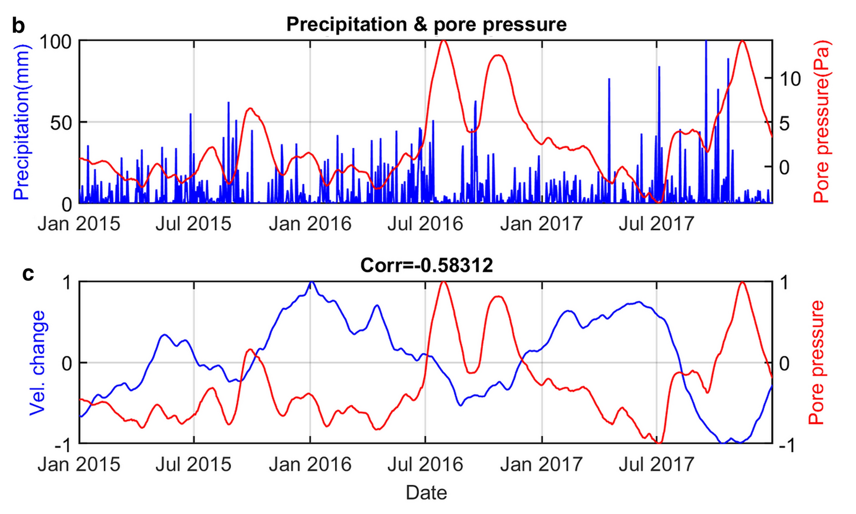
Introduction – Earthquake Occurrences
Tectonic processes
Non-tectonic processes (e.g., rainfall)
Anthropogenic triggering earthquakes
(Andajani et al., 2021)

Slide 4
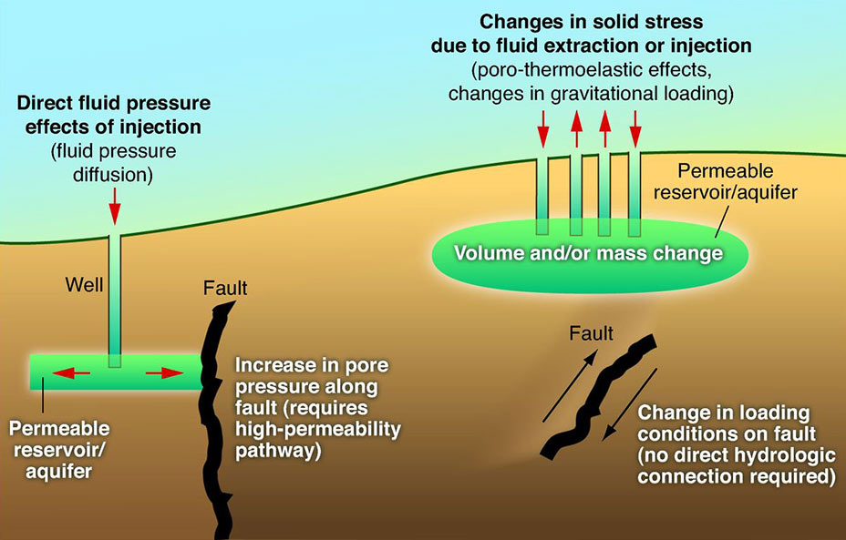
Introduction – Earthquake Occurrences
Tectonic processes
Non-tectonic processes
Anthropogenic triggering earthquakes
(Ellsworth, 2013)

Slide 5
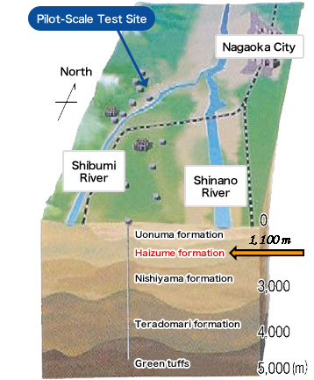
Introduction – Case Study in Nagaoka, Japan
2004 M_{w} 6.3 Chuetsu Earthquake hit Nagaoka area during CO₂ injection.
Objectives:
To develop an approach to distinguish CO₂ injection induced earthquakes from natural earthquakes
https://www.rite.or.jp/co2storage/en/safety/nagaoka/

Slide 6
Study Area

Slide 7
Methods
CO₂ injection-pore pressure change derived from fluids flow simulation
Seasonal pore pressure change (rain fall + snow melting)
Pore pressure change due to distant earthquake

Slide 8
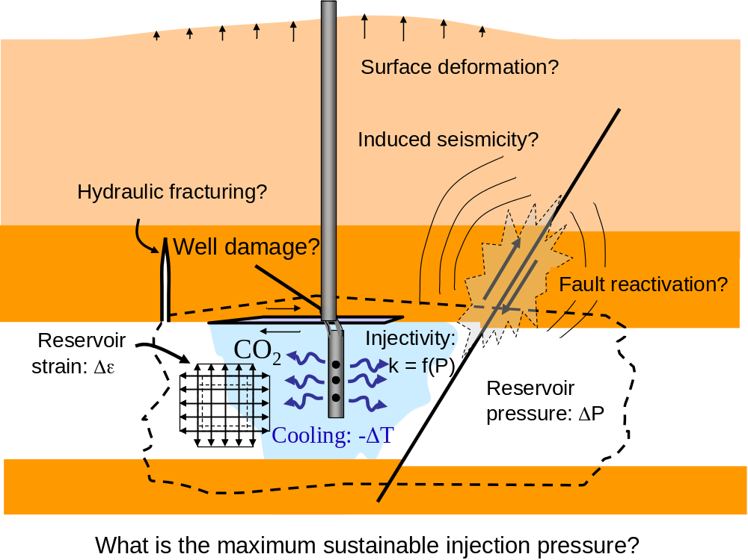
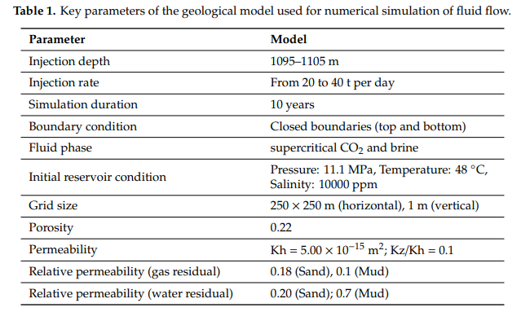
Methods (1)
CO₂ injection-pore pressure change derived from fluids flow simulation
Seasonal pore pressure change (rain fall + snow melting)
Pore pressure change due to distant earthquake
(Rutqvist, 2009)
8

Slide 9

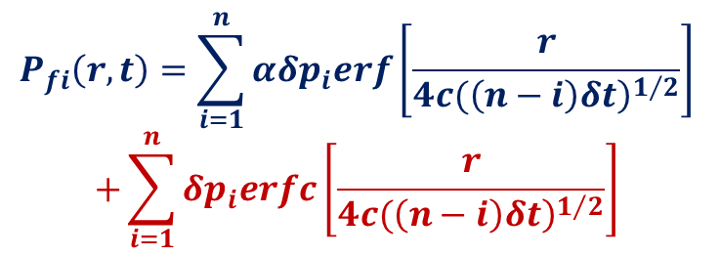

Methods (2)
Precipitation Load Change
CO₂ injection-pore pressure change derived from fluids flow simulation
Seasonal pore pressure change (rain fall + snow melting)
Pore pressure change due to distant earthquake
$${δp}_{i}=ρ.g.{δh}_{i}$$
Run off
Run off
Earth’s surface
Water Table
$r$ (km)
Time lag
Equation of pore pressure diffusion:
$$P_{fi}\left(r,t\right)=\sum_{i=1}^{n}{{αδp}_{i}erf\left[\frac{r}{{\left.4c(\left(n−i\right)δt\right)}^{1/2}}\right]}$$
$$+\sum_{i=1}^{n}{{δp}_{i}erfc\left[\frac{r}{{\left.4c(\left(n−i\right)δt\right)}^{1/2}}\right]}$$
Underground Pore pressure diffusion
9

Slide 10
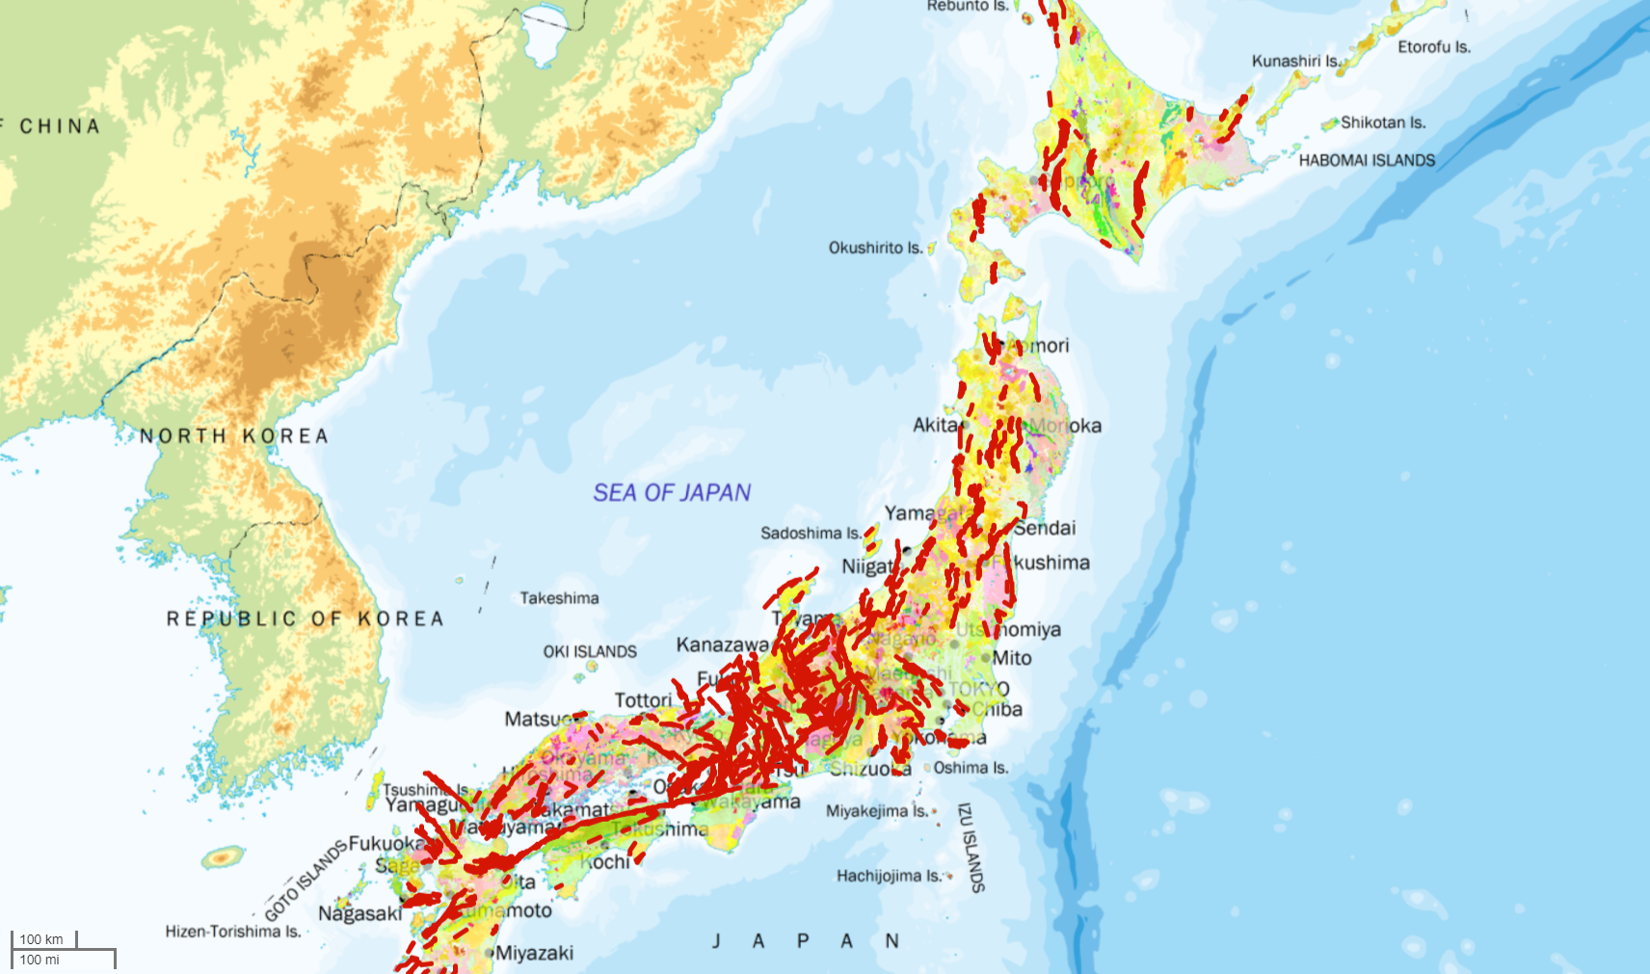
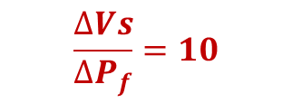
Methods (3)
CO₂ injection-pore pressure change derived from fluids flow simulation
Seasonal pore pressure change (rain fall + snow melting)
Pore pressure change due to distant earthquake
Equation of pore pressure change
due to remote earthquakes based on an
experimental relation (Tsuji et al., 2008):
$$\frac{∆Vs}{{∆P}_{f}}=10$$
2011 M_{w} 9.1 Tohoku
Earthquake
10
http://www.j-shis.bosai.go.jp/map/JSHIS2/download.html?lang=en

Slide 11
Results and Discussions - (1) change of pore pressure due to CO₂ injection (2003-2004)
Simulated pore pressure at 1103 m depth on the day of the Mw 6.8 Chuetsu earthquake (23 October 2004)
Pressure change and distance around the injection well versus the time lapse

Slide 12
Results and Discussions - (2) natural variations in pore pressure
Nagaoka CO₂ Injection Site

Slide 13
Results and Discussions - (2) natural variations in pore pressure

Slide 14
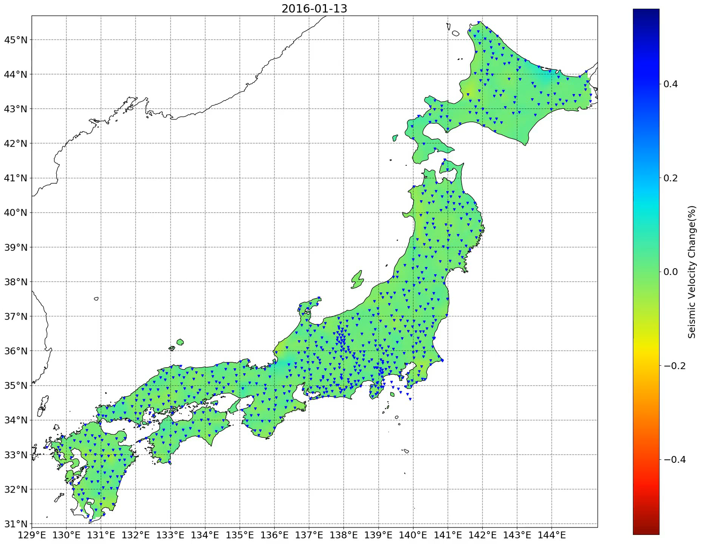
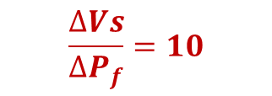
Results and Discussions - (3) pore pressure change due to remote earthquakes
Equation of pore pressure change
due to remote earthquakes based on an
experimental relation (Tsuji et al., 2008):
$$\frac{∆Vs}{{∆P}_{f}}=10$$
(Hutapea et al., 2020)
$$100 kPa > seasonal pore pressure$$
2011 M_{w} 9.1 Tohoku
Earthquake
14
http://www.j-shis.bosai.go.jp/map/JSHIS2/download.html?lang=en

Slide 15
Comparison of pore pressure increase due to CO₂ injection with natural variations

Slide 16
Conclusions
Our proposed approach can distinguish CO₂ injection induced earthquakes from natural earthquakes.
Natural seasonal fluctuations of pore pressure change up to 23kPa are much greater than those induced by CO₂ injection.
CO₂ injection at Nagaoka during 2003 and 2004 could not therefore trigger the 2004 Chuetsu earthquake.
Pore pressure increase of 100kPa due to remote earthquake is more significant than those from seasonal fluctuations.

Slide 17
Reference
Chhun, C.; Tsuji, T. Pore Pressure Analysis for Distinguishing Earthquakes Induced by CO₂ Injection from Natural Earthquakes. Sustainability 2020, 12, 9723. https://doi.org/10.3390/su12229723
Contact to Authors:
Takeshi Tsuji
E-mail: tsuji@mine.kyushu-u.ac.jp
Tel / Fax: +81 (0) 92-802-3316
H/P: http://geo.mine.kyushu-u.ac.jp/tsuji/english/e_index.html
Chanmaly Chhun
E-mail: chanmaly_chhun91@mine.kyushu-u.ac.jp

