Slide 1
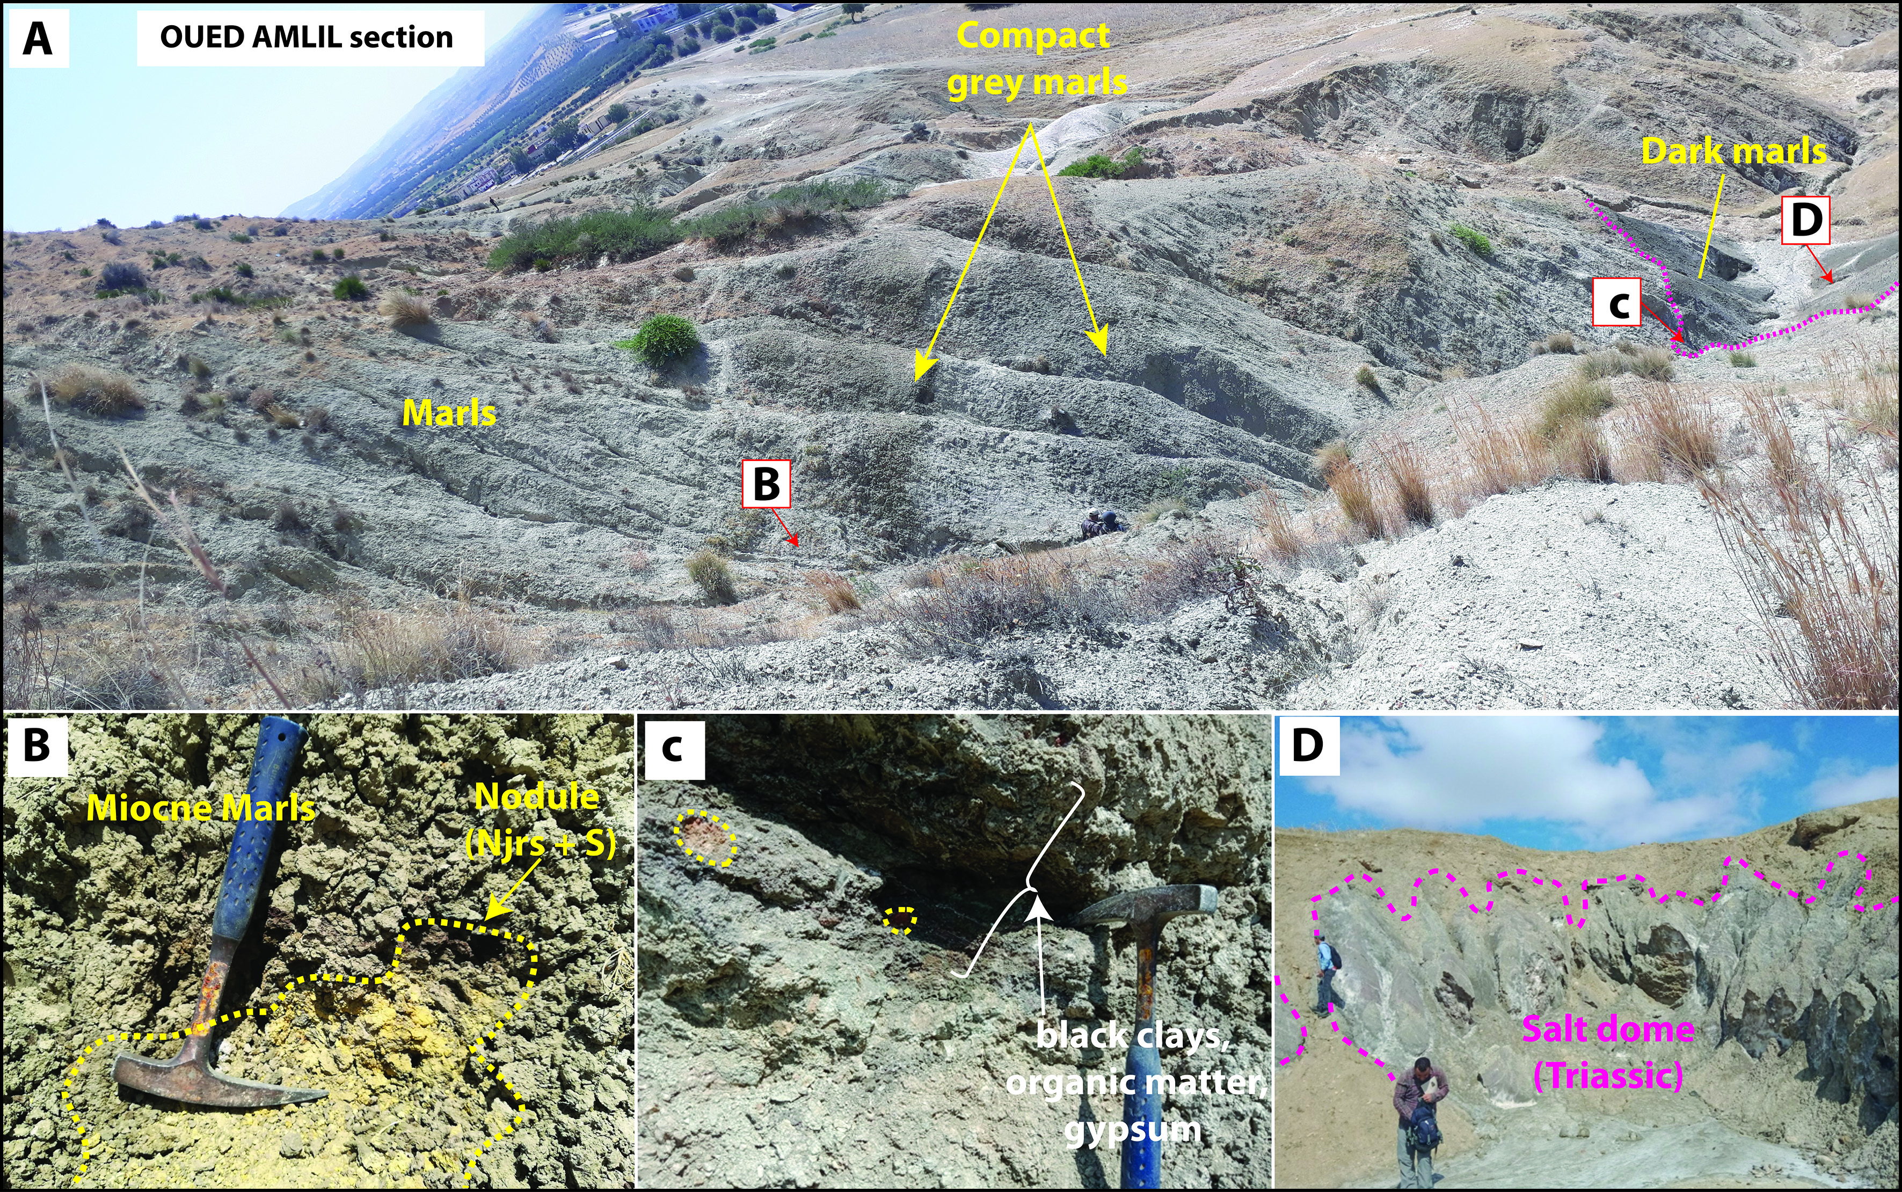
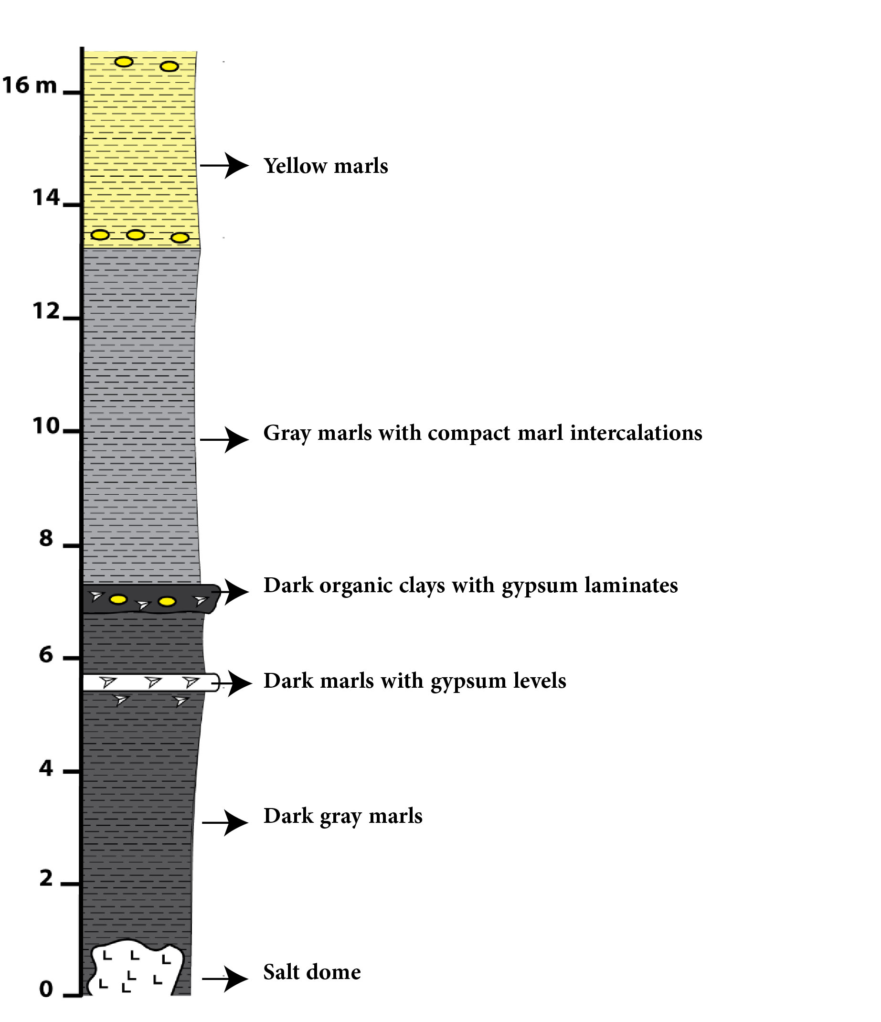
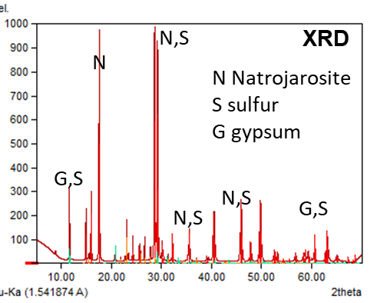
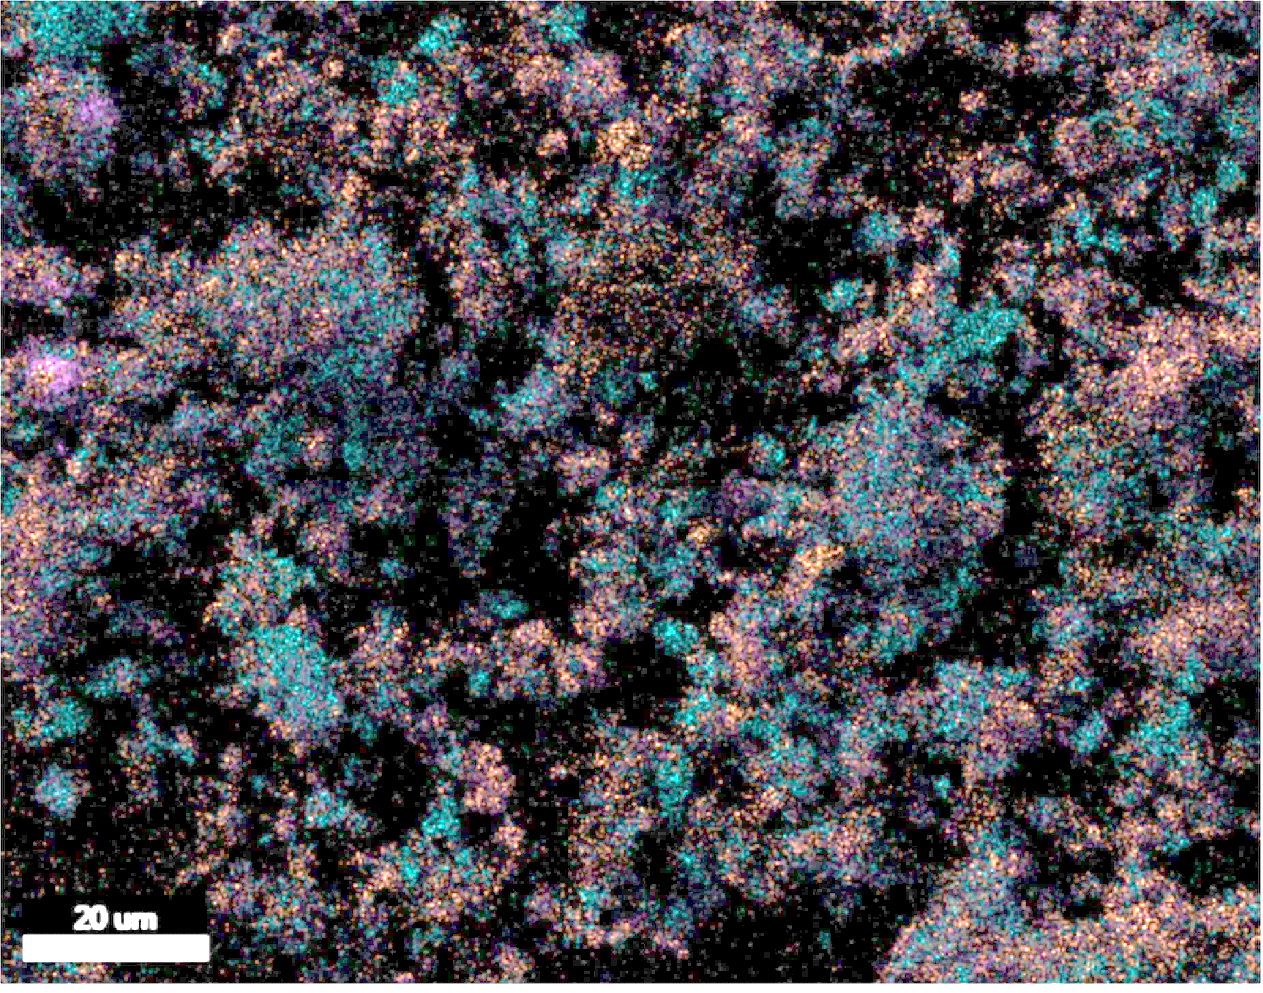
Biogenic native Sulfur linked to the Neogene deposits from the Riffian Corridors (Northern Morocco): preliminary study and characterization
Laila BOUBKARI¹, Otmane RAJI¹, Mohammed ACHALHI², Muhammad OUABID^{1,} Jean louis BODINIER¹
1 : Geology and Sustainable Mining, Mohammed VI Polytechnic University, Lot 660, Hay Moulay Rachid, Ben Guerir 43150, Maroc,
2 : Earth Sciences Department, National Superior School of Mining of Rabat (Ex. ENIM), Avenue Hadj Ahmed Cherkaoui - B.P 753 Agdal – Rabat, Maroc,
Neogene basins of the western Mediterranean
10 cm
Panoramic view of the Oued Amlil section;
SEM chemical composition (Fe, S, Ca)
Simplified geological map shows the Neogene deposits around the mediterranean Sea in Sicily (A), southern Spain (B), and Northern Morocco (C).

