Slide 1
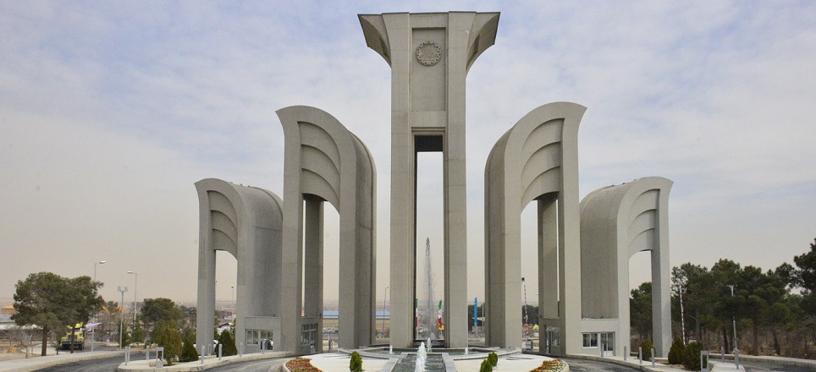


Dust storm frequency in relation to extreme droughts
in arid regions of Iran
Reza Modarres^{1*}, Poria Mohit Isfahani ²
1,2 Department of Natural resources, Isfahan University of technology, Iran
Email: reza.modarres@iut.ac.ir
* Center of Exclence for Risk management and natural hazars, Isfahan University of technology, Iran

Slide 2

Research questions
1- How is the temporal change of dust storm frequency in arid regions of Iran?
2- How droughts impact dust storm frequency in the changing environment?
3. How extreme droughts are related to dust storm frequency?

Slide 3
Methods and data
Data
Monthly Number of dust storms (NDD) when visibility is less than 1Km for stations of arid regions of Iran
Standardized Precipitation Index (SPI) time series in the selected stations as drought Index
Methods
1. Rolling kendal’s Tau correlation coefficent between SPI and NDD
2. Copula Functions to calculate joint (conditional) probability between drought and NDD

Slide 4
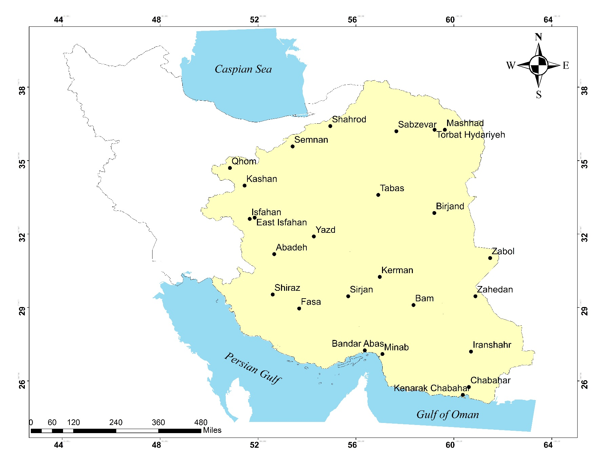

Slide 5
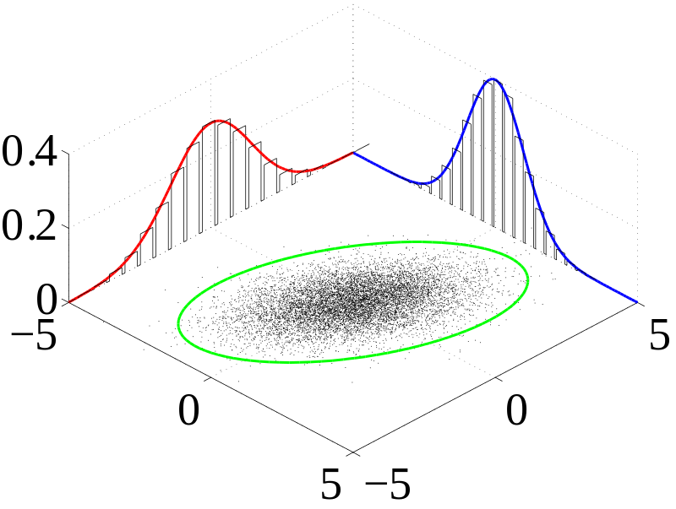

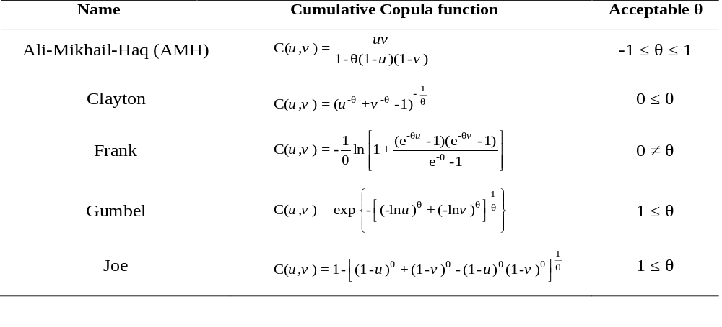
Copula Theorem
Sklar's theorem:
Archimedean Copulas formulation.

Slide 6
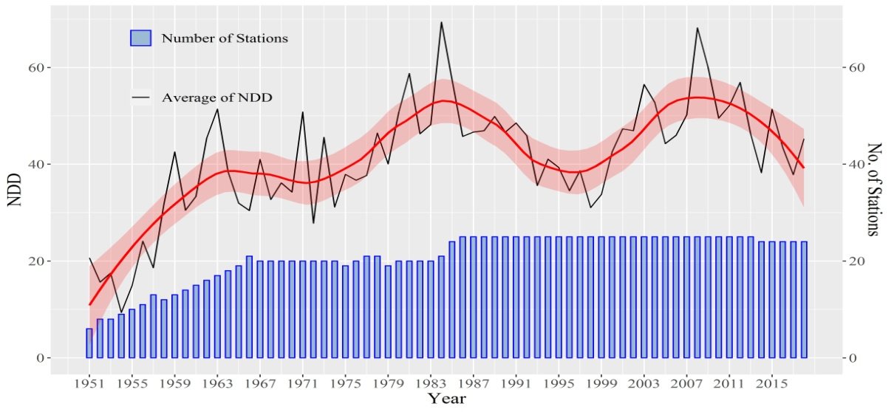
Temporal change in the average Number of dusty Days (NDD) per Station

Slide 7
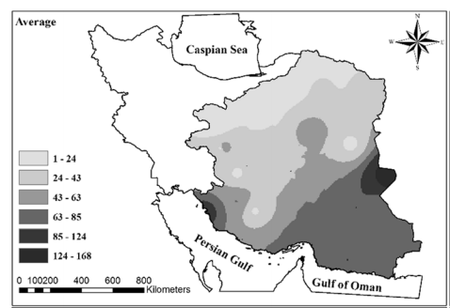
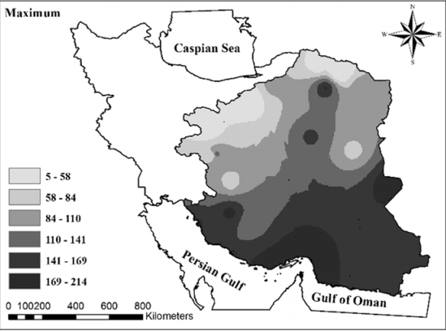
Spatial pattern of Annual Average and Maximum NDD
Average annual NDD
Maximum annual NDD

Slide 8
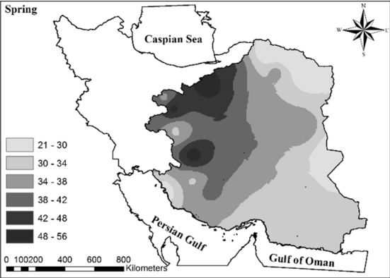
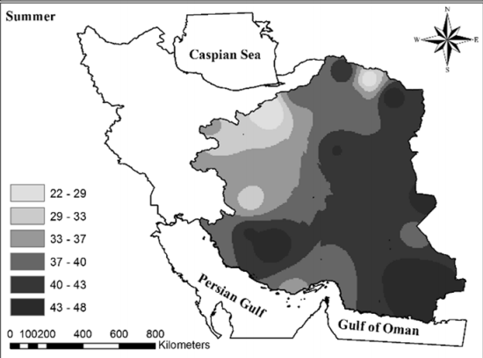
Seasonality of NDD
Spring
Summer

Slide 9
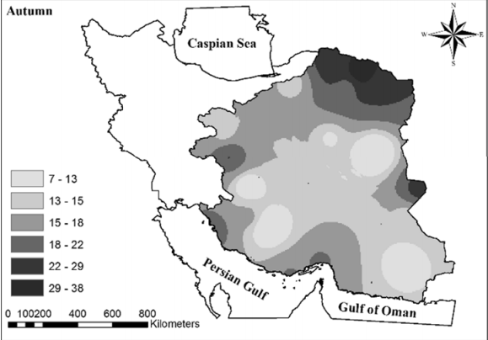
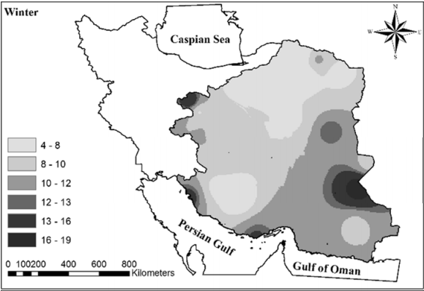
Seasonality of NDD
Autumn
Winter

Slide 10
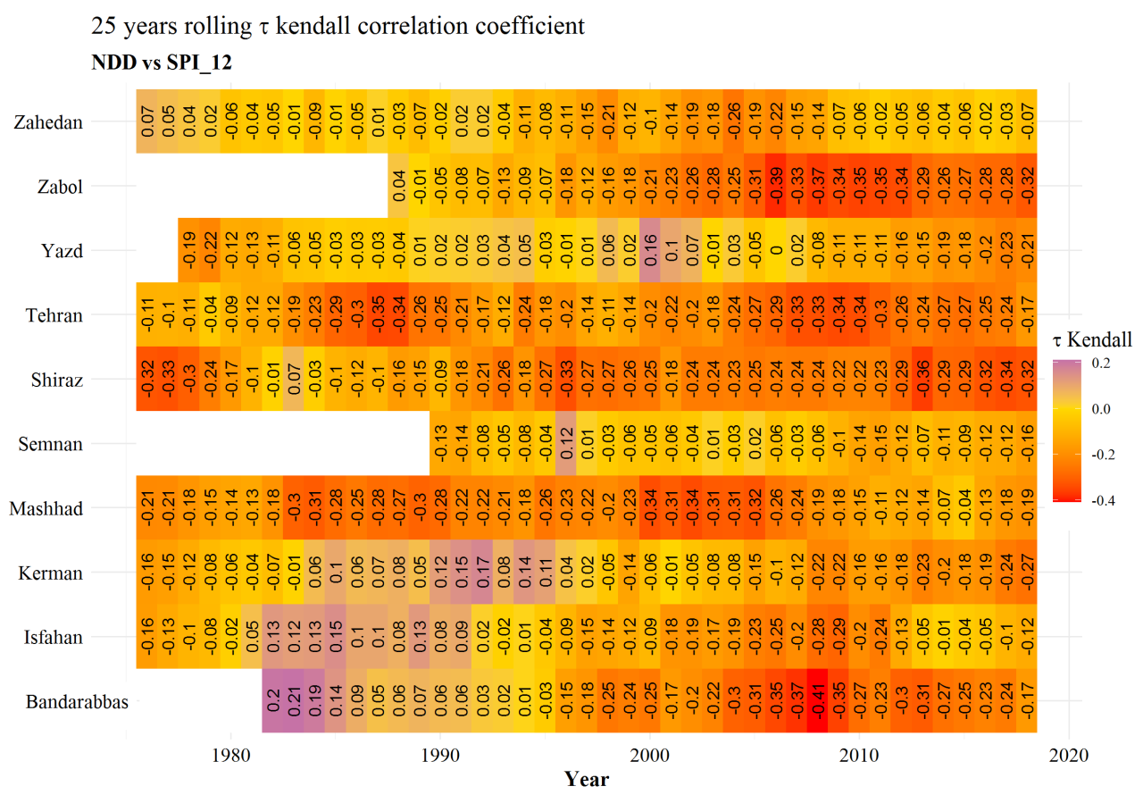
Examples of rolling Kendal’s tau correlation between SPI and NDD

Slide 11
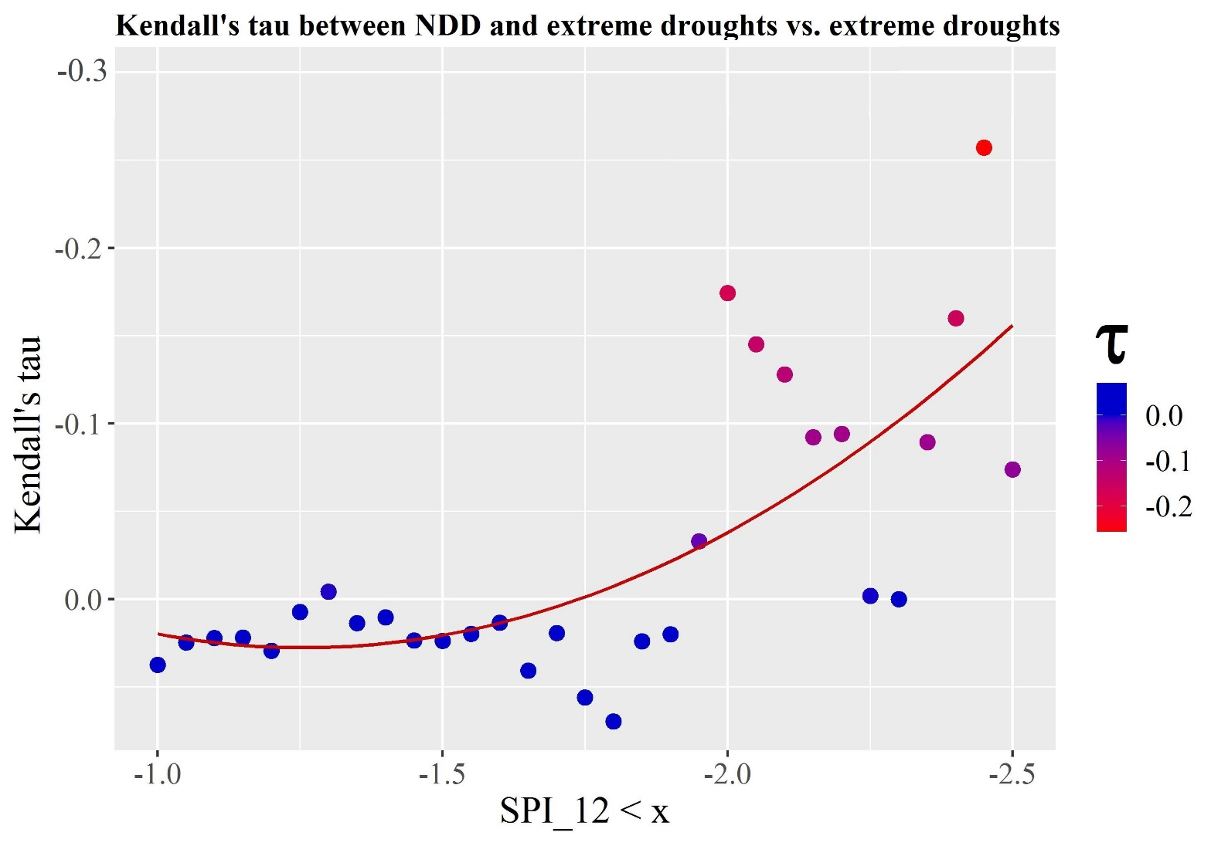
Kendal’s tau against severe and extreme droughts (SPI< -2.0)

Slide 12
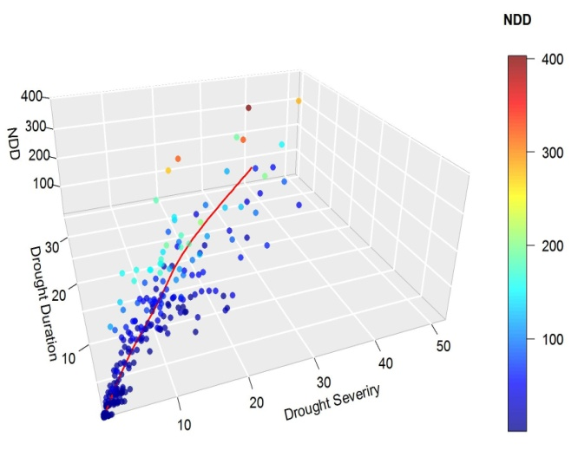
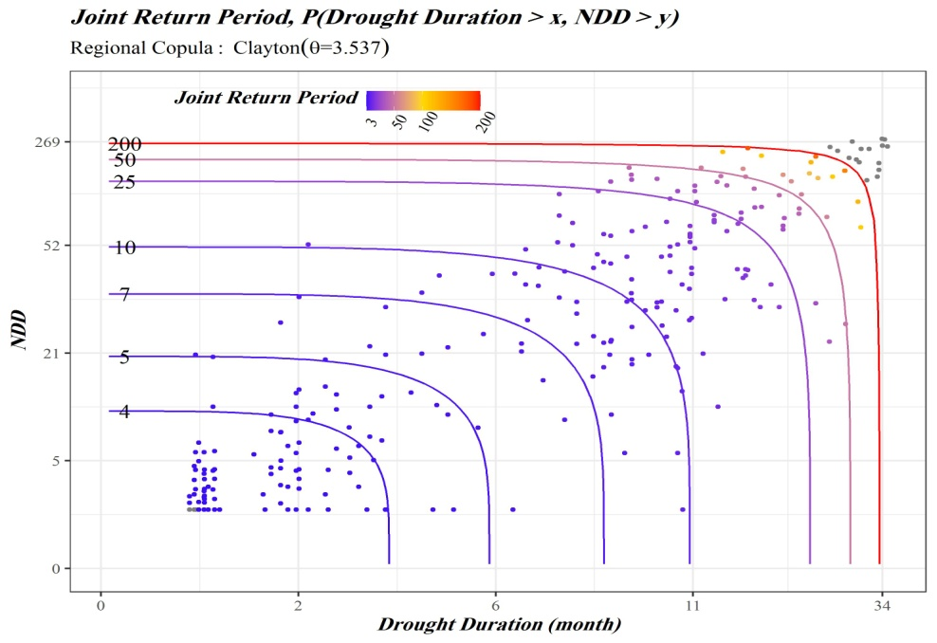
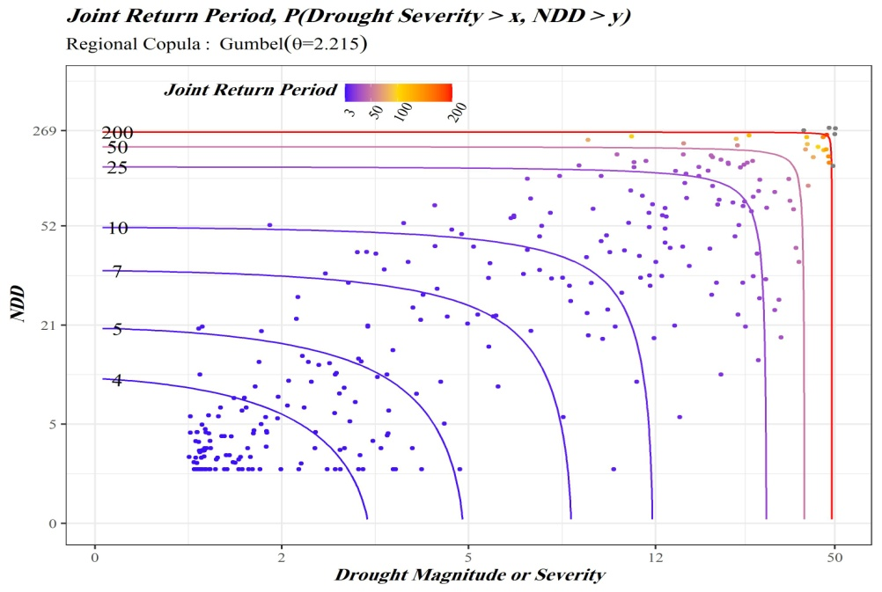
Drought and NDD Interaction
NDD
DROUGHT
Drought
Duration
Drought
Severity

Slide 13
Concluding remarks
Dust storm frequency in relation to drought is changing due to climate variability
Dust storms have higher co-occurrence likelihood with Severe and extreme droughts
The increasing number of dust storm frequency has a
non-linear association with extreme droughts
The higher drought duration will increase the number of dust storms

Slide 14

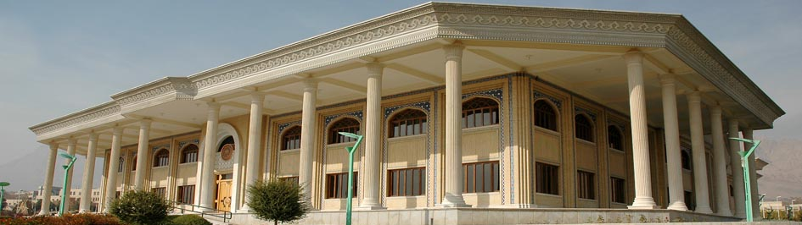
Thank You
Reza Modarres
https://rezamodarres.iut.ac.ir
Email: reza.modarres@iut.ac.ir
Twitter: @RezaModarres2
Poria Mohit Isfahani
https://www.researchgate.net/profile/
Poria-Mohit-Esfahani-2
Email: Poriamohit.72@gmail.com

