Slide 1
Urban flood modelling and sensitivity analysis: water exchange between the ground surface and the underground sewer network
Andrés González-Iñiguez
Prof. Patrick Willems
Civil Engineering Department
KU Leuven

Slide 2

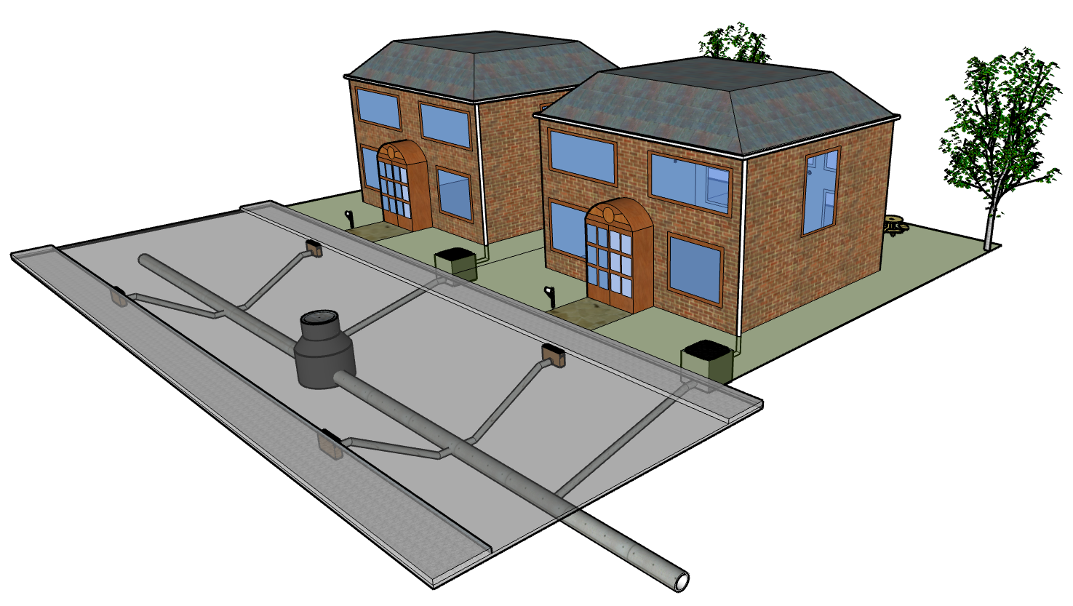
The urban drainage system
Rainfall
Ground surface – major system
  Overland flow
  Rooftop runoff
Sewer network – minor system
  Pipe flow
  Storage
Flow exchange
  Drainage flow
  Reverse flow
Rooftop runoff
Overland flow
Reverse flow
Infiltration
Pipe flow

Slide 3
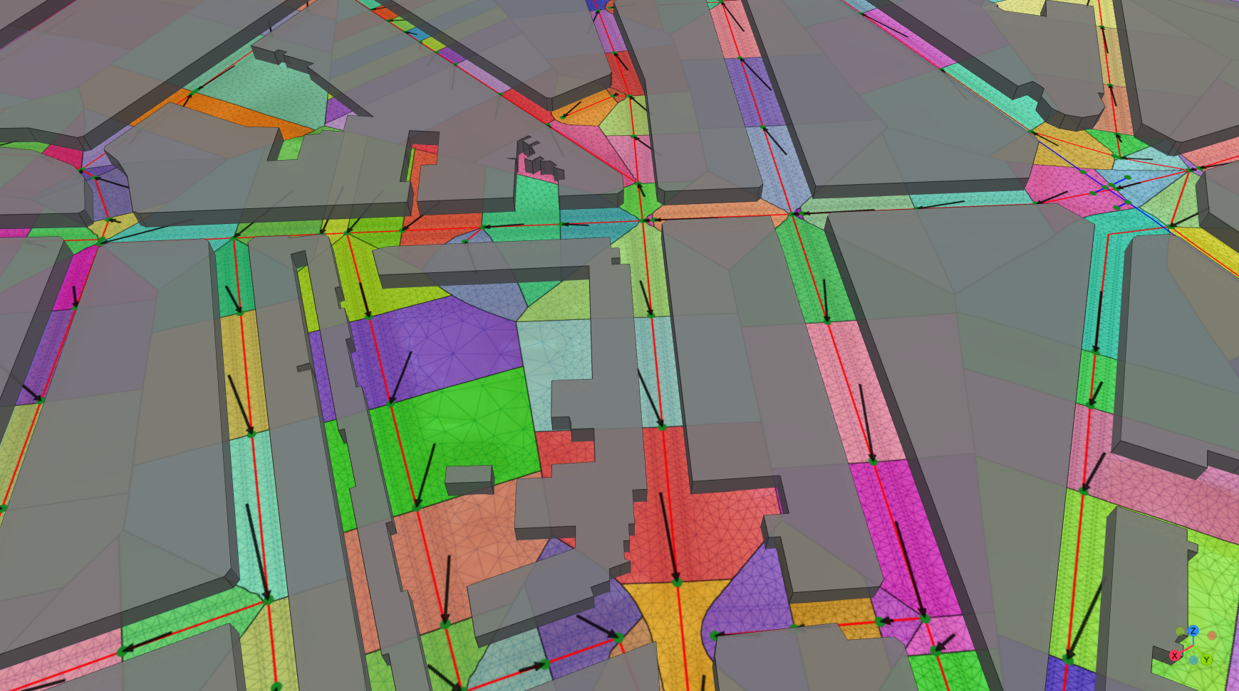
Typical 1D-2D model representation

Slide 4
Shortcomings of typical 1D-2D models
Rainfall applied in subcatchments instead of directly onto the ground surface.
Surface runoff enters directly into the sewer network.
Flooding occurs only after exceedance of the sewer network capacity.
Street inlets are ignored.

Slide 5

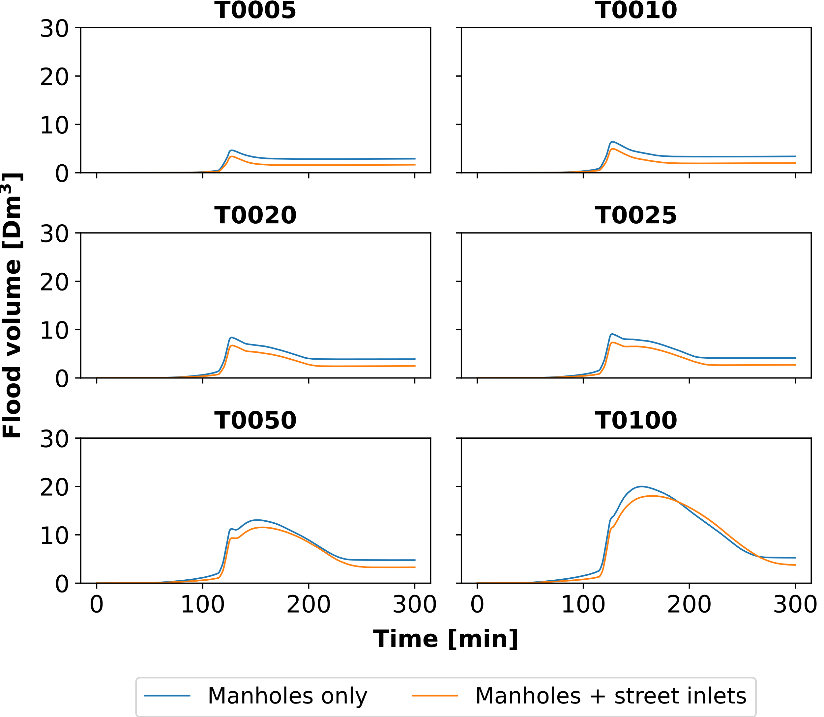


Street inlets inclusion effect
Notes:
Reduction:
T0005 27%
T0010 23%
T0020 20%
T0025 19%
T0050 12%
T0100 10%

Slide 6
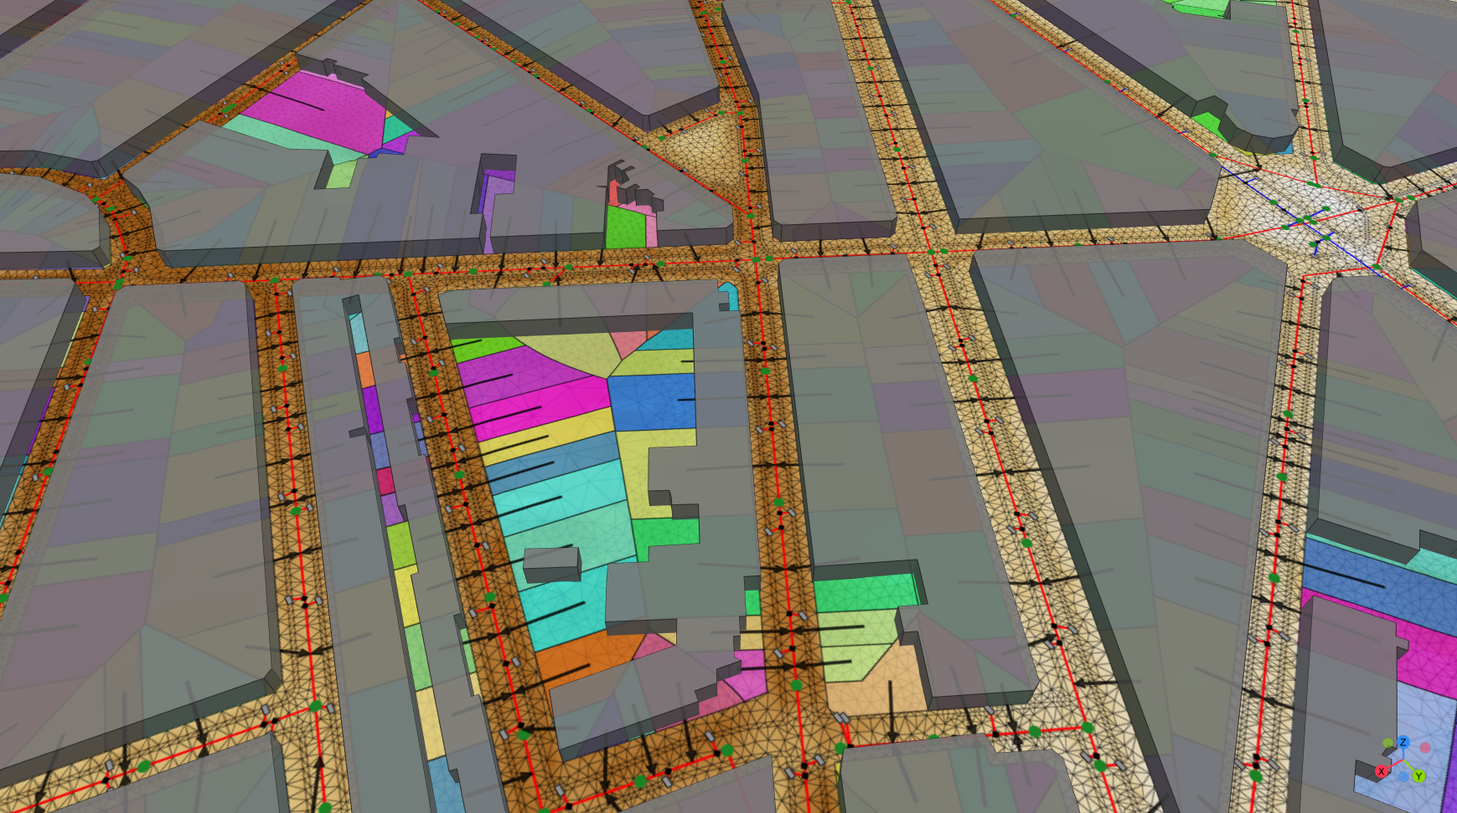
More realistic 1D-2D model representation

Slide 7
Increasing model detail: Concerns
Data availability
Overparameterization risk
Field campaigns
Remote detection using high-resolution imagery and machine learning (Vitry et al., 2018; Commandre et al., 2017)
Synthetic street inlets network (Bertsch et al., 2017)
Sensitivity test!

Slide 8
Objective
To identify processes and model parameters – within the water exchange interface – having a significant impact on the outputs of 1D-2D urban drainage models.

Slide 9
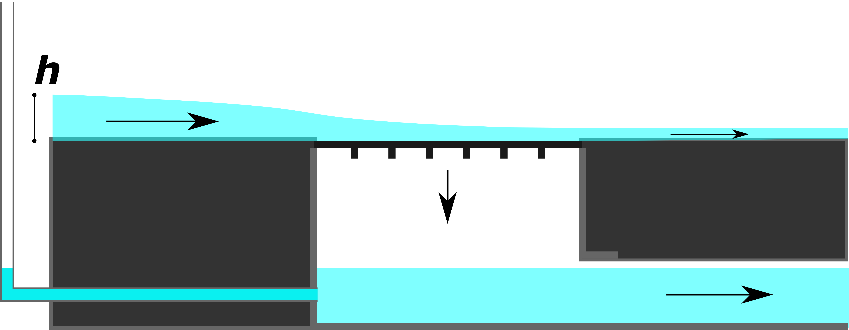
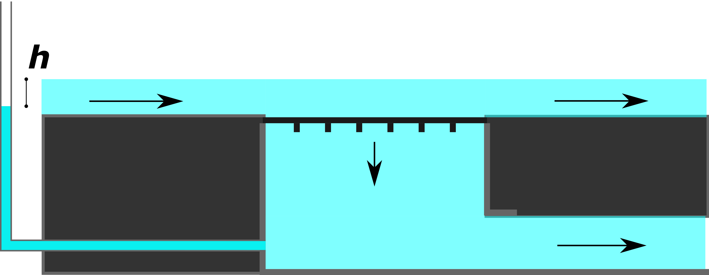
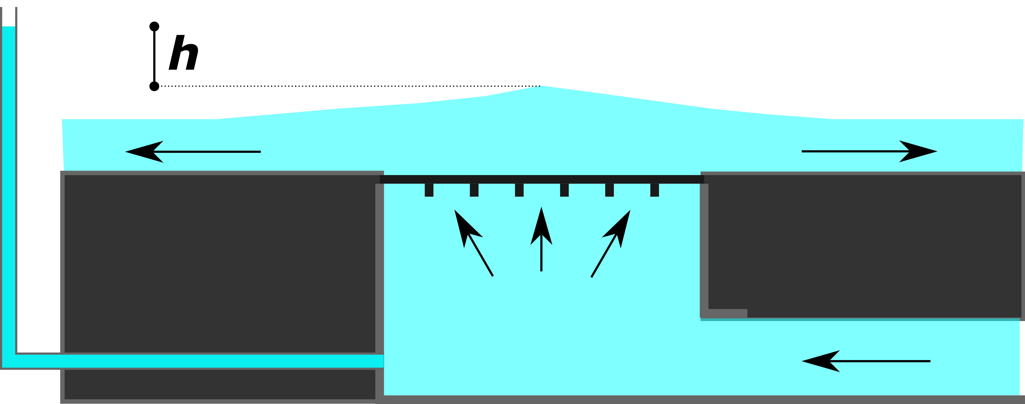
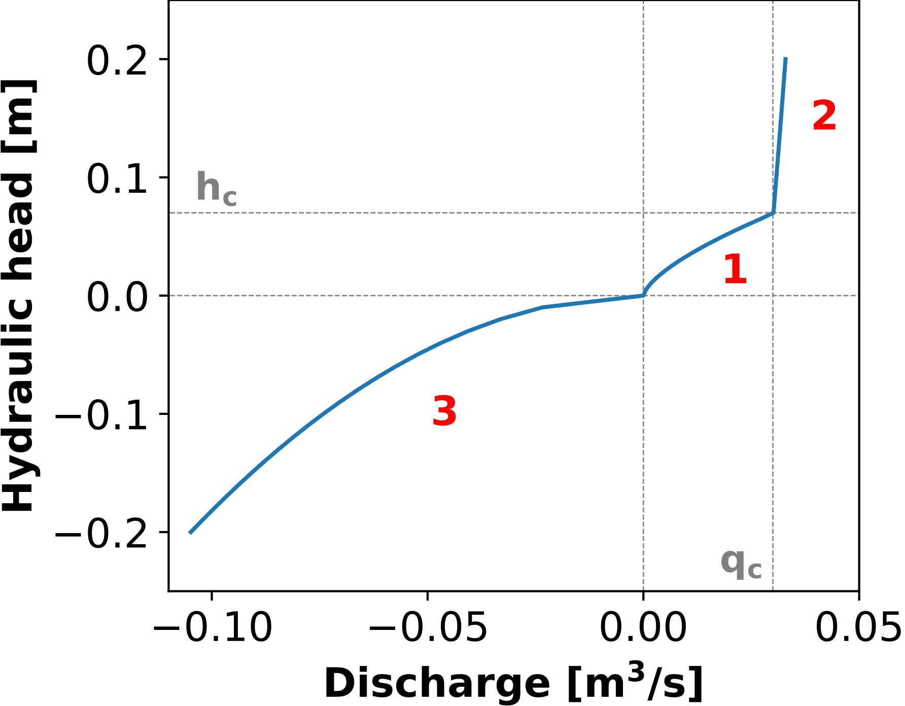






Flow through street inlets
Weir flow
Orifice flow
Orifice reverse flow
1
2
3
$$0≤h≤h_{q_{c}}$$
$$h>h_{q_{c}}$$
$$h<0$$
Flow equations
1)${ Q}_{i}=\left(1−k\right)∗C_{di}∗B_{i}∗\sqrt{g}∗h^{\frac{3}{2}}$
2) $Q_{i}=\left(1−k\right)∗C_{od}∗A_{g}∗\sqrt{2g(h+z_{ch})}$
3) $Q_{i}=−C_{or}∗A_{v}∗\sqrt{2g\left|h\right|}$

Slide 10
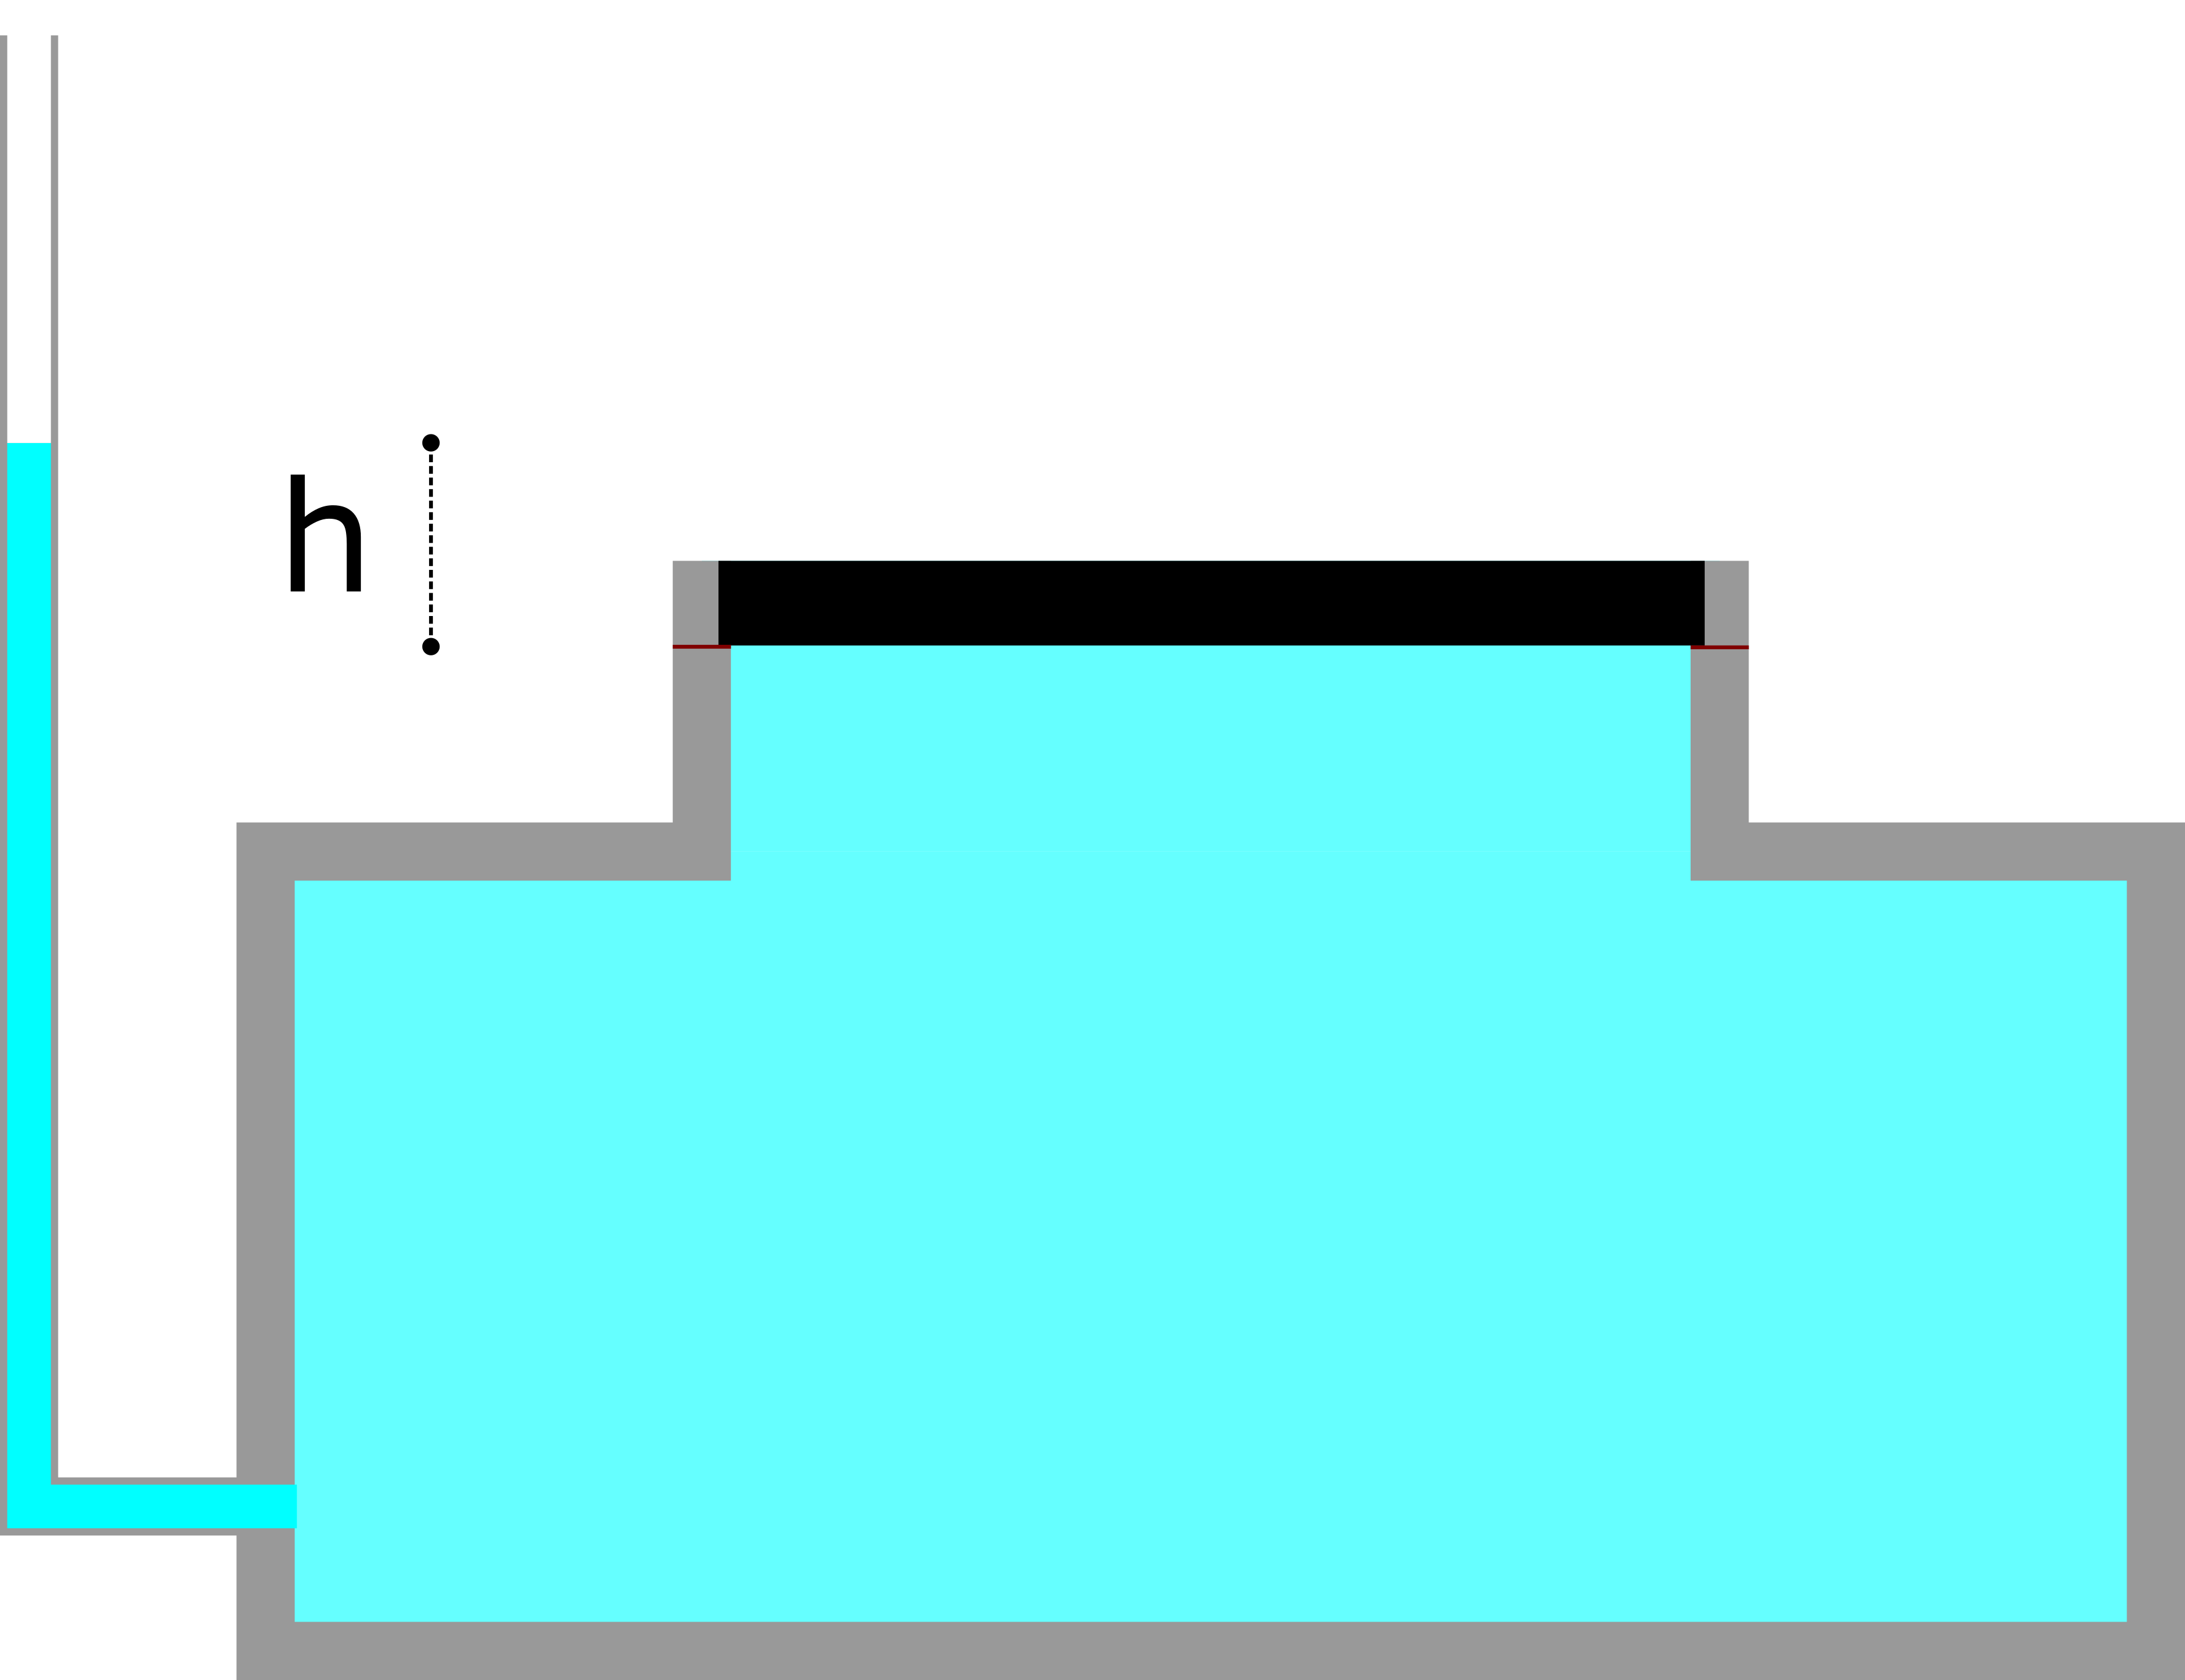
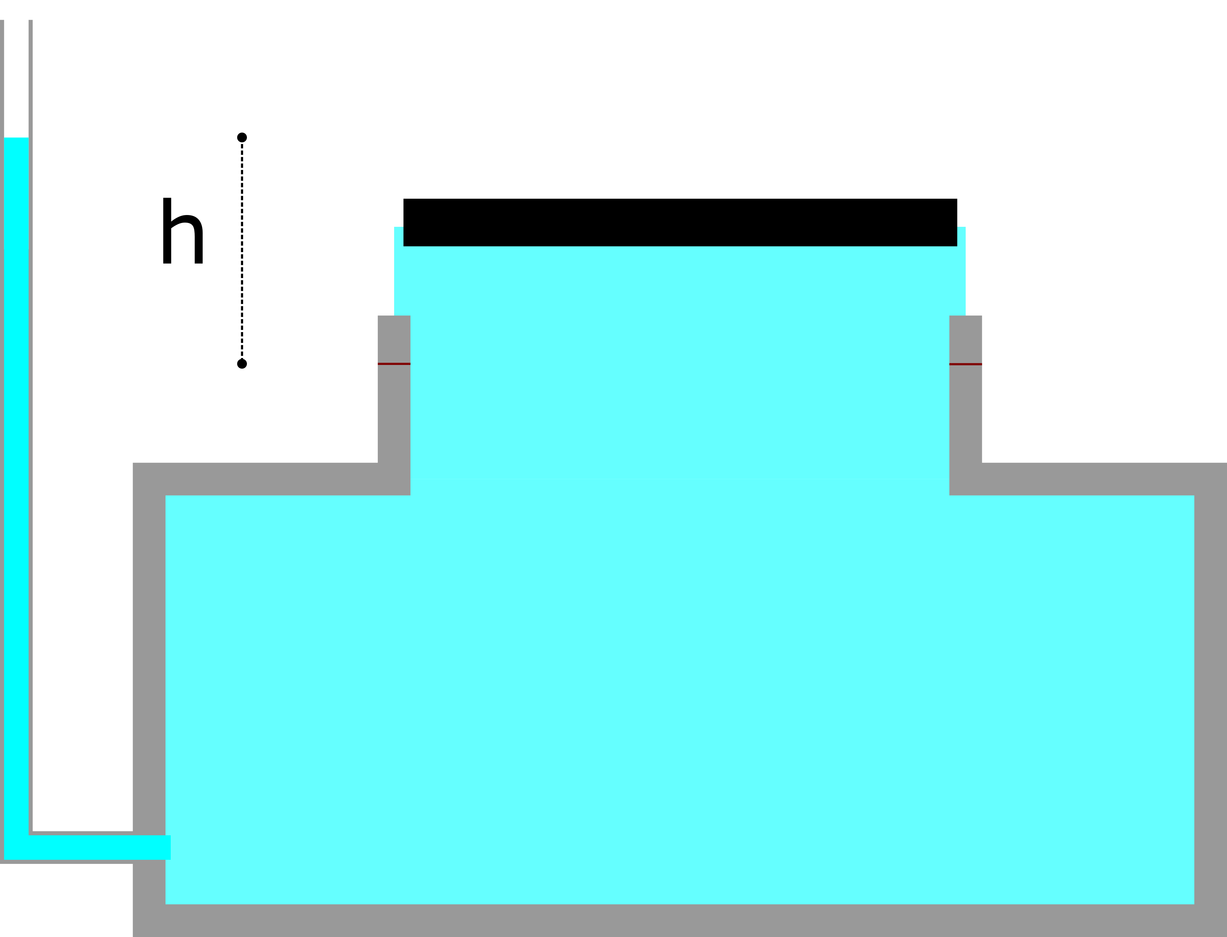
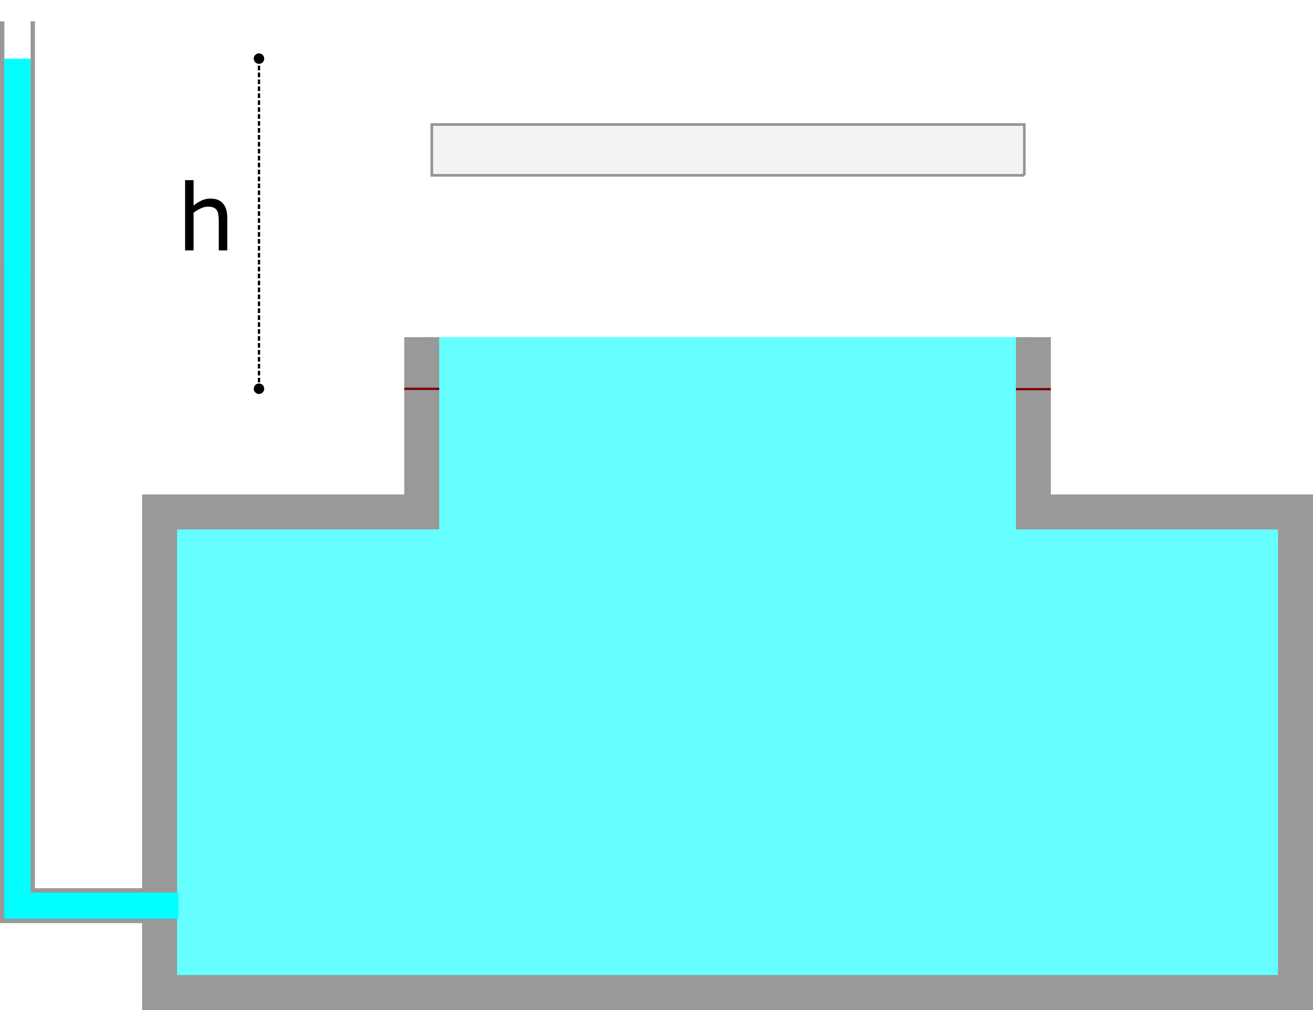
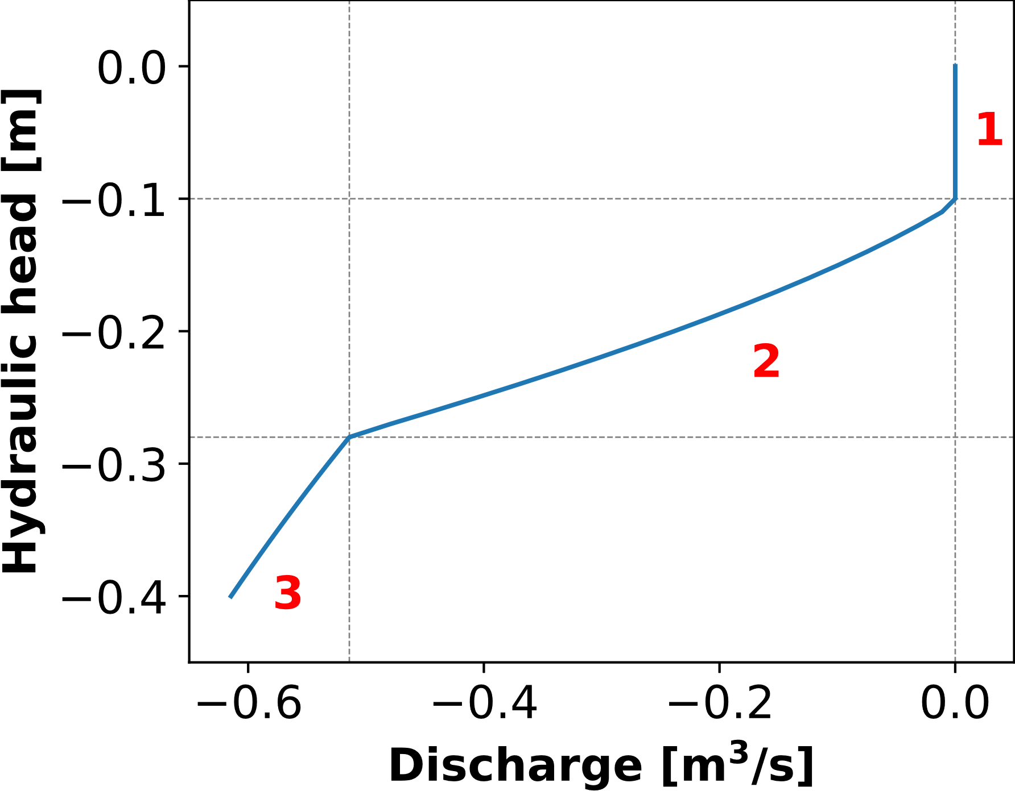







Flow through manholes
No flow
Orifice reverse flow
Orifice reverse flow
1
2
3
$$|h|≤{|h}_{eq}|$$
$$\left|h_{eq}\right|<{|h|≤|h}_{A_{c}}|$$
$$\left|h\right|>h_{A_{c}}$$
Flow equations
1)${ Q}_{m}=0$
2) $Q_{m}=−C_{om}∗A_{om}∗\sqrt{2g\left|h\right|}$
3) $Q_{m}=−C_{om}∗A_{c}∗\sqrt{2g\left|h\right|}$
$$h_{eq}=−\frac{W_{c}}{p_{w}gA_{c}}$$

Slide 11
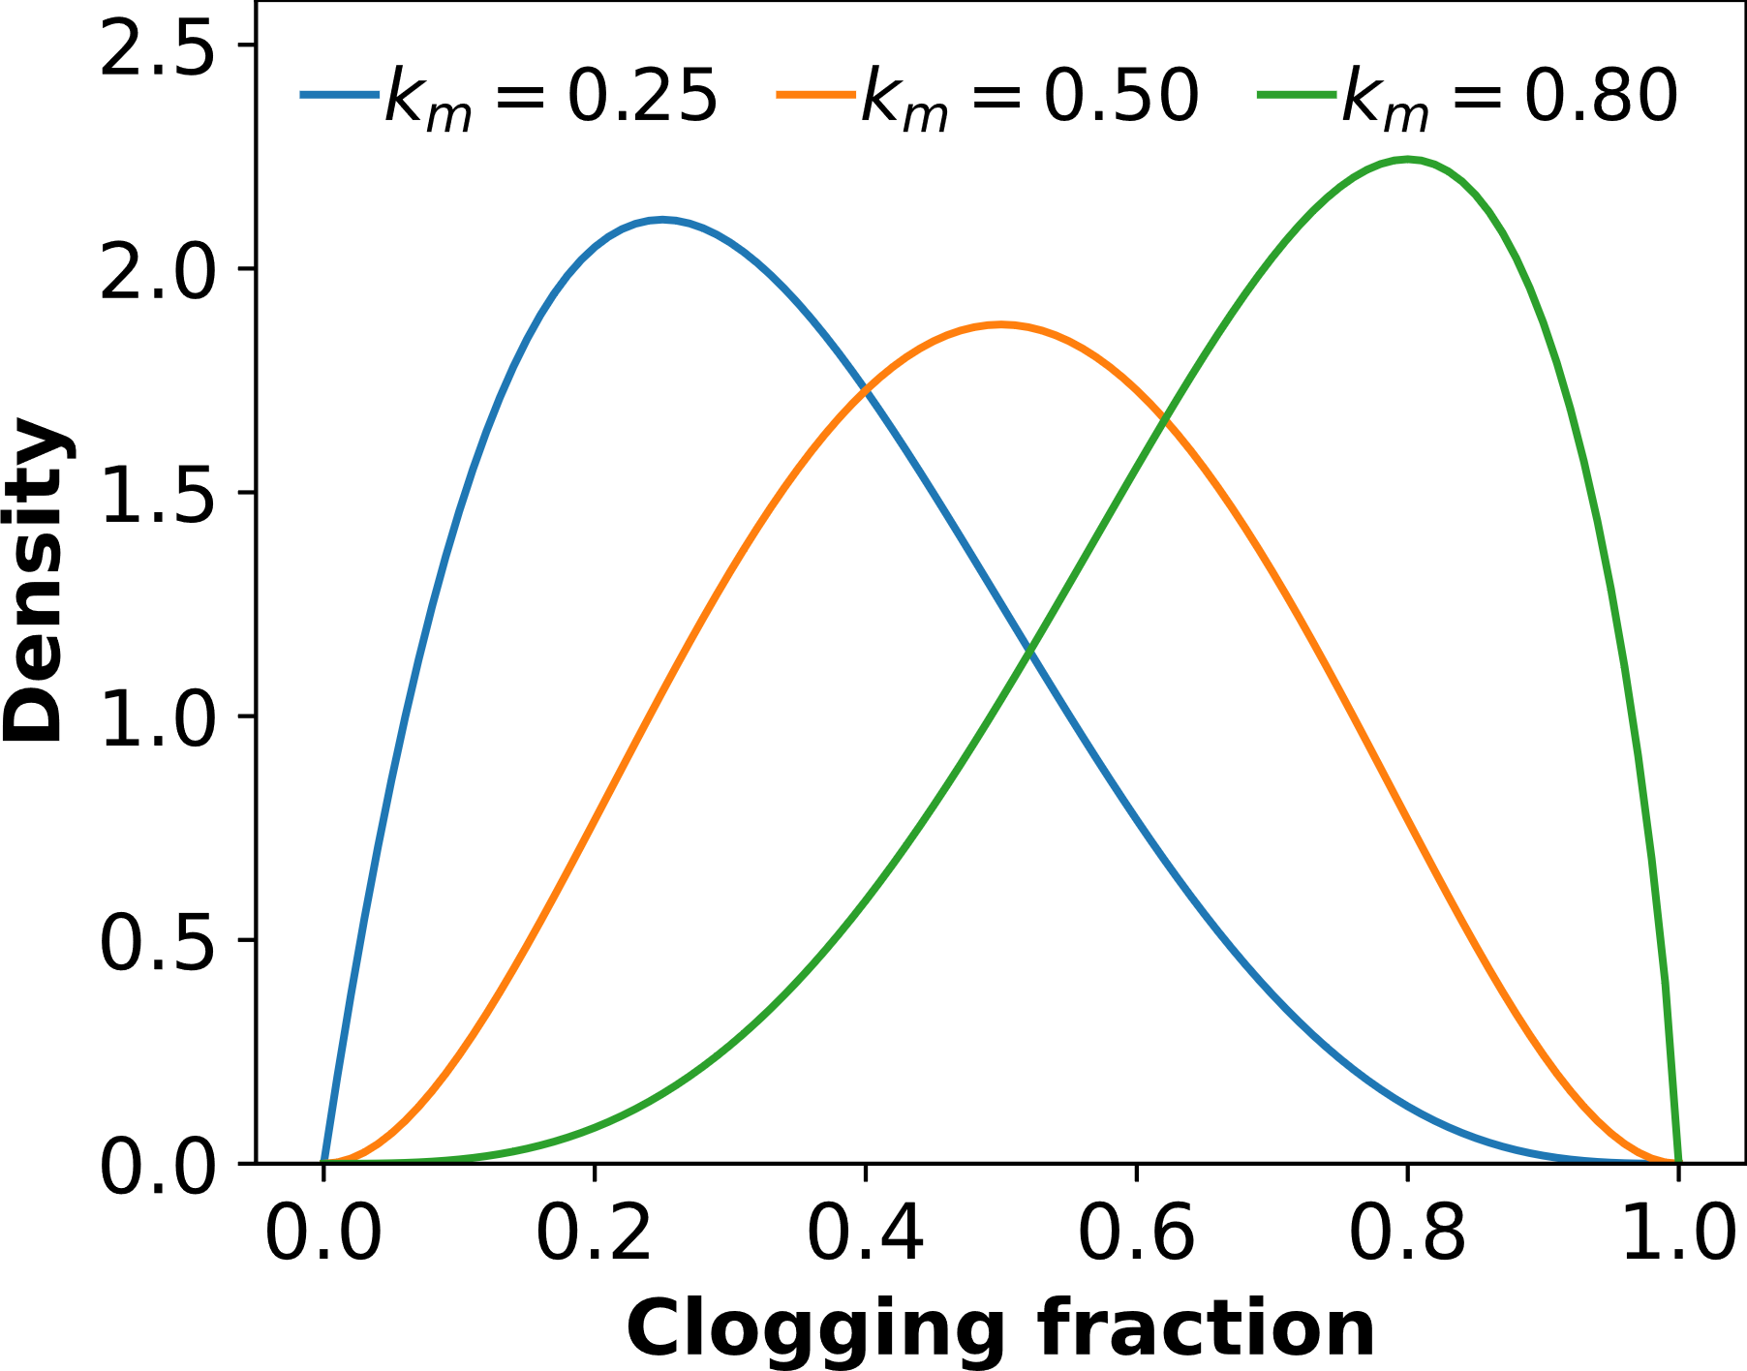
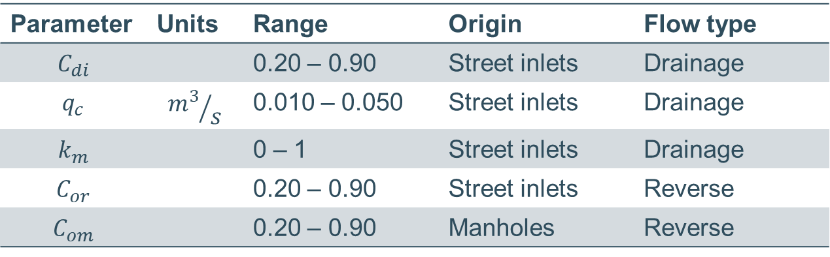
Sensitivity test – parameters to consider
Parameter | Units | Range | Origin | Flow type
$$C_{di}$$ |  | 0.20 – 0.90 | Street inlets | Drainage
$$q_{c}$$ | $${m^{3}}/s$$ | 0.010 – 0.050 | Street inlets | Drainage
$$k_{m}$$ |  | 0 – 1 | Street inlets | Drainage
$$C_{or}$$ |  | 0.20 – 0.90 | Street inlets | Reverse
$$C_{om}$$ |  | 0.20 – 0.90 | Manholes | Reverse
Beta-PERT distribution

Slide 12
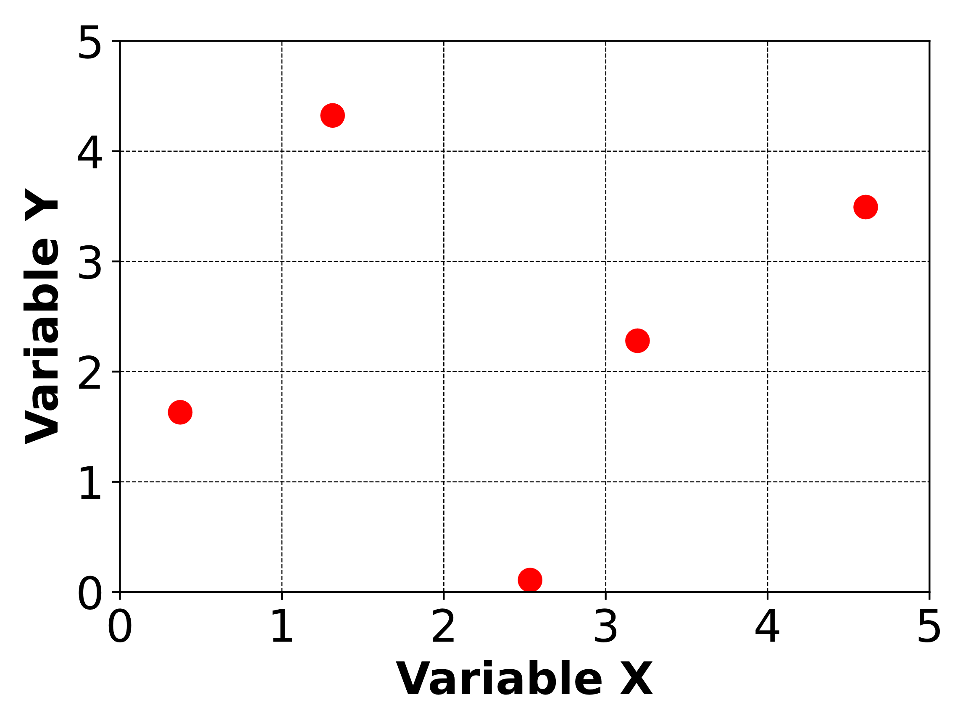
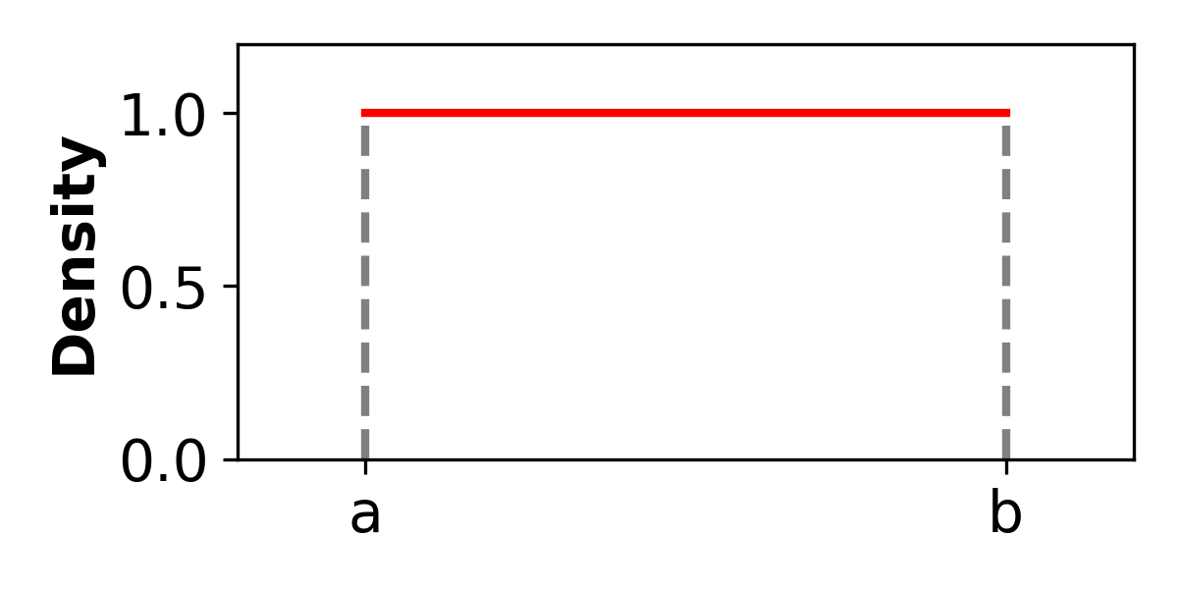
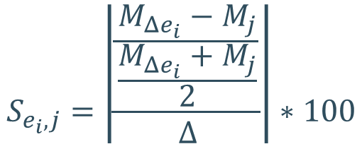



Sensitivity test – sampling method
Latin-Hypercube (LH) – One factor At the Time (OAT)
$$N_{simulations}=N\left(P+1\right)$$
$$ΔY$$
$$ΔX$$
$$S_{e_{i},j}=\left|\frac{\frac{M_{Δe_{i}}−M_{j}}{\frac{M_{Δe_{i}}+M_{j}}{2}}}{Δ}\right|∗100$$
Sensitivity index
Uniform distribution

Slide 13
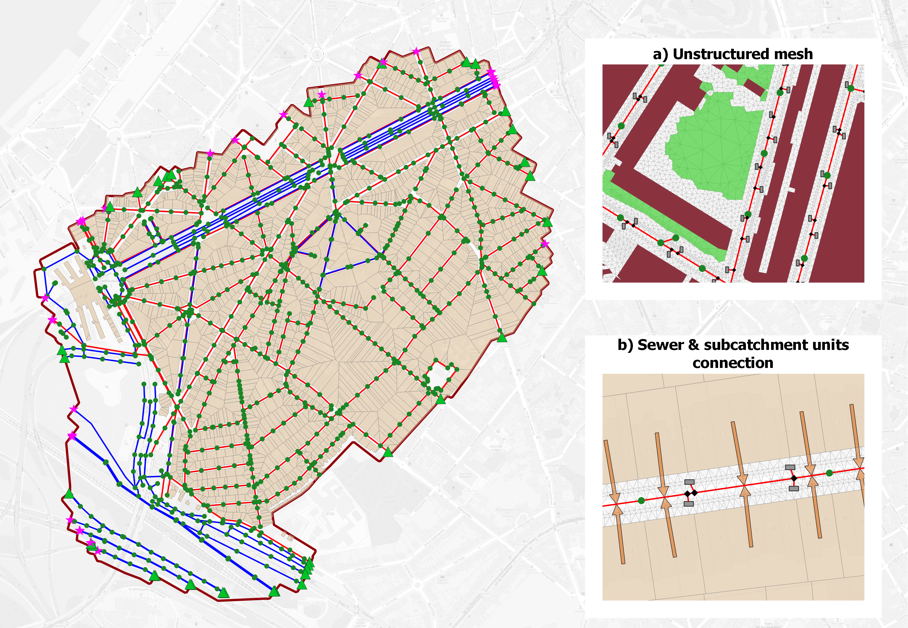
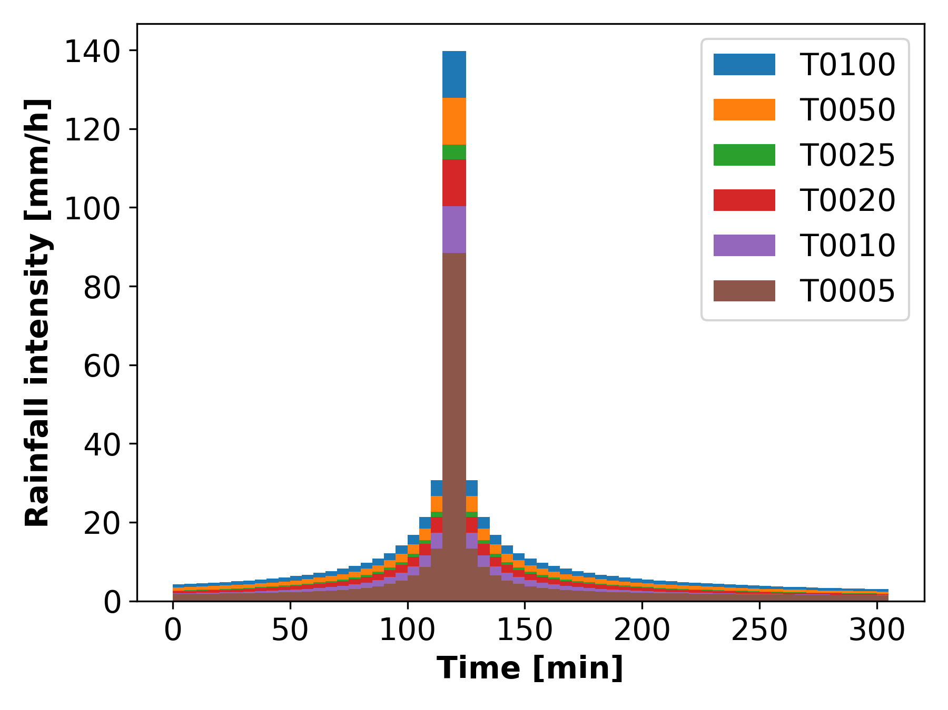
Case study
1.5 Km²
52.5 Km conduits (140 – 2500 mm)
1034 manholes, 2058 street inlets
70 boundary nodes
2458 subcatchments
372512 mesh elements (0.05 – 100 m², μ=2m²)
720 simulations
Notes:
Given the system's complexity, several tools were developed to aid at the automation of model construction and setting up. Starting from GIS les (vector and raster formats) as input, these tools produce
model object les (either .shp, .csv, or SQL queries) that are ready to import in the modelling software. The automated tasks include: 1) Pre-processing of geometry polygons used in 2D mesh generation.
It is checked that all polygons involved in 2D meshing are topologically correct, i.e., no overlapping, no slivers, and perfect snapping between adjacent polygons; 2) Automatic generation of `subcatchment'
units including the allocation of their properties (system type, land cover shares, number of inhabitants, etc.) and linking with sewer network objects; 3) Creation, linkage, and properties assignment of sewer
network elements (nodes and links). All these tools are available as Python scripts/modules.

Slide 14
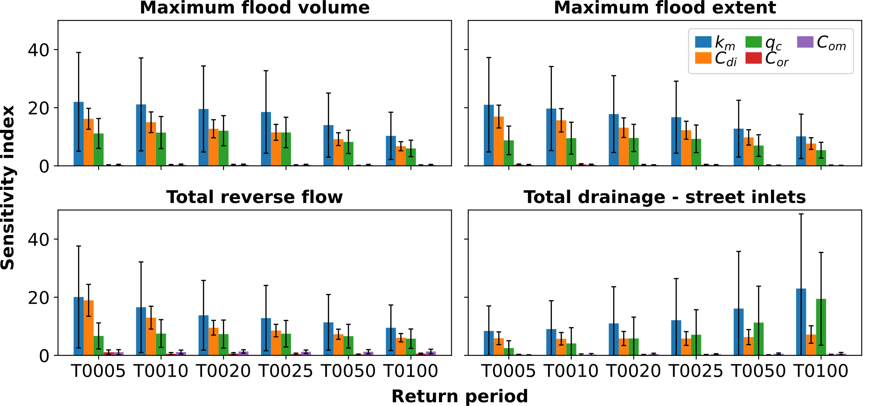
Sensitivity index results

Slide 15
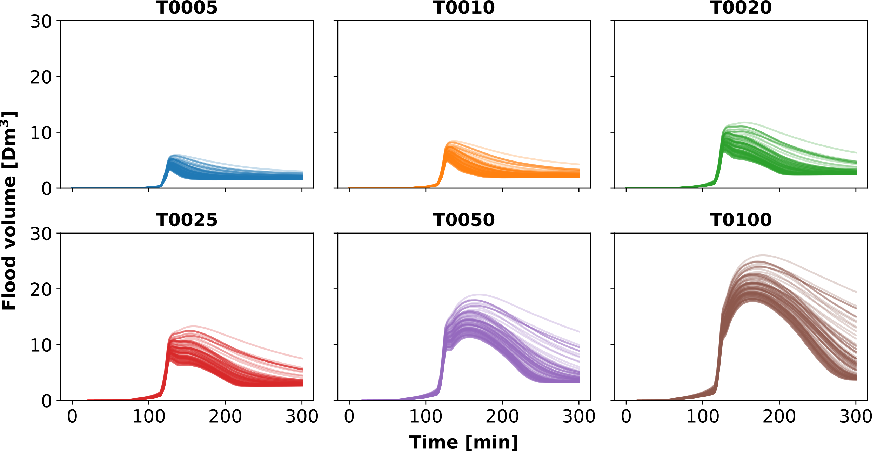
Total flood volume evolution
81%
76%
83%
46%
67%
87%

Slide 16
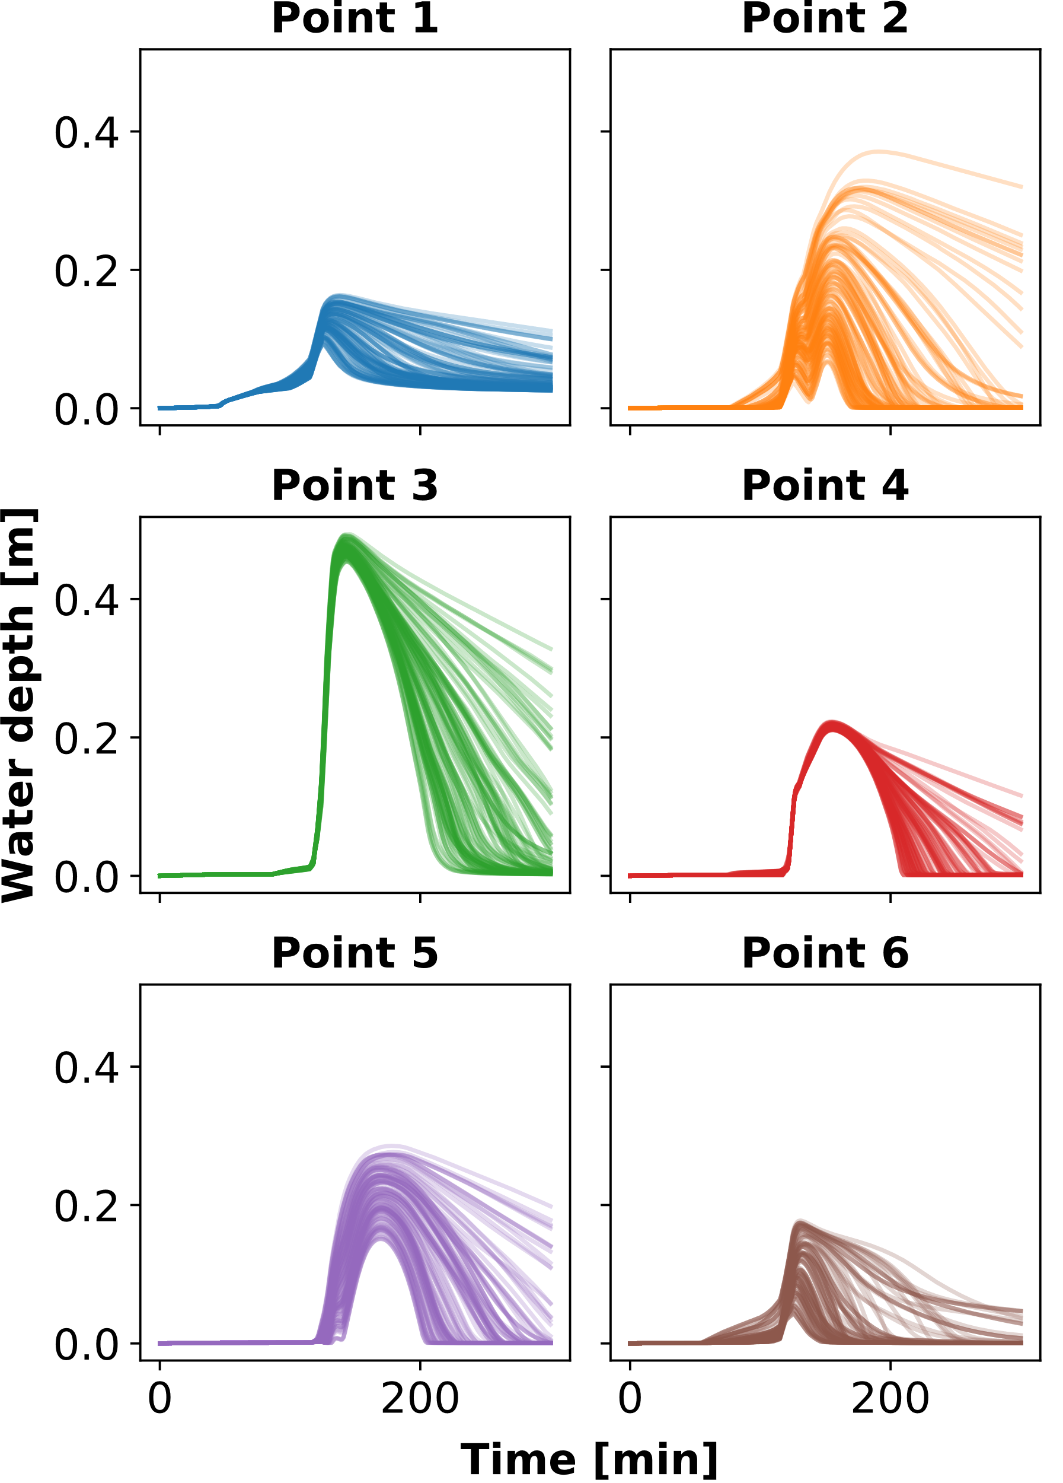
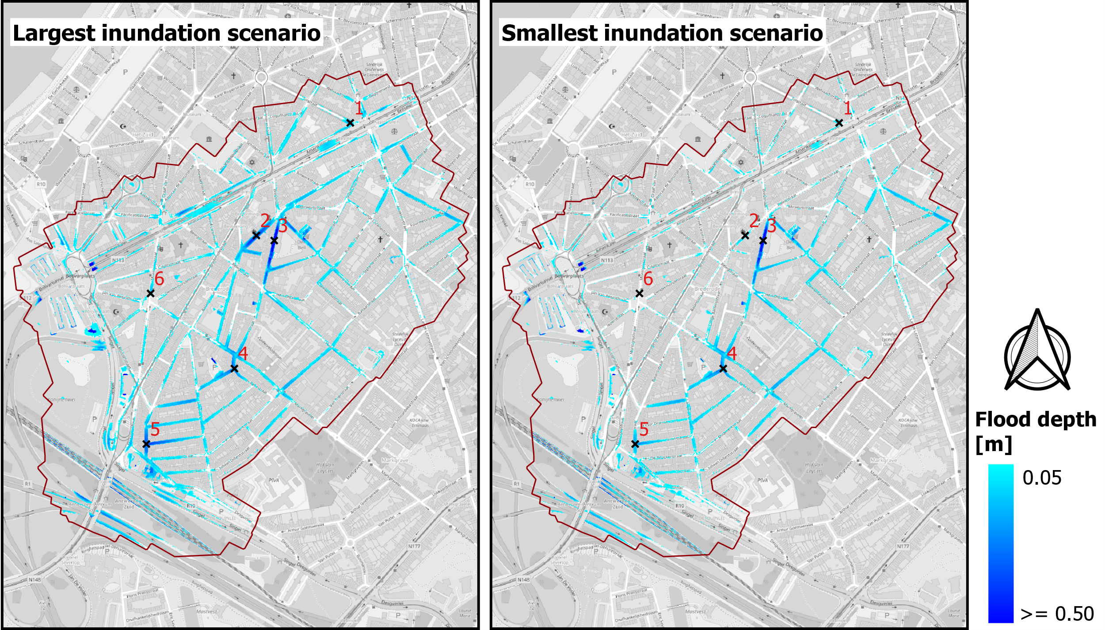
Flood depth – T0020 simulations

Slide 17
Computational resources
Windows 10 workstation: Intel Xeon @3.60 GHz, 32 GB RAM, NVIDIA Quadro P4000 GPU.
With GPU: runtimes between 6 to 9 MINUTES
CPU only: runtimes between 4.27 and 6.00 HOURS
Data processed: ≈ 1.4 TB

Slide 18
Conclusions
Prediction power of 1D-2D urban drainage models could greatly improve provided that detailed information on street inlets is available.
Calibration efforts should focus on parameters controlling drainage through street inlets – within parameters in the water exchange interface.
Parameters controlling reverse flow could be left with fixed default values.
Implementation of stochastic modelling approaches.
Notes:
Parameters controlling drainage through street inlets are highly sensitive.
Parameters controlling reverse flow have almost null sensitivity.

Slide 19
Questions?
Andrés González-Iñiguez
andresalfonso.gonzaleziniguez@kuleuven.be
a.gonzalez.iniguez@gmail.com

