Slide 1
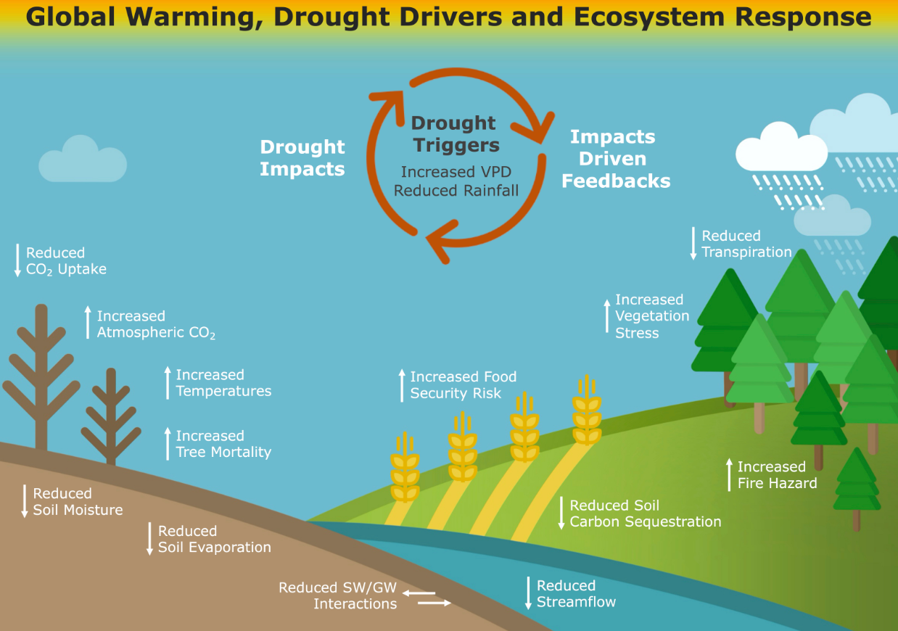
The role of multi-sensor remote sensing for drought characterization: challenges and opportunities
Integrating data from multi-sensor platforms could help us better study drought.
Remote sensing from multi-sensor platforms, facilitated by multivariate retrievals, may better reflect the extent and severity of drought conditions.
Multi-sensor platforms provide long-term observation records.
Multi-sensor platforms provide both high spatial and temporal resolution.
Multi-sensor platforms provide multiple lines of evidence and improve the robustness of analysis.
We provide a systematic review about the role of multi-sensor remote sensing for drought study from the perspective of datasets, phenomena, mechanism, modelling, challenges, and a road map for the future. The following are the major topics:
Satellite-based datasets for multi-sensor drought characterization.
Monitoring mechanisms of vegetation response to drought.
Monitoring land-atmospheric feedbacks mechanisms.
Exploring drought-induced tree mortality.
Investigating drought-related ecosystem fires.
Identifying post-drought recovery and drought legacy effects.
Capturing and monitoring flash droughts.
Drought trends under climate change.
Recent multi-sensor drought modelling.
Challenges and a road to the future.
Lixin Wang¹, Wenzhe Jiao¹, Matthew F. McCabe²
1. Indiana University – Purdue University Indianapolis
2. King Abdullah University of Science and Technology (KAUST)
Drought has complex impacts on the ecosystems
Jiao, W., Wang, L., & McCabe, M. F. (2021) Multi-sensor remote sensing for drought characterization: current status, opportunities and a roadmap for the future. Remote Sensing of Environment, 256, 112313.

