Slide 1

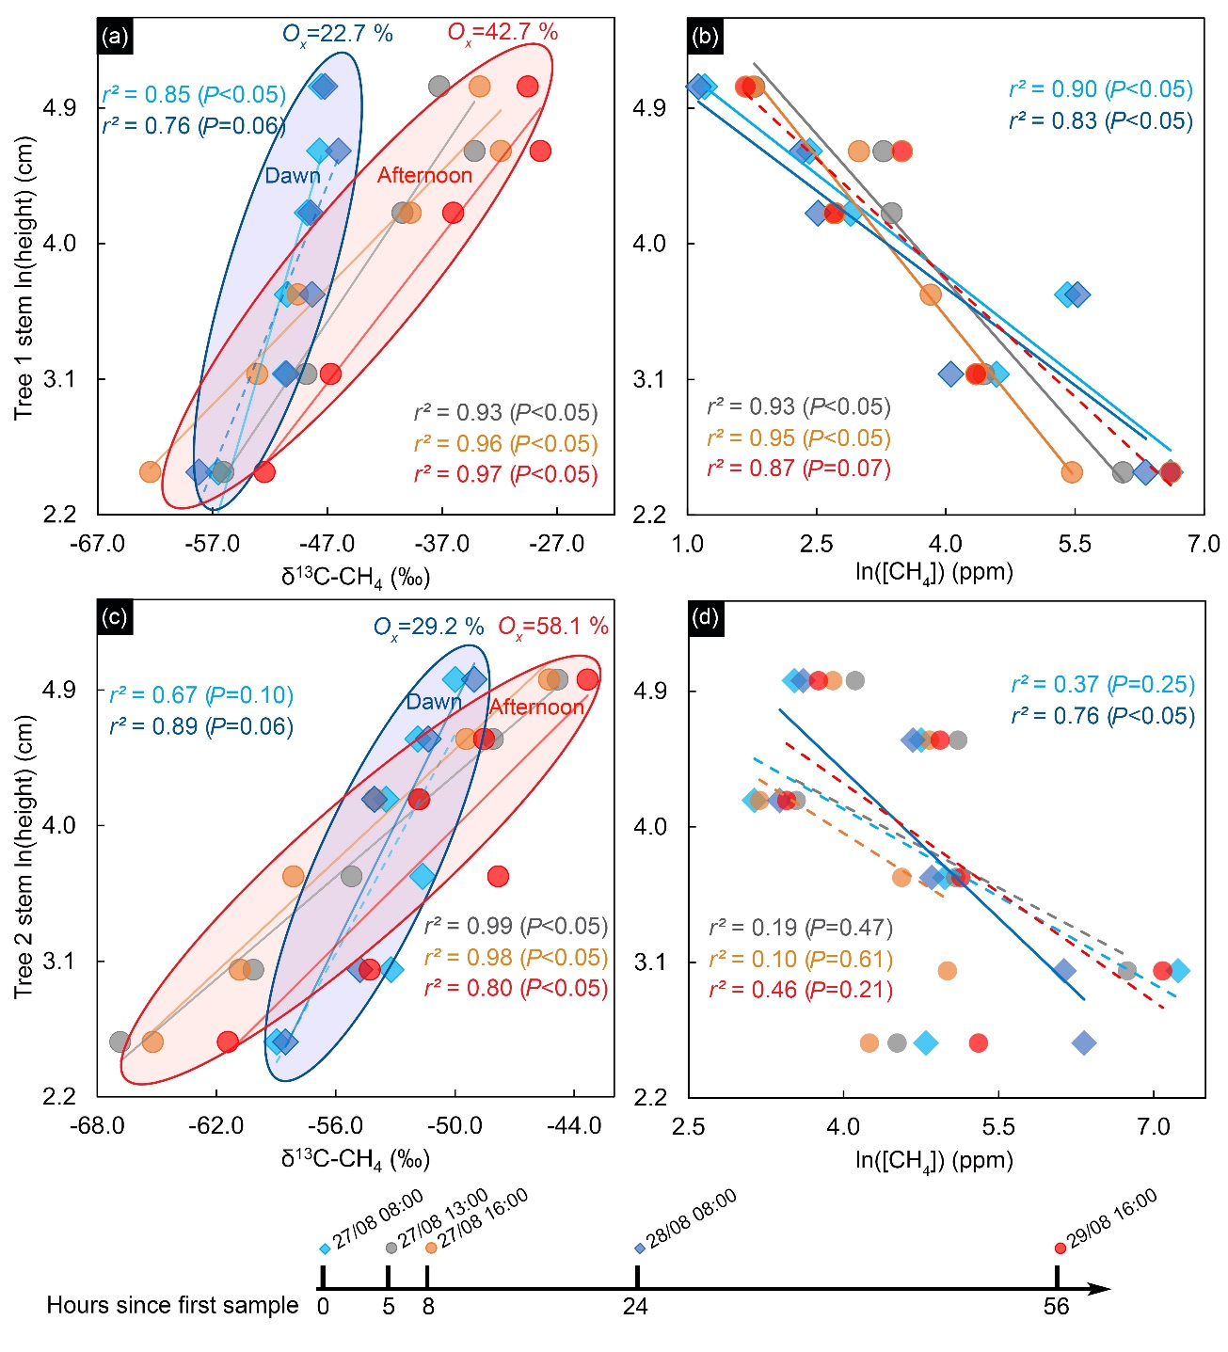
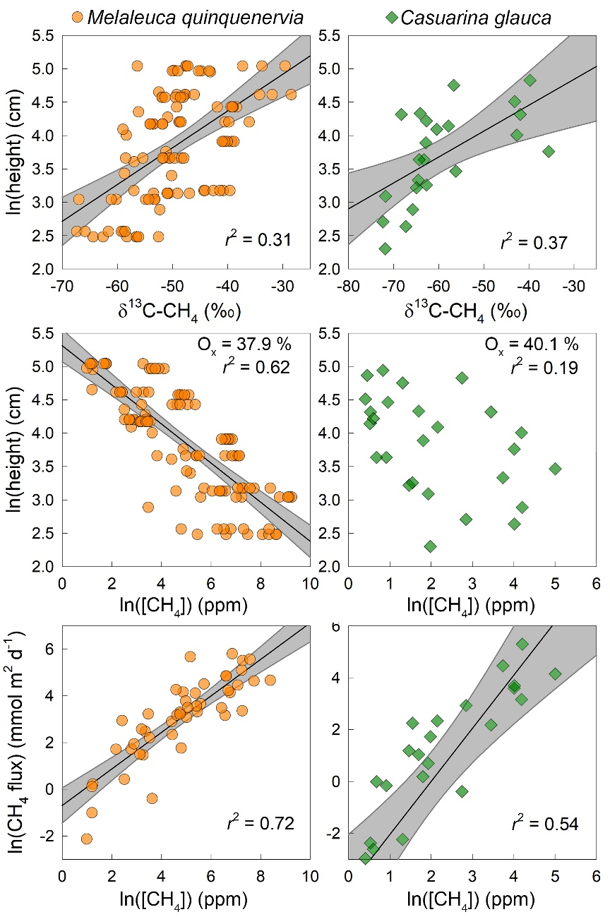
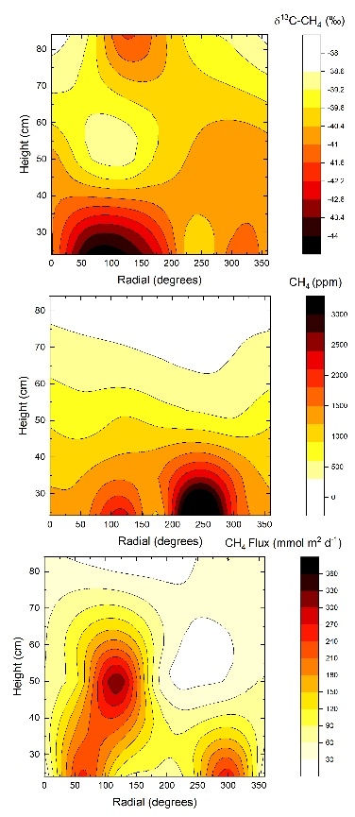
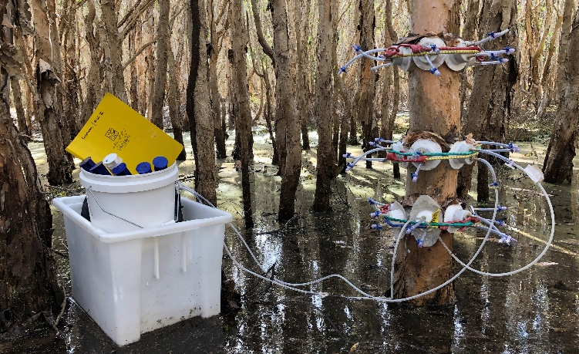
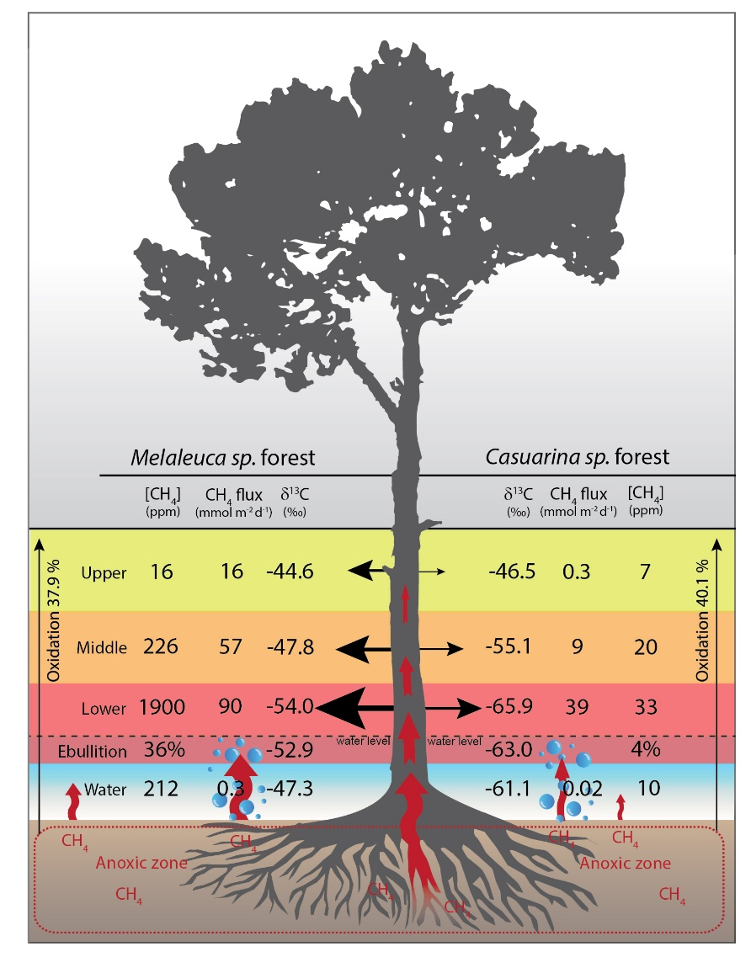
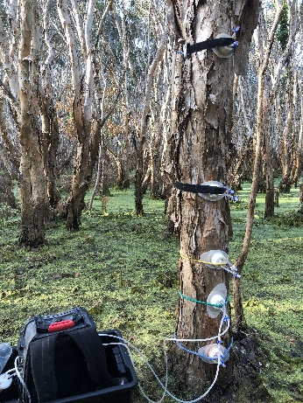
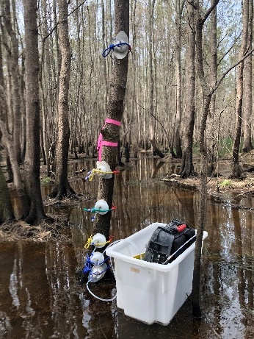

Isotopic evidence for axial tree stem methane oxidation within subtropical lowland forests⁵
Luke Jeffrey, D. Maher, D. Tait, M. Reading, E. Chiri, C. Greening & S. Johnston.
Background. Lowland trees can emit a substantial amount of methane (CH₄) from their stems¹⁻². Bark-dwelling methane oxidising bacteria (MOB) were recently shown to decrease the CH₄ emissions from trees³. We test the hypothesis that axial (vertical) CH₄ oxidation occurs within two lowland tree species and that the bulk of stem CH₄ emissions are of soil origins, evidenced using stable isotope analysis.
Results. (1) We found a clear decay in CH₄ flux, decay in stem [CH₄] (ppm) and enrichment of δ¹³CH₄ (‰) vs stem height in both tree species (Figs. 2,4).
(2) A substantial amount of CH₄ was oxidised during axial transport (33%).
(3) An axial time series revealed repeated afternoon oxidation rates were double that of dawn sampling (Fig. 4).
(4) The lower stem δ¹³CH₄ signatures overlapped the soil values suggesting soil CH₄ as primary stem source (Fig. 3).
(5) Novel XYZ sampling and 3D scanning (virtual 3D scan - click here) revealed heterogeneity in stem CH₄ flux, [CH₄] and δ¹³CH₄ (‰) was related to bark anomalies (Fig. 5)
Methods. Multiple SNIFF chambers⁴ were equilibrated on tree stems at various heights. 60mL of stem chamber gas and soil ebullition gas were analysed for CH₄ (ppm) and δ¹³CH₄ (‰) using a CRDS (Picarro, G2201-i). CH₄ fluxes were measured using a portable CRDS (Picarro, G4301).
Figure 4. A 56h timeseries of axial δ¹³CH₄ (‰) on two Melaleuca trees showing hysteresis trends between AM and PM sampling.
Figure 5. Novel XYZ plots (n=18 locations) revealing stem CH₄
heterogeneity corresponded with stem and bark anomalies
Figure 2. Correlation Summary of top) stem δ¹³CH₄ (‰) enrichment vs height; mid) [CH₄] depletion vs height; and low) CH₄ flux vs [CH₄] using all data from Melaleuca and Casuarina trees. O_{x} = average CH₄ oxidised between lower and upper stem.
Conclusions. Oxidation during axial transport within trees may amount to a substantial CH₄ sink (~33%) thus represents an exciting research frontier... Soil CH₄ signature matches lower stem CH₄. Future work will explore and quantify MOB oxidation processes, pathways and communities within other CH₄ emitting forest types globally.
Figure 1. Photos of lowland Melaleuca (left) & Casuarina (right) sampled using multiple SNIFF chambers⁴ at various heights in our study.
Figure 3. Summary of the ecosystem CH₄ parameters from the two subtropical lowland forest types
References (1)Pangala, S. et al. Large emissions from floodplain trees close the Amazon methane budget. Nature 552, 230 (2017). (2)Barba, J. et al. Methane emissions from tree stems: a new frontier in the global carbon cycle. New Phytologist 222, 18-28 (2019). (3)Jeffrey, L. et al. (2021). Bark-dwelling methanotrophic bacteria decrease methane emission from trees. Nature Communications. doi.org/10. 1038/s41467-021-22333-7 (2021). (4)Jeffrey, L. et al. A Small Nimble In Situ Fine-Scale Flux Method for Measuring Tree Stem Greenhouse Gas Emissions and Processes (S.N.I.F.F). Ecosystems 23, 1676-1689 (2020). (5)Jeffrey, L. et al. Isotopic evidence for axial tree stem methane oxidation within subtropical lowland forests. New Phytologist. https://doi.org/10.1111/nph.17343 (2021).
@Luke_Jeffrey

