Slide 1
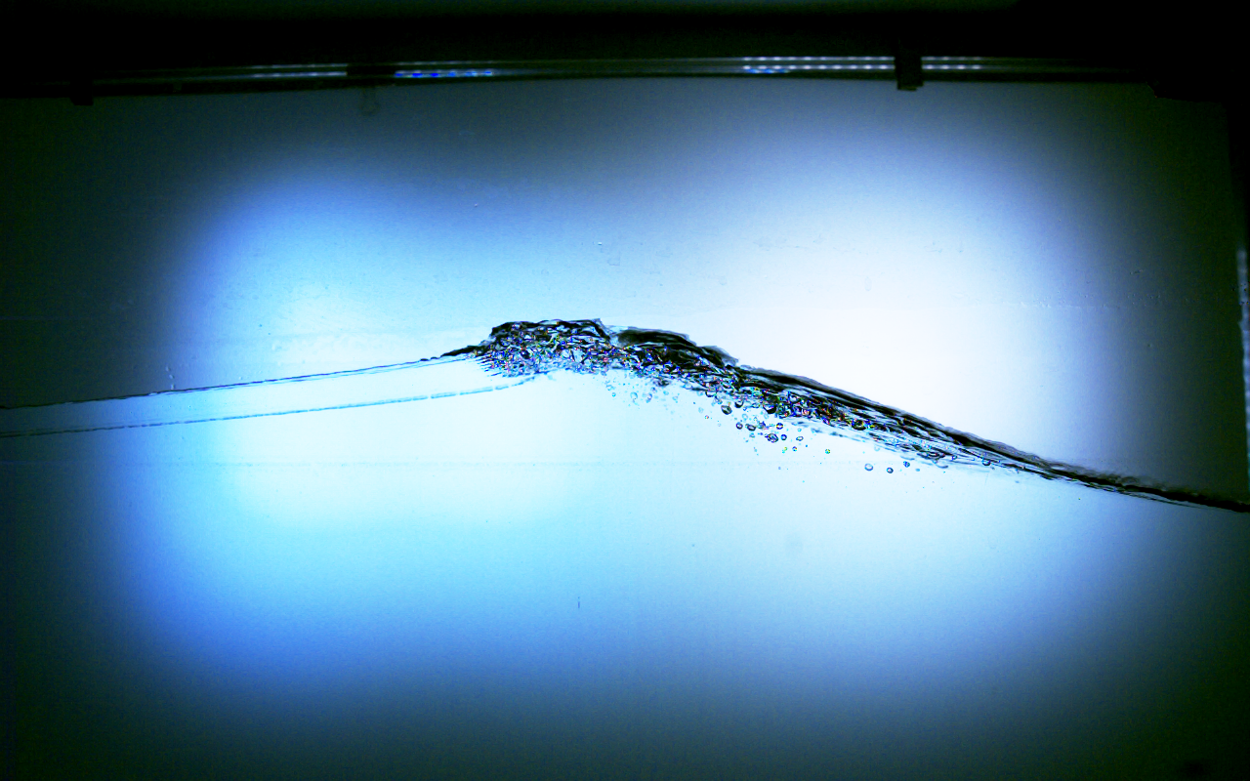


Evolution of
Bubble Statistics
due to Phase Shifted
Breaking Waves
Konstantinos Chasapis^{1,2} , Helen Czerski¹, Eugeny Buldakov²
¹ Department of Mechanical Engineering, University College London
² Department of Civil Engineering, University College London

Slide 2
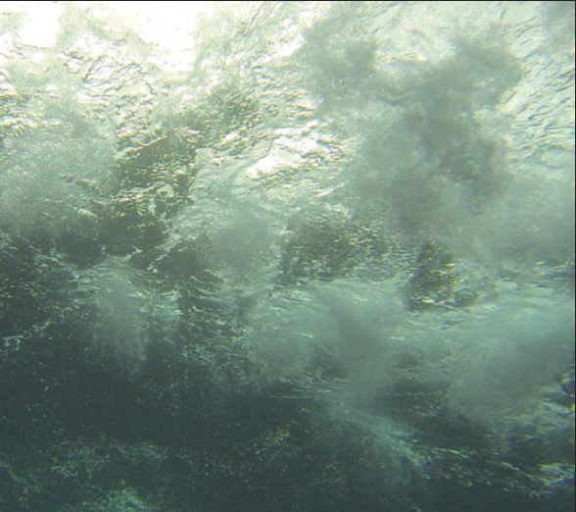
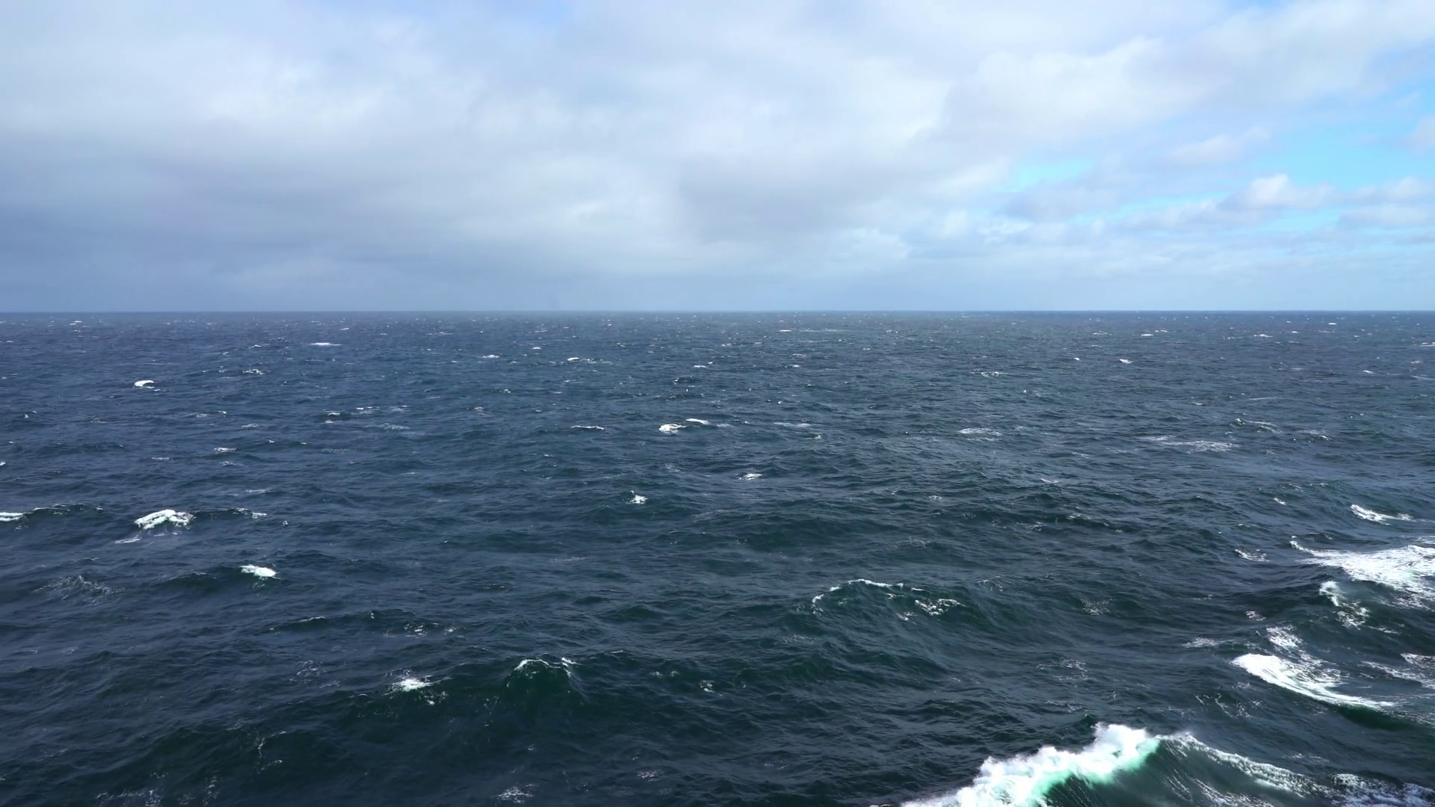
From a storm to a single breaker that traps air and generates bubbles.
Bubble cloud
Single breaker
Open sea with spilling breakers
u
Vol
Helen Czerski 2017 Phys. World 30 (11) 34
Size distribution, N(r)?
Volume per radius, V(r)?
Evolution of V(r)?
Spatial transport of V(r)?

Slide 3
What is missing?
Detailed measurements of bubble clouds of short lived larger bubbles (r>0.1mm)
relating to properties and classes of spilling breaking waves.
What is our hypothesis?
Bubble cloud spatiotemporal behaviour relates to the local features
of a spiller (storm breaking wave).
How do our experiments test it?
By generating focused breaking waves with identical spectral properties
and measuring local wave parameters and bubble sizes/volumes in space and time.

Slide 4
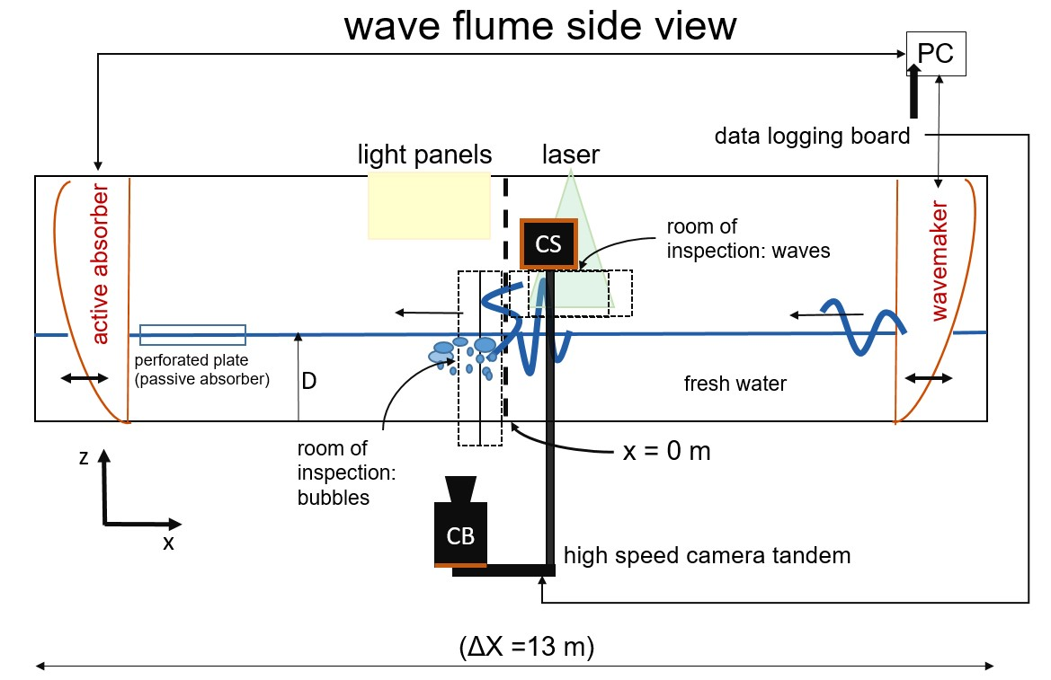
Experimental Set Up
CS: Camera Side
CB: Camera Bottom

Slide 5
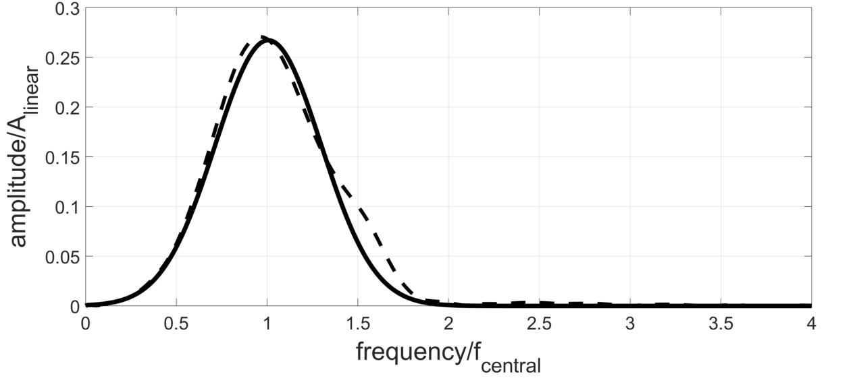
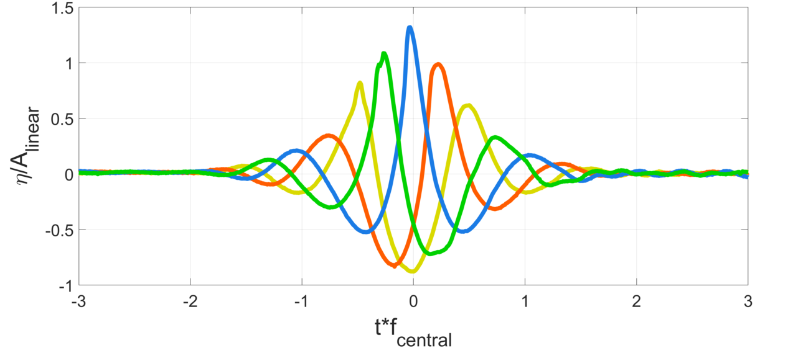
Breaking wave generation
--- linearized spectrum
target spectrum: Gaussian
f_{central} =1 Hz
Dispersive focusing of wave groups.
Linearized spectra match target spectrum.
All wave groups have same spectrum
Breaking is generated by increasing
steepness
Four types of waves are generated
by adding constant phase shifts to the
components of this spectrum. All four break.
The phase shifts:
0 (peak focused)
π/2 (positive slope focused)
π (trough focused)
3π/2 (negative slope focused)
3π/2
π/2
π
0 (peak)

Slide 6
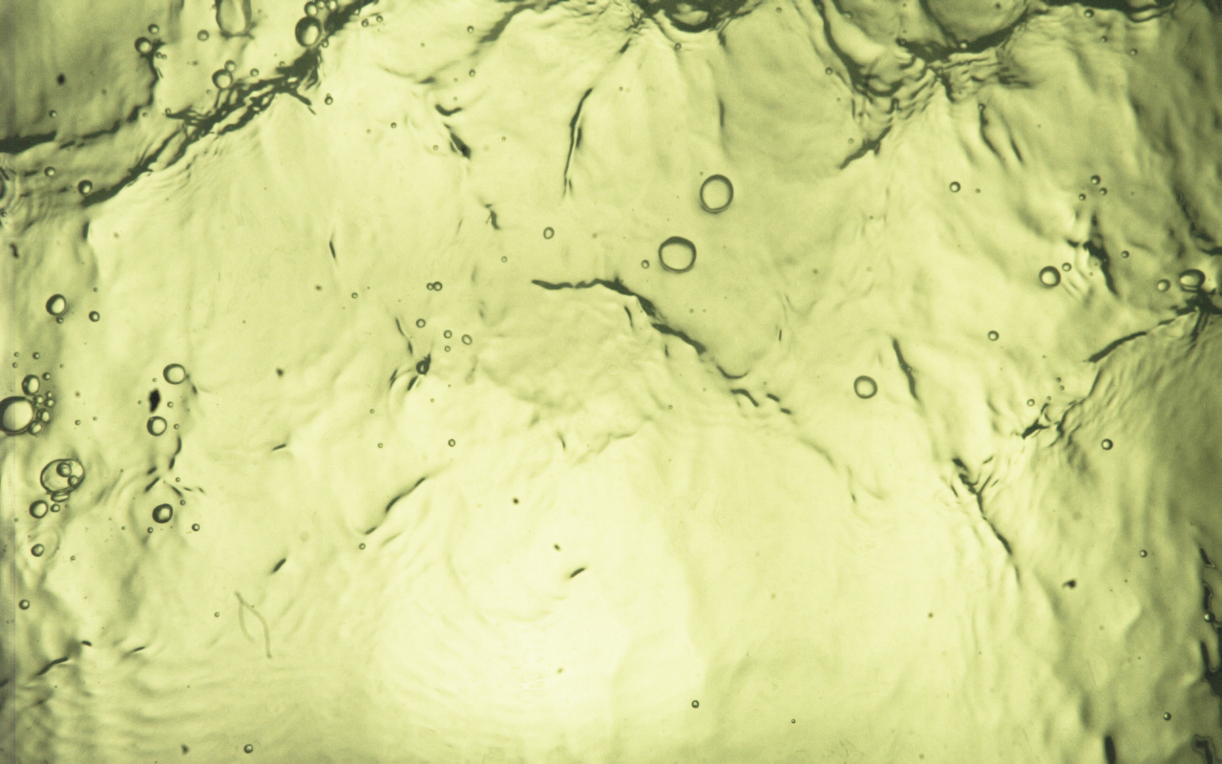
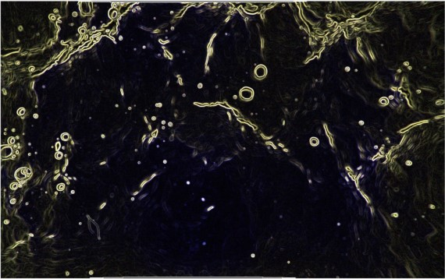
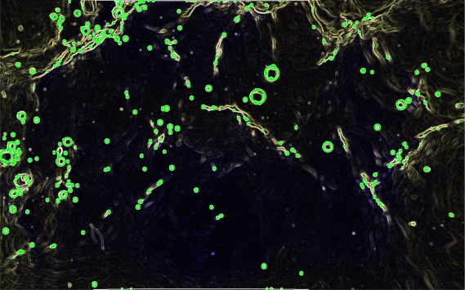
Material and method: crest and bubble detection
Two synced high speed cameras record
wave crests (side of flume) and bubbles (bottom of flume).
Examples: bubble detection
1. Input (image)
1
2. Calibration
Core steps of
wave and bubble
extraction
programs
3. Image pre processing
3
4. Feature extraction algorithm
wave
propagation
5. Output (radii, coordinates)
4-5

Slide 7
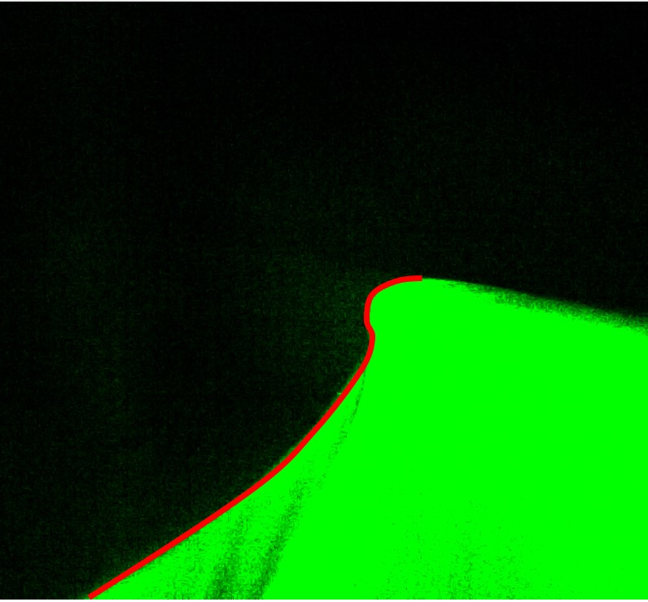
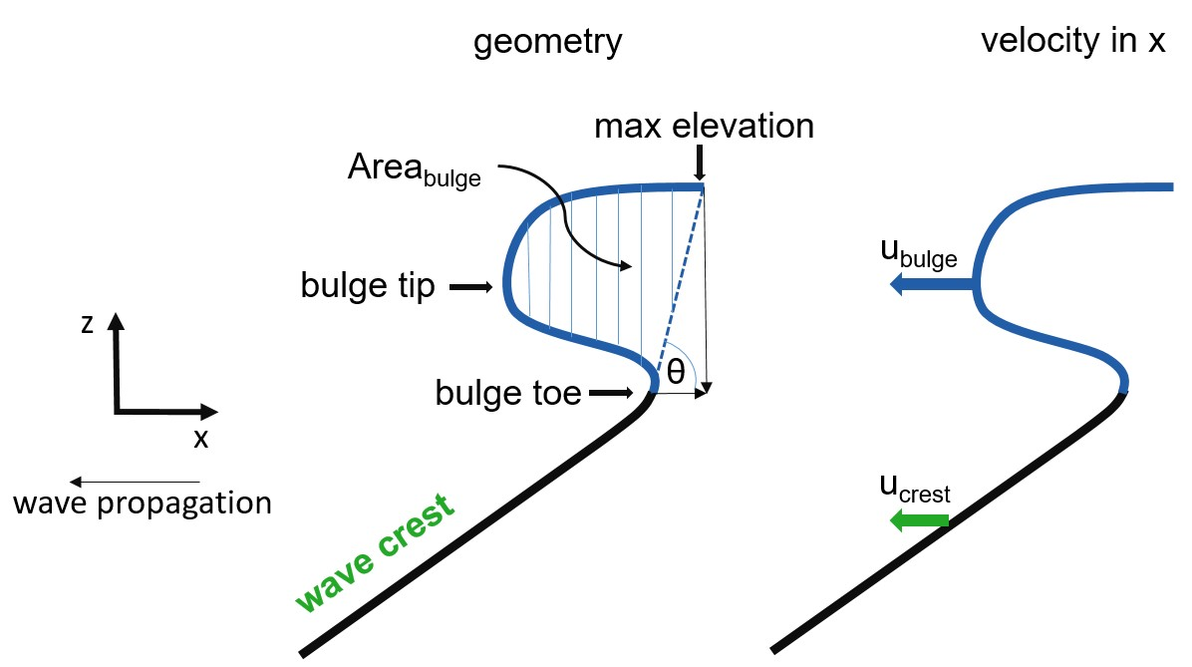
Method: extracted wave profile analysis
z
x
10 mm
conceptual image (not scaled) showing crest nomenclature
actual wave image with extracted profile (red)

Slide 8
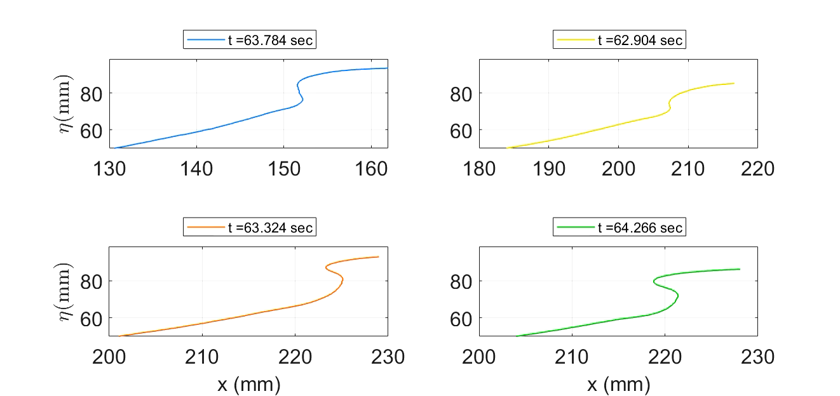
Results: extracted wave bulges
video shows evolution of bulges in a frame of reference moving with crest speed
peak
π
rolling on crest bulge:
spilling breaker
Bulge has a small
(or larger) tip:
micro plunging breaker
or
non-traditional spiller
π/2
3π/2
Play video here:

Slide 9
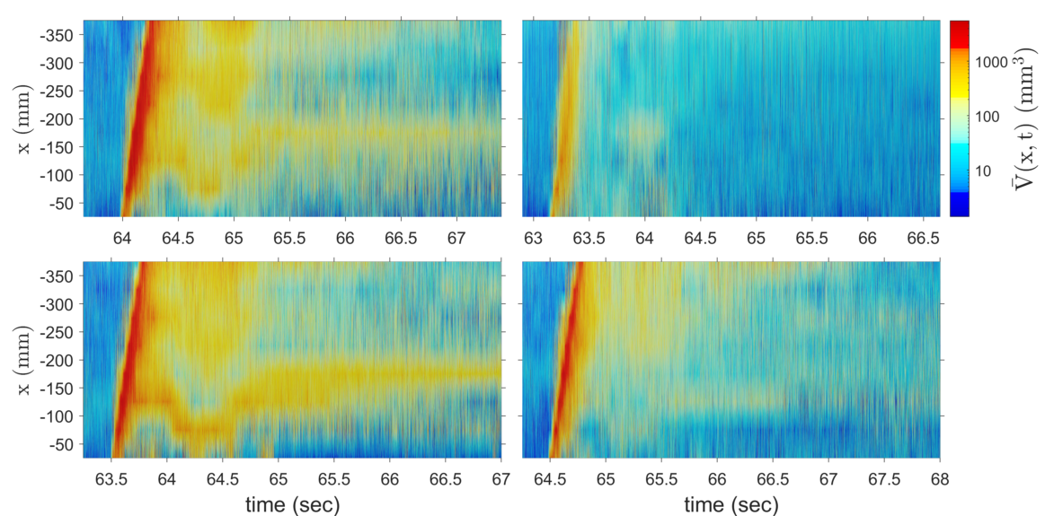
Results: evolution of total volume of bubbles $\overline{V}$(x,t)
bubble transport by breaking wave
almost no bubbles left
peak
π
π/2
3π/2
wave propagation

Slide 10
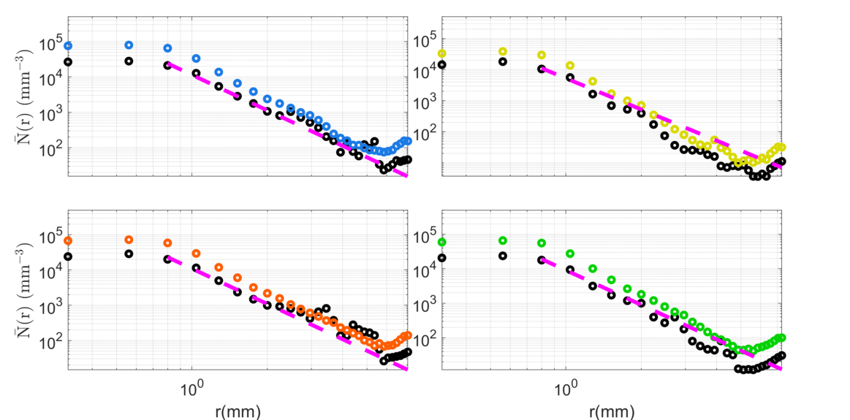
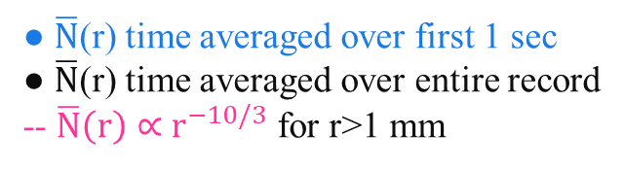
Results: ensemble averaged bubble size distributions
x = [-150:-200] mm
● $\overline{N}$(r) time averaged over first 1 sec
● $\overline{N}$(r) time averaged over entire record
-- $\overline{N}\left(r\right)∝{ r}^{−10/3}$ for r>1 mm
In trough (π) case, less bubbles are
generated in total and per all radii.
Larger bubbles (r>4mm) are practically
non existent. Size distribution is steeper
than model slope (in purple).
Secondary maximum at r=7 mm
in all cases indicates two bubble
generation mechanisms.
peak
π
π/2
3π/2
r = 1mm is the so called Hinze scale:
bubbles with r>1 mm fragment into smaller bubbles
bubbles with r<1 mm are stabilized by surface tension forces

Slide 11
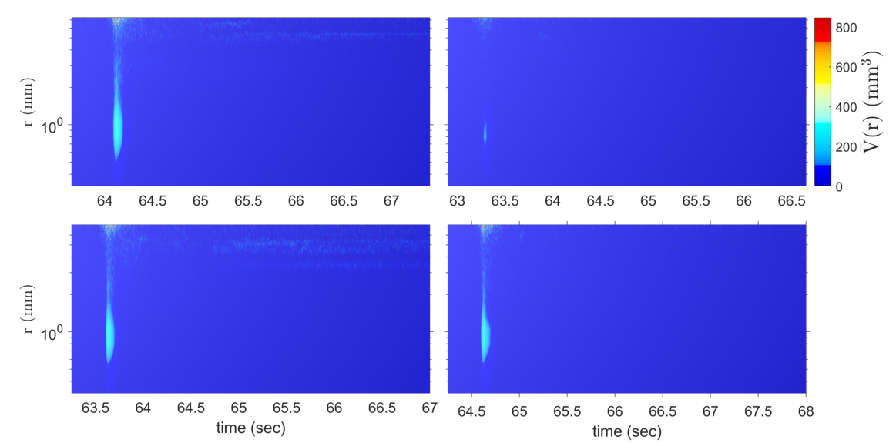
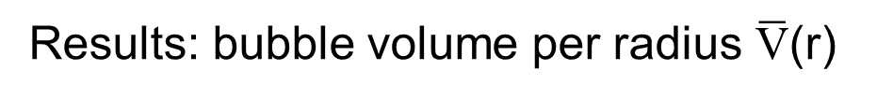
Results: bubble volume per radius $\overline{\text{V}}$(r)
x = [-150:-200] mm
r>4 mm bubbles
do not split in
smaller bubbles.
Hinze scaling indicates
that on bubble surface
pressure greater than
surface tension should
lead to bubble splitting.
But here another
process might be
responsible
for bubble rise-up
to the surface.
peak
π
two maxima:
r = 1 mm
r > 4 mm
π/2
3π/2

Slide 12
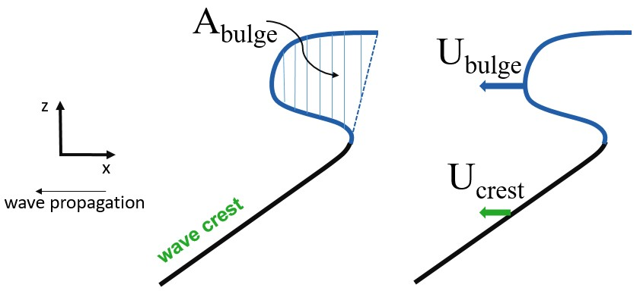
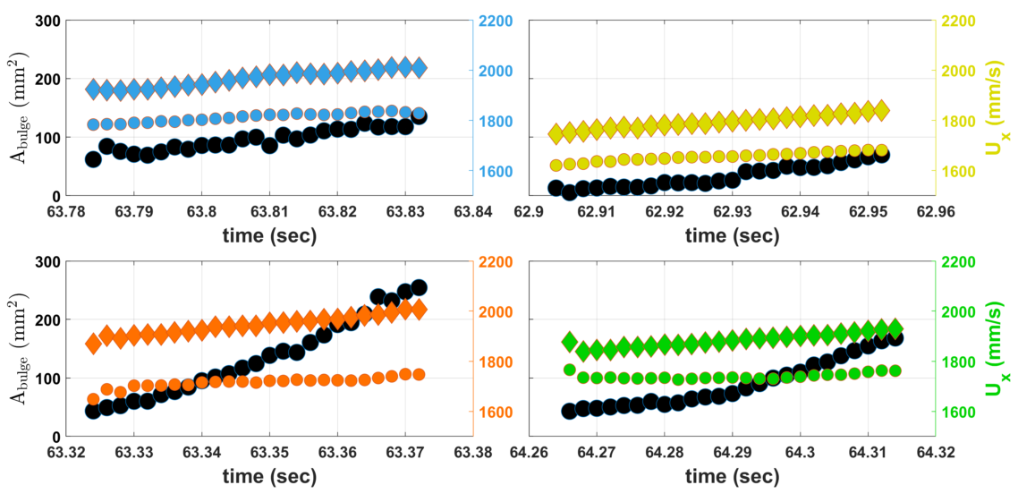
Results: bulge area and velocity of bulge/crest
♦ U_{bulge} ● U_{crest} ● A_{bulge}
peak
π
Area of bulge in trough case
is almost half compared to the
peak case at all times.
Velocities of trough bulge and
crest are also clearly smaller
than rest of cases.
However ratio of U_{bulge}/U_{crest}
reaches a constant value after
some time in all cases.
π/2
3π/2

Slide 13
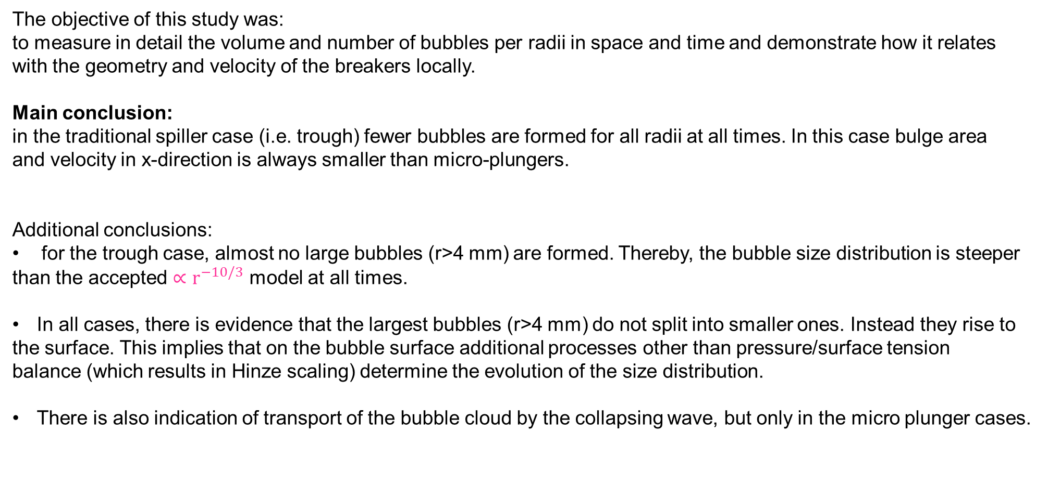
Conclusions
The objective of this study was:
to measure in detail the volume and number of bubbles per radii in space and time and demonstrate how it relates
with the geometry and velocity of the breakers locally.
Main conclusion:
in the traditional spiller case (i.e. trough) fewer bubbles are formed for all radii at all times. In this case bulge area
and velocity in x-direction is always smaller than micro-plungers.
Additional conclusions:
for the trough case, almost no large bubbles (r>4 mm) are formed. Thereby, the bubble size distribution is steeper
than the accepted ${∝r}^{−10/3}$ model at all times.
In all cases, there is evidence that the largest bubbles (r>4 mm) do not split into smaller ones. Instead they rise to
the surface. This implies that on the bubble surface additional processes other than pressure/surface tension
balance (which results in Hinze scaling) determine the evolution of the size distribution.
There is also indication of transport of the bubble cloud by the collapsing wave, but only in the micro plunger cases.

Slide 14
Future work
Additional experiments should be done with different wave spectra. This will monitor the effect of global wave
properties on bubbles.
Salt water experiments are very important. It is expected that wave crests will have different deformation
and bubble distributions will vary when salt is added in the water.
That being said, surface tension should be monitored and controlled.
Categories of breakers with bubble size/volume distributions should be feasible to make after that.
Finally, a more complete framework of the bulge characteristics should be developed. Measurements of fluid
velocity at the tip of the bulge will give a more complete picture of the limiting values of kinematic conditions at
breaking for specific wave spectra and phases.
So far we have observed that U_{bulge}/U_{crest} reaches a constant value after a while for all waves.
This limiting stage needs to be quantified and investigated for more time records.

Slide 15
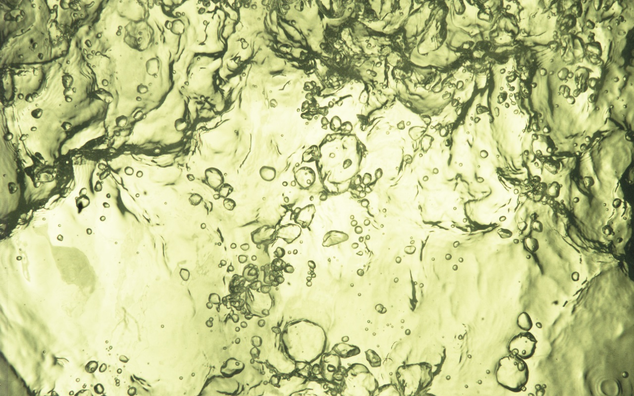
Thank you!

