Slide 1

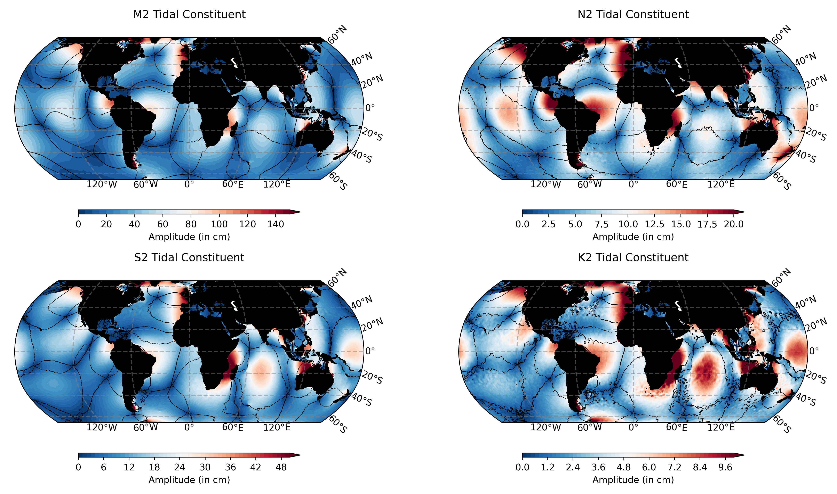
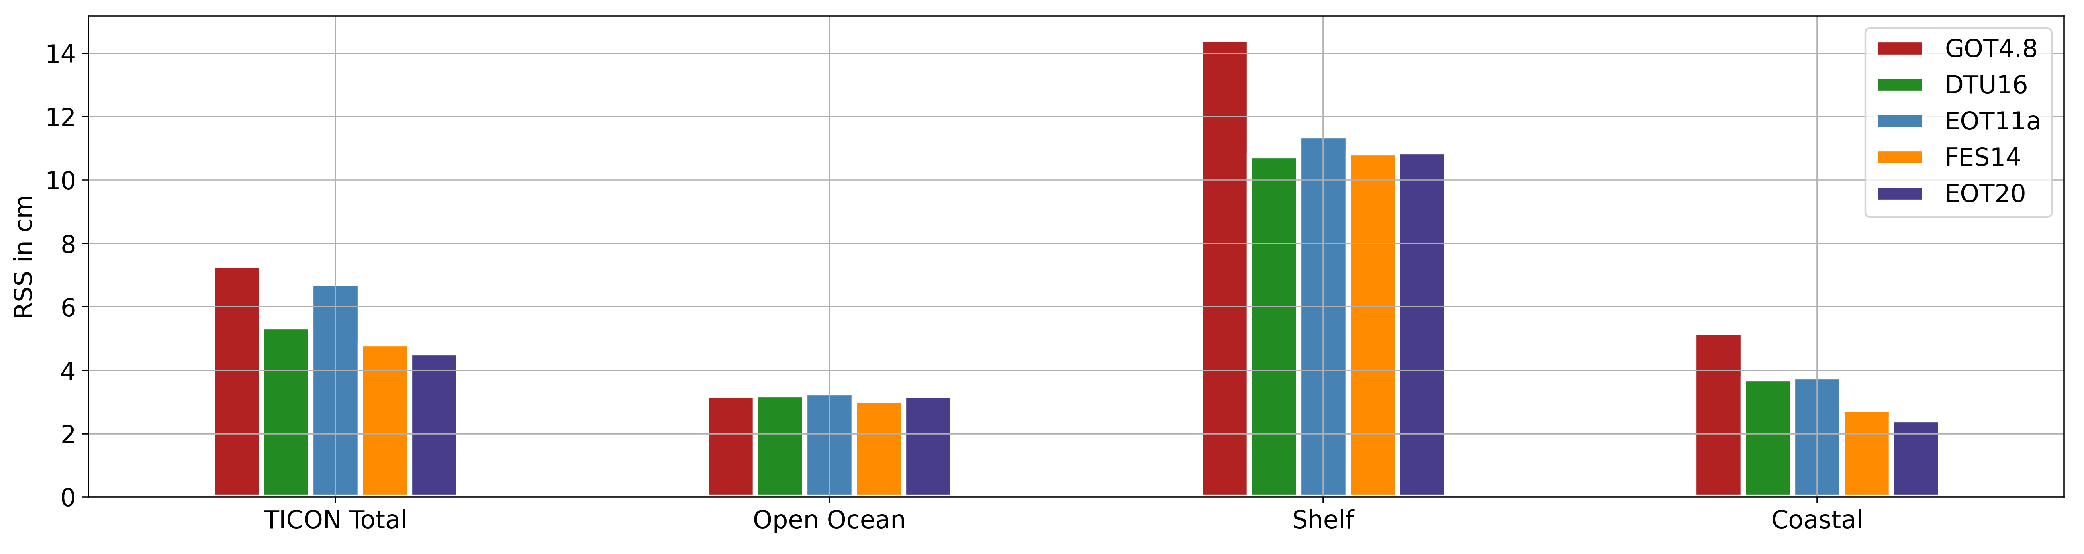
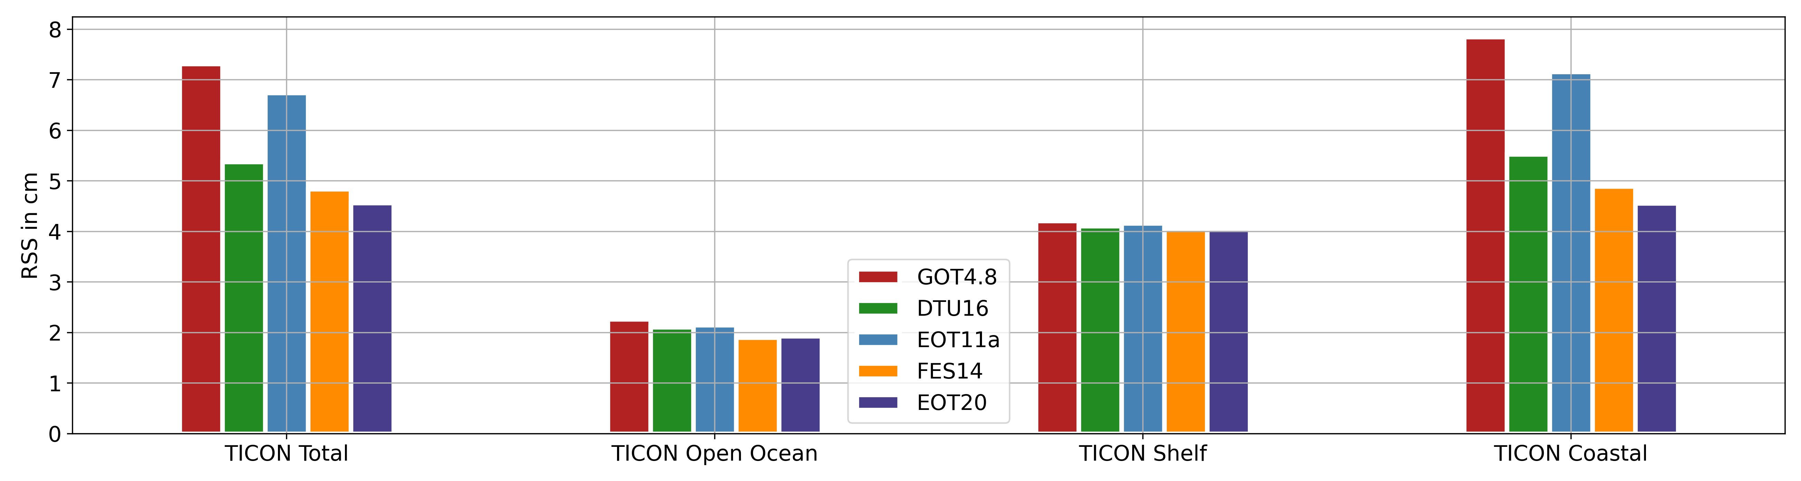
EOT20: A new global empirical ocean tide model derived from multi-mission satellite altimetry
M. Hart-Davis, D. Dettmering, G. Piccioni, C. Schwatke, M. Passaro, F. Seitz
Deutsches Geodätisches Forschungsinstitut, Technical University of Munich (DGFI-TUM), Munich, Germany
Summary
The development and validation of the latest in a series of global empirical ocean tide models developed at DGFI-TUM, EOT20.
EOT20 benefits from the recent developments in coastal altimetry, particularly the ALES retracker.
Key Findings
Compared to tide gauges, EOT20 demonstrates large improvements in the estimation of tides in the coastal region.
The sea-level variance is reduced when using the EOT20 as a tidal correction for satellite altimetry compared to the EOT11a and FES2014b ocean models.
Fig. 1. The amplitude and phase (contour lines in 60 degree increments) of the M2 tidal constituent
Fig. 2. The Root Square Sum (RSS) for the eight major tidal constituents from the five tide models in the different regions.

Slide 2




EOT20: A new global empirical ocean tide model derived from multi-mission satellite altimetry
Click to Listen
M. Hart-Davis*, D. Dettmering, G. Piccioni, C. Schwatke, M. Passaro, F. Seitz
Deutsches Geodätisches Forschungsinstitut, Technical University of Munich (DGFI-TUM), Munich, Germany
Contact – michael.hart-davis@tum.de
Session: Tides in the past, present and future. OS4.1
@hartdavismhd
29.04.2021

Slide 3

Introduction
Click to Listen
EOT20 is the latest in a series of empirical ocean tide (EOT) models derived using residual tidal analysis of multi-mission satellite altimetry at DGFI-TUM.
The aim of the EOT20 model is to provide a coastal improved estimation of tidal constituents without harming the open ocean performance
EOT20 takes advantage of the inclusion of more recent satellite altimetry data as well as more missions, the use of the updated FES2014 tidal model as a reference to estimated residual signals, the inclusion of the ALES retracker and improved coastline representation.
The model description is currently in review at: https://doi.org/10.5194/essd-2021-97 and the data is available at: https://doi.org/10.17882/79489.

Slide 4

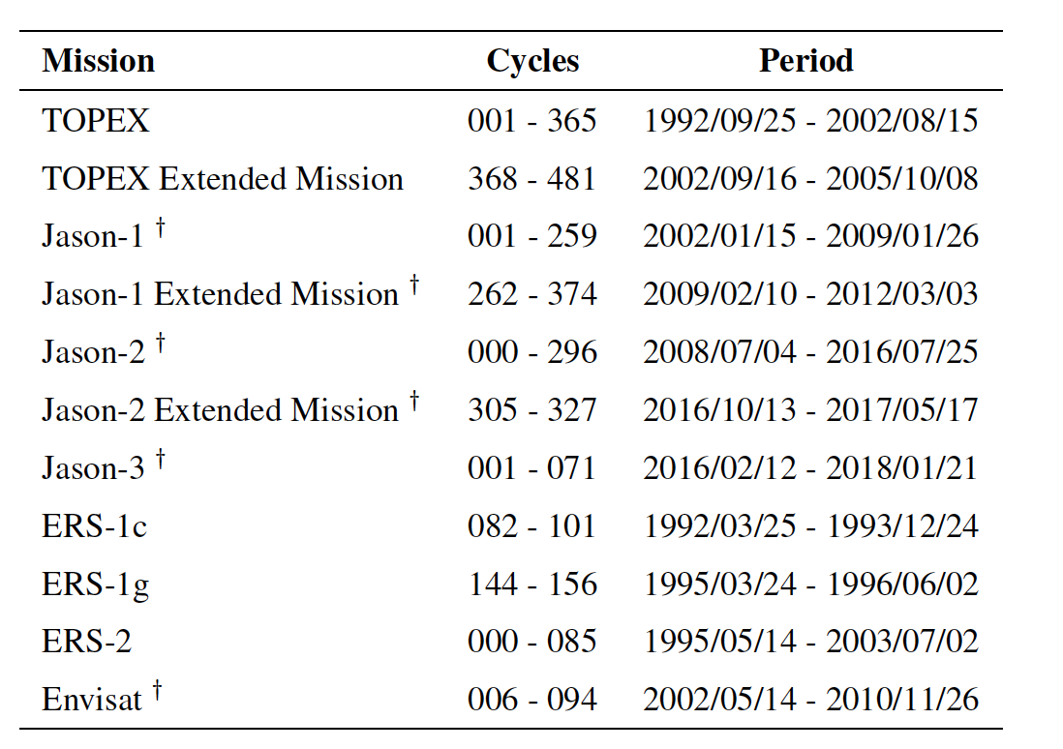
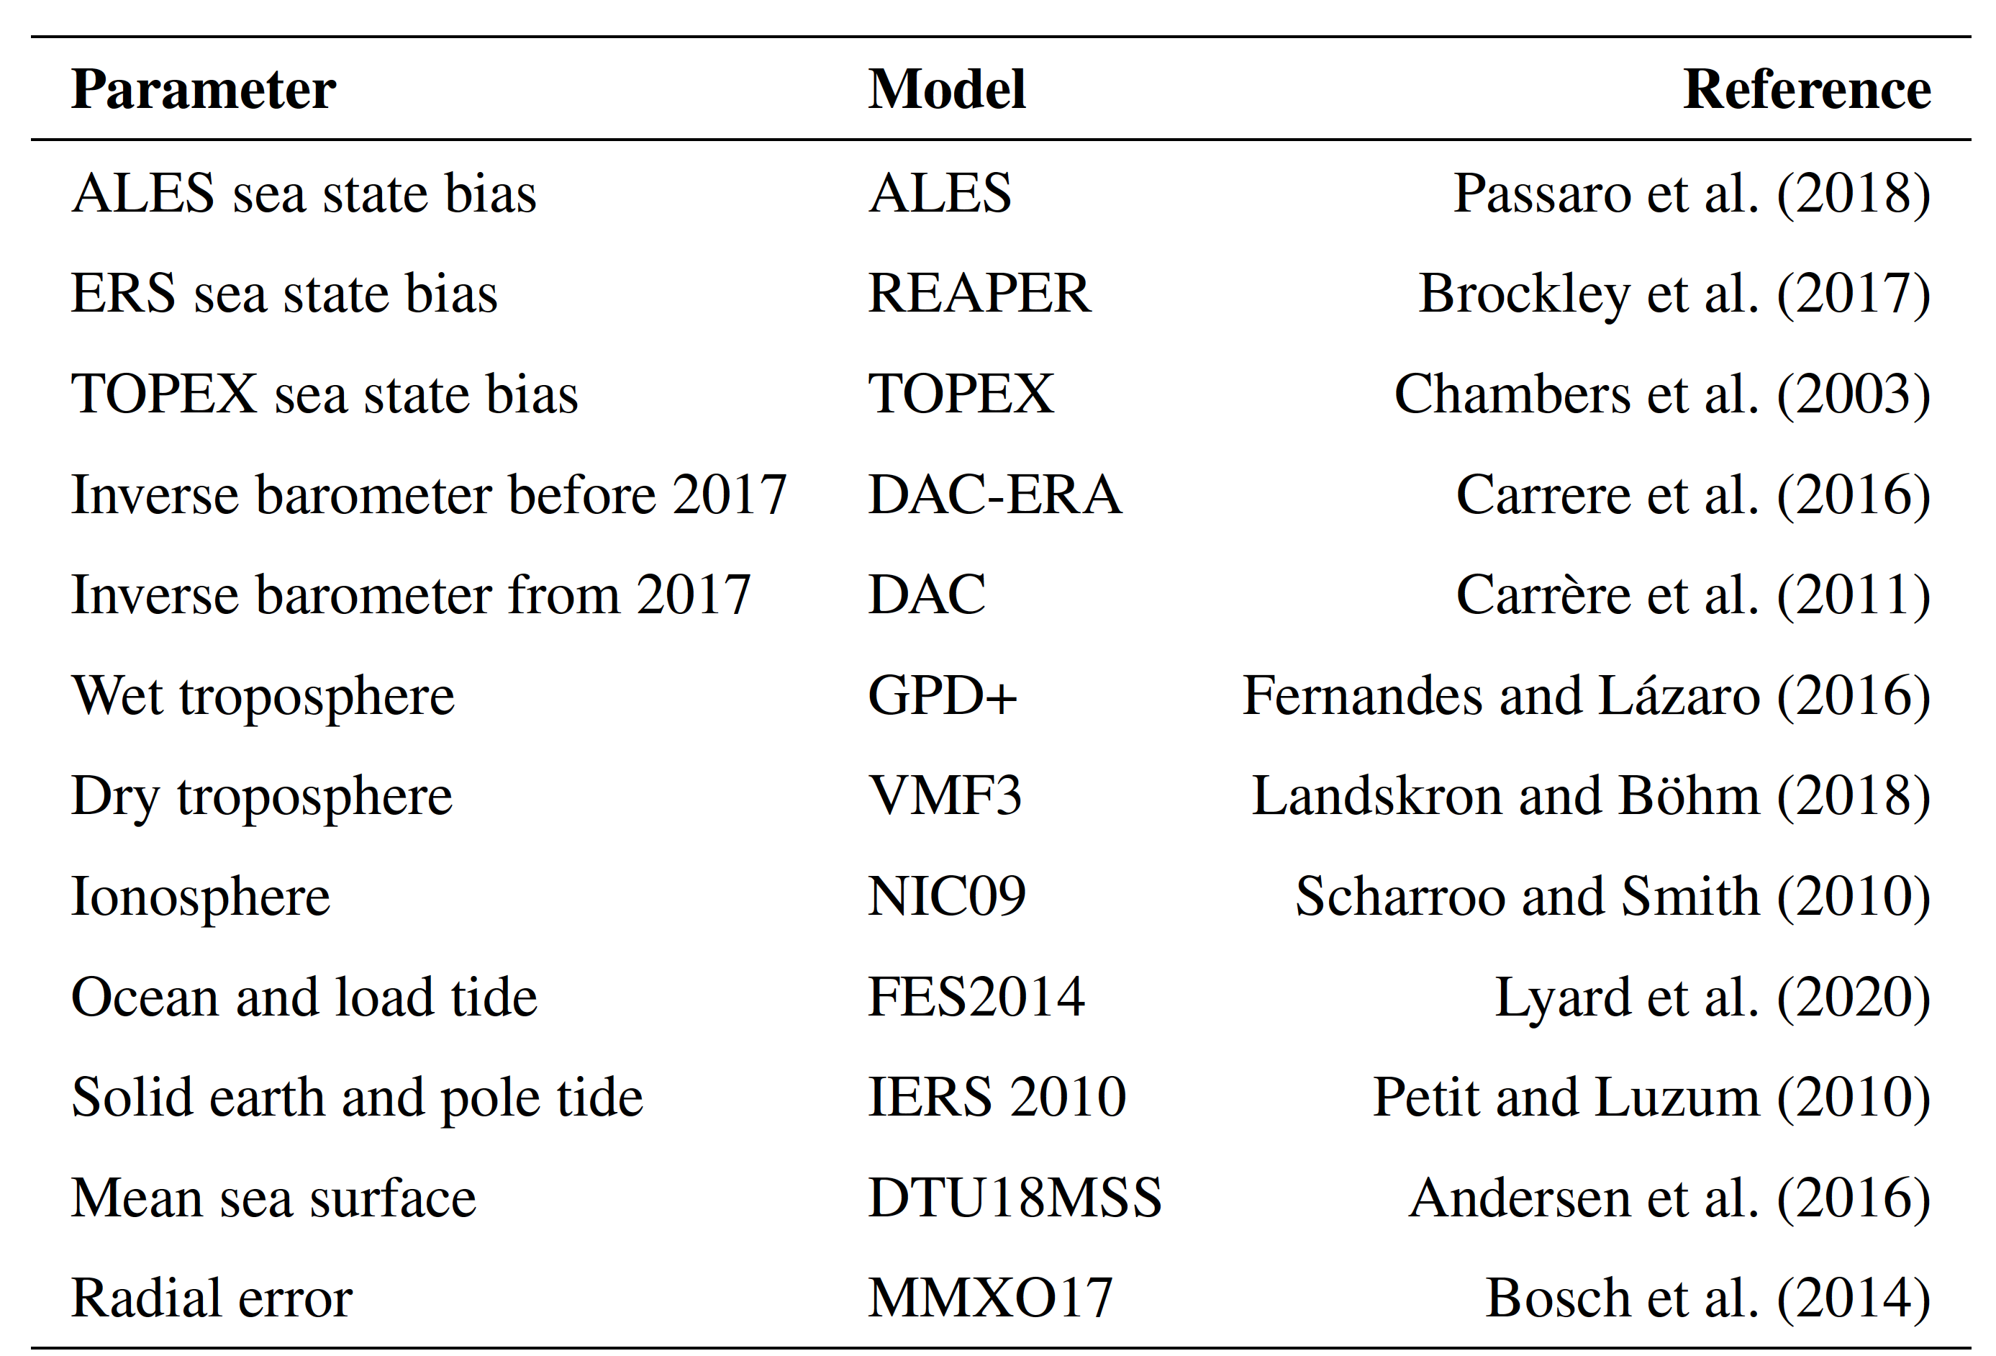
Satellite Altimetry – Sea Level Estimation
Click to Listen
Table 1. The satellite altimeter data used in this study obtained from OpenADB at DGFI-TUM (Schwatke et al., 2014).
Table 2 . List of corrections and parameters used to compute SLA for tidal residuals estimation.

Slide 5

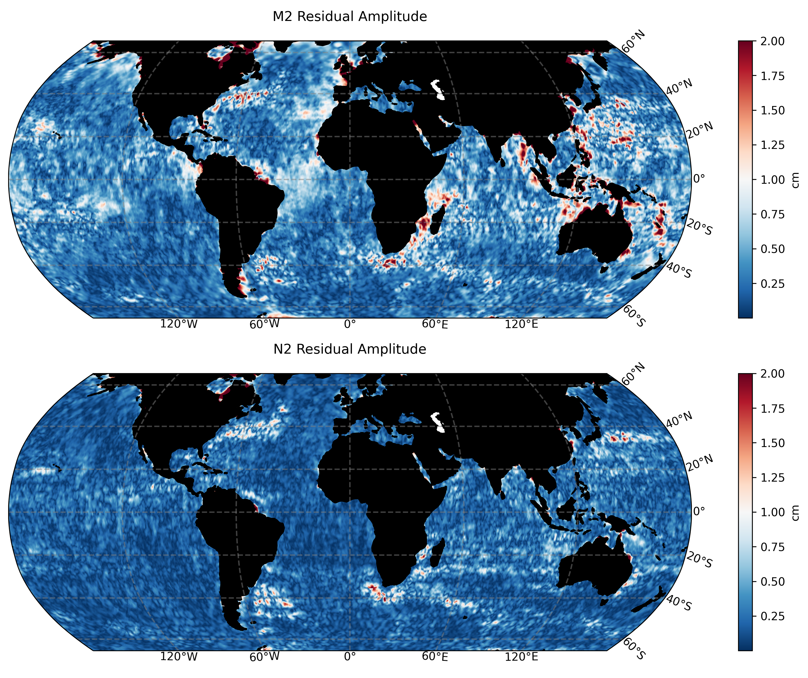
Residual Tide Analysis
Click to Listen
Weighted least-squares approach applied to solve the harmonic formula.
Variance Component Estimation to combine and weight satellite altimetry missions
Eventually results in amplitudes and phases of 17 tidal constituents, namely:
  2N2, J1, K1, K2, M2, M4, MF, MM, N2, O1, P1, Q1, S1, S2, SA, SSA and T2
Residuals are the elastic tide which is:
  Elastic = ocean + load tide
Figure. The residual amplitude of the M2 and N2 tidal constituents.

Slide 6

The Inclusion of a Coastal Flag (for ALES)
Click to Listen
Implementation of a coastal flag to allow for the full exploitation of ALES (Passaro et al 2014) sea level data.
Also relies on data that do not contain the ALES sea level data (e.g. TOPEX) for proper tidal estimation.
Has a positive on the estimation of tidal constituents in the coastal region.
7 km
3 km
TOPEX
TOPEX EM
ERS-1c
ERS-1g
ERS-2
Jason-1
Jason-1 EM
Jason-2
Jason-2 EM
Jason-3
Envisat

Slide 7
The Global EOT20 Model
Click to Listen
Figure. The amplitude and phase (contour lines in 60 degree increments) of the
M2, N2, S2 and K2 tidal constituents

Slide 8

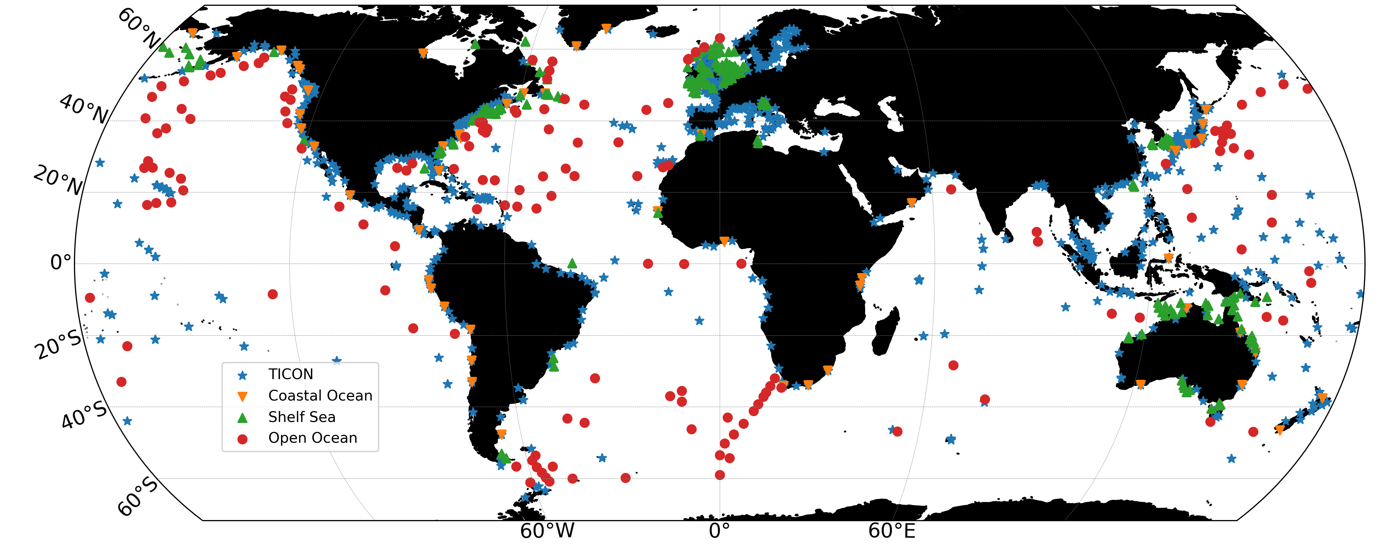
Global Tide Gauge Analysis
Click to Listen
Figure. The tide gauge distribution used in the validation of the models

Slide 9

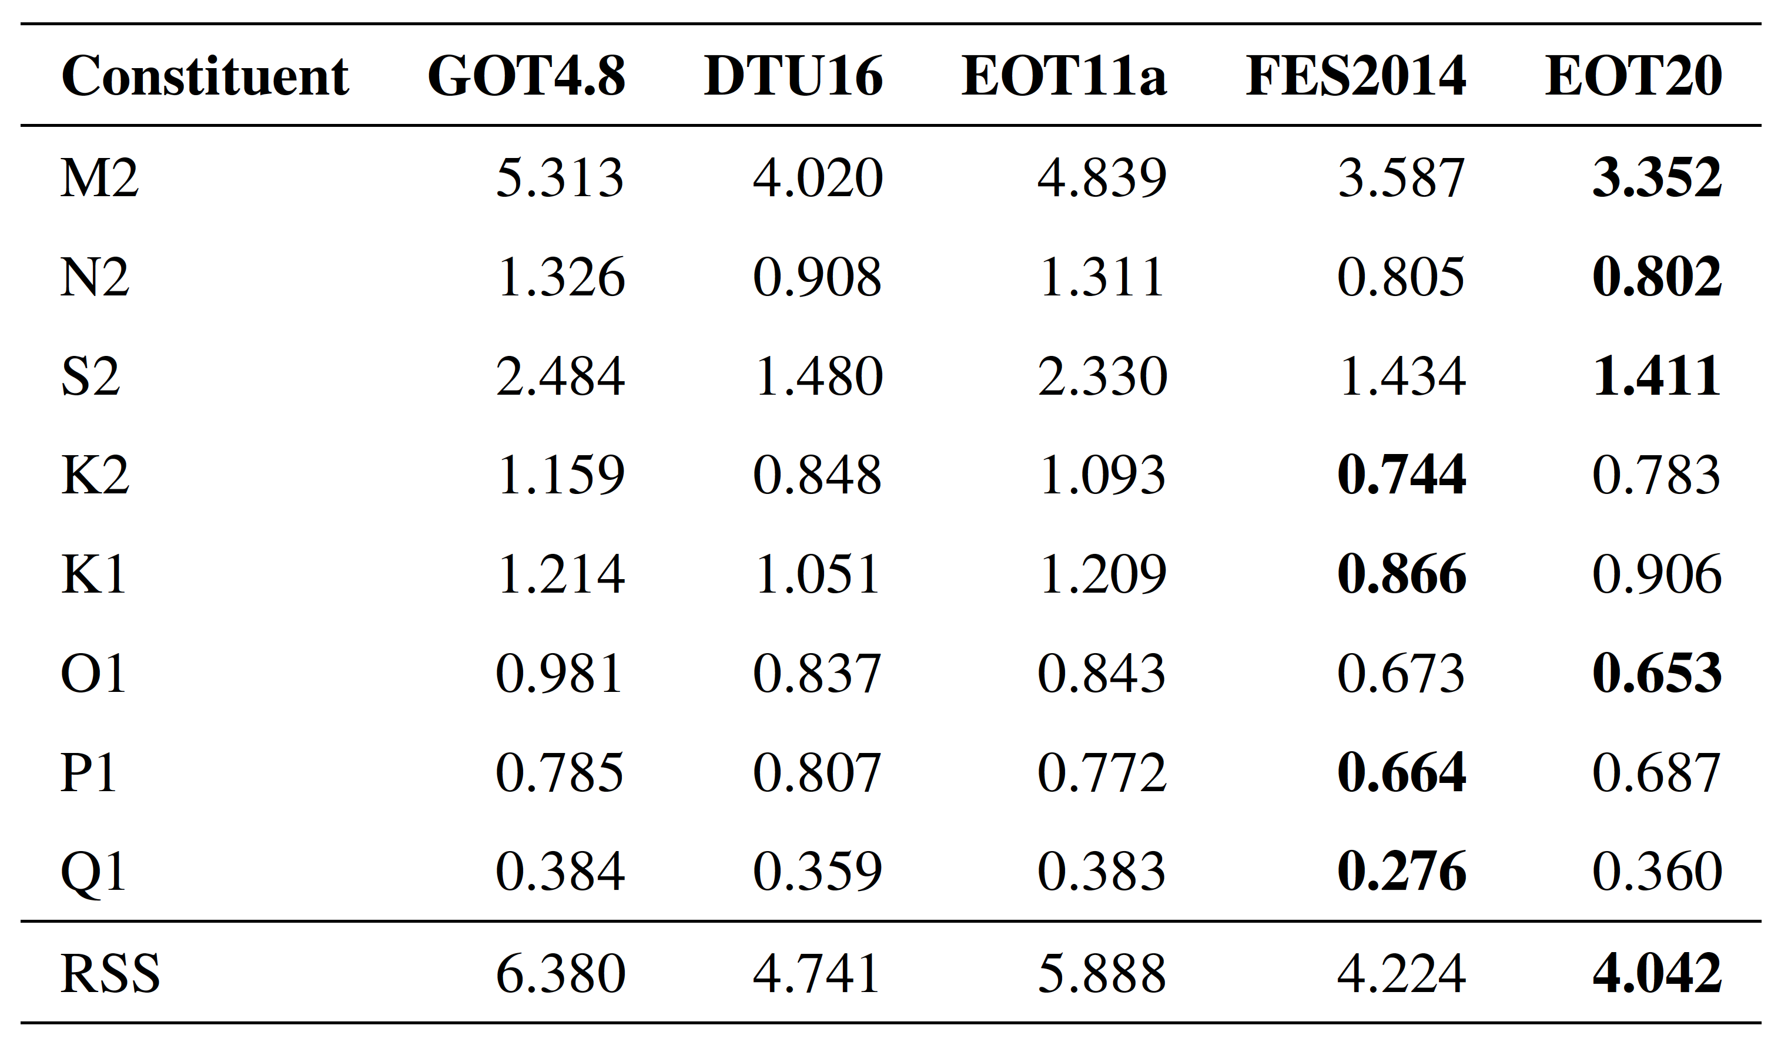
Global Tide Gauge Analysis
Click to Listen
Table. The Root Mean Square (RMS) and RSS (Root Square Sum) in cm of the eight major tidal constituents for five global tide models

Slide 10

Global Tide Gauge Analysis
Click to Listen
Figure. The Root Square Sum (RSS) for the eight major tidal constituents from the five tide models in the different regions.

Slide 11

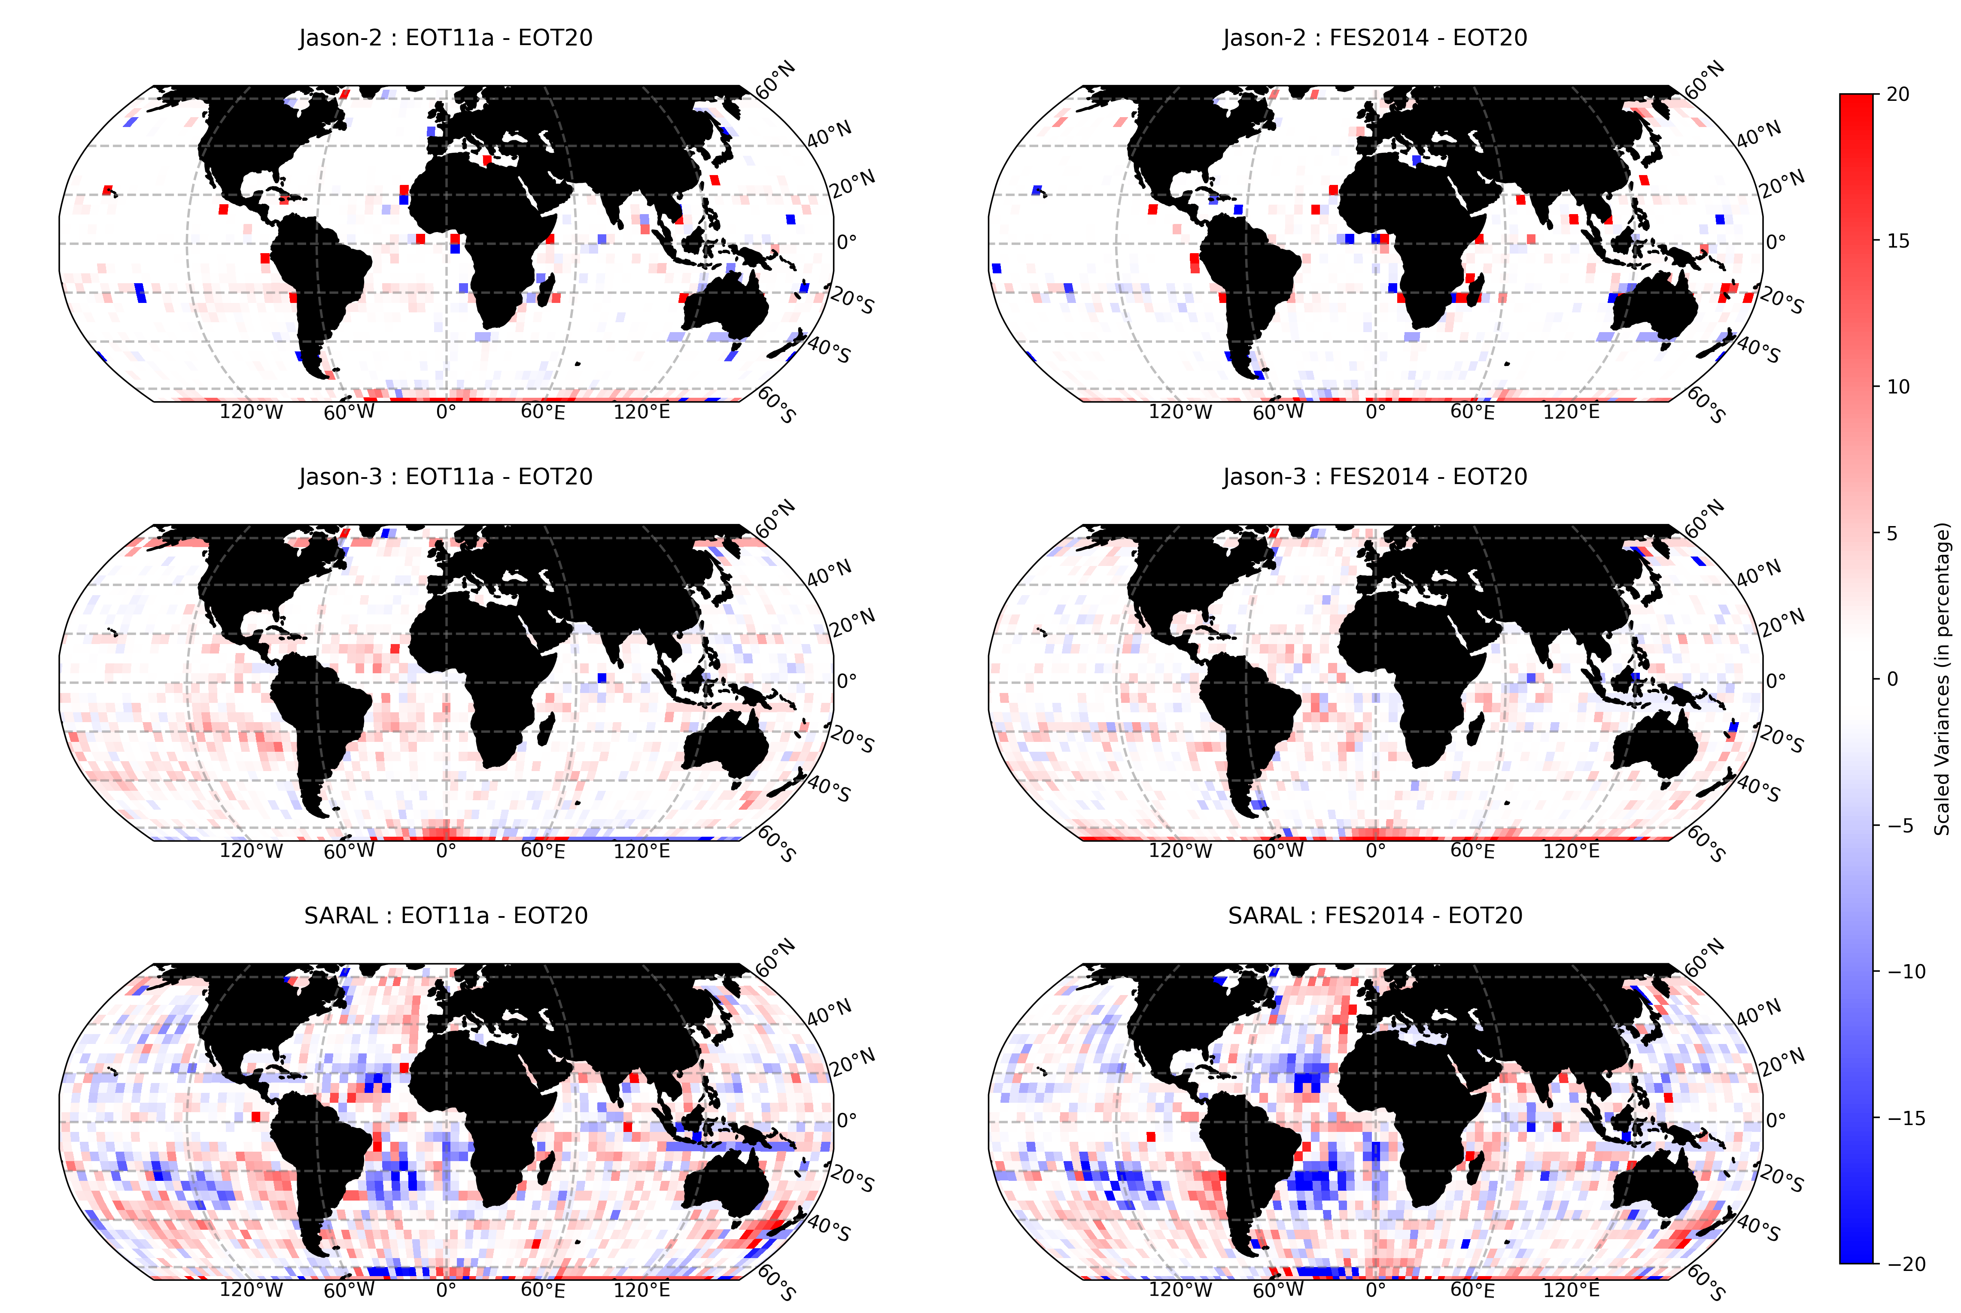
Gridded Sea Level Variance Analysis
Click to Listen
SLA estimated for three mission for each cycle
Ocean tide correction varied between EOT20, EOT11a and FES2014
Each cycle is gridded onto a 4-degree grid
Scaled variance between each cycle estimated for the full altimetry mission
Overall, EOT20 showed a mean reduction in variance compared to both EOT11 and FES2014 for all altimetry missions
Figure. The scaled sea-level variance differences between the tide models

Slide 12

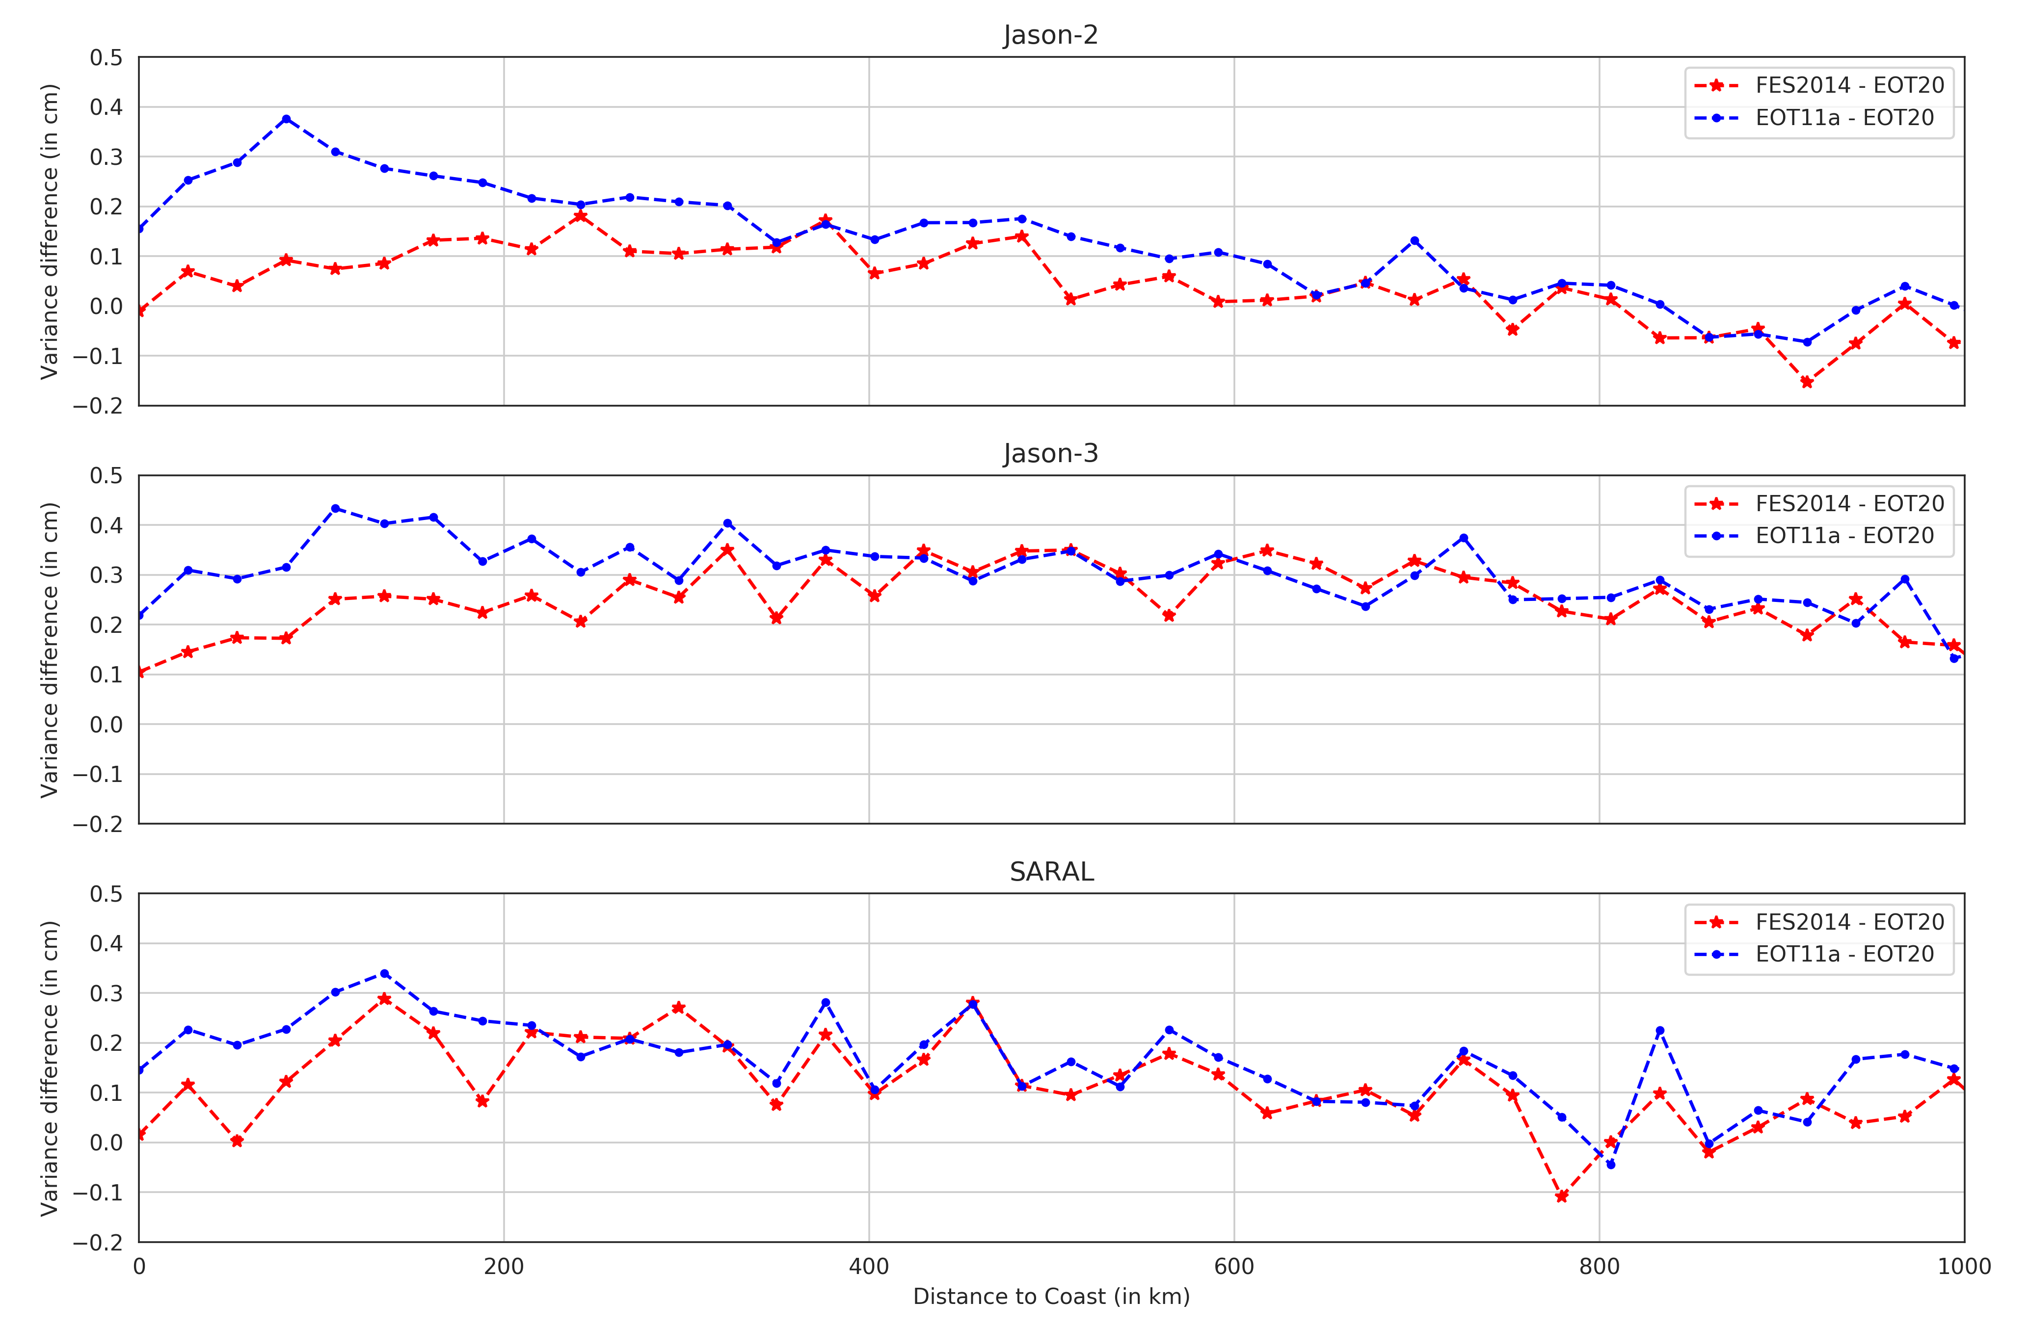
Gridded Scaled Variance Analysis
Click to Listen
Figure. The scaled variance differences between the tide models as a function of distance to coast.

Slide 13




Take home messages
Click to Listen
Development
Validation
Results
Future Work
EOT20 builds on the previous EOT global models by incorporating ALES retracked data, the FES2014 tide model as a reference model and an improved coastal representation
The model was validated using tide gauges and sea level variance analysis with the results being compared to other global tide atlases.
EOT20 demonstrates a clear improvement in the coastal region compared to other global ocean tide models.
The inclusion of additional altimetry missions to allow for the expansion into the polar regions and the improvement of altimetry data to optimise tide estimations.

Slide 14
ANY QUESTIONS?
Please email me:
michael.hart-davis@tum.de
Notes:
Work in progress

Slide 15
Key References
Hart-Davis, M. G., Piccioni, G., Dettmering, D., Schwatke, C., Passaro, M., and Seitz, F.: EOT20: A global ocean tide model from multi-mission satellite altimetry, Earth Syst. Sci. Data Discuss. [preprint], https://doi.org/10.5194/essd-2021-97, in review, 2021.
Hart-Davis M., Piccioni G., Dettmering D., Schwatke C., Passaro M. and Seitz F. 2021. EOT20 - A global Empirical Ocean Tide model from multi-mission satellite altimetry. SEANOE. https://doi.org/10.17882/79489.
Passaro, M., Cipollini, P., Vignudelli, S., Quartly, G. D., and Snaith, H. M.: ALES: A multi-mission adaptive subwaveform retracker for coastal and open ocean altimetry, Remote Sensing of Environment, 145, 173–189, 2014.
Piccioni, G., Dettmering, D., Bosch, W., and Seitz, F.: TICON: TIdal CONstants based on GESLA sea-level records from globally located tide gauges, Geoscience Data Journal, 6, 97–104, 2019a.
Piccioni, G., Dettmering, D., Schwatke, C., Passaro, M., and Seitz, F.: Design and regional assessment of an empirical tidal model based on FES2014 and coastal altimetry, Advances in Space Research, 2019b.
Ray, R. D.: Precise comparisons of bottom-pressure and altimetric ocean tides, Journal of Geophysical Research: Oceans, 118, 4570–4584, 2013.
Ray, R.D., 2020. Daily harmonics of ionospheric total electron content from satellite altimetry. Journal of Atmospheric and Solar-Terrestrial Physics, 209, p.105423.
Stammer, D., Ray, R., Andersen, O. B., Arbic, B., Bosch, W., Carrère, L., Cheng, Y., Chinn, D., Dushaw, B., Egbert, G., et al.: Accuracy assessment of global barotropic ocean tide models, Reviews of Geophysics, 52, 243–282, 2014.
Zaron, Edward D. "Baroclinic tidal sea level from exact-repeat mission altimetry." Journal of Physical Oceanography 49.1 (2019): 193-210.

