Slide 1
Development of an interactive Cloud-based seismic network modelling application on a common Geophysical Processing Toolkit platform
P. Golodoniuc, J. Attanayake, A. Jones, and S. Bradley

Slide 2
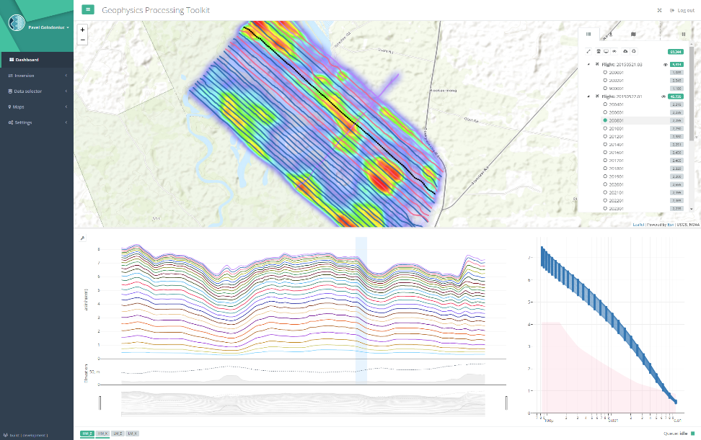
Geophysical Processing Toolkit
History
Started as an Airborne Electromagnetics (AEM) data processing and inversion framework featuring extensive interactive visualisation, Cloud-based scalable execution environment, modular architecture.
Evolution
The platform has been significantly reviewed, generalised, and rearchitected into an analytical platform to allow integration of modules not necessarily tied to geophysical processing.
Benefits and Capabilities
Common platform – multiple applications
Compute- and data-intensive processing
Interactive visualisation capability
Scalability
Pathways to commercialisation

Slide 3
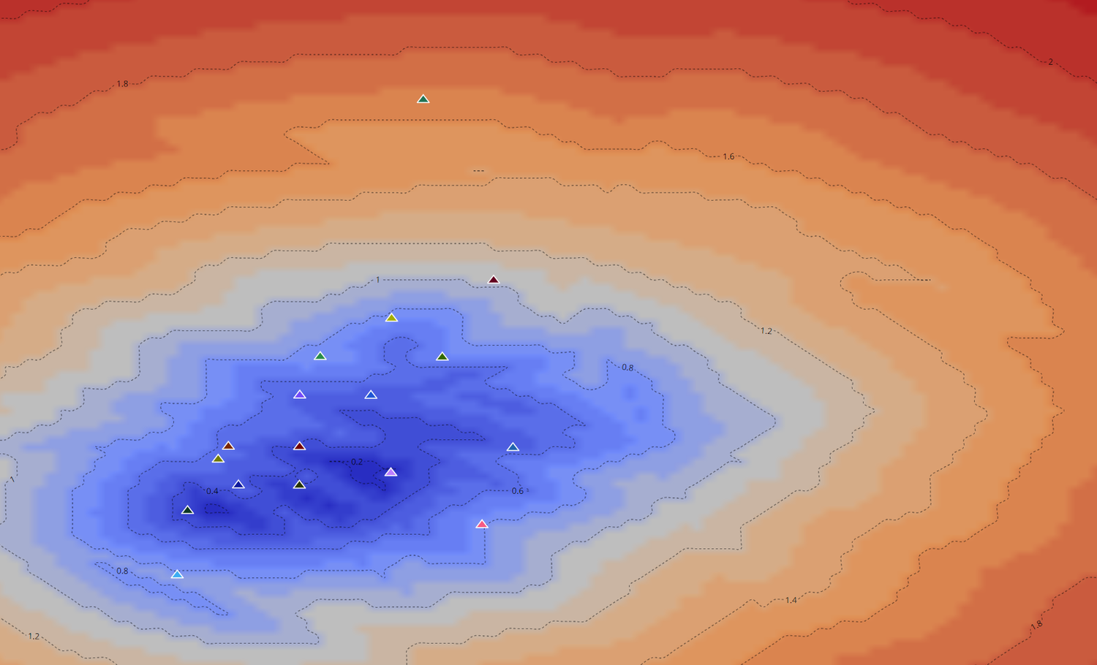
Seismic Network Design App a.k.a. SENSI
New applications
The first real test of the flexibility of the Geophysical Processing Toolkit (GPT) as a common platform for building analytical applications from a diverse range of science disciplines.
Developed as a collaborative project as part of the AuScope AVRE Engage Program with the seismology group at the University of Melbourne (UoM). The design and implementation phases took only three months to complete with the application delivered to the research community as open-access tool. SENSI application significantly leverages the capability of the existing GPT platform such as authentication, data management, visualisation capability, Cloud integration and scalability.

Slide 4
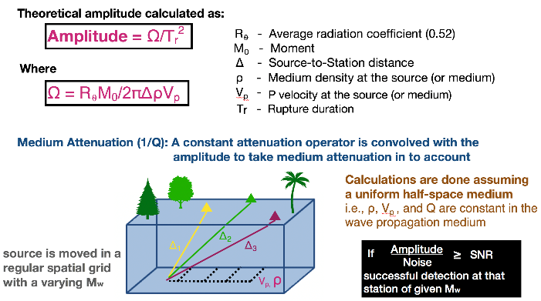
Scope
Optimisation of the seismic array design using an analytical method called SENSI. This approach allows users to design and test seismic networks, including the GipNet seismic array deployed to monitor seismicity in the Gippsland region in Victoria, Australia. The underlying physics and mechanics of the method are straightforward, and when applied sensibly, it can be used as a basis for the design of seismic networks anywhere in the world.
We have built an application leveraging a previously developed Geophysical Processing Toolkit (GPT) as an application platform and harnessed the scalability of a Cloud environment provided by the EASI Hub, which minimised the overall development time. The GPT application platform provided the groundwork for a web-based open-access application interface and enabled interactive visualisations to facilitate human-computer interaction and experimentation.

Slide 5
Our approach
First, we worked with the seismology team at The University of Melbourne to better understand their solution for optimising seismic array design to date: an analytical method called SENSI that has been developed by Tramelli et al. (2013) to design seismic networks, including the GipNet array deployed to monitor seismicity in the Gippsland region in Victoria, Australia.
The method can flexibly handle source (source depth and stress drop), medium (density, P and S velocity, attenuation), and station parameters. The underlying physics and mechanics of the code are straightforward, and when applied sensibly, it can be used as a basis for the design of seismic networks anywhere in the world.
Next, we imported this stand-alone modelling code into a scalable Cloud environment to allow for parallelisation, and built the Seismic Network Design App, a web application interface to allow interactive visualisations to facilitate human-computer interaction and experimentation. The app allows users to run simulations for a spread of input parameters and provides a variety of data visualisation options for comparative analysis.

Slide 6
Leveraging the GPT capability
The GPT allows integration of custom algorithms through a web-based user interface that seamlessly connects model design visual user interface, numerical modelling workflows, and interactive visualisation tools. The chosen approach not only significantly saved development time allowing the engineering team to focus on the development of the new application logic and tailored visualisations, but allowed to leverage existing infrastructure and shared features, e.g., authentication and user accounts, data management, storage, and integration with Cloud resources.
The architecture and design methodology of the GPT provides an abstraction layer allowing to integrate with custom numerical codes written in different languages and for different computing platforms (e.g., Windows, Linux, etc.) while avoiding the common pitfalls of cross-platform application development.

Slide 7
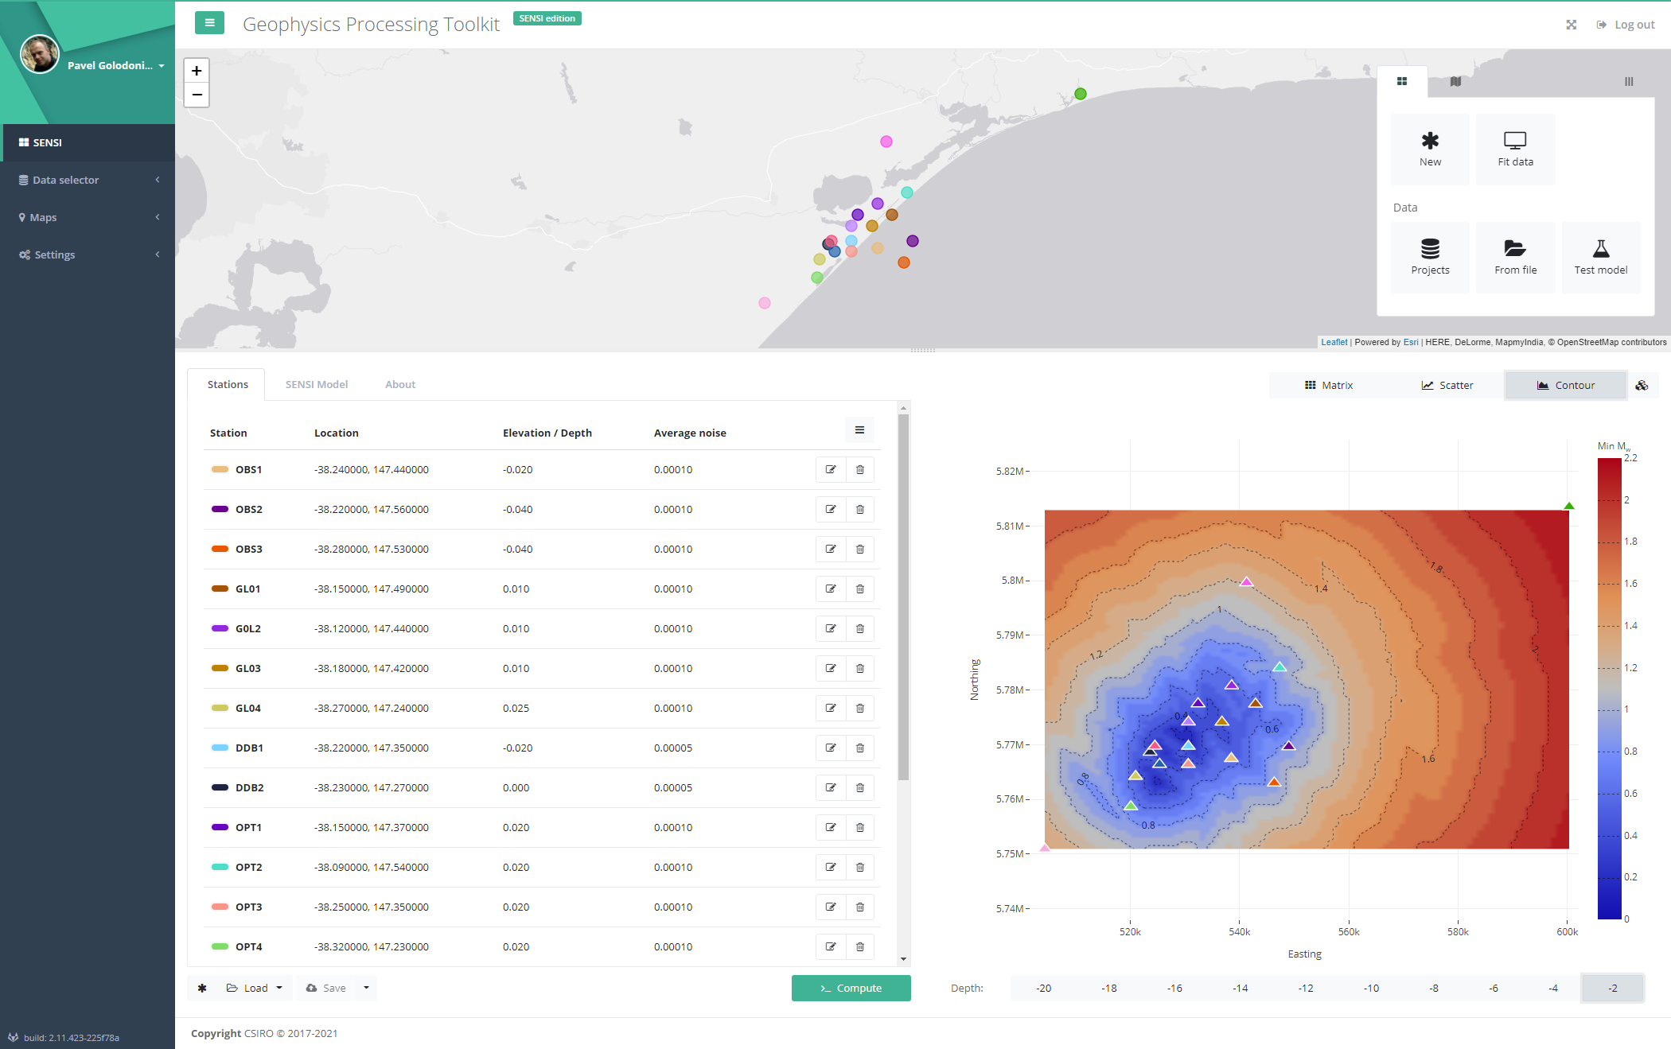
The application

Slide 8
Interactive data visualisation capability
Our objective was to equip users with the tools that would hide the technicalities and allow to focus on the main objective – development of an analytical solution for the most cost-efficient and suitable seismic network design before field deployment.
The SENSI App features a multi-view dashboard to allow immediate access to different aspects of the modelling workflow. The modelling dashboard provides an interconnected layout of different panes, including a GIS-style pane for the schematical representation of the seismometer array, model configuration, Earth model definition, project management functionality, multi-mode data visualisation, and simulation jobs monitoring pane.
The data visualisation forms an important aspect of the application. It allows users to analyse modelling results quickly, experiment and remodel seismic network design time- and cost-efficiently.

Slide 9
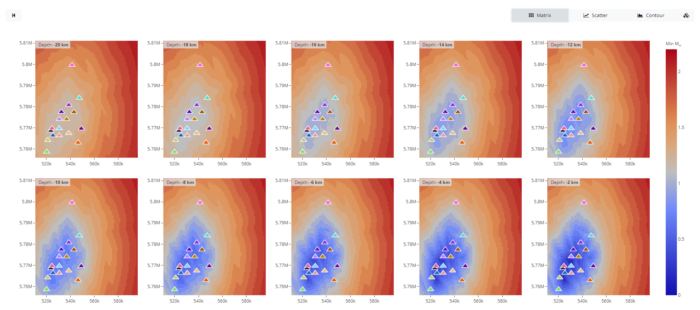
Interactive visualisation capability

Slide 10
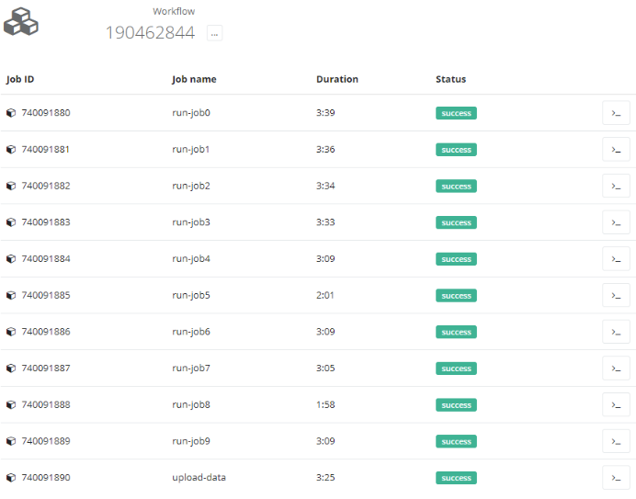
Leveraging the EASI Hub capability
The CSIRO’s EASI Hub model that is designed to accelerating technology readiness and transfer was chosen to provide the main mechanism to Cloud integration. The EASI Hub approach is using a Science-as-a-Service platform that readily supports scalable and low start-up cost access. It provided a cost-effective solution and a vehicle for science delivery to the general audience.
EASI Hub has been utilised as a managed Kubernetes (K8) cluster where a workflow engine (i.e., GitLab CI) was deployed. Jobs sent to the workflow engine trigger the cluster to scale up on-demand with cost-efficient virtual machines, providing enough computation resources in the cluster to run all the jobs simultaneously. The GPT platform manages the flow of data in and out of the jobs, provides an Application Programming Interface (API) for the SENSI App to display job status information, and enable the output data flow back to the client application.

Slide 11
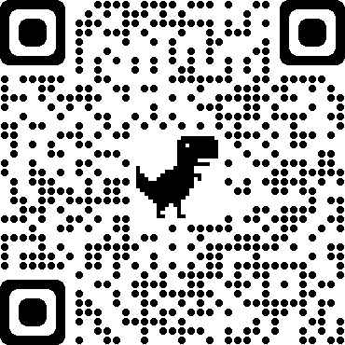
Conclusions
The development of the SENSI Seismic Network Design App has significantly leveraged existing platforms – GPT and EASI – that have seen years of strategic investment. This approach allowed to develop a fully-fledged modelling application in a short period of time while allowing it to benefit from future upgrades to underlying platforms. The SENSI App has also provided valuable feedback into the development and further advancement of the GPT platform core functionality.
The SENSI App is now released as an open-access application for the benefit of Australian national and, indeed, global audiences. It can be access at https://sensi.geoanalytics.group/ or via AuScope Virtual Research Environment store at http://avre.auscope.org/.
https://sensi.geoanalytics.group/

Slide 12
Acknowledgements
The original version of the Geophysical Processing Toolkit was developed under the Capricorn Distal Footprints project funded by the Science and Industry Endowment Fund (SIEF) as part of the Distal Footprints of Giant Ore Systems: UNCOVER Australia project (RP04-063). It was further supported and advanced via a strategic project development of CSIRO Mineral Resources.
The SENSI Seismic Network Design App was developed under the AuScope AVRE Engage Program in collaboration with the University of Melbourne. This work was enabled by AuScope and the Australian Government via the National Collaborative Research Infrastructure Strategy (NCRIS).
The authors acknowledge financial assistance provided through Australian National Low Emissions Coal Research and Development. ANLEC R&D is supported by Low Emission Technology Australia (LETA) and the Australian Government through the Department of Industry, Science, Energy and Resources. The GipNet array instrumentation received financial assistance through CO2CRC’s industry members, research partners and the Australian Government through the CCS Flagships Program, Department of Education and Training Education Investment Fund (EIF).
EASI arises from an Australian innovation called the “Australian Geoscience Data Cube”, originally developed out of a partnership between CSIRO, Geoscience Australia, and the National Computational Infrastructure (NCI). Since 2017, several international partners (NASA, USGS, CEOS, UK’s Satellite Applications Catapult) have also joined the partnership, now called the Open Data Cube (ODC) platform. Integration of the SENSI Seismic Network Design App with EASI was supported by
Dr Robert Woodcock.

