Slide 1




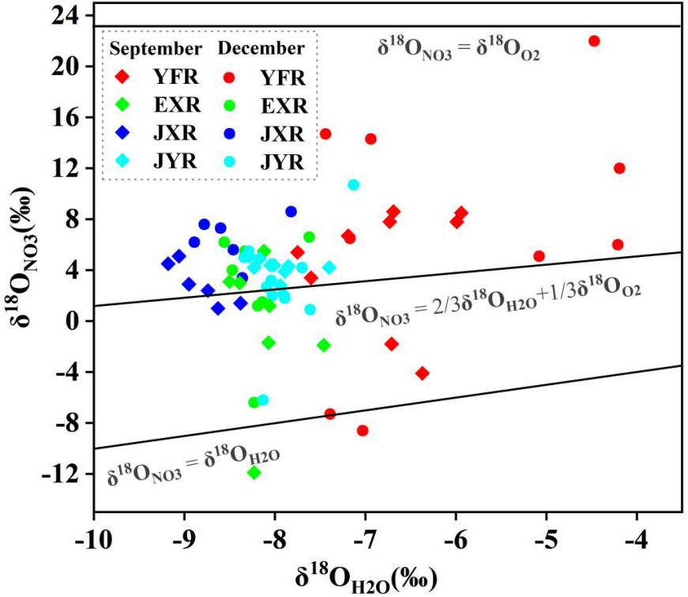
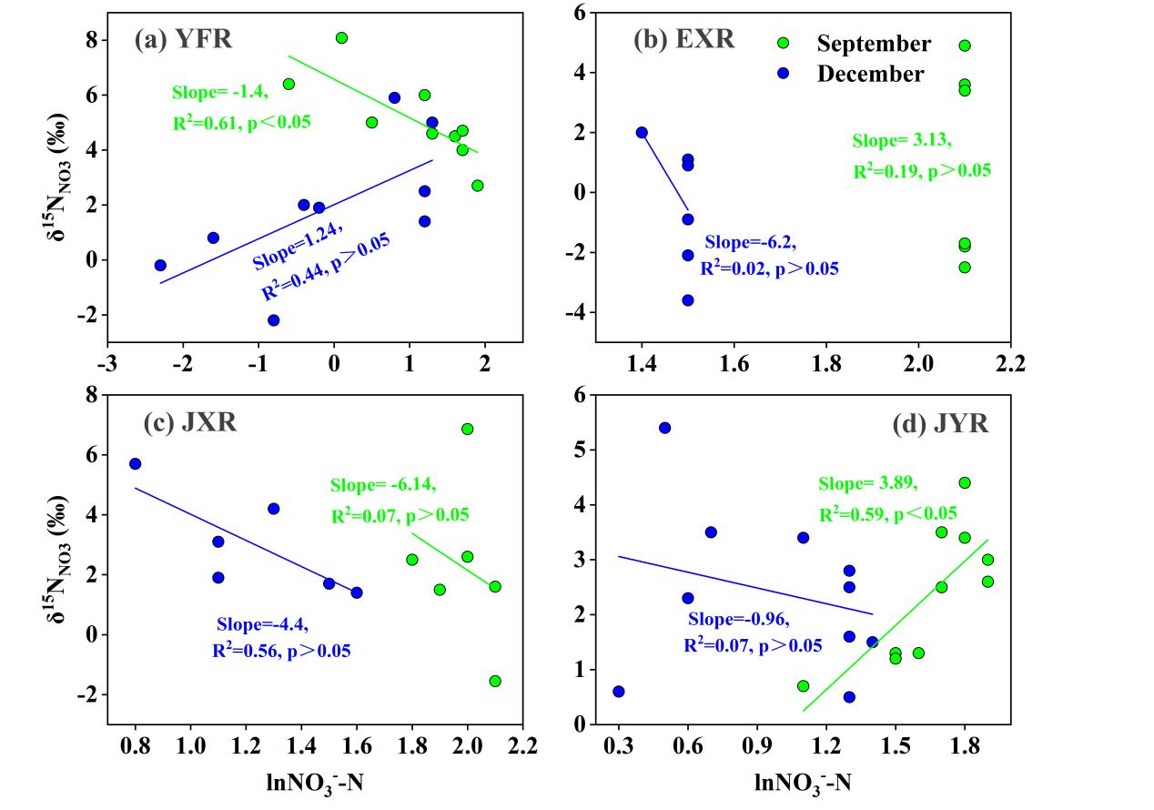
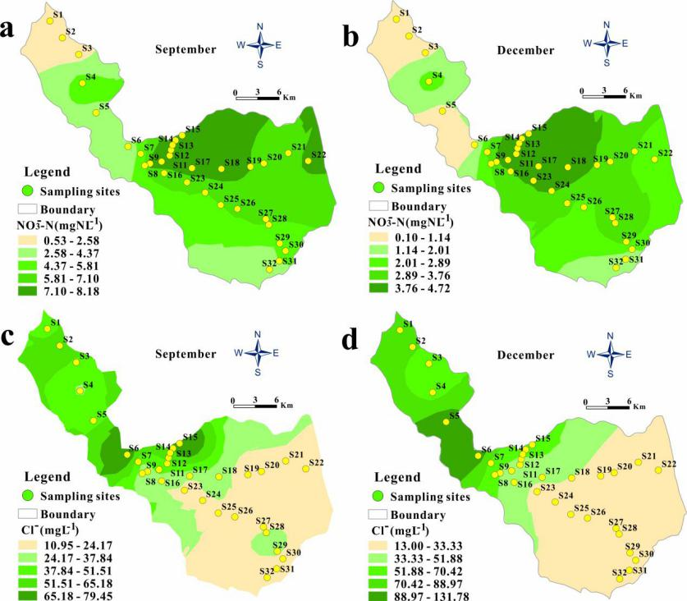
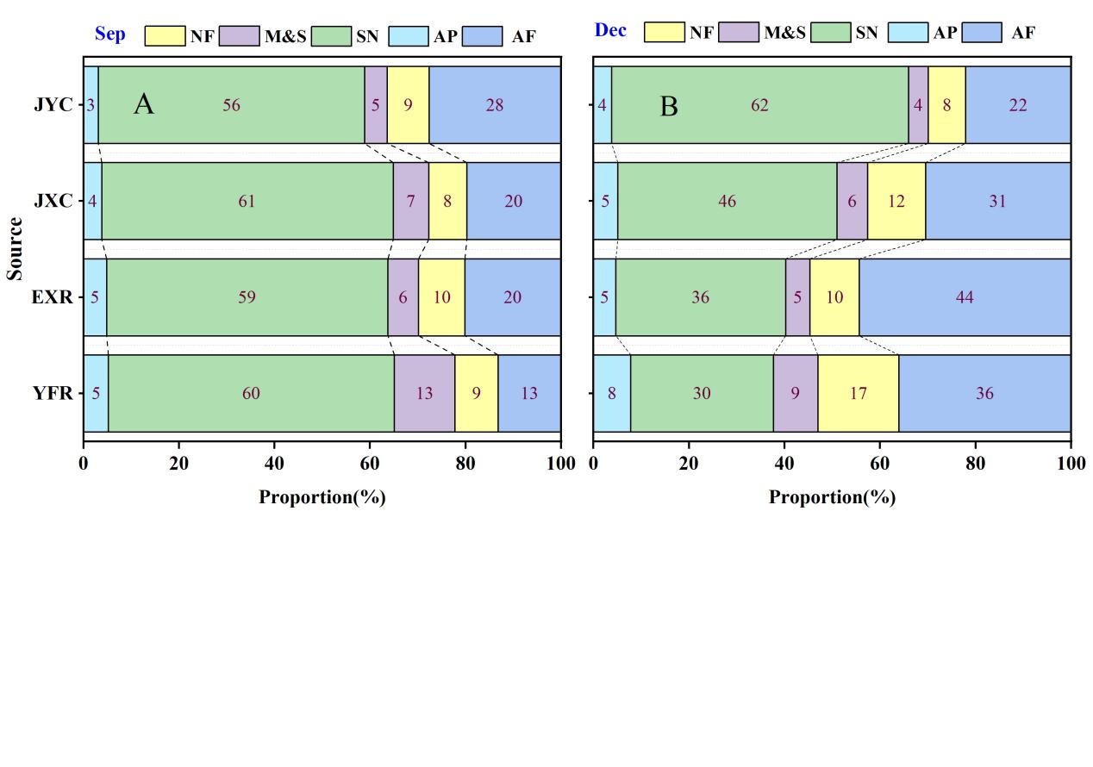
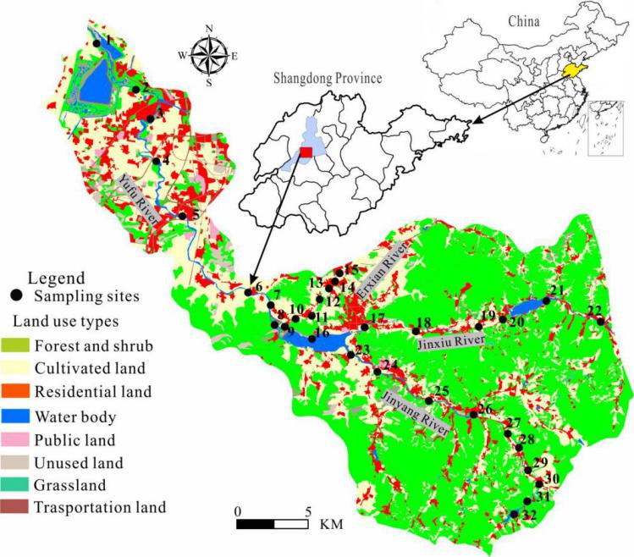
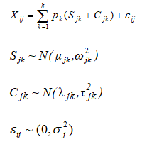
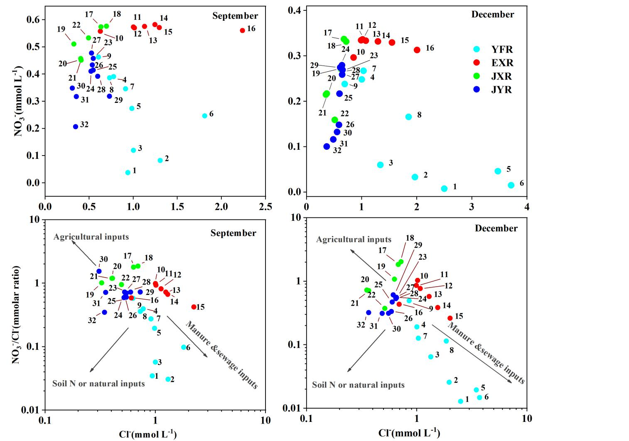
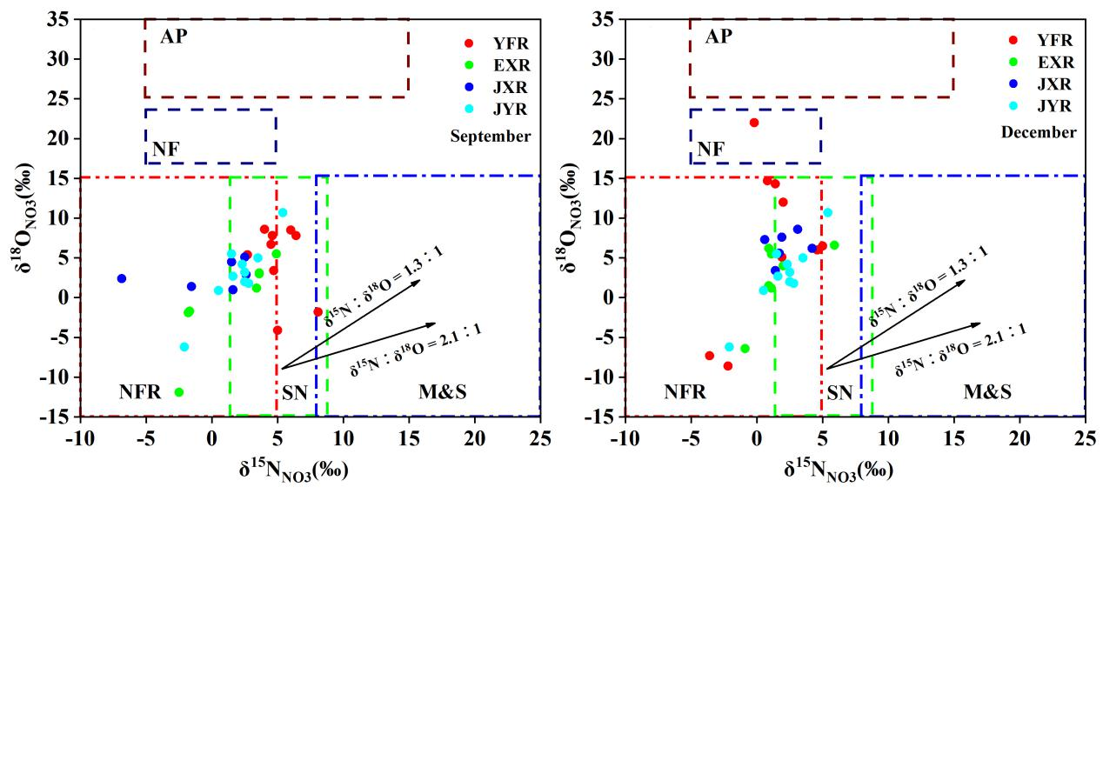
Identifying source and transformation of riverine nitrates in a karst watershed, North China: comprehensively using major ions, multiple isotopes and Bayesian model
Jie Zhang^{1, 2}, Menggui Jin^{1, 2}*, Mingda Cao^{1, 2}, Xin Huang^{1, 2}, Zhixin Zhang^{1, 2}
1 State Key Laboratory of Biogeology and Environmental Geology, China University of Geosciences, PR China
2 School of Environmental Studies, China University of Geosciences, PR China
Introduction
Over the past decades, anthropogenic activities, such as agricultural fertilization, and sewage discharge, have resulted in significantly increase of nitrogen in surface water. Nitrate (NO₃⁻) as an important form of nitrogen species, in which the increase of concentration may result in acidification and eutrophication in surface water and seriously threaten drinking water safety. Excessive NO₃⁻ concentrations in drinking water can increase the risk of a number of diseases and induce methemoglobinemia in humans, particularly in infants. Nitrate contamination of surface water is a global environmental problem of general concern. To mitigate nitrate pollution in surface water, it is crucial to identify nitrate sources and corresponding pollution loads. This is a prerequisite for water quality safety and environmental protection.
The objectives of this study are to (1) explore the spatial and seasonal variation of nitrogen species in different streams in the YFR watershed, Jinan, North China and evaluate their pollution level, (2) identify NO₃⁻ sources and transformations by the combination of hydrochemical, multi-isotopes (δ²H_{H2O}, δ¹⁸O_{H2O}, δ15N_{NO3}, δ¹⁸O_{NO3}) and land use, and (3) to quantify the contributions of NO₃⁻ sources by the Simmr model and propose management measures to reduce nitrogen pollution in the watershed. The results provide scientific basis for the water quality protection and sustainable water management in the study area or similar agricultural areas.
Materials and methods
  1
  The watershed is mainly composed of the mainstream and three tributaries. It is located in the semi-humid warm temperate zone and has a typical East Asian monsoon climate. The precipitation is concentrated in June to September. The dominated land use types are forest and shrub, followed by cultivated land and residential land. Terrain within the watershed is dominated by mountains, hills, and piedmont alluvial plain with considerable topographic relief.
  32 sampling sites in September and December 2019 covering the whole watershed (Fig.1) were identified.The T_{W}, pH, EC, and DO were measured in situ using a calibrated portable multi-parameter water quality meter (WTW Multi 3630).Cl⁻ and NO₃⁻ concentrations were determined by ion chromatography (Dionex ICS-3000, USA). The cadmium (Cd) reduction and azide reduction method was used to analyze δ¹⁵N_{NO3} and δ¹⁸O_{NO3} of water samples by reducing nitrate to N₂O. The isotopic signature of the produced N₂O was determined using a stable isotopic ratio mass spectrometer. The proportional contribution of different contamination sources to NO₃⁻ in different seasons was quantitatively evaluated by applying a simmr model.
  Results
  The NO₃⁻-N concentrations of all samples ranged from 0.1 to 8.15 mg/L, presenting a firstly increased and then decreased trend from the upstream to the downstream in both seasons, with a higher value in the tributaries(2.15-6.4 mg/L) than that in the mainstream(0.32-4.91 mg/L). For different watersheds, The NO₃⁻-N concentrations from high to low were EXR (6.27 mg/L), JXR(5.41 mg/L), JYR(4.09 mg/L), and YFR(2.67 mg/L), which also showed significant spatial variation.
Fig.5 δ¹⁵O_{NO3} VS δ¹⁸O_{H2O} Fig. 6 δ¹⁵N_{NO3} and Ln (NO₃⁻)
36% of the water samples fell within this range, indicating that nitrification was an important process affecting nitrate migration and transformation. Nevertheless, the remaining water samples did not fall within the nitrification range, which might be caused by evaporation, different biological processes or the variable proportion of oxygen from water and O₂. The linear correlation between δ¹⁵N_{NO3} and δ¹⁸O_{NO3} was not significant. The Ln (NO₃⁻) with δ¹⁵N_{NO3} in the watershed had no statistically significant negative linear correlation. The anoxic aquatic ecological environment(DO＜2 mg/L) is more beneficial to the occurrence of denitrification
  Conclusion
NO₃⁻ was the predominant form of inorganic nitrogen to water quality impairment in the watershed. The Cl⁻ and NO₃⁻/Cl⁻ indicated that nitrate in the watershed mainly derived from the mixture of agricultural inputs, soil organic nitrogen, sewage and manure. The isotopic compositions of NO₃⁻ revealed that both mixing of diffuse sources and biogeochemical attenuation controlled the fate of NO₃⁻ in the watershed. Meanwhile, the δ¹⁵N_{NO3} and δ¹⁸O_{NO3} isotopes and Simmr model showed that SN appeared to be the primary source of NO3- in the rivers while AF. Therefore, reducing the application of nitrogen fertilizer and improving the efficiency of agricultural irrigation provide the key to controlling nitrogen pollution in rivers and reservoirs in the watershed. This study provides scientific basis for the water quality protection and sustainable water management in the study area or the reservoirs or similar watersheds.
Fig.2 Geographical plot of NO₃⁻-N and Cl⁻ concentrations for the YFR watershed.
The mean NO₃⁻-N concentrations in the wet season (5.78 mg/L) were higher than that in the dry season (3.04 mg/L), showing significant seasonal variation. This is not consistent with results for surface water in other study areas
According to the output results from the Simmr model (Fig.7), the mean contribution rates of the five potential NO₃⁻ sources in the YFR watershed could be ranked as follows: SN(68.7%)>AF (17.2)>NF (7.2%)> AP(3.6%) >M&S(3.3%)in September and SN (44.3%) > AF (41.8%) > NF (6.9%) >M&S (3.9%) >AP(3.1%) in December.
  Discussion
The low Cl⁻ Vs NO₃⁻/Cl⁻ in most water samples indicated that NO₃⁻ mainly was derived from soil nitrogen, which may be related to the steep terrain slope and high forest coverage rate. Some water samples had low Cl⁻ and high NO₃⁻/Cl⁻, which may be attributed to the heavy use of chemical fertilizers in agriculture. nitrate contaminants in the watershed mainly derived from the mixture of soil nitrogen, agricultural fertilizer and manure or sewage.
Fig. 7 Fractional contributions of five potential
NO₃⁻ sources estimated by Simmr.
The contribution of SN to nitrate was the highest in the YFR watershed since the watershed is dominated by steep karst terrain and land use is dominated by natural vegetation and farmland. The contribution of AF to nitrate is second only to that of SN, which might be related to the intensity of agricultural activities in the watershed. NF contributed 6.9% and 7.2% in September and December, respectively, indicating that the application of NF was relatively limited in the watershed. The M&S contribution ranged between 3.3% in September and 3.9% in December, indicating that the contribution of M&S to nitrate was small in the study area. This might be related to the strict management measures in the watershed. The contribution of AP to NO3- was low in both sampling campaigns in the watershed, and similar values have been observed in other study areas
Simmr model
Fig. 3 Scatter plots of NO₃⁻ /Cl⁻ vs. Cl⁻
  Fig.1 Location, sampling site and land-use distribution of the YFR watershed
As shown in Fig.5, the δ¹⁵N_{NO3} and δ¹⁸O_{NO3} values of most water samples had fallen into the ranges of SN and AF in September. This indicates that nitrate mainly derived from the contribution of SN and AF in September.
Fig.4 Cross-plot of δ¹⁵N_{NO3} and δ¹⁸O_{NO3}
Only Site 2 was located at the overlap between M&S and SN, indicating that nitrate from M&S was relatively limited in the watershed in September. The δ¹⁵N_{NO3} and δ¹⁸O_{NO3} values of most water samples in December also fallen into the ranges of SN and AF, suggesting that NO₃⁻ was also mainly derived from SN and AF. Meanwhile, the average value of δ¹⁵N_{NO3} for nitrate was slightly lower in December than that in September, and was closer to AF. This indicated that the contribution of nitrate from AF in December was higher than that in September.
Notes:
Citations!

