Slide 1



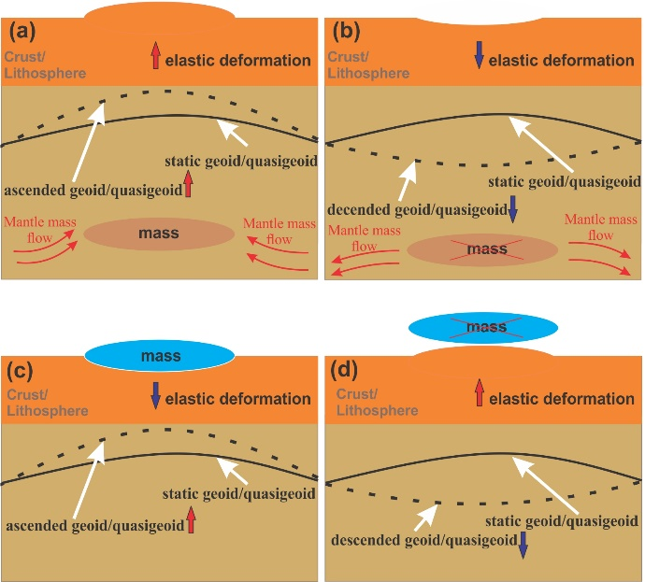
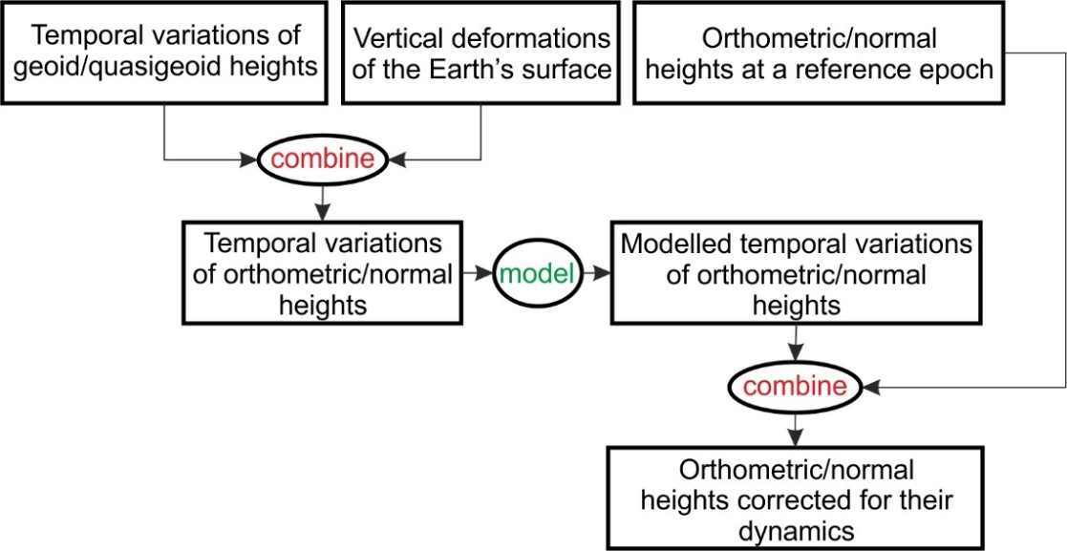
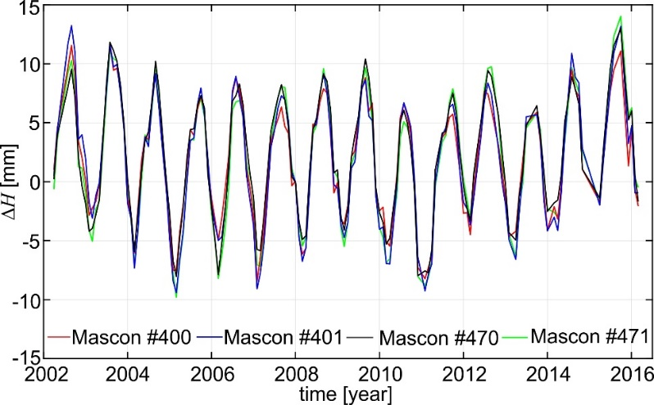
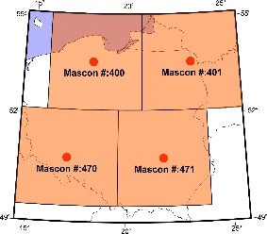
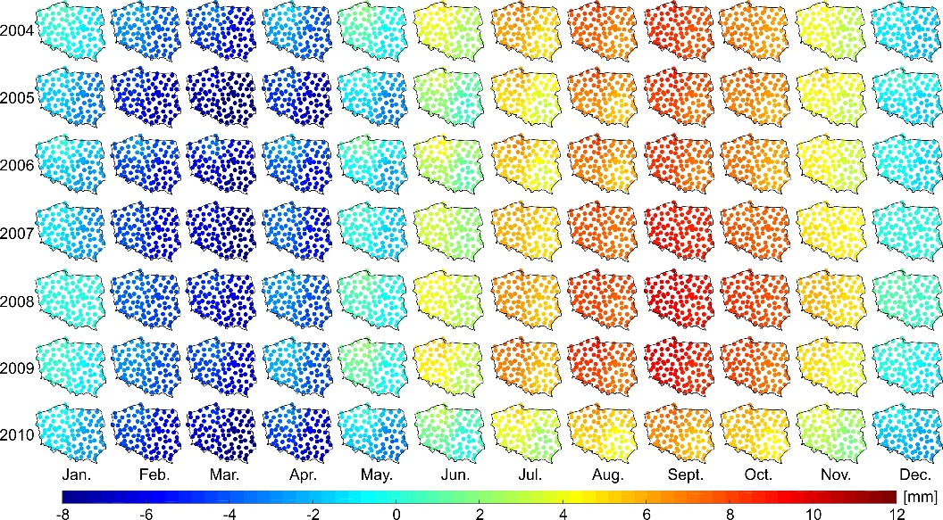
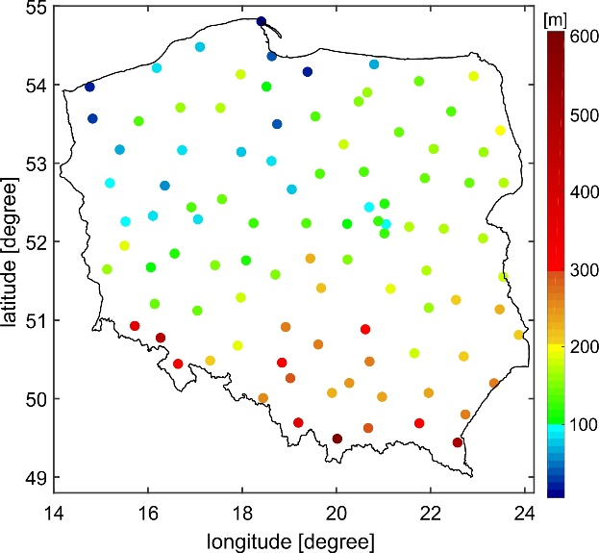
On the dynamics of physical heights and their use for the determination of accurate orthometric/normal heights
Walyeldeen Godah, Malgorzata Szelachowska, Jan Krynski
Institute of Geodesy and Cartography (IGiK), Centre of Geodesy and Geodynamics, Warsaw, Poland
a) The impact of temporal mass variations on heights
b) General steps to determine orthometric/normal heights corrected for their dynamics
c) Temporal variations of orthometric/normal heights (∆H/∆H*) determined over Poland using GRACE data
d) Modelled ∆H/∆H*
e) Static orthometric/normal heights
Main conclusions
Temporal variations of orthometric/normal heights (∆H/∆H*) over Poland reach up to 23 mm
∆H/∆H* can be modelled with 1 mm accuracy
∆H/∆H* can be predicted for the next six months with the accuracy of ca. 1 – 2 mm
Overall, orthometric/normal heights corrected for their dynamics are required for fulfilling the contemporary geodetic scientific and applications purposes

