Slide 1
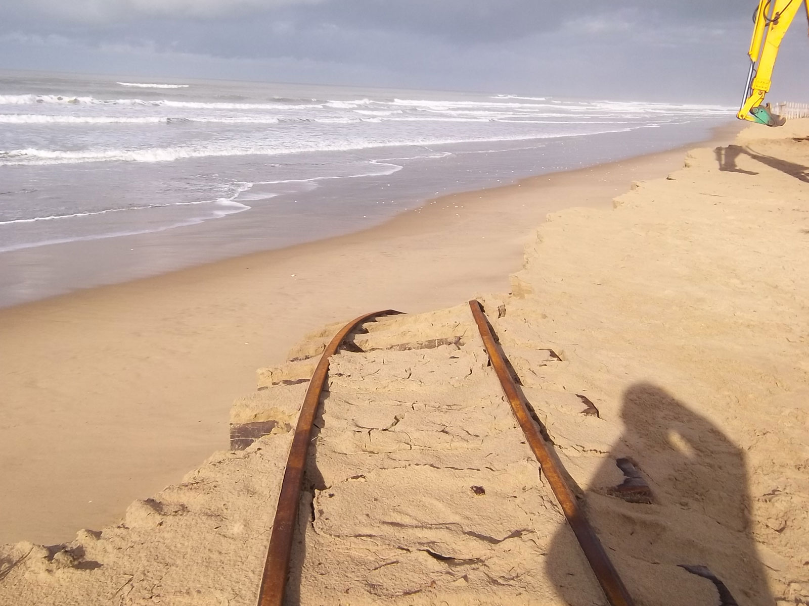
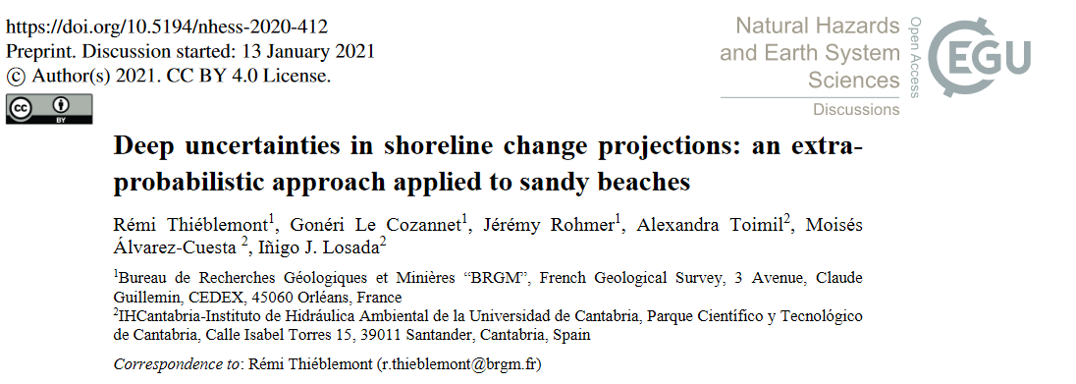


Deep uncertainties in shoreline change projections: an extra-probabilistic approach applied to sandy beaches
Rémi Thiéblemont¹, Gonéri Le Cozannet¹, Jérémy Rohmer1, Alex Toimil², Moisés Álvarez-Cuesta² & Iñigo J. Losada²
¹BRGM – French Geological Survey
²IH-Cantabria
http://www.le-ptit-train.com/environnement.htm#gallery-5
EGU 2021 online assembly
APR. 27th 2021

Slide 2
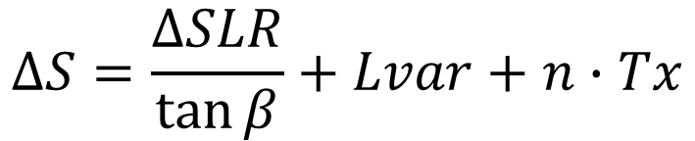
Introduction
Deep uncertainty in empirical shoreline change modeling
Secular trend
$$∆S=\frac{∆SLR}{\tan{β}}+Lvar+n∙Tx$$
Shoreline change
Interannual-to-decadal variability
Bruun rule
Secular trend and Lvar are derived from observational records
Bruun rule includes two sources of deep uncertainty:
  SLR projections & choice of coastal impact model (1/tanβ)
Both include aleatory (e.g. internal variability) & epistemic (lack of knowledge) uncertainties

Slide 3
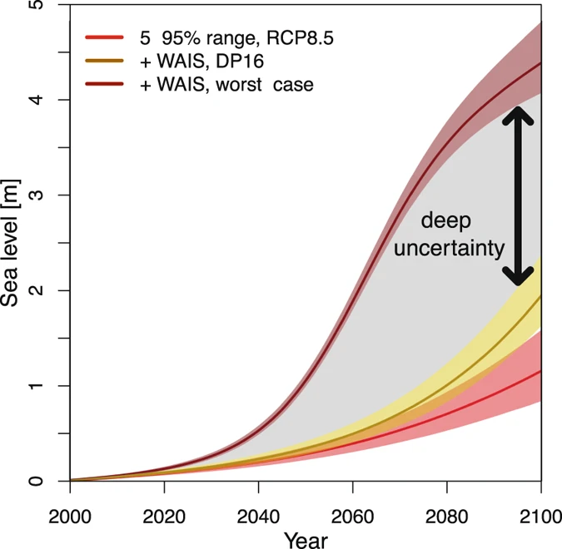
Introduction
Deep uncertainty in SLR
Sea-level change projections over the 21st century
Bakker et al. (2017)
Deep uncertainty in SLR projections namely stems from WAIS contribution

Slide 4
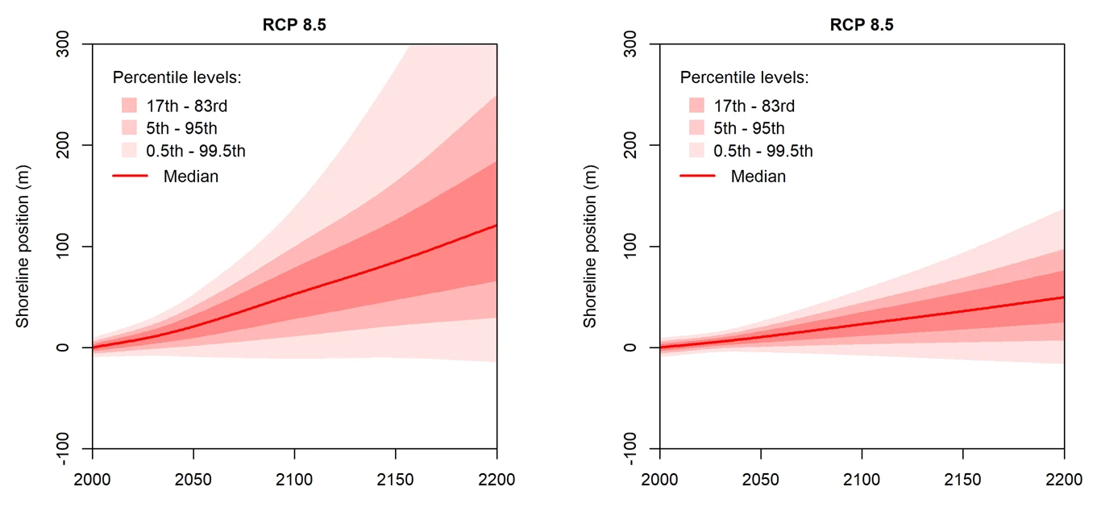
Introduction
Deep uncertainty in the choice of the coastal impact model
Shoreline change projections in Aquitaine
Bruun rule
PCR model
Le Cozannet et al. (2019)
The choice of the coastal impact model strongly affects shoreline projections

Slide 5
Motivation
How to account exhaustively and transparently for uncertainty of different kinds in future shoreline change in a single framework ?
The extra-probabilistic approach

Slide 6
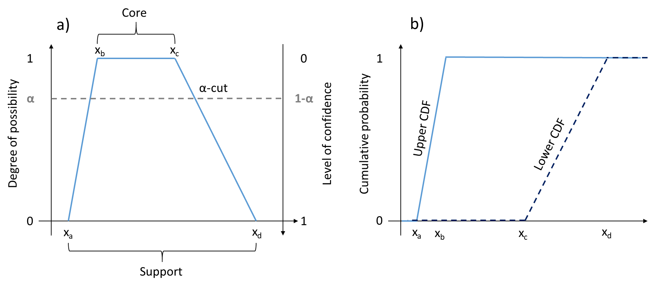
An extra-probabilistic framework for shoreline change projections
Example of possibility distributions

Slide 7
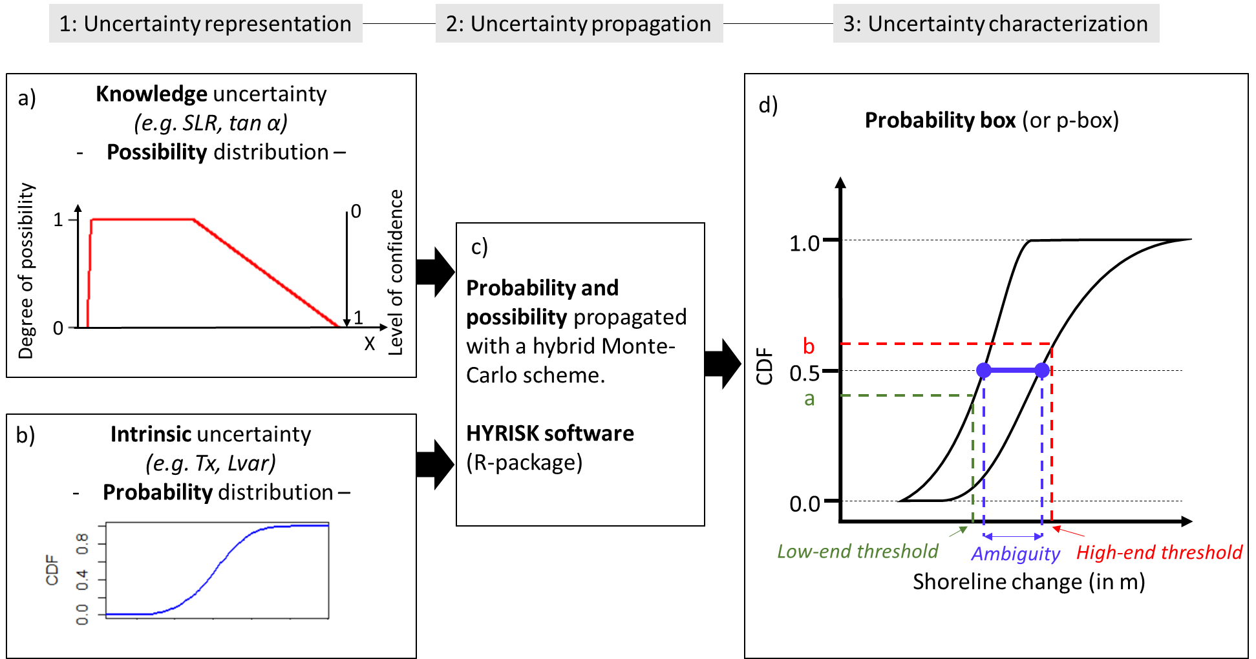
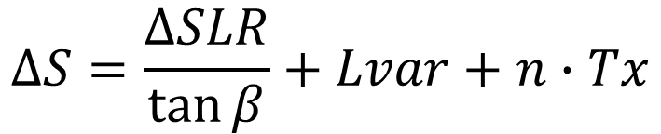
An extra-probabilistic framework for shoreline change projections
Workflow
$$∆S=\frac{∆SLR}{\tan{β}}+Lvar+n∙Tx$$
https://cran.r-project.org/web/packages/HYRISK/HYRISK.pdf

Slide 8
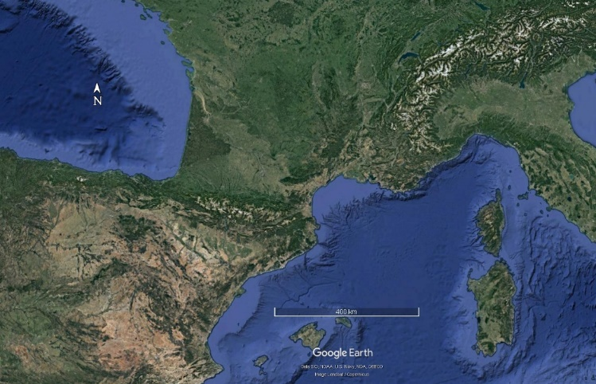
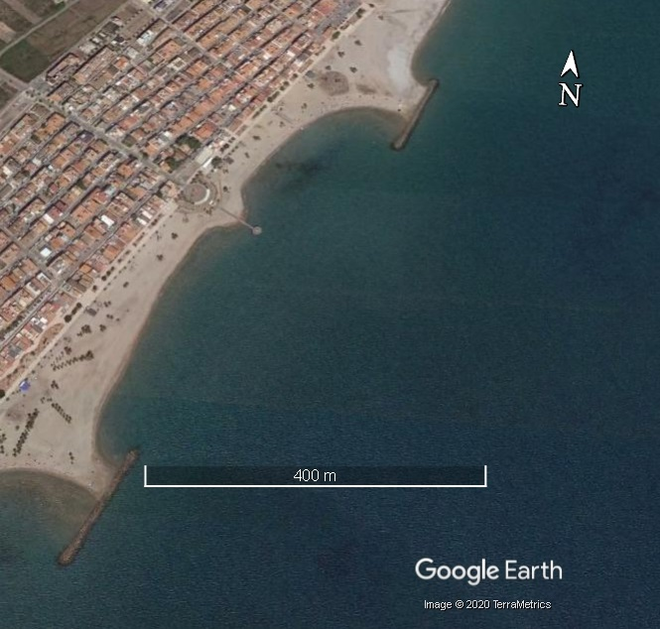
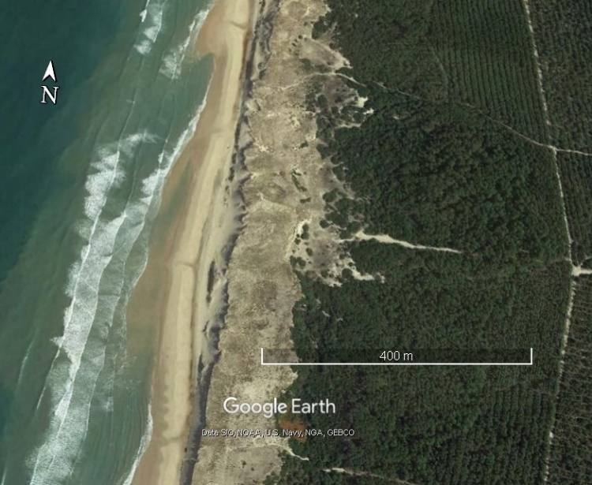
Case studies
Two sites
a/ Sites location
c/ Castellón (Chilches, site 2)
400 km
b/ Aquitaine (Naujac-sur-mer, site 1)
400 m
400 m

Slide 9
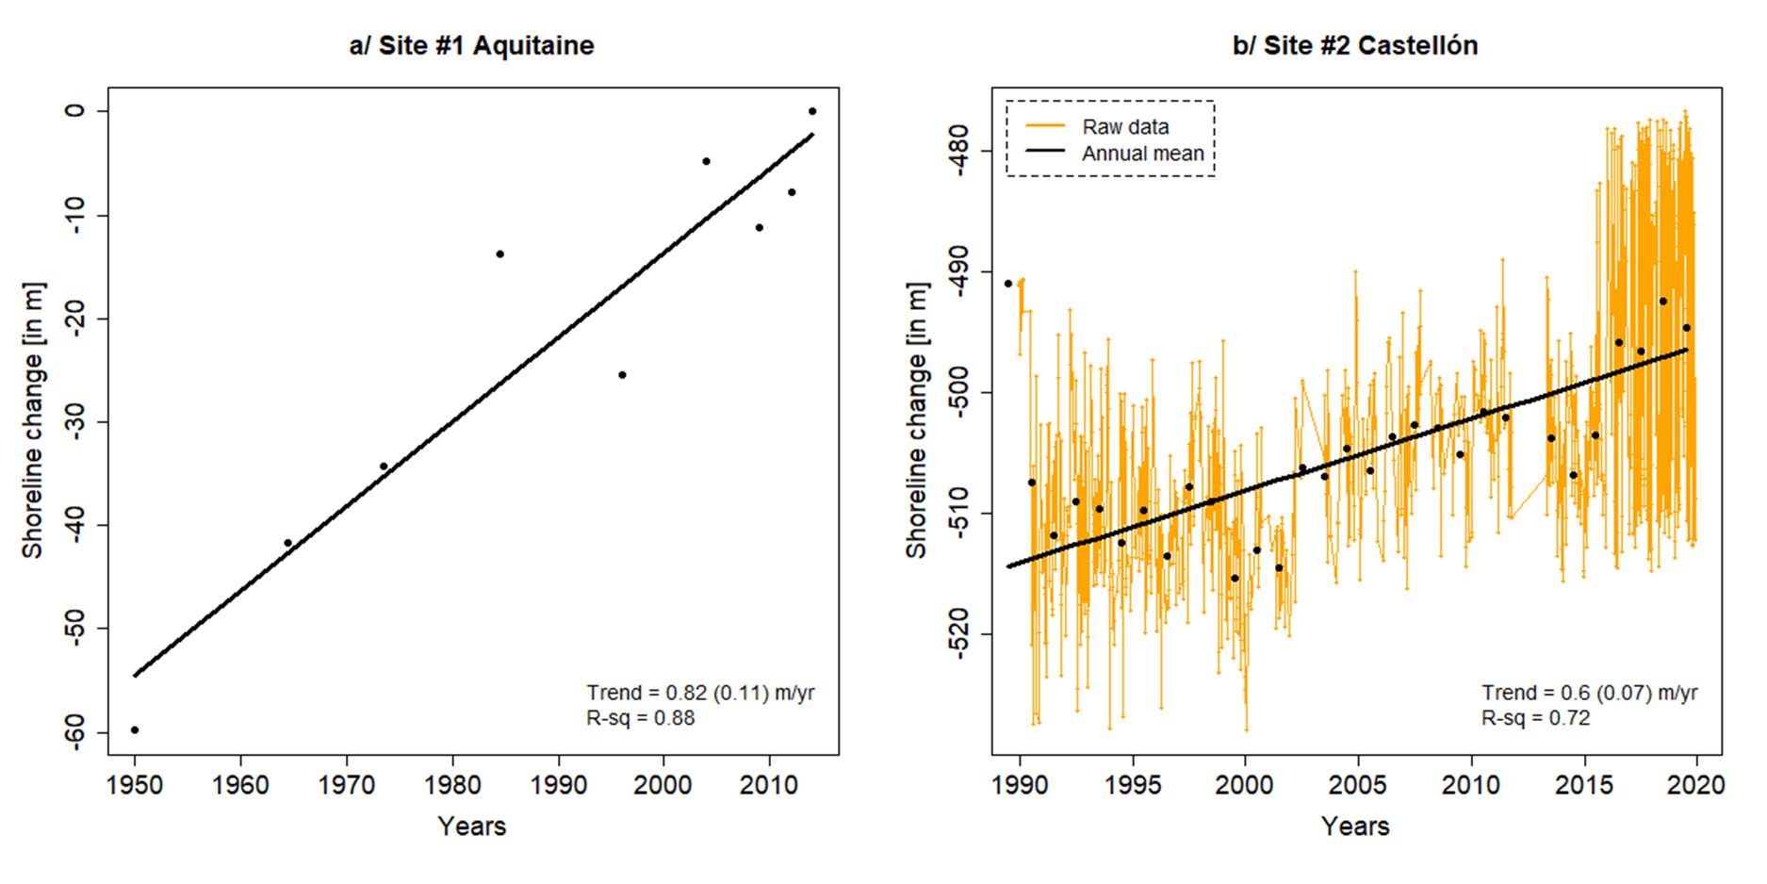
Case studies
Data
Observational records of shoreline change in Aquitaine and Castellon
orthomosaics photos (Castelle et al., 2018)
Satellite – CoastSat (Vos et al., 2019)
Both sites are eroding. Data sources and sampling are highly different

Slide 10
Case studies
Definition of uncertainties
Variable |  | Input definition | Value
Lvar | Aquitaine | Proba - gaussian | 7.3 m
 | Castellon | Proba – gaussian | 5 m
Tx | Aquitaine | Proba – gaussian | 0.72 +/- 0.11 m/yr
 | Castellon | Proba – gaussian | 0.50 +/- 0.07 m/yr
Tan β | Aquitaine | Possi - Trapeze | [1%,1.2%,1.5%,10%]
 | Castellon | Possi – Trapeze | [1.5%,2%,3.5%,10%]
Past SLR | Aquitaine | Proba – gaussian | 2.3 +/- 1 mm/year
 | Castellon | Proba – gaussian | 3.1 +/- 1 mm/year
Proj SLR 2100 (RCP8.5) | Aquitaine | Possi – Trapeze | [0.37,0.39,0.98,1.82]
 | Castellon | Possi – Trapeze | [0.44,0.47,1.03,1.83]

Slide 11
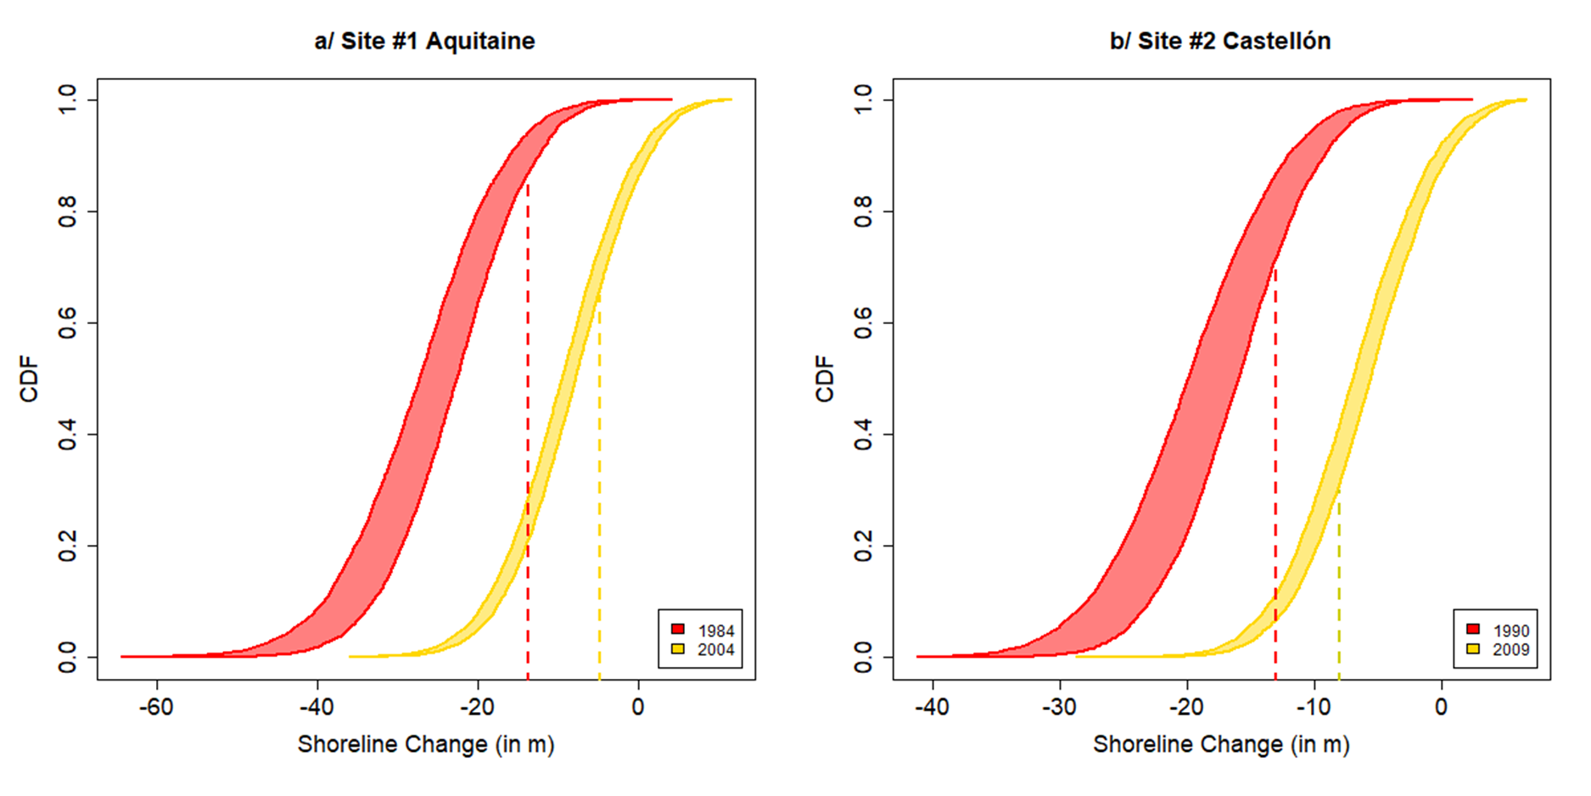
Results
Validation over the historical records
Past shoreline change p-box in Aquitaine and Castellon
obs
Site 1: 55% of the observations within the 25%-75% probability bounds
Site 2: 78% of the observations within the 25-75% probability bounds

Slide 12
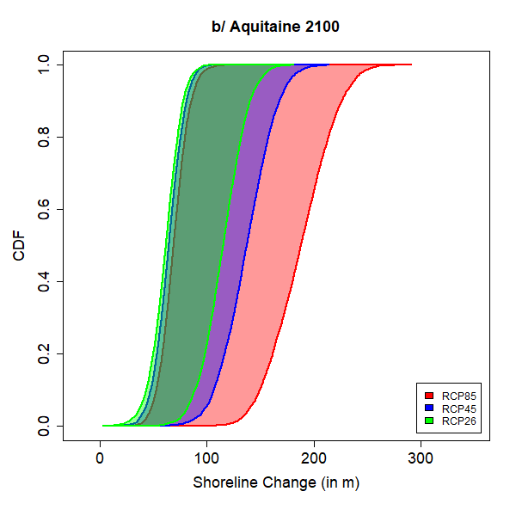
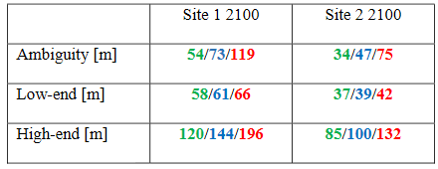
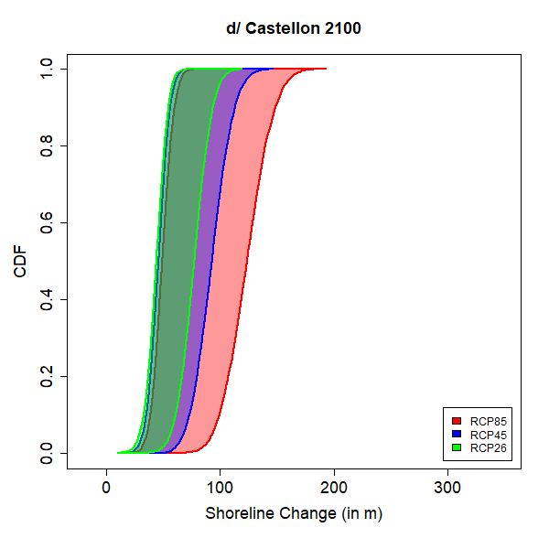
Results
Projections
ambiguity
low-end
high-end

Slide 13
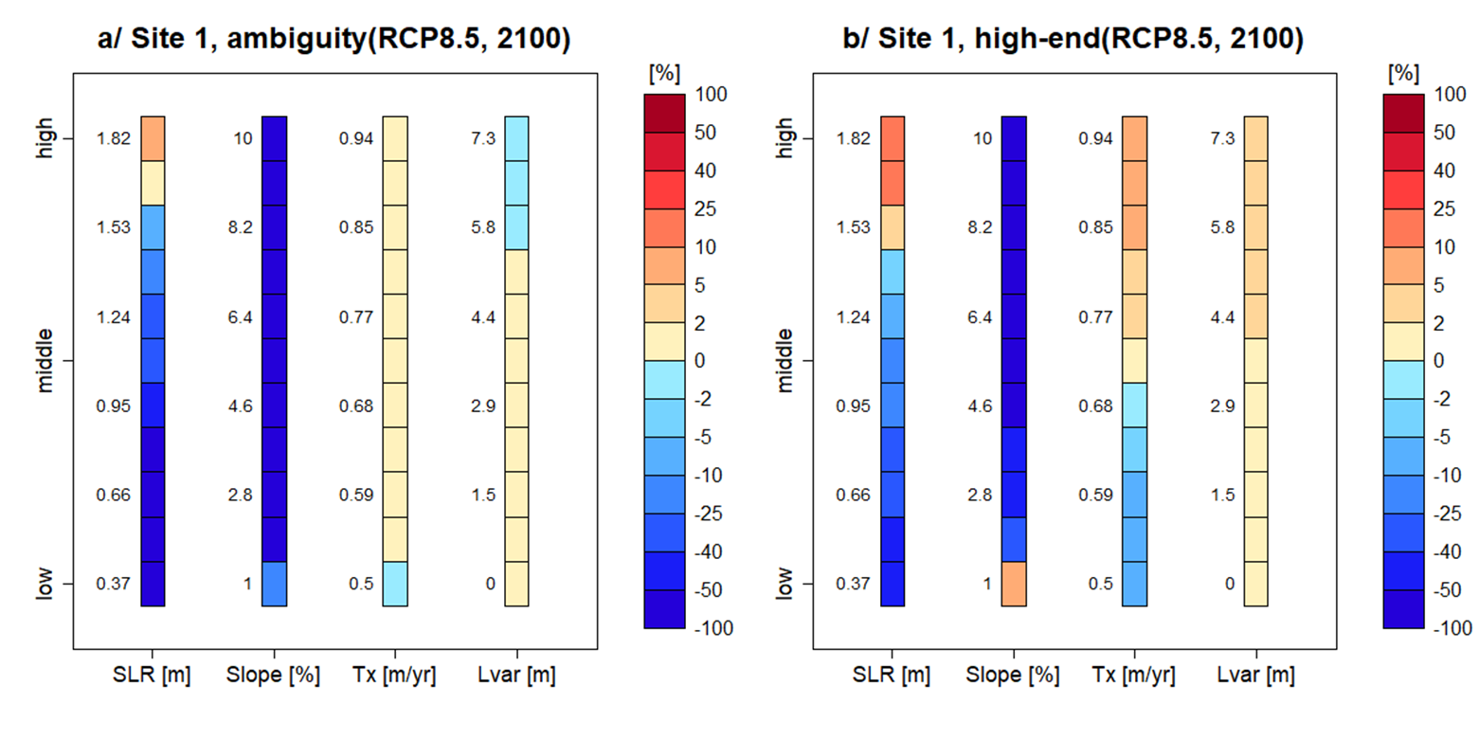
Results
Sensitivity of shoreline change projections to uncertainty sources
How ambiguity & high-end changes if a source of uncertainty is known exactly ?
If future SLR does not exceed the likely range (i.e. ~1 m), the ambiguity would be lowered by more than 50 %.

