Slide 1
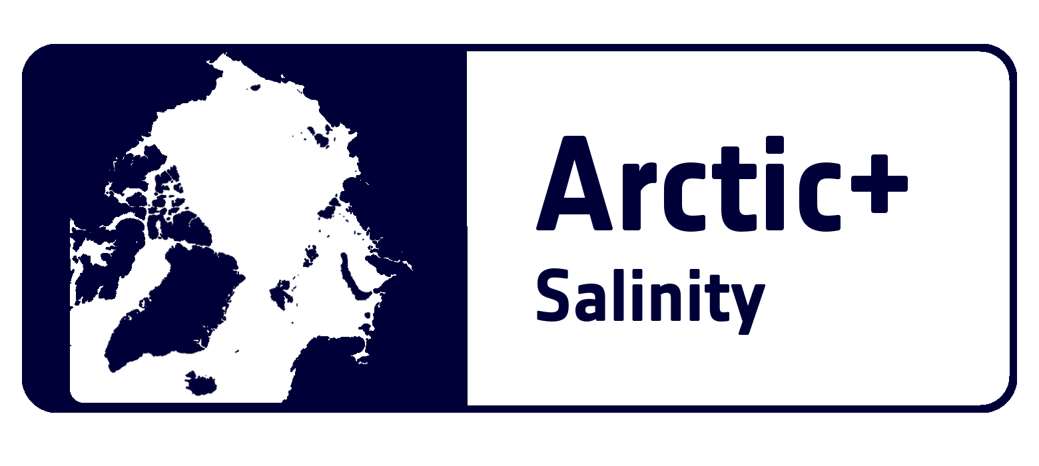
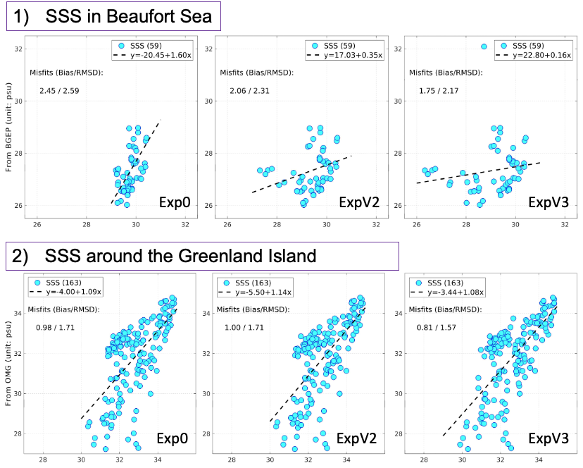
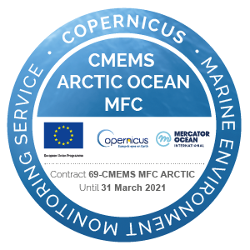

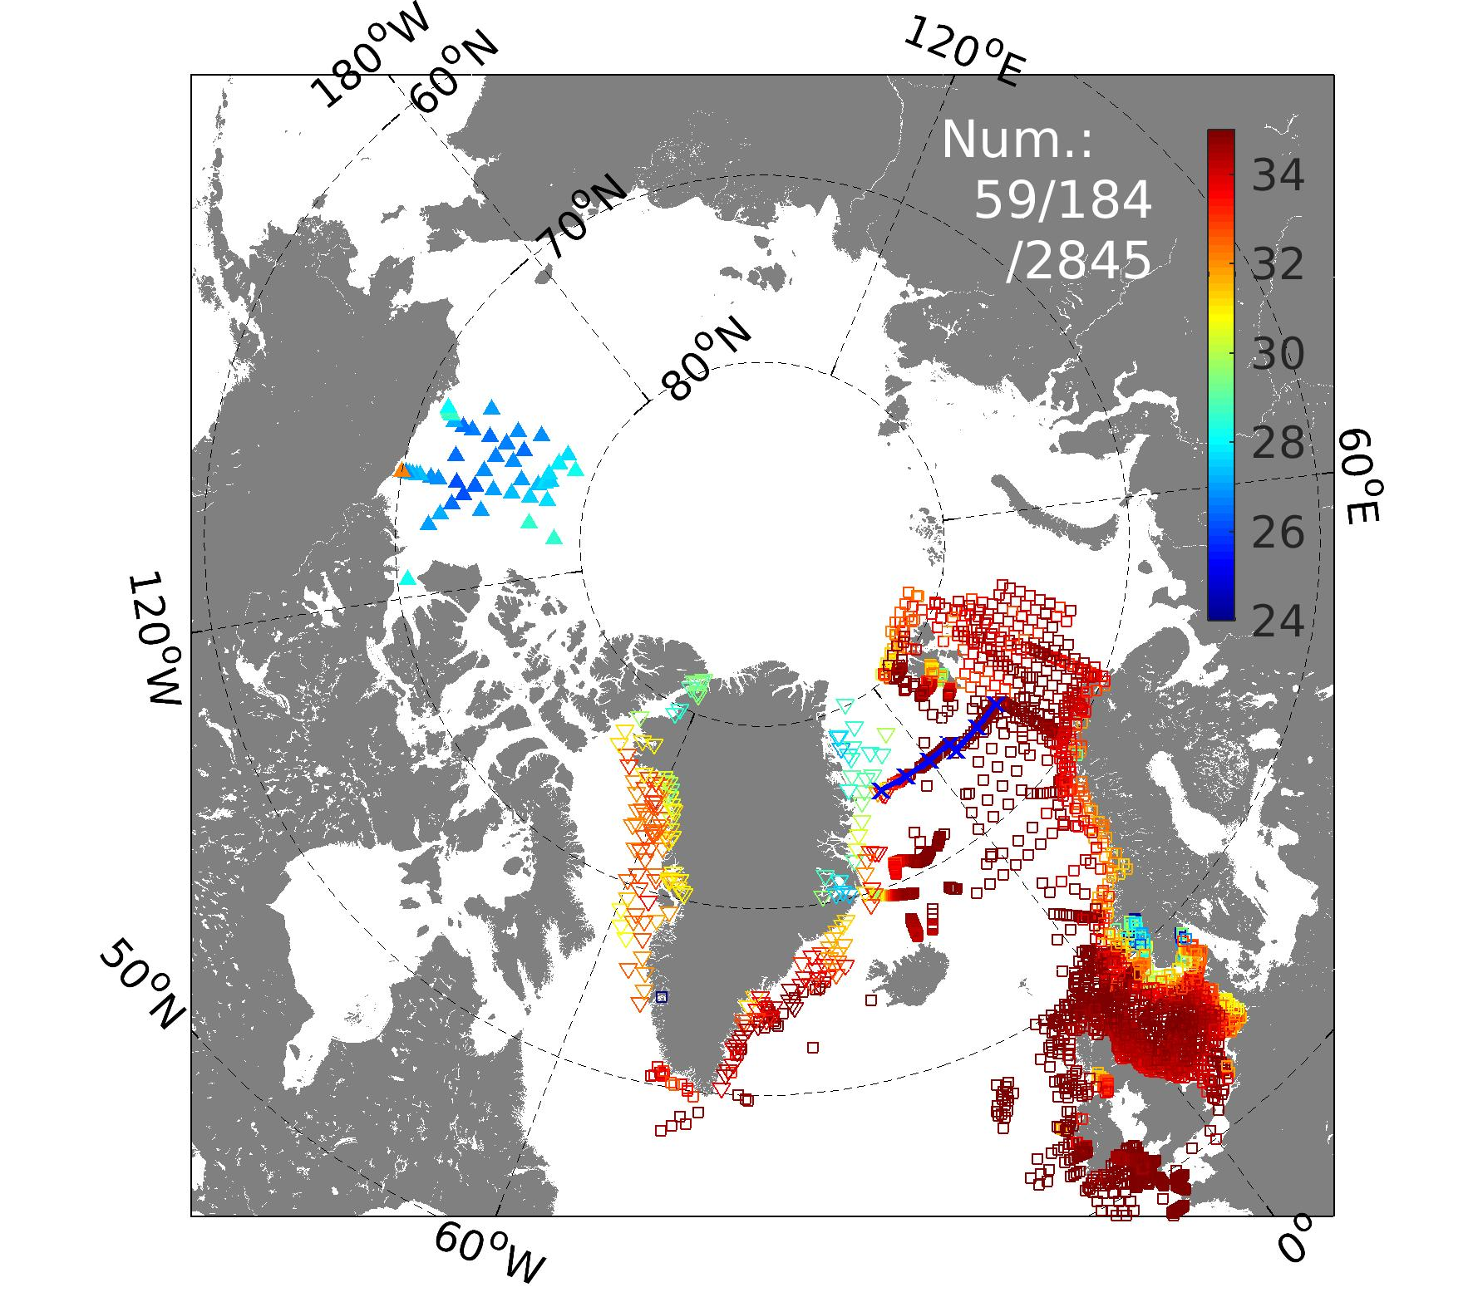
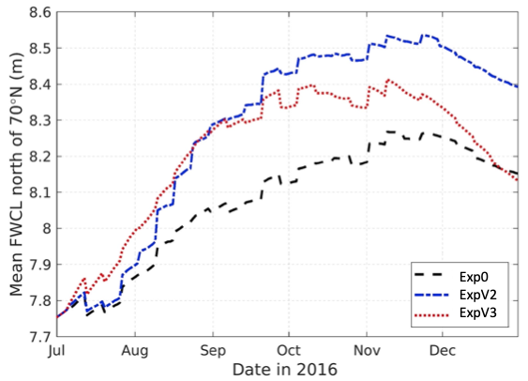


EGU21-2150: vEGU21|19-30 April 2021
Salty bias/RMSE decreased
Impacts of assimilating Arctic surface sea salinities from SMOS in a coupled ocean and sea ice reanalysis
15.9%/10.8%
28.6%/16.2%
Jiping Xie¹, Roshin P. Raj¹, Laurent Bertino¹, Justino Martínez², Carolina Gabarró², and Rafael Catany3³
1. Nansen Environmental and Remote Sensing Center, Norway
2. Barcelona Expert Center, Spain
3. ARGANS, UK
Contact: jiping.xie@nersc.no
TOPAZ assimilation setting: DEnKF with 100 member; Weekly assimilation all ocean and ice observations; Time period: July-Dec. 2016
Exp0: using the default assimiation setting but no SSS assimilation. (CMEMS portal: ARCTIC_REANALYSIS_PHYS_002_003)
ExpV2: Exp0 + Arctic SSS Version 2 from BEC (bec.icm.csic.es; released in 2018)
ExpV3: Exp0 + Arctic SSS Version 3.1 from the ESA project: Arctic+SSS
17.3%/8.2%
In-situ SSS for validation :
Mean Fresh Water Content (>70ºN)
(Proshutinsky et al., 2009)
BGEP: Beaufort Gyre Experiment Project (WHOI)
Greenland project (NASA): OMG https://omg.jpl.nasa.gov/portal/browse/
ICES(https://ocean.ices.dk/HydChem/HydChem.aspx?plot=yes)
1)
3)
2)
S_{ref} =34.8
Integration depth; S≤34.8
Summary: A novel sea surface salinity data product from SMOS has been tested for assimilation, the results show the V3 product of SSS is advantager than the V2, and therefore being more fit for the Arctic reanalysis.

