Slide 1

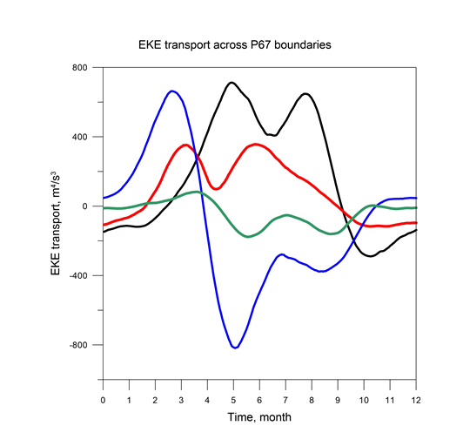
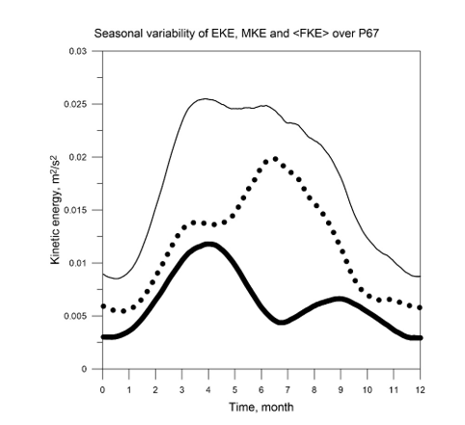
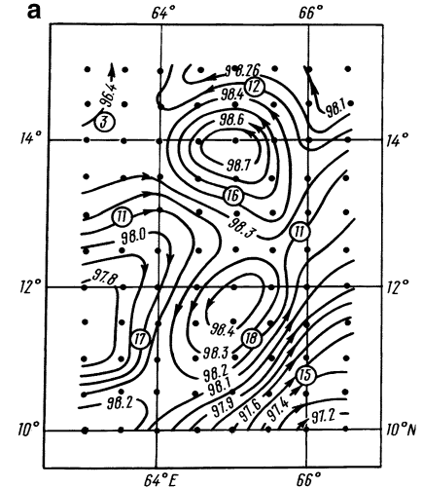
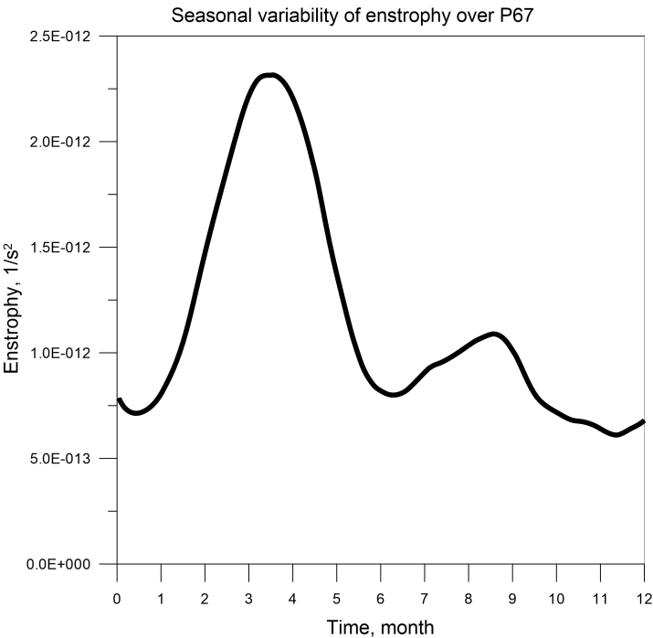

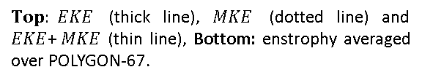
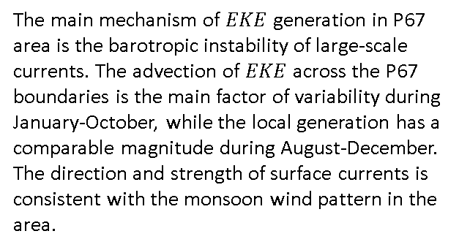
Generation and seasonal variability of eddy kinetic energy in the central Indian Ocean
Georgy I. Shapiro and Jose Maria Gonzalez-Ondina
INTRODUCTION
The breakthrough in our knowledge of ocean eddies came with the discoveries of open ocean eddies in the POLYGON-67 (P67) experiment in the central Indian Ocean [Штокман и др., 1969].
RESULTS
Transports through the west (black line), east (red line), south (blue line) and north (green line) boundaries
$Top: EKE$ (thick line), $MKE$ (dotted line) and $EKE$+$MKE$ (thin line), Bottom: enstrophy averaged over POLYGON-67.
CONCLUSIONS
The main mechanism of $EKE$ generation in P67 area is the barotropic instability of large-scale currents. The advection of $EKE$ across the P67 boundaries is the main factor of variability during January-October, while the local generation has a comparable magnitude during August-December. The direction and strength of surface currents is consistent with the monsoon wind pattern in the area.
Dynamic topography and geostrophic currents at 150m (January 21–February 7, 1967)
The current study extends the original findings to assess the generation mechanisms and seasonal variability of Indian Ocean mesoscale eddies in the same area.
REFERENCE. Shapiro, G.I. and Gonzalez-Ondina, J.M., 2020. Seasonal Variability of Eddy Kinetic Energy in the Central Indian Ocean: POLYGON-67 Revised. Physical Oceanography, 27(6), pp. 573-589. doi:10.22449/1573-160X-2020-6-573-589

