Slide 1
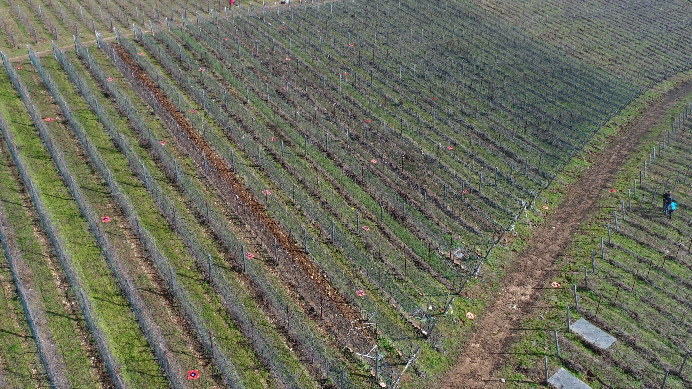








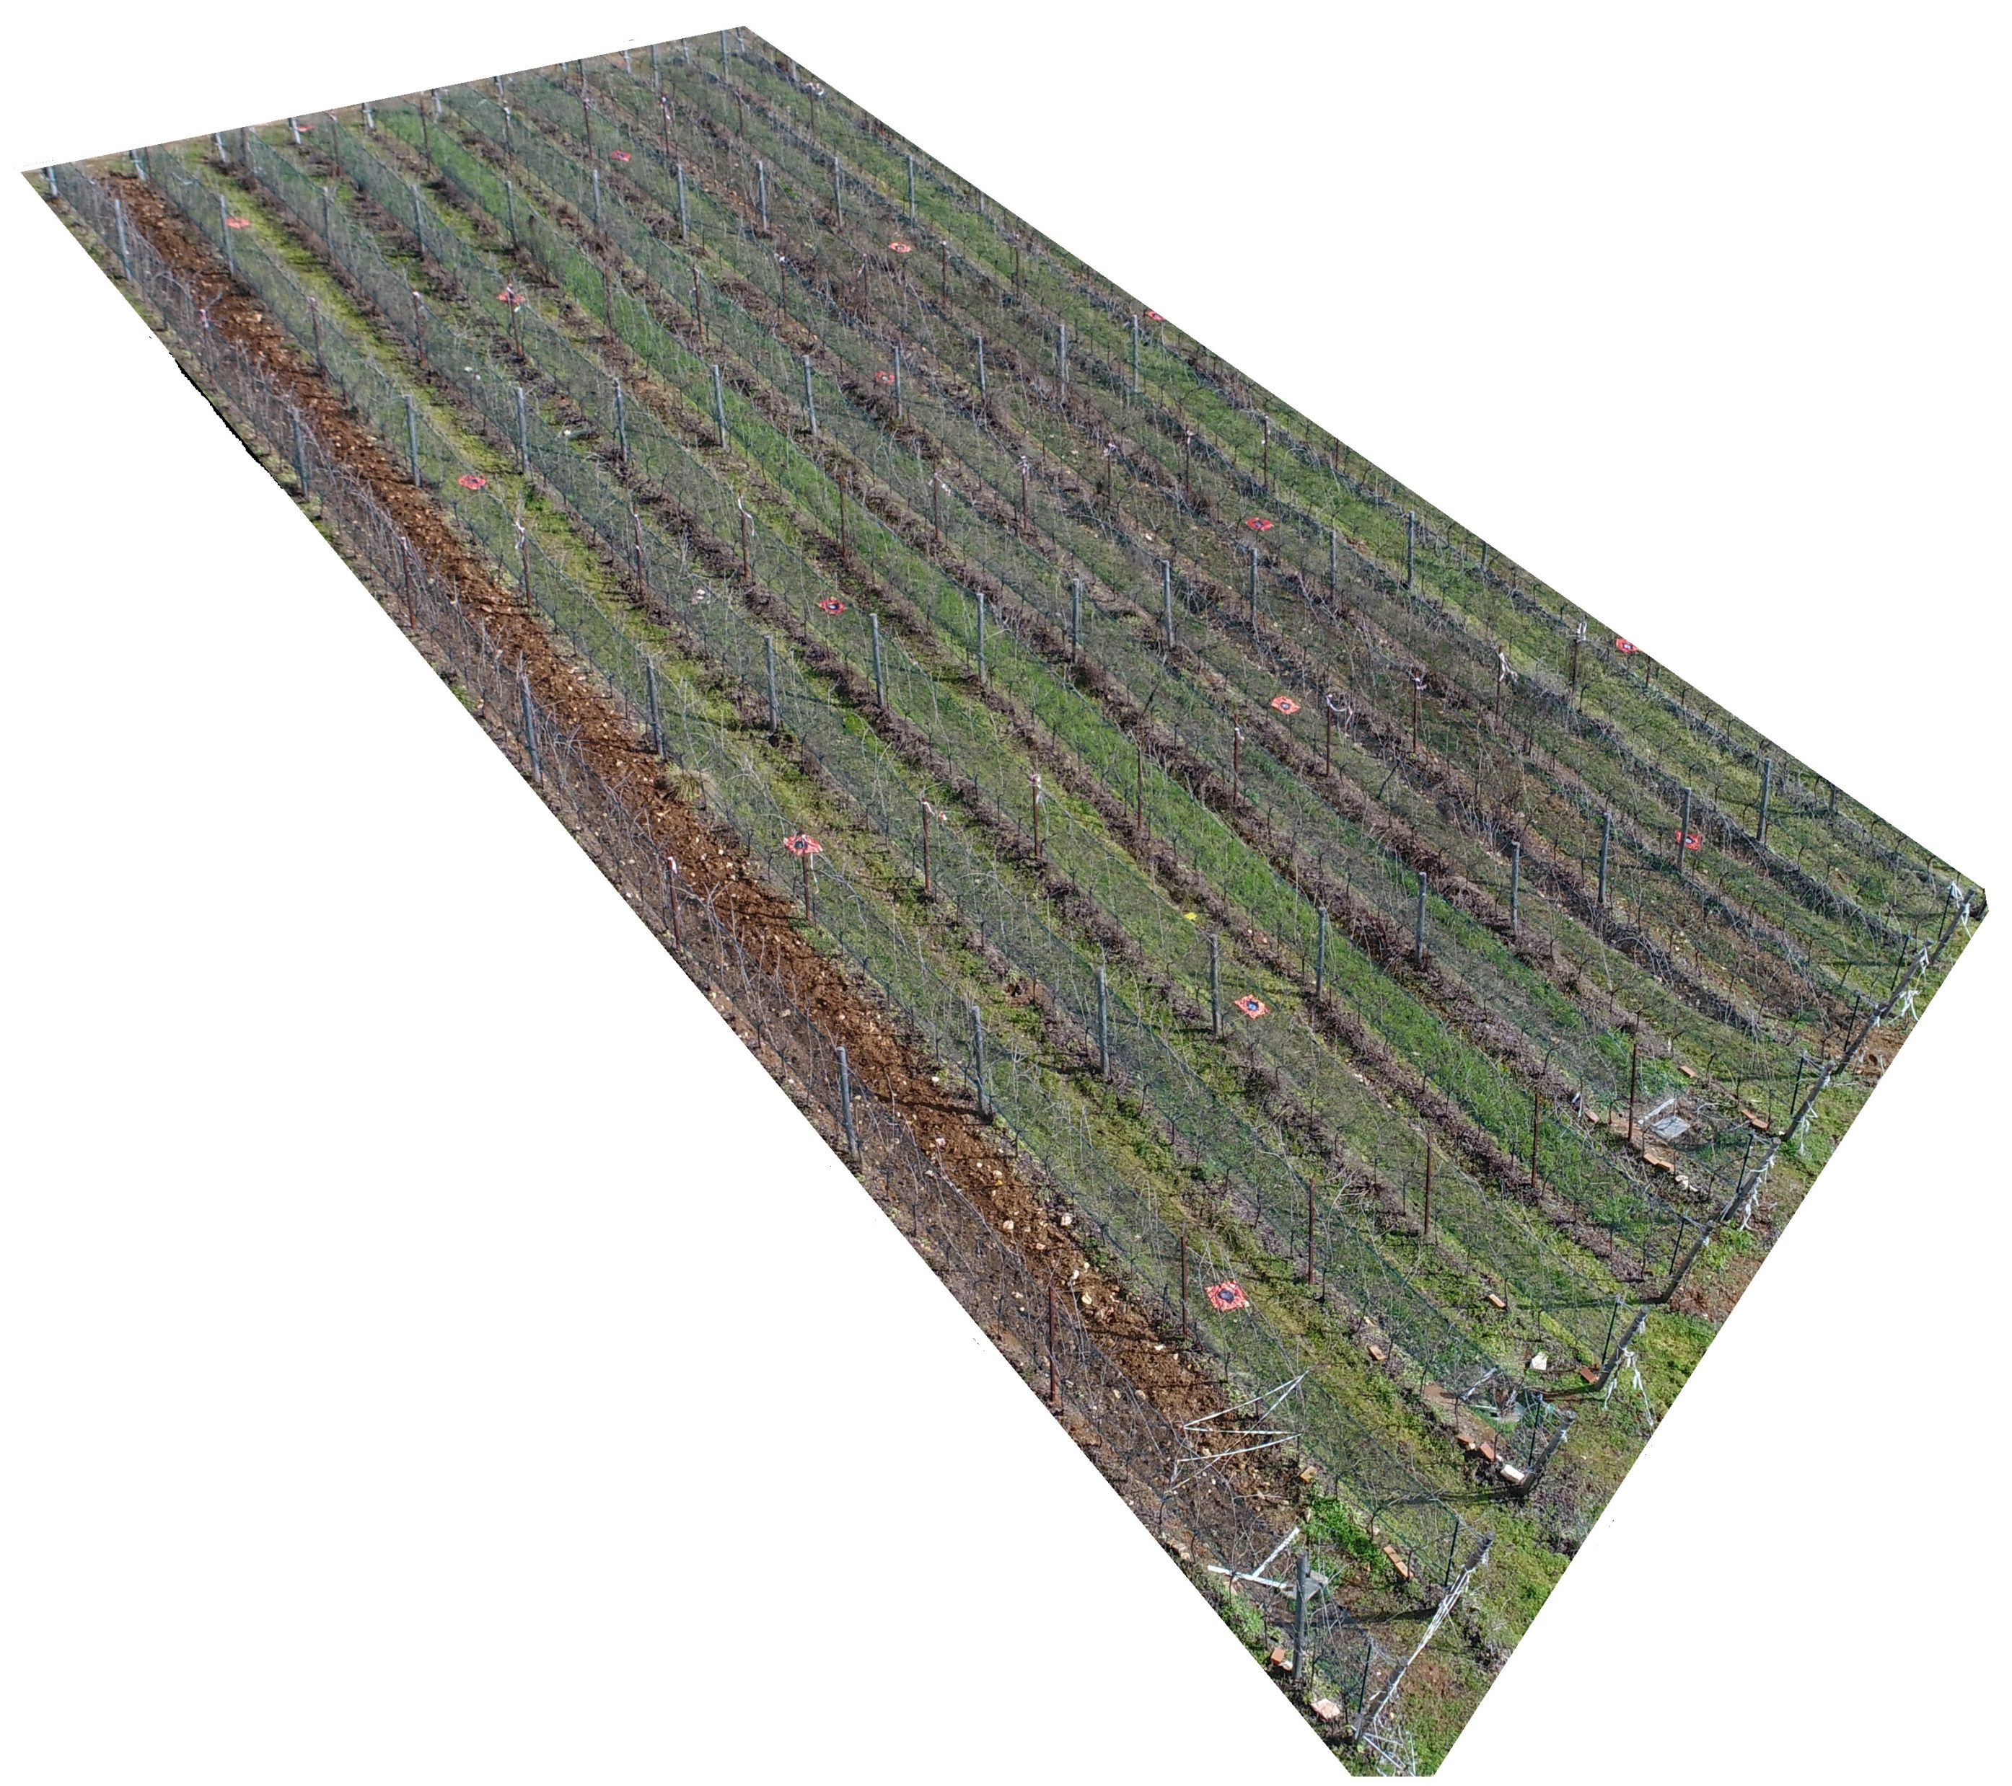













https://doi.org/10.5194/egusphere-egu21-2158
Earth Surface Processes
and Society
(2)
study area
AIM OF THE RESEARCH
(3)
methods
(1)
introduction
(4)
results
The role of inter-row grass cover in steep viticulture: understanding soil erosion combining in-field observation and remote sensing
Eugenio Straffelini ⁽¹⁾, Stefan Otto ⁽²⁾, Anton Pijl ⁽¹⁾, Enrico Marchesini ⁽³⁾, Simone Gottardi ⁽³⁾, Nicola Tormen ⁽⁴⁾, Andrea Pitacco ⁽¹⁾, Luca Tezza ⁽¹⁾, Paolo Tarolli⁽¹⁾
(5)
outcomes
⁽¹⁾ Department of Land, Environment, Agriculture and Forestry, University of Padova, 35020 Legnaro (PD), Italy, eugenio.straffelini@unipd.it
⁽²⁾ National Research Council, Institute for Sustainable Plant Protection, Agripolis, 35020 Legnaro (PD), Italy, stefan.otto@cnr.it
⁽³⁾ Agrea s.r.l, 37057 San Giovanni Lupatoto (VR), Italy, enrico.marchesini@agrea.it
⁽⁴⁾ WBA Project s.r.l, 37137 Verona (VR), Italy, nicola.tormen@gmail.com

Slide 2













https://doi.org/10.5194/egusphere-egu21-2158
Earth Surface Processes
and Society
This work aims to evaluate the effectiveness of different types of grass cover in terms of erosion and runoff generation in steep slope viticulture.
We propose the combination of 2 different approach:
  Field-based measurement of water & sediment using special traps;
  Modelling based on high-resolution UAV-SfM data
(1)
introduction
AIM OF THE RESEARCH
(2)
study area
(3)
methods
(4)
results
(5)
outcomes
home:

Slide 3
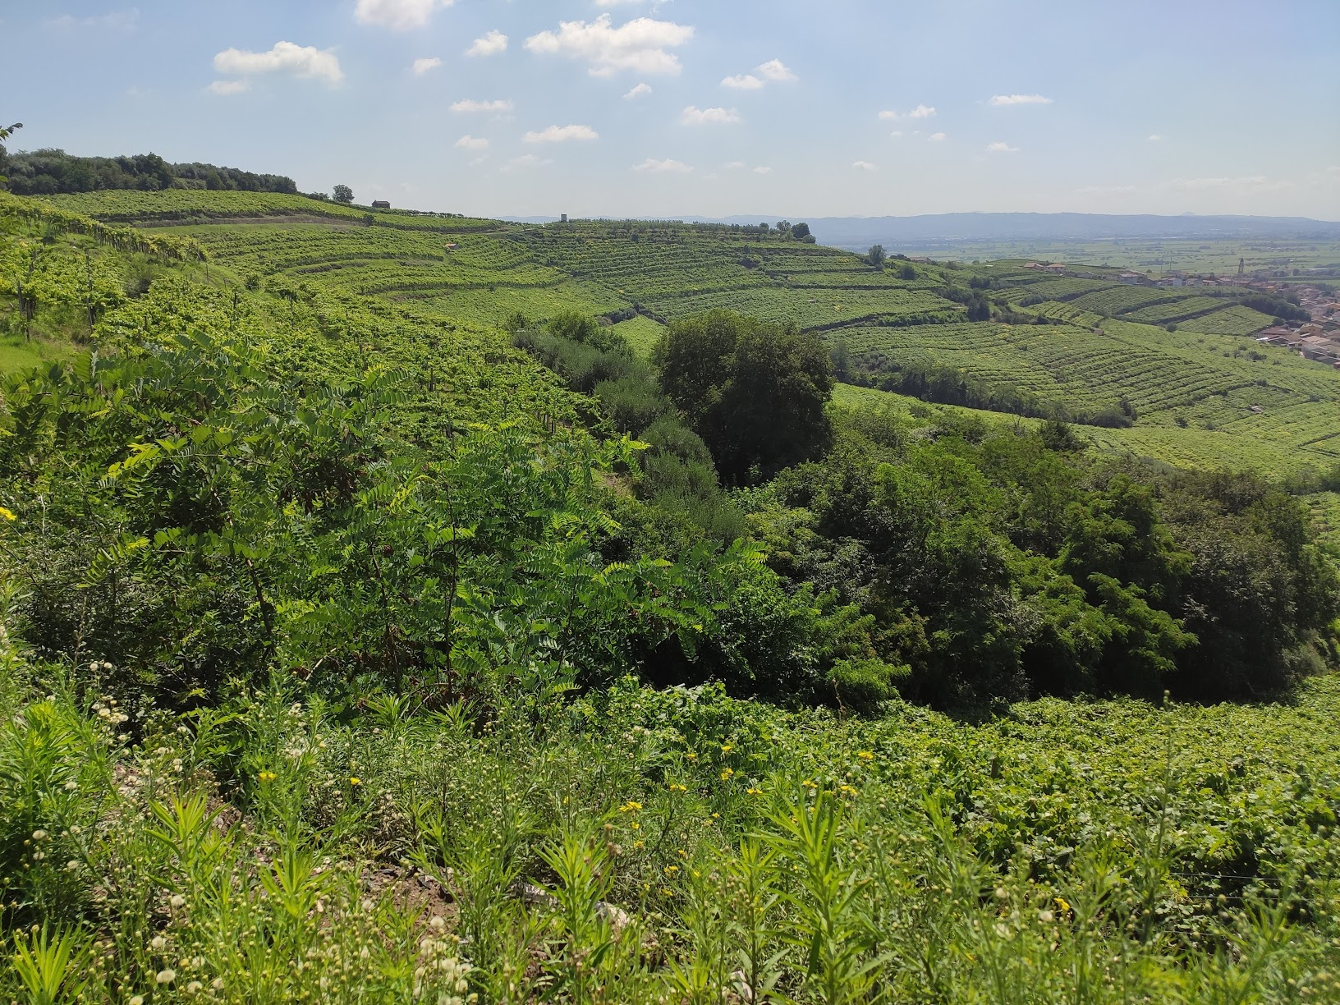
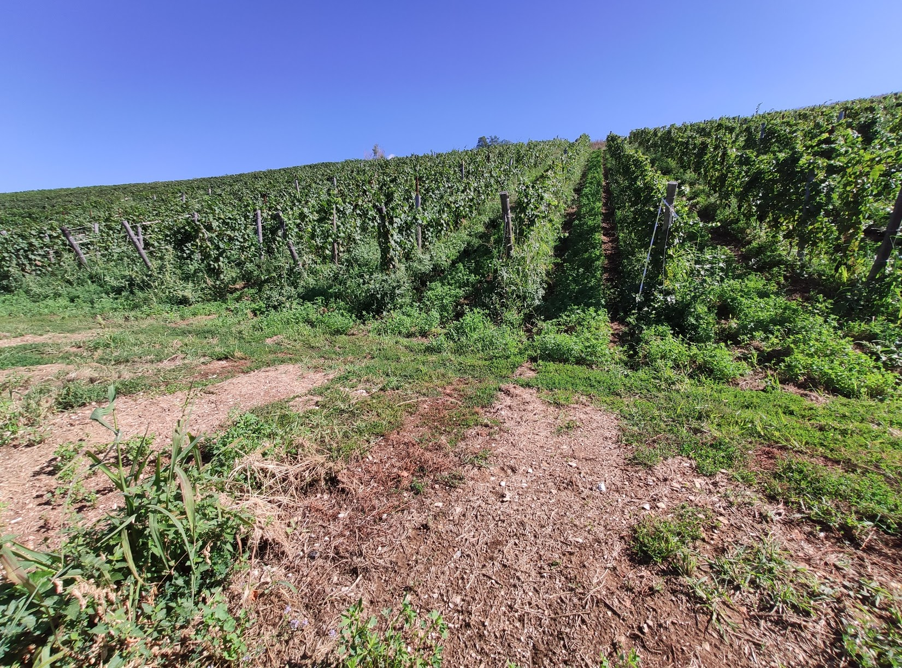
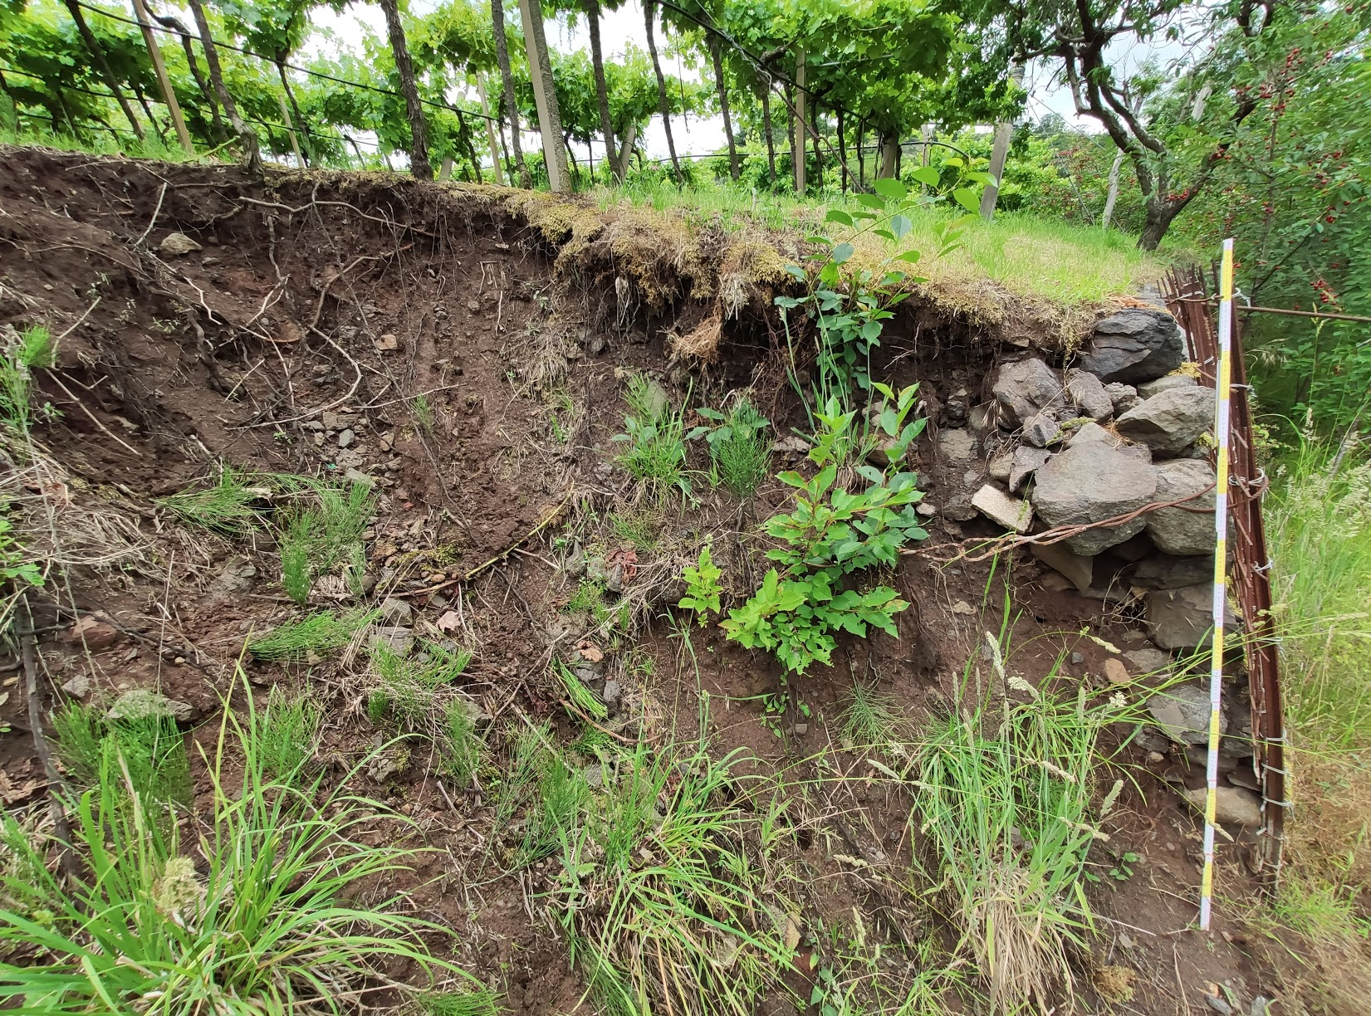
https://doi.org/10.5194/egusphere-egu21-2158
Earth Surface Processes
and Society
Steep slope viticulture is a common practice in the Mediterranean basin offering landscapes of considerable environmental and socio-economic value. However, these complex agricultural systems are very fragile.
One of the main problems is soil erosion due to extreme rainfall, both in terms of drop splash and water accumulation. This may cause a progressive reduction in soil fertility and the occurrence of instabilities and land degradation phenomena.
Sustainable farming techniques may provide innovative solutions to reduce the risk of soil erosion. A virtuous approach involves the use of herbaceous coverings between the rows of vines, for many reasons. They provide active protection from the kinetic energy of water droplets; reduce the amount of water flowing on the surface positively affecting the infiltration capacity of the soil; improve ecosystem services in the vineyard.
(1)
introduction
home:

Slide 4
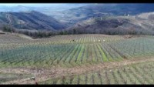
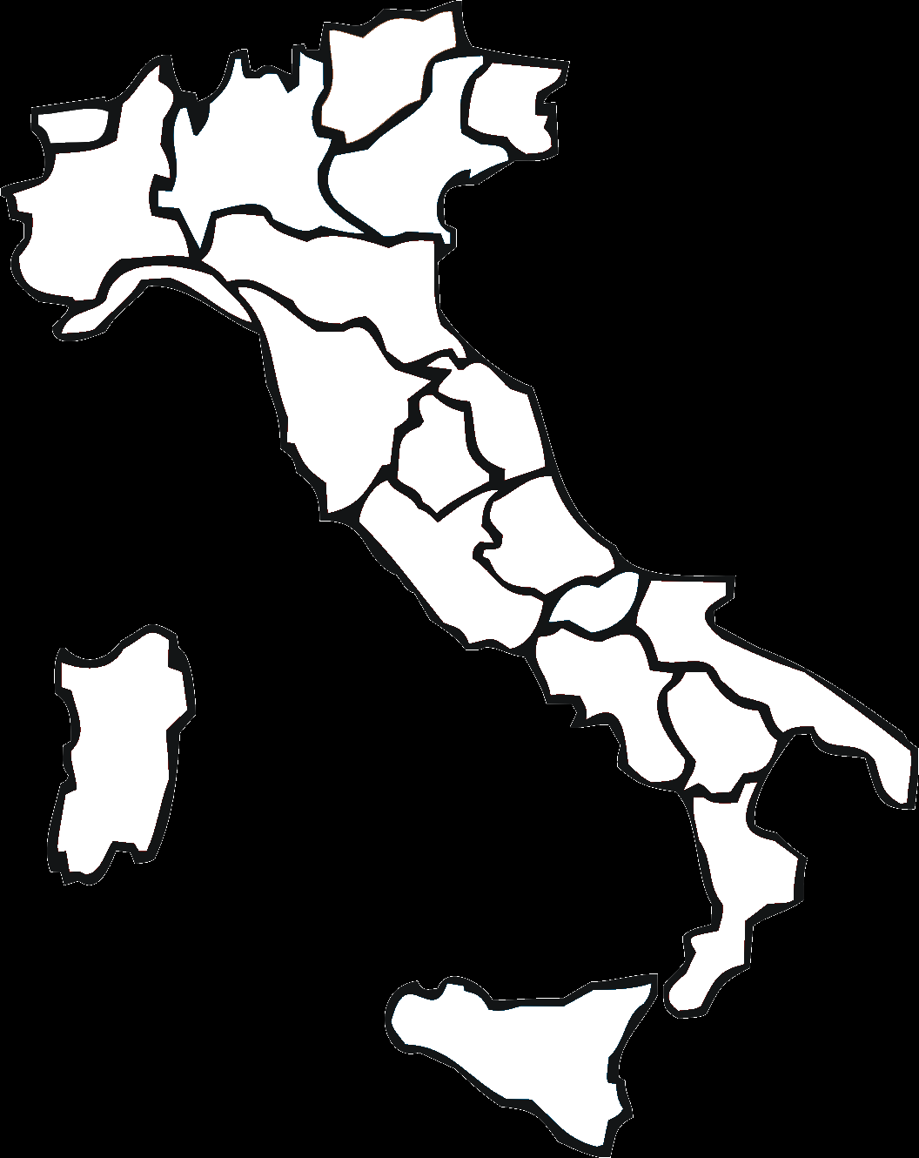


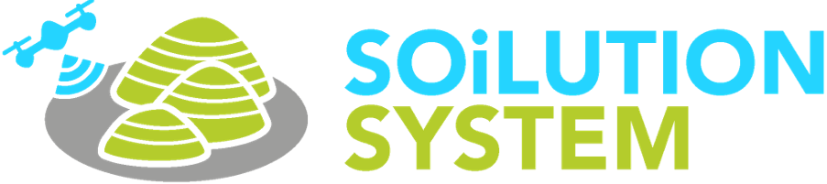
https://doi.org/10.5194/egusphere-egu21-2158
Earth Surface Processes
and Society
Veneto region, IT
(2)
study area
home:
www.soilutionsystem.com

Slide 5




https://doi.org/10.5194/egusphere-egu21-2158
Earth Surface Processes
and Society
grass cover comparison
(3)
methods
Continuous tillage
Native
erosion/deposition analysis
Single tillage
Nectariferous
(year 1 & 2)
home:
Reference

Slide 6
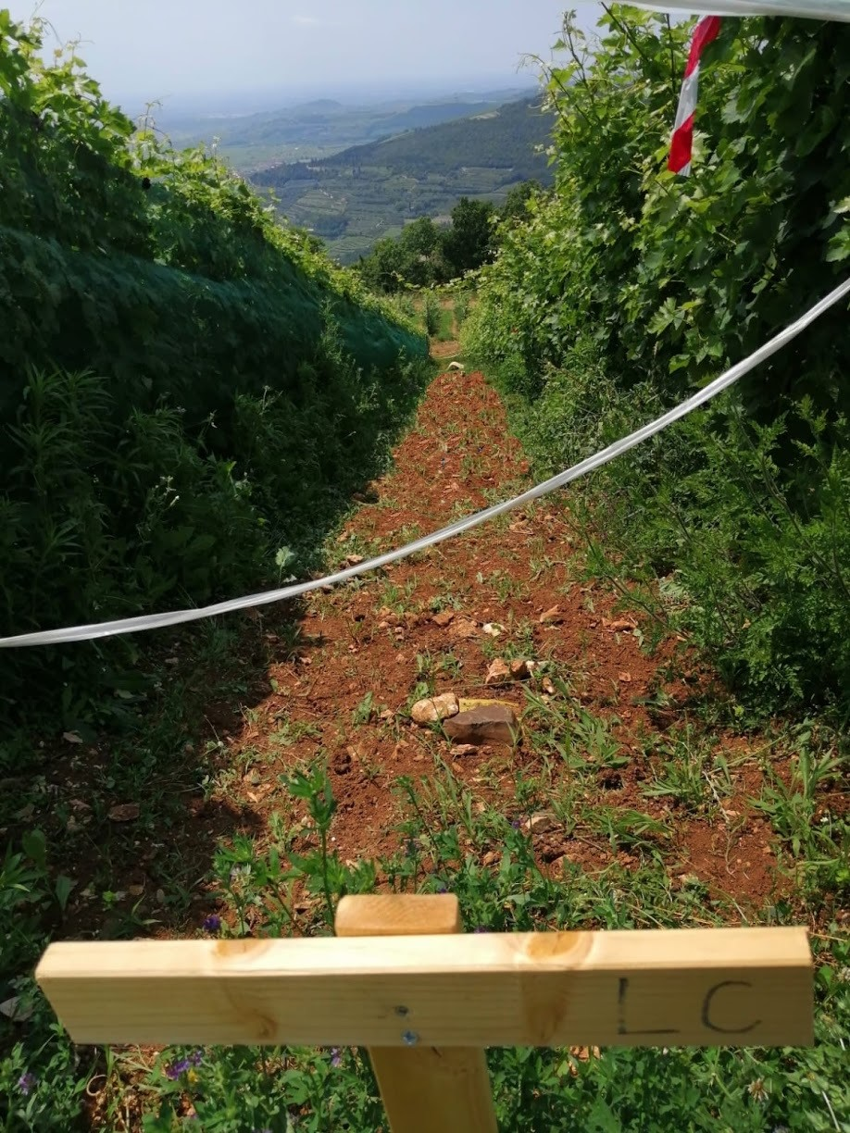
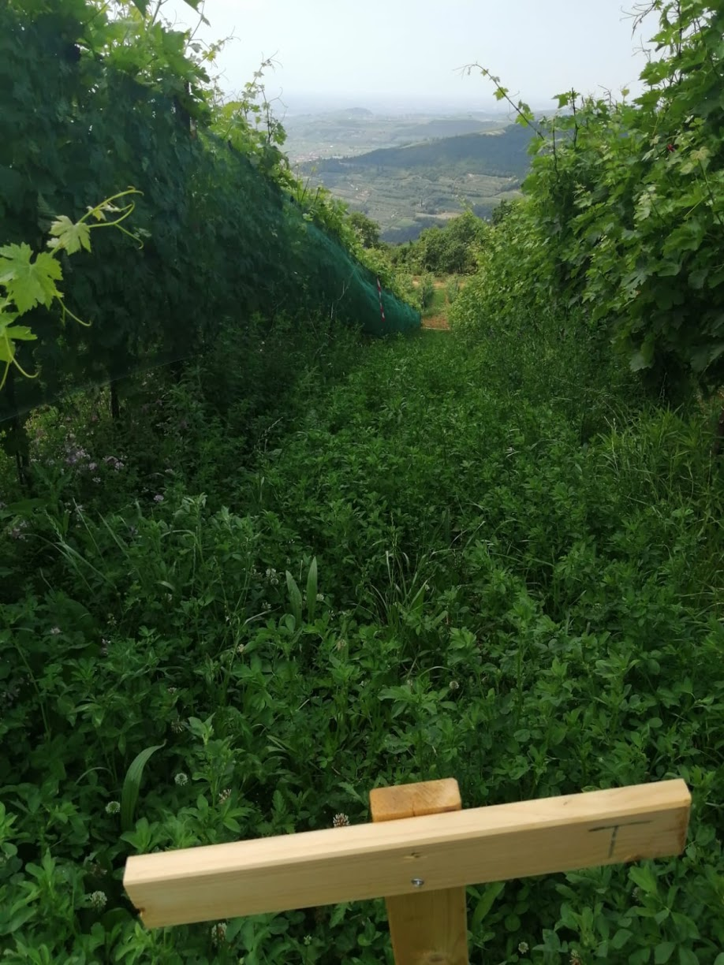
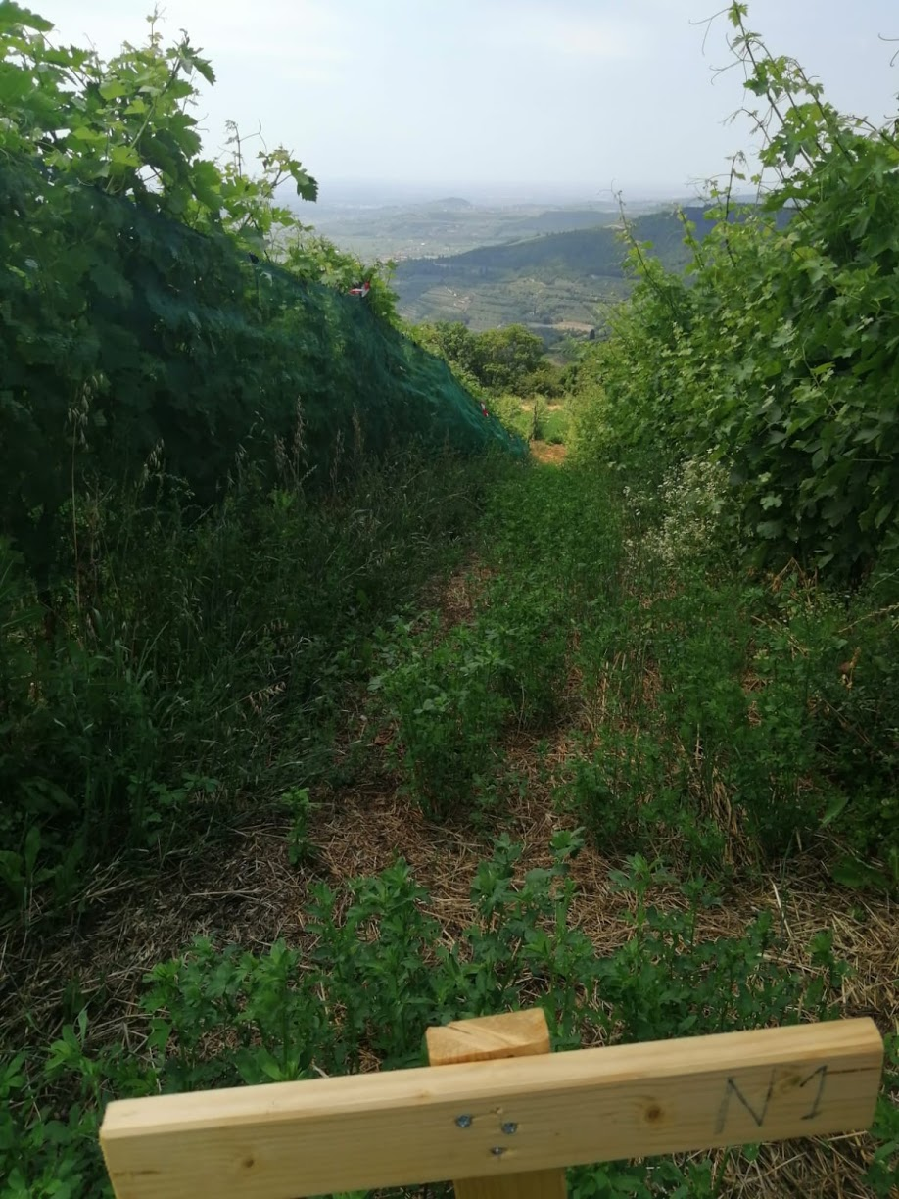
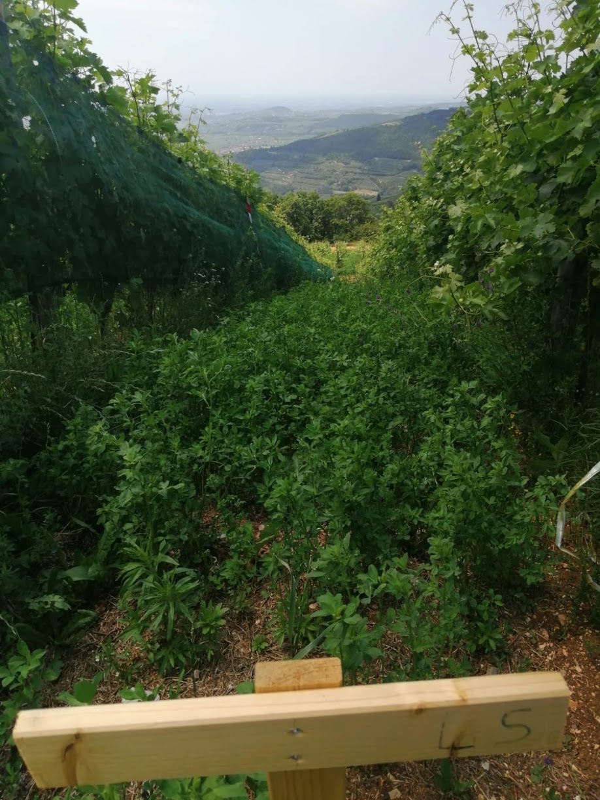
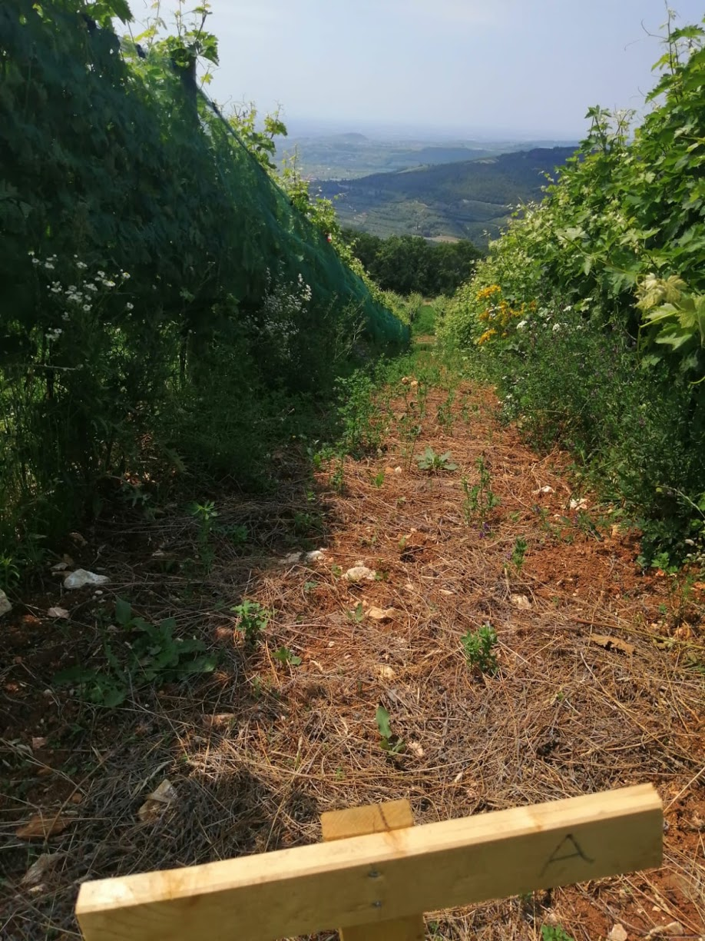


https://doi.org/10.5194/egusphere-egu21-2158
Earth Surface Processes
and Society
grass cover comparison
(3)
methods
Continuous tillage
Reference
Nectariferous
Single tillage
Native
methods:
Row ploughed continuously throughout the year to ensure bare soil removing grass and vegetation cover
Row managed in the same way as the vineyard is traditionally managed. Constant herbaceous cover throughout the year and use of machinery
Row managed by annual herbaceous cover designed to promote rapid growth and consisting of pollen and nectar seed mix. Use of machinery
Row ploughed and sown in autumn and not tilled again during the year. Use of machinery
Row sown with native species of the place where the vineyard is located. Use of machinery
home:

Slide 7





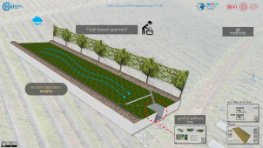
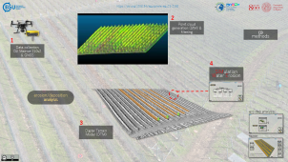
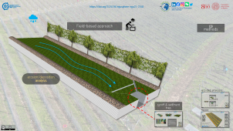
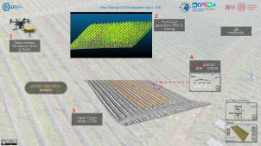
https://doi.org/10.5194/egusphere-egu21-2158
Earth Surface Processes
and Society
Field-based approach
(3)
methods
erosion/deposition analysis
Modelling approach
methods:
home:

Slide 8





https://doi.org/10.5194/egusphere-egu21-2158
Earth Surface Processes
and Society
Field-based approach
(3)
methods
erosion/deposition analysis
ero-dep analysis:
runoff & sediment trap
home:

Slide 9
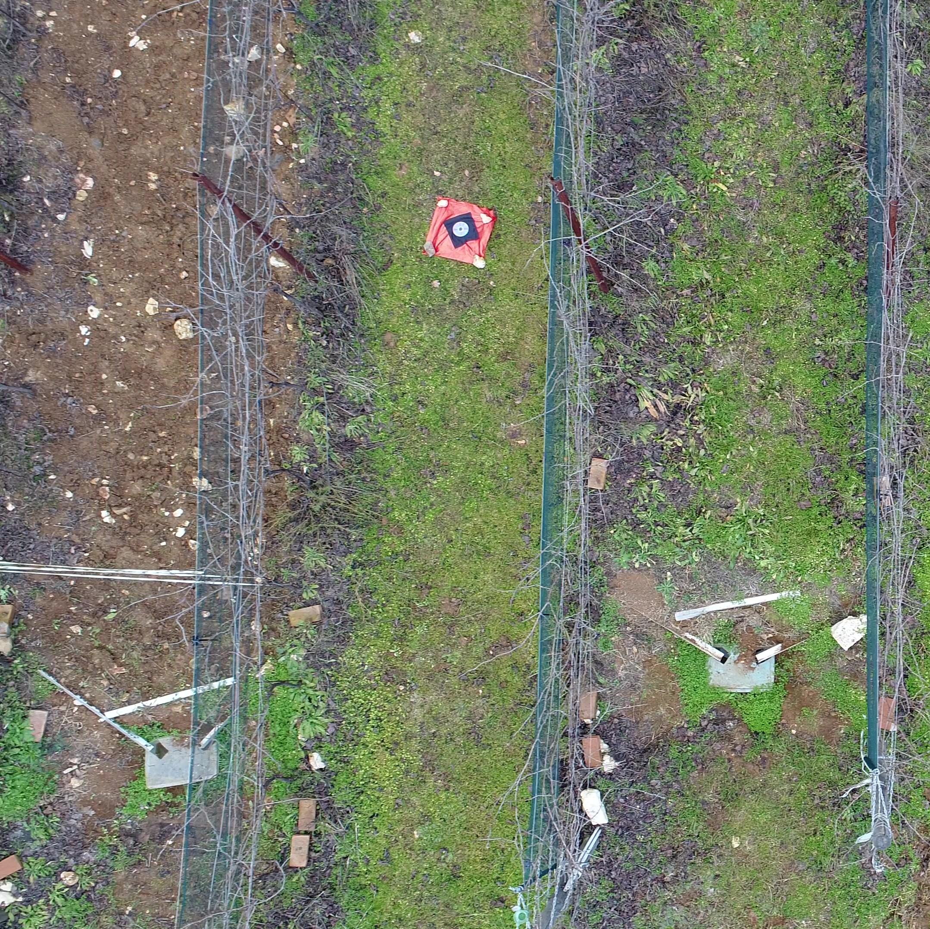
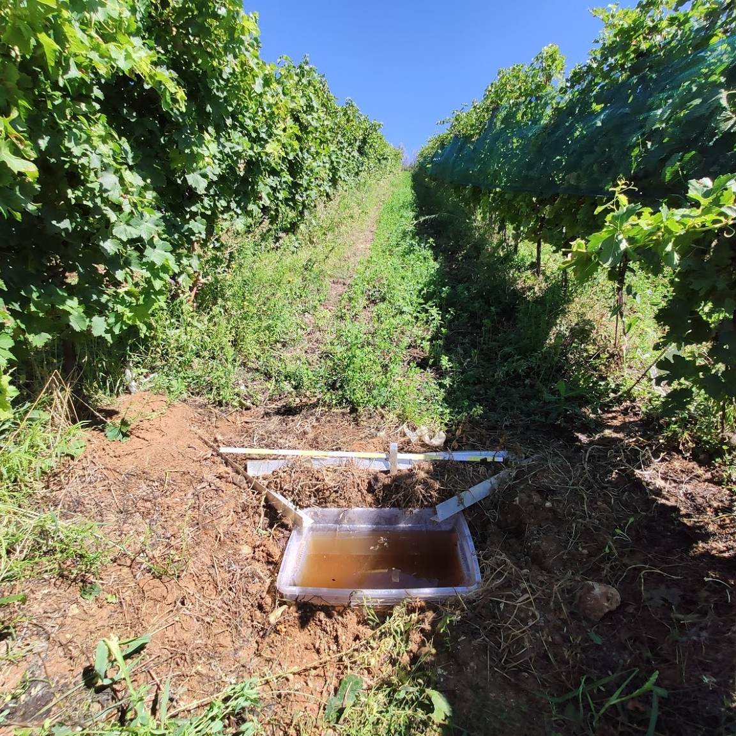



https://doi.org/10.5194/egusphere-egu21-2158
Earth Surface Processes
and Society
80 m²
25 %
Setting up of a system (cost-effective and easy-to-install) that collect runoff/sediment transported to the bottom of the experimental rows;
The system consists of a box and aluminum channels that transport the runoff/sediment inside;
Rainfall is constantly monitored using weather station data and from field measurements of total precipitation;
Following the intense precipitation that generated the runoff, the amount of water in the box is measured and a sample is collected. By sediment concentration analysis, the amount of soil and water caused by the precipitation is estimated;
This provides an assessment of the runoff and sediment generating capacity of each type of management studied.
Field-based approach:
home:

Slide 10
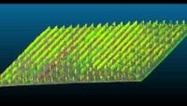

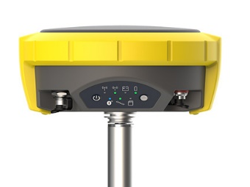
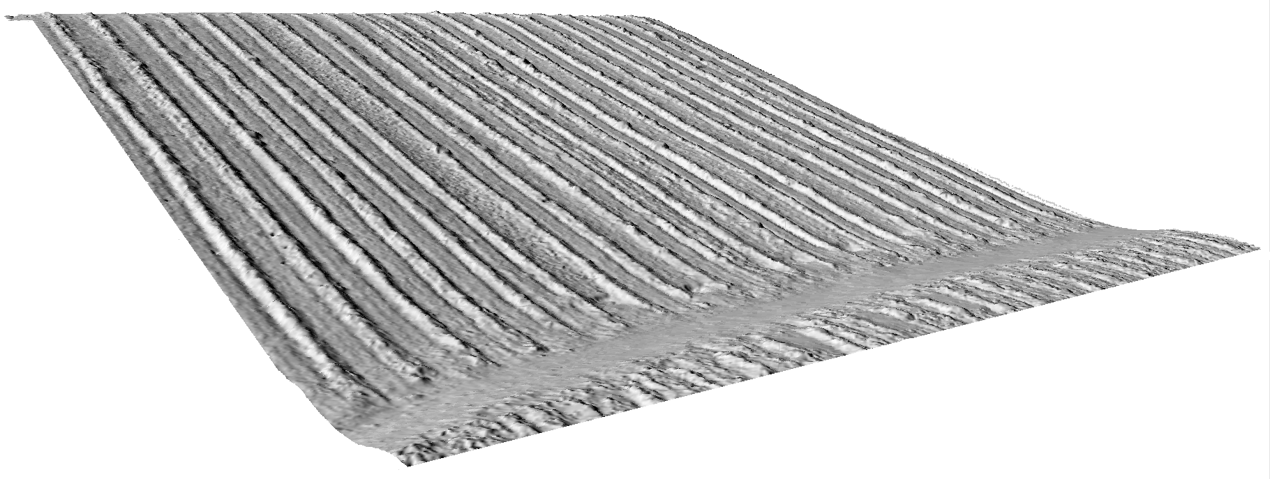


https://doi.org/10.5194/egusphere-egu21-2158
Earth Surface Processes
and Society
2
Point cloud generation (SfM) & filtering
(3)
methods
1
Data collection
DJI Matrice 210v2 & GNSS
4
SIMulation Water Erosion
erosion/deposition analysis
ero-dep analysis:
3
Digital Terrain Model (DTM)
home:

Slide 11



https://doi.org/10.5194/egusphere-egu21-2158
Earth Surface Processes
and Society
erosion/deposition analysis
(3)
methods
SIMWE
r.sim.water
r.sim.sediment
simulation of surface runoff
simulation of soil erosion/transportation/deposition
input
output
input
output
DTM
Soil infiltration rate
Rainfall value
Manning value
Runoff depth (mm)
Runoff discharge(m³/s)
DTM
Runoff depth (mm)
Soil characteristics
Manning value
Transport capacity [kg/ms]
Sediment concentration [particle/m³]
Sediment flux [kg/ms]
Erosion/deposition [kg/m²s]
modelling approach:
Model developed by Mitas and Mitasova (1998)
home:

Slide 12
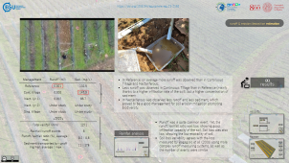
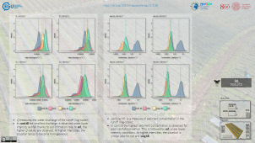
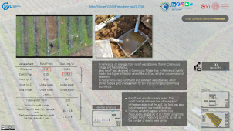
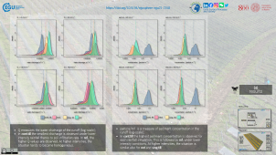

https://doi.org/10.5194/egusphere-egu21-2158
Earth Surface Processes
and Society
Field-based approach
(4)
results
erosion/deposition estimation
Modelling approach
methods:
home:

Slide 13
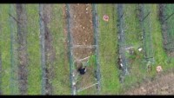
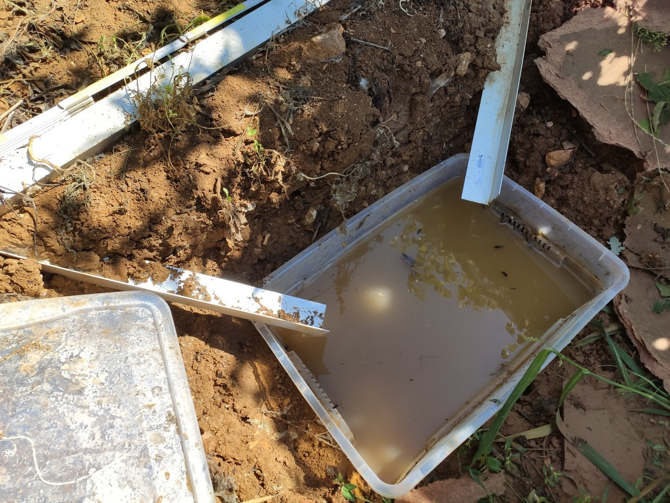




https://doi.org/10.5194/egusphere-egu21-2158
Earth Surface Processes
and Society
runoff & erosion/deposition estimation
Management | Runoff (m³) | Sed. (mg/L)
Reference | 0.021 | 132.5
Cont. tillage | 0.020 | 147.5
Nect. (yr 1) | 0.012 | 88.7
Nect. (yr 2) | Under study | Under study
Sing. tillage | Under study | Under study
In Reference, on average more runoff was observed than in Continuous Tillage and Nectariferous;
Less runoff was observed in Continuous Tillage than in Reference (mainly thanks to a higher infiltration rate of the soil), but a higher concentration of sediment;
In Nectariferous less runoff and less sediment was observed, which proved to be a good management for soil erosion mitigation promoting biodiversity.
(4)
results
results:
↓2020↓
Total rainfall (mm) | 1271
Rainfall/runoff events | 8
Runoff/rainfall ratio (%), average | max | 0.2 | 0.8
Sediment transported by runoff (kg/ha), average | max | 11 | 176
Runoff was a quite common event. The runoff/rainfall ratio was low, showing good infiltration capacity of the soil. Soil loss was also low, showing the low erodibility of soil.
Soil loss variability agrees with the loss measured by Bagagiolo et al. (2008) using more complex runoff measuring systems, as well as the number of events were similar
Rainfall analysis
home:

Slide 14
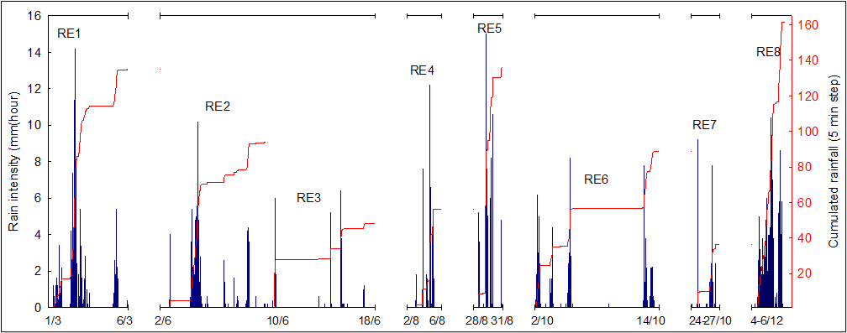


https://doi.org/10.5194/egusphere-egu21-2158
Earth Surface Processes
and Society
Rainfall Analysis
(4)
results
runoff & erosion/deposition estimation
RE1 >> RE8 are the 8 rainfall that generated runoff
home:

Slide 15
https://doi.org/10.5194/egusphere-egu21-2158
Earth Surface Processes
and Society
(4)
results
results:
Q measures the water discharge of the runoff (log-scale);
In cont.till the smallest discharge is observed under lower intensity rainfall thanks to soil infiltration rate. In ref., the higher Q values are observed. At higher intensities, the situation tends to become homogeneous.
particle/m³ is a measure of sediment concentration in the runoff (log-scale);
In cont.till the highest sediment concentration is observed for each rainfall simulation. This is followed by ref. under lower intensity conditions. At higher intensities, the situation is similar also for net and sing.till.
home:

Slide 16
https://doi.org/10.5194/egusphere-egu21-2158
Earth Surface Processes
and Society
Management | Runoff (m³) | Sed. (mg/L)
Reference | 0.021 | 132.5
Cont. tillage | 0.020 | 147.5
Nect. (yr 1) | 0.012 | 88.7
Nect. (yr 2) | Under study | Under study
Sing. tillage | Under study | Under study
Both approaches show the importance of inter-row grass cover to protect the soil surface for mitigating soil loss;
A single tillage during autumn in combination with nectariferous grass cover may provide a balance between the effect of the tillage (> infiltration rate), soil protection and sustainability in the management
↓2020↓
Total rainfall (mm) | 1271
Rainfall/runoff events | 8
Runoff/rainfall ratio (%), average | max | 0.2 | 0.8
Sediment transported by runoff (kg/ha), average | max | 11 | 176
(5)
outcomes
results:
home:

